Slide 1
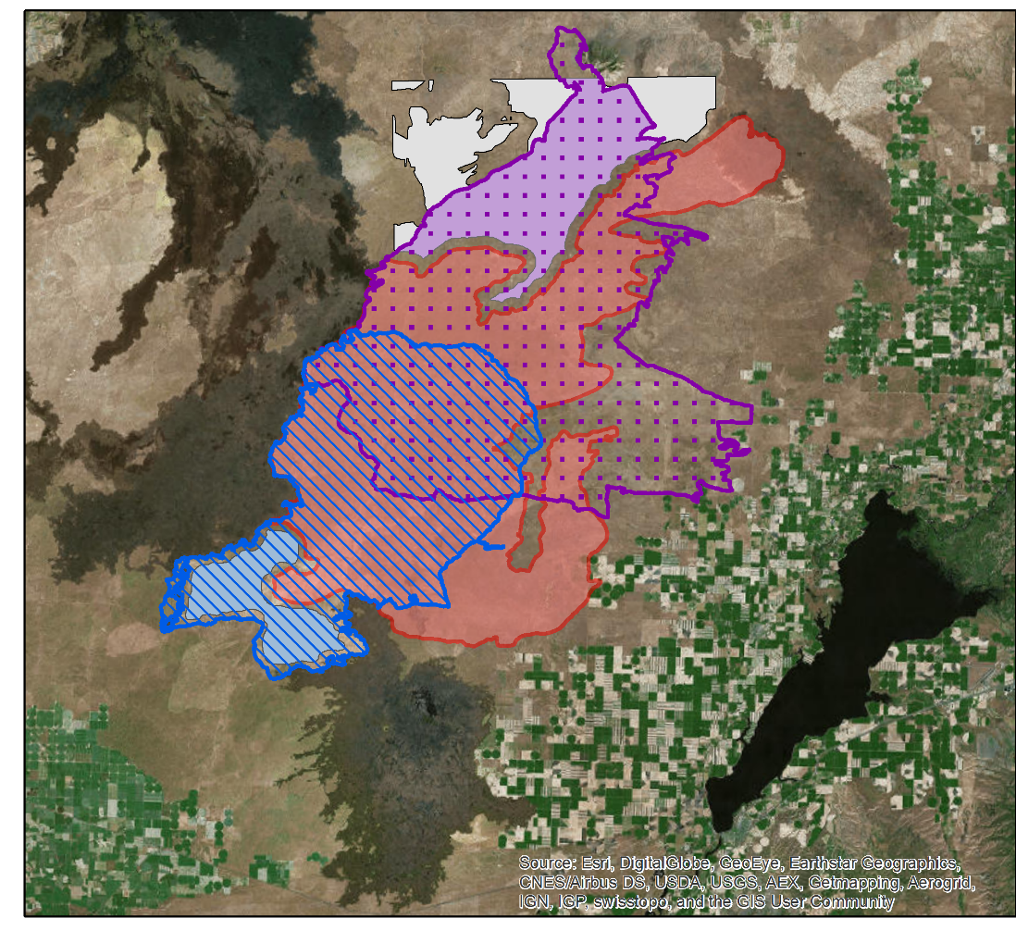
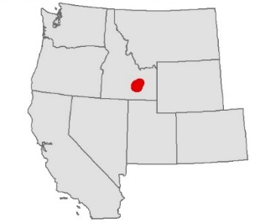

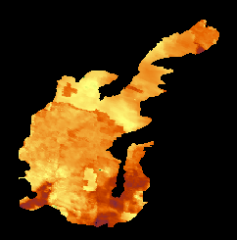
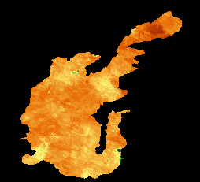
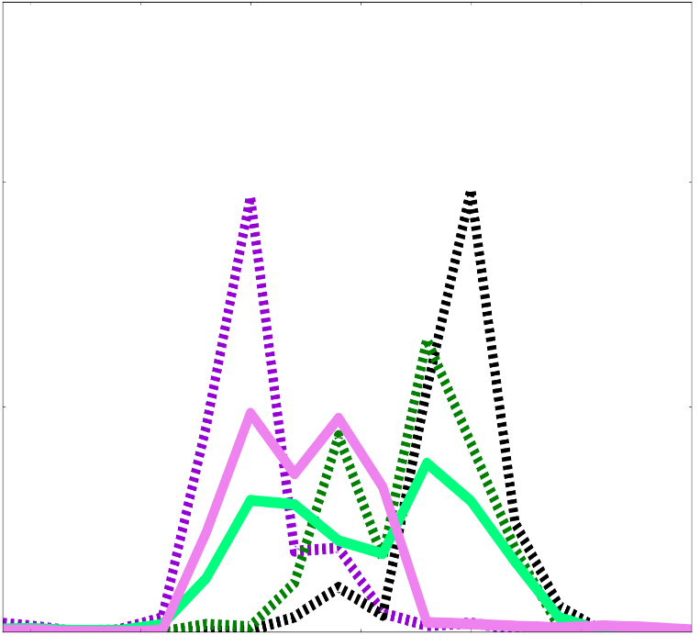
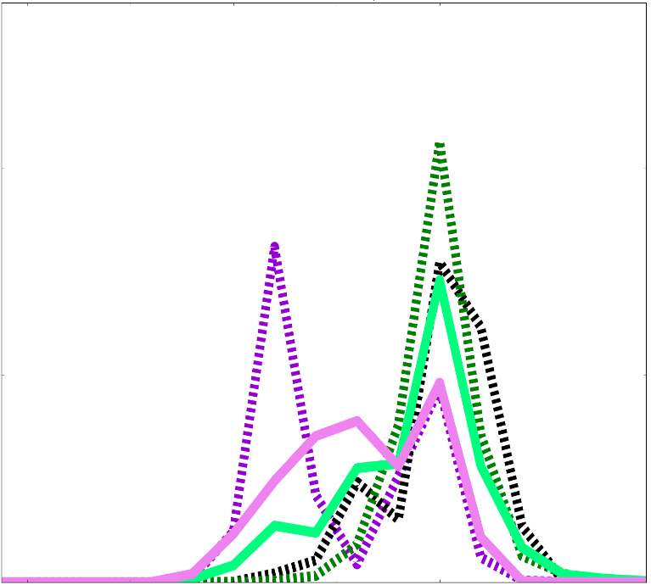
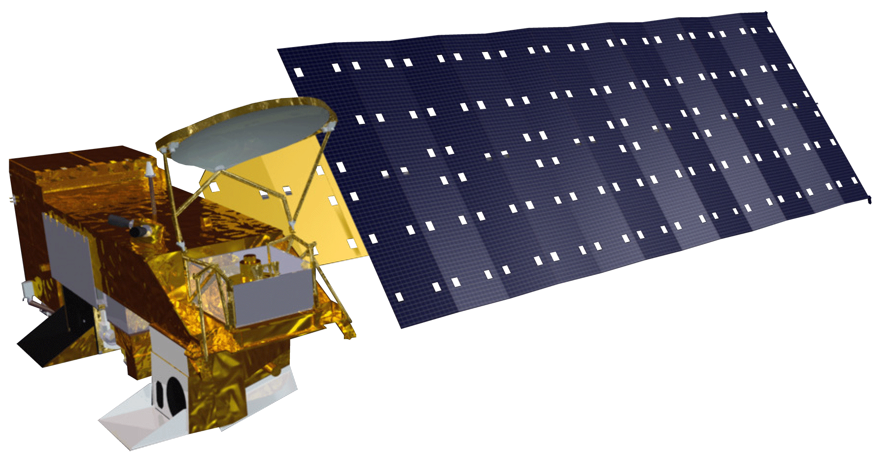
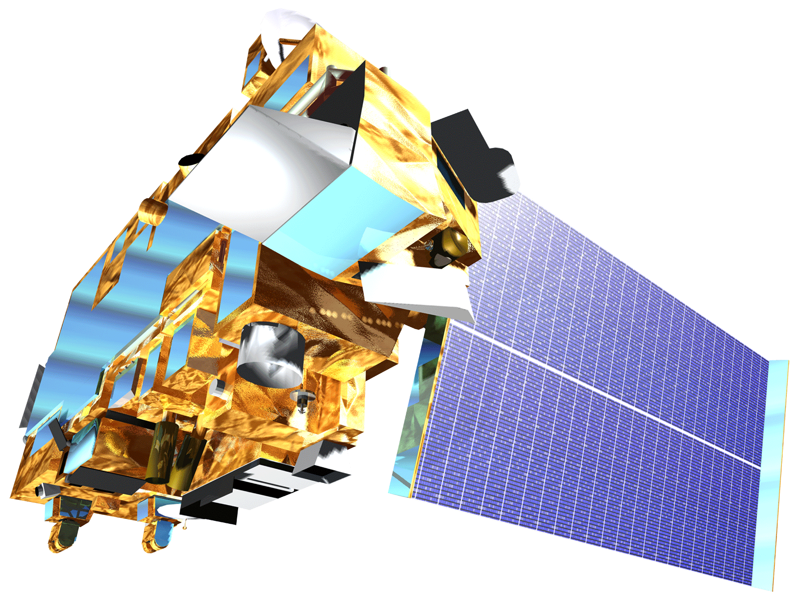
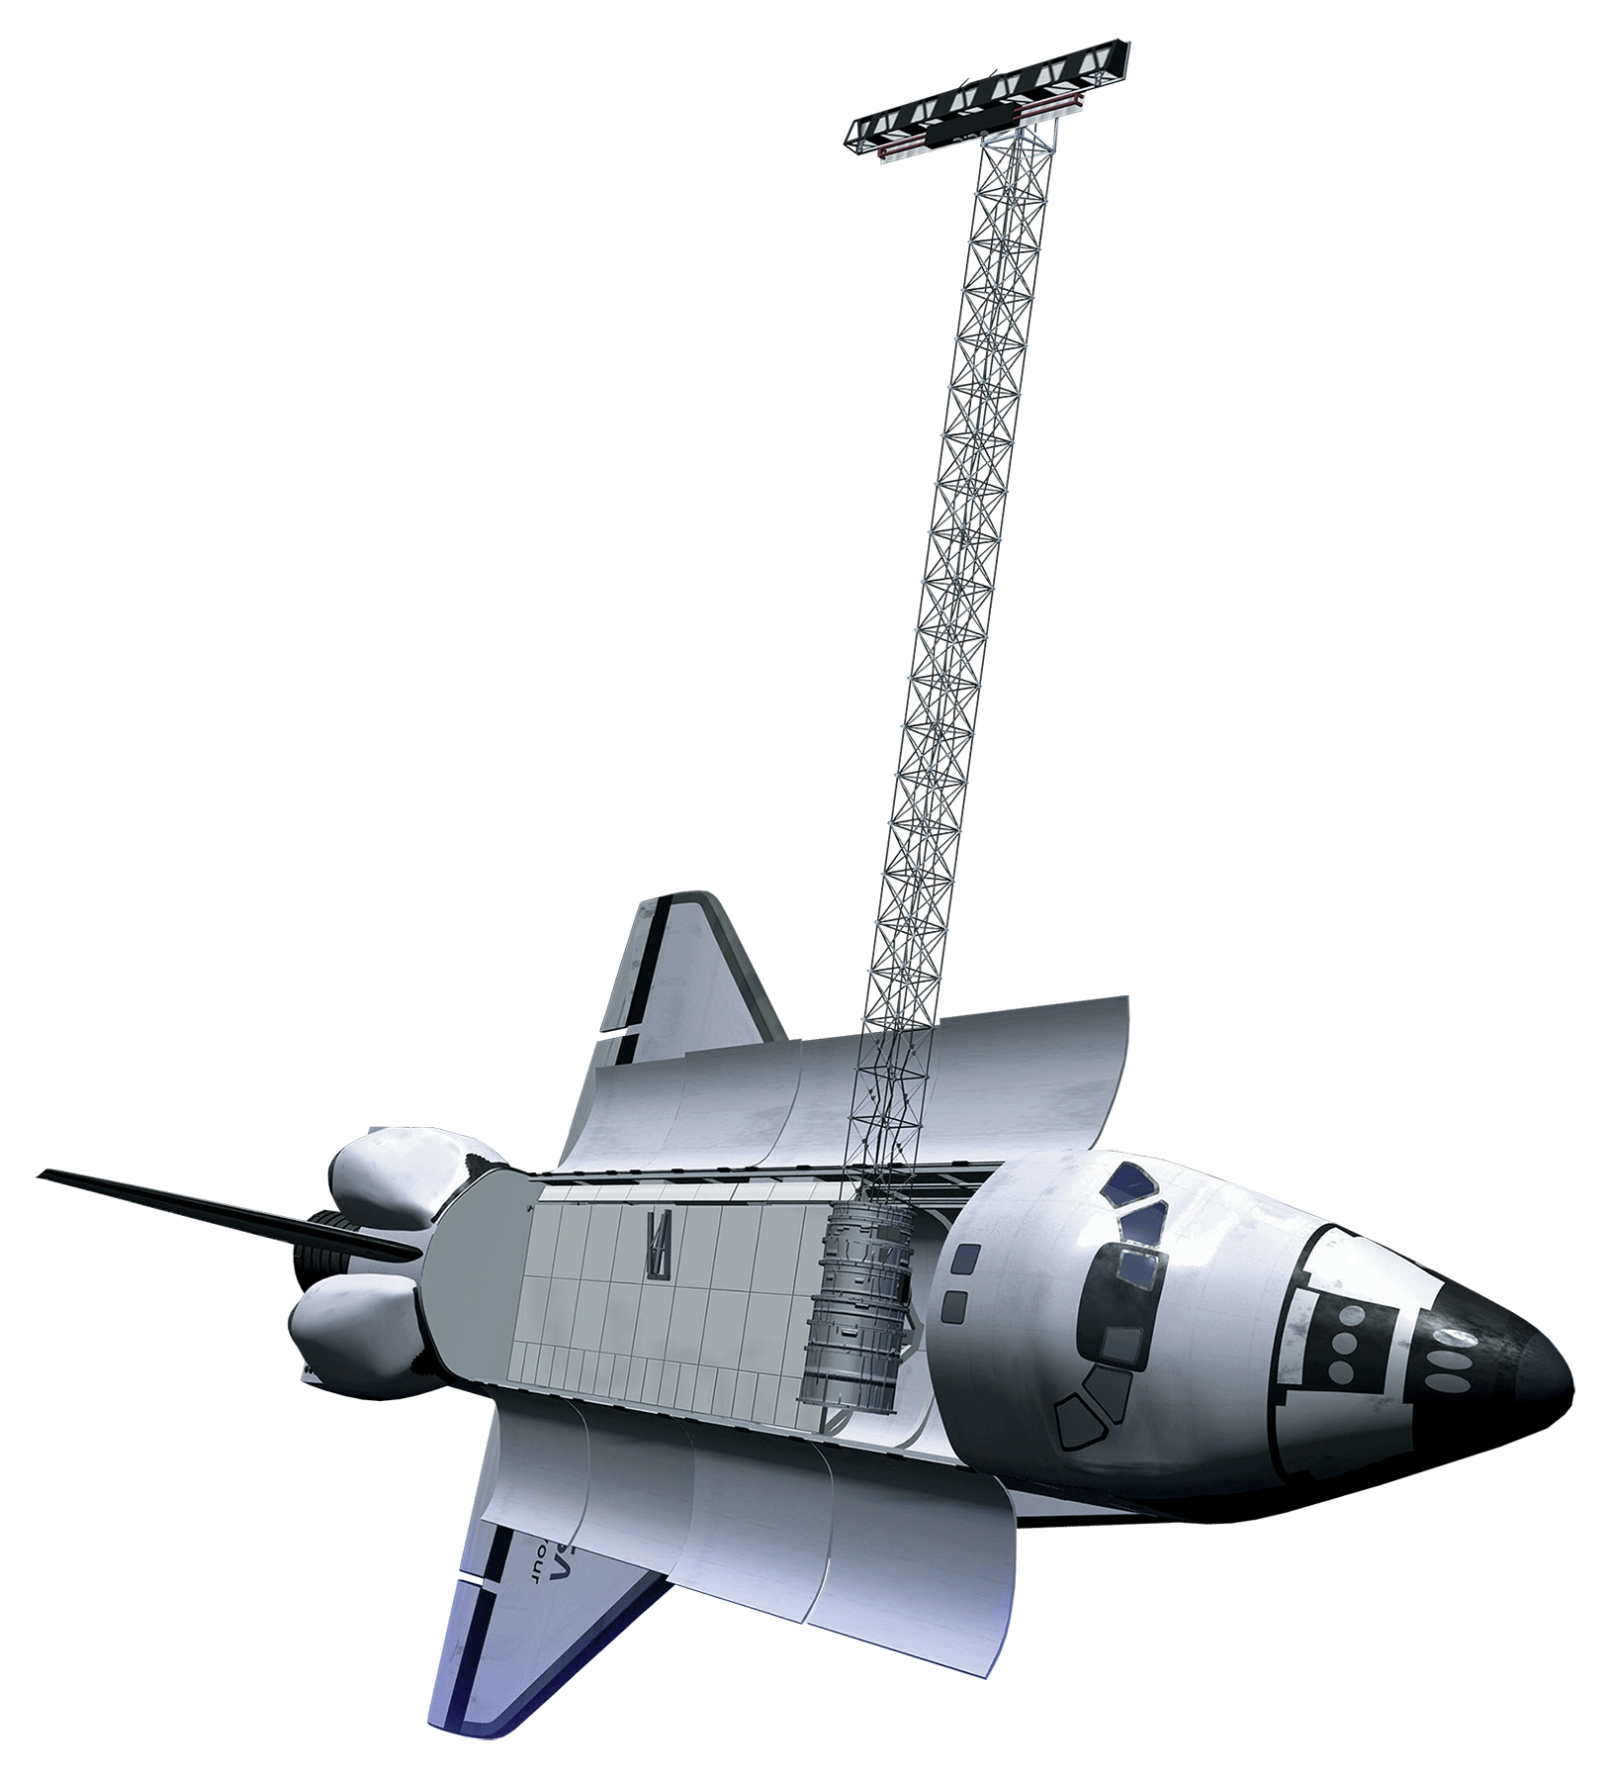
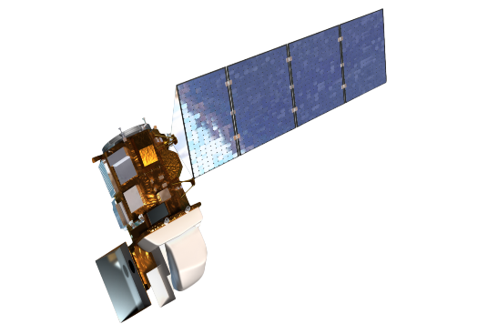
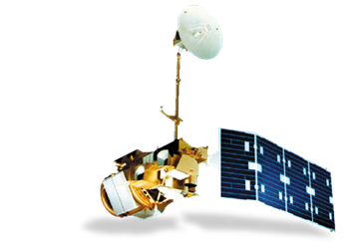
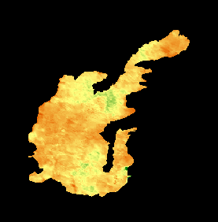
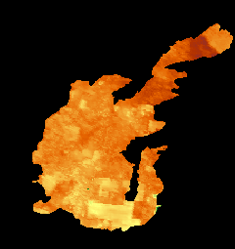
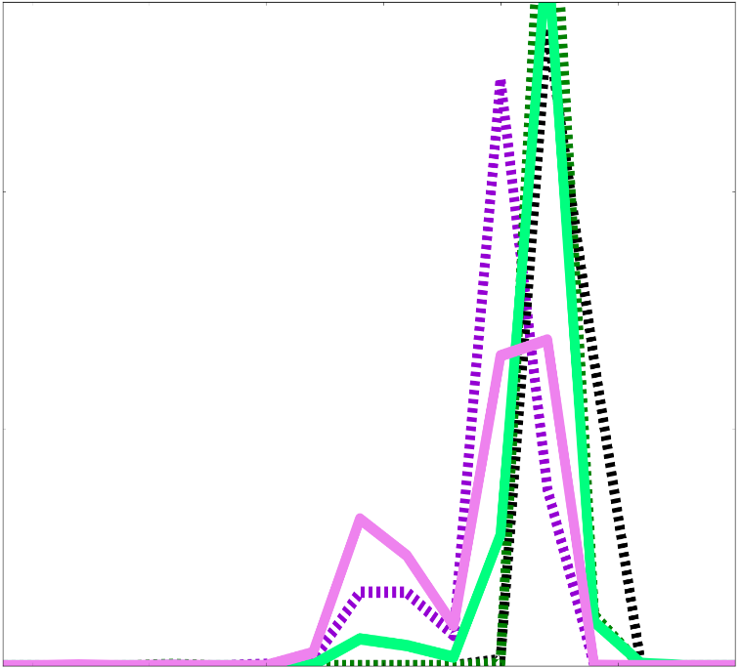
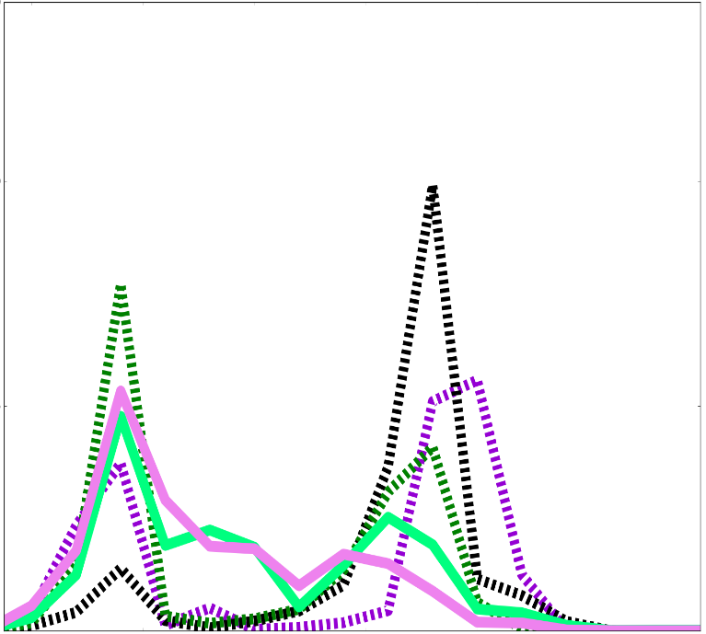

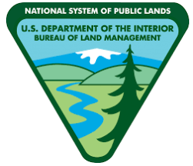






Enhancing Pre- and Post-Wildfire Vegetation Type Characterization Using NASA Earth Observations
Abstract
Study Area
Increasing wildfire frequency has emphasized the importance of post-wildfire recovery efforts in southern Idaho’s sagebrush-steppe ecosystem. The changing fire regime favors annual invasive grass species while hindering native grasses and sagebrush habitat regeneration, causing a positive feedback cycle of invasive plants. Due, in part, to this undesirable process, the sagebrush-steppe ecosystem is one of the most endangered in the US. In this project, the Idaho NASA DEVELOP team partnered with the Bureau of Land Management, Idaho Department of Fish and Game, and the US Department of Agriculture to characterize ecosystem recovery following the 2006 Crystal wildfire. Vegetation recovery following the Crystal fire (2006) was observed from 2001 to 2016 using NASA Earth observations Landsat 5 Thematic Mapper (TM), Landsat 8 Operational Land Imager (OLI), Aqua and Terra Moderate Resolution Imaging Spectroradiometer (MODIS), and the Shuttle Radar Topography Mission (SRTM). In addition, significant factors affecting recovery were identified, and recovery of the landscapes carbon sequestration capacity was assessed. Key variables analyzed included biomass production, seasonally accumulated precipitation, max seasonal temperature, and elevation including slope and aspect. These factors affect land management by driving the success or failure of recovery efforts.
Wildfire Perimeters and
Control Areas
Mule Butte (1999)
Mule Butte Control
Cox Well Fire (1996)
Cox Well Control
Crystal Fire (2006)
No Burn Control
Results
Pre-Crystal Fire (2001)
Pre-Crystal Fire (2004)
Earth Observations
70
70
MODIS Aqua
MODIS Terra
SRTM
50
50
Pixels at peak NDVI (%)
Pixels at peak NDVI (%)
25
25
80
100
120
140
160
180
200
80
100
120
140
160
180
200
Post-Crystal Fire (2008)
Day of Year
Post-Crystal Fire (2015)
Day of Year
Landsat OLI 8
Landsat TM 5
70
70
Objectives
50
50
Identify the key ecological variables responsible for long term wildfire recovery
Quantify the rate of recovery within the Crystal fire area
Detect the change in sagebrush steppe habitat and the introduction of non-native vegetation
Pixels at peak NDVI (%)
Pixels at peak NDVI (%)
Southern Idaho Disasters
25
25
80
100
120
140
160
180
200
80
100
120
140
160
180
200
Methodology
0.2
Day of Year
Mule Butte Fire Control
Mule Butte Fire Burned
Cox’s Well Fire Control
Day of Year
NDVI
0.8
Cox’s Well Fire Burned
None Burned
Processed Data
Used NDVI and MSAVI2 to identify vegetation and growth productivity
NDVI maxima are shown for two pre-fire and two post-fire years within the 2006 Crystal Wildfire boundary. Corresponding graphs show the seasonality of the values shown in each image. The increasing magnitude and bimodality of the maximum NDVI data suggests that the presence of cheatgrass has increased in the region since 2006. The Crystal fire is likely to have contributed to this expansion.
Temporal Analysis
Monitored vegetation indices over time, specifically pre- and post- wildfire
Crystal-Grass/sage R-squared |  | Crystal-Sage R-squared |  | Crystal-Unseeded R-squared
Mean | 0.26 | Mean | 0.29 | Mean | 0.22
Standard Error | 0.07 | Standard Error | 0.02 | Standard Error | 0.04
Median | 0.19 | Median | 0.30 | Median | 0.25
Standard Deviation | 0.19 | Standard Deviation | 0.05 | Standard Deviation | 0.11
Regression Analysis
Identified key variables (slope, aspect, rainfall, growing degree days, previous fire exposure) necessary for ecosystem recovery and how their affects on productivity over time.
Project Partners
R-squared values determined though multi-regression analysis of climatic variables are analyzed for the mean, median, standard error, and standard deviation. Low R-squared values mean variables have low predictive power, thus are not highly correlated with vegetation recovery.
U.S. Bureau of Land Management (BLM)
USDA Agricultural Research Service
Idaho Department of Fish and Game (IDFG)
NASA RECOVER Science Team
Conclusions
The magnitude and timing of paired vegetation peaks suggests that invasive cheatgrass had increased in the years following the fire and became further established in the combined Mule Butte/Crystal Fire area.
After the Crystal fire, vegetation in the burned region continues to experience earlier vegetation peaks than in corresponding controls. This suggests that full recovery may not have occurred by 2015, nine years after the fire.
Regression analysis suggests that the recover of vegetation could not be effectively predicted using the common ecological variables analyzed in the Crystal fire area.
Team Members
Acknowledgements
Austin Counts
(Team Lead)
Nicholas Olsen
Courtney Ohr
The Southern Idaho Disasters team would like to thank our contributors for their help.
Science Advisors: Keith Weber (GIS Training and Research Center at ISU)
Joseph Spruce (NASA, Langley Research Center)
Partners: Karen Krause, BLM Natural Resource Specialist; Patrick E. Clark, USDA Range
Scientist; Scott Bergen, IDFG Principal Wildlife Research Biologist; and
Ryan Walker, IDFG Biologist
Caitlin Toner
Cassidy Quistorff
BLM at Idaho State University GIS TReC – 2017 Summer

