Slide 1
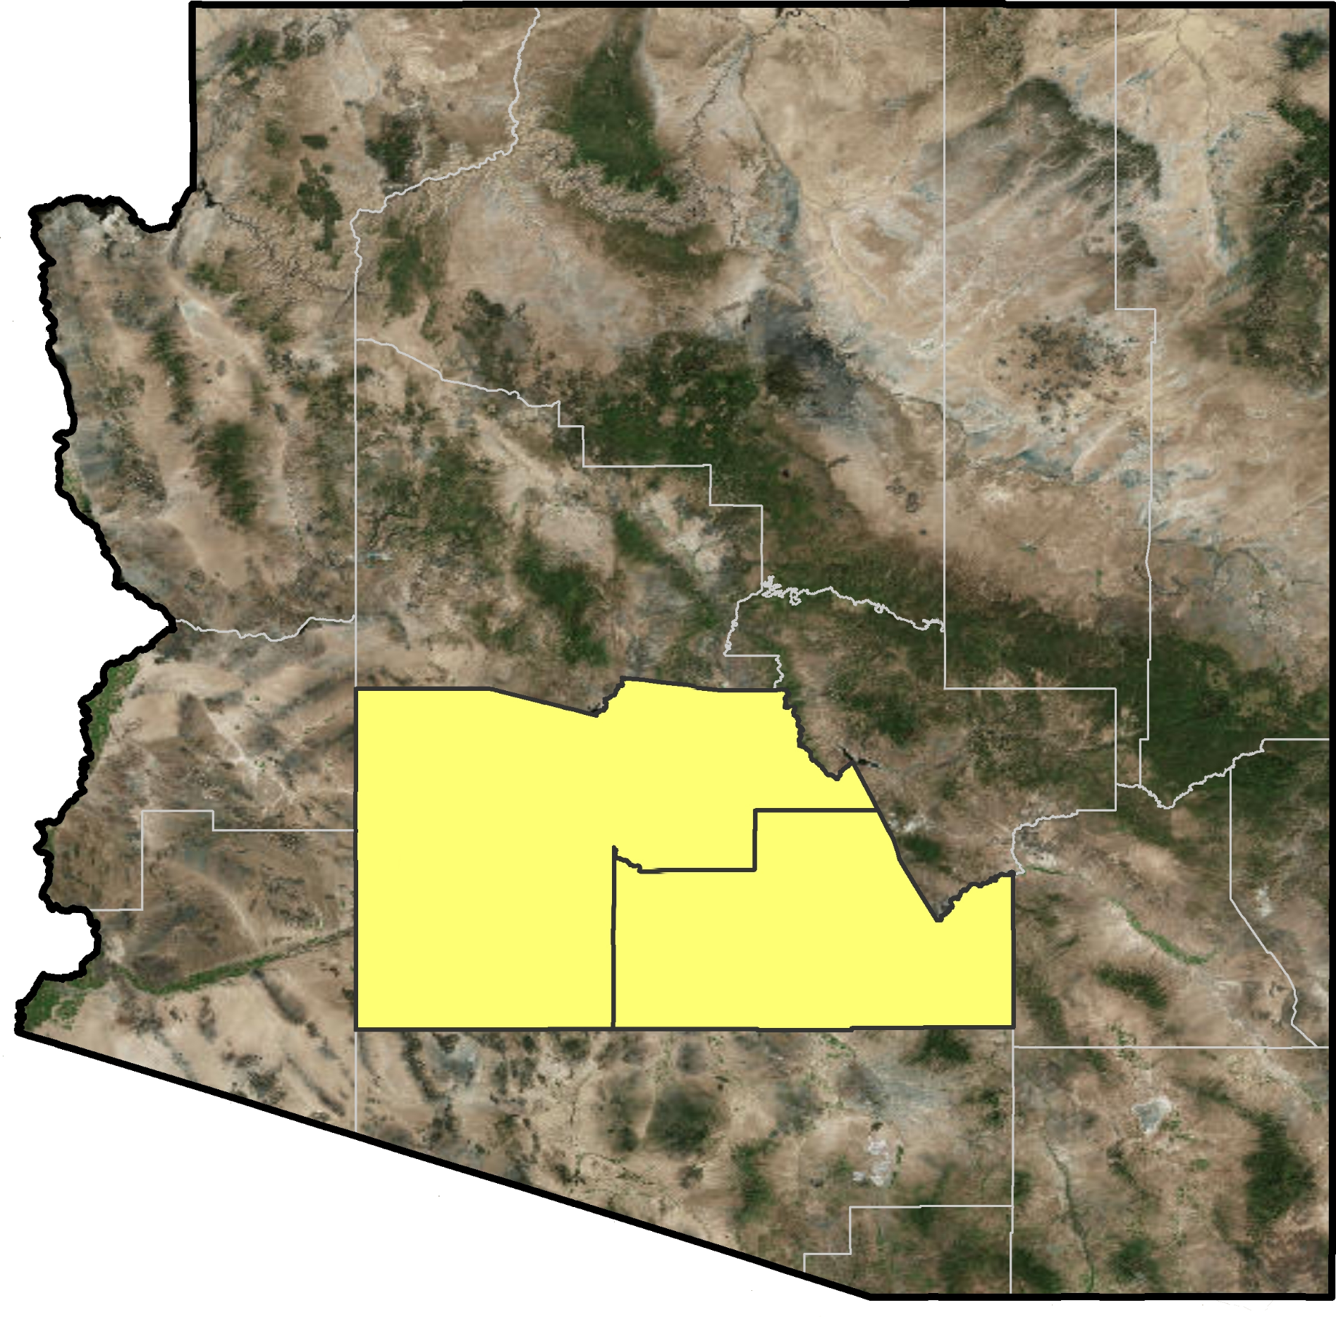
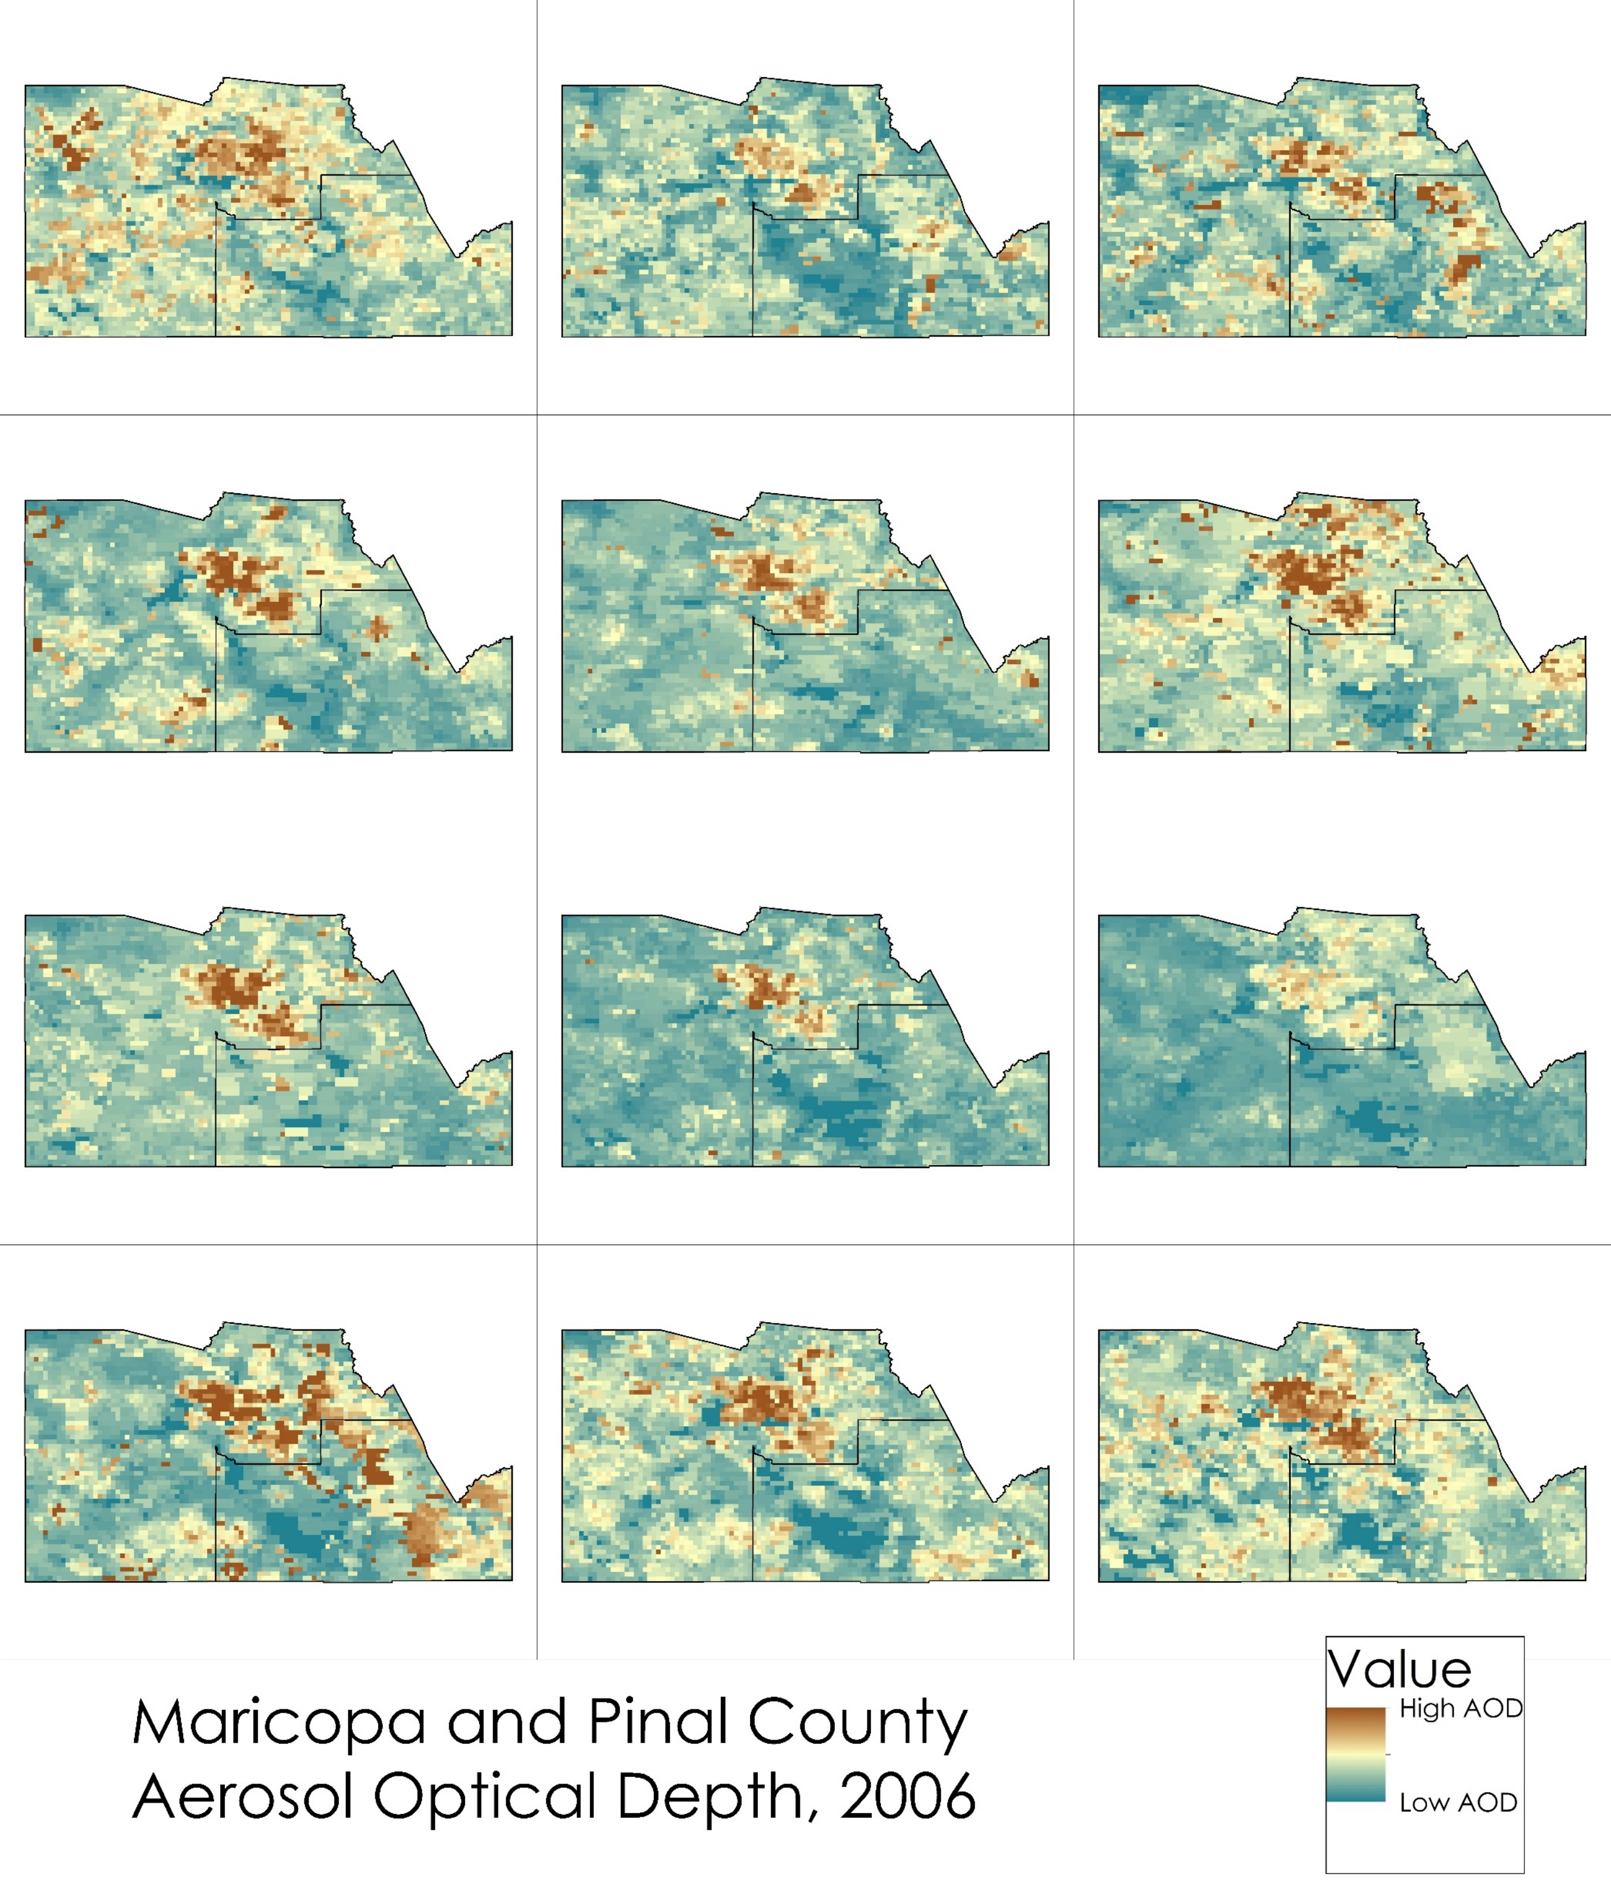
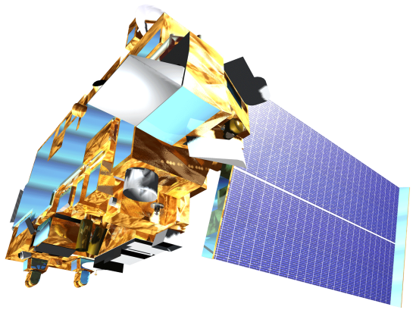
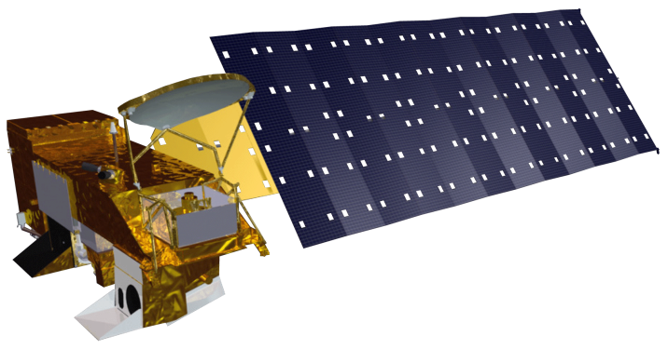
Monitoring PM₁₀ Concentrations with MODIS Aerosol Optical Depth Measurements for Enhanced Public Health and Air Quality Decision Making and Epidemiology
Abstract
Objectives
One of the most prevalent issues with air quality monitoring is the lack of distribution of sampling sites that gather data regarding particulate matter (PM) concentrations in the surrounding environment. By utilizing data from the Moderate Resolution Imaging Spectroradiometer (MODIS) on the Aqua and Terra satellites, we constructed a mixed model to provide a significantly high correlation between aerosol optical depth (AOD) and PM₁₀ concentrations. Due to the mixed model’s use of additional periodic variables such as meteorological and environmental factors, the model is applicable in conjunction with satellite data in the absence of ground-based monitors to present a better picture of the air quality in Maricopa County, Arizona.
Model PM₁₀ concentrations with a mixed model with AOD from MODIS
Produce monthly continuous maps of PM₁₀ concentrations in Maricopa County for a 10 year period (Jan 2006 – Dec 2015)
Perform hotspot analysis on spatial and /or temporal areas of interest for further epidemiological research
Study Area
Methodology
Arizona
Monthly PM₁₀ Surface
One month of raster images
Pm_{ij} = (α + u_{j}) + (β₁ + v_{j})AOD_{ij} + (β₂ + k_{j})Temperature_{ij} + β₃Elevation_{i} + β₄Major Roads_{i} + β₅OpenSpace_{i} + ε_{ij}(u_{j}v_{j}k_{j})~[(0 0 0), Σ]
Apply PM10 Mixed Model
Monthly PM₁₀ Surface
Maricopa County
x120 Months (10 years)
Pinal County
PM₁₀ Surface Pixel
Results
January
February
March
Earth Observations
Maricopa County Health & Air Quality
April
May
June
Landsat 5 (1984)
Terra (1999)
Aqua (2002)
July
August
September
Conclusions
Satellite data help to pinpoint potential particulate matter issues to a specific geographic area and provide an easily interpretable graphic view to enhance decision-making for health and air quality.
Additional and more specific model variables results in higher correlation values between satellite AOD data and PM₁₀ observations.
Desert regions are a particular challenge to analyze using satellite data due to the high amount of reflection of the surface, so improving calibration for desert regions improves model correlations.
October
November
December
Project Partners
Maricopa County Department of Public Health
Maricopa County Air Quality Department
Arizona State University, School of Geographical Sciences and Urban Planning
Team Members
Acknowledgements
The authors would like to thank:
Dr. Itai Kloog, Geography and Environmental Development Department, Ben-Gurion University of the Negev, Be'er Sheva, Israel
Dr. David Hondula, Arizona State University, DEVELOP Arizona Advisor
Lance Watkins, DEVELOP Arizona Center Lead
Any opinions, findings, and conclusions or recommendations expressed in this material are those of the author(s) and do not necessarily reflect the views of the National Aeronautics and Space Administration. This material is based upon work supported by NASA through contract NNL11AA00B and cooperative agreement NNX14AB60A.
Jason Hodgson
Project Lead
Leslie Araujo
Tamara Dunbarr
Maricopa County Department of Public Health and Arizona State University – Summer 2016

