Slide 1
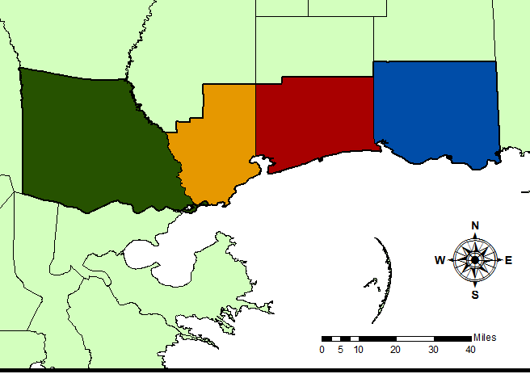
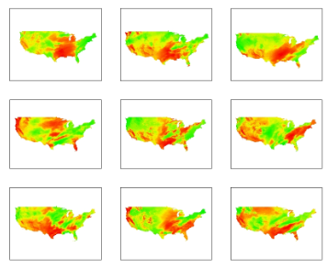
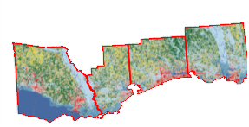
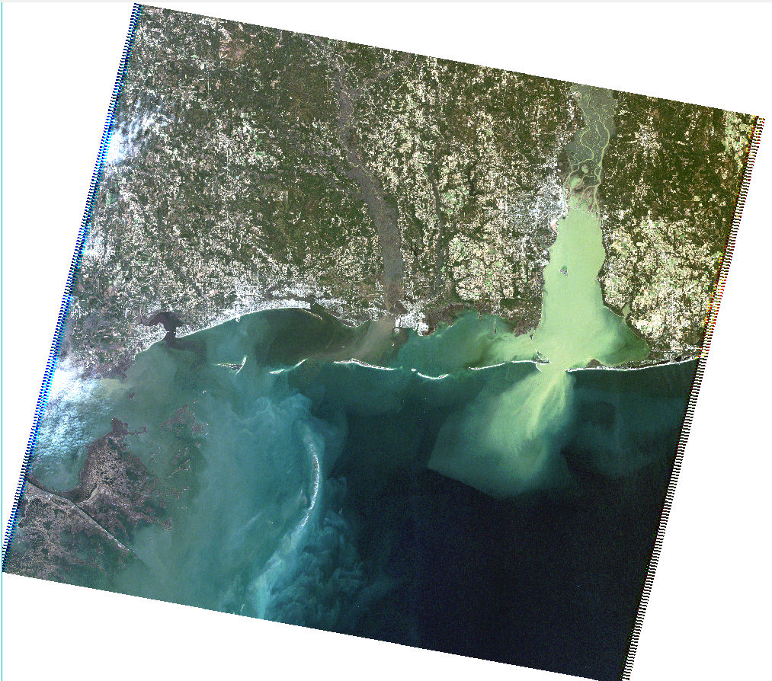
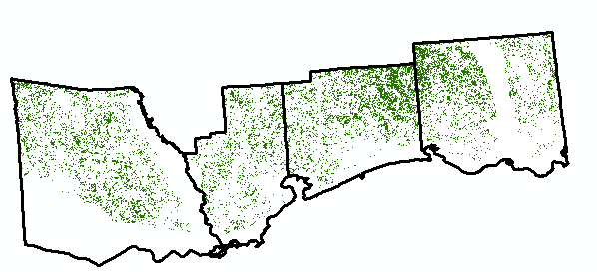
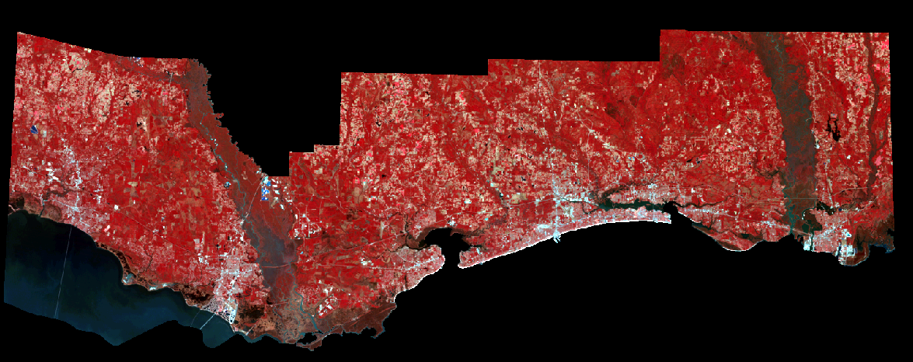

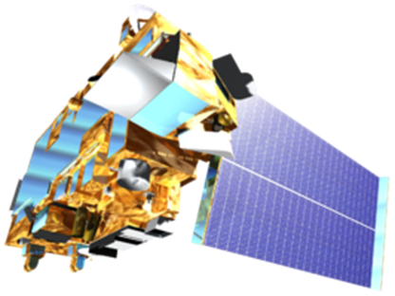
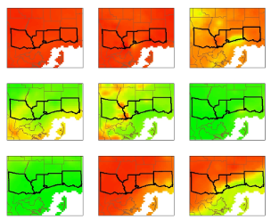
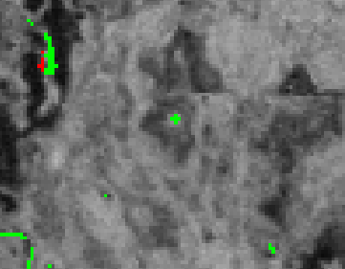
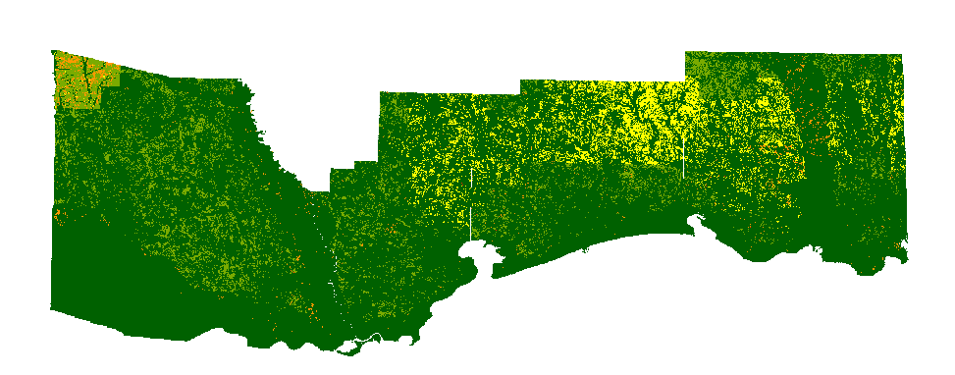
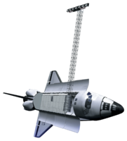

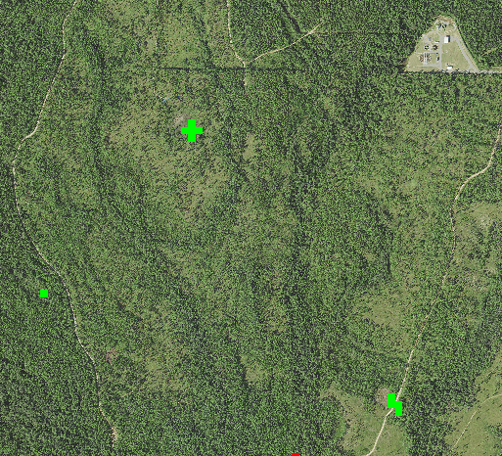
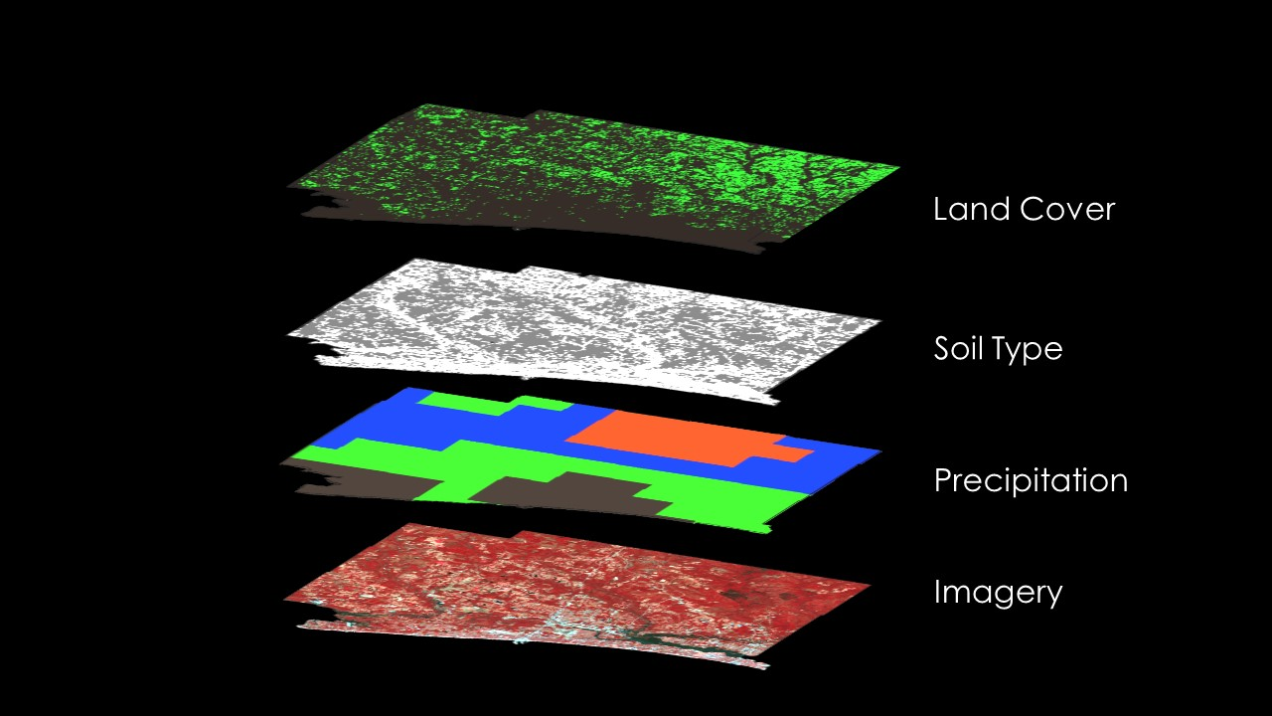
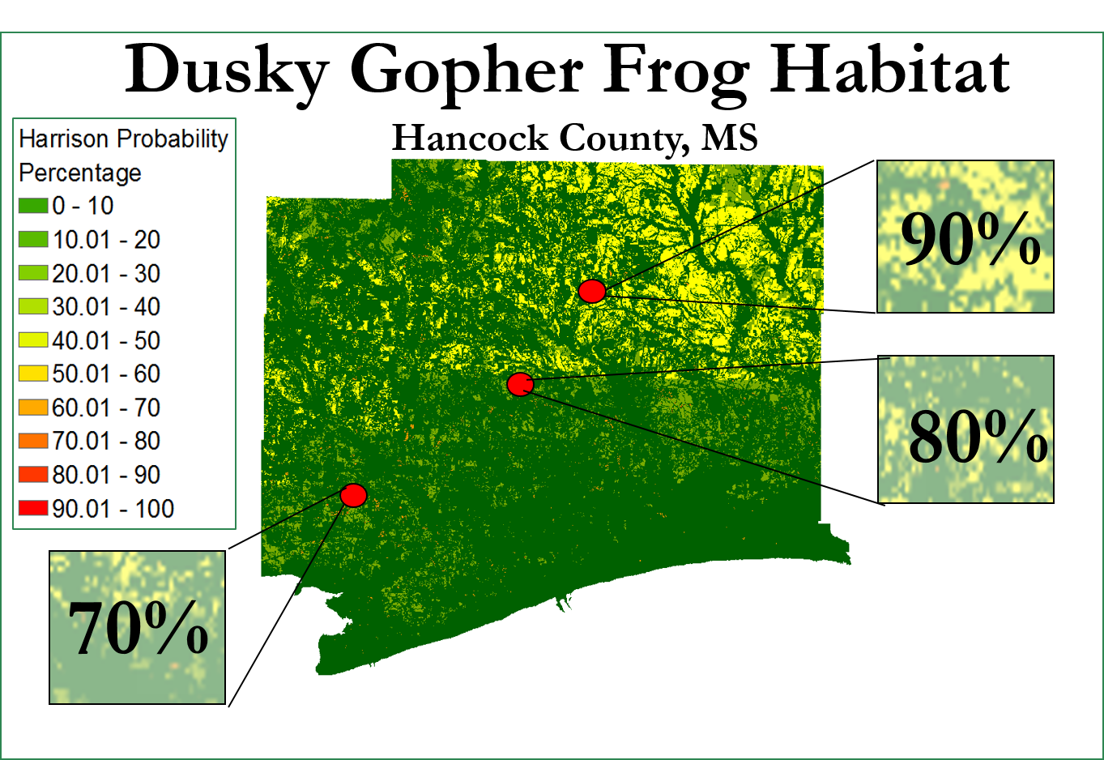
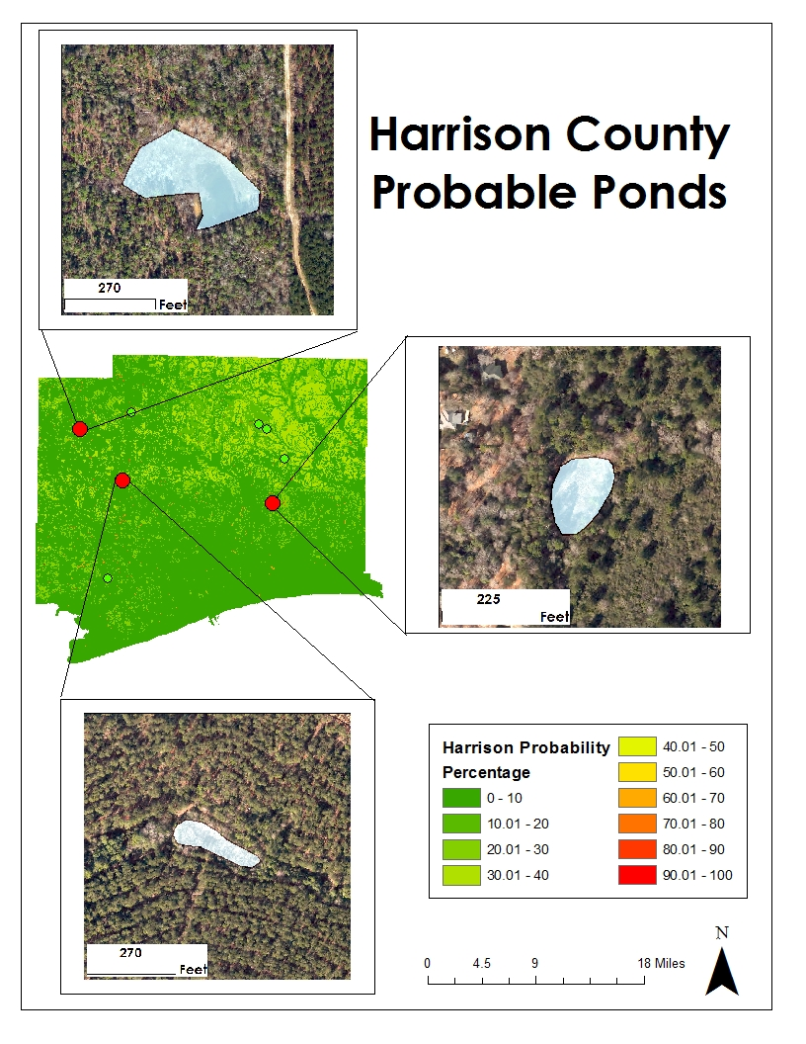
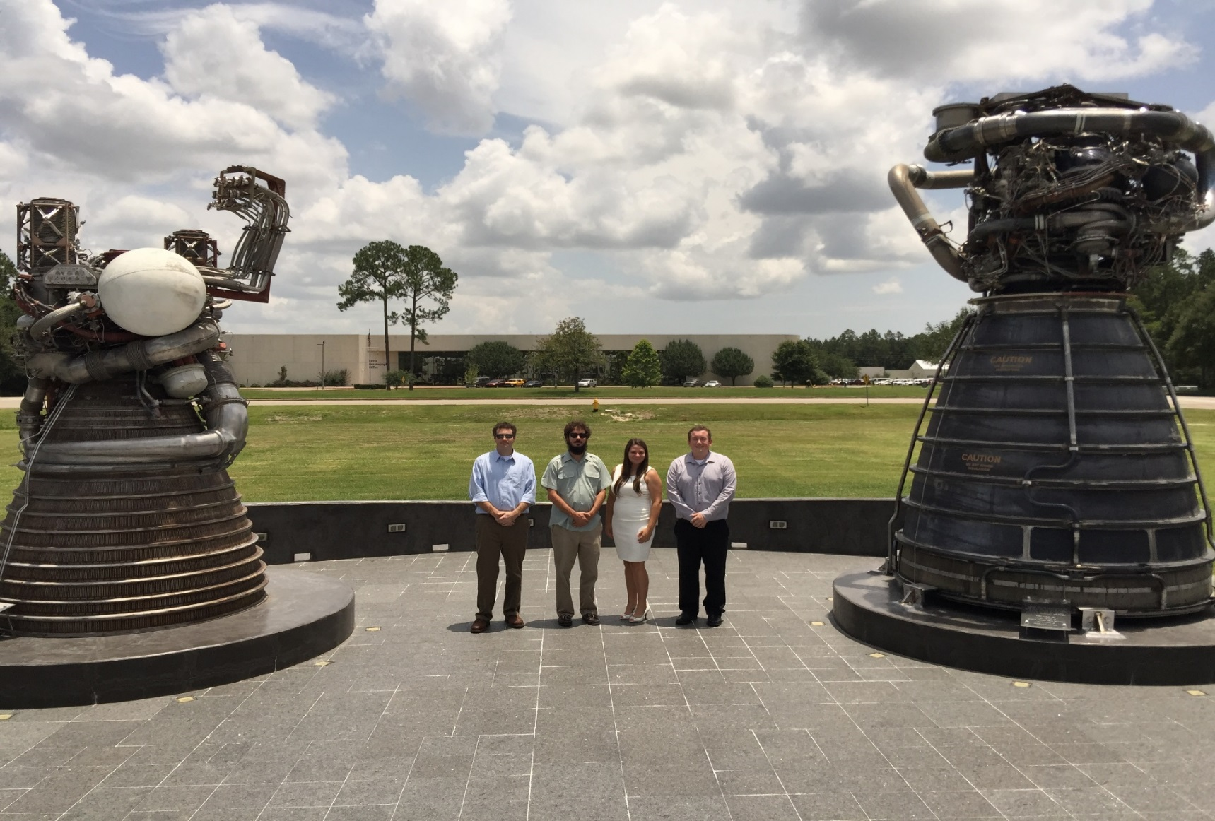



Mississippi Ecological Forecasting
Utilizing NASA Earth observations to locate potential habitat for the dusky gopher frog
Ross Reahard (Project Lead), Rudy Bartels, James Brooke, Meredith Williams
NASA DEVELOP National Program at John C. Stennis Space Center
Abstract
Objectives
The dusky gopher frog (DGF), Lithobates sevosus, is currently found in only four ponds in south Mississippi. This small, wild population is threatened by high risk of inbreeding due to genetic isolation, loss of habitat due to land development, wildfire suppression, and runoff from surrounding roadways and urban areas. In response, this project used data from NASA Earth observations to locate potential habitat for the DGF. Landsat 8 OLI was used to calculate vegetation indices and produce updated land cover classifications. ASTER imagery and Landsat 5 data were used to calculate vegetation indices and water quality indices for the study area. These products then utilized to identify suitable ponds for DGF habitat, to assess their canopy cover and hydrology over the course of the year, to locate emergent and submerged vegetation, and to derive proximity to roadways, developed land, and other bodies of water. National Agriculture Imagery Program aerial data were also assessed for detecting ponds smaller than those detectable at the Landsat scale. This project was performed to help augment current decision-making practices regarding where relocation and reintroduction ponds for the DGF should be established to help monitor, protect, and restore this critically endangered species. Using this information, partnering organizations will be able to identify and map areas with the ideal land cover, water quality, and elevation characteristics for DGF habitation.
Utilize NASA Earth observations to locate potential habitat for the dusky gopher frog, the most endangered species of frog in North America.
Study Area
Methodology
Precipitation
Landcover
Soil
Imagery
St. Tammany Parish, LA
Hancock County, MS
Harrison County, MS
Jackson County, MS
Anomalies
Clipped
Clipped
ENVI
Earth Observations
Normalized and Clipped
Weighted
Mosaicked
Weighted
Landsat 8 (OLI)
Terra
Indices
Change Detection
Final Image
Space Shuttle
Landsat 5
Results
Conclusions
The DGF habitat probability model enabled location of areas that have the potential habitat parameters for the dusky gopher frog. Probability values of 70 percent and above were found in the study area.
The greatest amount of suitable habitat probability values between 70 and 100 percent were located in the Northeastern part of Harrison County Mississippi.
The summary statistics revealed most areas had lower than 50 percent probability for the dusky gopher frog habitat, a possible signature of rapid urbanization in the study area.
An assessment of the probability model, using the stratified random sampling method, rated the model at approximately 75 percent accuracy.
Team Members
Project Partners
Acknowledgements
The Nature Conservancy
U.S. Fish & Wildlife Service
U.S. Army Corps of Engineers
USDA Forest Service
Joseph Spruce - Senior Scientist and Lead Science Advisor at NASA SSC
James “Doc” Smoot - Senior Scientist and Assistant Science Advisor at NASA SSC
Julie Moore – US Fish and Wildlife Service (USFWS)
NASA DEVELOP National Program Office
Jim Lee - The Nature Conservancy (TNC) - Biologist
Ed Moody - USDA Forest Service: DeSoto Ranger District - Wildlife Biologist
Linda LaClaire - US Fish and Wildlife Service (USFWS) - Wildlife Biologist
Danny Hartley – US Army Corps of Engineers – Wildlife Biologist
Shelby Barrett – SSC DEVELOP, Former Assistant Center Lead
Michael Brooke, Ross Reahard (Team Lead), Meredith Williams, Rudy Bartels
NASA John C. Stennis Space Center

