Slide 1
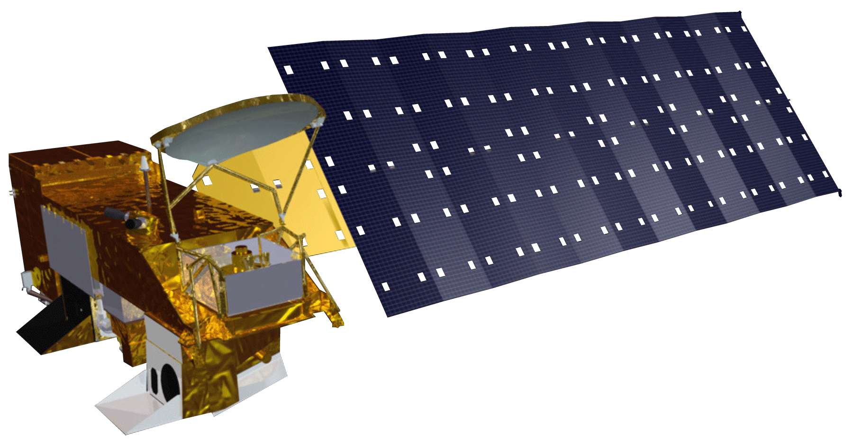
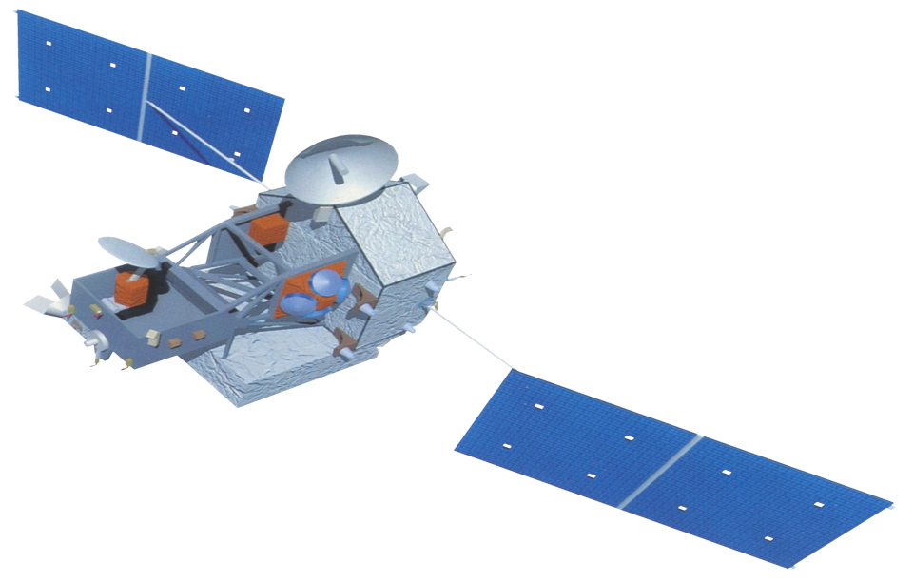
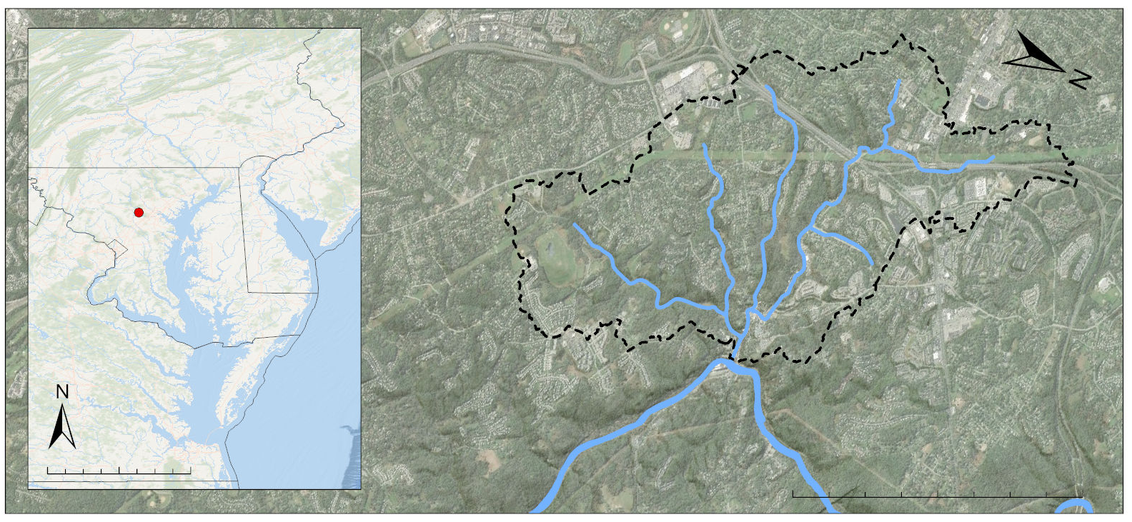
Enhancing a Statistical Flood Risk Model to Continue Improving Early Warning Systems and Public Safety in Ellicott City, Maryland
Abstract
Objectives
Ellicott City Disasters II
As flooding events in the United States grow in frequency and intensity, the use of technological advancements and applied science are increasingly necessary for effective flood monitoring and warning systems. The NASA DEVELOP Ellicott City Disasters II project investigated the use of machine learning for applications in flood risk detection to support the improvement of early warning systems. To strengthen the efforts of the Howard County Office of Emergency Management (OEM) in building a more robust flood monitoring system, the project improved the original statistical flood risk model, FLuME (Flood Learning Model Environment), programmed by the first DEVELOP term The enhancements incorporated an additional six years of precipitation and soil moisture data from the North American Land Data Assimilation System (NLDAS), modeled using Aqua Advanced Microwave Scanning Radiometer for EOS and Tropical Rainfall Measuring Mission TRMM Microwave Imager. These Earth observations were supplemented by stream gauge data from the OEM and the US Geological Survey. The resultant flood risk model FLASH (Flood Learning Environment and Severity Assessment Hub) was trained to evaluate input variables and predict stage height in Ellicott City in real time. The addition of an advanced deep learning framework known as long short-term memory improved the model’s ability to capture relationships between variables. To assess the effectiveness of the new model, FLASH produced a model efficiency metric of 0.99, a significant improvement over the 0.85 value produced by the previous model. The project assisted the OEM in pursuing the integration of open data and NASA Earth observations into a threat matrix capable of informing near real-time decision making.
Improve the existing statistical flood risk model with use of Long Short-Term Memory (LSTM) machine learning framework to provide stage height predictions
Utilize additional in situ data from project partners to contextualize model outputs and improve model accuracy
Conduct sensitivity analysis to determine the impact of each input variable on overall model performance
Earth Observations
Aqua MODIS
TRMM TMI
Study Area
Methodology
Tiber-Hudson Watershed Boundary
Inputs
(Known)
LSTM Layers
(Hidden)
Output (Known)
Predicted Value
Ellicott City
NJ
Precipitation
MD
DE
Soil Moisture
Ellicott City Water Level
VA
ATLANTIC OCEAN
RIVER
Historic Downtown
Discharge
0
25
50
100 Miles
PATAPSCO
0
0.5
1
2 Miles
Results
0.0
FLASH Model Performance (2016-2020)
2018 Flood Event: FLASH Model Prediction with 95% CI
0.00
0.2
0.25
Precipitation (in)
Precipitation (in)
0.4
0.50
0.6
FLASH
0.75
Training
Testing
Observed
FLASH
123
123
Observed
Over-curb
Flooding
120
120
Warning 2
Ellicott City Stage (ft)
Ellicott City Stage (ft)
Warning 1
117
117
114
2016
2017
2018
2019
2020
May 27 18:00
May 28 00:00
May 28 06:00
May 28 12:00
May 28 18:00
The model’s prediction for stage height is shown in green compared to the actual measured stage height in black. The data over the course of the study period is split in 2018, half for training of the model and half for testing.
Using our input variables during the 24 hours prior to the event, FLASH was able to forecast the severity of the flood event from 15 minutes ahead.
Conclusions
Project Partners
Implementing an LSTM deep-learning framework improved the FLASH model’s performance compared to FLuME.
Data of finer temporal resolution proved effective for accurately forecasting flood events in Ellicott City.
NASA Earth observations coupled with well documented ground data bolstered model performance.
Howard County Government, Office of Emergency Management
Howard County Government, Stormwater Management Division
NOAA National Weather Service, Baltimore-Washington Weather Forecast Office
Acknowledgements
Team Members
This project was made possible with the help of our Science Advisors Dr. John Bolten, Dr. Sujay Kumar, and Perry Oddo, GSFC Center Lead Darcy Gray, and the Ellicott City Disasters I team members Terra Edenhart-Pepe, Julio Peredo, Caroline Resor, and Callum Wayman. Special thanks to our partners: the Howard County Government, especially Brian Cleary, Mike Hinson, Chris Meyer, Christopher Strong, Shaina Hernandez, and Calvin Ball, and Christopher Strong of the Baltimore-Washington Weather Forecast Office of NOAA-NWS.
Alina Schulz
Team Lead
Scott Cunningham
Jonathan Donesky
Matthew Pruett
Maryland – Goddard

