Slide 1
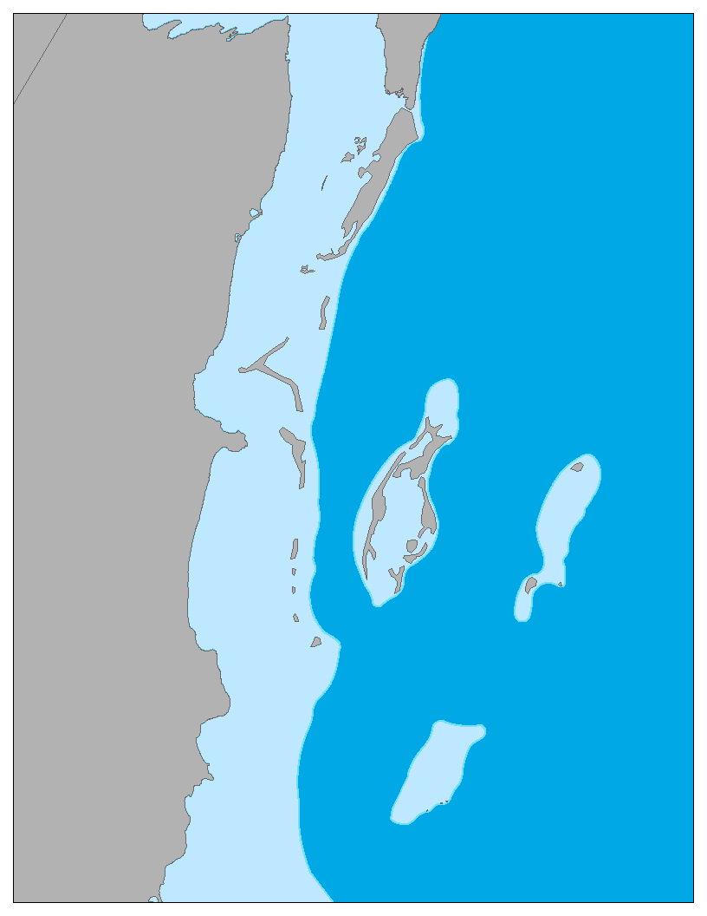
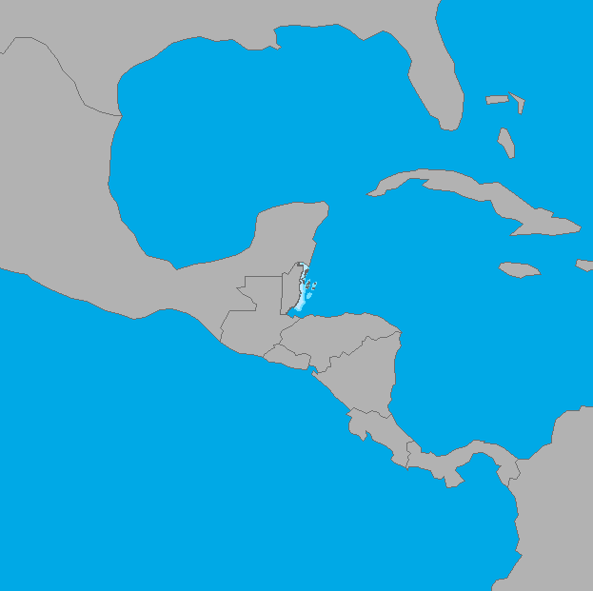
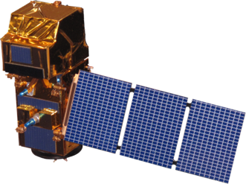
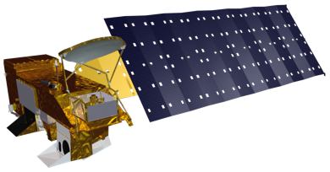
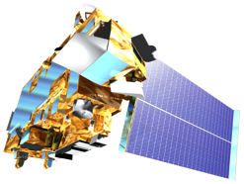
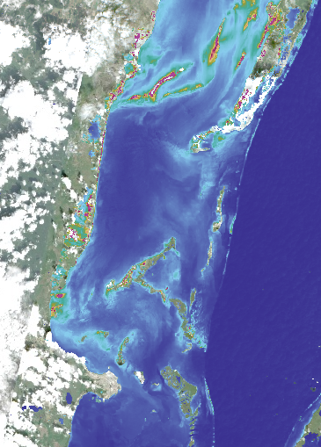
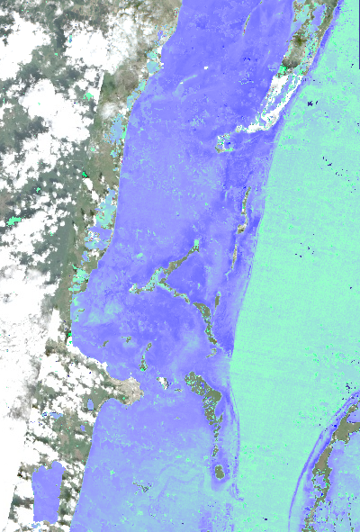
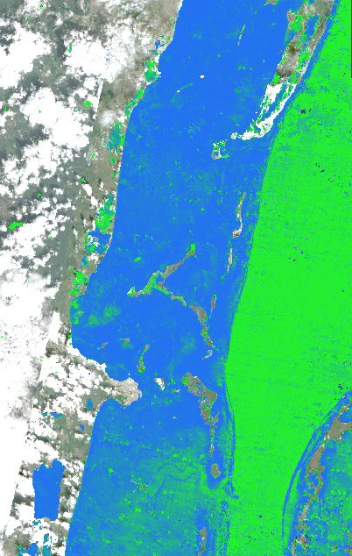
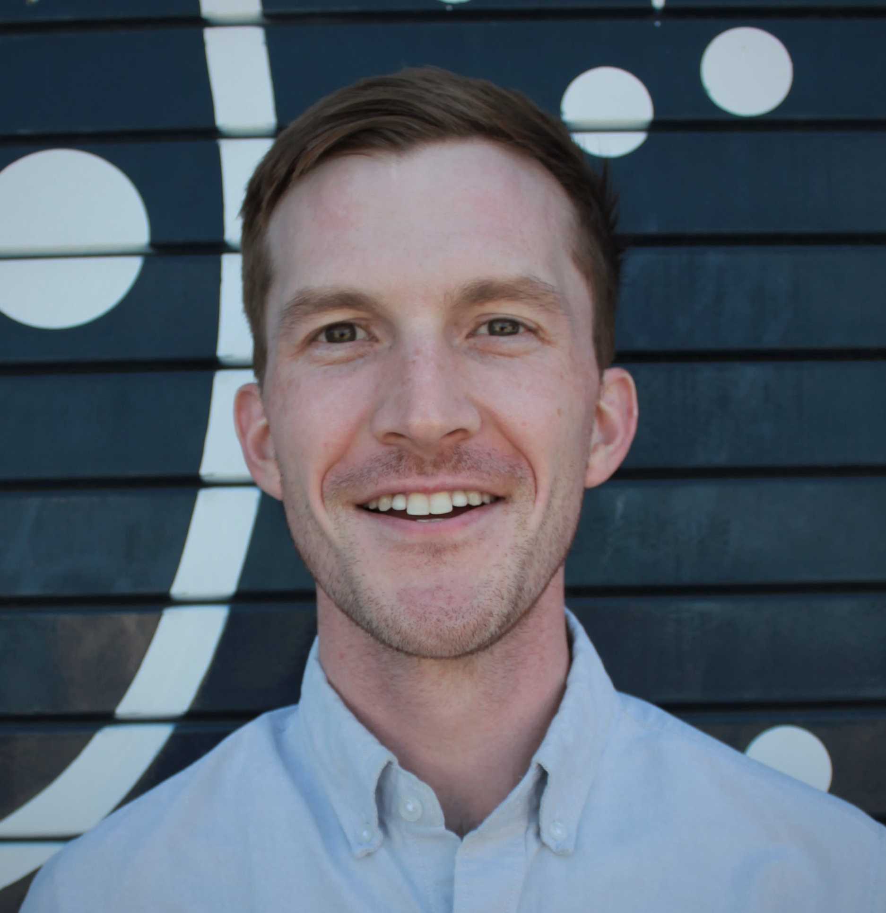
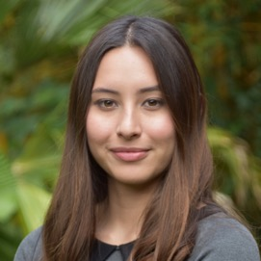
A Google Earth Engine Dashboard for Assessing Coastal Water Quality in Belize’s Coral Reefs to Identify Sustainable Development Goals for Achieving Sustainable Use of Natural Resources
Abstract
Study Area
The Belize Barrier Reef is a biodiverse marine ecosystem and the largest coral reef system in the western hemisphere. The reef also provides ecosystem services in the form of fisheries and tourism and is estimated to be responsible for 12 to 15% of the nation’s gross domestic product. Retaining these ecosystem functions requires sustainable coastal management and preservation of water quality, especially in the face of global changes in climate and local anthropogenic impacts. The Belize Water Resources Team at NASA Jet Propulsion Laboratory and NASA Ames Research Center partnered with the Coastal Zone Management Authority and Institute, a Belizean governmental agency, and the Wildlife Conservation Society to evaluate water quality conditions and inform coastal management decisions. Using Google Earth Engine, we developed a tool that outputs a time series of sea surface temperature, turbidity, and chlorophyll-a concentration derived from Landsat 8 Operational Land Imager (OLI) and Sentinel-2 Multispectral Instrument (MSI), Aqua Moderate Resolution Imaging Spectroradiometer (MODIS) and Terra MODIS satellite imagery. With optical data available from 2013 onward, our partners can efficiently identify reef areas threatened by depreciating water quality, designate Marine Protected Areas and no-take zones, and conduct temporal analyses of water quality changes following environmental disturbance events, such as hurricanes. Additionally, this tool will assist in identifying indicators that may be used to measure Belize’s progress towards Sustainable Development Goals regarding marine environments. Using the tool, partners can better monitor changing water quality and make decisions accordingly in regards to sustainable resource use, coral reef conservation practices, and environmental capital.
USA
Gulf of Mexico
Caribbean Sea
Mexico
Belize
Pacific Ocean
Caribbean Sea
N
0 600 1200 km
N
0 15 30 km
Objectives
Belize Barrier Reef Reserve System
Support project partners in efforts to improve coastal management
Utilize NASA Earth observations to identify areas around reef system that may suffer from poor water quality
Create Google Earth Engine (GEE) dashboard to generate maps and time series information for chlorophyll-a, turbidity, and sea surface temperature (SST)
Validate GEE results with ACOLITE algorithm outputs to ensure accuracy
Earth Observations & Methodology
Landsat 8 OLI
Sept 2013 - June 2019
Sentinel-2 MSI
2016, Dec 2018 - June 2019
Aqua MODIS
Jan 2012 - June 2019
Terra MODIS
Jan 2012 - June 2019
Results
TURBIDITY
TURBIDITY
SEA SURFACE TEMPERATURE
2016 Sentinel-2
Avg Chlorophyll-a Concentration
(mg/m³)
CHLOROPHYLL-A
CHLOROPHYLL-A
N
Nechad et al. (2009)
Mishra & Mishra (2012)
(A_{T} )(P_{W})
B E L I Z E B A R R I E R R E E F
T =
NDCI =
R_{rs}(708) - R_{rs}(665)
Belize Water Resources
1 - (P_{W} / C)
R_{rs}(708) + R_{rs}(665)
B E L I Z E C I T Y
T = turbidity
P_{W} = water-leaving reflectance
A_{T} , C = calibration parameters
NDCI = Normalized Difference Chlorophyll Index
R_{rs} = (Remote Sensing) reflectance
Feb 2016
June 2016
Dec 2016
May 2016
Aug 2016
Nov 2016
Oct 2016
April 2016
July 2016
Sept 2016
March 2016
Date
Chlorophyll-a (mg/m³)
0 15 30 km
0 25
Turbidity (FNU)
Chlorophyll-a
concentration (mg*m⁻³) = a₀+(a₁*NDCI)+(a₂*NDCI²)
Post Hurricane Earl vs. 2016 Avg: Chlorophyll-a Concentration Differences
(mg/m³)
2016 Aqua/Terra MODIS SST and Chlorophyll-a Monthly Averages
Chlorophyll-a
Temperature
Jan 2016
June 2016
Dec 2016
Feb 2016
May 2016
Aug 2016
Nov 2016
Oct 2016
April 2016
July 2016
Sept 2016
B E L I Z E B A R R I E R R E E F
March 2016
Date
B E L I Z E C I T Y
-3 0 3
Temperature (C)
Hurricane Earl
a
b
c
Conclusions
Chlorophyll-a (mg/m³)
N
0 10 20 km
low turbidity
low NDCI
high NDCI
low chlor-a
high chlor-a
Increases in chlorophyll-a concentrations were observed after the occurrence of Hurricane Earl in August 2016.
Cloud computing platforms coupled with a user-friendly interface provide environmental managers with a robust tool for observing environmental conditions and changes.
Currently available surface reflectance products on GEE tend to overestimate chlorophyll-a concentrations, suggesting that scenes processed with atmospheric correction schemes geared towards terrestrial analysis are poorly suited for coastal analysis.
high turbidity
Turbidity (a), NDCI (b), and Chlorophyll-a (c) output maps generated from their respective methodologies and algorithms. Imagery from January 27, 2019.
Project Partners
Team Members
Wildlife Conservation Society
Coastal Zone Management Authority and Institute (Belize)
Acknowledgements
Dr. Emil Cherrington (The University of Alabama in Huntsville, NASA SERVIR)
Dr. Christine Lee (NASA Jet Propulsion Laboratory, California Institute of Technology)
Dr. Juan Torres-Pérez (NASA Ames Research Center)
Sean McCartney (NASA Goddard Spaceflight Center)
Farnaz Bayat and Erika Higa (NASA DEVELOP Center Leads)
Sol Kim, Rafael Grillo Avilla, Xiaowei Wang (UC Berkeley PhD Students)
This material contains modified Copernicus Sentinel data (2016-2019), processed by ESA.
Charlie Devine
Project Co-Lead
Alice Lin
Project Co-Lead
Alana Higgins
Sophia Skoglund
California – JPL & California – Ames | Summer 2019

