Slide 1

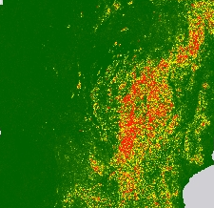
East Africa Disasters II
Maggi Klug (Project Lead)
Assessing Landslide Characteristics and Developing Susceptibility and Exposure Maps in Malawi
Max Grossman
Jordan Cissell

Slide 2

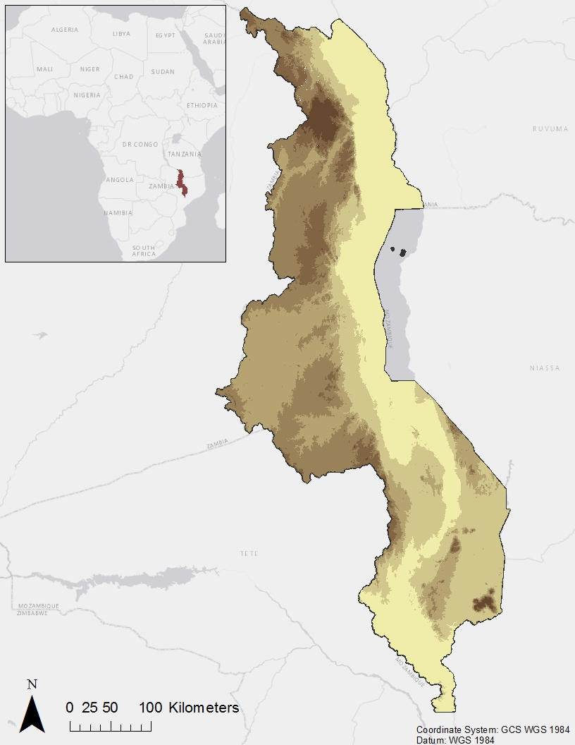
Study Area and Period
Malawi
Elevation
Eastern Africa – Malawi
  Land area: 94,080 km²
  Mountainous Northwestern, Central Western, and Southeastern regions
  Central Western and Southeastern regions most densely populated
  Rainy season from Nov. to Apr., dry season from May to Oct.
Study Period: Jan 2000 – Apr 2016
Image Source: Sarang
Elevation (m)
0 - 500
501 – 1,000
1,001 – 1,500
1,500 – 2,000
2,001 – 3,000
Notes:
The area that this project focuses on is Malawi, which is in Eastern Africa. It has a total land area of about 94,000 square kilometers. As you can see in this elevation map, there are Mountainous regions especially in the Northwest but also the Central Western and Southeastern parts of the country. These central and southeastern regions happen to also be the most densely populated areas with cities such as Lilongwe, Zomba, and Blantyre. Malawi experiences its rainy season from the months of November to April which is important to note because landslides often occur along with intense rainfall events. And finally the time period that is being studied for this project is between January of 2000 to April of 2016.
Image from Wikimedia Commons: https://commons.wikimedia.org/wiki/Malawi#/media/File:Flag_of_Malawi.svg

Slide 3
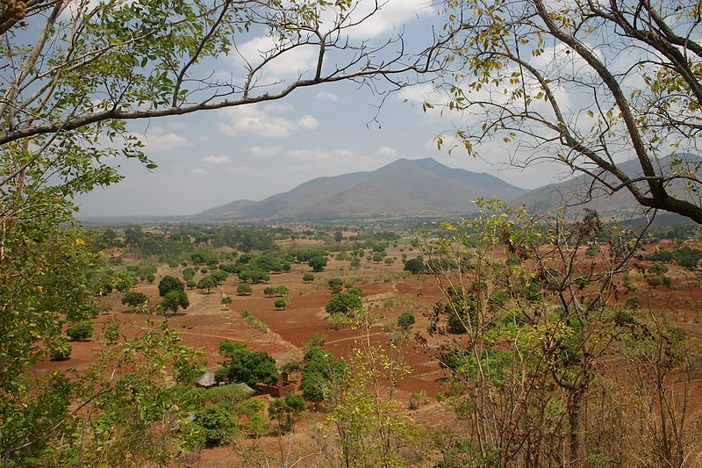
Background
Topography, agriculture, and rainy season make regions of Malawi prone to landslides
Disaster-mitigation efforts are often limited
More precise mapping of areas susceptible to landslides will help inform disaster management and prevention
Image Source: Dr. Thomas Wagner
Notes:
Steep topography, land-intensive agriculture, and an intense rainy season make regions of Malawi prone to landslides. Mitigation efforts for natural disasters such as landslides are often limited to avoid in landslide-prone areas. However, more precise mapping of areas that susceptible to landslides and a more thorough understanding of what triggers them will help enhance disaster management and prevention practices.
Image from Wikimedia Commons: https://commons.wikimedia.org/wiki/File:Malawi_01.jpg

Slide 4
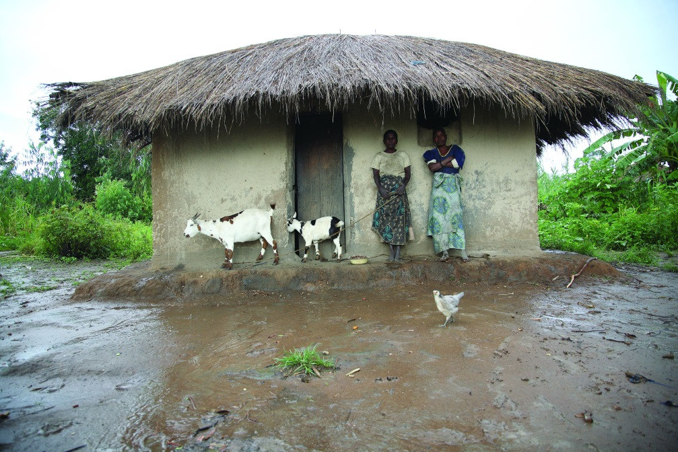

Community Concerns
Vulnerability from growing population and land-reliant economy
History of costly landslide events
Malawians often lack resources to perform mitigation or recovery efforts
Image Source: ILRI/Stevie Mann
Image Source: Swathi Sridharan
Notes:
Malawi is particularly vulnerable to disasters because if its growing population and land reliant economy. For example, a 1991 landslide in the Phalombe district took an estimated 700 to 1,000 lives, displaced 100,000 people, destroyed crops and infrastructure, and necessitated more than 23,000,000 U.S. Dollars in international assistance. Events like this can be devastating because many Malawians lack the resources to perform mitigation or recovery efforts after disasters such as landslides.
Image 1 from Wikimedia Commons: https://commons.wikimedia.org/wiki/File:ILRI,_Stevie_Mann_-_Household_takes_refuge_from_the_rain_in_central_Malawi.jpg
Image 2 from Wikimedia Commons: https://commons.wikimedia.org/wiki/Category:People_of_Malawi#/media/File:Groundnut_harvesting_in_Malawi.jpg

Slide 5
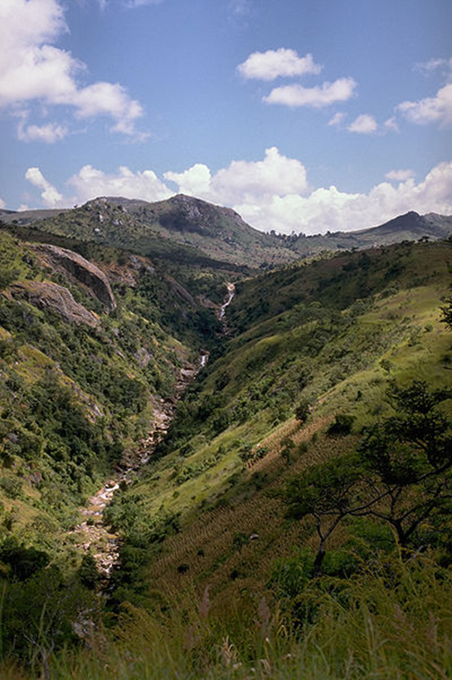
Project Partners
Regional Centre for Mapping of Resources for Development (RCMRD)
NASA SERVIR Coordination Office at MSFC
NASA SERVIR Applied Science’s Team at NASA GSFC
Image Source: Hans Hillewaert
Notes:
All of our project partners promote work to build decision-makers capacity for distaste preparedness and climate risk.
The Regional Centre for Mapping of Resources for Development works with East and South African countries, helping these countries to integrate geospatial and earth systems data into their analysis, planning, management, and communication activities that are related to disaster and climate risk.
NASA SERVIR, a join USAID & NASA venture, provides the geospatial data, scientific modeling, and analysis needed to improve developing countries’ environmental decision making capacity.
Image from Wikimedia Commons: https://commons.wikimedia.org/wiki/File:Golomoti_escarpment_(Malawi).jpg

Slide 6

Objectives
Update the Global Landslide Catalog
Landslide Susceptibility and Exposure Maps
Performance Assessments of Satellite Rainfall Products
Notes:
Our project are three.
First, the project updates the Global Landslide Catalog. The purpose of updating the global landslide catalog (an interactive map of landslides reported around the world) was to enhance the SERVIR Applied Science Teams’ and GLC users’ capability to monitor landslides globally (as the greater the number of landslides within the GLC, the more effective efforts landslide modeling and monitoring). Additionally the points we found were integral to our modeling.
Secondarily, the project created a Landslide Susceptibility and Exposure Maps. These first map was created to show areas highly susceptible to landslides and the second to show where and the number of Malawians’ exposed to landslides.
Lastly measurements from precipitation products, GPM and TRMM, were assessed. These assessments, which compares CHIRPS 2.0 precipitation estimates to GPM and TRMM precipitation estimates, to investigate how well these products measure rainfall in Malawi. In doing so, future ‘near real time’ landslide modelers will have a guide of sorts when choosing an instrument to acquire precipitation estimates from.

Slide 7

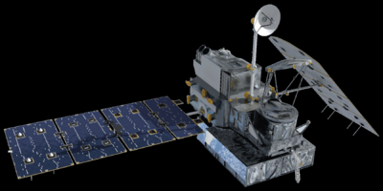
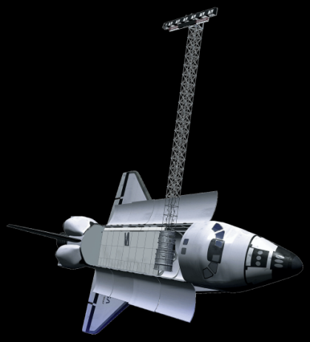


Satellites/Sensors Used
TRMM - PR
GPM - IMERG
SRTM-v3
C-band
Landsat 5 - TM
Landsat 8 - OLI
Notes:
Five Sensors and Satellites were used in this assessment:
The Tropical Rainfall Measurement Mission Precipitation Radar (TRMM-PR) and the Global Precipitation Measurement Integrated Multi-satellitE Retrievals (GPM IMERG) were used, as mentioned, within the precipitation assessment.
The Shuttle Radar Topography Mission C-band (SRTM C-band) was used to create a Digital Elevation Model in Malawi, an input for modeling, and to extract topographic and hydrologic layers (such as the topographic wetness index, distance to streams and ridges, and curvature.
Landsat 5 Thematic Mapper (Landsat 5 TM) and Landsat 8 Operational Land Imager (Landsat 8 OLI) were used during the investigation for landslide scars when updating the Global Landslide Catalog.

Slide 8
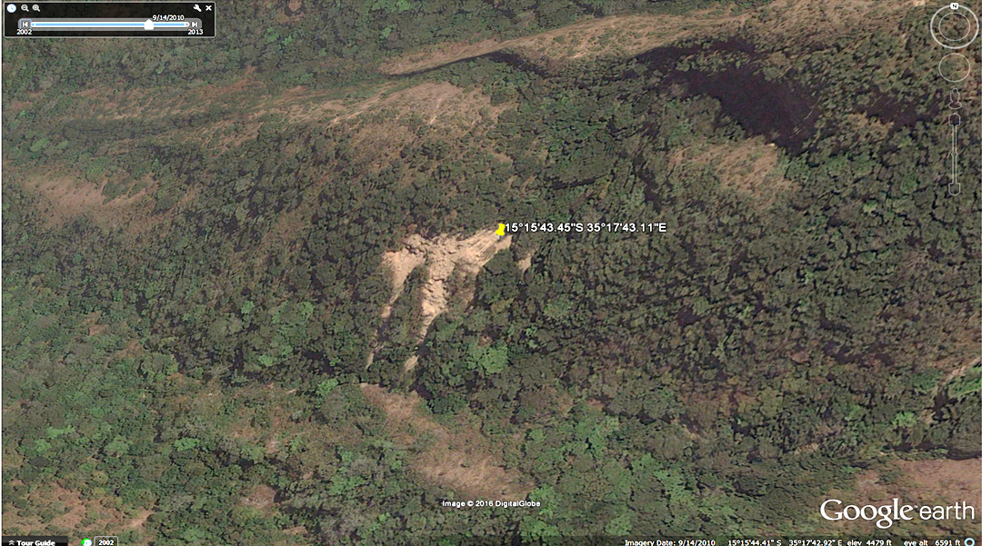
Methodology
Updated Global Landslide Catalog
Updated Global Landslide Catalog
Google Earth Worldview Imagery
Manually pinpoint landslide locations and dates
Image Source: Google Earth
Notes:
The Global Landslide Catalog was updated using the following process:
First, the team searched throughout Malawi in Google Earth for landslide scars. When found, the historic time slider feature in google earth was used to narrow down landslide occurrence dates to within a month.
points that met this requirement were used to update the global landslide catalog, 17 points in total, and all points, 316 points including the GLC points and those with out definitive dates, were used within our model.

Slide 9
Methodology
Landslide Susceptibility and Exposure Maps
Variables:
Elevation Slope Plan curvature Profile curvature Distance to streams Distance to roads | Distance to fault lines Terrain Roughness Depth to bedrock Land cover Soil type
Landslide Presence Points
MaxEnt Model
Landslide Exposure Map
Landslide Susceptibility Map
Intersect with Population data
Notes:
The Landslide Susceptibility Map was generated as follows:
First layers were generated for variables we determined during our literature review to be associated with landslides. Specifically, these are variables that incite the shear stress on a slope to overwhelm a slope’s shear resistance. These included elevation, slope, plan curvature, profile curvature, distance to streams, distance to roads, distance faults line, terrain roughness, depth to bedrock, land cover, soil type.
Once created, layers and landslide points found when updating the GLC were inputted into the Maximum Entropy model. The model then used layer values at the landslide points to generate thresholds used to generate the landslide susceptibility map, which illustrates susceptibility on a scale of 0 to 1.
Then, a subset layer of moderately and highly landslide susceptible areas (areas with values above 0.25) was buffered 1 kilometer and intersected with LandScan population distribution data to produce a Landslide Exposure Map.

Slide 10
Methodology
GPM and TRMM Assessment
Monthly and Daily Totals
Take points from GPM & TRMM datasets
Extract values to points
Correlate GPM and TRMM with CHIRPS
Monthly and Daily Extremes
Separate upper quartile of sampled points
Correlate quartile datasets with CHIRPS
Notes:
We assessed the performance of TRMM and GPM estimates against CHIRPS 2.0 precipitation data at two temporal resolutions: monthly totals and daily rates averaged per month. Rasters depicting each time interval for each dataset were displayed in ArcMap, and 500 random points were generated within the study area. The values of TRMM, GPM, and CHIRPS at these points were extracted to a Microsoft Excel spreadsheet, and the respective correlation coefficients between GPM and CHIRPS and TRMM and CHIRPS were calculated for each month. The monthly correlations were averaged to generate an average correlation coefficient for each satellite.
Monthly and daily correlation coefficients were also generated for precipitation extremes. In Excel, the top quartile of each month’s values for each satellite were correlated against the corresponding CHIRPS data points, and these monthly correlations were again averaged to produce a total average correlation for each pairing.

Slide 11
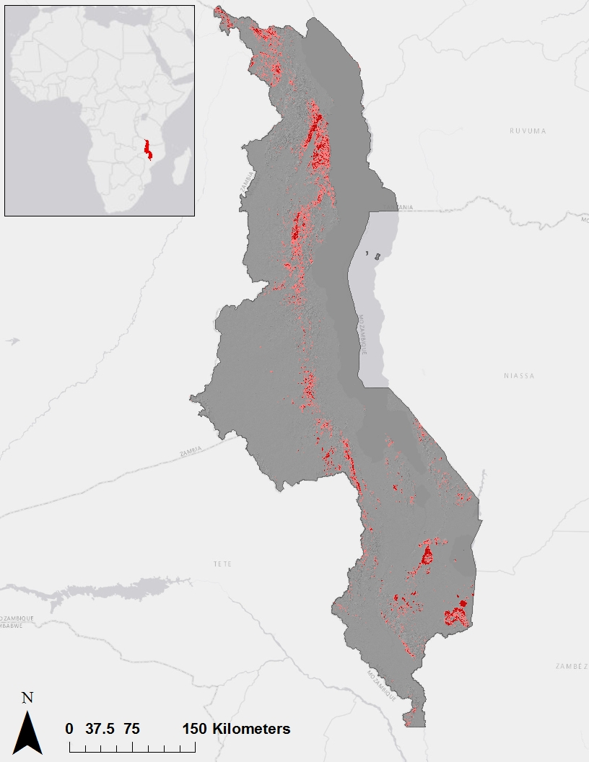
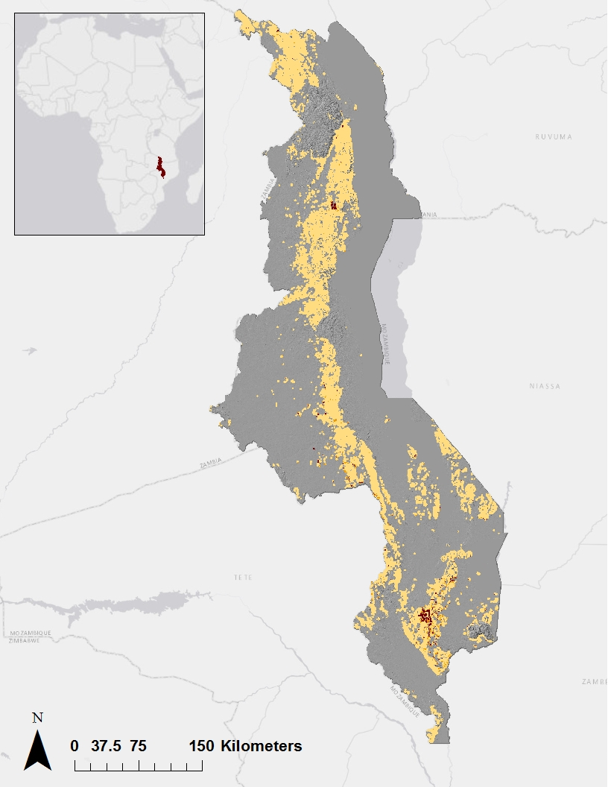
Results
Landslide Susceptibility
in Malawi
Exposure Map of Malawi
Northwest, Central, and Southeastern Malawi are susceptible
Cities such as Blantyre, Zomba and Mzuzu are exposed
Over 13 million people live in susceptible areas
Susceptibility
People per
Square Kilometer
Moderate
High
1 - 500
500 - 1,000
1,000 – 37,000
Notes:
The Northwestern, Central, and Southern regions of Malawi were found to be the most susceptible to landslide events. Areas highly susceptible to landslides were concentrated in areas located along the slopes of the Nyika Plateau in the Northwest and the Mulanje and Zomba Mountains in the Southeast, and variables including elevation, slope, and land cover, especially deforested areas, were found to be some of the most significant indicators of landslide susceptibility. The Landslide Susceptibility Map was assessed to have an accuracy of 85 percent.
The Landslide Exposure Map showed that 13,394,338 Malawian people lived in or within 1-kilometer of areas that were moderately or highly susceptible to landslides. Of that group, 5,520,000 people lived in or within 1-kilometer of areas that were highly susceptible to landslides. Landslide exposure in Malawi was most highly concentrated near the urban population centers of Mzuzu in Northern Malawi and Blantyre and Zomba in Southeastern Malawi.

Slide 12
Results
GPM and TRMM Assessment
Data Source | Temporal Resolution | Average Correlation Coefficient for March 2014 to Jan. 2015 | Minimum Correlation Coefficient | Maximum Correlation Coefficient
TRMM | Total Monthly | 0.358 | -0.198 | 0.890
 | Averaged Daily | 0.373 | -0.058 | 0.866
GPM | Total Monthly | 0.199 | -0.117 | 0.745
 | Averaged Daily | -0.025 | -0.538 | 0.607
Both TRMM and GPM correlated more highly with CHIRPS 2.0 in rainy season months
On average, TRMM correlated more closely with CHIRPS 2.0 than GPM
Notes:
Both TRMM and GPM tended to correlate more highly with CHIRPS 2.0 during the rainy season months of November through April. Conversely, correlation coefficients during the dry season between May and October generally hovered below 0.5, and often reached lows between 0.02 and 0.3
These results indicate that GPM- and TRMM-based measurements may be most useful and accurate for near-real time studies and modeling efforts during the rainy season months.

Slide 13
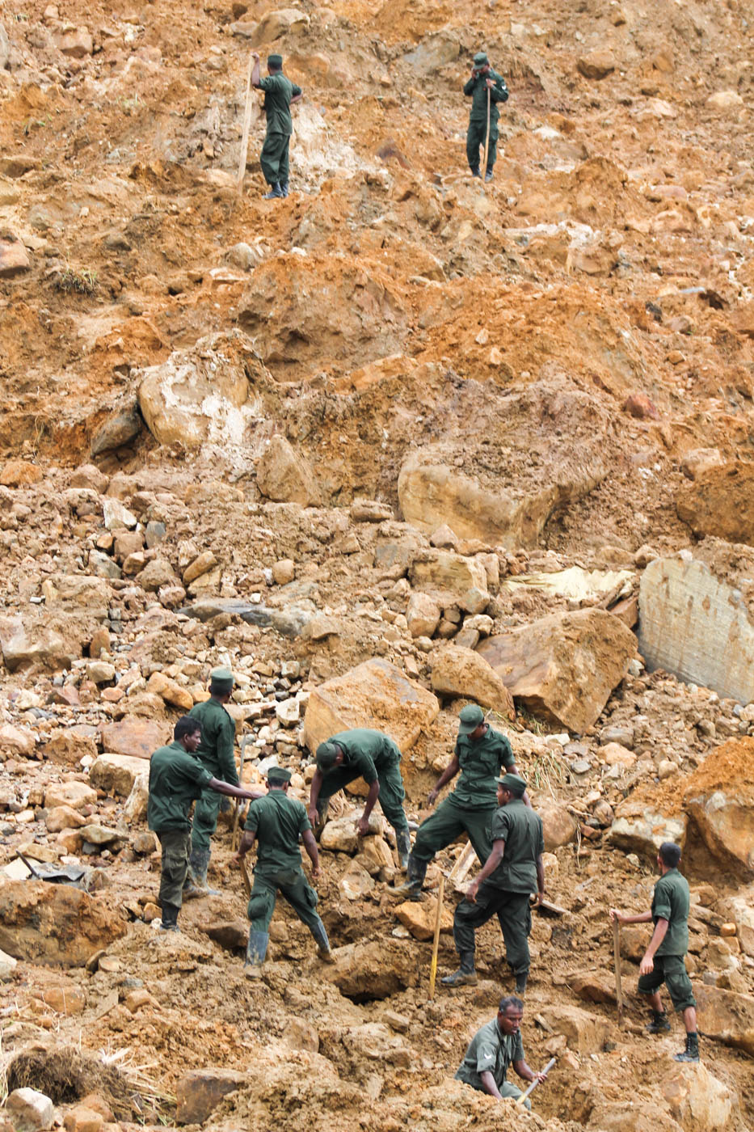
Conclusions
Approximately 15 updates to the GLC will enhance documentation of landslide events in East Africa
Susceptibility and exposure maps will inform stakeholders’ and decision-makers’ mitigation and recovery efforts
GPM and TRMM assessment will guide future projects’ use of these products, especially in near real-time context
Image Source: Vikalpa/Groundviews/CPA
Notes:
As of the start of this project in June 2016, the Global Landslide Catalog (GLC) listed only one landslide event for Malawi. This project resulted in the addition of 15 landslide points with less than one-month temporal resolution to the GLC, information that will increase the amount of available documentation of landslide events in Malawi and contribute to future susceptibility and exposure modeling in East Africa.
The landslide susceptibility and exposure maps created through this project, while static depictions, will nevertheless inform government officials’ and local stakeholders’ ongoing infrastructural planning to avoid building in potentially disastrous areas or to prioritize the implementation of aid programs and centers in areas of maximum exposure.
The assessment of GPM and TRMM performance will help guide future researchers’ decisions regarding which data products to employ in Malawi studies depending on the project’s study period and objectives.
Image from Wikimedia Commons: https://commons.wikimedia.org/wiki/File:CPA_Koslanda_IMG_5220_%2815096957393%29.jpg

Slide 14
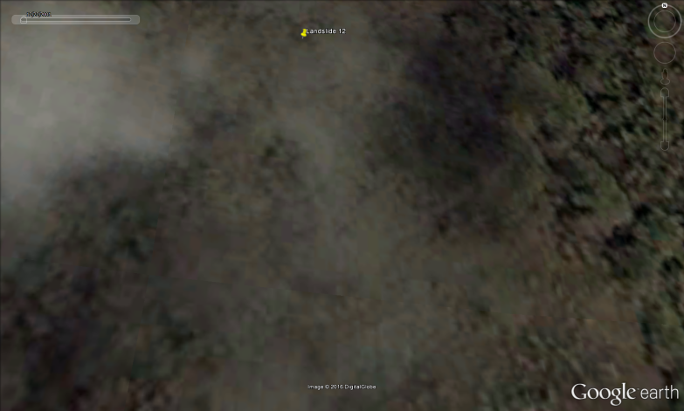
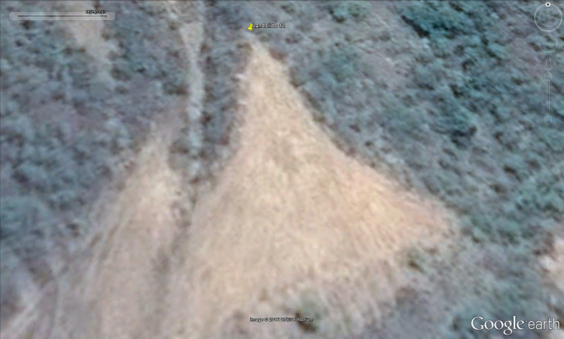
Errors and Uncertainties
12/22/2001
11/14/2013
Images Source: Google Earth
Pinpointing exact dates of landslide occurrences
Sensor spatial and temporal discrepancies
Sensors’ temporal and spatial scales inconsistent with landslide trigger scales
Notes:
At the conclusion of the project, errors and uncertainties associated with methodology and outcomes still exist. Pinpointing the exact dates of landslide occurrences using Google Earth proved difficult in certain situations in which the first available “before landslide” image had been captured one or several years before the “after landslide” image.
Additionally, differences among remotely sensed and ground-derived datasets in spatial and temporal resolution necessitated the resampling of some data layers to ensure consistency with others, a process that inherently introduced some degree of spatial error to the analysis. The scales of remotely sensed data were also sometimes inconsistent with the scales of environmental factors triggering landslide occurrence in the real world.

Slide 15
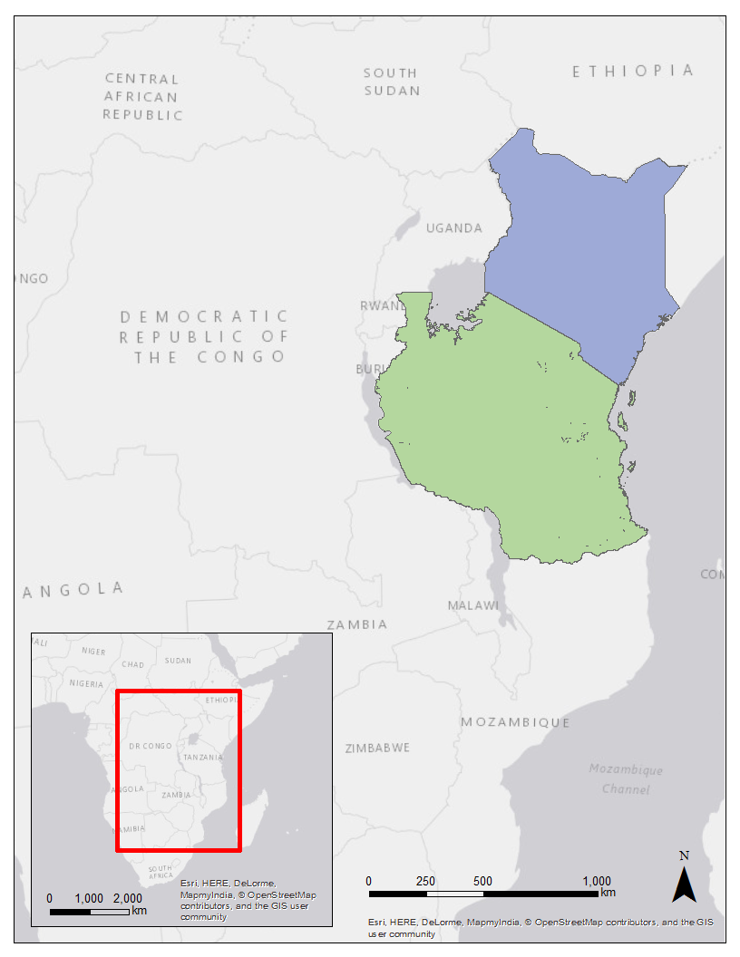
Future Work
Expand study area to other African countries such as Tanzania or Kenya
Create near real-time model
Compare GPM-IMERG and TRMM daily ground validation estimates to CHIRPS 2.0 daily precipitation measurements
Kenya
Tanzania
Notes:
For future work, we would like to extend the study area to other African countries that are impacted by landslide events, such as Tanzania or Kenya. Something that this team tried, but could not create due to a limited number of exact dates on landslide points, was to make a near real-time model using a semi-automated Python script. This would be able to identify the precipitation thresholds directly before specific landslide occurrences and create a near real-time susceptibility map of what areas are experiencing those landslide triggers whenever new satellite information becomes available. And finally we would like to improve the GPM TRMM assessment by comparing them to a dataset with more ground control points for a more accurate representation of the satellites’ performances

Slide 16
Partners
Denis Macharia, RCMRD – SERVIR Eastern & Southern Africa Disaster Lead
Africa Flores, NASA SERVIR – Eastern & Southern Africa Coordination Lead
Dr. Dalia Kirschbaum, NASA SERVIR – GPM Applications Scientist
Advisors
Dr. Jeffrey Luvall, NASA at NSSTC
Dr. Robert Griffin, University of Alabama in Huntsville
Eric Anderson, NASA SERVIR Coordination Office at MSFC
Others
Leigh Sinclair, UAH/ITSC
Daryl Ann Winstead, NASA DEVELOP
Padraic Conner, Previous NASA DEVELOP
contributor
Tyler Finley, Previous NASA DEVELOP contributor
Jeanné le Roux, Previous NASA DEVELOP
contributor
Faith Mitheu, NASA SERVIR – Eastern & Southern
Africa Disaster Co-Lead
Dr. Walter Petersen, GPM Project Scientist
Notes:
Finally we would like to thank our partners: Denis Macharia from RCMRD, and Africa Flores and Dr. Dalia Kirschbaum from NASA SERVIR; our advisors and mentors: Dr. Jeffrey Luvall, Dr. Robert Griffin, and Eric Anderson; the previous East Africa Disasters team: Leigh Sinclair, Padraic Conner, Tyler Finley, and Jeanne le Roux; and finally Daryl Ann Winstead, Faith Mitheu, and Dr. Walter Peterson for their guidance as well. Thank you for your time, are there any questions?

Slide 17
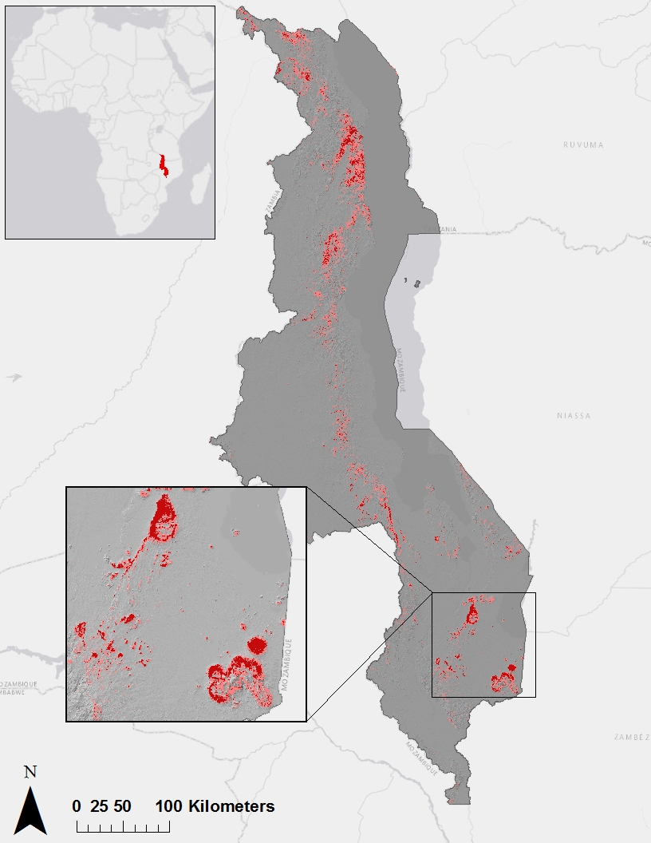
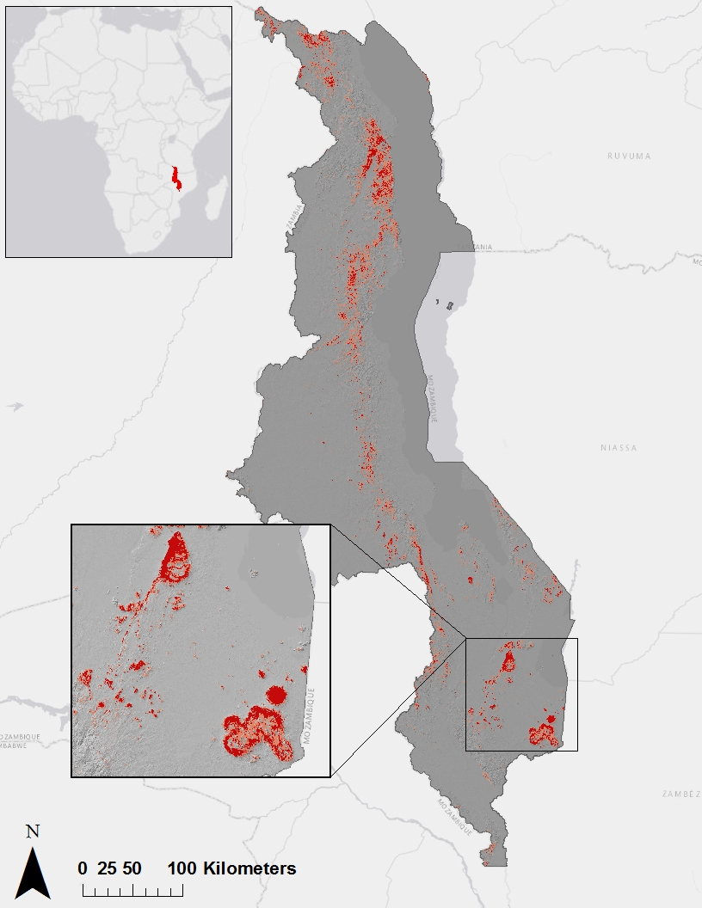
Landslide Susceptibility
in Malawi
Landslide Susceptibility
in Malawi
Susceptibility
Susceptibility
Accuracy:
74.19 %
Accuracy:
77.42 %
Moderate
Moderate
High
High
Notes:
The map on the left shows the MaxEnt model that was run without precipitation or soil moisture and the image on the right shows the MaxEnt model that was run without precipitation.

Slide 18
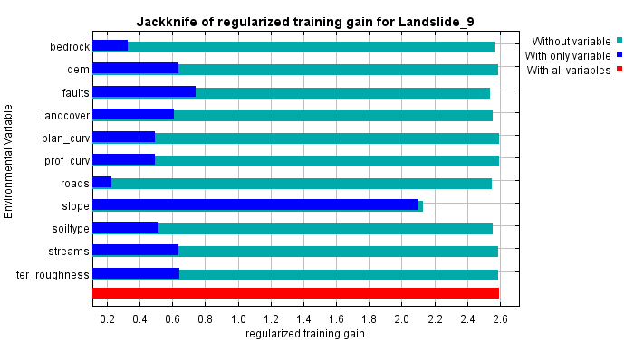

Slide 19
Correlation Assessment for GPM IMERG and CHIRPS 2.0
Month | Correlation Coefficient for Monthly Total Data | Correlation Coefficient for Daily Rate Averaged per Month Data | Correlation Coefficient for Extreme Monthly Total Data | Correlation Coefficient for Extreme Daily Rate Averaged per Month Data
March 2015 | 0.575 | 0.091 | 0.202 | -0.117
April 2015 | 0.745 | 0.607 | 0.417 | 0.547
May 2015 | 0.382 | 0.161 | 0.223 | 0.133
June 2015 | -0.084 | -0.309 | -0.069 | -0.432
July 2015 | -0.015 | -0.538 | 0.576 | -0.564
August 2015 | 0.123 | -0.417 | -0.285 | -0.389
September 2015 | 0.009 | -0.308 | 0.454 | -0.164
October 2015 | 0.429 | 0.412 | 0.418 | 0.445
November 2015 | -0.117 | 0.184 | -0.368 | 0.043
December 2015 | 0.081 | -0.048 | 0.510 | 0.383
January 2016 | 0.433 | 0.007 | 0.314 | 0.054
Average | 0.199 | -0.025 | 0.219 | 0.006

Slide 20
Correlation Assessment for TRMM PR and CHIRPS 2.0
Month | Correlation Coefficient for Monthly Total Data | Correlation Coefficient for Daily Rate Averaged per Month Data | Correlation Coefficient for Extreme Monthly Total Data | Correlation Coefficient for Extreme Daily Rate Averaged per Month Data
March 2014 | 0.847 | 0.848 | 0.155 | 0.077
April 2014 | 0.890 | 0.866 | 0.715 | 0.622
May 2014 | 0.056 | -0.058 | -0.194 | -0.163
June 2014 | 0.027 | 0.041 | 0.078 | 0.547
July 2014 | 0.160 | 0.170 | 0.119 | 0.295
August 2014 | 0.332 | 0.174 | 0.269 | 0.460
September 2014 | 0.405 | 0.257 | 0.251 | 0.306
October 2014 | 0.296 | 0.264 | 0.009 | 0.033
November 2014 | 0.513 | 0.508 | 0.466 | 0.451
December 2014 | -0.198 | 0.417 | -0.256 | 0.476
January 2015 | 0.608 | 0.622 | 0.249 | 0.259
Average | 0.358 | 0.373 | 0.169 | 0.306

