Slide 1
Wise
Disasters
Identifying the Historic and Future Extent of Flooding Throughout Wise County, Virginia.
Authors: Kimberly Berry (Project Lead), Abhijeet Singh Baghel, Grant Bloomer, Zachary Tate
The CREST Model combines Digital Elevation Model, Stream Flow, Evapotranspiration and Precipitation to output flood conditions.
Abstract
Wise County is located in the Appalachian Mountains of southwest Virginia. Mountainous terrain increases the amount of runoff into local drainage basins during strong storms, which can increase the frequency of flash floods. This project determined areas that are more susceptible to flooding using Esri ArcGIS and The Coupled Routing and Excess Storage (CREST) model to analyze data collected from Landsat 5 Thematic Mapper, Landsat 8 Operational Land Imager, and Shuttle Radar Topography Mission (SRTM). These sensors collected data on rainfall, elevation, and land use change from 2000-2015. The modeled flooding data was compared to estimated historical floods to increase the confidence of the CREST modeled flood predictions. Maps created from the flood models have been handed off to the Wise County Emergency Operations Center for use in planning for future flood events.
DEVELOP Wise
NASA DEVELOP National Program at the Wise County Clerk of Court’s Office
Earth Observations
Shuttle Radar Topography Mission (SRTM)
Global Precipitation Measurement (GPM)
Tropical Rainfall Measuring Mission (TRMM)
Partners
Wise County, Virginia Board of Supervisors
Wise County, Virginia Office of Emergency Management
Advisors
Dr. Kenton Ross, NASA DEVELOP National Program
Dr. DeWayne Cecil, Global Science and Technology, NOAA NCEI
Bob VanGundy, The University or Virginia’s College at Wise

Slide 2
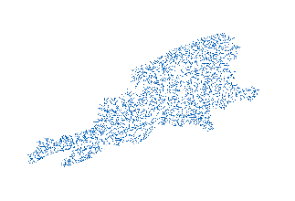
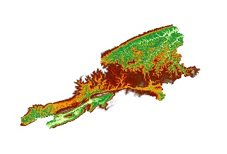
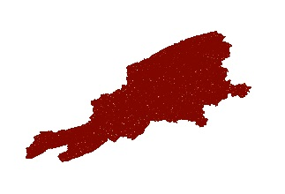
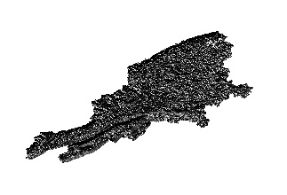
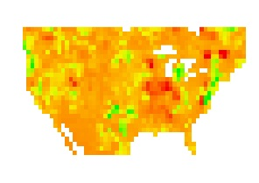
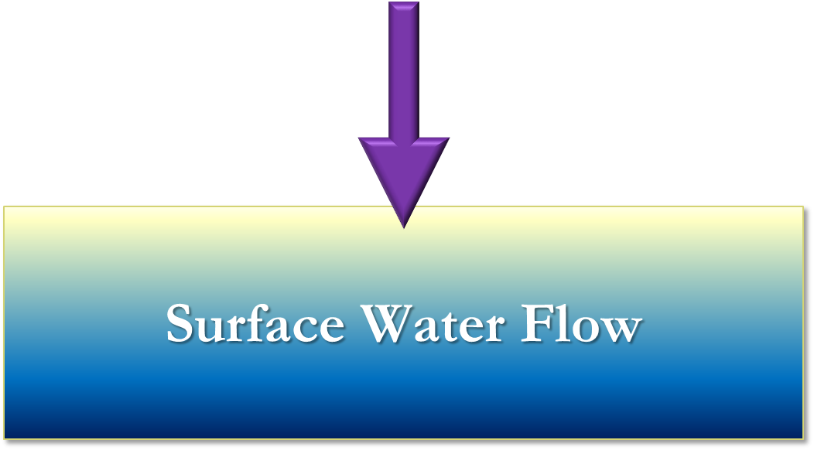
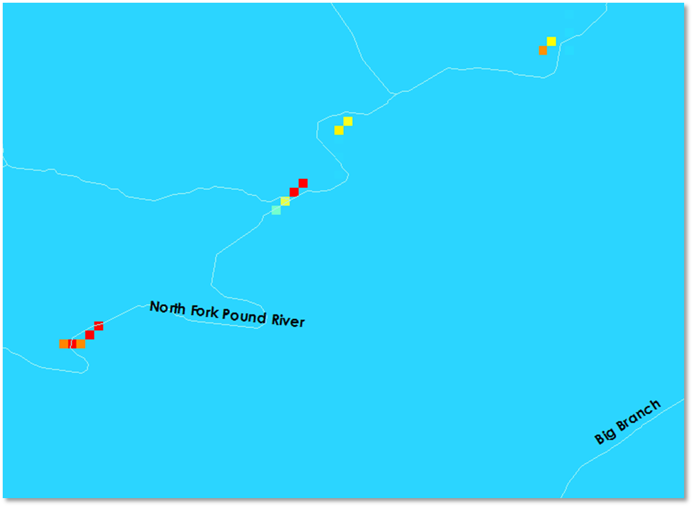
Streams
Networks
Digital Elevation
Flow Accumulation
Flow
Direction
Data Acquisition
Basics Folder
Data Acquisition
Precipitation
Data
Potential Evapotranspiration
Rain Data
(PETs)
CREST Model inputs
CREST Inputs
To run the Crest Model, several inputs are required. SRTM DEM’s were used as the base elevation map. Using the DEM, Flow Direction and Flow accumulation were derived. USGS Stream data was used to denote what pixels had streams. gSSURGO soil data was used to denote soil type and permeability so the model could determine where water would be absorbed as ground water or continue flowing. Both TRMM and GPM precipitation datasets were used. TRMM data is still available but the sensor has stopped collecting data and has since then been replaced by the GPM sensor. Lastly, Potential Evapotranspiration data was acquired from the Global Land Data Assimilation System (GLDAS).
Conclusions
Before final conclusions can be reached, the CREST model requires calibration of hydrologic variables and the input of initial conditions.
Model may be improved for future use by including impervious areas and vegetation conditions.
Current plans to include more stream gauges in Wise County will improve stream monitoring coverage and can improve the calibration of the CREST model.
High: 20.2
Low: -8.5
Calculated Discharge
above Initial Conditions
(m³/s)
CREST Model output

