Slide 1
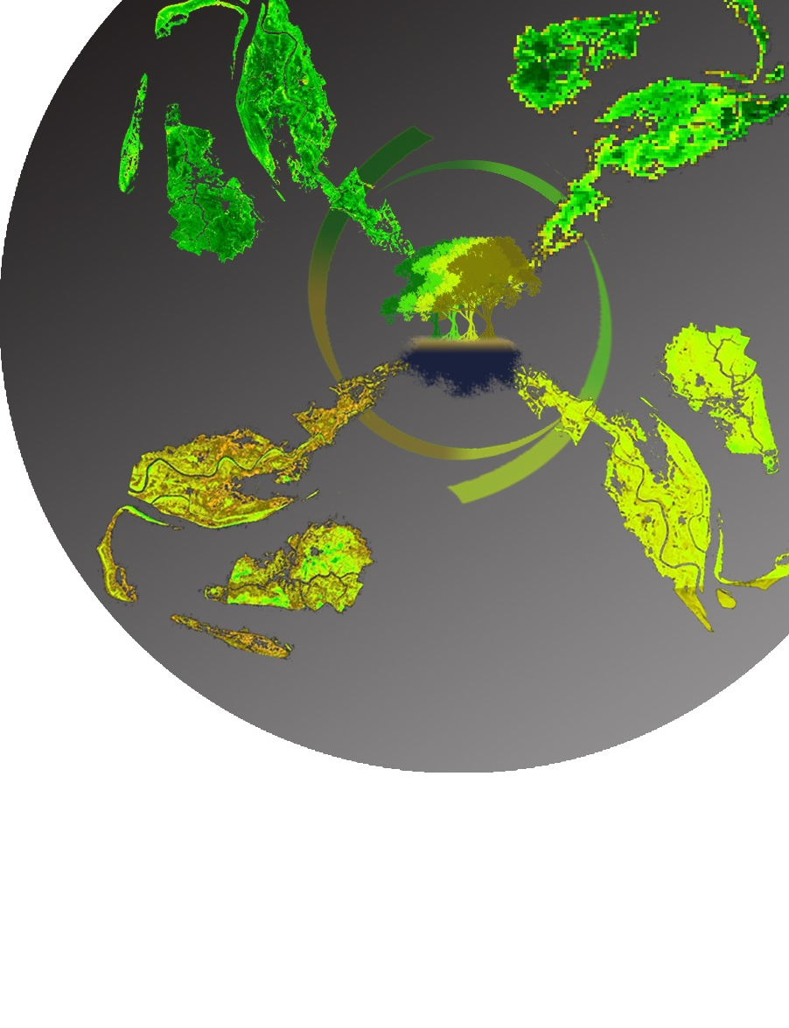
Abhishek Kumar (Project Lead)
Roger Bledsoe
Caren Remillard
EASTERN INDIA ECOLOGICAL FORECASTING
María José Rivera
A Multi-Sensor Approach to Enhance the Prediction of Mangrove Biophysical
Characteristics in Bhitarkanika Wildlife Sanctuary and Chilika Lagoon, Odisha, India
Jessica Staley
Patricia Stupp

Slide 2
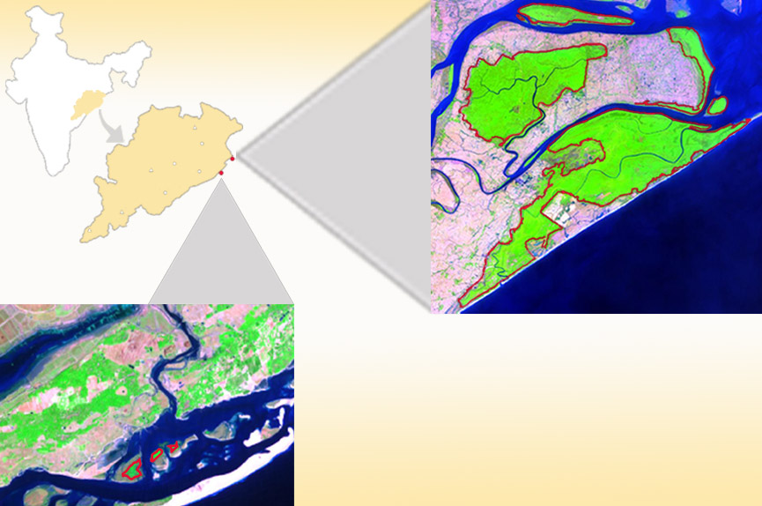
Study Area
Bhitarkanika
Latitude: 20.71ºN
Longitude: 86.86ºE
Mangrove Types: Dense, Closed & Open
Total Mangrove Species: 55
Mangrove Area: 145 km²
Chilika
Latitude: 19.84º N
Longitude: 85.47º E
Mangrove Types: Open, Small patches
India
Odisha
Bhitarkanika Wild Life Sanctuary
0
kilometers
15
Red polygon outlines mangrove area
Chilika Mangroves
Source: Eastern India Ecological Forecasting
Notes:
Chilika Lagoon and Bhitarkanika Wildlife Sanctuary are two notable east coast wetland sites recognized as the Ramsar Convention on Wetlands and both are situated in the state of Odisha. As the world’s second largest lagoon, Chilika holds three small, but distinct mangrove patches near the opening of the Bay of Bengal. Bhitarkanika Wildlife Sanctuary is located north of Chilika Lagoon on a delta formed by Brahmani and Baitarani rivers and has several large and dense patches of mangroves.
Base Map Source: Orissa Tourism

Slide 3
Community Concerns
Residents from 36 villages receive valuable resources and services from the mangroves.
Mangroves have been overexploited or converted to various other forms of land use.
Encroachment upon forests, unauthorized aquaculture practices, and discharge of effluent place even more pressure on mangrove forests and biodiversity.
Source: Wildlife Institute of India (2003)
Notes:
Residents from 36 nearby villages receive valuable resources and services from the mangroves, including food, raw materials, medicinal and ornamental products and vacation/leisure sites.
Mangroves have been overexploited or converted to various other forms of land use, including agriculture, aquaculture, salt ponds, terrestrial forestry, and urban and industrial developments.
Bhitarkanika Wildlife Sanctuary and Chilika Lagoon supports several populations of crocodiles, lizards, migratory birds, and several rare and endangered mammals.
Image Source: http://irade.org/eerc/pdf/WB_FR_RuchiBadola.pdf

Slide 4
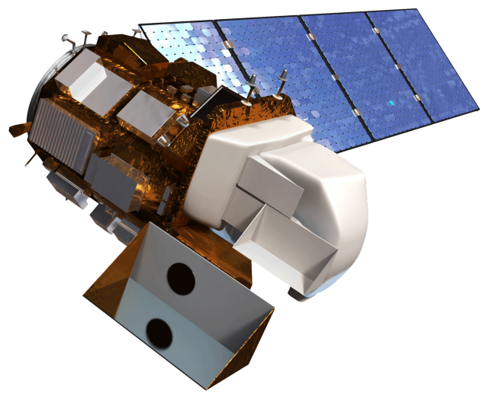
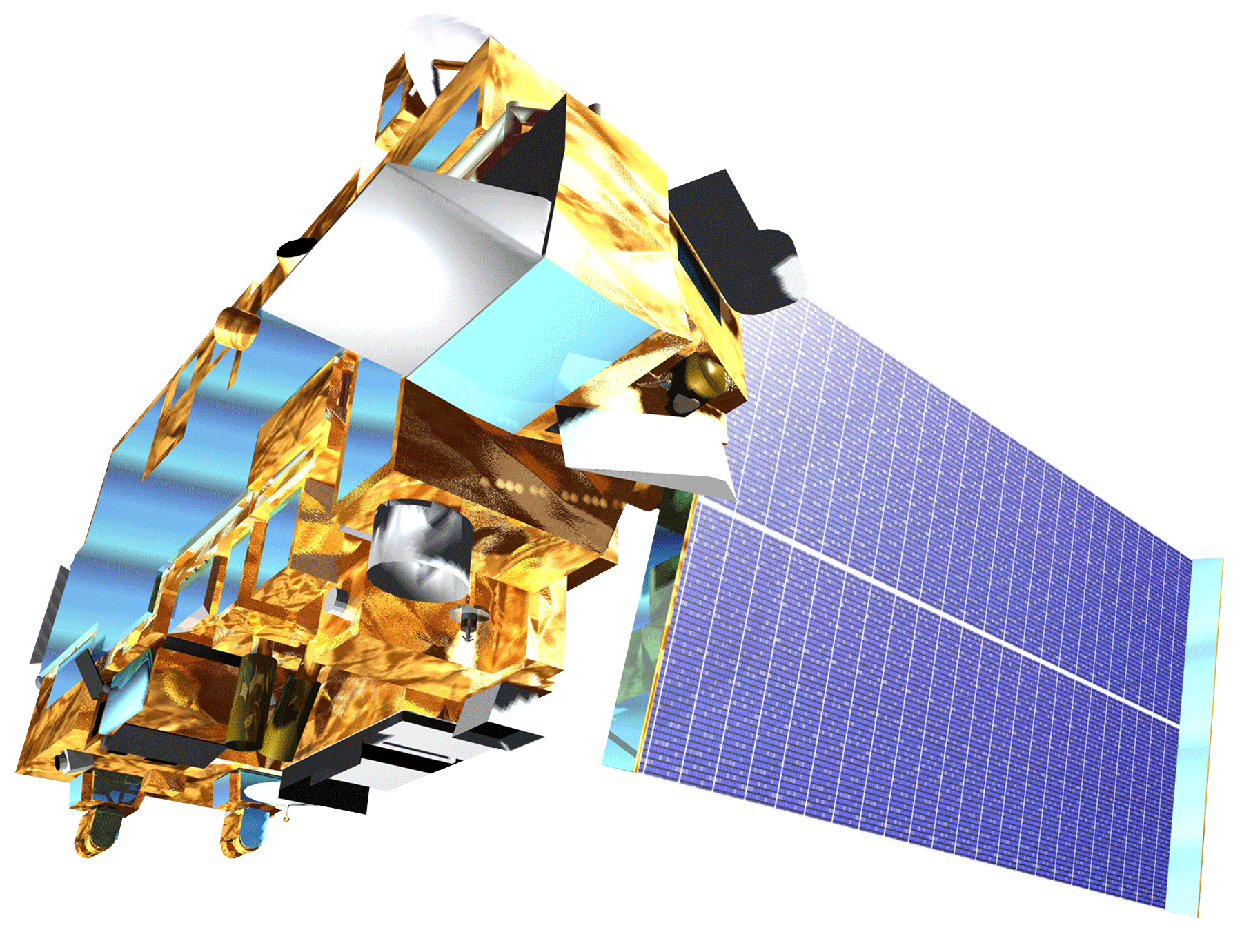
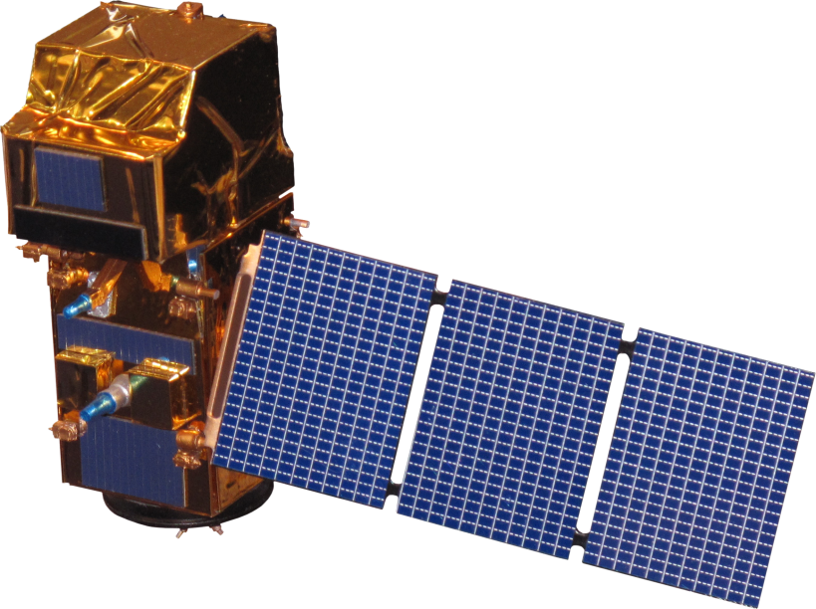
Objectives
Landsat-8 OLI
Develop a multi-sensor mangrove biophysical characteristics prediction tool for Bhitarkanika Wildlife Sanctuary and Chilika Lagoon using moderate resolution remote sensing reflectance data.
Derive a phenology in order to enhance management and restoration efforts by the Department of Forest and Environment in Odisha, India.
Terra ASTER and MODIS
Image Credit: NASA
Sentinel-2 MSI
Image Credit: NASA
Source: NASA
Notes:
The primary objective of the study is to integrate multiple satellite sensors such as MODIS, OLI, ASTER, MSI to estimate biophysical characteristics (CHL, LAI, GPP) of mangroves. The secondary objective is to create multiple time series showing seasonal and spatial variability in health of mangroves by using Chlorophyll as proxy parameter. The end-products and results will be used by the Ministry of Environment and Forests, Odisha and Chilika Development Authority to improve management efforts.
Satellite Image Source: NASA’s DEVELOPedia

Slide 5
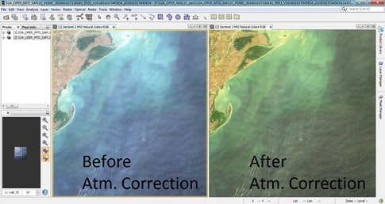
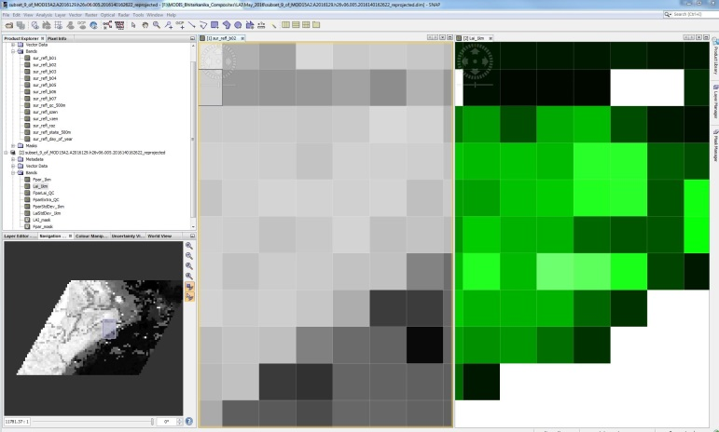
Methodology
Satellite Data
Standard Surface Reflectance Products
Landsat OLI | Terra MODIS
CHL Model
Spatiotemporal Bio-physical
Parameter Maps
LAI, GPP, CHL
True Color Images
TOA Products
Sentinel-2 | Terra ASTER
8-Day Standard Product
Terra MODIS
Resampled to 1km
Surface Reflectance
(500m)
GPP, LAI
(1km)
Vegetation Index
NDVI
Seasonal Mangrove Analysis
Atmospheric Correction
GPP, LAI Model
Workflow Diagram
Atmospheric Correction
Re-sampling Pixels at 1km
Correlation
Comparison
Source: Eastern India Ecological Forecasting
Notes:
Satellite data acquired by multiple sensors were downloaded from various sources (LAADS, USGS earth explorer, Scientific Data Hub, Giovanni). Data processing were accomplished using various software (SNAP, ERDAS, ENVI, ArcGIS) and models were implemented to produce final product. Finally, a time series was created to observe seasonal and inter-annual variability.

Slide 6
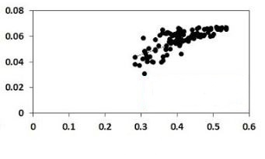
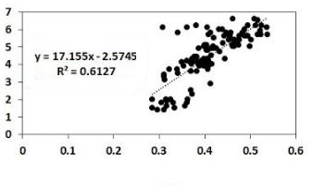
Results
Calibration Results
Bands & Indices | Abbreviation | Formula | LAI Correlation Coefficient (R) | LAI Correlation Equation | GPP Correlation Coefficient (R) | GPP Correlation Equation
Blue | B3 | R_{rs}(B3) | 0.64 | y= -.93.098x + 6.7841 | 0.64 | y = -0.5418x + 0.0699
Red | B1 | R_{rs}(B1) | 0.69 | y= -55.106x + 6.8859 | 0.71 | y = -0.3287x + 0.0709
Green | B4 | R_{rs}(B4) | 0.53 | y= -54.753x + 7.5682 | 0.59 | y = -0.3543x + 0.0765
Near-InfraRed | B2 | R_{rs}(B2) | 0.49 | y= 24.498x – 2.102 | 0.45 | y = 0.1315x + 0.0212
Shortwave Infrared-1 | B5 | R_{rs}(B5) | 0.1 | y= -3.9268x + 5.5421 | 0.095 | y = -0.0218x + 0.0624
Shortwave Infrared-2 | B6 | R_{rs}(B6) | 0.54 | y= -18.622x + 7.2501 | 0.56 | y = -0.1126x + 0.0733
Normalized Difference Vegetation Index | NDVI | [R_{rs}(NIR)- R_{rs}(B1)]/ [R_{rs}(NIR)+R_{rs}(B1)] | 0.69 | y= 9.5734x – 2.392 | 0.73 | y = 0.0599x + 0.0135
Enhanced Vegetation Index 1 | EVI1 | 2.5*[(R_{rs}(NIR)- R_{rs}(B1)])/ (1+R_{rs}(NIR)+6*R_{rs}(B1)-7.5* R_{rs}(B3)] | 0.78 | y= 17.009x – 2.6598 | 0.77 | y = 0.098x + 0.0153
Enhanced Vegetation Index 2 | EVI2 | 2.5*[(R_{rs}(NIR)- R_{rs}(B1)])/ (1+R_{rs}(NIR)+2.4*R_{rs}(B1)] | 0.78 | y= 17.155x - 2.5745 | 0.77 | y = 0.0983x + 0.0161
Normalized Difference Vegetation Index (Green) | NDVI(G) | [R_{rs}(NIR)- R_{rs}(B4)]/ [R_{rs}(NIR)+R_{rs}(B4)] | 0.63 | y= 12.398x - 3.6427 | 0.68 | y = 0.078x + 0.0054
Simple Ratio | SR | [R_{rs}(NIR)/R_{rs}(B1)] | 0.65 | y= = 0.3428x + 2.0964 | 0.67 | y = 0.0021x + 0.0421
Normalized Difference Moisture Index | NDMI | [R_{rs}(NIR)- R_{rs}(B6)]/ [R_{rs}(NIR)+R_{rs}(B6)] | 0.65 | y= 7.4622x + 2.3086 | 0.69 | y = 0.046x + 0.0431
y = 0.0983x + 0.0161
R = 0.7688
GPP (kg-C/m²)
EVI2
y = 17.155x - 2.5745
R = 0.7828
LAI
EVI2
Source: Eastern India Ecological Forecasting
Notes:
Comparison between different bands and indices correlation results for biophysical parameters including leaf area index and gross primary productivity. The best result is highlighted in yellow on the table and presented by scatter plots.

Slide 7
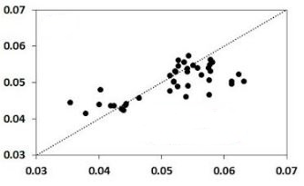
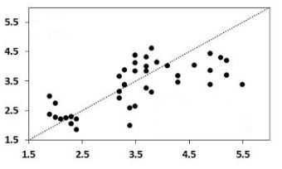
Results
Validation and Error Estimation
Bands & Indices | LAI: Root Mean Square Error (RMSE) | LAI: Percentage Normalized Root Mean Square Error (%NRMSE) | GPP: Root Mean Square Error (RMSE) | GPP: Percentage Normalized Root Mean Square Error (%NRMSE)
Blue | 1.15 | 31.89 | 0.0066 | 23.63
Red | 1.08 | 30.19 | 0.0063 | 22.76
Green | 1.33 | 37.01 | 0.0076 | 27.47
Near-InfraRed | 0.82 | 22.88 | 0.0059 | 21.26
Shortwave Infrared-1 | 1.47 | 40.91 | 0.0087 | 31.28
Shortwave Infrared-2 | 1.42 | 39.49 | 0.0082 | 29.51
Normalized Difference Vegetation Index | 1.29 | 33.32 | 0.0073 | 25.64
Enhanced Vegetation Index 1 | 0.77 | 19.86 | 0.0055 | 19.26
Enhanced Vegetation Index 2 | 0.76 | 19.54 | 0.0053 | 18.64
Normalized Difference Vegetation Index (Green) | 1.28 | 32.93 | 0.0072 | 25.41
Simple Ratio | 1.46 | 37.46 | 0.011 | 37.44
Normalized Difference Moisture Index | 1.18 | 30.32 | 0.0069 | 24.19
EVI2
RMSE: 0.0053
NRMSE: 18.64%
GPP (Predicted)
GPP(Measured)
EVI2
RMSE: 0.76
NRMSE: 19.54%
LAI (Predicted)
LAI (Measured)
Source: Eastern India Ecological Forecasting
Notes:
Validation result comparison between individual bands and various indices included in the calibration of GPP and LAI. These results were derived from an independent data set (n=60) corresponding to three different seasons to avoid any seasonal bias. The best result is highlighted in yellow on the table and presented by scatter plots.

Slide 8
Results
Seasonal Spectral Variability
Mean Spectra
Fall
Winter
Fall
Winter
Spring Summer
Surface Reflectance
Surface Reflectance
MODIS Spectral Bands
Spring
Summer
MODIS Bands | Center Wavelength and Bandwidth (nm)
Blue (B3) | 469 (459 – 479)
Green (B4) | 555 (545 – 565)
Red (B1) | 645 (620 – 670)
Near-Infrared (B2) | 859 (841 – 876)
Shortwave Infrared-1 (B5) | 1240 (1230 – 1250)
Shortwave Infrared-2 (B6) | 1635 (1628 – 1652)
MODIS Spectral Bands
Source: Eastern India Ecological Forecasting
Notes:
MODIS surface reflectance spectra derived from 20 random points from the Bhitarkanika study area after resampling pixels from 500m to 1km to match with biophysical parameter products (GPP, LAI) which are generated at 1 km resolution. The red edge (NDVI) clearly showed variation in different seasons, very steep in the fall and gradually reduced in the following seasons. The mean spectra clearly shows the variation in the different seasons with respect to different bands.

Slide 9
Results
ASTER Cross-Calibration
Mean Spectra
Sentinel-2 Cross-Calibration
Mean Spectra
Source: Eastern India Ecological Forecasting
Notes:
Variability in surface reflectance magnitude between standard product corresponding to Landsat-8 OLI bands and atmospherically corrected Terra ASTER and Sentinel 2 MSI bands. This variability is because of different atmospheric correction techniques used for different products such as FLAASH for ASTER and Sen2Cor for Sentinel 2. To overcome this issue Terra ASTER and Sentinel 2 MSI indices (NDVI and EVI2) were cross-calibrated with Landsat-8 OLI.

Slide 10
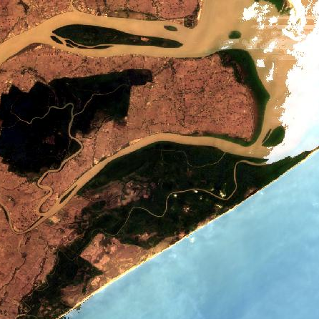
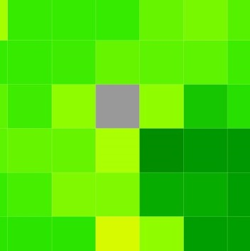
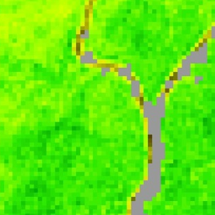
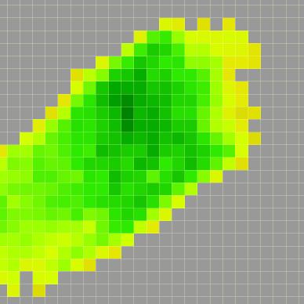
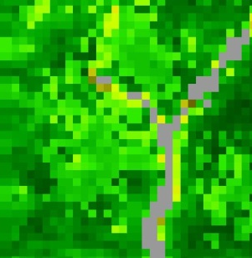
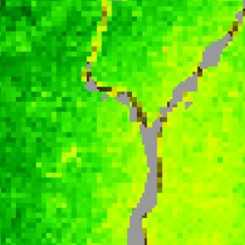
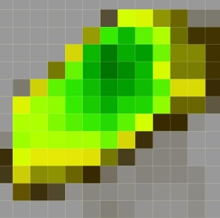
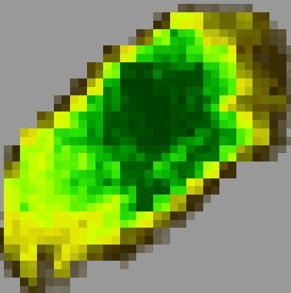
Results
Bhitarkanika
Chilika
MODIS
MODIS
ASTER
ASTER
CHL (µg/cm²)
CHL (µg/cm²)
0 78
0 78
OLI
MSI
OLI
MSI
Source: Eastern India Ecological Forecasting
Notes:
These figures show the difference in spatial resolution between the four sensors and similar range of Chlorophyll content (after cross calibration) during spring season. Spatial resolution is as follows: Terra MODIS 250m, Terra ASTER 15m, Landsat-8 OLI 30m, and Sentinel-2 MSI 10m.

Slide 11
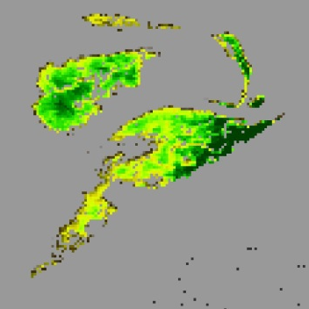
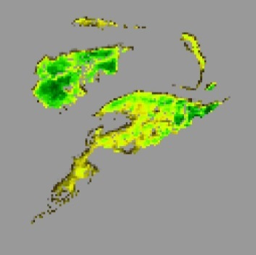
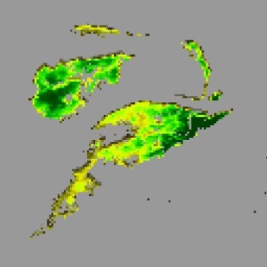
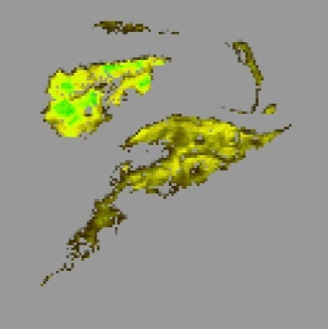
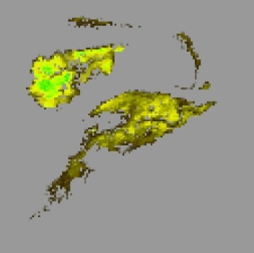
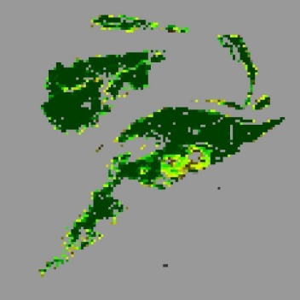
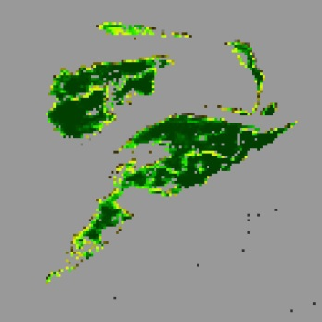
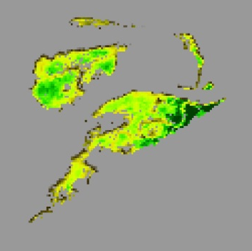
Results
CHL: Terra MODIS Composites (2013 – 2016)
January
February
March
April
May
October
November
December
CHL: Landsat 8 OLI Composites (2013 – 2016)
CHL (µg/cm²)
0 78
Source: Eastern India Ecological Forecasting
Notes:
Monthly spatio-temporal variability in mangroves leaf chlorophyll content (2013-2016). October and November (Fall season) showed higher values and lower values was observed in April and May (Summer Season).

Slide 12
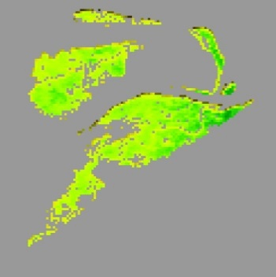
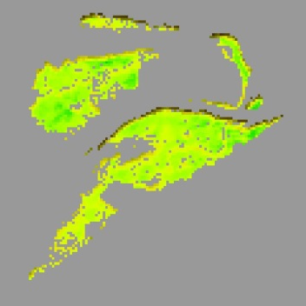
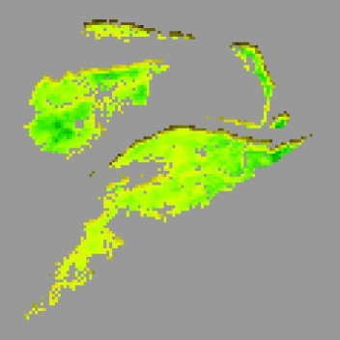
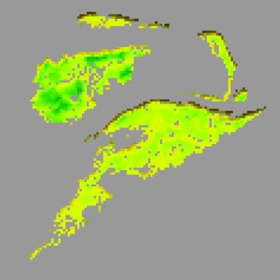
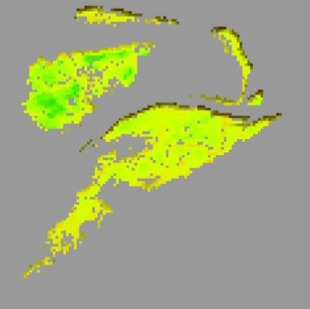
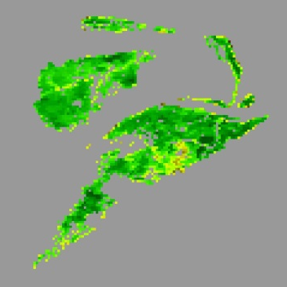
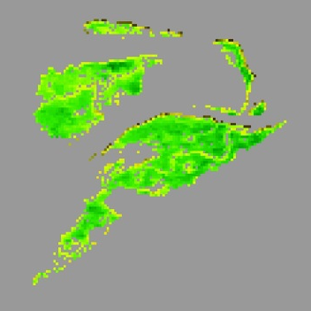
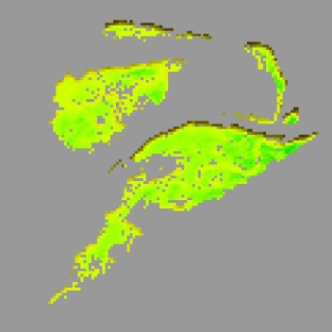
Results
GPP: Terra MODIS
January
February
March
April
May
October
November
December
GPP: Landsat 8 OLI
GPP (g-C/m²)
0 56
Source: Eastern India Ecological Forecasting
Notes:
Monthly spatio-temporal variability in mangroves GPP (2013-2016). October and November (Fall season) showed higher values and lower values was observed in April and May (Summer Season).

Slide 13
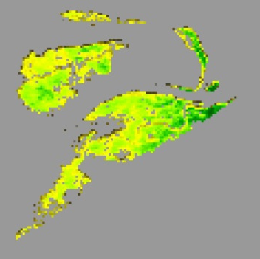
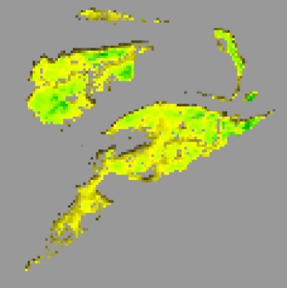
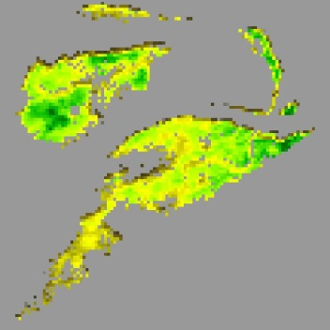
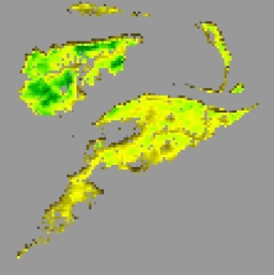
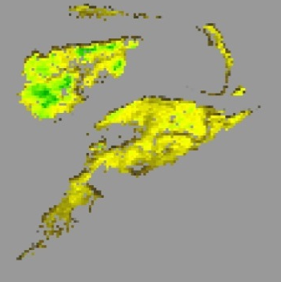
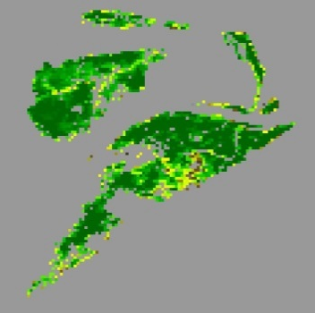
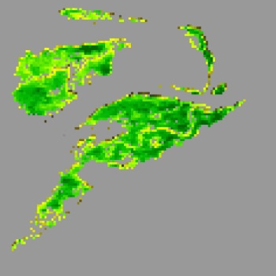
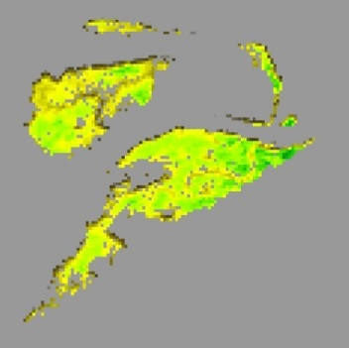
Results
LAI: Terra MODIS
January
February
March
April
May
October
November
December
LAI: Landsat 8 OLI
LAI
0 6
Source: Eastern India Ecological Forecasting
Notes:
Monthly spatio-temporal variability in mangroves leaf area index (2013-2016). October and November (Fall season) showed higher values and lower values was observed in April and May (Summer season).

Slide 14
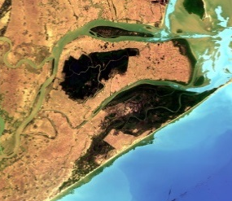
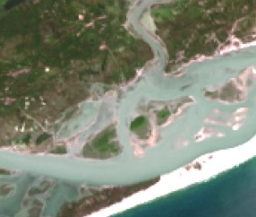
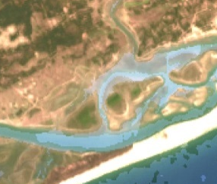
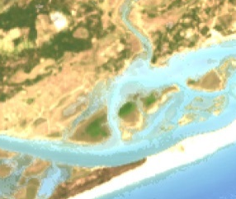
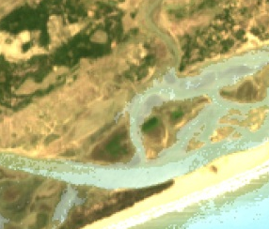
Results
Bhitarkanika – Landsat 8 OLI
Chilika – Landsat 8 OLI
Fall
Winter
Spring
Summer
Fall
Winter
Spring
Summer
True Color
78
CHL (µg/cm²)
0
56
GPP (gC/m²)
0
6
LAI
Source: Eastern India Ecological Forecasting
Image Credit: NASA
0
Notes:
Figure shows the seasonal changes of each biophysical parameter (CHL, GPP, LAI) for both Bhitarkanika and Chilika. For each biophysical parameter in both study areas, the values are highest in fall, are moderate in winter and spring, and are lowest in summer. True color images clearly indicated the surface is greener during fall and became gradually drier in the following seasons.

Slide 15
Results
Bhitarkanika
80.0
Chilika
72.1
July 2015
64.2
June 2015
Aug 2015
Sept 2015
Oct 2015
Nov 2015
56.3
48.4
Precipitation (mm/hr)
40.5
Precipitation
Results
32.6
24.7
16.8
8.9
1.0
Dec 2015
Jan 2016
Feb 2016
March 2016
April 2016
May 2016
Hurricane
Phailan (Category 5)
Impact
Source: NASA Giovanni
Notes:
Monthly mean precipitation variability observed using transects derived from NASA’s Giovanni web application tool. Highest rainfall was observed during the monsoon season (June-September). In October 2013, high rainfall value was observed due to a category 5 Hurricane Phailin impact.
Source: http://giovanni.gsfc.nasa.gov/giovanni/

Slide 16
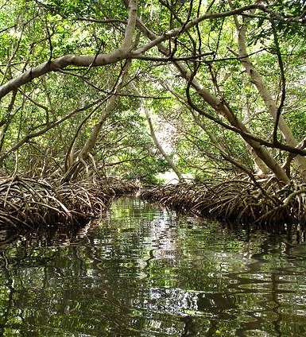
Conclusion
The methodology developed in this study can be used to predict mangrove biophysical parameters.
All biophysical parameters followed a similar seasonal pattern.
Cross-calibration was required for Top of Atmosphere (TOA) Products because they differ in atmospheric correction technique.
The accuracy of biophysical models can be further improved by incorporating field data.
Source: cesar.castro.g
Notes:
The methodology developed in this study can be used to predict the mangroves biophysical parameters including CHL, GPP, and LAI.
All biophysical parameters followed a similar seasonal pattern reaching peak values in the fall season, moderate values in the winter and spring seasons, and low values in the summer season.
Cross-calibration is required for Top of Atmosphere (TOA) Products, such as Sentinel-2 and ASTER, because they differ in atmospheric correction technique.
The accuracy of biophysical models can be further improved by incorporating field data in the future.
Image Source: https://www.flickr.com/photos/cesarcastrog/11254546635/

Slide 17
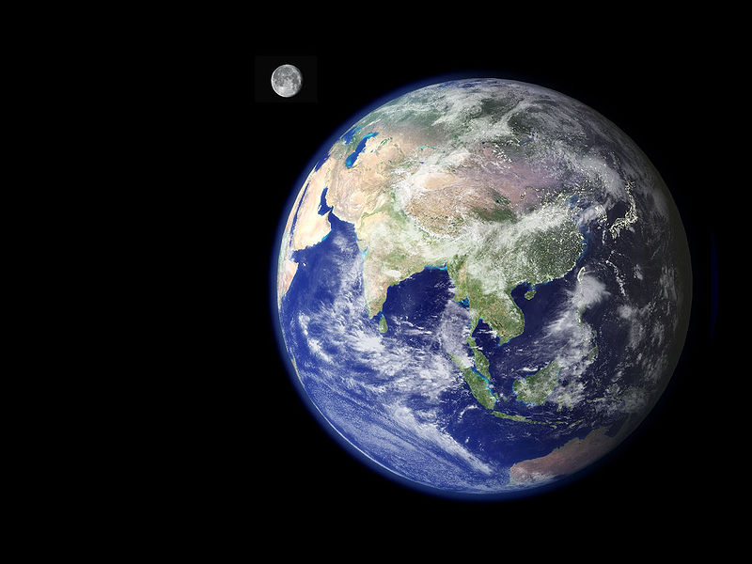
Future Work
Incorporate field data.
Improve the cross-calibration of satellite sensors.
Utilize radar data to overcome cloudy satellite images.
Analyze the factors affecting mangrove health and seasonality.
Classify different types of mangrove in the study area using hyperspectral data.
Estimate long-term change in mangrove land area coverage.
Source: NASA
Notes:
Incorporate field data to improve predictive accuracy of biophysical models.
Improve the cross-calibration between multiple satellite sensors by incorporating co-incident date images (lacked during this term).
Utilize radar data to overcome cloud affected satellite images that are frequently encountered during data collection.
Analyze various factors affecting mangroves health and cause of seasonal variability of biophysical parameters.
Classify different types of mangroves present inside the study area using hyperspectral data.
Estimate change in mangroves’ land area coverage by comparing long-term data.
Satellite Image Source: NASA’s DEVELOPedia
Earth Image Source: https://commons.wikimedia.org/wiki/File:Nasa_earth.jpg

Slide 18
Science Advisor
Dr. Deepak Mishra, University of Georgia Department of Geography
Project Partner
Dr. Gurdeep Rastogi, Senior Scientist, Wetland Research and Training Center
Others
Sean Cameron, Assistant Center Lead and Project Coordination Fellow
Dr. Marguerite Madden, UGA Lead Science Advisor

