Slide 1
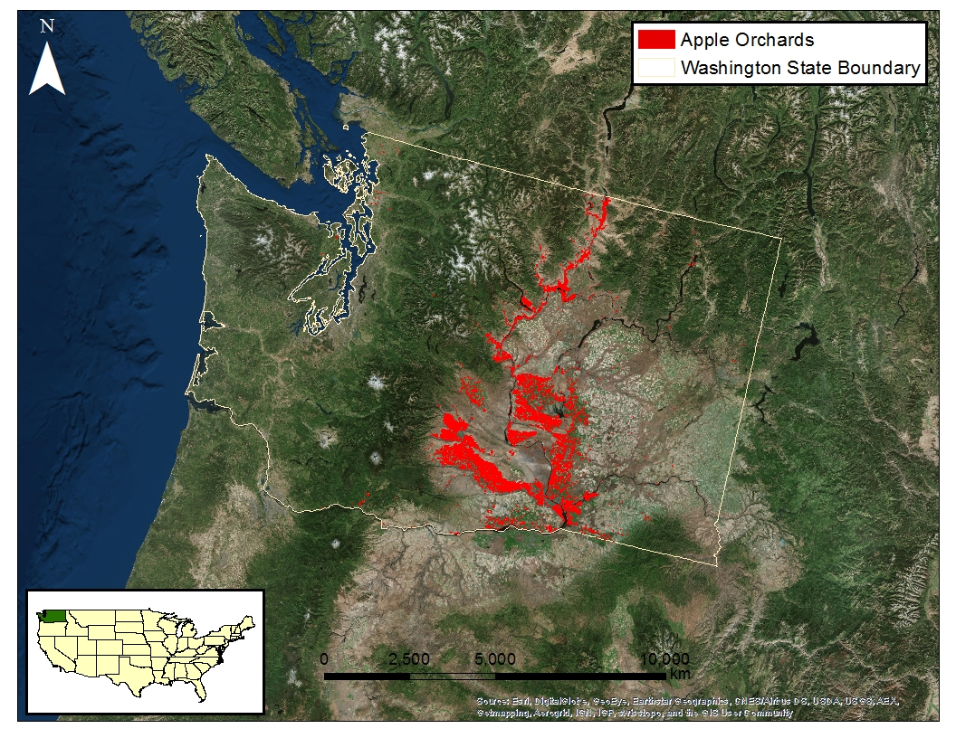
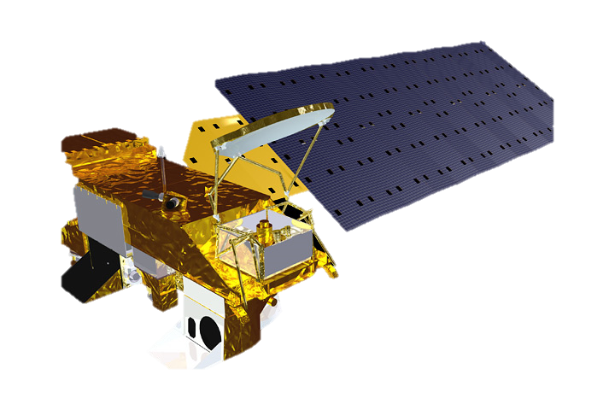
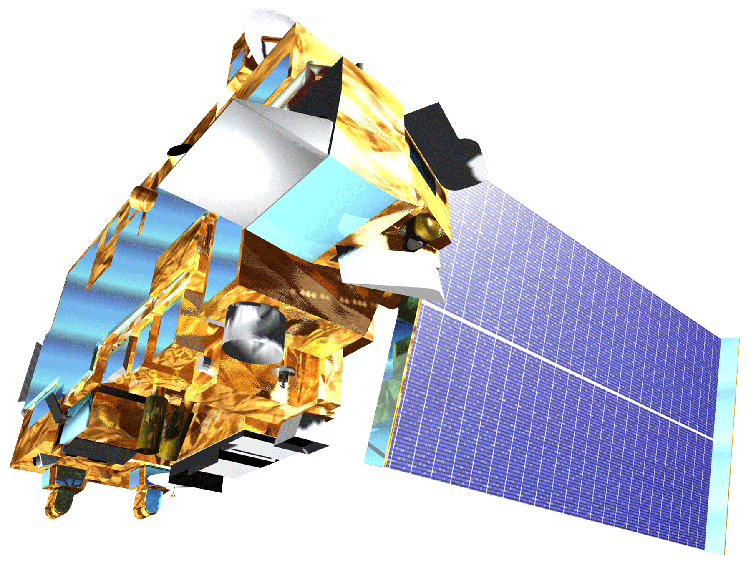
Northwest United States Agriculture
Evaluating suitability for apple cultivation based on accumulated chill hours in Washington State from 2003 – 2065
Lydia Cuker (The College of William & Mary), Laura Lykens (Old Dominion University), Alyssa Walzak (Christopher Newport University), Tim Stelter (Christopher Newport University)
NASA Langley Research Center
To be added later
Incorporate temperature forecasts into methods of assessing possible climate shifts in ideal apple growing locations in the state of Washington.
Map accumulated chill unit results to help orchard growers make decisions regarding adaption of their apple growing processes to climate fluctuations.
Data Acquisition
Data Processing
Data Analysis
Hourly Temperature
NOAA Ground
Weather Stations
2003 – 2013
Average hourly
temperature per day
Utah Model
Convert to T_{air}
Current Accumulated
Chill Units
Land Surface
Temperature (LST)
MODIS
2003 – 2013
Apply temperature fluctuation curve to daily T_{max} and T_{min}
Utah Model
Current Accumulated
Chill Units
Aqua
Forecasted Air Surface Temperature (tas)
CMIP5 North American CORDEX Climate Model
2040 – 2070
Add forecasted changes
to T_{max} and T_{min}
Utah Model
Fit temperature curve to forecasted T_{max} and T_{min}
Forecasted Accumulated Chill Units
Terra
Current
Accumulated Chill Units Map
2045 Forecasted Accumulated Chill Units Map
2065 Forecasted Accumulated Chill Units Map
To be added later
Team Photo to be added later
Lydia Cuker (Team Lead)
Laura Lykens
Alyssa Walzak
Tim Stelter
Dr. Michael Glenn
Appalachian Fruit Research Station
USDA- Agriculture Research Service
Dr. Kenton Ross
NASA DEVELOP National Program
Science Advisor
Dr. Noel Baker
NASA Postdoctoral Program Fellow
Nathan Owen
NASA DEVELOP – Langley Center Lead
Jeffry Ely
NASA DEVELOP Geoinformation Scientist
Chad Smith
NASA DEVELOP – Langley Assistant Center Lead

