Slide 1
NASA DEVELOP National Program
Participant Expectations:
Tips for Success, Guidelines & Best Practices

Slide 2
Guidebook
Provides participants with the history and logistics of DEVELOP, as well as an overview of NASA’s Applied Sciences & Capacity Building elements, operational guidelines, information about deliverables, and resources available.
Read the guidebook and fill out and sign the NASA media release on your first day in the office.
The Guidebook is the best resource for information,
if you have a question - check there first!
Notes:
Delete?

Slide 3
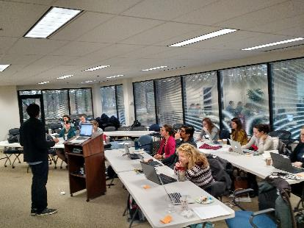
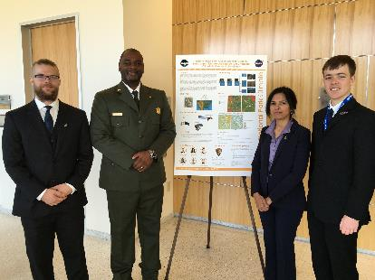
Tips for Success: Flexibility
Be flexible.
Have an open mind.
Be ready to present what you are doing at the drop of a hat.
Be able to adapt.
Accept change will happen.
Expect the unexpected!
“A tree that is unbending, is easily broken.”
-- Lao Tzu --

Slide 4
Tips for Success: Organization
Stay organized.
Know when things are due.
Keep track of your files.
Pay attention to detail.
Nomenclature matters.
Be strategic – identify objectives, identify potential solutions and paths forward.
“A place for everything and everything in its place.”
-- Benjamin Franklin --

Slide 5
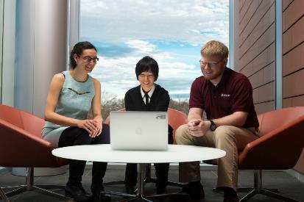
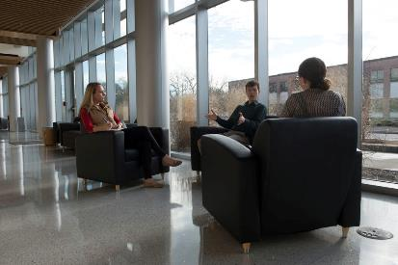
Tips for Success: Collaboration
Two heads are always better than one - collaborate!
Teamwork is key – get to know your team.
Do not discriminate, learn from those who are different than you.
Network! Network! Network! - it’s all about who you know – talk to your teammates, participants at your node and other nodes, NPO, advisors, partners, etc!
“Coming together is a beginning; keeping together is progress; working together is success.”
-- Henry Ford --

Slide 6
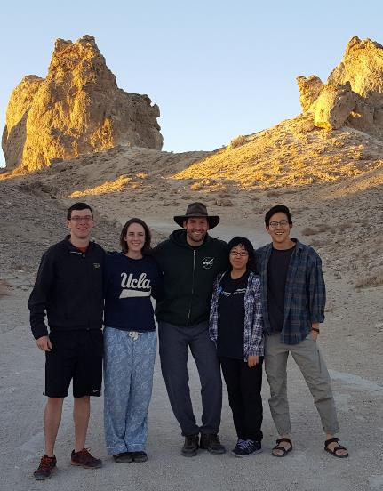
Tips for Success: Going Above & Beyond
Go above and beyond.
Help where you are needed.
Be willing to accept tasks that arise unexpectedly.
Look for innovative solutions and ideas.
Try new things.
Explore the opportunities that DEVELOP has for you!
“There are no traffic jams along the extra mile.”
-- Roger Staubach --

Slide 7
Tips for Success: Respect
Be mindful and respectful of those around you – you represent the DEVELOP Program and your node.
Demonstrate integrity.
Respect others’ property – do not steal or damage materials.
Act fairly and promote harmony in the workplace by showing common courtesy to others.
Encourage a positive working environment.
“Respect for ourselves guides our morals, respect for others guides our manners.”
-- Lawrence Sterne --
Notes:
Update picture?

Slide 8
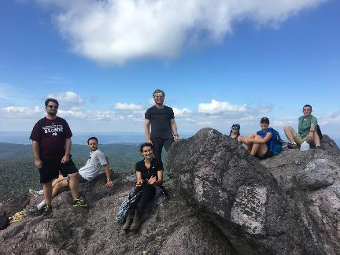
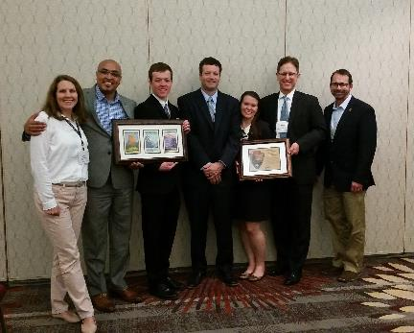
Tips for Success: Stay Positive & Learn
Maintain a positive attitude – a person’s productivity is directly affected by the attitudes of the people around them, so striving for a positive outlook in the work place is of the utmost importance.
Have fun and learn!
Use this opportunity to build your resumé with new skills.
Don’t give up! DEVELOPers never say die.
“Perpetual optimism is a force multiplier.”
-- Colin Powell --

Slide 9
Tips for Success: Follow Guidelines
Be on time for work!
Attend meetings and lectures as directed.
Never plagiarize – it is punishable by law.
Say no to drugs.
Harassment of any type will not be tolerated.
Profanity and lewdness are not permitted.
Abide by the dress code.
Research is the property of DEVELOP and the team – you must have permission from your Center Lead and NPO BEFORE submitting or presenting your project anywhere.
DEVELOP participants are expected to follow rules and regulations of their team’s location, their employer, and NASA.

Slide 10
Professionalism & Dress Code
Professionalism: “the conduct, aims, or qualities that characterize or mark a profession or a professional person”
DEVELOP is an opportunity for all participants to improve in their professionalism.
Appearance
Demeanor
Reliability
Competence
Ethics
Poise
Organizational Skills
Written Correspondence
Phone Etiquette
Accountability
Why?
DEVELOP’s signature is that of professionalism and respect. We respect ourselves, our partners, and NASA. We go above and beyond. We stand out from our peers. We strive for excellence in all things we do.
Business Casual:
Pants: Khakis or slacks
Skirts: Appropriate business skirts at/near knee length
Dresses: Appropriate length (at/near knee) dresses, no spaghetti straps
Shirt: Collared shirts, polo shirts, blouses, sweaters
Shoes: Dress shoes (no sandals, no sneakers, no flip flops)
Accessories & Makeup: Be conservative
Formal Presentations: Formal Suits (Dark Colored - Black, Navy, Gray) & Dress Shoes

Slide 11
Use of Government Equipment (@NASA)
US Government computers are for authorized users only.
It is NASA's policy to permit limited personal use of Government office equipment, including information technology (IT).
The limited personal use of Government office equipment by NASA employees and contractors shall not interfere with official business, violate existing laws, and should involve only minimal additional expense to the Government.
Unauthorized use of the computer accounts and computer resources to which you are granted access is a violation of Federal Law; constitutes theft; and is punishable by law.
Misuse of assigned accounts and accessing others' accounts without authorization is strictly forbidden.
Failure to abide by these provisions may constitute grounds for termination of access privileges, administrative action, as well as civil or criminal prosecution.
NASA 2540.1G & NPR 2810.1A: http://insidenasa.nasa.gov/ocio/policy/policy_direct/index.html

Slide 12
Privacy
Expect NO privacy when using a government computer or emailing a government email address.
Strict computer use policy in effect - every keystroke is stored, every NASA email is public domain.
NASA Policy:
NASA employees and contractors do not have a right to expect privacy while using Government office equipment at any time, including accessing the Internet and using email.
The Government maintains call details and network access records to monitor telephone activity and Internet access.
The Government also employs monitoring tools to track system performance and improper usage.
This applies to those emailing a NASA email as well.
NASA 2540.1G & NPR 2810.1A: http://insidenasa.nasa.gov/ocio/policy/policy_direct/index.html

Slide 13
Computer Usage
Online Policies:
Internet should be used for official purposes only, meaning absolutely no games, commercial radio or music/video downloads.
No Facebook, Twitter, etc. unless it’s for DEVELOP purposes!
Due to bandwidth considerations, streaming audio and video are prohibited unless for official business (project related is ok).
Limited personal emails are acceptable as long as they do not interfere with work.
Be mindful of the websites you visit and links you click on.
Be aware and careful of phishing attempts.
Software:
Installation of legally licensed software is permitted if the software is necessary to complete your project - but you must have approval from your Center Lead.
Do not make copies of proprietary software.
If you have questions regarding permissibility of software, please contact your Center Lead or IT Senior Fellow.

Slide 14
Cell Phone Usage
Ringers should be set to silent or vibrate during work hours.
Cell phone usage should be kept to a minimum, including texting.
Personal phone calls should be made during lunch or before/after work.

Slide 15
Participant Reporting
1. Info Sheet
This is a spreadsheet used to maintain accurate participant records & report demographic stats about program (e.g. diversity, education).
2. Personal Growth Assessments
These are two online assessments (entrance & exit) that collect information relating to participant skill levels and expectations, which help to gather the impact of DEVELOP, and provide valuable feedback to nodes and the program.
Entrance Assessment - week 1
Exit Assessment - week 9
3. Exit Survey
This is an anonymous online survey that we ask all participants to take. It is DEVELOP’s performance review and allows for a national perspective on the program, leadership, and advisors. It helps DEVELOP evolve and improve, and we value your input greatly!
Link emailed - week 10
4. Performance Reviews
DEVELOP’s main objective is to assist participants in developing both professionally and personally. Part of this process is giving feedback in performance reviews at the middle and end of the term. Please consider this process constructive and take any feedback as goals for improvement.
Midterm Review - typically weeks 5 or 6
End of Term Review - typically weeks 9 or 10

Slide 16
Annual Alumni Survey
SSAI and Wise County pursue mechanisms for evaluating performance and impact of DEVELOP activities. In recent years, an annual survey has been shared with alumni to assess the impact of DEVELOP, enhance the network of alumni engaged with the program, and assess the career fields that participants progress into. We look forward to surveying you in the near future!
Before you leave this term, please make sure that DEVELOP has the best email address to reach you. The survey goes out every June.
Annual Alumni Survey provides:
“Success Stories” for highlight activities
Reporting metrics & indicators
Method for signing up to receive The DEVELOPer Newsletter
Information to invite alumni to special events

Slide 17
Dealing with Personnel Issues
Things will arise!
#1 – Don’t put anything in writing. Should a personnel issue arise, immediately and verbally communicate the situation up the chain.
Do not send emails about the situation - remember that NASA emails are NOT private.
Maintain a positive work environment where participants feel comfortable coming to you with issues they are having with other DEVELOPers.
If someone up the chain is the issue, skip that link in the chain.
If you need counseling for how to respond to a specific situation talk to NPO.
SSAI Rep: Karen Allsbrook
Wise Rep:
Lauren Childs-Gleason
NPO
Center Lead
Project Lead
Team Member

Slide 18
Payments & Taxes
Participants are paid on a step scale based on applicant classification and education level.
In order for a participant to qualify for the next step pay rate, the individual must be currently taking classes or graduated at that grade level.
Ex. a participant who finishes their sophomore year in the spring is only eligible to move to the next pay step in the fall once he/she begins taking junior level classes
All necessary taxes are withheld from participants’ paychecks based on tax enrollment forms
Foreign nationals who are from countries that do not have a tax treaty with the United States will see an automatic 30% of their payment withheld by their funding organization and sent to the IRS.
To see which countries have tax treaties with the US visit this website - www.irs.gov/publications/p519/ar02.html#en_US_2013_publink1000222821.
As a DEVELOP participant, it is each individual’s responsibility to have the appropriate health and medical coverage. SSAI and Wise County do not provide insurance coverage for temporary employees.

Slide 19
Thank You!
Have a great term!

