Slide 1
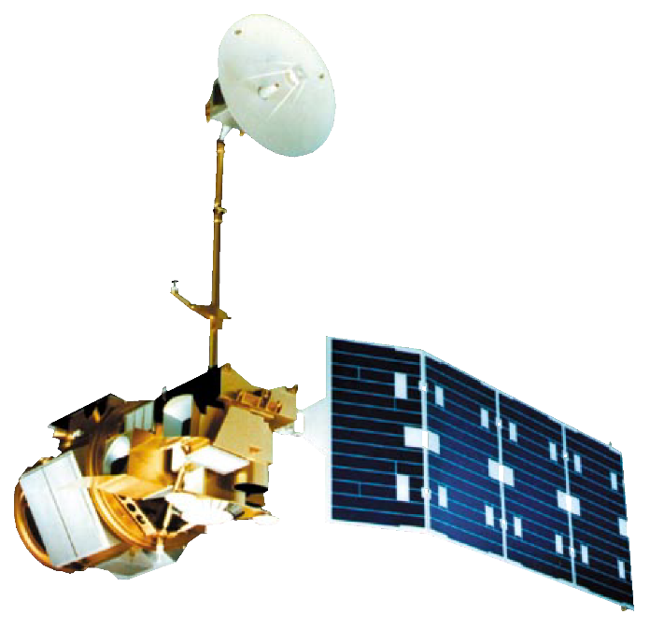
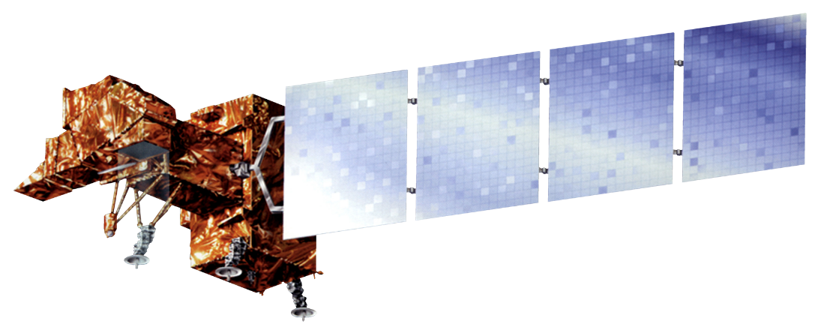
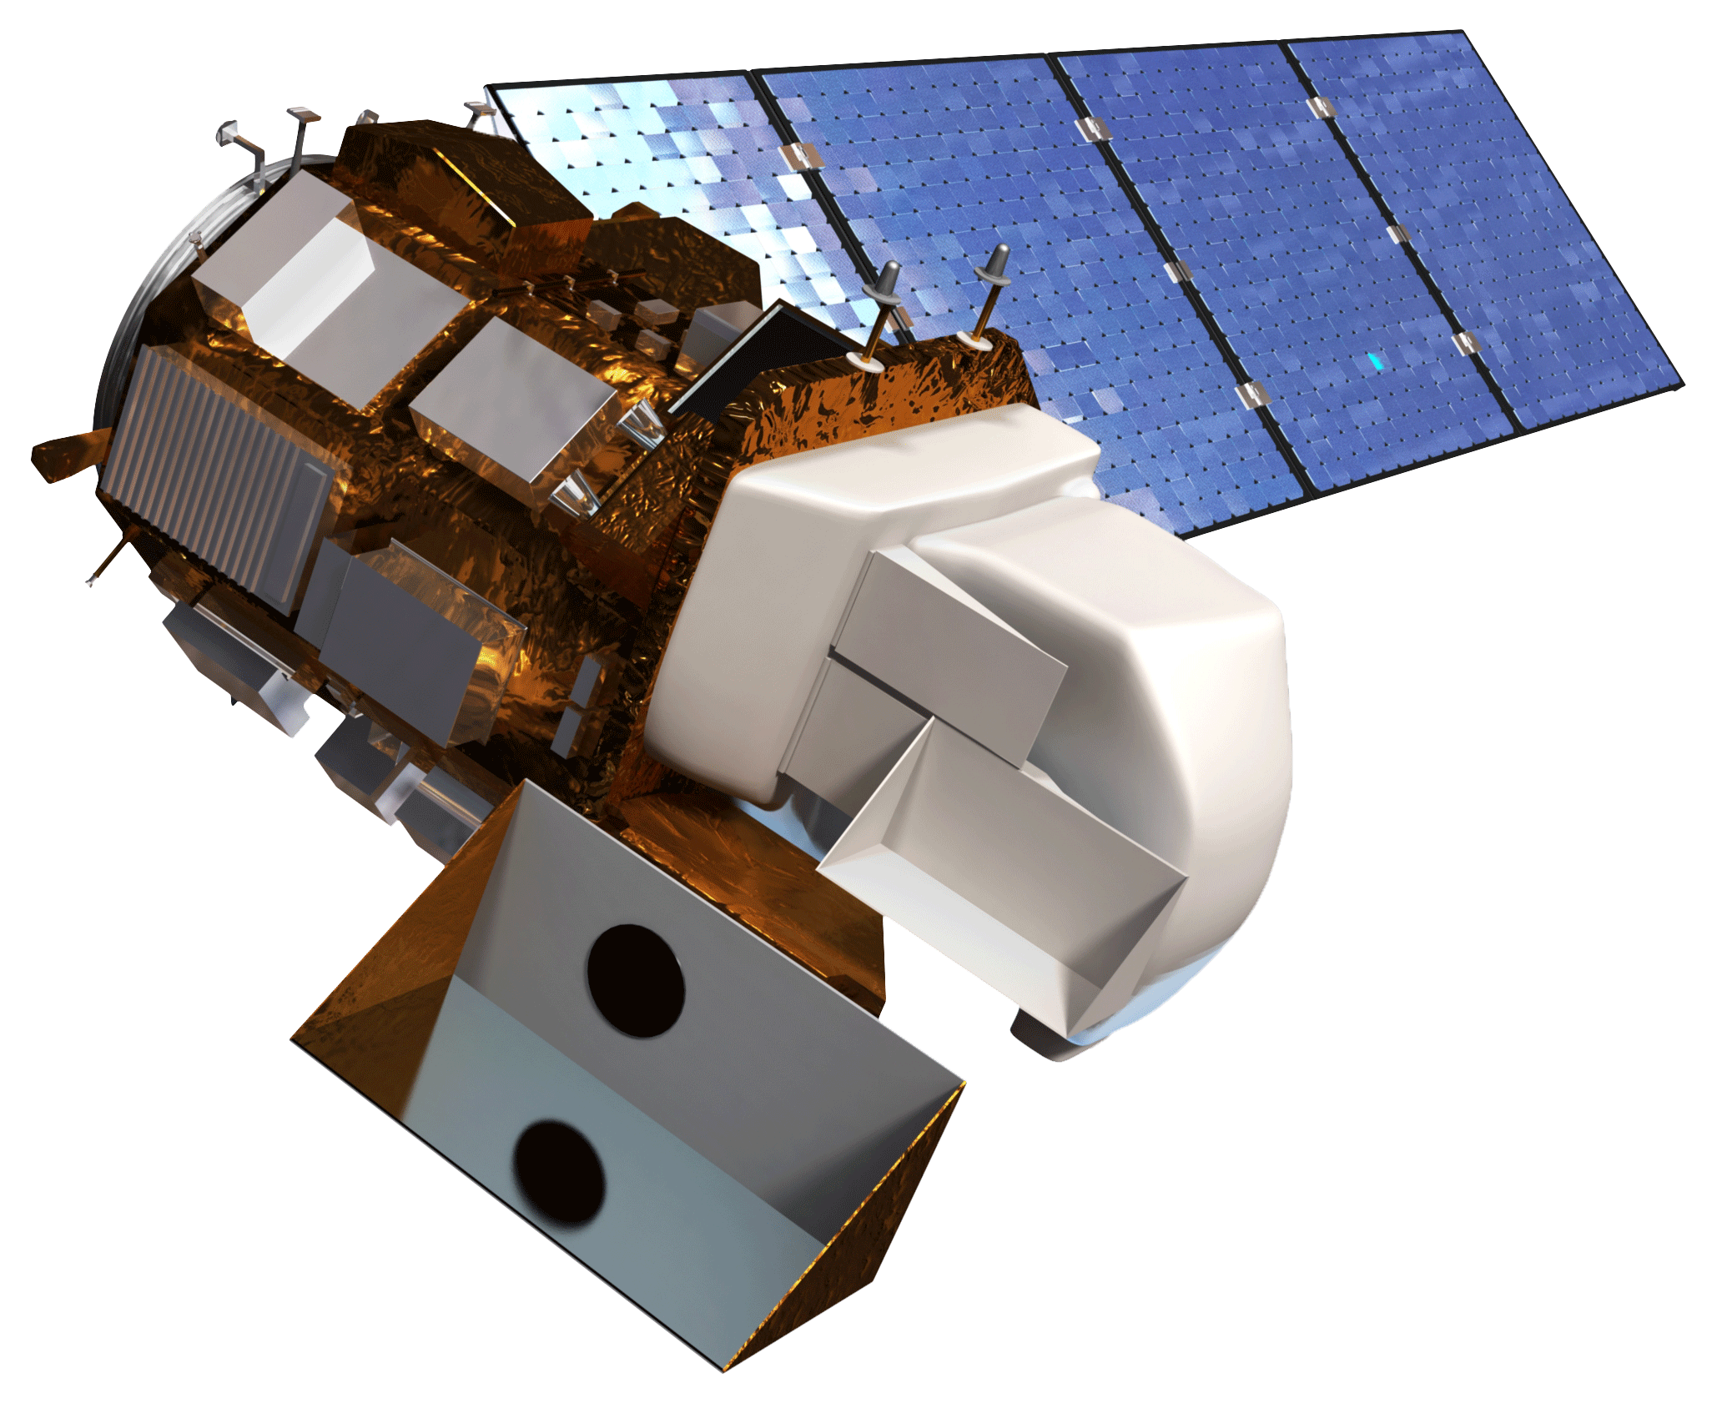
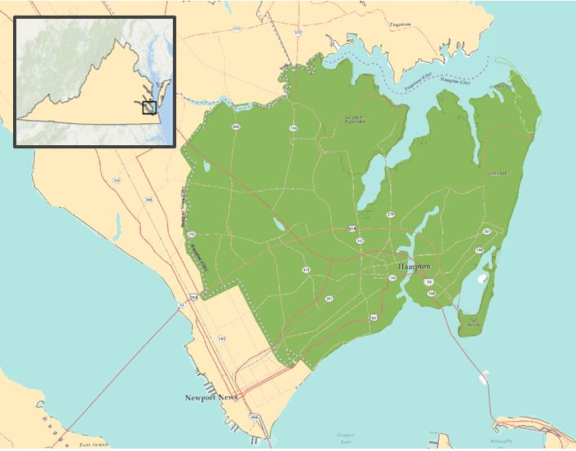



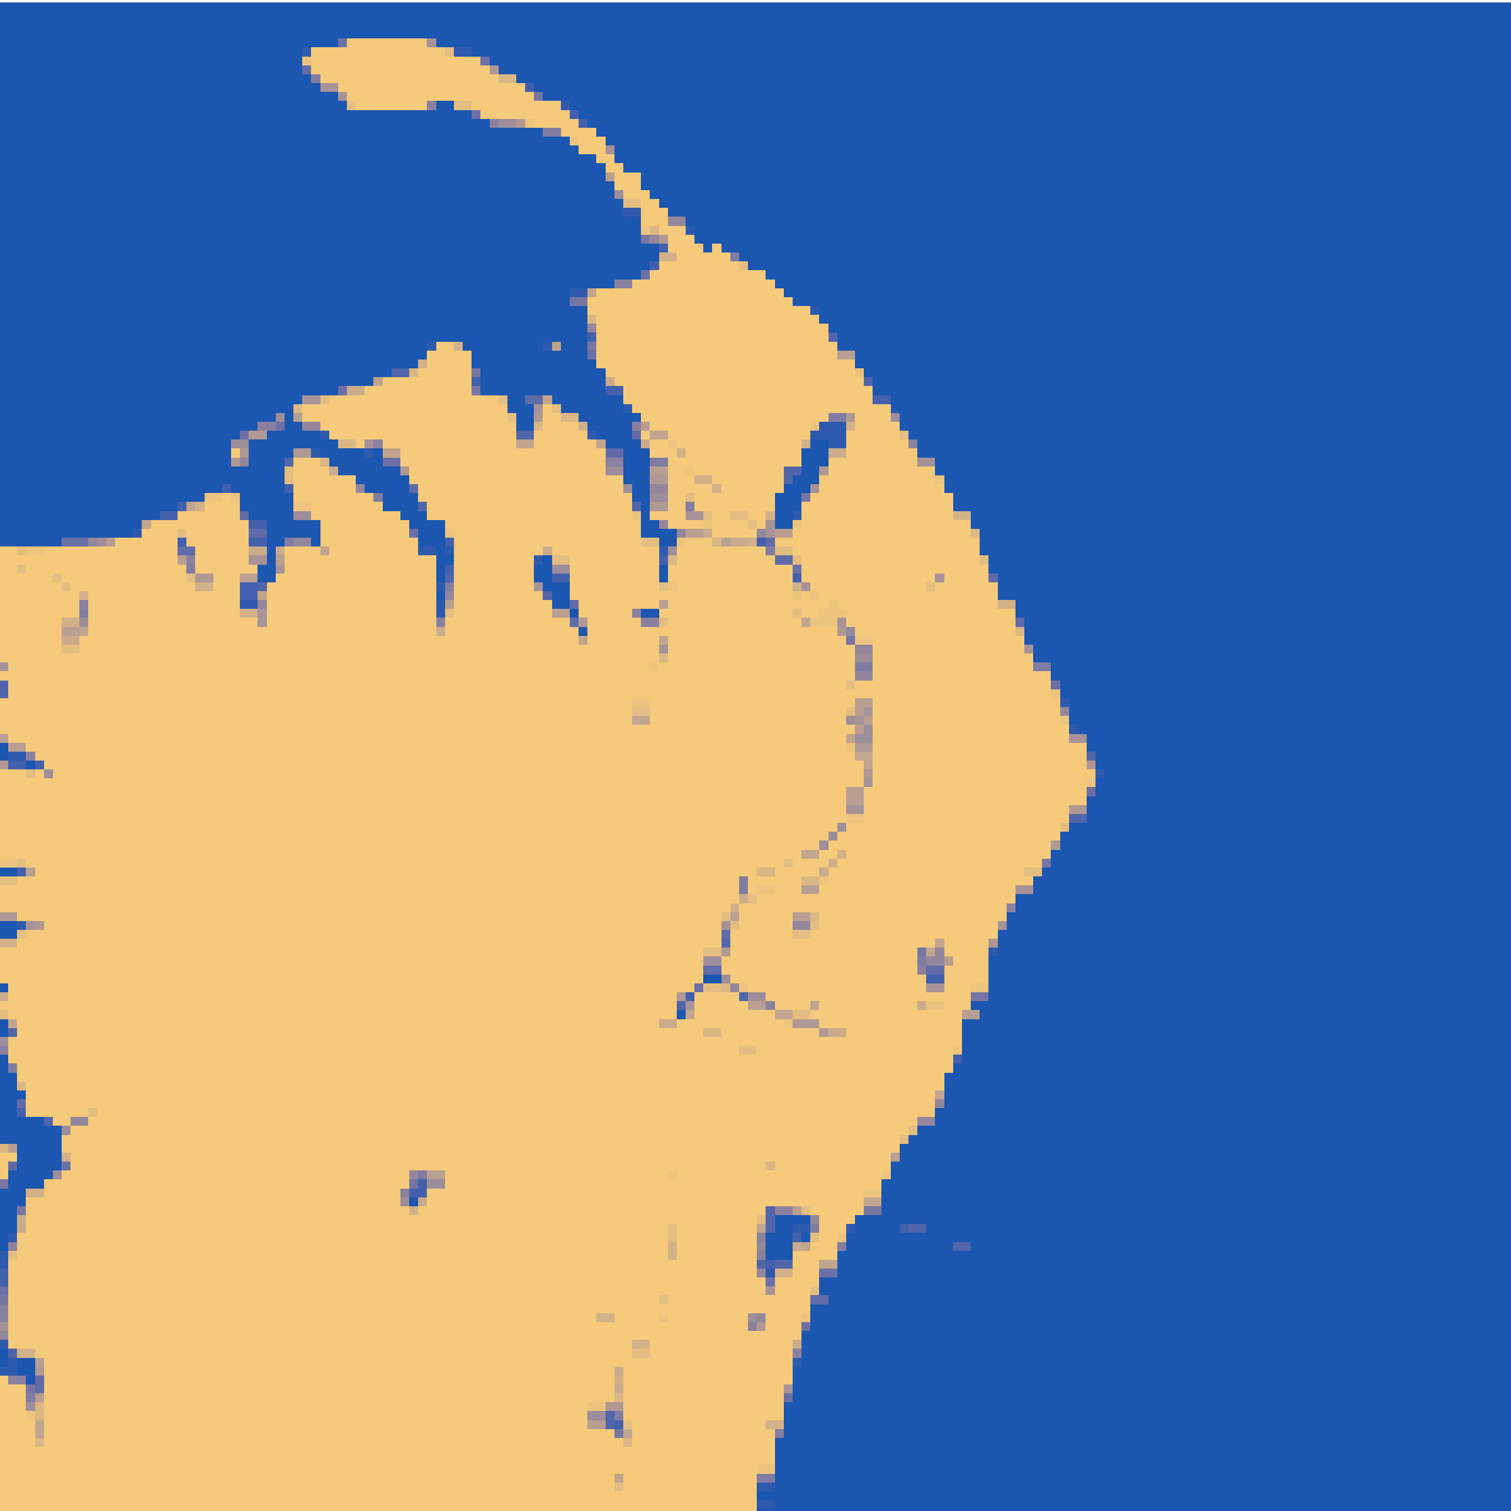
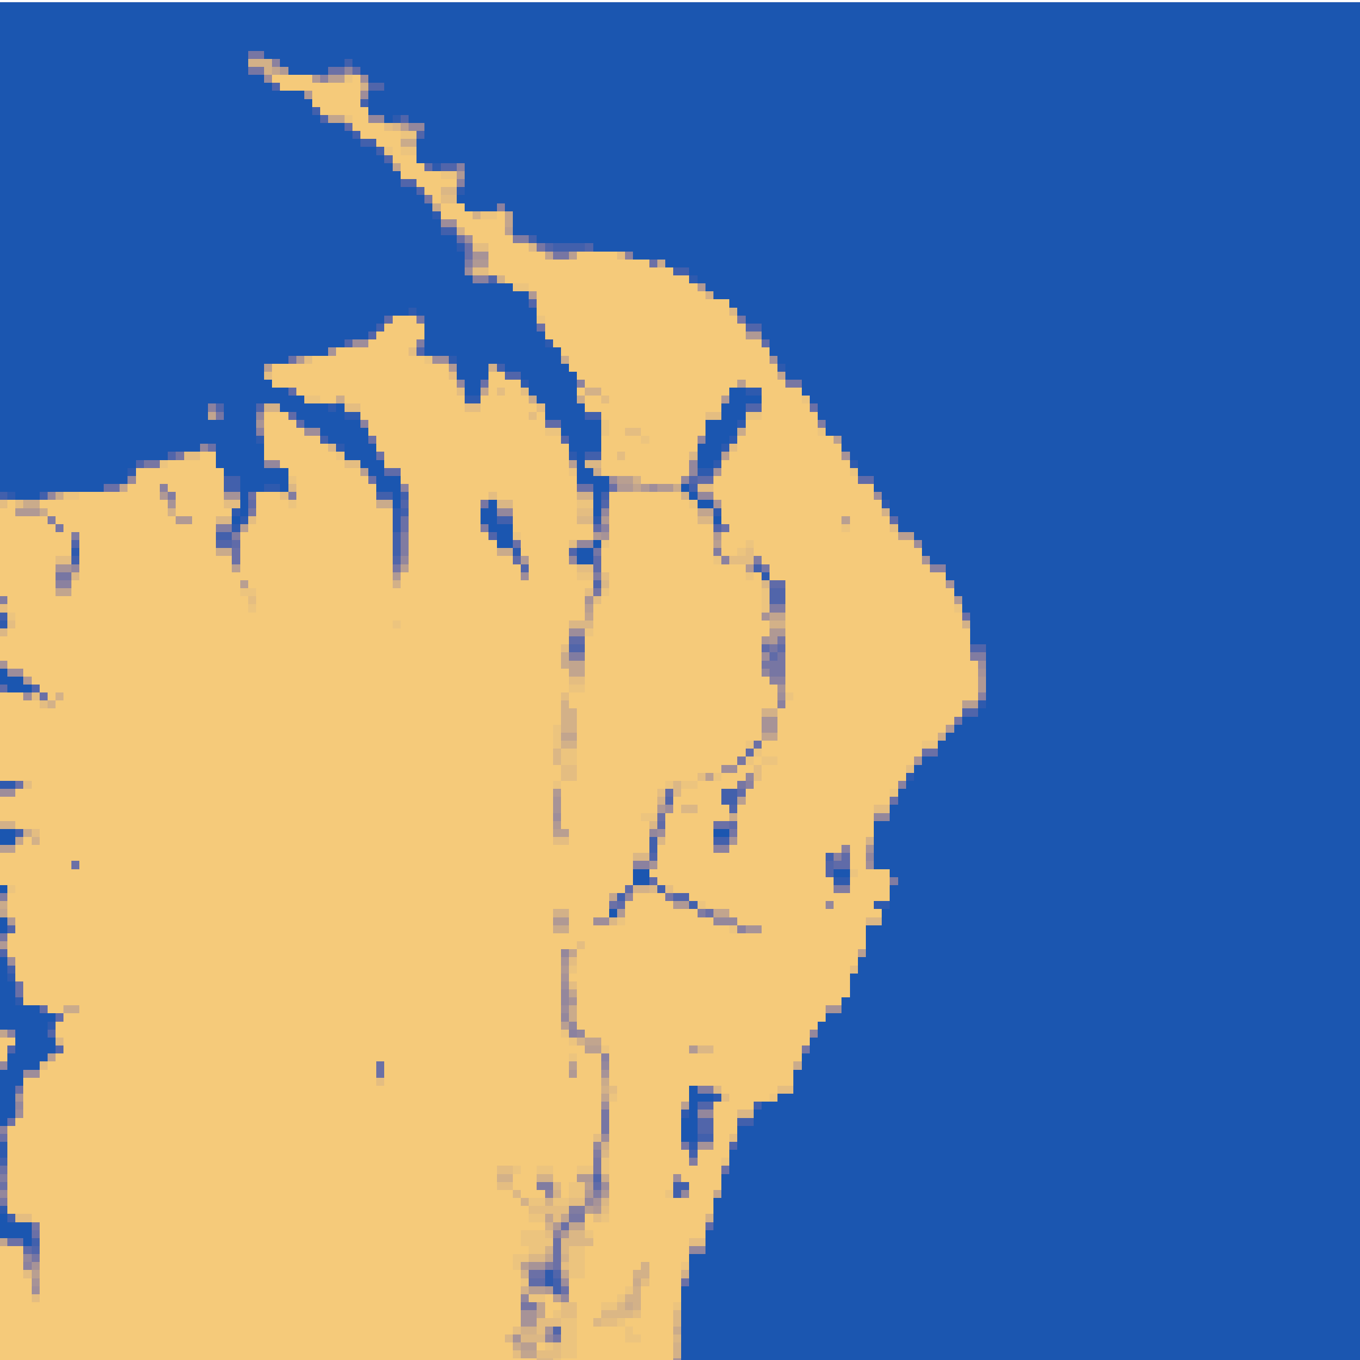
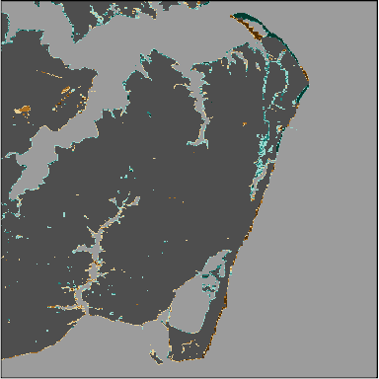
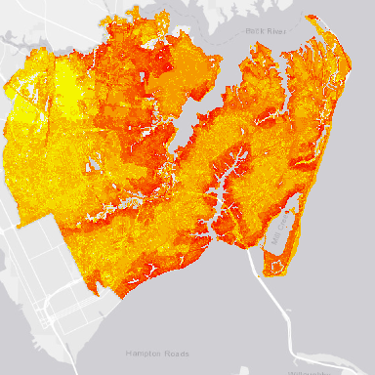
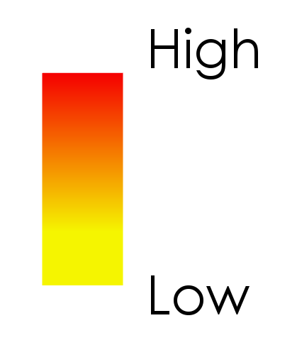

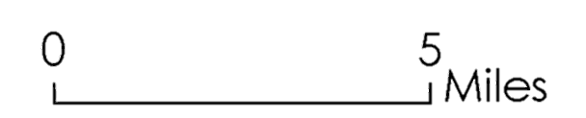
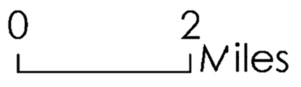







Enhancing Coastal Management by Monitoring Hampton’s Coastline and Assessing Barrier Island Transgression with the Aid of NASA Earth Observations
Abstract
Earth Observations
Situated at the mouth of the Chesapeake Bay, Hampton, Virginia is one of the most vulnerable areas in the United States for environmental stressors such as flooding, sea level rise, and storm surge. The city is engaged in several initiatives and partnerships to aggregate geospatial data to improve their coastal resilience planning. The City of Hampton is working towards visualizing the changing dynamics of its coastline and preparing more efficiently for future storm events. In order to assist in achieving these goals, this project capitalized on the temporal range of the Landsat series of optical satellites to create a 30-year time analysis from 1988 to 2018 of the Hampton coastline. The team derived coastline maps by consolidating multiple images from each year to generate annual average coastline locations, which were then incorporated into risk assessment maps and an ArcGIS story map. The results delineate areas that are at-risk to shoreline loss while demonstrating that there is a more recent trend towards modest shoreline inundation and transgression. By building a greater understanding of the fluctuations of Hampton’s coastline, city planners can more effectively build resilience plans and communicate with policy makers.
Landsat 5 TM
Landsat 7 ETM+
Landsat 8 OLI
Objectives
Develop an efficient model for analyzing long-term shoreline changes
Identify the regions of the city that are vulnerable to coastal erosion
Aid the city’s shoreline conservation efforts through the creation of a risk map
Create a GIS Story Map for public awareness addressing the city’s coastal concerns and management efforts
Study Area
Back River
Methodology
Landsat 5 TM
1988 to 2012
Landsat 7 ETM+
1999 to 2018
Landsat 8 OLI
2013 to 2018
Chesapeake Bay
Data
Acquisition
Data Processing within Google Earth Engine
Computed NDWI and MNDWI, set water threshold equal to zero
Annual Coastline Averages for the 30 Year Period
James River
Virginia
Results worked into risk maps
and ArcGIS Story Map
for public outreach
Risk Maps, Annual Average Maps, and ArcGIS Story Map = Project End Products
Miles
City of Hampton
Results
${\text{n}}_{\text{1988}}$= 52
${\text{n}}_{\text{2017}}$= 117
-100 to -67
-67 to -33
1 (Water)
-33 to -10
1 (Water)
-10 to 10
10 to 33
0 (Land)
33 to 67
0 (Land)
67 to 100
Coastline Annual Averages
where n is equal to the total amount of Landsat images in the year
Average Percent of Pixel Covered by Water Over Time from 1988 to 2017
Coastal Erosion Risk Map
Conclusions
Project Partner
The defined high risk areas on the shoreline are at Factory Point, Grandview Nature Preserve Point, and the Salt Ponds Inlet.
The defined low risk area along the shoreline is Fort Monroe.
The Coastline Annual Land Cover Change (CALCC) tool has the ability to analyze episodic storm events showing large coastal erosion during Hurricane Isabel and Hurricane Michael.
The City of Hampton
Team Members
Acknowledgements
The team would like to thank the City of Hampton DEVELOP Partners, as well as the following people from the NASA DEVELOP Program:
Patrick Frier | Center Lead at NASA DEVELOP Langley
Matthew Tisdale | NASA Atmospheric Science Data Center
Dr. Kenton Ross | Lead Science Advisor for NASA DEVELOP National Program
EXAMPLE
Danielle Ruffe
Project Lead
Eric Deutsch
Holly Gould
Shaifali Prajapati
Hampton Roads Urban Development
Virginia – Langley | Fall 2018

