Slide 1
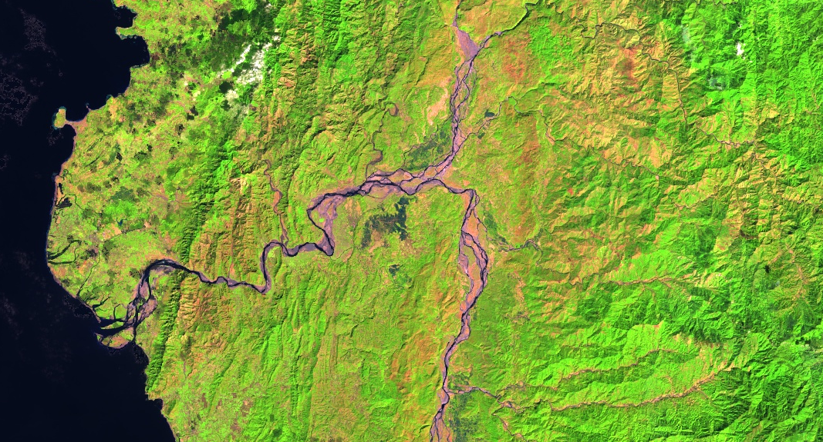


Daniel T. Martin
(Project Lead)
Allison Daniel
PHILIPPINES DISASTERS
Jessica Vermillion
Utilizing NASA and NOAA Earth Observations to Enhance the United Nation’s Office for the Coordination of Humanitarian Affairs Storm Preparation and Disaster Relief Planning Methods
Kelly Meehan
NOAA National Center for Environmental Information
2017 Spring
Notes:
(Jessica)
Speaker Notes:
Introduce everyone
My name is Jessica
Daniel (Team Lead)
Allison
Kelly
Our project focused on the risk of tropical cyclones in the Philippines.
Header text point size should be between 40 and 60 on most slides.
Body text point size should be at least 20.
Use Century Gothic.
Keep text to a minimum.
Try to use a consistent font size between slides.

Slide 2
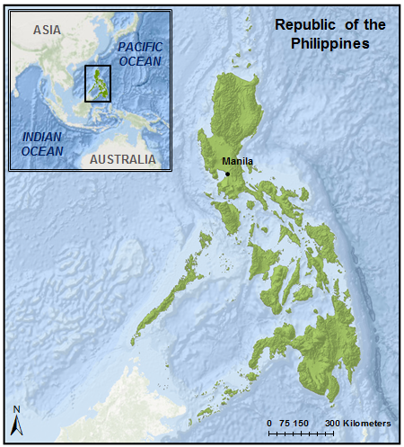
Introduction
Study Area: The Philippines
Study Period: 1982-2015
Philippines: Island nation made up of 7,107 islands
Population: 98.38 Million
Notes:
(Jessica)
Speaker Notes:
The Philippines is an island nation including more than 7,000 islands and a population above 98 million
According to the World Risk Index the Philippines ranks 3rd out of 173 countries most vulnerable to natural disasters
Image Source:
https://www.flickr.com/photos/hywell/16277688961/in/photolist-qNppPF

Slide 3
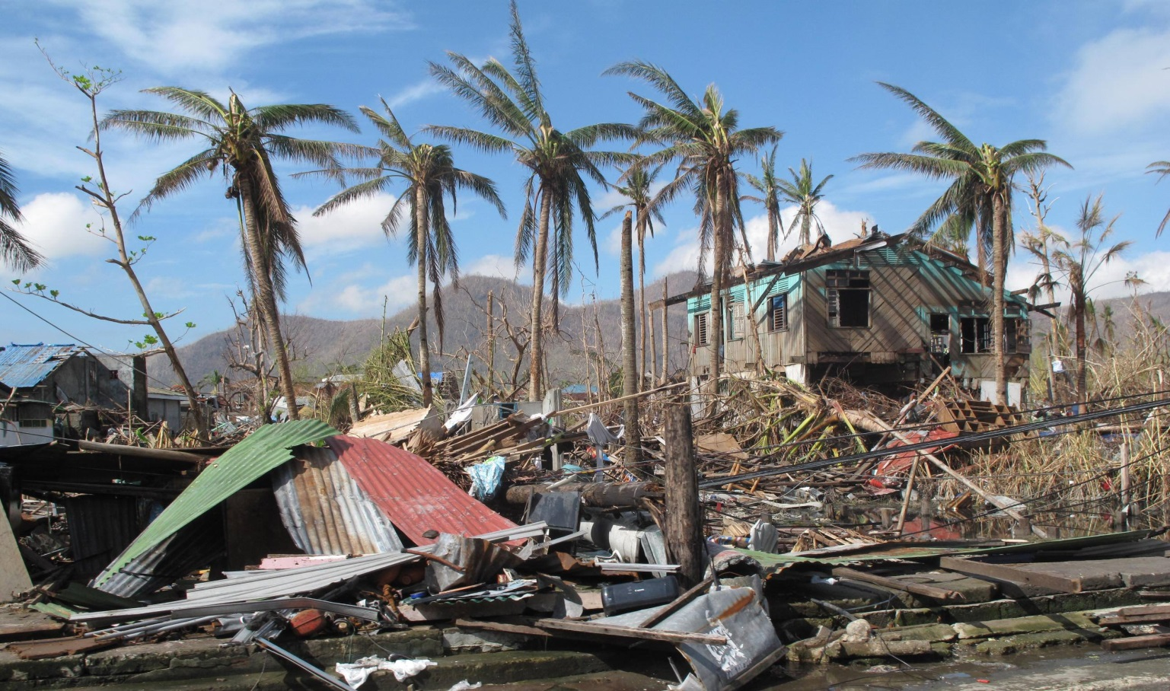
Community Concern
19 cyclones enter the Philippine Sea each year (average of 6 – 9 make landfall)
Haiyan/Yolanda (2013) deadliest storm on record
Population displacement leads to serious health , social, and economic consequences
Image Credit: UK-AID
Notes:
(Jessica)
Speaker notes:
19 Cyclones/ year
Each year approximately 19 tropical cyclones enter the surrounding area of the Philippines, of that an average of 6-9 make landfall, causing mass destruction and population displacement
Haiyan/Yolanda (2013)
Haiyan hit the Philippines in November of 2013
Haiyan is the deadliest storm to date
Over 6000 deaths
Population Displacement
Tropical Cyclones cause mass destruction and population displacement
During a cyclone women and children are 14 times more likely than men to die
After a tropical cyclone women and children also face many challenges
Often the eldest child is forced to quit school and help provide for the family
Women often have to play both the roll of the home maker and bread winner.
When they are searching for a job there is a high risk of them accidentally becoming involved in human trafficking
Government
Facing such devastation The Philippine’s government wishes to improve their disaster preparation and mitigation techniques
Image Source:
https://www.flickr.com/photos/dfid/11290331484/in/photolist-icFUcE-hDFNQ1-qrSzeY-hE5oza-hGHBmq-hDHLwN-hDEHVH-hvJAMp-hNmLyi-hDGdJb-hyKbGR-hwX5xK-roLP4b-hyZrKj-roLNPo-hvJB5i-hwX4gq-jQq2xo-hDHLdb-nf8sXa-hDGUK2-huH4bV-hwWbiK-huFurR-hwWaKR-hwWAKm-hwX3tc-hvLb31-hGFDQN-hvLD8w-hLRUWr-hLSSuE-hDFdHG-hDHE46-hM6Acy-hGT29Q-nf1eTN-nwVEzx-hyKUkQ-hH73th-hM6fsW-qrSxzq-nh27oJ-i2oriV-hxAe6y-hDHrja-qrSvjd-nwCdKp-hLT7tF-hxAMf1

Slide 4
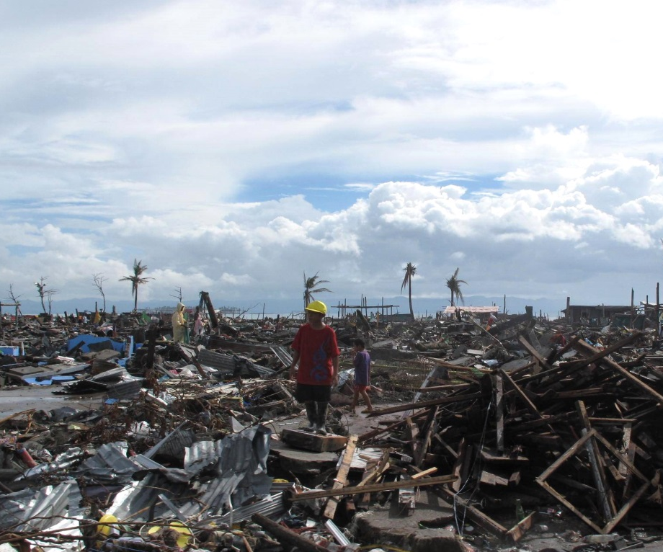
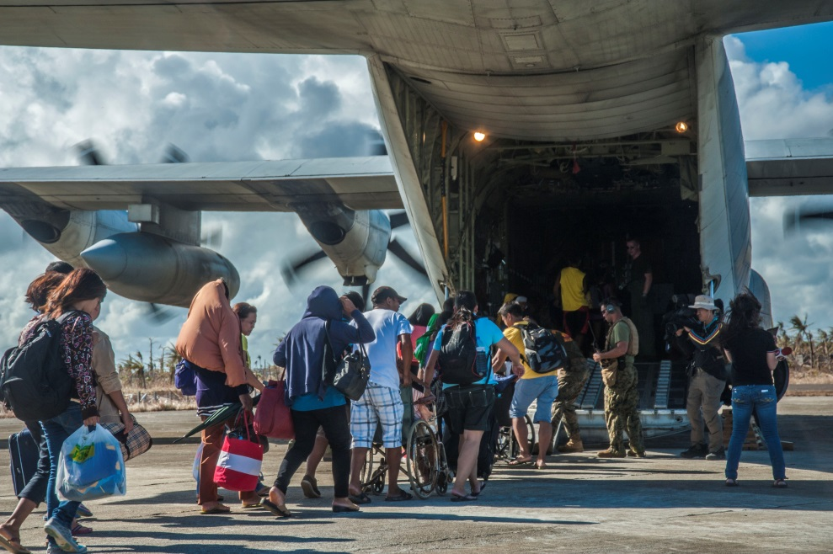
Objectives
Produce hazard and vulnerability maps by combining tropical cyclone tracking and intensity climatologies with population demographics
Image Credit: UK-AID
Assess gender vulnerability based on hazard climatology to help partners identify areas of greatest vulnerability
Image Credit: DVIDSHUB
Notes:
(Allison)
Speaker notes:
1. The overall objective of this project was to create tropical cyclone vulnerability maps of the Philippines to assess areas at risk of storm impacts, such as flooding and wind damage.
2. We also looked at areas with populations that were most vulnerable to these impacts. This is where our project partners come into play.
Image Source:
(LEFT)https://www.flickr.com/photos/dfid/11290380063/in/photolist-icG9De-nYd9Zc-sck9GX-rwYtN6-hsRzzr-r7pYfH-hsQYyL-hsQZ8m-nvQ8gm-hGSBkB-hPS39J-hDFLcq-iYY2VJ-roK17r-hDFL7A-iYZPbU-hvMWzo-hvMBY5-hwkVnZ-hwXooL-rwLYvS-icFUdG-icFUcE-hDFNQ1-qrSzeY-hE5oza-hGHBmq-hDHLwN-hDEHVH-hvJAMp-hNmLyi-hDGdJb-hyKbGR-hwX5xK-roLP4b-hyZrKj-roLNPo-hvJB5i-hwX4gq-jQq2xo-hDHLdb-nf8sXa-hDGUK2-huH4bV-hwWbiK-huFurR-hwWaKR-hwWAKm-hwX3tc-hvLb31
(CENTER)https://www.flickr.com/photos/dvids/10928176686/in/photolist-hDFLcq-iYY2VJ-roK17r-hDFL7A-iYZPbU-hvMWzo-hvMBY5-hwkVnZ-hwXooL-rwLYvS-icFUdG-icFUcE-hDFNQ1-qrSzeY-hE5oza-hGHBmq-hDHLwN-hDEHVH-hvJAMp-hNmLyi-hDGdJb-hyKbGR-hwX5xK-roLP4b-hyZrKj-roLNPo-hvJB5i-hwX4gq-jQq2xo-hDHLdb-nf8sXa-hDGUK2-huH4bV-hwWbiK-huFurR-hwWaKR-hwWAKm-hwX3tc-hvLb31-hGFDQN-hvLD8w-hLRUWr-hLSSuE-hDFdHG-hDHE46-hM6Acy-hGT29Q-nf1eTN-nwVEzx-hyKUkQ

Slide 5

Project Partnership
Partner: United Nations Office for the Coordination of Humanitarian Affairs (UN-OCHA)
End-use: target areas of greatest need for further development in disaster response and mitigation techniques
Image Credit: Didier Baertschiger
Notes:
(Allison)
Speaker notes:
1. Our 1st partner organization was the United Nations Office for the Coordination of Humanitarian Affairs (UN-OCHA), who asked that we integrate population demographic data into our project to identify areas of greatest hazard vulnerability. To do this, we worked with the gender advisor, Rowena Dacsig, to gather data and identify variables within the data that were of greatest concern. This organization plans to use our project results to enhance their disaster prevention and mitigation plans moving forward.
2. Our 2nd partner organization was the Operational Satellite Applications Program, part of the United Nations Institute for Training and Research (UNOSAT). We worked with the GIS Technical Expert within this organization, Rohini Swaminathan, also to gather data related to the project. This organization is mainly interested in enhancing international research collaboration, so they’ll work to help us distribute our project results to possible end-users.
Image Source: https://www.flickr.com/photos/didierbaertschiger/5000171025/in/photolist-8BRbDg-BE14gh-rTgT9z-7KG1uu-rDe81y-fermG-oxmkak-HAA7BG-7h9HHH-feu3H-f55GP-4YhGNo-4X4iv1-oH3rW9-2aL2H5-qt8NP9-4EtPH2-pnLupw-oHZNH4-oqVcYb-5DFQT5-aVJA8c-2w738e-oGjGUK-aWhWX2-6paHqo-4T5tK2-Cwp7Y-BLuxF-dFRTDK-7xFXo6-f55bj-r1WvaY-6f3Ea4-pJMUMb-8RZJ6g-8EPzr3-6hxAUa-rhXGKa-fcFiS-aTBqH6-7t1q5t-rE7rPG-dKSBo7-oCZduR-4VXi7w-bAhJbV-qyTSYa-35ZLFP-vUHJTq

Slide 6
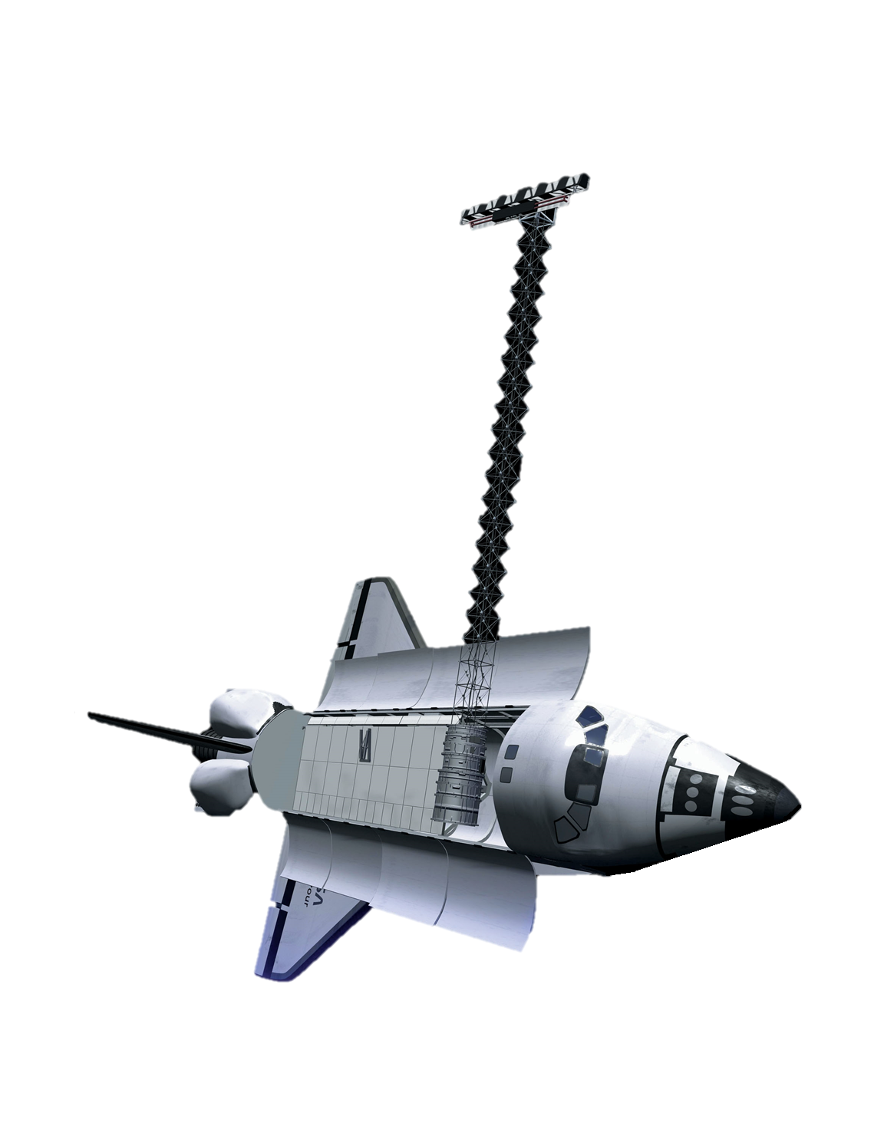
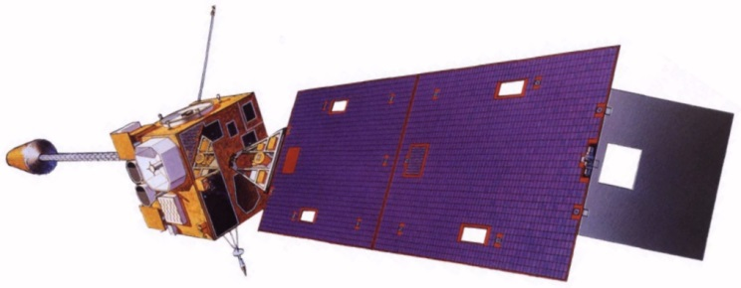
Satellites & Sensors
Shuttle Radar Topography Mission (SRTM)
                Data collected from shuttle-mounted hardware in 2014
          Global DEM
Geostationary Operational Environmental Satellite (GOES) Suite
Precipitation Estimation from Remotely Sensed Information Using Artificial Neural Networks, Climate Data Record (PERSIANN-CDR)
Data derived from suite of satellites, i.e. GOES, METEOSAT, etc.
SRTM
GOES-8
Notes:
(Allison)
Speaker notes:
SRTM
This mission is an international research effort that obtained digital elevation models to generate a high-resolution (90 meters) topographic database of Earth.
We combined this with our other datasets (demographics, precipitation, and cyclone tracks) to better assess areas prone to landslides
GOES-8
This was an American weather satellite (part of NOAA’s GOES system) that orbited the earth at the equator, completing a full cycle each day. The goal of this mission was to keep a constant eye on the western hemisphere for tropical storm outbreaks, collecting data at a 0.25x0.25 degree resolution.
We used this in part with our PERSIANN precipitation data when looking at the case study for Tropical Storm Yolanda/Haiyan, which occurred in November, 2013.
Image Sources:
SRTM: http://www.dlr.de/iss/en/desktopdefault.aspx/tabid-1412/2072_read-3536/gallery-1/216_read-2/
GOES-8: https://www.google.com/search?q=GOES-8+image&tbm=isch&imgil=8RtN0oJi2ejmQM%253A%253BurpUV5hL8vWFUM%253Bhttp%25253A%25252F%25252Frammb.cira.colostate.edu%25252Fdev%25252Fhillger%25252Fgeo-wx.htm&source=iu&pf=m&fir=8RtN0oJi2ejmQM%253A%252CurpUV5hL8vWFUM%252C_&usg=__-ommeJI07se6uo7rJyP3JO4LWn8%3D&biw=1545&bih=912&ved=0ahUKEwiKpdWEz9jSAhVRziYKHX0OBE8QyjcIQg&ei=0UHJWMr4N9GcmwH9nJD4BA#imgrc=_

Slide 7
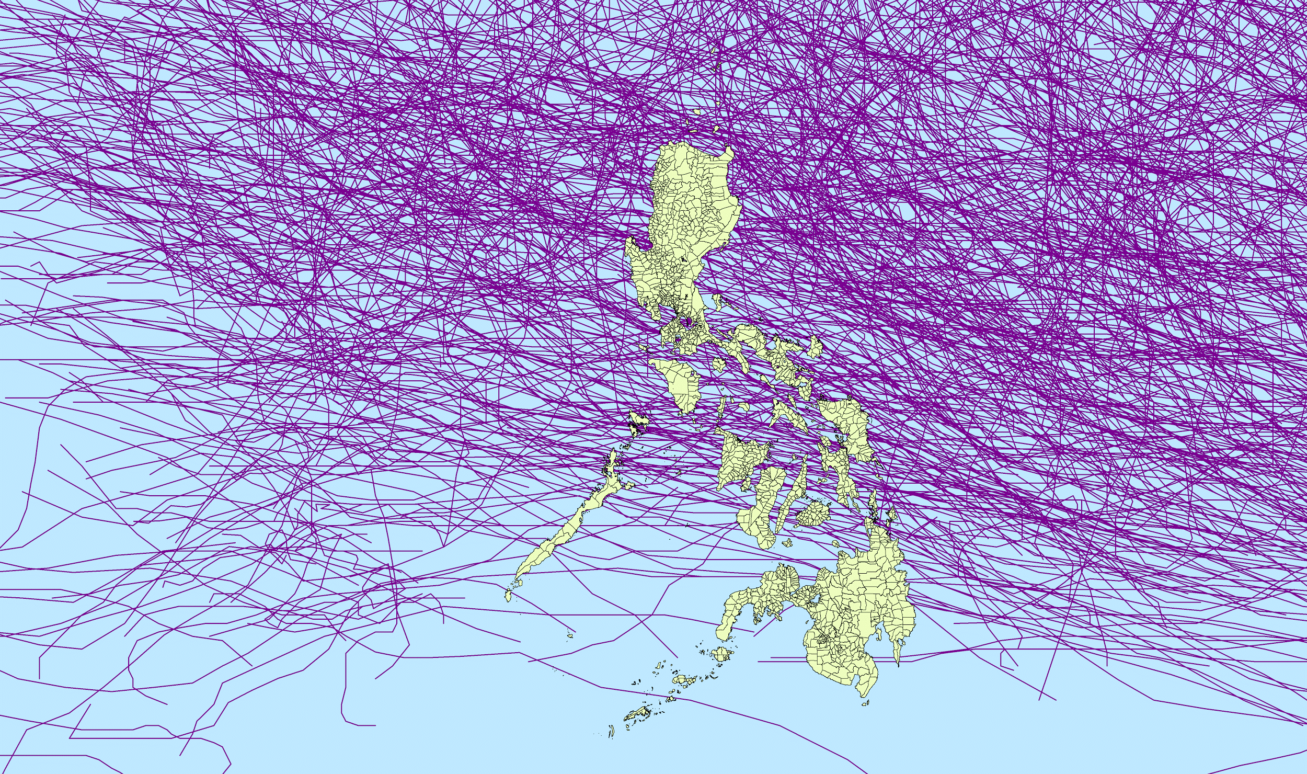
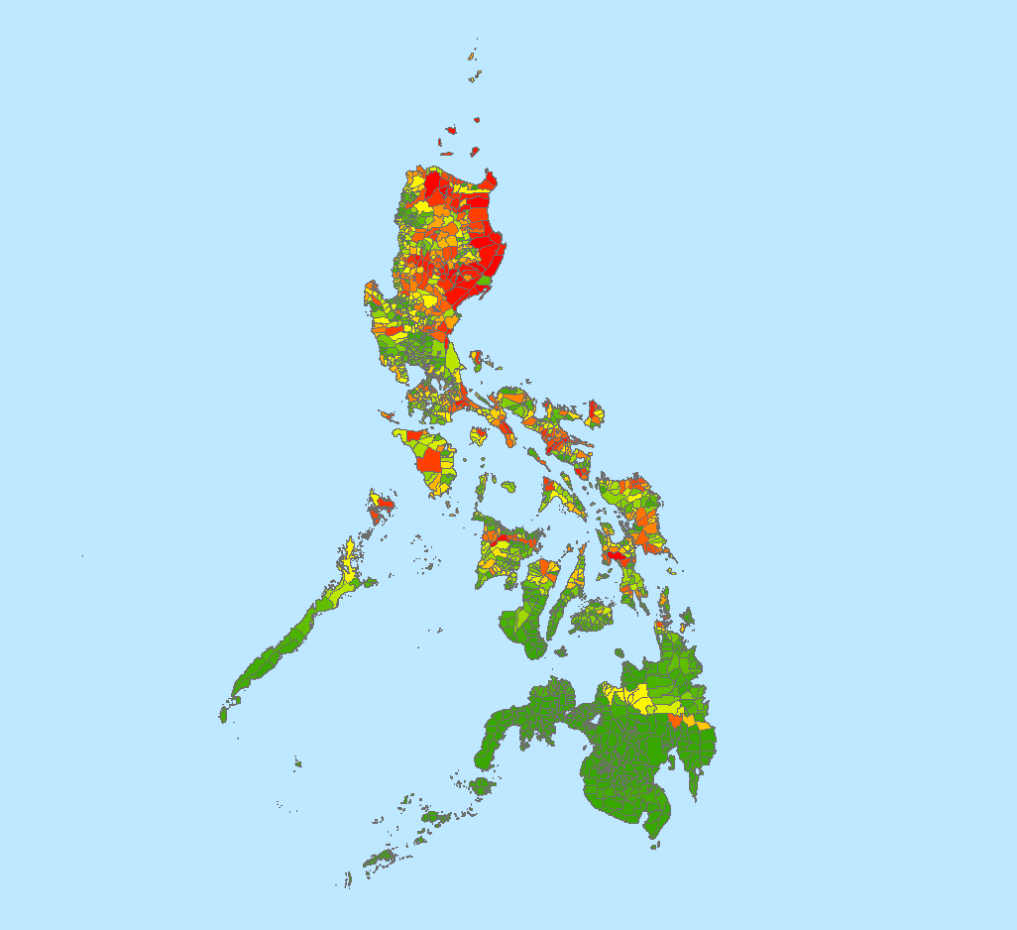
Methodology
DATA ACQUISITION: IBTrACS Cyclone Tracks, Philippines Municipalities/Demographics, SRTM, PERSIANN
PROCESSING & ANALYSIS: Derive natural hazards like Accumulated Cyclone energy, combined with demographic variables
END PRODUCTS: Derive Heat Map factoring all variables weighted by significance
          Natural Hazard Factors
          West Pacific track segments
          Dissolve into unique storms
          Derive individual storm impact (ACE)
          Total ACE by municipality
          (sum of segment ACE)
Study Period Tracks (1982-2015)
Accumulated Cyclone
Energy (ACE)
Notes:
(Daniel)
First slide showing basic methods/figures:
We downloaded the raw IBTrACS which were then sorted by Tropical Cyclone Warning Signal (http://www.pagasa.dost.gov.ph/index.php/learning-tools/94-weather/478-philippine-public-storm-warning-signal)
Major considered TCWS 3-5
[one of several experiments]: After dissolving tracks by storm/serial number, count was made on intersection with municipalities (also by regions if we’d like to do that)
We obtained demographic data from our partners at UN OCHA. These data were from the 2016 census and included the number of households that had the following:
A female solo parent, poor household headed
A poor household with a disabled female
A poor household with an elderly female over the age of 65
A poor household with a weak roof
A poor household with weak outer walls
A poor household with an unsanitary toilet facility
A poor household with a unsafe drinking water
For each of these variables, we calculated the ratio of the number of households per municipality that fell into this ratio, by the total number of households within that municipality
We applied an min max ratio of each of these seven variables, and weighted them equally in order to produce an.
We applied a min/max scaling to our municipality ACE vulnerability values, and weighed them equally with our overall vulnerability based on demographics. This produced an overall threat score for each municipality.
This threat map was combined with other demographic data such as population density, whatever Kelly’s working on such as single-headed households

Slide 8
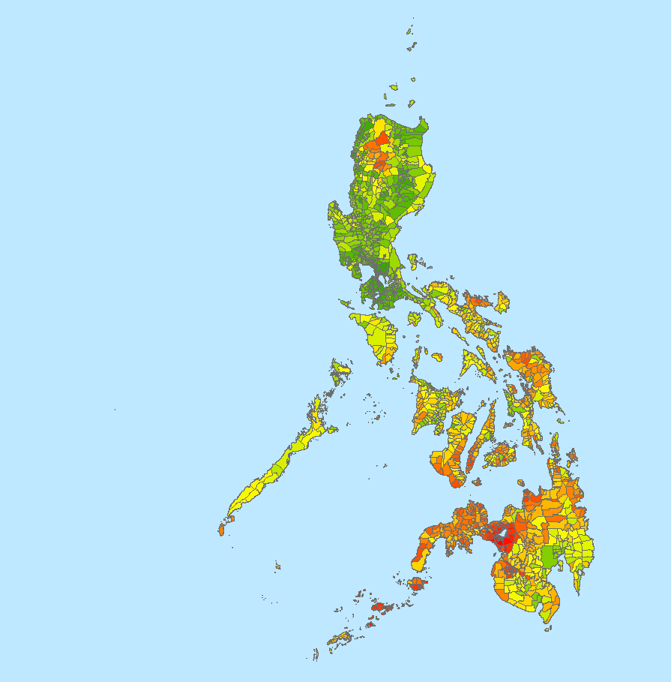
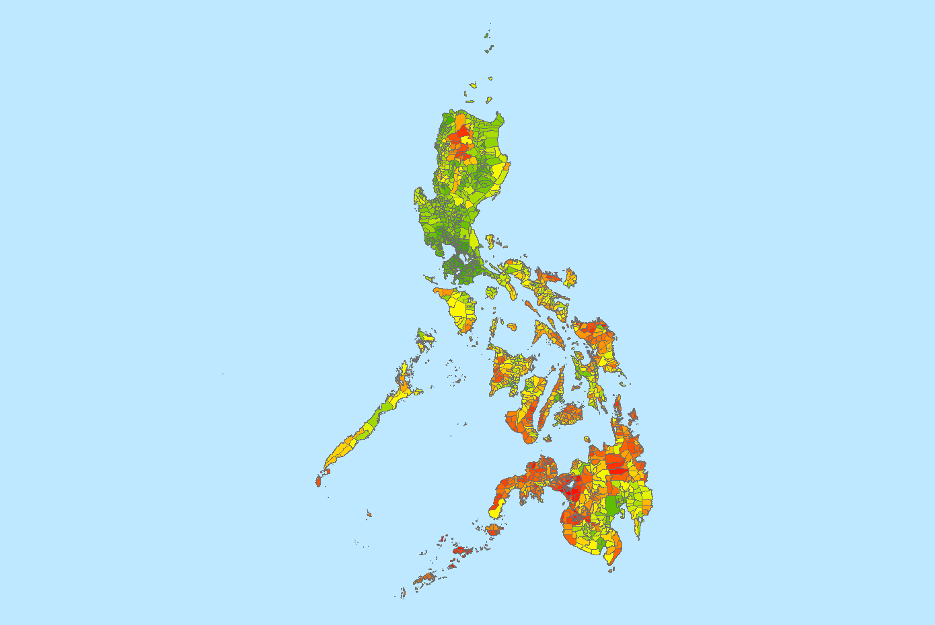
Methodology
DATA ACQUISITION: IBTrACS Cyclone Tracks, Philippines Municipalities/Demographics, SRTM, PERSIANN
PROCESSING & ANALYSIS: Derive natural hazards like Accumulated Cyclone energy, combined with demographic variables
END PRODUCTS: Derive Heat Map factoring all variables weighted by significance
          Demographic Vulnerability Factors
            single mother household
          disabled female
          elderly female
          weak roof
          weak outer walls
          unsanitary toilet facility
          unsafe drinking water
Single Mother Households
Demographic Threat
Notes:
(Daniel)
First slide showing basic methods/figures:
We downloaded the raw IBTrACS which were then sorted by Tropical Cyclone Warning Signal (http://www.pagasa.dost.gov.ph/index.php/learning-tools/94-weather/478-philippine-public-storm-warning-signal)
Major considered TCWS 3-5
[one of several experiments]: After dissolving tracks by storm/serial number, count was made on intersection with municipalities (also by regions if we’d like to do that)
We obtained demographic data from our partners at UN OCHA. These data were from the 2016 census and included the number of households that had the following:
A female solo parent, poor household headed
A poor household with a disabled female
A poor household with an elderly female over the age of 65
A poor household with a weak roof
A poor household with weak outer walls
A poor household with an unsanitary toilet facility
A poor household with a unsafe drinking water
For each of these variables, we calculated the ratio of the number of households per municipality that fell into this ratio, by the total number of households within that municipality
We applied an min max ratio of each of these seven variables, and weighted them equally in order to produce an.
We applied a min/max scaling to our municipality ACE vulnerability values, and weighed them equally with our overall vulnerability based on demographics. This produced an overall threat score for each municipality.
This threat map was combined with other demographic data such as population density, whatever Kelly’s working on such as single-headed households

Slide 9
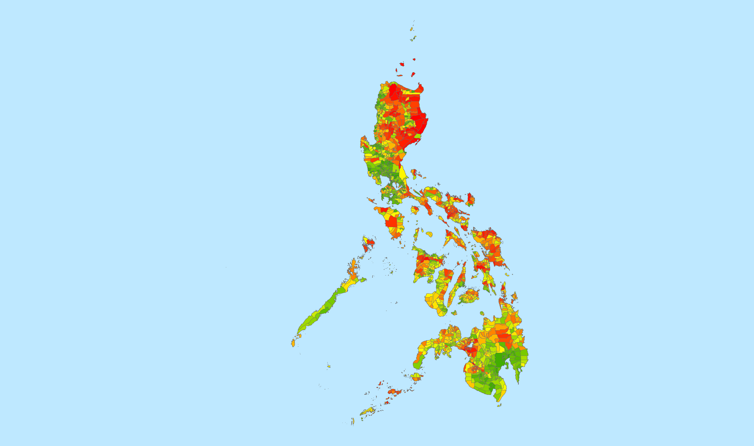
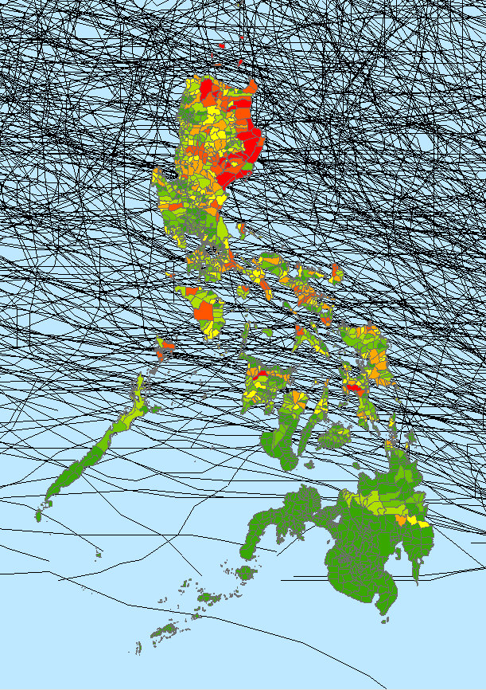
Results
          Tracks: 26907 Segments, 1888 directly impacting Philippines (within 100 km)
          315 Unique storms, 188 major (winds >65 kts)
          Demographics: Majority of single mother households in central, southern Philippines
          Natural Hazard North, Demographic Hazard South
+
=
Natural Hazards
Demographics
Low High
Final Threat Map
Notes:
(Daniel)
Results suggest that a complex combination of risk is involved with cyclones/demographic vulnerability: Majority of tracks (left, center) occur north wheras vulnerable populations such as single female households (right) remain south; a weighting scheme will further explain where exactly (somewhere near populated center) the greatest need for attention exists.

Slide 10
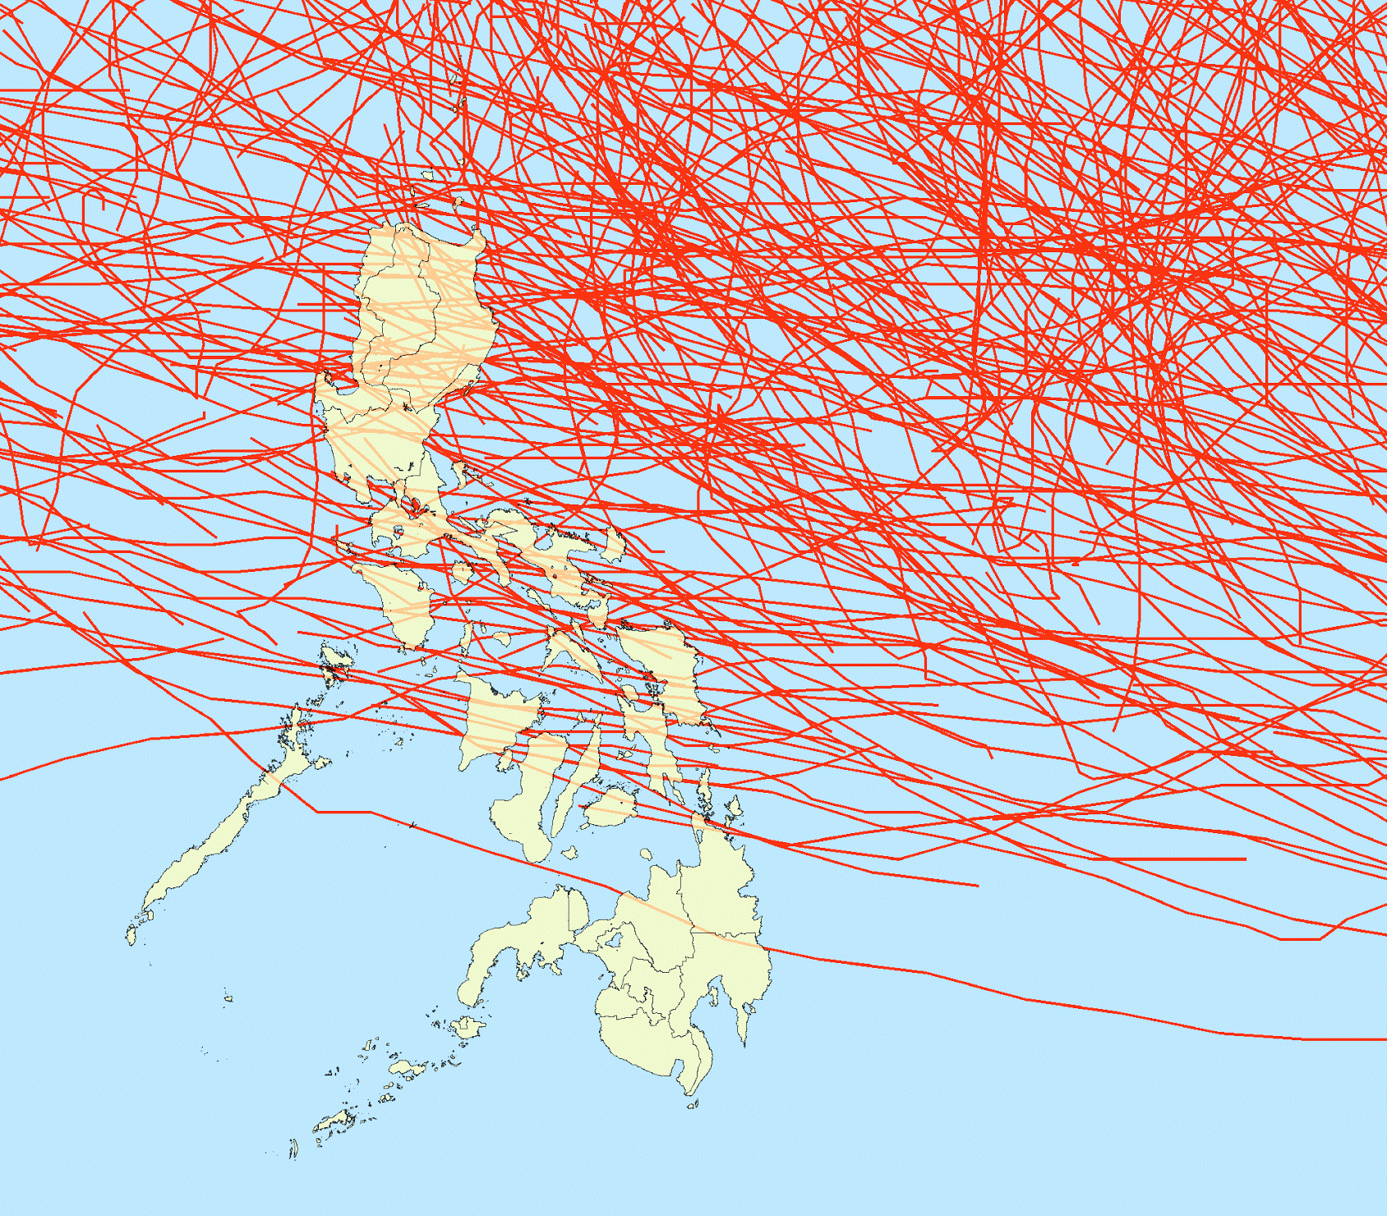
Conclusions
          Identified areas of greatest risk
          Provided useful information regarding areas of specific portion of the Philippines population in need of greatest disaster relief mitigation
          Techniques can be applied to other high hazard vulnerability island nations
Notes:
(Kelly)
Using a unique combination of natural and demographic hazard analysis, we were able to combine variables and show what areas were most vulnerable to cyclones in the Philippines
UN-OCHA can use these data in decision making processes, such as the allocation of resources or prioritization of advanced warning systems
Techniques can be applied to other areas of the globe that are sensitive to natural disaster.

Slide 11
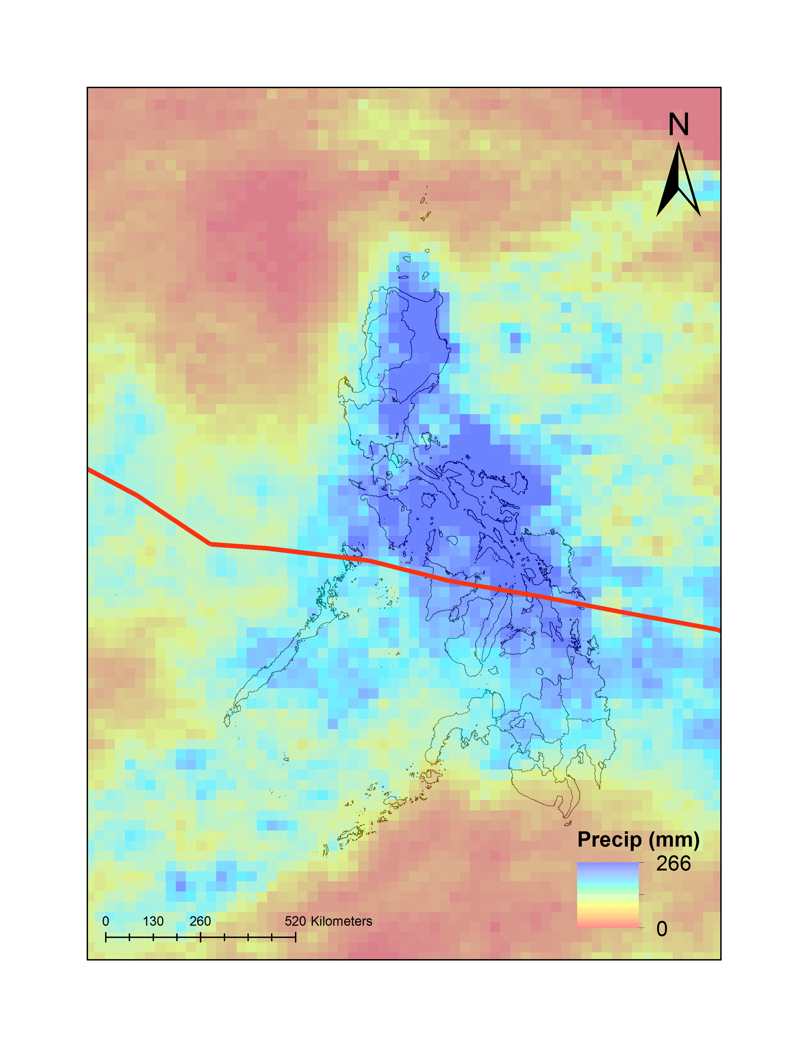
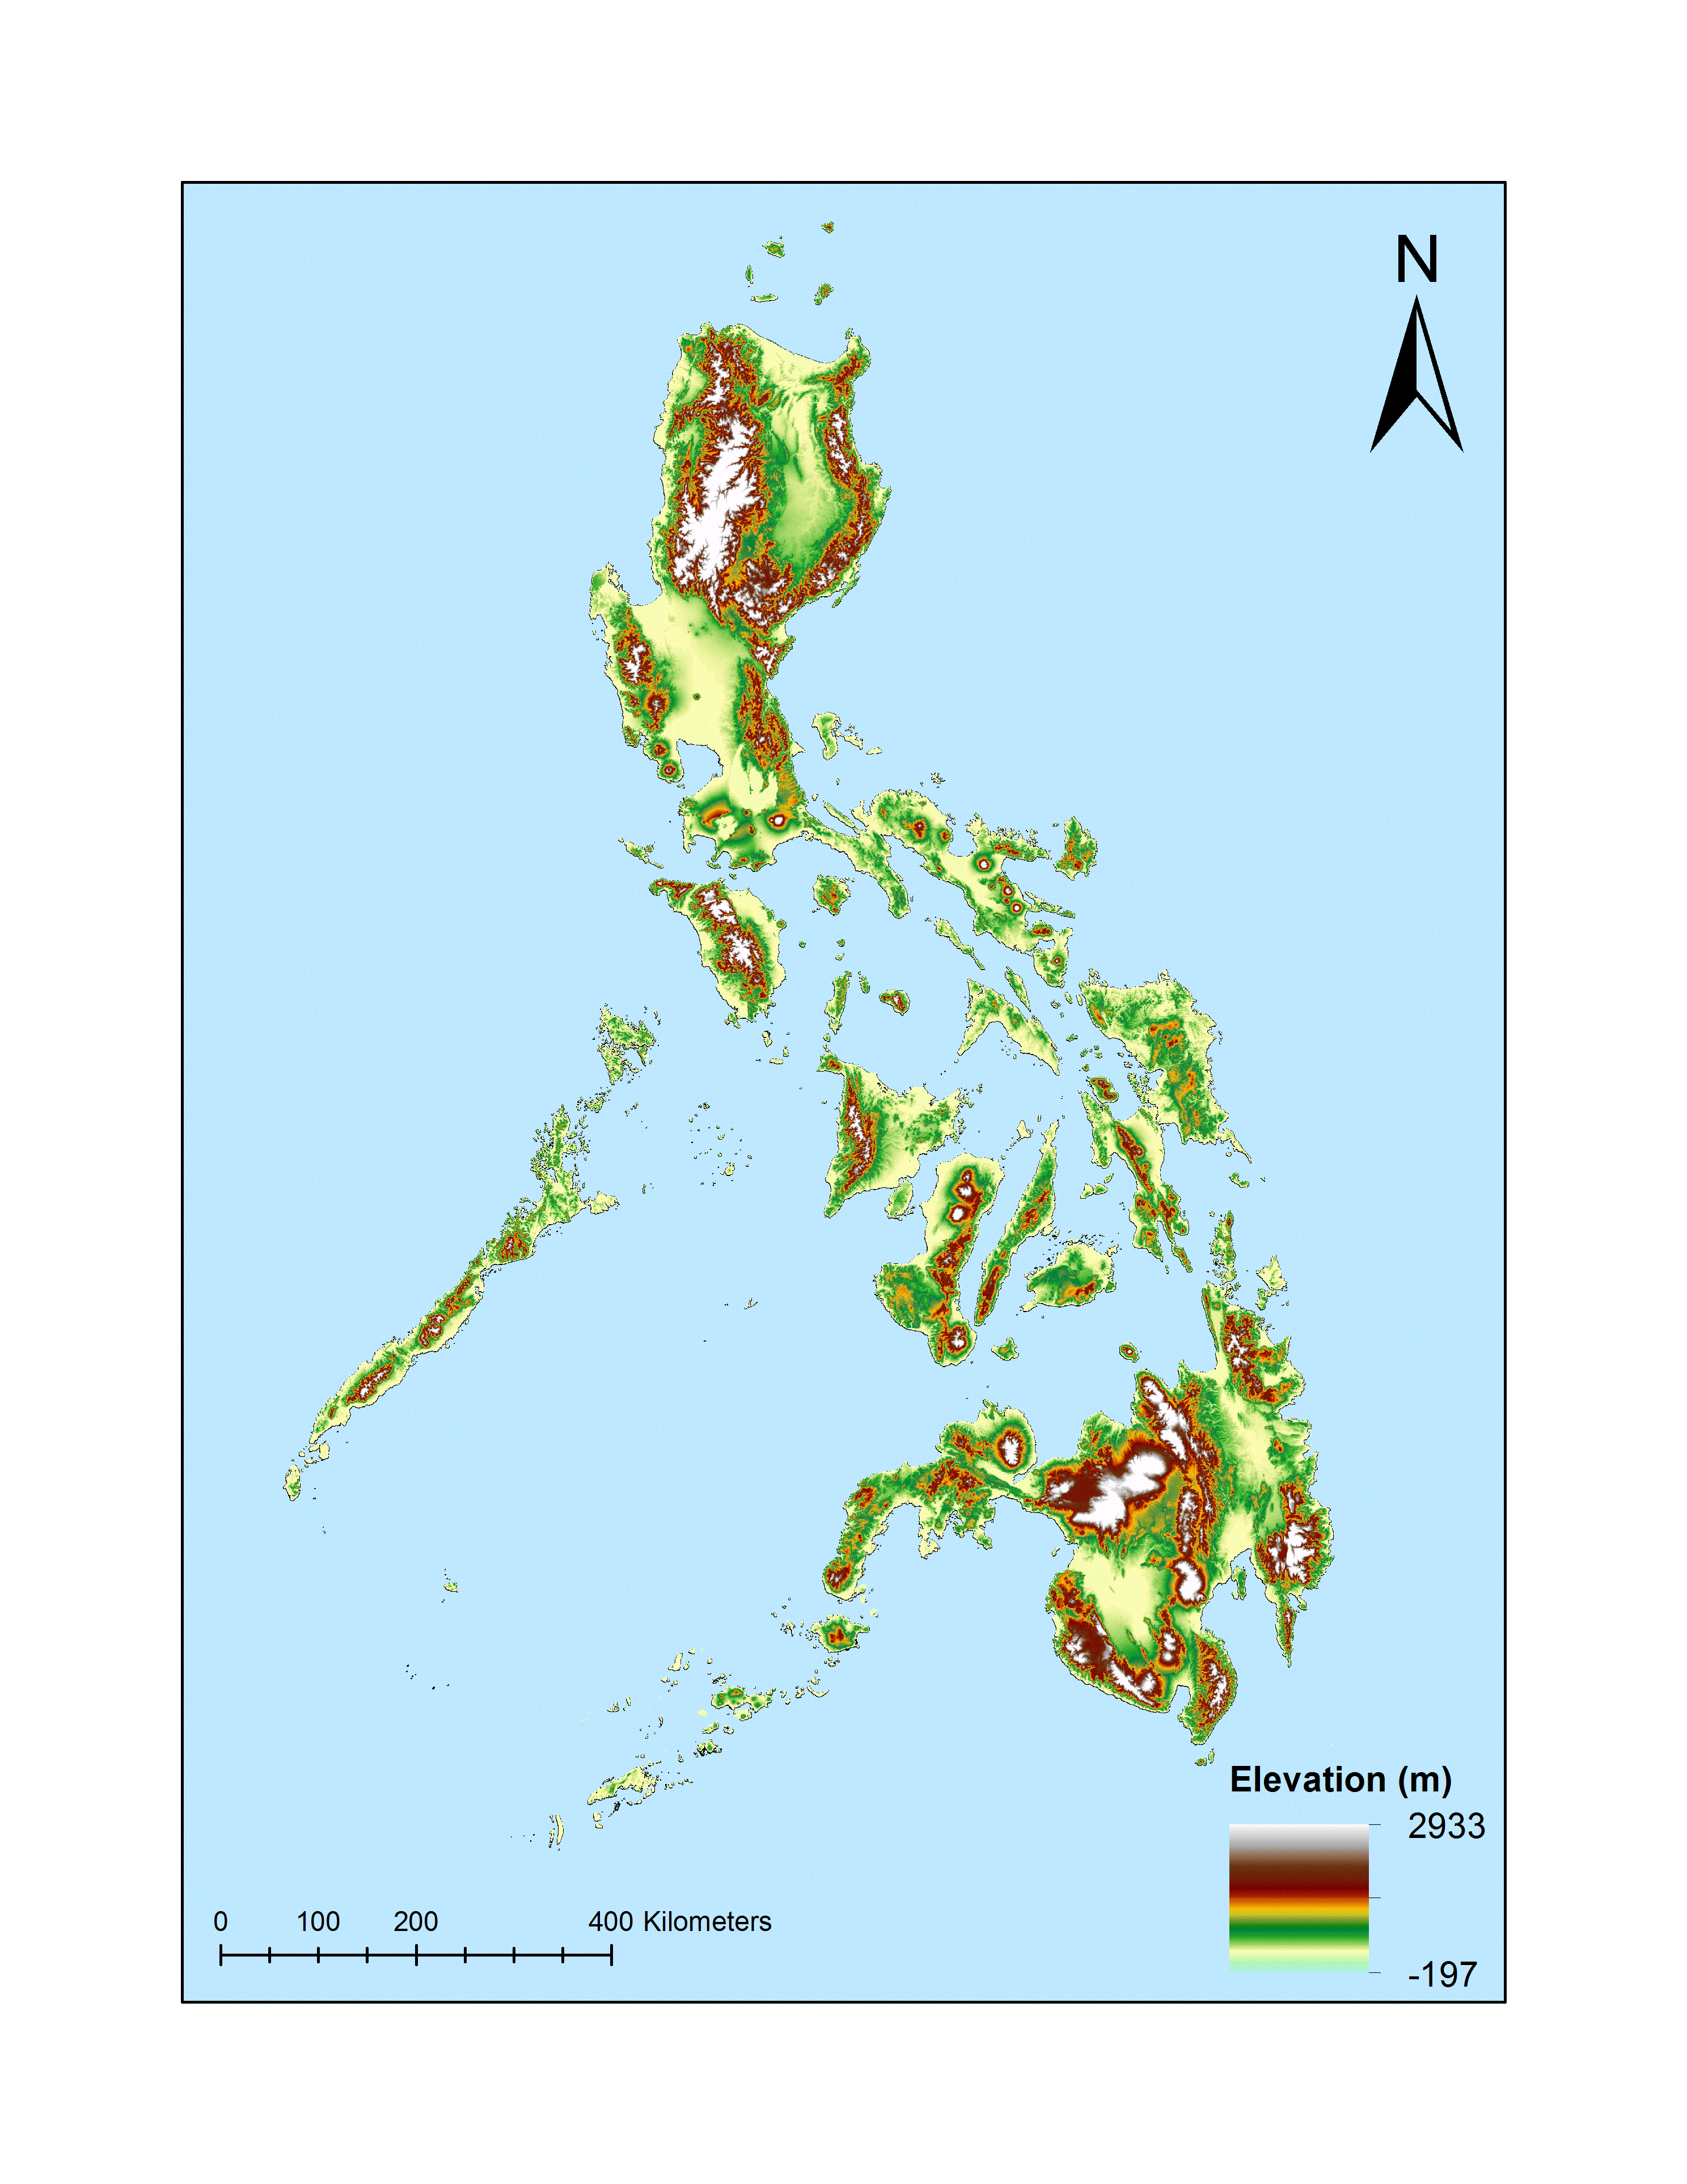
Errors & Uncertainties
          Limitations
          Track Data derived from satellite—values for wind speed not high precision
          Precipitation Data also satellite derived, cannot account for smaller scale forcing
          Missing demographic data
          Relative measures of vulnerability (emphasis on lower populations)
Notes:
(Kelly)
Tracks: Provided by real time analysis of satellite data; winds derived from satellites also due to no aircaraft observations
Precip: Sensor derives rates from cloud info, does not take into account terrain effects (more rainfall on windward side eg)

Slide 12
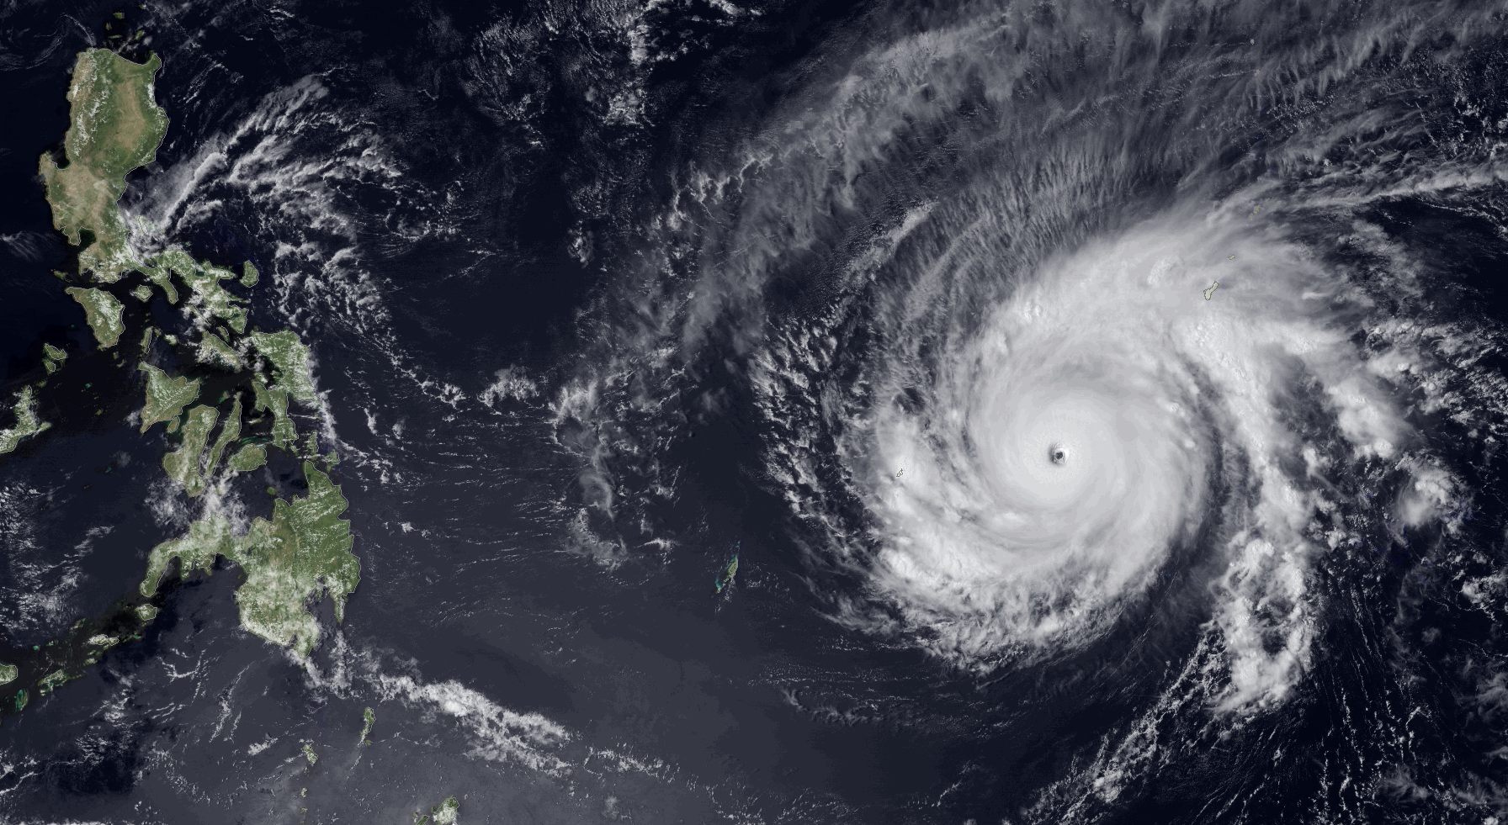
Future Work
          Consider other variables such as population density, track width, different weighting schemes.
          Determine focal statistics to create gradients v. binary results (e.g., rasters, buffers)
          Continue in depth analysis of precipitation/flooding threats, corroborate with in situ observations (i.e., rain gauge data)
Image Credit: NOAA
Notes:
(Kelly)
Future work includes further analysis of demographic variables as well as testing a new approach to analyzing storm intensity using stereographic methods from the ISS.
Image Source:
Super Typhoon Maysak strengthening in the Western Pacific Ocean (March 2015) -
https://www.flickr.com/photos/noaaphotolib/20386049560/in/photolist-hvY9d4-x4rQi7

Slide 13

Acknowledgements
Science Advisors
Dr. Carl Schreck, Cooperative Institute for Climate and Satellites-North Carolina, National Centers for Environmental Information
Dr. L. DeWayne Cecil, Global Science & Technology, National Centers for Environmental Information
Project Partners
Rowena Dacsig, United Nations-Office for the Coordination of Humanitarian Affairs, Gender Advisor
Joseph Addawe, United Nations Office for the Coordination of Humanitarian Affairs, Information Management Analyst
Other
Ken Knapp, Center for Weather and Climate, National Centers for Environmental Information
Notes:
(Kelly)
We need you notes

Slide 14
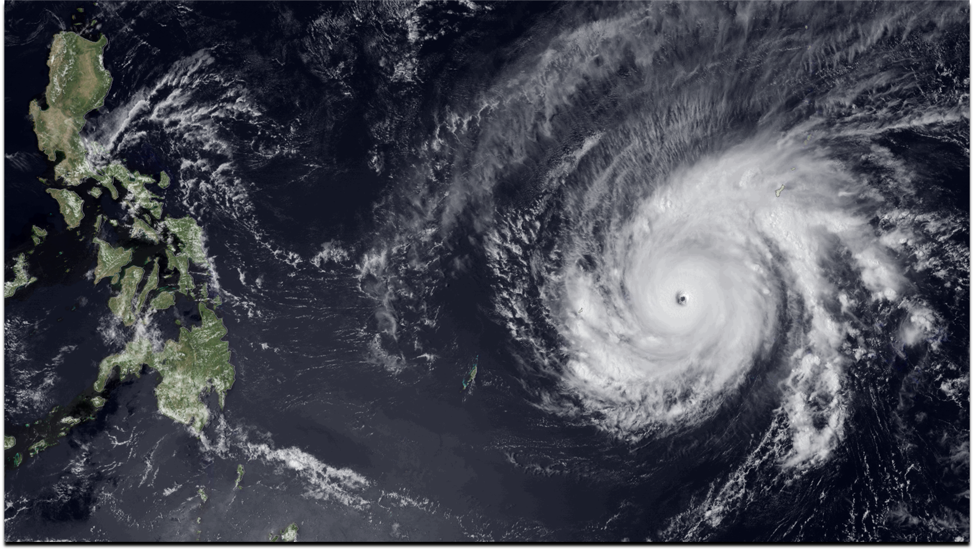
Questions?
Image Credit: NOAA

Slide 15
Appendix A: Threat Map Equations
Overall Threat Value = (NaturalHazard * 0.5) + (DemographicHazard * 0.5)
NaturalHazard = ((ACE - min(ACE)) / ((max(ACE) - min(ACE))
DemographicHazard = Average(Scaled single mother + disabled female + elderly female + weak roof + weak outer walls + unsanitary toilet + unsafe water vulnerability)
*Household counts are for poor households only. Each demographic variable was scaled using the same min/max normalization equation pattern as in Overall Natural Disaster Threat Values

Slide 16
Appendix B: SRTM DEM for Philippines

