Slide 1
DEVELOP National Program
About DEVELOP:
History, Organization, and Personnel

Slide 2
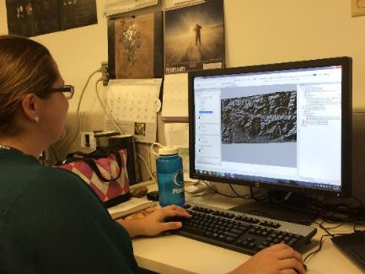
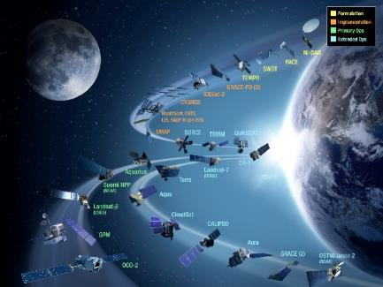
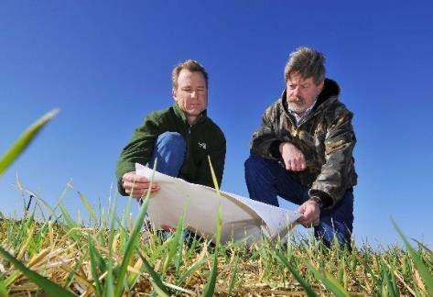
CBP’s DEVELOP National Program
“Shaping the future by integrating Earth observations into global decision making.”
Participants + Earth Observations + Decision Makers
DEVELOP bridges the gap between NASA Earth Science and society, building capacity in both its participants and end-user organizations
to better prepare them to handle the environmental challenges
that face society.
Capacity Building : www.nasa.gov/applied-sciences/capacitybuilding

Slide 3
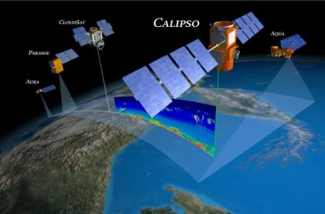
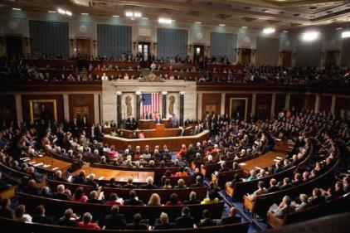
The DEVELOP Elevator Speech
So what is DEVELOP?
DEVELOP, part of NASA’s Applied Sciences Program, addresses environmental and public policy issues by conducting interdisciplinary feasibility projects that apply the lens of NASA Earth observations to community concerns around the globe. Bridging the gap between NASA Earth Science and society, DEVELOP builds capacity in both participants and partner organizations to better prepare them to address the challenges that face our society and future generations. With the competitive nature and growing societal role of science and technology in today’s global workplace, DEVELOP is fostering an adept corps of tomorrow’s scientists and leaders.
NASA’s Applied Sciences’
DEVELOP National Program
Measurements
and Predictions
Communities
DEVELOP’s Website: http://develop.larc.nasa.gov

Slide 4
DEVELOP’s Mission, Vision, & Core Values
MISSION
VISION
Integrating NASA Earth observations
with society to foster future innovation and cultivate the professionals of tomorrow by addressing diverse environmental issues today.
Shaping the future by integrating Earth observations into global decision making.
COLLABORATION
Cultivating teamwork, multi-disciplinary solutions, and open communication to bridge the gap between science and society
INNOVATION
Fostering rapid feasibility projects to harness ingenuity and demonstrate the applications of Earth science
PASSION
Pursuing all endeavors with energy, excitement, and enthusiasm to sustain a high level of excellence and respect
DISCOVERY
Exploring the potential of NASA’s investment in Earth science to make the extraordinary possible

Slide 5
DEVELOP’s Culture
Our approach to teamwork is based on a philosophy that each team member brings unique experience and important expertise to tasks at hand. We encourage and reward vigorous, open flows of communication on all issues, in all directions.
We are committed to creating an environment that fosters teamwork and processes that support continuous learning, innovation, and an openness to new ideas.
We are nimble, quick to respond, and go where others don’t, providing more service than is expected.
We pursue all endeavors with energy, excitement, and enthusiasm and are committed to maintaining an environment of trust, built upon honesty, ethical behavior, respect, and candor.
DEVELOP nurtures an organizational culture in which individuals make full use of their time, talent, and opportunities to pursue excellence in both the ordinary and the extraordinary.
Collaborative
Innovative
Dynamic
Service-Oriented
Passionate
Excellent

Slide 6
NASA’s Core Values
Safety
Excellence
SAFETY
Mission Success
EXCELLENCE
TEAMWORK
INTEGRITY
Teamwork
Integrity

Slide 7
DEVELOP’s Current Core Values
COLLABORATION
Cultivating teamwork, multi-disciplinary solutions, and open communication to bridge the gap between science and society
INNOVATION
Fostering rapid feasibility projects to harness ingenuity and demonstrate the applications of Earth science
PASSION
Pursuing all endeavors with energy, excitement, and enthusiasm to sustain a high level of excellence and respect
DISCOVERY
Exploring the potential of NASA’s investment in Earth science to make the extraordinary possible

Slide 8
DEVELOP Locations (aka Nodes)
California – Ames
Maryland – Goddard
California – JPL
Virginia – Langley
Alabama – Marshall
6. Alabama – Mobile
7. Arizona – Tempe
8. Colorado – Fort Collins
9. Georgia – Athens
10. Idaho – Pocatello
11. North Carolina – NCEI
12. Virginia – Wise

Slide 9
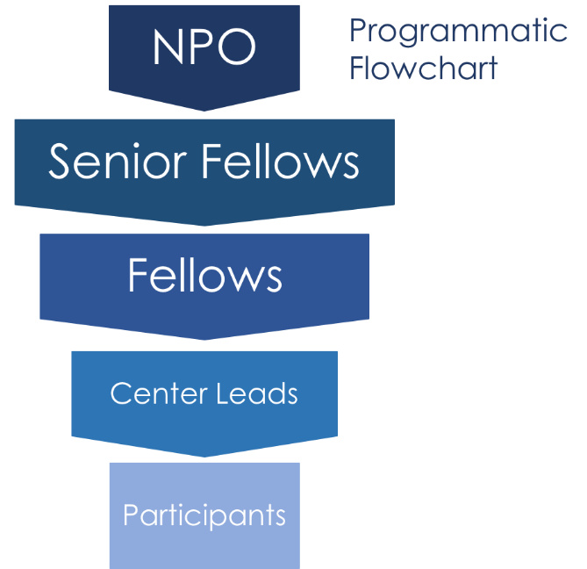
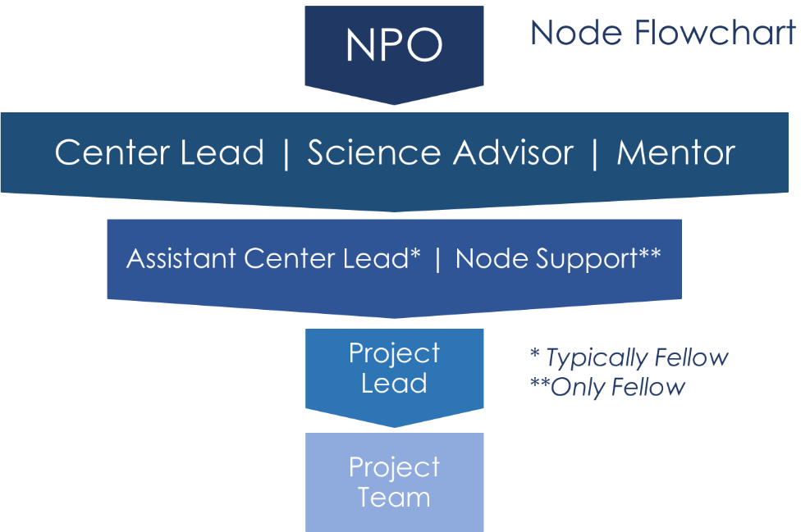
DEVELOP Hierarchy
National Hierarchy
Node Hierarchy

Slide 10
National POCs
DEVELOP
NPO
Mike Ruiz
Lindsay Rogers
Karen Allsbrook
Lauren Childs-Gleason
Dr. Kenton Ross
Jennifer Tindell
Senior Fellows
Georgina Crepps
Amanda Clayton
Jordan Vaa
DEVELOP
Fellows
Mercedes Bartkovich (MSFC)
Daniel Carver (CO)
Kate Cavanaugh (JPL)
Brooke Colley (VA)
Austin Counts (VA)
John Dilger (ARC)
Liz Dyer (AZ)
Leah Kucera (ID)
Sara Lubkin (GSFC)
Jonathan O’Brien (NC)
Danielle Quick (AL)
Nick Rousseau (JPL)
Austin Stone (GA)
DEVELOP Node Leadership
Arizona - Tempe
Lance Watkins (CL)
Liz Dyer (ACL)
California – Ames
Jenna Williams (CL)
John Dilger (ACL)
California – JPL
Erika Higa (CL)
Kate Cavanaugh (ACL)
Colorado – Fort Collins
Timothy Mayer (CL)
Dan Carver (ACL)
Georgia – Athens
Caren Remillard (CL)
Sean Cameron (ACL)
Idaho – Pocatello
Brandon Crawford (Acting CL)
Leah Kucera (ACL)
Maryland – Goddard
Victor Lenske (CL)
Sara Lubkin (ACL)
North Carolina – NCEI
Alec Courtright (CL)
Jonathan O’Brien (ACL)
Virginia – Langley
Emily Gotschalk (CL)
Virginia – Wise
Eric White (CL)
Brooke Colley (ACL)
Austin Counts (ACL)
Alabama – Marshall
Maggi Klug (CL)
Helen Baldwin (ACL)
Alabama – Mobile
Farnaz Bayat (CL)
Danielle Quick (ACL)

Slide 11
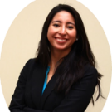
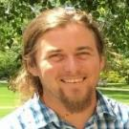
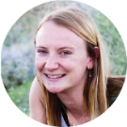
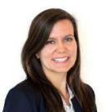
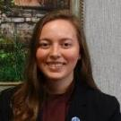
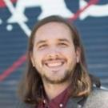
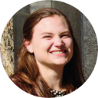
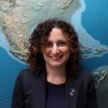
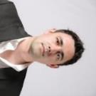
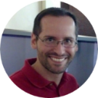
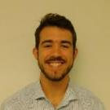
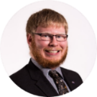
FY18 Fellows Class
What is a DEVELOP Fellow? A recent college graduate who spends one year with DEVELOP growing both personally and professionally, and contributing to the program as a whole. Each Fellow serves in a dual-role, splitting their time between their node and NPO-related tasks.
Amanda Clayton
Virginia – Langley
PC Senior Fellow
Mercedes Bartkovich
Alabama – Marshall
PC Fellow
Daniel Carver Colorado – Fort Collins
Geo Fellow
Kate Cavanaugh
California – JPL
Geo Fellow
Georgina Crepps
Virginia – Langley
IA Senior Fellow
John Dilger
California – Ames
Geo Fellow
Brooke Colley
Virginia – Wise
IA Fellow
Austin Counts
Virginia – Wise
Comm Fellow
Liz Dyer
Arizona – Tempe
IA Fellow
Leah Kucera Idaho – Pocatello
Comm Fellow
Sara Lubkin
Maryland – Goddard
PC Fellow
Jonathan O’Brien
North Carolina – Asheville
Comm Fellow
Jordan Vaa
Virginia – Langley
IT Senior Fellow
Danielle Quick
Alabama – Mobile
IA Fellow
Nick Rousseau
California – JPL
PC Fellow
Austin Stone
Georgia – Athens
Comm Fellow

Slide 12
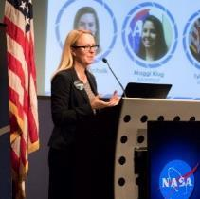
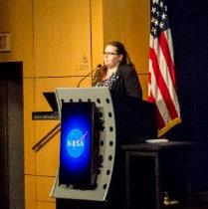
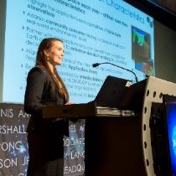
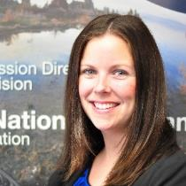
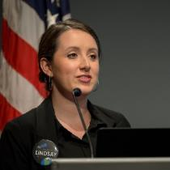
Questions? Contact…
Lauren Childs-Gleason: Lauren.M.Childs@nasa.gov, 757-864-4204
Georgina Crepps: Georgina.S.Crepps@nasa.gov, 757-864-5548
Amanda Clayton: Amanda.L.Clayton@nasa.gov, 757-864-5552
Jordan Vaa: Jordan.S.Vaa@nasa.gov, 757-864-4554
Karen Allsbrook: Karen.N.Allsbrook@nasa.gov, 757-864-1276
Lindsay Rogers: Lindsay.M.Rogers@nasa.gov, 757-864-7283
Deadlines, conferences, telecons, Fellow class, CL position competition, publications, international activities, partner engagement, project hand-offs, graphic design support, print materials, recruiting, VPS, Wise County
Impact Analysis Team-related items, tracking metrics, indicators, socioeconomic impact analysis, PSI, participant surveys, alumni survey, using the national telecon line
Project Coordination Team-related items, publications, deliverables, deadlines, webinars, DEVELOPedia project pages
IT Team-related items, DEVELOPedia, DEVELOP website, DEVELOP Exchange, software, hardware, software release authority
Contracts, payroll, status reports/invoices, schedule adjustments, online application system, travel, employment verifications, SSAI
Communications Team-related items, social media, newsletter, recruiting, military engagement, outreach activities, Ambassador Corps, media requests
Topics Not Listed Here: ANYONE! We love answering questions and will direct you to the right person if we can’t answer ☺

Slide 13
Social Media
DEVELOP National Program: features projects, node highlights & accomplishments, VPS announcements www.facebook.com/developnationalprogram
Once a DEVELOPer, Always a DEVELOPer: job posts
https://www.facebook.com/groups/387243741376125/
Articles & Important Events: Tweet @NASA_DEVELOP or #NASADEVELOP
http://twitter.com/#!/nasa_develop
NASA DEVELOP National Program:
VPS and promotional videos www.youtube.com/user/NASADEVELOP
NASA DEVELOP National Program: features projects, node highlights & accomplishments, and VPS announcements
https://plus.google.com/+NASADEVELOP
NASA DEVELOP National Program: job posts, job skills & tips, and important events. This is a private group! Follow the link to join!
www.linkedin.com/groups/4343498
Watch time spent on social media. If you are going to be on there it should probably be on the DEVELOP pages liking and commenting on DEVELOP things!

Slide 14
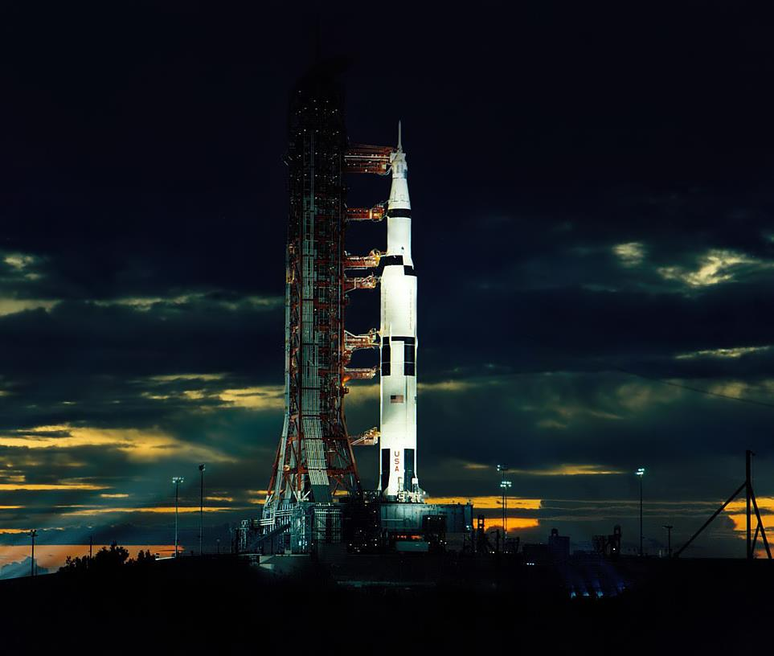
THANK YOU!
Joining the DEVELOP family means being part of NASA’s Legacy.
Learn it.
Know it.
Live it.

