Slide 1
North Carolina Water Resources
Utilizing NASA Earth Observations to Monitor Harmful Algal Blooms in the Albemarle and Pamlico Sounds of North Carolina
Chad Smith (Project Lead)
Jelly Riedel
Keith Benjamin
Daniel Wozniak
Matthew Carter

Slide 2
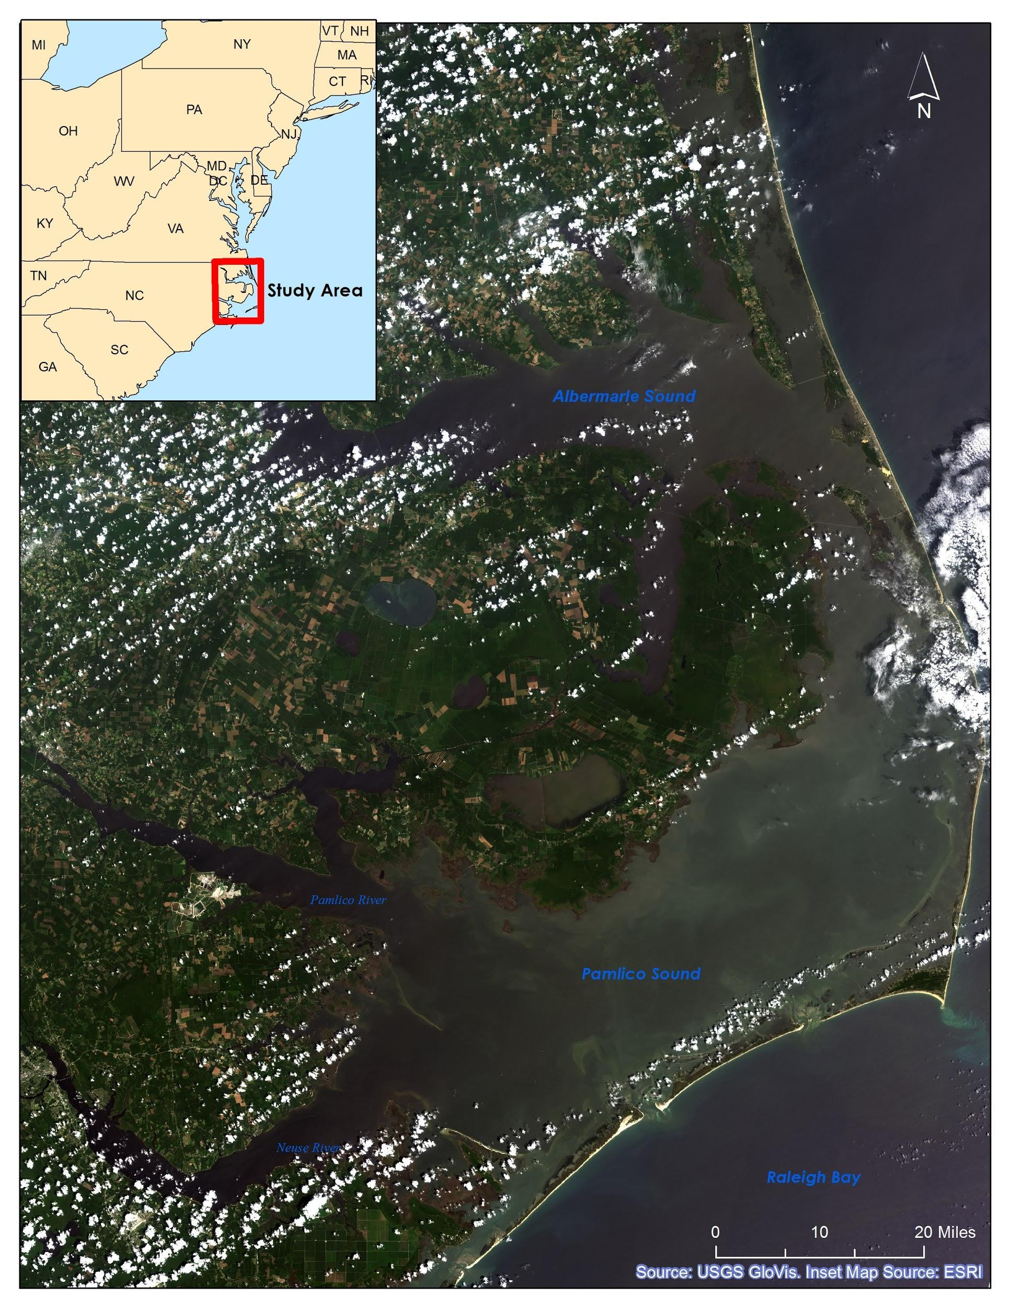
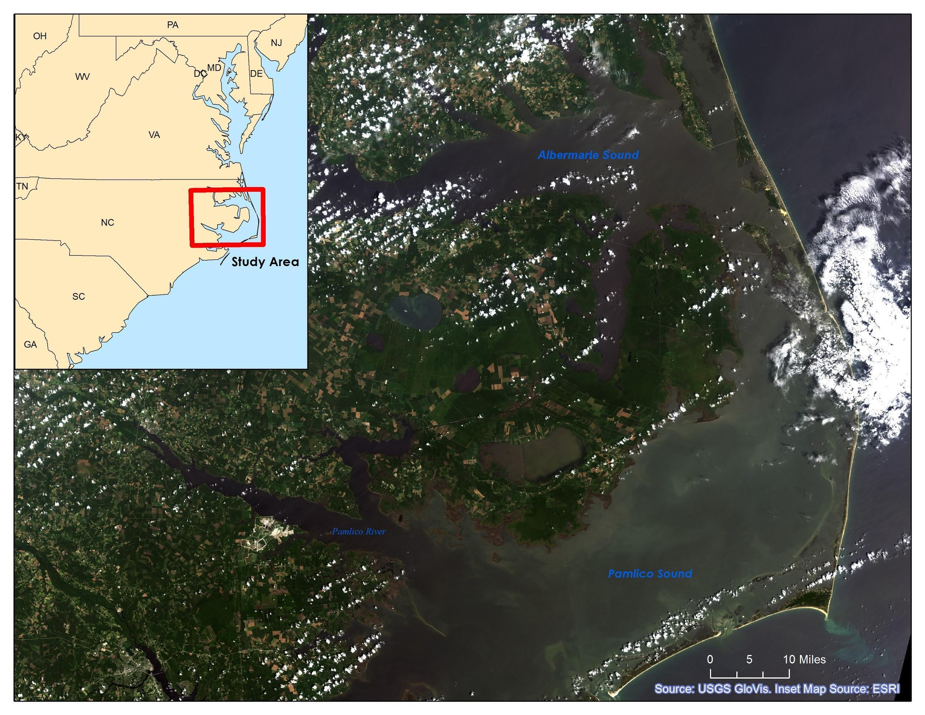
Community Concerns
Why are the Albemarle and Pamlico Sounds so important?
2nd largest estuary in the US
Contains 99% of the Atlantic coast’s submerged aquatic vegetation (SAV)
Supports one of the nation’s richest fisheries
Valuable to sportsmen and tourists
Notes:
I think this map looks too dark. We can replace it with a lighter image. I can mess with the symbology in the raster to make it appear lighter.
The Albemarle-Pamlico National Estuarine Complex is the 2nd largest estuary in the United States
Contains 99% of the Atlantic coast’s submerged aquatic vegetation outside of Florida
Supports one of the nation’s richest fisheries
Valuable for its appeal to recreational sportsmen and tourists

Slide 3
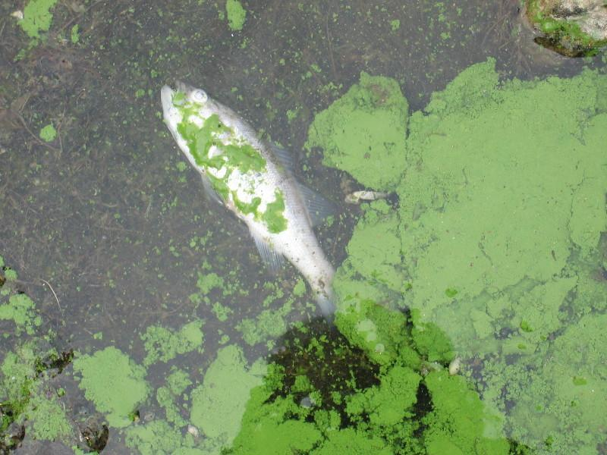
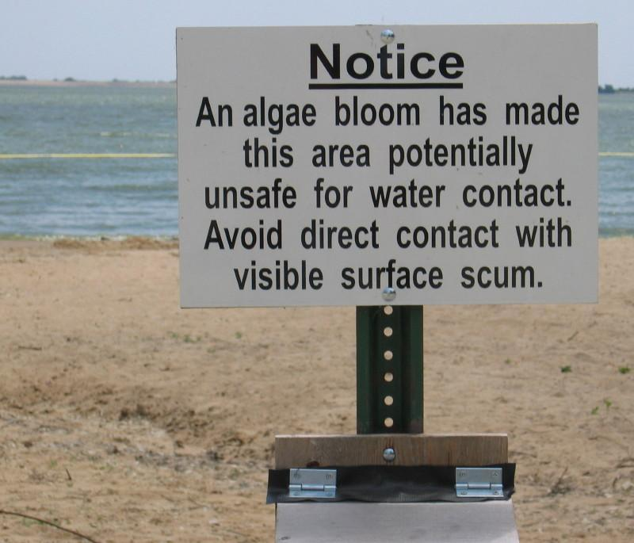
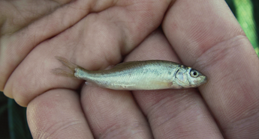
Community Concerns
Dangers of Harmful Algal Blooms (HABs):
Toxins in concentrations lethal to wildlife and domestic animals
Adverse human health effects
Hypoxic zones
Reduced light availability in water column for SAV
Source: USGS
Source: USGS
Source: USGS

Slide 4
Project Partners
Dr. Michelle Mooreman, Biologist
USGS North Carolina Water Science Center
Jim Hawhee
Dean Carpenter
Dr. Bill Crowell, Director
Albemarle-Pamlico National Estuary Partnership (APNEP)

Slide 5
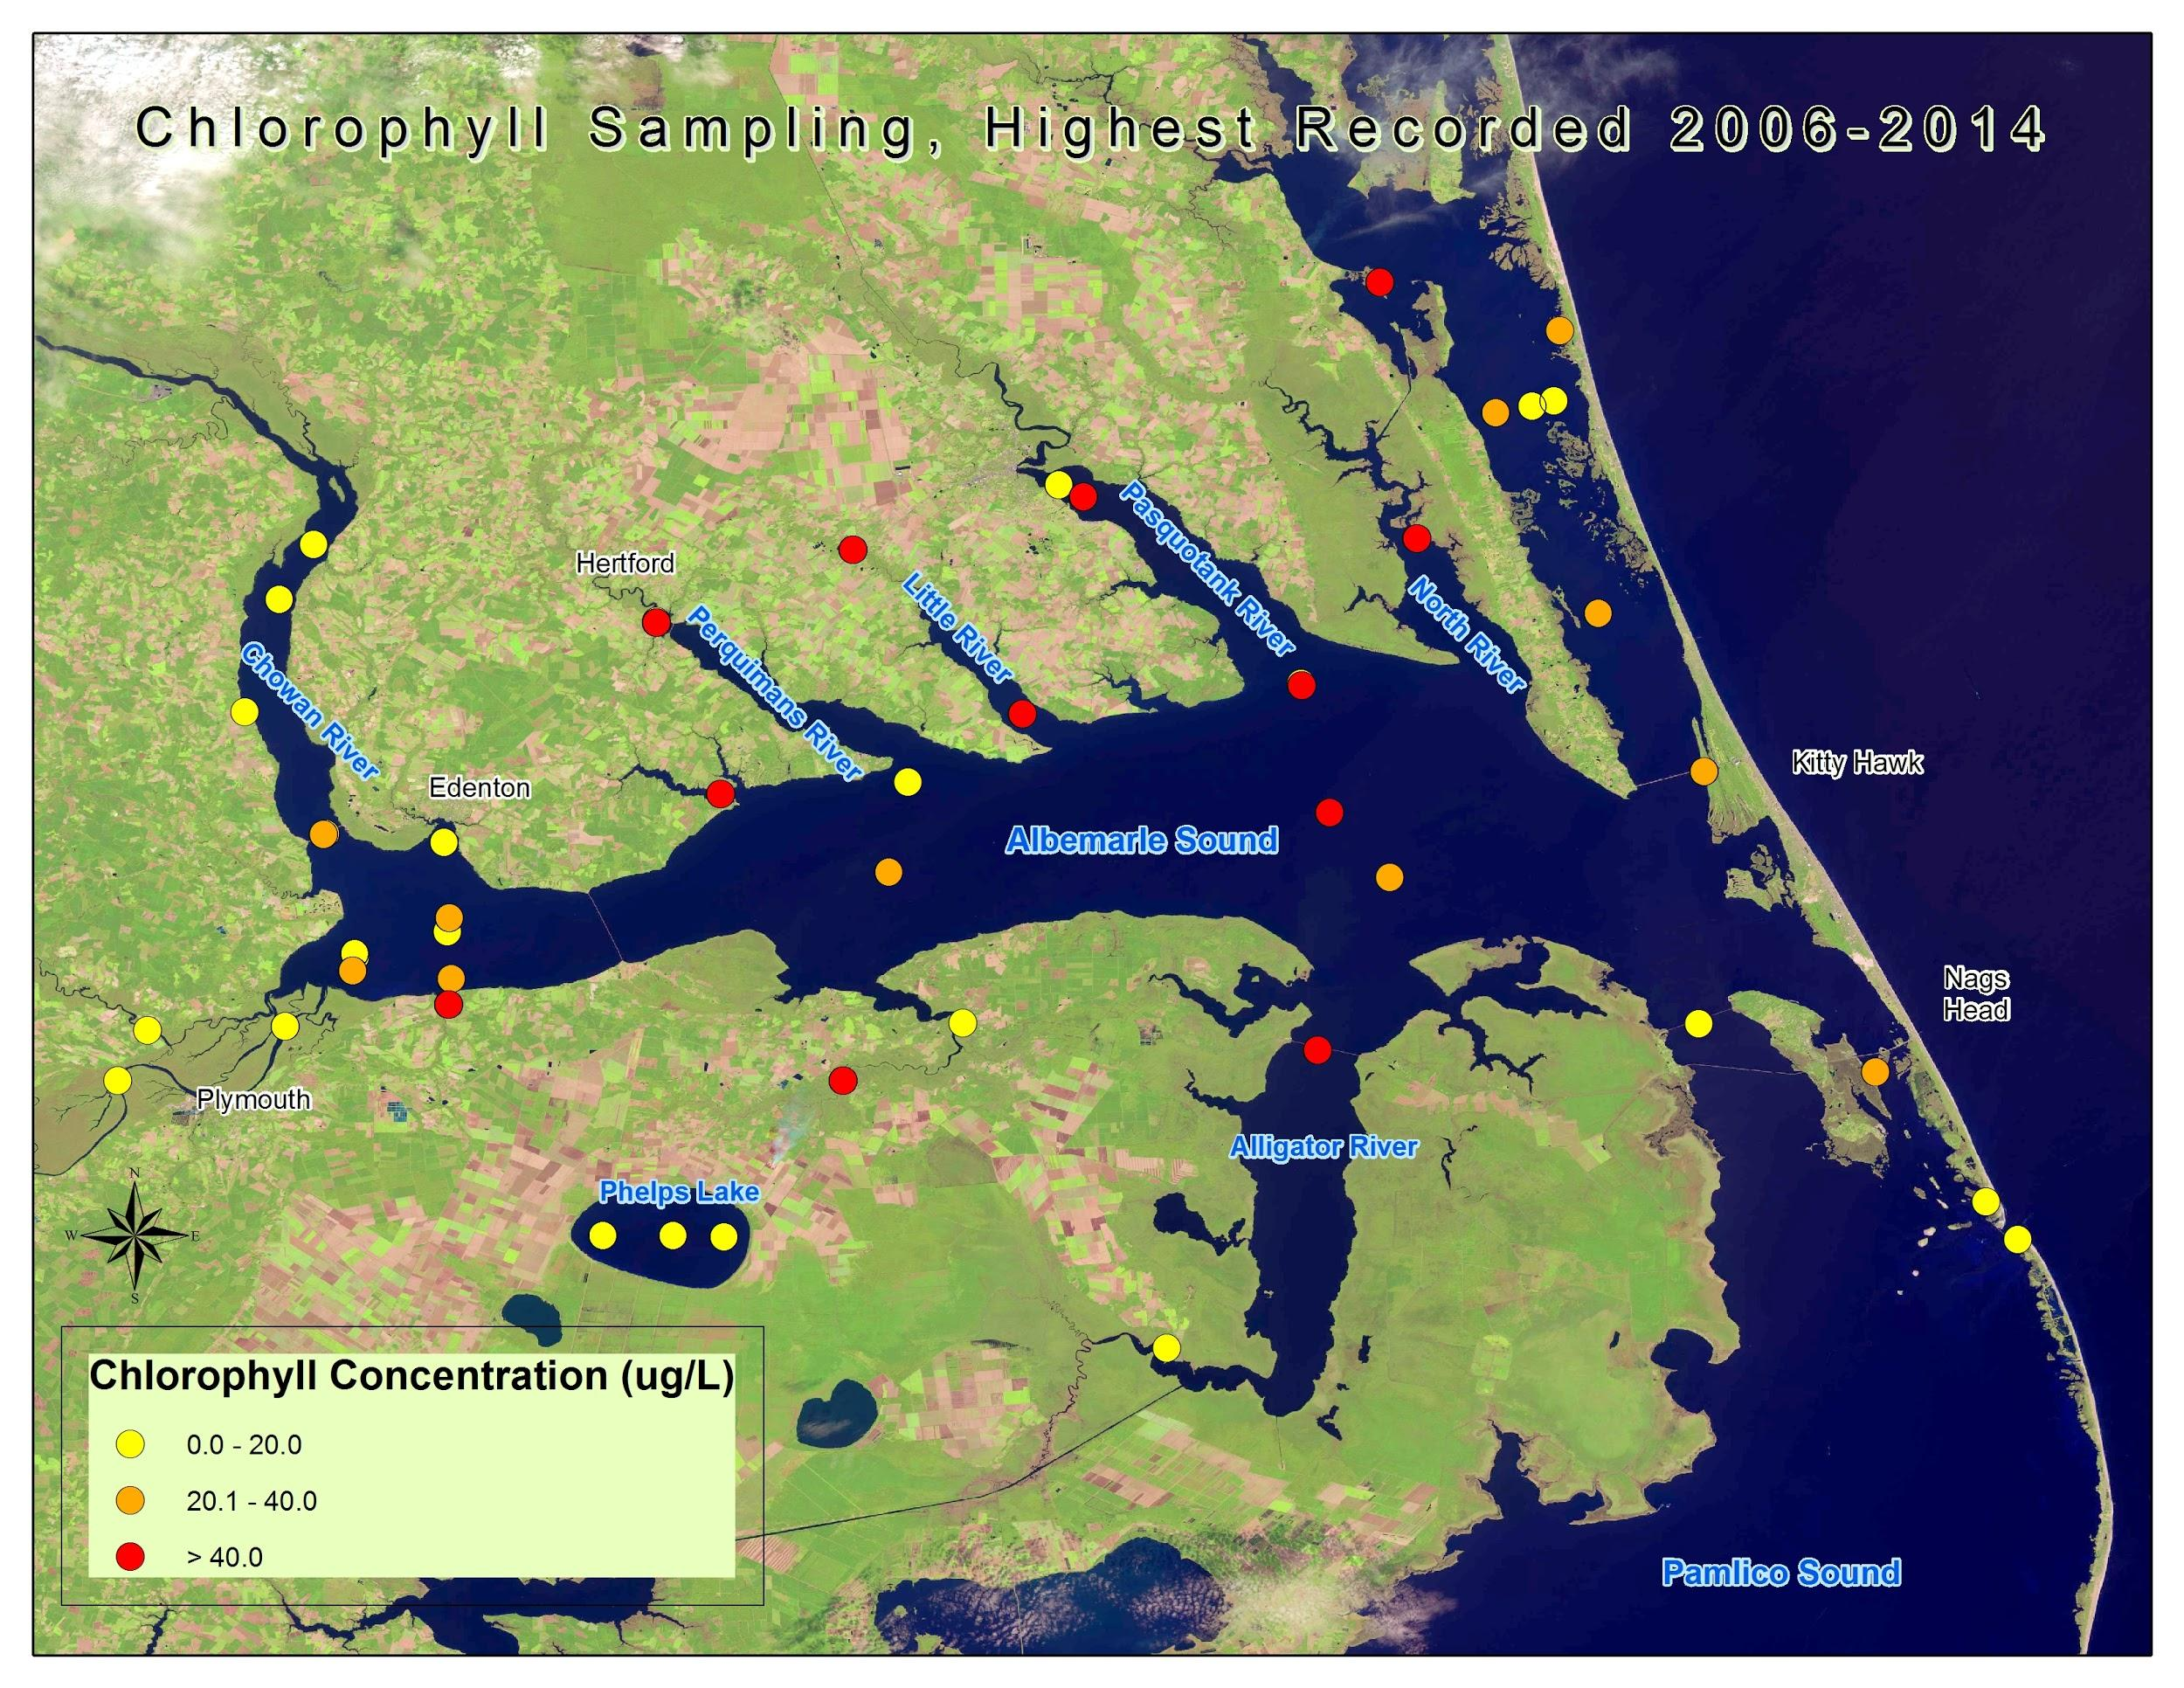
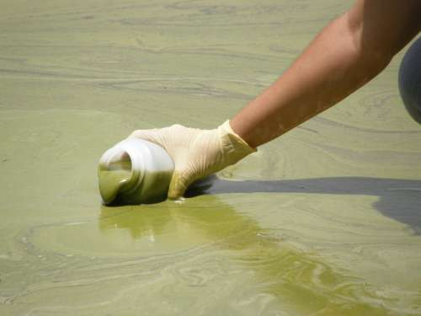
Project Objectives
Create a 10 year time-series representation of HAB extent from 2004 to 2014 using Chl-a as a proxy for algae
Compare MODIS-derived HAB maps with in situ water sample data provided by USGS North Carolina Water Science Center
Provide end-users with informational maps of large-scale HAB extent
Source: USGS

Slide 6
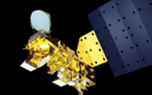
Project Methodology
NASA Earth Observations:
Data Acquisition:
Landsat 8 OLI
Landsat 7 ETM+
Landsat 1-5 MSS
USGS Glovis
Source: NASA
Aqua MODIS
Level 2 Data
GSFC Ocean Color
SeaDAS
Source: NASA
In situ Data:
USGS Water Sample Data & Station Locations
USGS North Carolina Water Science Center & NWQMC
Source: USGS

Slide 7
Project Methodology
MODIS Level 2 Daily Swath Ocean Color Data
Reject Partial Images
Decompress, Image Processing
Reproject Images
Clip/ Limit Processing Extent
MODIS-derived Chl-a Maps
MODIS Chl-a Band
Compare with Point Sample Data
USGS NC Water Science Center Data
Sample Point Shapefiles
Water Sampling Locations - NWQMC
Notes:
add animations for each thing

Slide 8
Results
our chl-a maps (did/did not) appear to match water sample data in a non-qualitative analysis of accuracy.
(Pending. The analysis that will lead to this is in progress.)

Slide 9
Discussion
(Pending. This will reflect the results and analysis, both of which are currently in progress.)

Slide 10
Uncertainty / Error Analysis
Many different algorithms to determine chl-a from MODIS. Algorithm use introduces uncertainty with the optically complex waters of the sound.
Sample site locations’ data are recorded to track algae concentration in affected waters, then compared to determine the correlation between this data and MODIS data.

Slide 11
Conclusions
(Pending. This will reflect aspects of the project which are still in progress.)

Slide 12
Benefits of Research
Large extent of HAB monitoring and a historical record of HAB behavior
Model that can be applied to monitoring such both into the future and in different parts of the world
More precise correlation between in situ water sample data and chl-a measurements derived from satellite data.

Slide 13
Future Work
Refinement of the regression analysis to validate the model.
Refinement of the modeling process so that it can be applied to other areas of the world.
Investigation of relationships between chl-a concentration and other water quality factors (dissolved O2, N, P, etc).

Slide 14
Acknowledgements
Advisors
Dr. Kenton Ross, DEVELOP National Science Advisor
Partners
Dr. Michelle Mooreman, Biologist, USGS North Carolina
Water Science Center
Jim Hawhee, Dean Carpenter, & Dr. Bill Crowell, Director, Albemarle-Pamlico National Estuary Partnership (APNEP)
Others
thanks to Jeff Ely, Geoinformation Scientist
This material is based upon work supported by NASA through contract NNL11AA00B and cooperative agreement NNX14AB60A.

