Slide 1
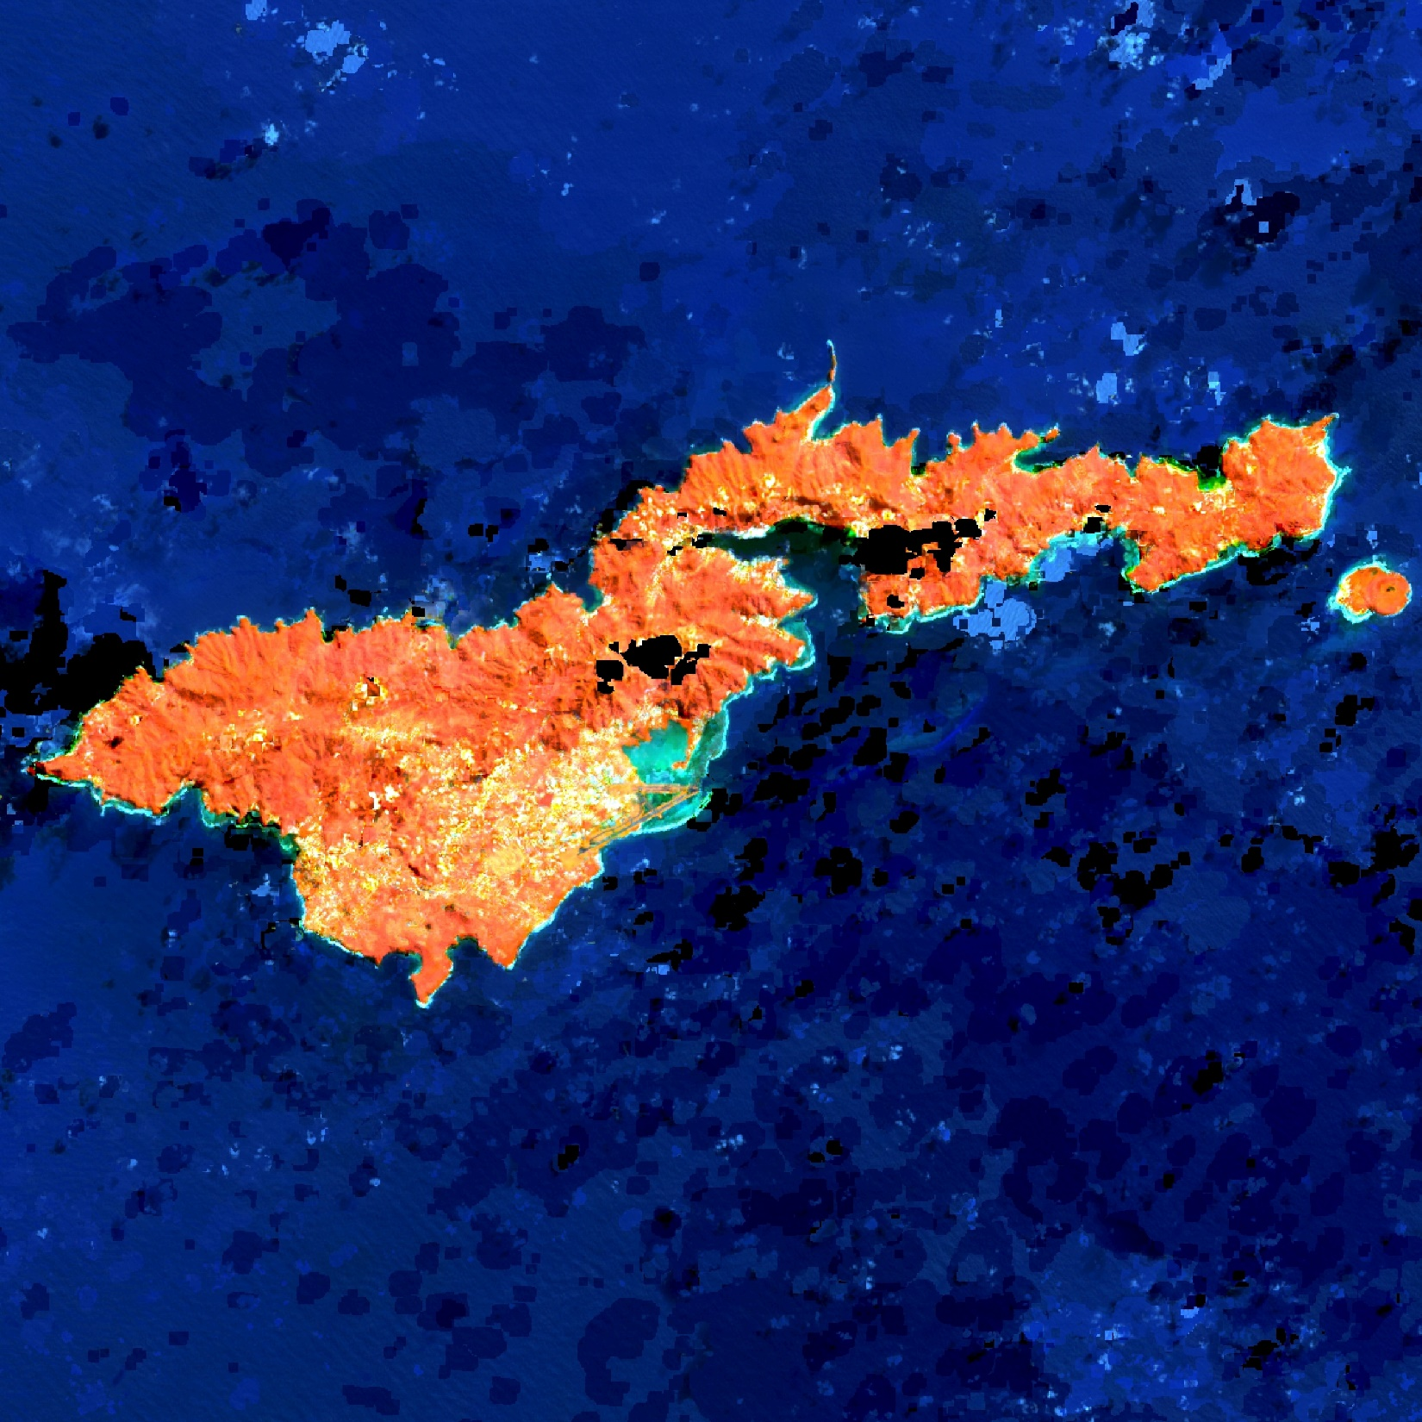
AMERICAN SAMOA WATER RESOURCES
Evaluating the Impacts of Land Cover and Water Quality Changes in American Samoa to Improve Watershed Management
Marshall Worsham
Melissa Collin
Eric Davis
Arev Markarian
California – Ames| Summer 2019
Notes:
The American Samoa Water Resources team at Ames Research Center used NASA Earth observations to investigate the impacts of land cover change on coastal water quality in this remote Pacific archipelago.
------------------------------Image Information Below ------------------------------
Map Source: NASA DEVELOP Summer 2019 ARC American Samoa Water Resources Team, created in Google Earth Engine

Slide 2
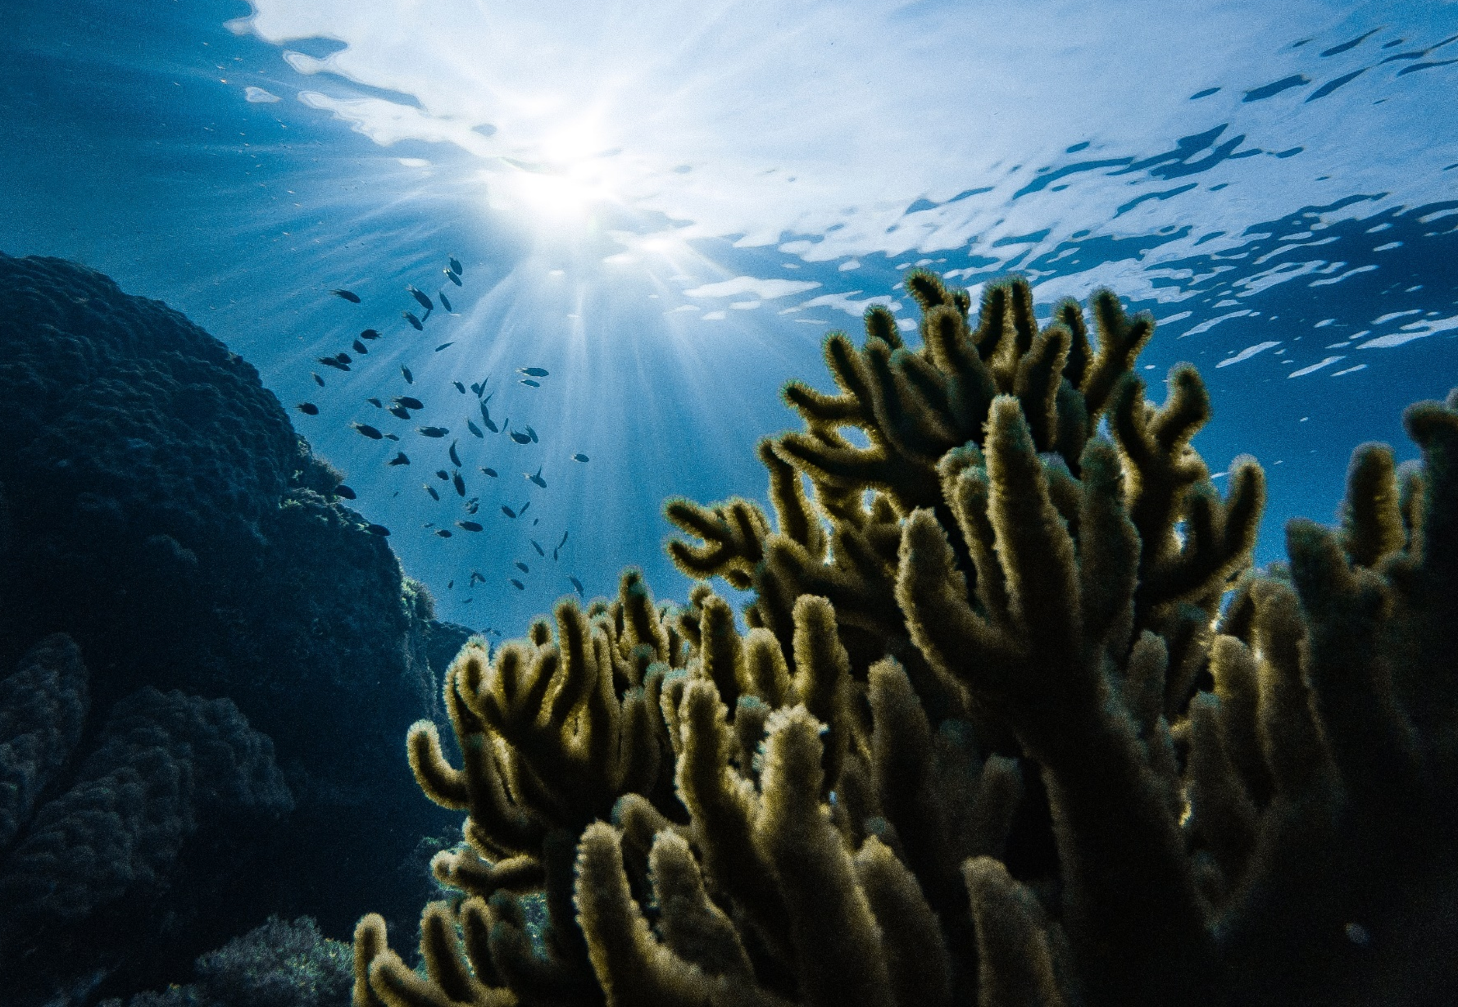
CONTENTS
Partners
American Samoa
Community Concerns
Project Objectives
Methodology
Results
Conclusions
Future Work
Acknowledgements
Image credit: Marek Okon, Unsplash
Notes:
In this presentation, we’ll start off by naming our project partners in American Samoa. Then, we’ll offer an overview of the study area, community concerns, and project objectives, before moving on to the methods and sensors we used. Finally we will finish with results, conclusions, and suggestions for future work.
------------------------------Image Information Below ------------------------------
•Image Credit: Marek Okon
•Image Source: Unsplash, Unsplash License, https://unsplash.com/photos/tWWCqIMiUmg

Slide 3
PARTNERS
US Coral Reef Task Force, Watershed Partnership Initiative
American Samoa Department of Marine and Wildlife Resources, Coral Reef Advisory Group
Builds partnerships, strategies, and support for coral reef conservation
Conducts and disseminates research on causes of reef decline
Motivations
Understand trends in land cover and water quality change
Acquire data to inform decision-making on coastal management
Leads community conservation initiatives and enforces regulations
Develops and implements watershed and reef management plans
Notes:
We want to begin by recognizing our partners in American Samoa, without whom this project could not have happened. We worked closely with two agencies, the US Coral Reef Task Force, Watershed Partnership Initiative (WPI) and the American Samoa Department of Wildlife and Marine Resources, Coral Reef Advisory Group (CRAG).
The WPI is a coordinating body, linking agencies and researchers to build strategies and support for reef conservation. They also coordinate scientific studies on the causes of—and solutions to—reef decline.
CRAG develops and leads community-based conservation initiatives across American Samoa, with a big focus on watershed and coral reef management.
Together, they were motivated to better understand spatial and temporal trends in land-use and land-cover change—or LULCC—in American Samoa over the last decade. They were also hoping to acquire time-series data that could inform their decision-making around coastal management.

Slide 4

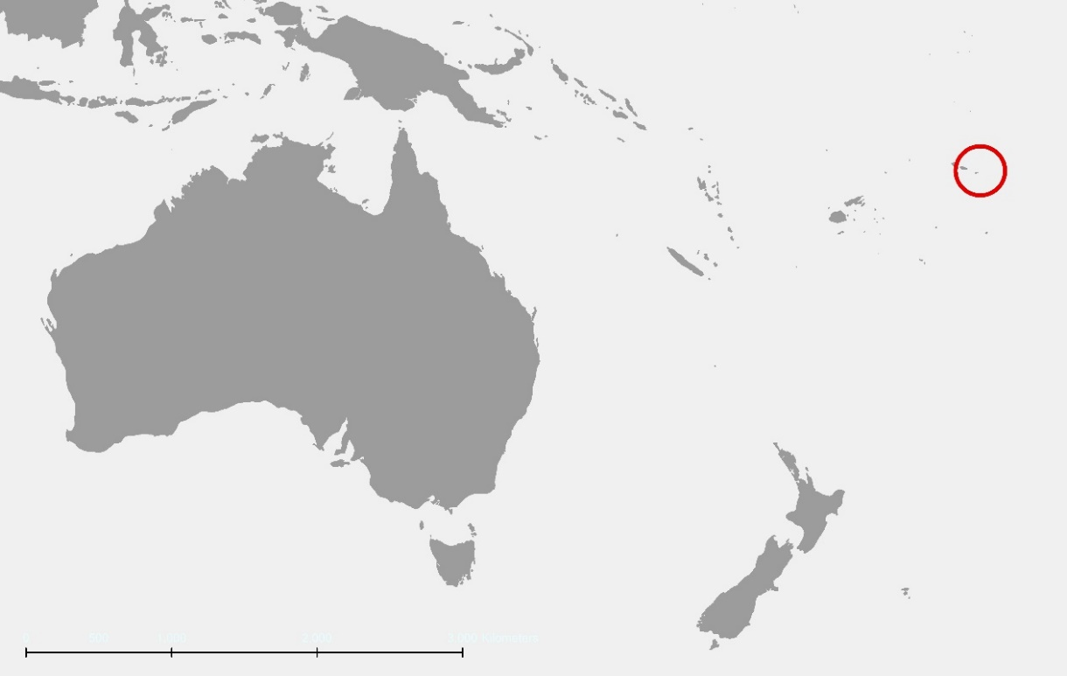
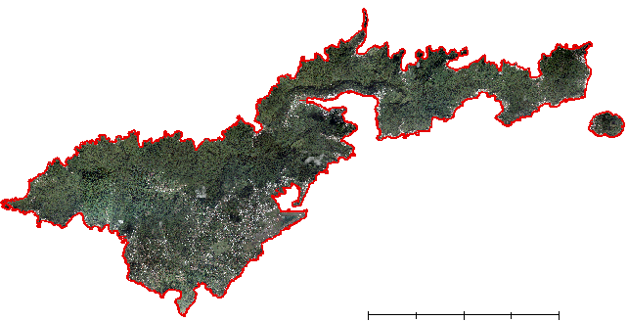
AMERICAN SAMOA
N
American
Samoa
Australia
New
Zealand
0
3000 km
0
2.5
5
10
km
-14.30=° N, -170.72° E
Map credit: American Samoa Water Resources Team, ESRI ArcMap 10.6
Notes:
American Samoa is an unincorporated United States territory in the Oceania region, roughly 4,000 km northeast of Australia. The territory comprises the eastern portion of the Samoan archipelago. Its five volcanic islands and two coral atolls have a combined land area of approximately 200 km²—about the size of Washington, DC.
American Samoa’s climate is warm and wet year-around, with average air temperatures in the rainy season hovering between 27°C and 28°C. The archipelago gets a lot of rain: precipitation averages range from about 300 to 500cm a year.
------------------------------Image Information Below ------------------------------
•Map Credit: American Samoa Water Resources Team, Summer 2019
•Map Source: US Department of Agriculture, Natural Resources Conservation Service Pacific Islands Orthoimagery 2017, processed in ESRI ArcMap 10.6

Slide 5
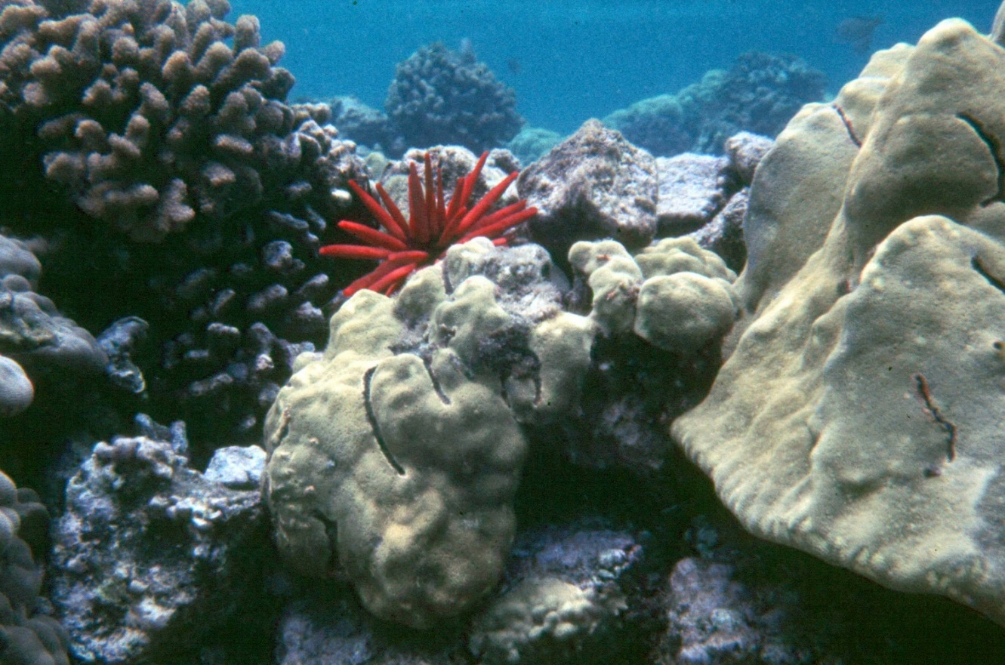
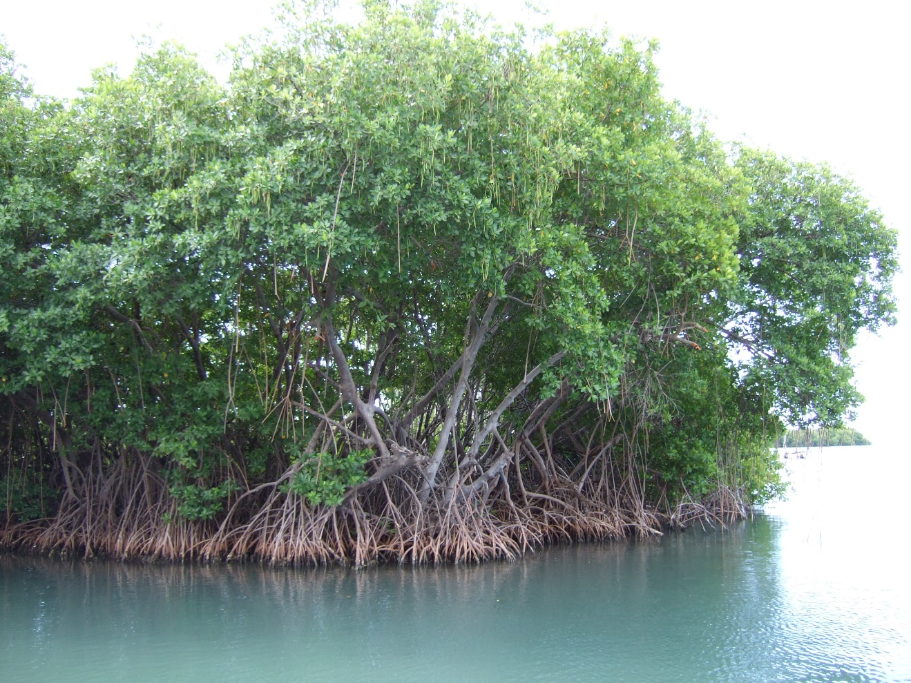
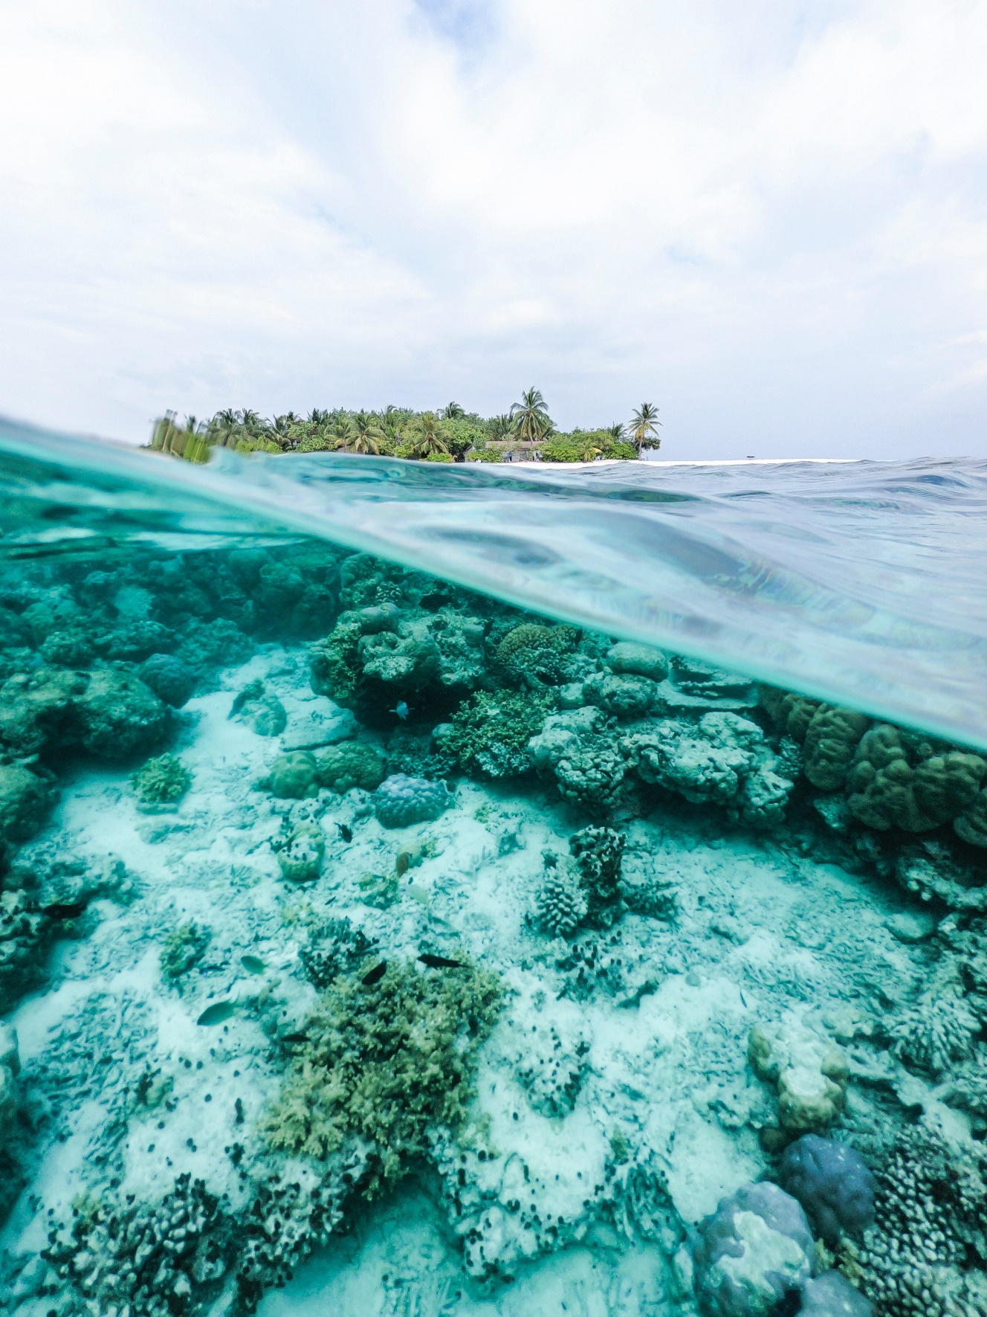
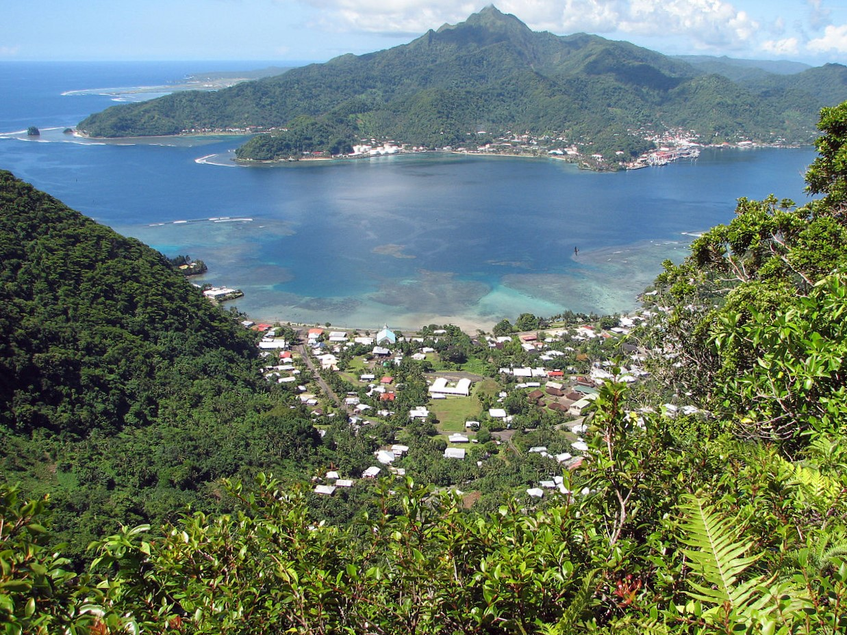
COASTAL ECOSYSTEMS
Coral Reefs
Mangrove Forests
US National Park Service
Boricudaeddie, Wikimedia Commons
Lagoons
Embayments
Ishan (@seefromthesky), Unsplash
US National Park Service
Notes:
The islands are also home to rich, yet sensitive coastal ecosystems. These include teeming coral reefs, dense mangrove forests, tranquil lagoons, and sweeping bays. Reefs cover approximately 295 km² of the near-shore seafloor. These habitats are not only key biodiversity hotspots; they’re also the building blocks of the coastal barrier system, and they support tourism and local fisheries, two mainstays of the local economy.
------------------------------Image Information Below ------------------------------
•Image Credits:
Coral Reefs: US National Park Service
Mangrove Forests: Boricudaeddie
Lagoons: Ishan (@seefromthesky) on Unsplash
Embayments: US National Park Service
•Image Sources:
Coral Reefs: US National Park Service, https://www.nps.gov/media/photo/gallery-item.htm?pg=5656271&id=EE7829DF-155D-4519-3ED894882FCB74BD&gid=EE7826A0-155D-4519-3EDD76494A360467, Public Domain
Mangrove Forests: Boricudaeddie, CC BY-SA 3.0, https://commons.wikimedia.org/w/index.php?curid=3055361
Lagoons: Unsplash, Unsplash License, https://unsplash.com/photos/8qEuawM_txg
Embayments: US National Park Service, https://commons.wikimedia.org/wiki/File:PagoPago_Harbor_NPS.jpg, Public Domain

Slide 6
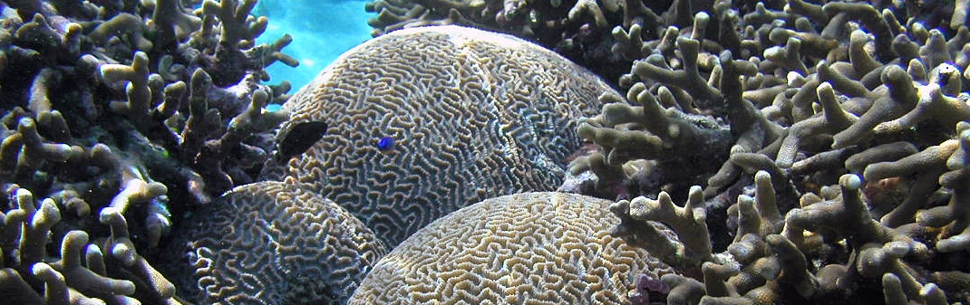
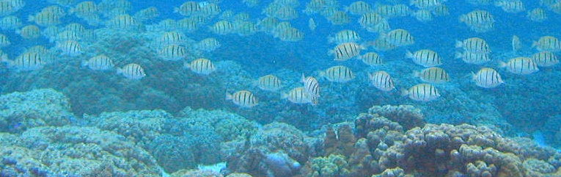
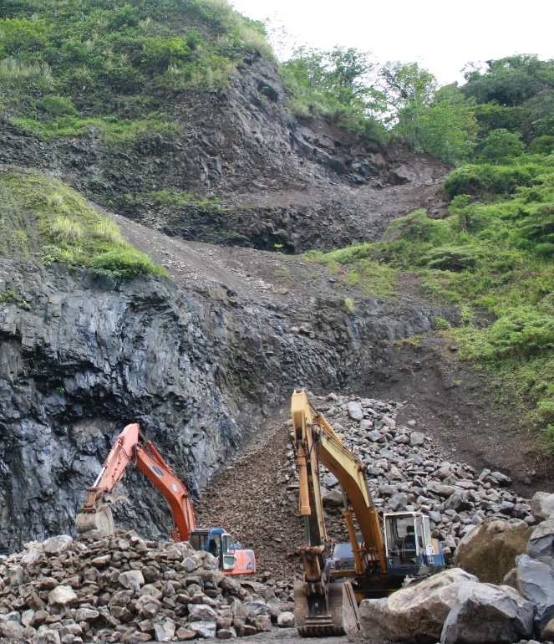
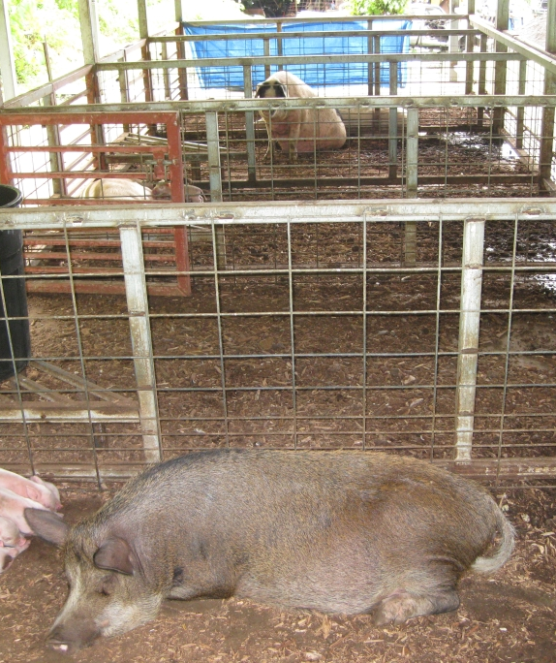
COMMUNITY CONCERNS
Coastal water quality is declining
Land-based sources of pollution (LBSP) negatively impact coastal ecosystems
Research is needed to evaluate relationships between land-use change and water quality
Image credits: US National Park Service; Dr. Juan Torres-Pérez; USDA Natural Resources Conservation Service
Notes:
Although the reefs have proven resilient to disturbances like cyclones and bleaching events, chronic anthropogenic disturbances pose an increasingly severe threat to these systems—and are limiting their ability to bounce back. Over the past couple of decades, water quality in near-shore reefs has been deteriorating. Some of this degradation is attributable to pollutants and nutrients running off through watersheds that drain into the ocean. These pollutants come from point sources, such as piggeries and mines, as well as non-point sources, like palm plantations and leaky wastewater infrastructure.
As development in American Samoa expands, we expect the impacts to reefs to multiply. However, to validate that assumption, conservation managers need to know how much and in what ways land use and land cover have changed. And they need to understand the strength of the relationship between those changes and fluctuations in near-shore water quality.
This is where remote sensing comes in. By applying satellite imagery to these questions, we can quantify the extent of land use and land cover change over time, and our partners can use this information to support the prudent management of coastal watersheds.
------------------------------Image Information Below ------------------------------
•Image Credits:
Coral: US National Park Service
Quarry: Dr. Juan Torres-Pérez
Piggery: USDA Natural Resources Conservation Service
•Image Sources:
Coral: US National Park Service, https://www.nps.gov/media/photo/gallery-item.htm?pg=5656271&id=EF3DA660-155D-4519-3E99595111B7F496&gid=EE7826A0-155D-4519-3EDD76494A360467, Public Domain
Quarry: Personal photo (written permission given)
Piggery: USDA Natural Resources Conservation Service, https://www.nrcs.usda.gov/wps/portal/nrcs/detail/pia/newsroom/features/?cid=nrcs142p2_037685, Public Domain

Slide 7
PROJECT OBJECTIVES
Quantify the magnitude of land use and land cover change (LULCC) on Tutuila and identify “hotspots” of greatest change
Discern near-shore water quality trends and analyze their relationship with LULCC in adjacent watersheds
Produce maps and geospatial analyses to enable partners to optimize watershed management strategies and protect coastal ecosystems in future
Provide end users with effective outreach materials to support community-based conservation efforts
Notes:
The objective of the American Samoa Water Resources project was to quantify historical patterns of land-use and land-cover change, or LULCC, and to analyze their relationship with trends in water quality. Along the way, we also generated maps, geospatial datasets, and outreach materials designed to help our partners optimize watershed management strategies and support their community-based conservation efforts.
------------------------------Image Information Below ------------------------------
•Image Credit: Claude Monet
•Image Source: http://commons.wikimedia.org/wiki/File:Claude_Monet_-_The_Magpie_-_Google_Art_Project.jpg, insert here whether this image is provided by a DEVELOPer/partner, public domain, or the type of creative commons license the image was published under – e.g. CC BY-SA

Slide 8
METHODOLOGY
Notes:
Now, we’ll move on to our methodology—how we did it.

Slide 9
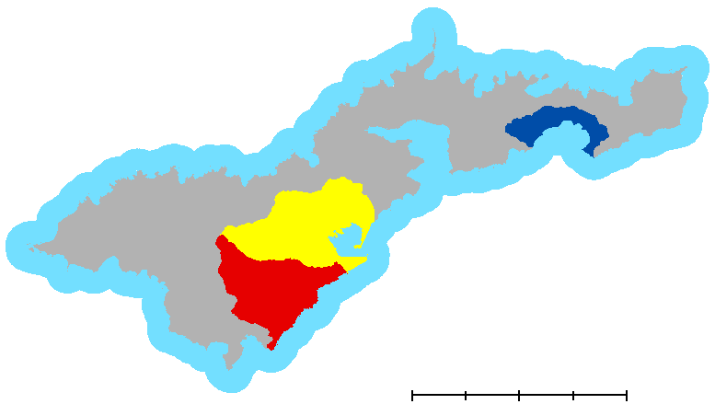

STUDY DOMAIN
N
Study Area
Tutuila, American Samoa
Study Period
2012 to 2019
April to October
Boundaries
Tafuna Plain
Nu’uuli Watershed
Faga’itua Watershed
Tutuila
Near-shore water (1km)
0
2.5
5
10
km
Image credit: American Samoa Water Resources Team, ESRI ArcMap 10.6
Notes:
Our project centered on Tutuila, American Samoa’s largest island. At roughly 142 km², Tutuila hosts the majority of American Samoa’s 55,000 human inhabitants.
We used Earth observations to explore how land cover and water quality have changed over time across the whole island, and at a more granular scale in three high-priority areas: Tafuna Plain, the Nu’uuli Watershed and the Faga’itua Watershed.
------------------------------Image Information Below ------------------------------
•Map Credit: American Samoa Water Resources Team, Summer 2019
•Map Source: USGS Hydrology Shapefiles, processed in ESRI ArcMap 10.6

Slide 10
METHODS SUMMARY
LANDSAT 8
OLI
USDA NRCS ORTHOIMAGES
EARTH OBSERVATIONS
PREPROCESSING
SR CORRECTION
CLOUD MASK
CLIP
WATER QUALITY EVALUATION
WATERSHED - SCALE LAND CLASSIFICATION
IMAGE COMPOSITES
ISLAND - SCALE LAND CLASSIFICATION
TIME SERIES ANALYSIS
RANDOM FOREST MODELING
ZONAL STATISTICS
MODEL OUTPUTS
Notes:
Our study comprised four phases of analysis.
First, we used Landsat 8 Operational Land Imager data from 2013 to 2019 to perform an island-scale land classification. To mitigate the extensive cloud cover throughout most of the year, we created cloud-masked composites from scenes taken from April to October, the island’s driest season. Next, we pulled high-resolution orthoimagery from the USDA Natural Resources Conservation Service to run a more granular land classification in the three priority watersheds. Then, we used a single Landsat 8 image from each year to derive chlorophyll-a concentrations in near-shore and ocean waters.
We evaluated the land cover and water quality outputs for changes over time. We used these data points, along with a range of variables parameterizing other anthropogenic and geophysical factors, to evaluate the relationship between LULCC and water quality using a random forest model in RStudio.

Slide 11

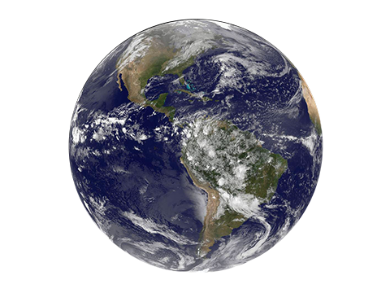
NASA EARTH OBSERVATIONS
Landsat 8
Sensor: Operational Land Imager (OLI)
Spatial resolution: 30 meters/pixel
Temporal resolution: 16 days
Altitude: 705 km
Path: 68
Row: 70
Scene size: 185 km x 180 km
Image credits: NASA
Notes:
The team employed NASA Earth Observations derived from Landsat 8’s Operational Land Imager, OLI. Path 68 & Row 70 of the satellite captured imagery of Tutuila in one swath, at 30-m resolution every 16 days.
------------------------------Image Information Below ------------------------------
•Image Credits:
Landsat 8: DEVELOPedia
Earth: NASA
•Image Sources:
Landsat 8: http://www.devpedia.developexchange.com/dp/index.php?title=List_of_Satellite_Pictures, provided by DEVELOPedia.
Earth: NASA, Public Domain https://solarsystem.nasa.gov/planets/earth/overview/

Slide 12
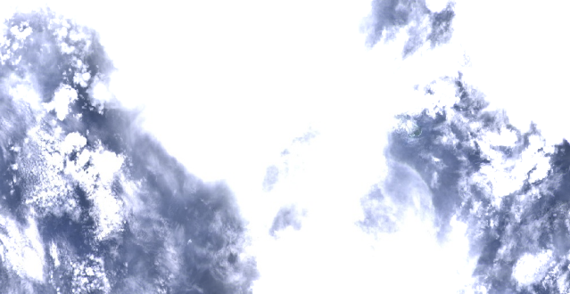
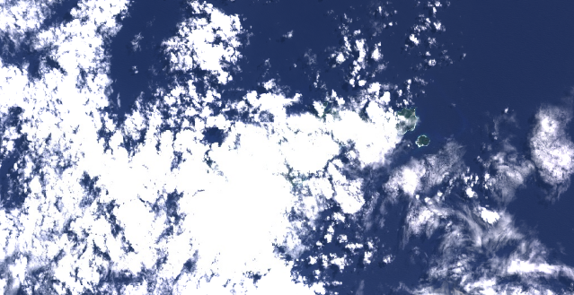
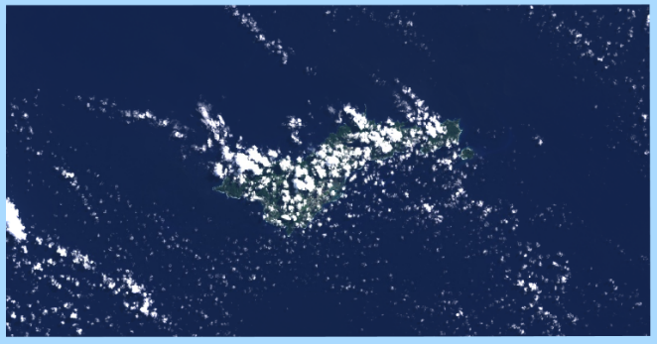
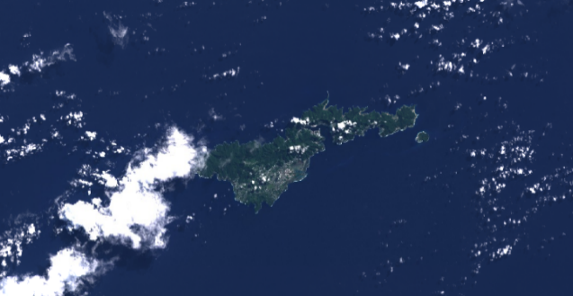

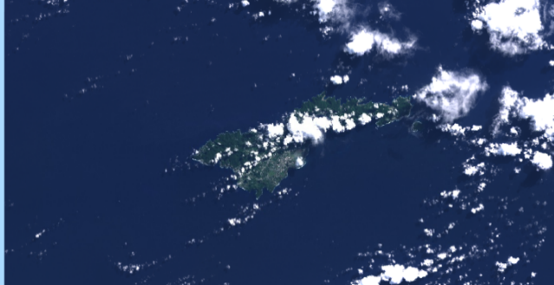
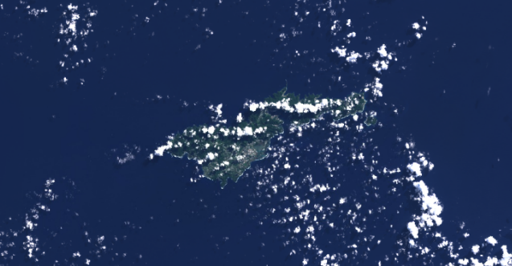
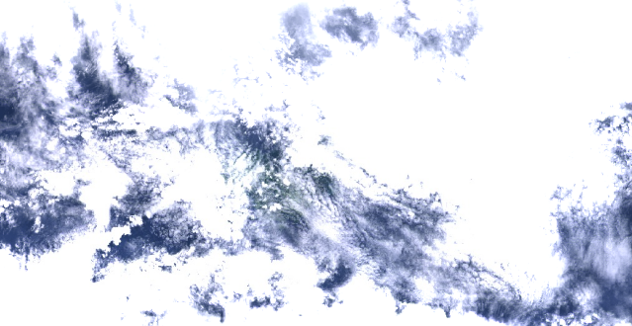
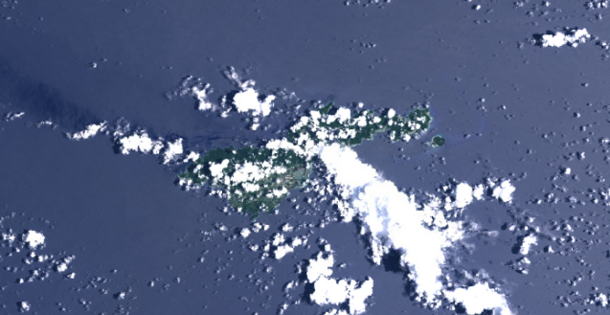
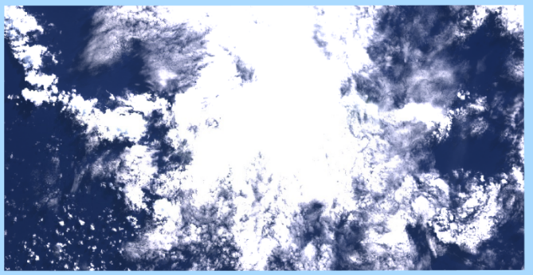
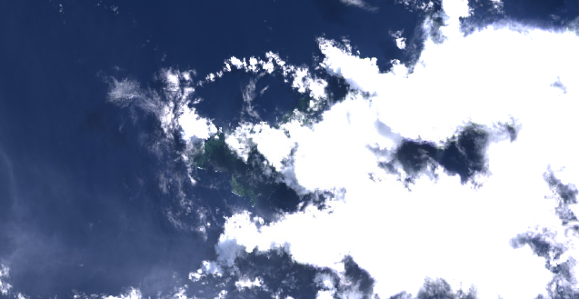
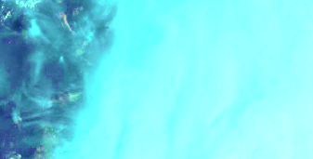
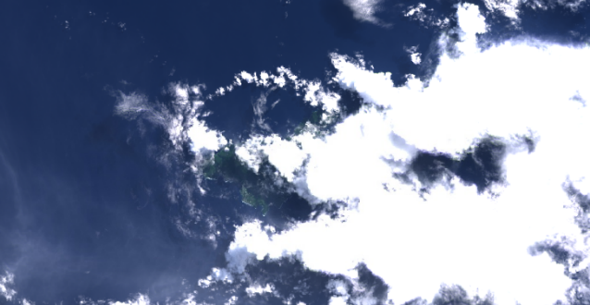
DATA SELECTION
PLACEHOLDER CLOUD-MASKED COMPOSITE IMAGE
Image credit: American Samoa Water Resources Team, Google Earth Engine
Notes:
Unfortunately, the scenes over our study area were often obscured by cloud cover; this required us to generate composite images to effectively monitor the area of interest remotely over time.
[CLICK FOR ANIMATION]
To create these composites, we selected Landsat 8 scenes with less than 30% cloud cover and used them to synthesize a single, relatively unobscured image from each year.
------------------------------Image Information Below ------------------------------
•Map Credit: American Samoa Water Resources Team, Summer 2019
•Map Source: Landsat 8 OLI 2016, processed in Google Earth Engine

Slide 13
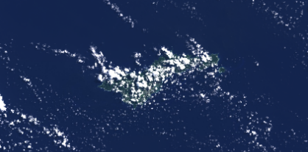
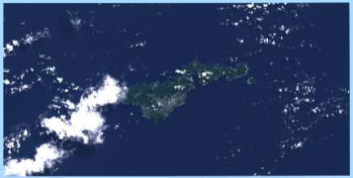
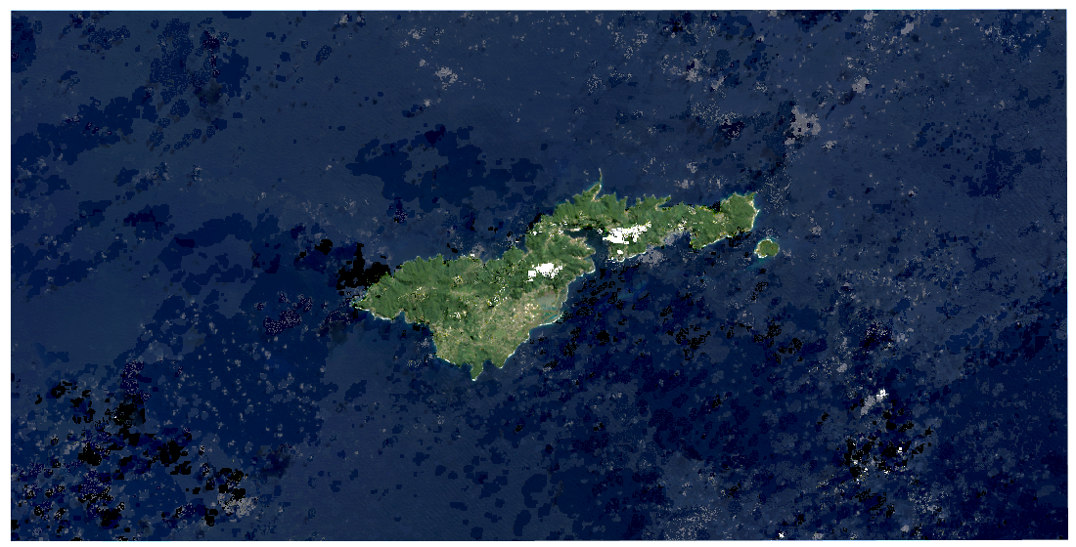

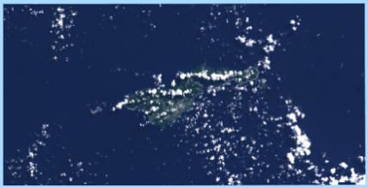

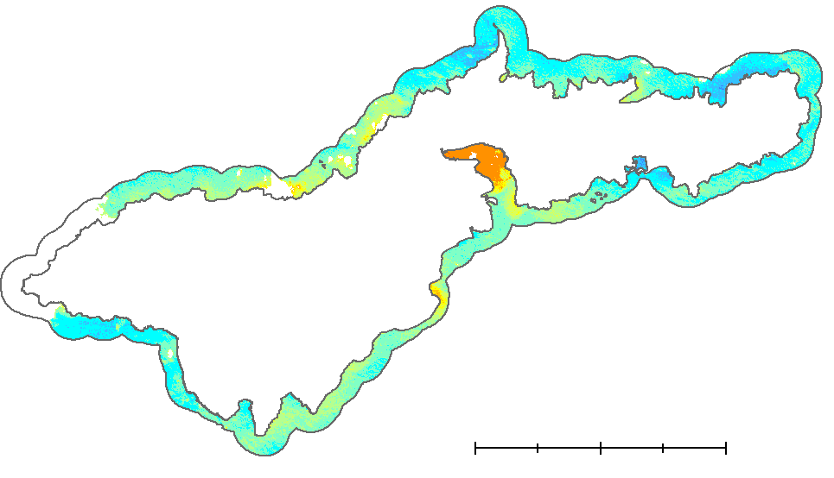
CLOUD MASKING
N
April 22, 2018
May 24, 2018
Pixel-Band Masking
Landsat 8 OLI Imagery — 2018
June 9, 2018
June 25, 2018
0
5
10 km
2018 Composite
Oct 31, 2018
Map credit: American Samoa Water Resources Team, Google Earth Engine
Notes:
In this example, we acquired five Landsat 8 surface reflectance images from the dry season in 2018.
Then, in Google Earth Engine, we applied a cloud and shadow mask using Landsat 8's pixel QA band. This band is generated from the surface reflectance images by the USGS using an algorithm called CFMASK, which identifies clouds, cloud shadows, and snow. The algorithm uses decision trees to classify pixels into one of those categories, then validates the decisions using statistics across the scene. With the QA pixel classifications, we applied a masking function to each image to remove cloudy regions and then composited the images. In this way, the least cloudy pixels from the image collection were assembled into a single scene. We repeated the process for each year in the study period.
------------------------------Image Information Below ------------------------------
•Map Credit: American Samoa Water Resources Team, Summer 2019
•Map Source: Landsat 8 OLI 2018, acquired and processed in Google Earth Engine

Slide 14
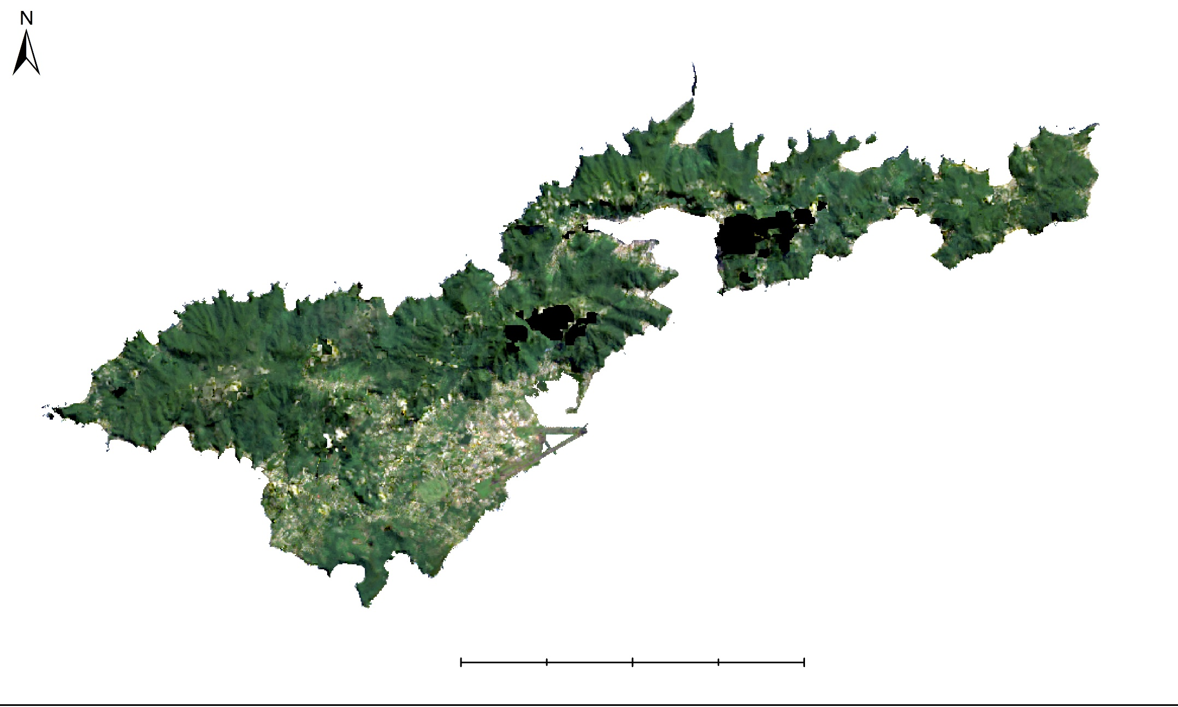
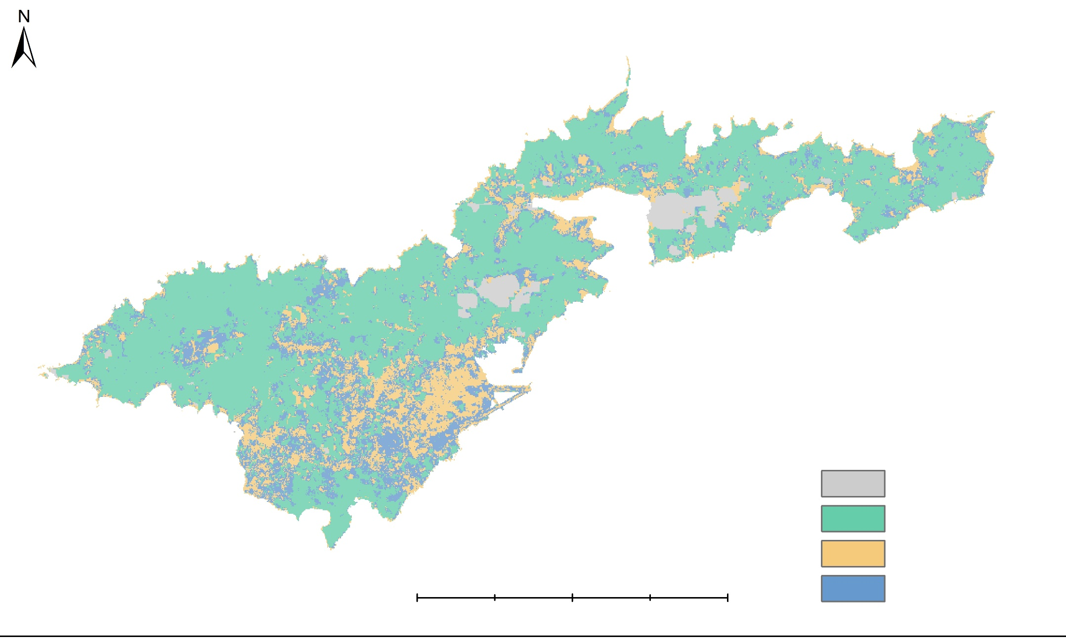
LAND CLASSIFICATION: TUTUILA ISLAND
N
Land Cover Classes
Clouds
Canopy
Impervious
Bare/Agriculture
0
2.5
5
10 km
Map credit: American Samoa Water Resources Team, ESRI ArcMap 10.6
Notes:
Next, we performed a land classification on the composites using four classes: clouds, tree canopy, bare earth/agriculture, and impervious surfaces. Using tools in ArcMap 10.6 we created training polygons within the island boundary, over areas where we were confident that the pixels represented a specific type of land cover, such as tree canopy or bare earth. From here, we ran the training polygons through the supervised classification tool in ArcMap to classify the image. The tool used the training points to identify other areas with similar spectral signatures and produced a land-cover map. We repeated this process for each year, 2013–2019. We used these maps to conduct a time-series analysis to evaluate the extent and direction of LULCC change and to identify hotspot areas of greatest change.
------------------------------Image Information Below ------------------------------
•Map Credit: American Samoa Water Resources Team, Summer 2019
•Map Source: Landsat 8 OLI 2018, processed in Google Earth Engine and ESRI ArcMap 10.6

Slide 15
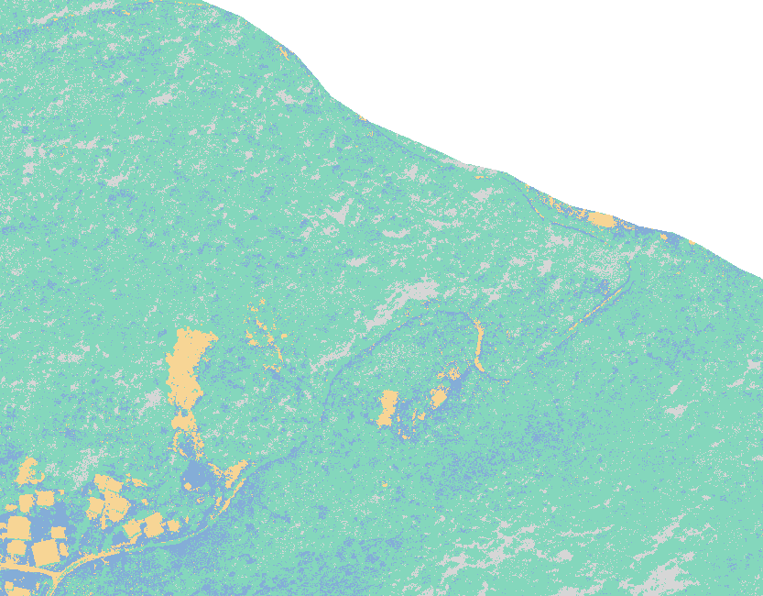
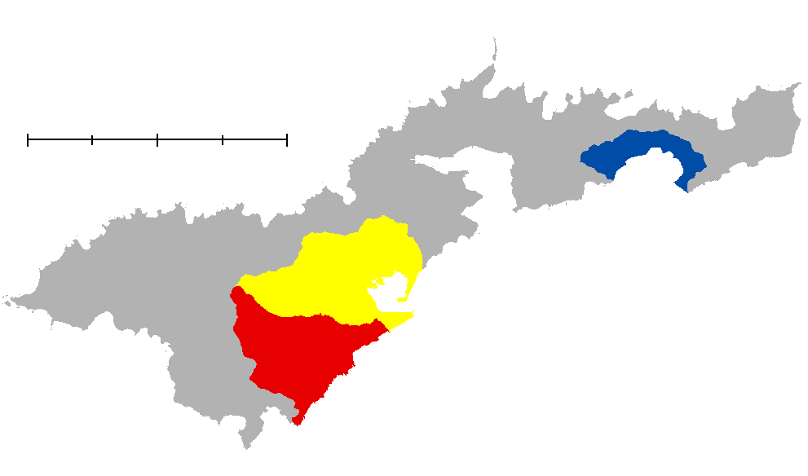
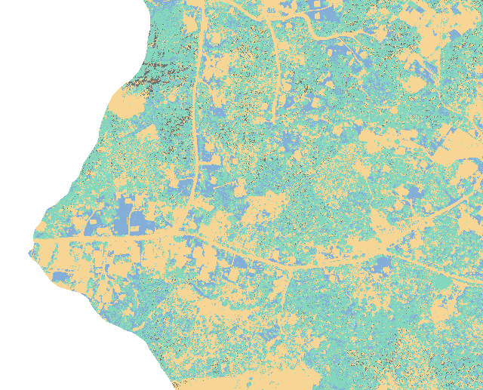
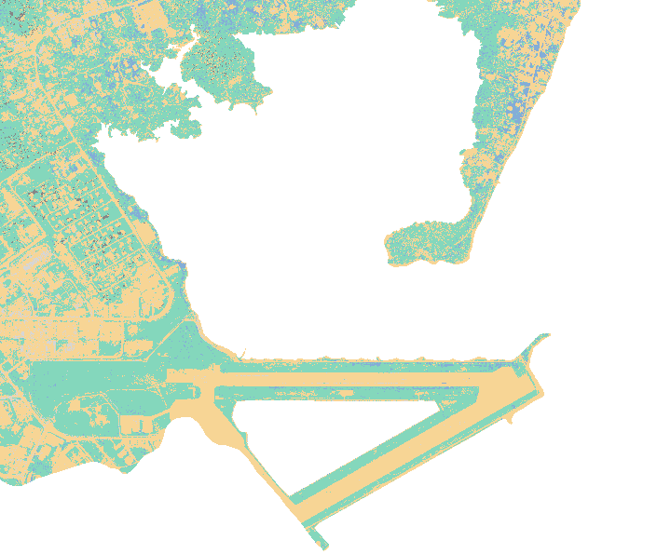
LAND CLASSIFICATION: WATERSHEDS
N
Land Cover Classes
Grass
Canopy
Faga’itua Watershed
Impervious
Shadow
0
5
10 km
Nu’uuli Pala Watershed
Tafuna
Plain
Map credit: American Samoa Water Resources Team, ESRI ArcMap 10.6
Notes:
We used the same procedure on orthoimages sourced from the USDA NRCS from 2012 and 2017. Although these images didn’t offer the same temporal resolution as Landsat 8, they did give us 0.5 m spatial resolution, which allowed us to differentiate types of cover at much smaller scales. We ran the classification for three priority watersheds: Tafuna Plain, the Nu’uuli watershed, and the slopes surrounding Faga’itua Bay. The process segmented land cover into four distinct classes, captured in the images here.
------------------------------Image Information Below ------------------------------
•Image Credit: American Samoa Water Resources Team, Summer 2019
•Image Source: US Department of Agriculture, Natural Resources Conservation Service Pacific Islands Orthoimagery 2017, processed in ESRI ArcMap 10.6

Slide 16
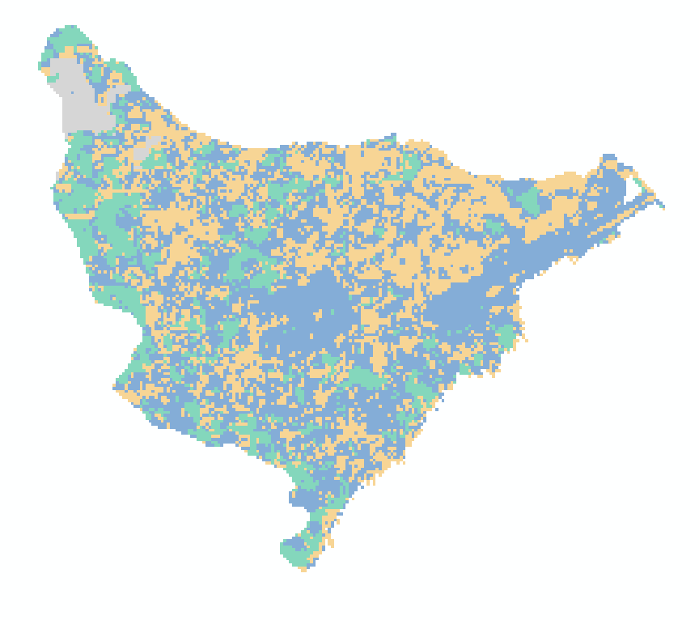
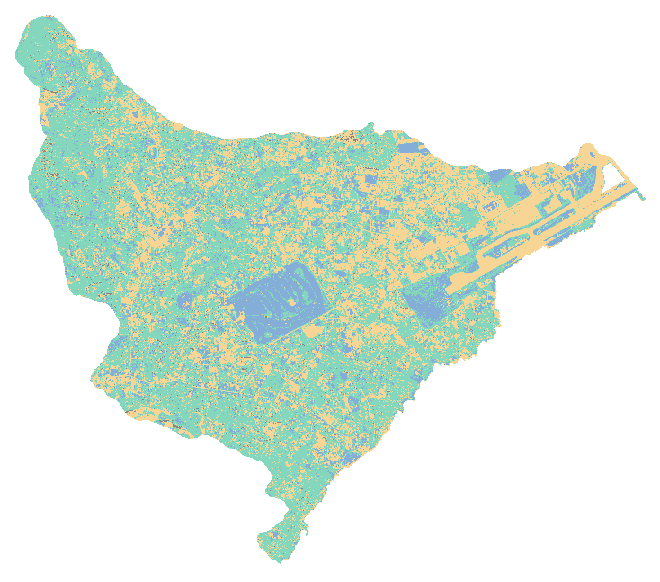

LAND CLASSIFICATION: RESOLUTIONS
Tafuna Watershed 2017
N
Landsat 8
30m
USDA NRCS Orthoimage
0.5m
Land Cover Classes
Land Cover Classes
Bare/Grass/Agriculture
Grass/Agriculture
Canopy
Canopy
Impervious
Impervious/Bare
Cloud
Shadow
0
1
2
km
Map credit: American Samoa Water Resources Team, ESRI ArcMap 10.6
Notes:
These 2017 images portray the differences in spatial resolution between the two datasets—Landsat 8 on the left, and the NRCS orthoimage on the right.
------------------------------Image Information Below ------------------------------
•Image Credit: American Samoa Water Resources Team, Summer 2019
•Image Sources:
Landsat: Landsat 8 OLI 2018, processed in Google Earth Engine and ESRI ArcMap 10.6
USDA NRCS Orthoimage: US Department of Agriculture, Natural Resources Conservation Service Pacific Islands Orthoimagery 2017, processed in ESRI ArcMap 10.6

Slide 17

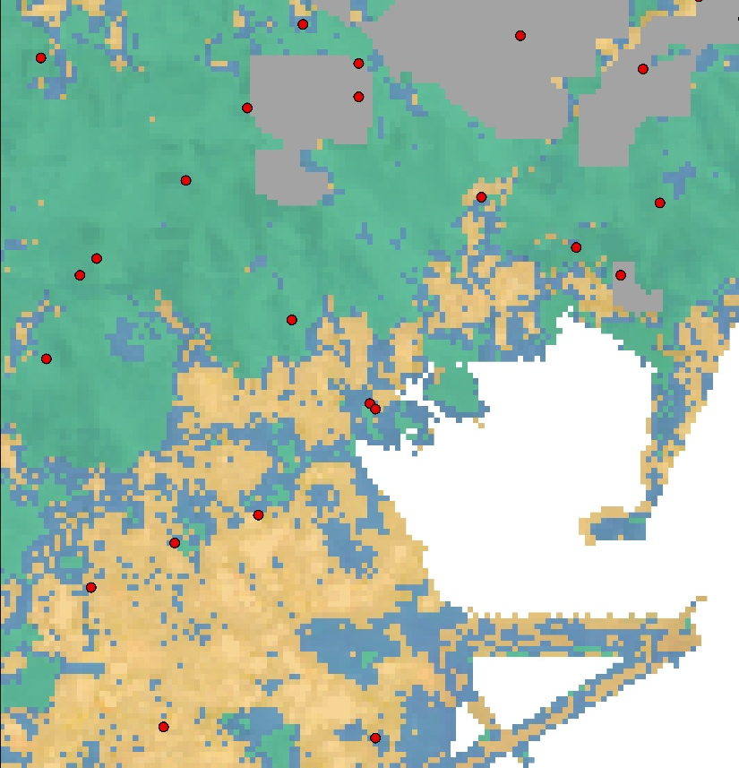
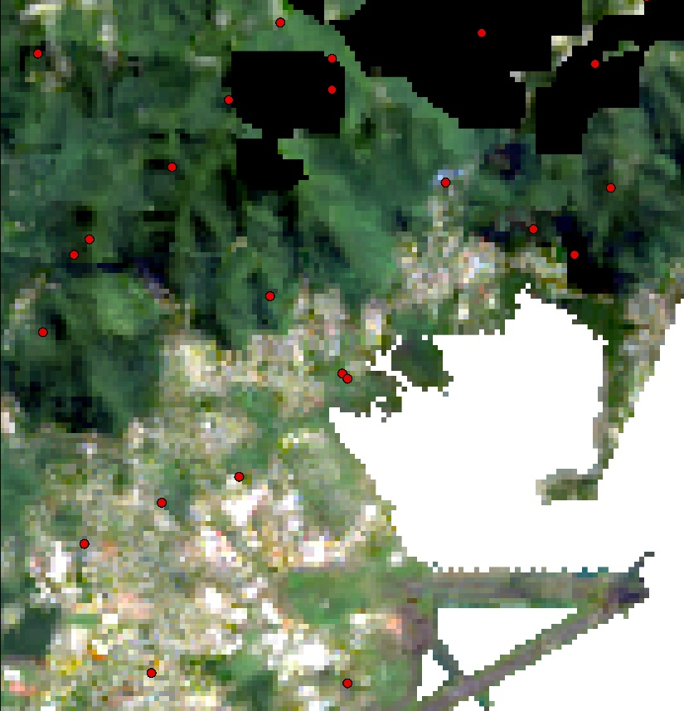
ACCURACY ASSESSMENTS
Quantifying Error
Generated 200 stratified random points per scene
Checked point classifications against original image
Calculated percent accuracy and Kappa coefficient
Reported results for each scene and overall
N
0
0.5
1 km
Image credit: American Samoa Water Resources Team, ESRI ArcMap 10.6
Notes:
After classifying the images, we conducted accuracy assessments on both island- and watershed-scale data to validate the results. In ArcMap, we generated 200 stratified random points for each classified image and compared the classification value of each point with visual interpretation of the image. We then created confusion matrices to analyze how well the classifications performed. We quantified errors of omission and commission, as well as an overall accuracy score and Kappa coefficient. Kappa is a more robust measurement of accuracy that accounts for the possibility of agreement by chance. It’s reported as an index value, ranging from 0 to 1, with 0 representing agreement equivalent to random chance and 1 representing perfect agreement.
------------------------------Image Information Below ------------------------------
•Map Credit: American Samoa Water Resources Team, Summer 2019
•Map Source: Landsat 8 OLI 2018, processed in Google Earth Engine and ESRI ArcMap 10.6

Slide 18
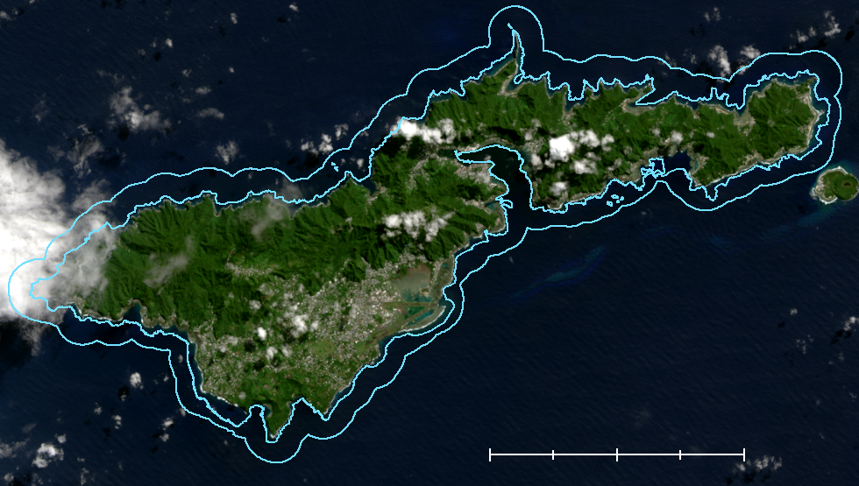

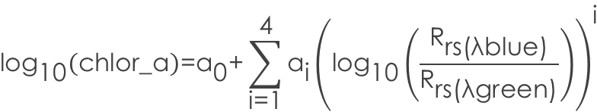

WATER QUALITY ANALYSIS
N
Chlorophyll-a Concentration (mg m⁻³)
0.00 – 0.10
0.10 – 0.20
0.20 – 0.30
0.30 – 0.40
0.40 – 0.50
O’Reilly Band Ratio Chl OC2 Algorithm
0.50 – 0.60
0.60 – 0.70
$${\text{log}}_{\text{10}}\left(\text{chlor}\text{_}\text{a}\right)\text{=}{\text{a}}_{\text{0}}\text{+}\sum_{\text{i}\text{=1}}^{\text{4}}{{\text{a}}_{\text{i}}}{\left({\text{log}}_{\text{10}}\left(\frac{{\text{R}}_{\text{rs}\text{(}\text{λblue}\text{)}}}{{\text{R}}_{\text{rs}\text{(}\text{λgreen}\text{)}}}\right)\right)}^{\text{i}}$$
0.70 – 0.80
0.80 – 0.90
O’Reilly Band Ratio Chl_OC2 algorithm
0.90 – 1.00
$${\text{log}}_{\text{10}}\left(\text{chlor}\text{_}\text{a}\right)\text{=}{\text{a}}_{\text{0}}\text{+}\sum_{\text{i}\text{=1}}^{\text{4}}{{\text{a}}_{\text{i}}}{\left({\text{log}}_{\text{10}}\left(\frac{{\text{R}}_{\text{rs}\text{(}\text{λblue}\text{)}}}{{\text{R}}_{\text{rs}\text{(}\text{λgreen}\text{)}}}\right)\right)}^{\text{i}}$$
1.00 – 2.00
0
2.5
5
10
km
2.00 – 3.00
0
5
10
km
> 3.00
Map credit: American Samoa Water Resources Team, ESRI ArcMap 10.6
Notes:
Next, for the water quality analysis, we used visible-spectrum data to determine the concentration of chlorophyll-a in the near-shore water. Chlorophyll-a is a good proxy for water quality because it measures the amount of algae growing in a waterbody, and a symptom of degraded water quality is an excess of algal biomass. Chl-a can be detected in surface reflectance data through a suite of algorithms with high fidelity to in situ observations.
To run this analysis, we went back to the original Landsat 8 data and acquired top-of-atmosphere images. And instead of using composites, which would have distorted the computations, we chose a single image for each year, i.e. the least cloudy image from each dry season. We clipped these to a region of near-shore water around Tutuila. The inner boundary of this region follows the 25m-depth contour line derived from a bathymetric model of the island. The outer boundary is a 1km buffer around the Tutuila landform. This extraction process allowed us to study the near-shore water, while excluding pixels depicting land and visible seafloor, which would have also distorted water quality readings.
We derived Chl-a concentrations from the clipped Landsat 8 scenes using the O’Reilly band ratio Chl_OC2 algorithm in Acolite and R (O’Reilly et al., 1998). We produced raster datasets depicting point observations of Chl-a concentrations for a single day each year.
------------------------------Image Information Below ------------------------------
•Image Credit: American Samoa Water Resources Team, Summer 2019
•Map Source: Landsat 8 OLI 2013, processed in ESRI ArcMap 10.6

Slide 19
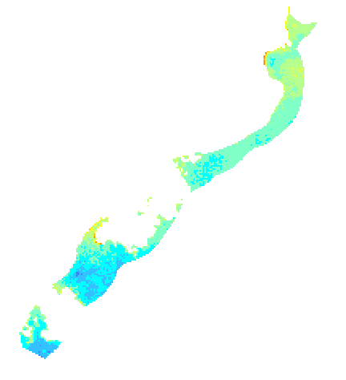
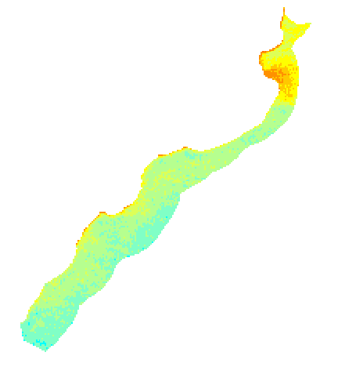
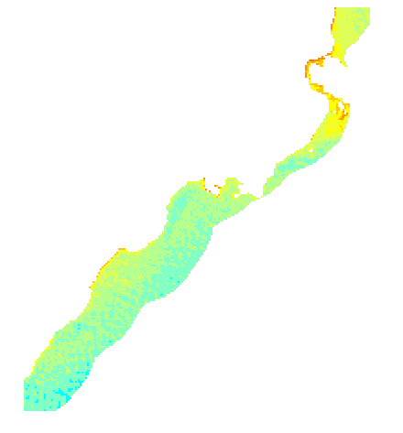
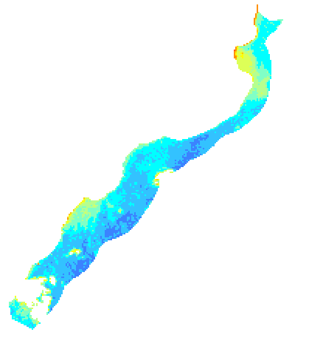
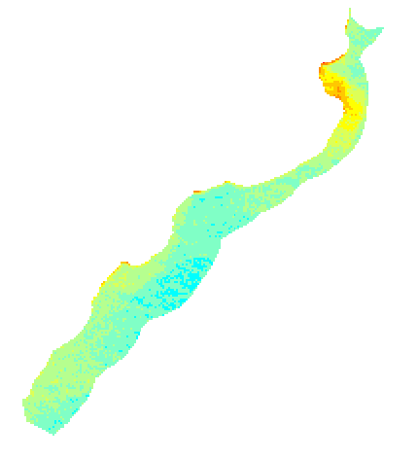
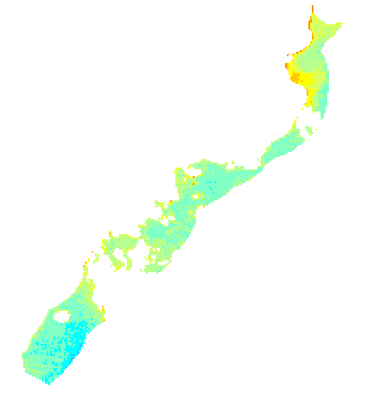
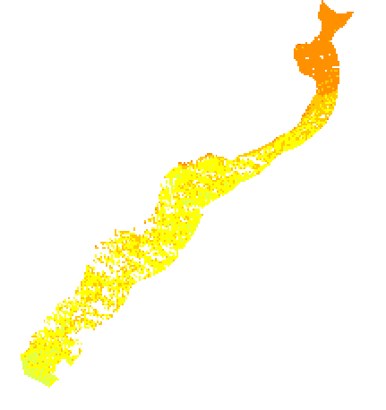

ZONAL STATISTICS
Near-shore water divided into 23 zones based on watershed boundaries
Mean chlorophyll-a concentrations calculated per zone
Mean values integrated into random forest model
Tafuna-Nu’uuli Watershed Zone
Tutuila Near-shore Zones
0
5
10
km
0
1
2
km
Notes:
Then, to facilitate statistical analysis of the drivers of water quality change, we divided near-shore water into 23 zones based on watershed boundaries, and extending out to that 1km buffer. We ran summary statistics calculations to derive mean chlorophyll-a concentrations per zone each year. We then used these results as values on the response variable in a random forest regression model
------------------------------Image Information Below ------------------------------
•Image Credit: American Samoa Water Resources Team, Summer 2019
•Image Source: Landsat 8 OLI/TIRS 2016, processed in ESRI ArcMap 10.6

Slide 20

RANDOM FOREST MODEL
Random forest modeling is a machine learning method that uses an ensemble of decision trees to fit data and perform programmed tasks, such as regression.
We employed RFM to:
  Determine whether LULCC was associated with water quality variability
  Identify factors with strongest explanatory power
The model provided partners with quantitative evidence to support coastal management interventions.
Image credit: NOAA Earth System Research Laboratory
Notes:
We wrapped up the analysis by incorporating our land classifications and water quality changes over time into a random forest regression model. By integrating 16 environmental, meteorological, and anthropogenic variables, the team aimed to identify the factors that had the most significant impact on water quality. Variable Importance values were derived for each factor and presented to our partners to inform future coastal management strategies.
------------------------------Image Information Below ------------------------------
•Image Credit: NOAA Earth System Research Laboratory
•Image Source: https://www.esrl.noaa.gov/gmd/obop/smo/triptotula.html

Slide 21
RESULTS
Notes:
So, what did we find?

Slide 22








LAND COVER: TUTUILA ISLAND
N
2013 2014 2015 2016
Mean Accuracy: 81.04 % Kappa Coefficient (0–1): 0.66
2017 2018 2019
0
5
10
km
Clouds
Canopy
Impervious
Bare/Ag
Map credit: American Samoa Water Resources Team, ESRI ArcMap 10.6
Notes:
Here you can see the land cover classifications for the island of Tutuila, produced annually with Landsat 8 imagery from 2013 to 2019. The simple percent agreement calculated from these images ranged from approximately 76 to 87 percent, with an overall average of 81 percent. The Kappa coefficients ranged from 0.52 to 0.80, with a mean of 0.66. With the Kappa coefficient, again, 0 represents agreement equivalent to random chance and 1 represents perfect agreement. 0.66 is considered a “good” level of agreement.
------------------------------Image Information Below ------------------------------
•Map Credit: American Samoa Water Resources Team, Summer 2019
•Map Source: Landsat 8 OLI 2013-2019, processed in Google Earth Engine and ESRI

Slide 23





LAND COVER: TUTUILA ISLAND
N
Change from 2013 to 2018
Percent Change (%)
Change (32.4%)
No Change (67.6%)
Clouds
0
5
10 km
Canopy Impervious Bare/Ag Clouds
Map credit: American Samoa Water Resources Team, ESRI ArcMap 10.6
Notes:
We then analyzed the change in island-scale land cover between images from 2013 and 2018. All cloudy pixels from both years were aggregated together and excluded from each image to allow for a more accurate comparison. A slight decrease in canopy and an increase in impervious surfaces were observed between 2013 and 2018, while bare/agriculture stayed relatively consistent. More change was observed in the populated regions of the island, such as in the Tafuna Plain in the southwest, while more forested areas remained largely unchanged.
------------------------------Image Information Below ------------------------------
•Map Credit: American Samoa Water Resources Team, Summer 2019
•Map Source: Landsat 8 OLI 2013-2018, processed in Google Earth Engine and ESRI ArcMap 10.6

Slide 24






LAND COVER: WATERSHEDS
N
Tafuna Plain
Faga’itua
Nu’uuli
2012
2017
0
1
2 km
Shadow
Canopy
Impervious/Bare
Grass/Agriculture
Map credit: American Samoa Water Resources Team, ESRI ArcMap 10.6
Notes:
Here are land cover classifications for the three watersheds: Tafuna Plain, Faga’itua, and Nu’uuli watershed, produced from the high-resolution NRCS orthoimages from 2012 and 2017.
------------------------------Image Information Below ------------------------------
•Map Credit: American Samoa Water Resources Team, Summer 2019
•Data Source: US Department of Agriculture, Natural Resources Conservation Service Pacific Islands Orthoimagery 2012 and 2017, processed in ESRI ArcMap 10.6

Slide 25



LAND COVER CHANGE: WATERSHEDS
Tafuna Plain
Faga’itua
Nu’uuli
N
Change
No change
0
1
2 km
Land Cover Change 2012–2017
100
80
60
40
20
0
Canopy
Canopy
Map credits: American Samoa Water Resources Team, ESRI ArcMap 10.6
Notes:
Using the same methodology as in the island scale analysis, we analyzed overall change in in land cover at the watershed scale. The orthoimagery had little to no cloud cover, but instead had shadows that we had to remove. More changes were observed in the Tafuna Plain and Nu’uuli watersheds, which are highly populated, while the Faga’itua watershed, which has a smaller population and more dense, forested areas, experienced less change. Percent cover of tree canopy appears to be increasing in every watershed; however we attribute these results to spectral variation between the orthoimages, rather than actual on-the-ground changes. There was likely some seasonal variation in spectral signatures in the images, and the mosaicking process may have introduced some noise that our classifications picked up.
------------------------------Image Information Below ------------------------------
•Map Credit: American Samoa Water Resources Team, Summer 2019
•Data Source: US Department of Agriculture, Natural Resources Conservation Service Pacific Islands Orthoimagery 2012 and 2017, processed in ESRI ArcMap 10.6

Slide 26




PATTERNS OF LAND INTENSIFICATION
PLACEHOLDER IMAGE
Areas of substantial change detected in high- resolution land classifications
Canopy-to-bare conversions indicate land intensification between 2012 and 2017
PLACEHOLDER IMAGE
PLACEHOLDER IMAGE
2012
2017
Change from 2012 to 2017
Map credit: American Samoa Water Resources Team, ESRI ArcMap 10.6
Notes:
While overall change proved difficult to detect accurately at the whole-watershed scale, the classifications did reliably detect smaller areas of change. Conversion of the canopy class to bare/impervious can be observed in the results and is an indicator of land intensification over the 5-year period. The high-resolution classifications enabled us to pick up these small structural changes in land cover, which would not have been detectable in the Landsat data.
------------------------------Image Information Below ------------------------------
•Image Credit: American Samoa Water Resources Team, Summer 2019
•Map Source: US Department of Agriculture, Natural Resources Conservation Service Pacific Islands orthoimagery 2017, processed in ESRI ArcMap 10.6

Slide 27


WATER QUALITY TRENDS
N
PLACEHOLDER IMAGE
Chlorophyll-a Concentration (mg m⁻³)
2013
0.00 – 0.10
0.10 – 0.20
0.20 – 0.30
0.30 – 0.40
PLACEHOLDER IMAGE
0.40 – 0.50
0.50 – 0.60
0.60 – 0.70
0.70 – 0.80
0.80 – 0.90
0.90 – 1.00
2019
1.00 – 2.00
2.00 – 3.00
> 3.00
0
5
10
km
Map credit: American Samoa Water Resources Team, ESRI ArcMap 10.6
Notes:
Now, to the water quality side of the equation. Overall, chlorophyll-a concentrations in near-shore water ranged from 0.0 to more than 3.0 mg per cubic meter, with an IQR between 0.10 and 0.50. These observations are slightly higher than, but generally on par with in situ observations reported in the US EPA’s National Coastal Condition Assessment monitoring in 2010. Weighted mean chl-a values computed across the sampling area ranged from 0.41 mg per cubic meter (2017) to 0.84 mg per cubic meter (2019).
Inter-annual observations revealed a slightly increasing trend. However, the reliability of this inference is limited by the temporal resolution; with only seven annual observations taken in five different months, it is not clear that the trend accurately portrays in-water variance. Chlorophyll concentrations may in fact vary on a weekly or monthly basis within the range of mean values reported.
------------------------------Image Information Below ------------------------------
•Image Credit: American Samoa Water Resources Team, Summer 2019
•Map Source: Landsat 8 OLI 2016, processed in ESRI ArcMap 10.6

Slide 28
RANDOM FOREST MODEL
Random forest regression explained 45.75% of the variance in Chl-a readings over time
Variable importance and partial dependence were calculated for 16 explanatory variables
Limited data and available imagery demand circumspection
5 Strongest Explanatory Variables
Chlorophyll-a
Daily Max Wind (m/s)
Daily Average Temp. (°C)
Daily Average Wind (m/s)
% Bare/Ag Land Cover
Daily Max Temp. (°C)
Notes:
Finally, we turn to the random forest regression model. Our model explained 45.75% of the variance in water quality readings around Tutuila over the study period. Of the 16 potential explanatory variables integrated into the model, the five most powerful are reported here. Daily maximum wind speed appears to contribute the strongest percent increase in RMSE. One of the variables derived from the Landsat LULCC analysis shows up in the top five, accounting for an 11.5% increase in RMSE. (You can think of % increase in RMSE as a measure of the explanatory power that would be lost if a given variable were removed from the model).
However, the sparse availability of Landsat 8 imagery limited the reliability of the model, so the results should be considered with careful interpretation. Machine learning functions better with more data, so more regular observations over a longer period, as well as validation with in situ data, would strengthen the reliability of the model and its outputs.

Slide 29
CONCLUSIONS
Notes:
From these results, we’ve come away with five conclusions.

Slide 30
CONCLUSIONS
Although Earth-observing satellites can monitor LULCC, current instruments have limited capacity to detect change at island scale
By masking and compositing Landsat 8 images across a season, cloud cover can be removed to facilitate analysis of surface reflectance data
Island-scale classifications indicated a net change in land cover from canopy to impervious surfaces
Chlorophyll-a concentrations showed an increasing trend, although the inference is limited by the low frequency of observations
The analysis offers a reproducible method that can be used to monitor LULCC and water quality, given more frequent observations
Notes:
While current Earth-observing satellites are effective for monitoring land use and land cover changes, current instruments are limited in their capacity to detect significant change on an island as small as Tutuila. Next, by masking and compositing the Landsat 8 surface reflectance images using multiple images across a season, nearly cloud-free composites for each year can be created to facilitate land classification and change mapping. Third, the island-scale classifications depicted an overall net change from tree canopy to impervious surfaces across the island. On the water quality side, chlorophyll-a concentrations trended higher over seven years, although the inference is limited by the low frequency of observations. And finally, despite limitations, the analysis presents a reproducible method that can be used to monitor LULCC and water quality in American Samoa in the future.

Slide 31

ERRORS AND UNCERTAINTIES
Land classifications were done with composite imagery to maximize visible land cover, at the expense of temporal consistency
High resolution mosaics contained spectral variation and seasonal nuances that compromised the feasibility of land classification and LULCC detection
Water quality readings taken by Landsat 8 OLI were derived from the O’Reilly Chl OC2 Band Ratio algorithm, which has not been locally calibrated
Insufficient frequency of observations for random forest modeling
Clouds over Nu’uuli Watershed 2012
Image credit: American Samoa Water Resources Team, ESRI ArcMap 10.6
Notes:
Given these conclusions, let’s talk about errors and uncertainties. Although the applications of the outputs can be immediately useful, there are some uncertainties to be mindful of when interpreting the results:
The persistent clouds characteristic of the island required a trade-off between spatial coverage and temporal consistency, and we prioritized spatial coverage. The land classifications were therefore conducted on composited images that maximized visible land cover. This yielded temporal inconsistencies, which are especially evident in areas of patchy cloud cover found in the orthoimagery.
High-resolution orthoimages contained spectral variation that impacted the feasibility of classifying land cover and discerning LULCC.
Water quality readings were derived from the O’Reilly Chl OC2 Band Ratio algorithm. Though this is an accepted method for calculating Chl-a concentrations, the algorithm has not been tested with site-specific measurements around Tutuila. Ideally, the algorithm’s coefficients would be calibrated to the study site.
Because random forest models require temporal consistency across variables, our regression was limited by our lowest-frequency variable, in this case, annual Chl-a observations.
------------------------------Image Information Below ------------------------------
•Image Credit: : American Samoa Water Resources Team, Summer 2019
•Map Source: US Department of Agriculture, Natural Resources Conservation Service Pacific Islands Orthoimagery 2012, processed in ESRI ArcMap 10.6

Slide 32


FUTURE WORK
Incorporate alternative Earth observations into the analysis
Validate remotely sensed observations with in situ measurements
Test alternative classification methods to improve accuracy
Sentinel-2 MSI (ESA)
ER-2 (NASA)
Image credits: DEVELOPedia, NASA
Notes:
In future, we suggest expanding the scope of the study in the following ways to overcome some of the limitations we encountered:
Incorporating additional Earth observations and sensors into the study to increase temporal resolution and observable spectral information
For instance, incorporating Sentinel-2 MSI, from the ESA’s Copernicus mission would be a valuable supplement to NASA’s Landsat 8
Regular aerial image capture could overcome challenges presented by persistent cloud cover
And the using LiDAR AND ANOTHER SENSORs could capture changes in biomass and spectral differences in canopy cover for more granular analysis
As in any remote sensing study, in situ measurements could be used to monitor the efficacy of Earth observation sensors.
Finally, while we tested four alternative methods for land classification, none yielded higher accuracy rates than the supervised classification method we settled on. Future work could assay spectral-band and object-based methods to improve classification accuracy.
------------------------------Image Information Below ------------------------------
•Image Credits
Sentinel-2: DEVELOPedia
ER-2: NASA
Image Sources
Sentinel-2: http://www.devpedia.developexchange.com/dp/index.php?title=List_of_Satellite_Pictures, provided by DEVELOPedia.
ER-2: https://www.nasa.gov/centers/dryden/multimedia/imagegallery/ER-2/EC99-45225-1.html

Slide 33
Va’amua Henry Sesepasara, US Coral Reef Task Force, Watershed Partnership Initiative
Fa’asalafa Diana Kitiona, American Samoa Department of Marine and Wildlife Resources, Coral Reef Advisory Group
Alice Lawrence, American Samoa Department of Marine and Wildlife Resources, Coral Reef Advisory Group
Sabrina Woofter, American Samoa Department of Marine and Wildlife Resources
Katie Nalesere, American Samoa Department of Marine and Wildlife Resources
Dr. Juan Torres-Pérez, Bay Area Environmental Research Institute, NASA Ames Research Center
Dr. John Olson, California State University Monterey Bay
Tomoko Acoba, Joint Institute for Marine and Atmospheric Research, NOAA and the School of Ocean and Earth Science and Technology, University of Hawai’i at Manoa
Dr. Kenton Ross, DEVELOP National Program, NASA Langley Research Center
Tony Kimmet, US Department of Agriculture, Natural Resources Conservation Service, National Geospatial Center of Excellence
Fa’amao Asalele, American Samoa Environmental Protection Agency
Antonina Teo, American Samoa Environmental Protection Agency
Dr. Christopher Shuler, University of Hawai'i at Manoa
Megs Seeley, DEVELOP Geoinformatics Fellow, NASA DEVELOP National Program Tempe Node
Farnaz Bayat, DEVELOP Center Lead, NASA Ames Research Center
Jerrold Acdan, DEVELOP Project Coordination Fellow, NASA Ames Research Center
Notes:
And last but not least, here’s the long list of people the American Samoa Water Resources Team would like to thank.

