Slide 1
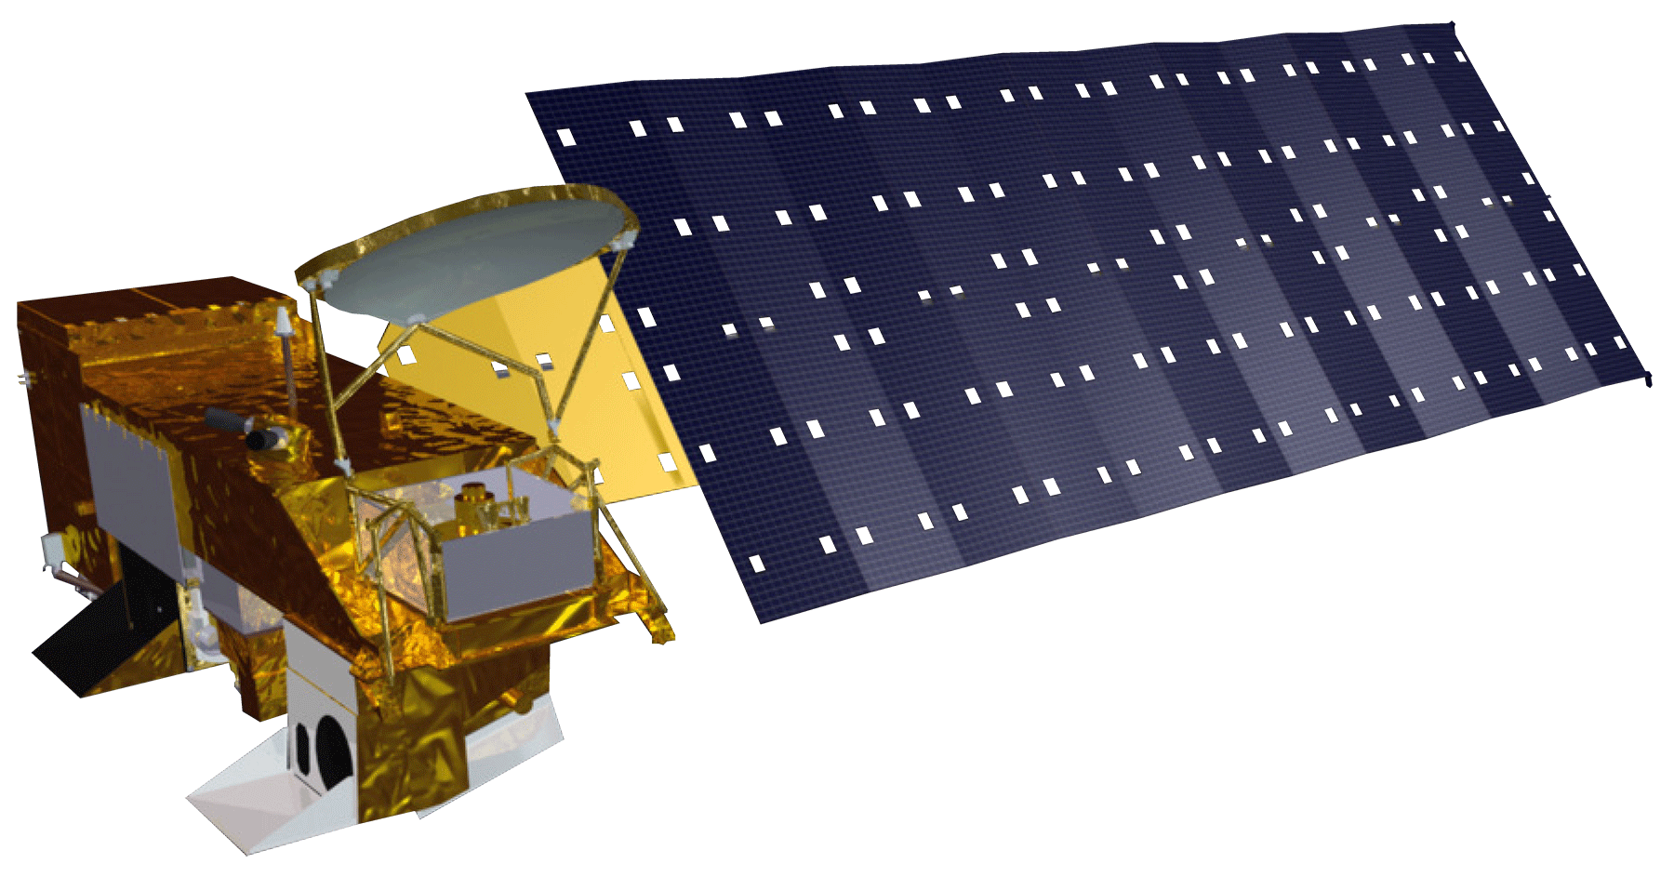
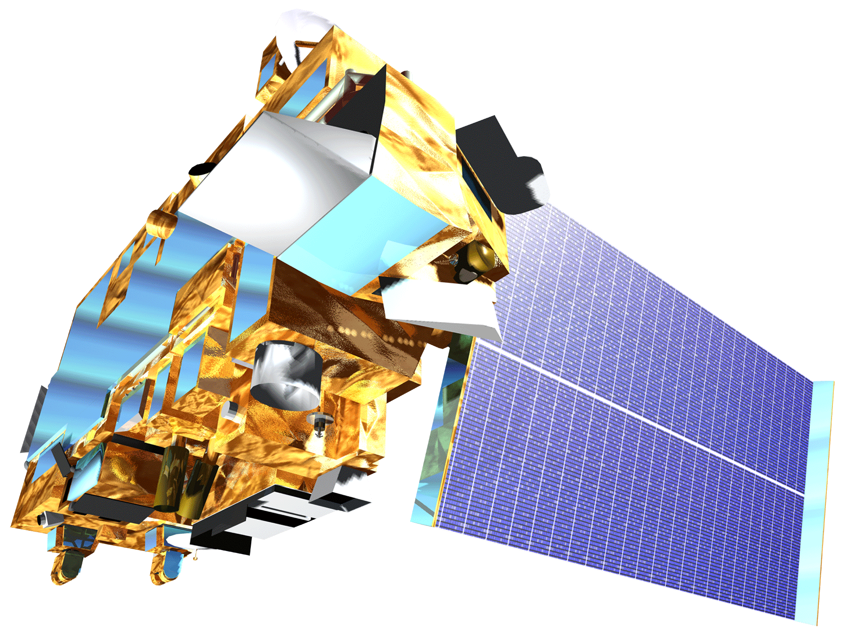
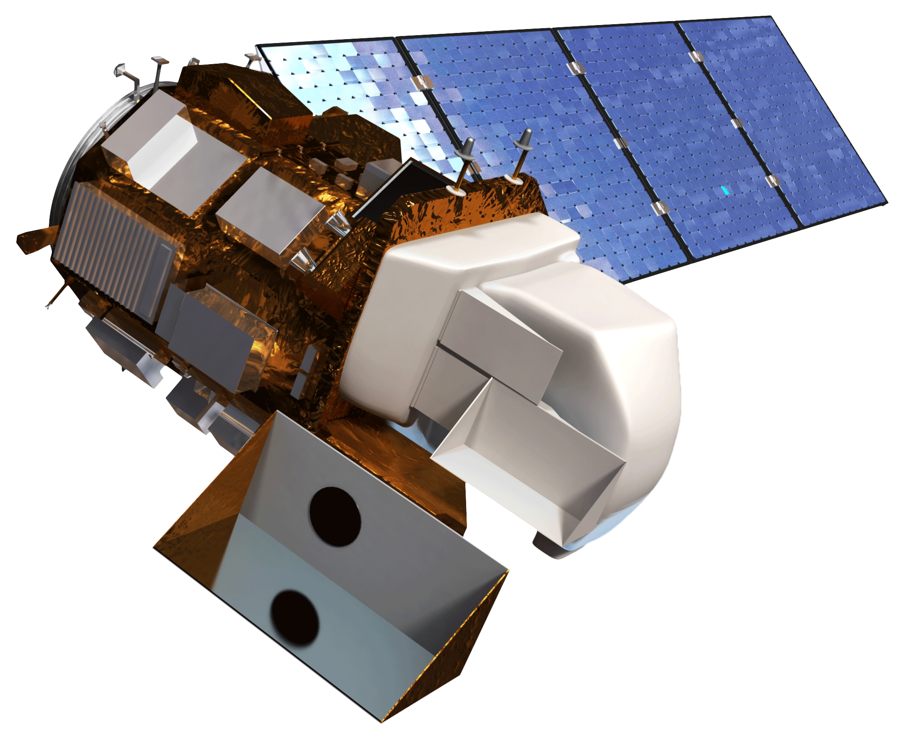
Arizona Health & Air Quality II
Enhancing Extreme Heat Intervention and Preparedness Activities in Maricopa, Co. Arizona with NASA Earth Observations
Daniel Finnell (Project Lead), Teresa Fenn, Ashley Brodie, Richard Muench
DEVELOP National Program at NASA Langley Research Center
Study Area Temporary map, Will be made editable
Objectives
Abstract
Keep this blank for now.
Body text point size should be at least 24.
Caption text point size should be at least 16.
Feel free to rename, move, and resize sections as needed.
Automate the creation of heat vulnerability maps in Maricopa County, AZ
Create a tool to monitor heat severity
Connect to OPeNDAP for access to near real-time data
Maricopa Co., Arizona
Methodology
Data Sources
Data Products
Processing
Earth Observations
Mesowest & Synoptic Labs
Weather Station:
Daily High, Daily Low, Pressure, Humidity
Python Scripts from Term 1
Earthdata Search manual data collection
Aqua MODIS:
Land SurfTemperatureace
Compiling and automation of scripts
Aqua MODIS
Terra ASTER
Survey Results; CASPER
Terra ASTER:
Elevation
Connection to OPeNDAP servers
Landsat 8 OLI:
Land Surface Temperature
Landsat 8 OLI
Results
Conclusions
Use images.
Make sure that it has some sort of flow, that it makes sense. Show your results in a logical order.
No bullets.
Use bullets.
Use complete sentences with periods.
Team Members
Project Partners
Acknowledgements
Daniel Finnell (Project lead), Teresa Fenn, Ashley Brodie, Richard Muench
Arizona Department of Health Services (ADHS)
Phoenix Heat Relief Network
National Weather Service Phoenix Forecast Office
Environmental Remote Sensing and Informatics Lab (ERSL) at Arizona State University
Center for Policy Informatics (CPI) at Arizona State University
We would like to thank the NASA DEVELOP Arizona Health & Air Quality Term 1 team: Amy Stuyvesant, Geordi Alm, Rocky Garcia, Emma Baghel, April Rascon, Bernardo Gracia.
We would also like to thank Brian and Matt Tisdale from the ASDC for assisting us with OPeNDAP.
NASA Langley Research Center

