Slide 1
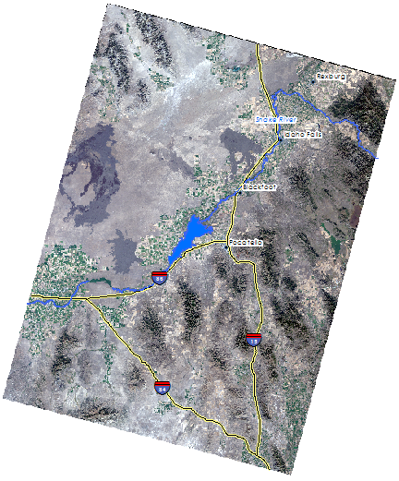
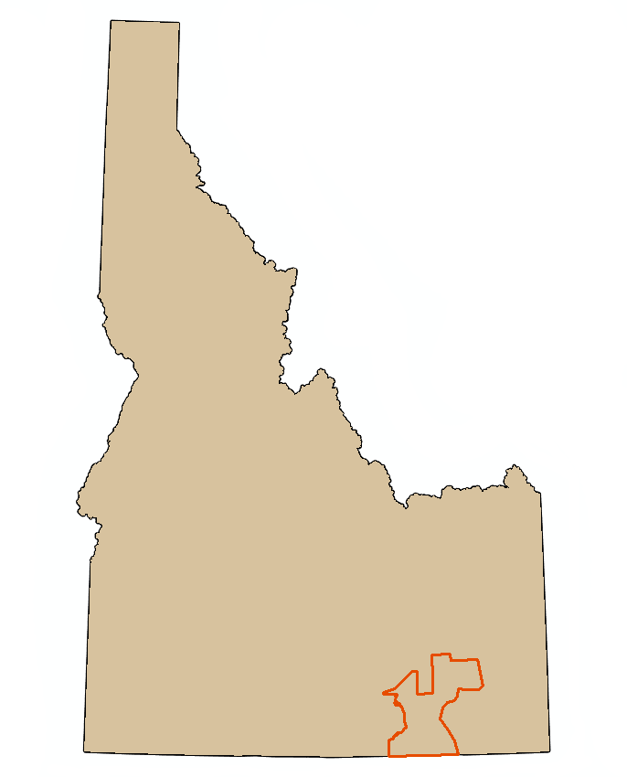
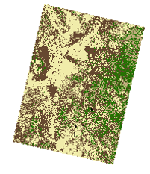
Southeast Idaho Disasters
Juniper Encroachment and Management in the Western U.S Relative to Catastrophic Wildfires
Zachary Simpson (Project Lead), Jenna Williams, Sara Ramos
Keith Weber (Science Advisor)
Abstract
Objectives
Keep this blank for now.
Body text point size should be at least 24.
Caption text point size should be at least 16.
Feel free to rename, move, and resize sections as needed.
Juniper Distribution Map
Wildfire Risk Assessment Map for the Wildland Urban Interface (WUI) based on juniper density.
Study Area
Southeast Idaho
Landsat WRS-2 Path 39 Row 30
Landsat WRS-2 Path 39 Row 31
Methodology
2013 NAIP
Landsat 8
2015 Juniper Density map
2010 Census Data
2014 RSAC
Point Classification
Landsat 7
2009 Juniper Density map
WUI Risk Map
This project analyzed four classes of land cover: bare ground, juniper mix, mixed forest and sagebrush/herbaceous. Points were digitized using 2013 NAIP (National Agriculture Imagery Program) imagery and correlated with 2014 Caribou-Targhee National Forest mid-level vegetation data from the US Forest Service Remote Sensing Application Center RSAC to correctly identify species type. The data consisted of 1,111 classification sites in total: 201 bare ground, 224 juniper mix, 433 mixed forest, and 253 sagebrush/ herbaceous.
Landsat 7 and Landsat 8 (path 39 row 30 and path 39 row 30) images for September in 2015 and 2009 were mosaicked together and corrected for atmospheric effects using the Cos(t) model. Calculations to derive surface reflectance from multispectral bands were computed using the IDRISI TerrSet Landsat archive import module.
Combining Landsat imagery and the land cover classes a classification tree (CT) analysis of these data was preformed. Classification tree was used because it is a non- parametric data driven analysis allowing for the development of a decision tree training and model validation of this data set (Miller & Franklin, 2002). These sites were randomly divided up into a 60% training sites that were used to build the model and 40% test sites that were used to assess the accuracy of the model.
Census data from 2010 was used to identify housing units in combination with the 2015 juniper distribution map a wildfire risk map was created to show areas that are at a greater risk to wildfire outbreak.
Earth Observations
Results
Landsat 8 Operational Land Imager (OLI)
Artist’s illustration of Landsat 5. Credit: USGS
This image show the preliminary results form a Classification
Tree Analysis. The map produced displays four
land cover classes. It highlights areas with high
concentrations of Juniperus spp.
Conclusions
Use bullets.
Use complete sentences with periods.
Land Cover
Agriculture/Grasslands
Sagebrush
Juniper
Bare Ground
Team Members
Project Partners
Acknowledgements
Bureau of Land Management
Idaho Department of Lands
Idaho Fish and Game
Forest Service
NASA RECOVER
Keith Weber (ISU), Mark Carroll (GSFC), John Schnase (GSFC), Mike Kuyper (BLM), Chris Burger (BLM), Chris Colt (FS), Evan DeHamer (IFG), Scott Bergen (IFG), Ryan Howerton (ISU),
Zachary Simpson
Sara Ramos
Jenna Williams
Pocatello, Idaho

