Slide 1
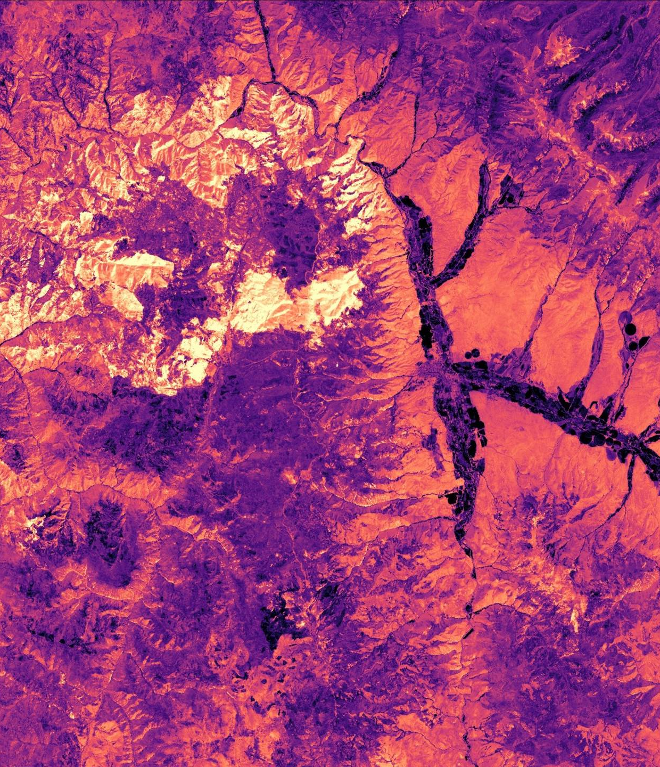

Website Image
Summer 2023
Project Short Title
DEVELOP Node Name (ex: Virginia – Langley)
ANNIVERSARY

Slide 2
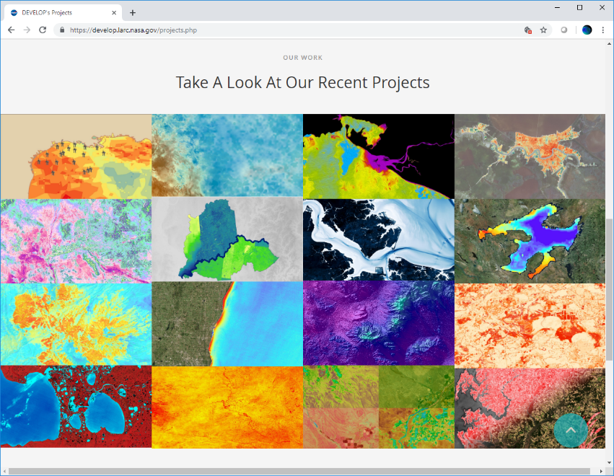
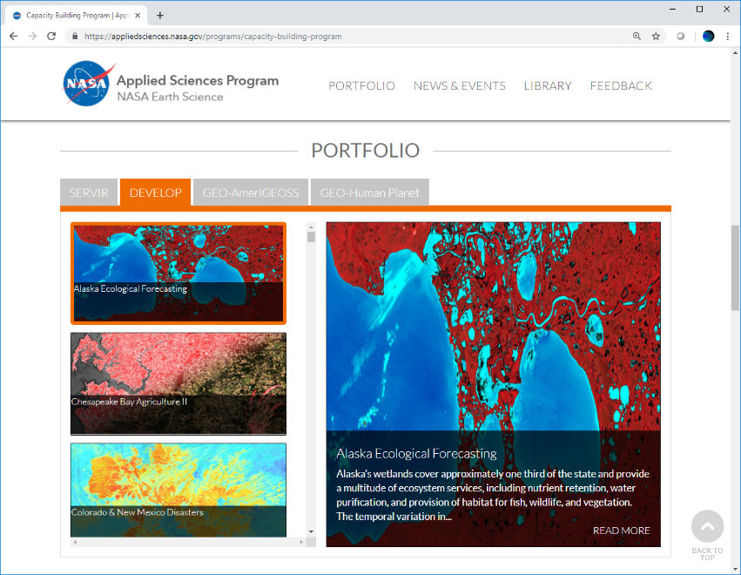
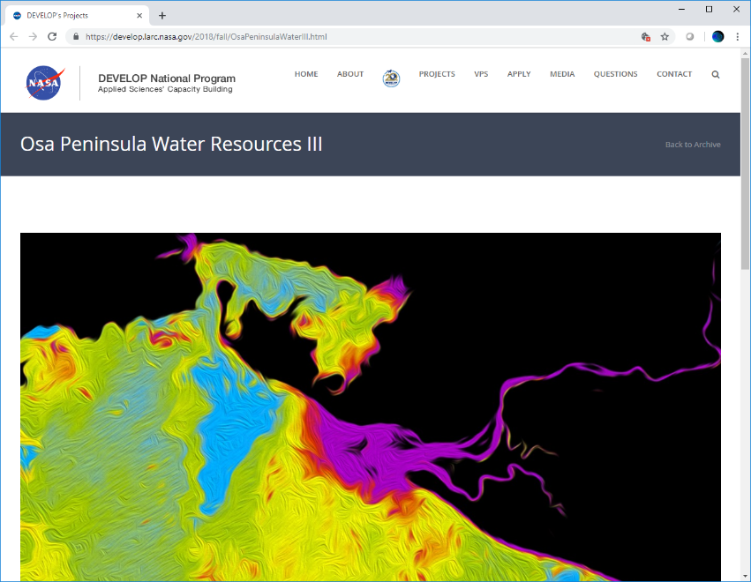
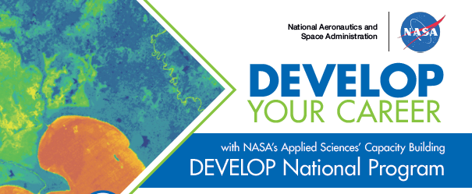
Delete this slide before submission.
Web Image: Purpose and Overview
This should be an attractive, processed image of your study area that will represent the project and be used for:
Your close-out presentation
The project page on the DEVELOP website
Content on NASA’s Applied Sciences website
DEVELOP promotional materials
Future publications
Website Image Bracket Competition

Slide 3
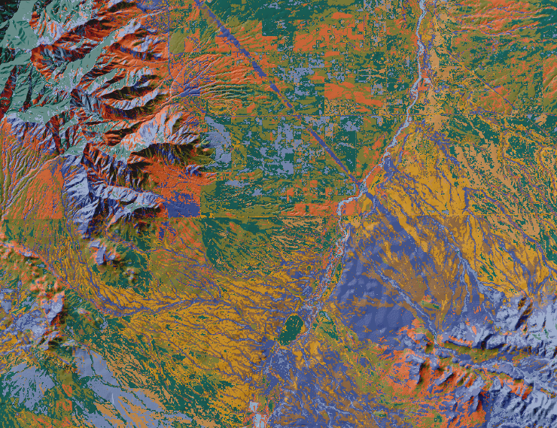
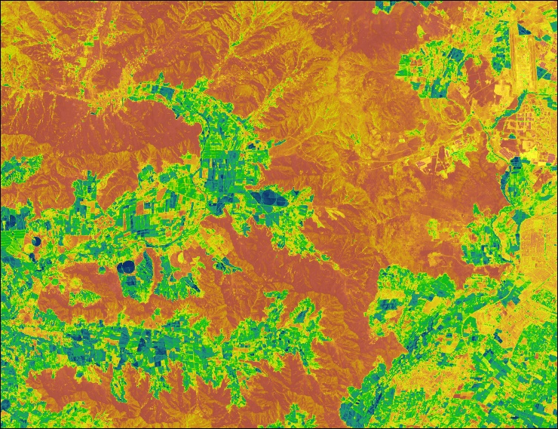
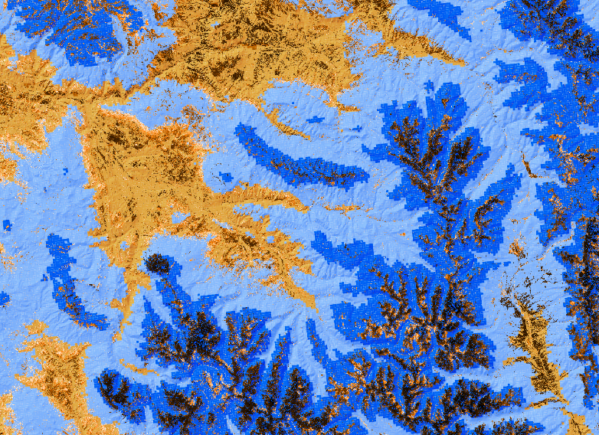
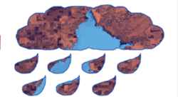
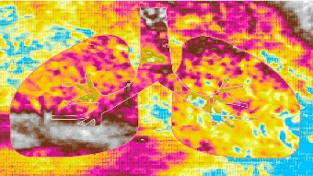
Delete this slide before submission.
Web Image: Requirements
High-resolution: 1920 x 1440 (300+ dpi), landscape orientation
  Specify the resolution when you export from your GIS software
  Otherwise, you can use an online resizer like this one → http://resizeimage.net/
Saved as a JPEG or PNG
At least one image provided is derived from recent data (2022 to 2023)
The entire frame is filled with imagery, meaning absolutely NO blank space
Cannot be clipped to a shape and there should be no large, clip art style overlays

Slide 4
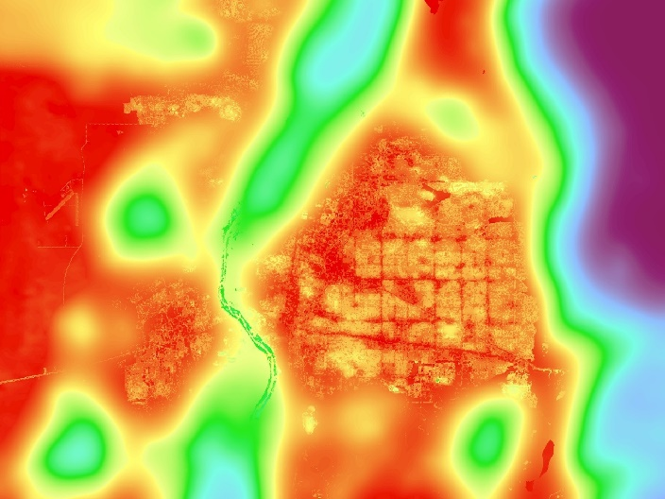
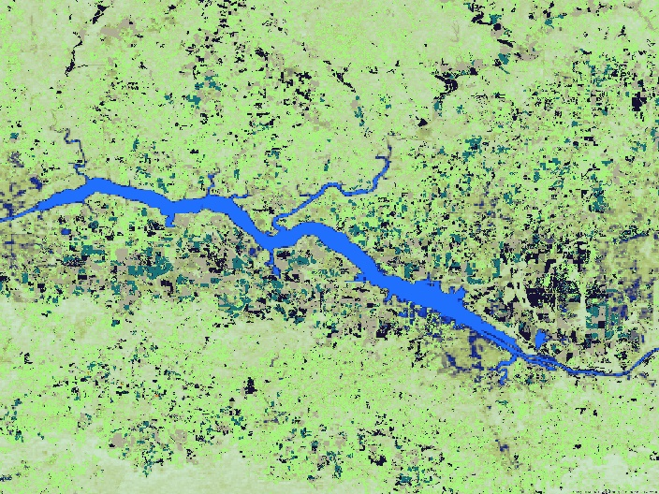
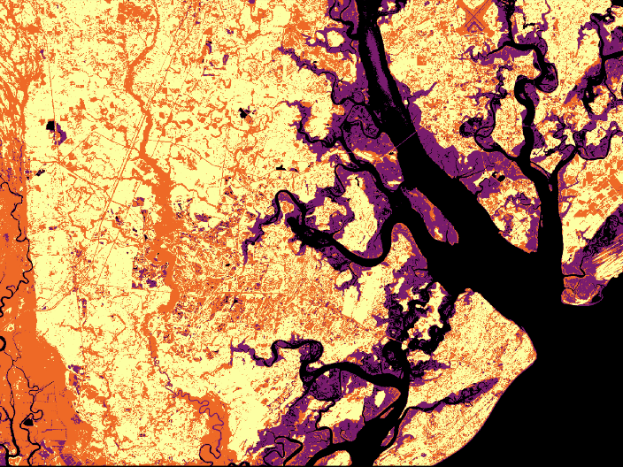
Delete this slide before submission.
Web Image: Requirements
Image is derived from NASA sensor data
  Not from an outside source
  Not a photograph of the team or a landscape
  Why? DEVELOP is a NASA-funded program that is focused on highlighting NASA data applications.
  Exception: NC projects can use CDR data if necessary
Some kind of processing has taken place
  The team actually created the image
  Not just a raw satellite image or simple re-order of spectral bands (e.g., a false color composite)
Including non-NASA data along with NASA data in the creation of your image is fine, but you can’t include a map or diagram someone else made.

Slide 5
Delete this slide before submission.
Web Image: Captions
Questions to answer:
What satellite & sensor do the data come from?
What is/are the date(s) of data?
What is the data showing? (e.g., precipitation, turbidity, land cover, etc.)
Where is the image?
What is the general interpretation and/or analysis of the processed data?
What does the color scale represent?
Not so great captions:
“Las Cruces Heat”
“CERES data overlaid on a solar site development suitability map.”
“Segmented tree canopies colorized by heights, showing stem density within the study area.”
“Slope raster embedded with bison image.”

Slide 6
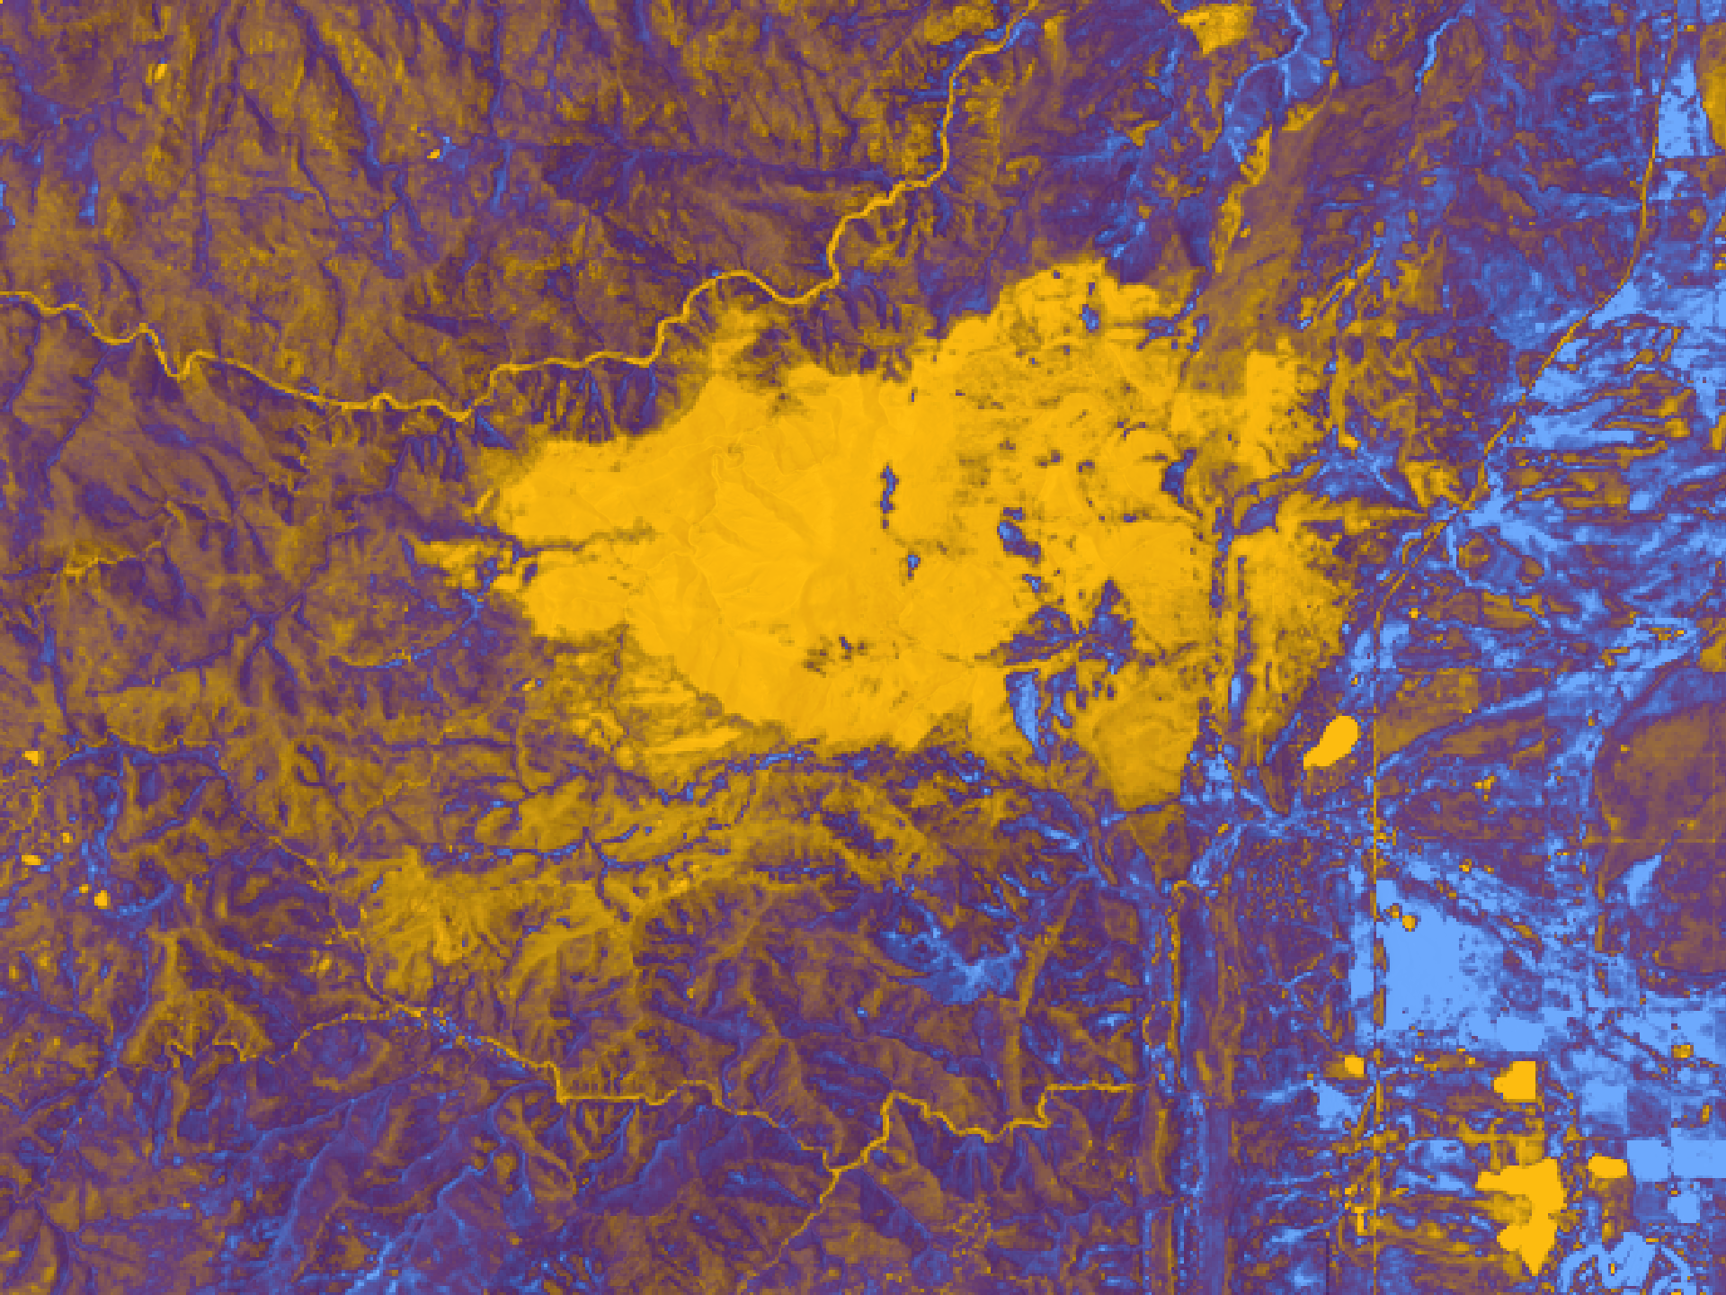
EXAMPLE
1
Boulder County Disasters
Caption: Tasseled cap greenness calculated from a May 2021 Landsat 8 OLI image. The concentrated orange area depicts the 2020 Cal-Wood fire burn perimeter in Boulder County, Colorado. Bright orange represents negative greenness values and light blue represent positive greenness values. Tasseled cap calculations helped to model forest carbon and inform land managers on fuel treatment impacts on carbon storage.
Metadata Tags: Landsat 8 OLI, Tasseled Cap Greenness, Sarah Hettema, Jennifer Rogers, Ibuki Sugiura, Erin Twaddell

Slide 7
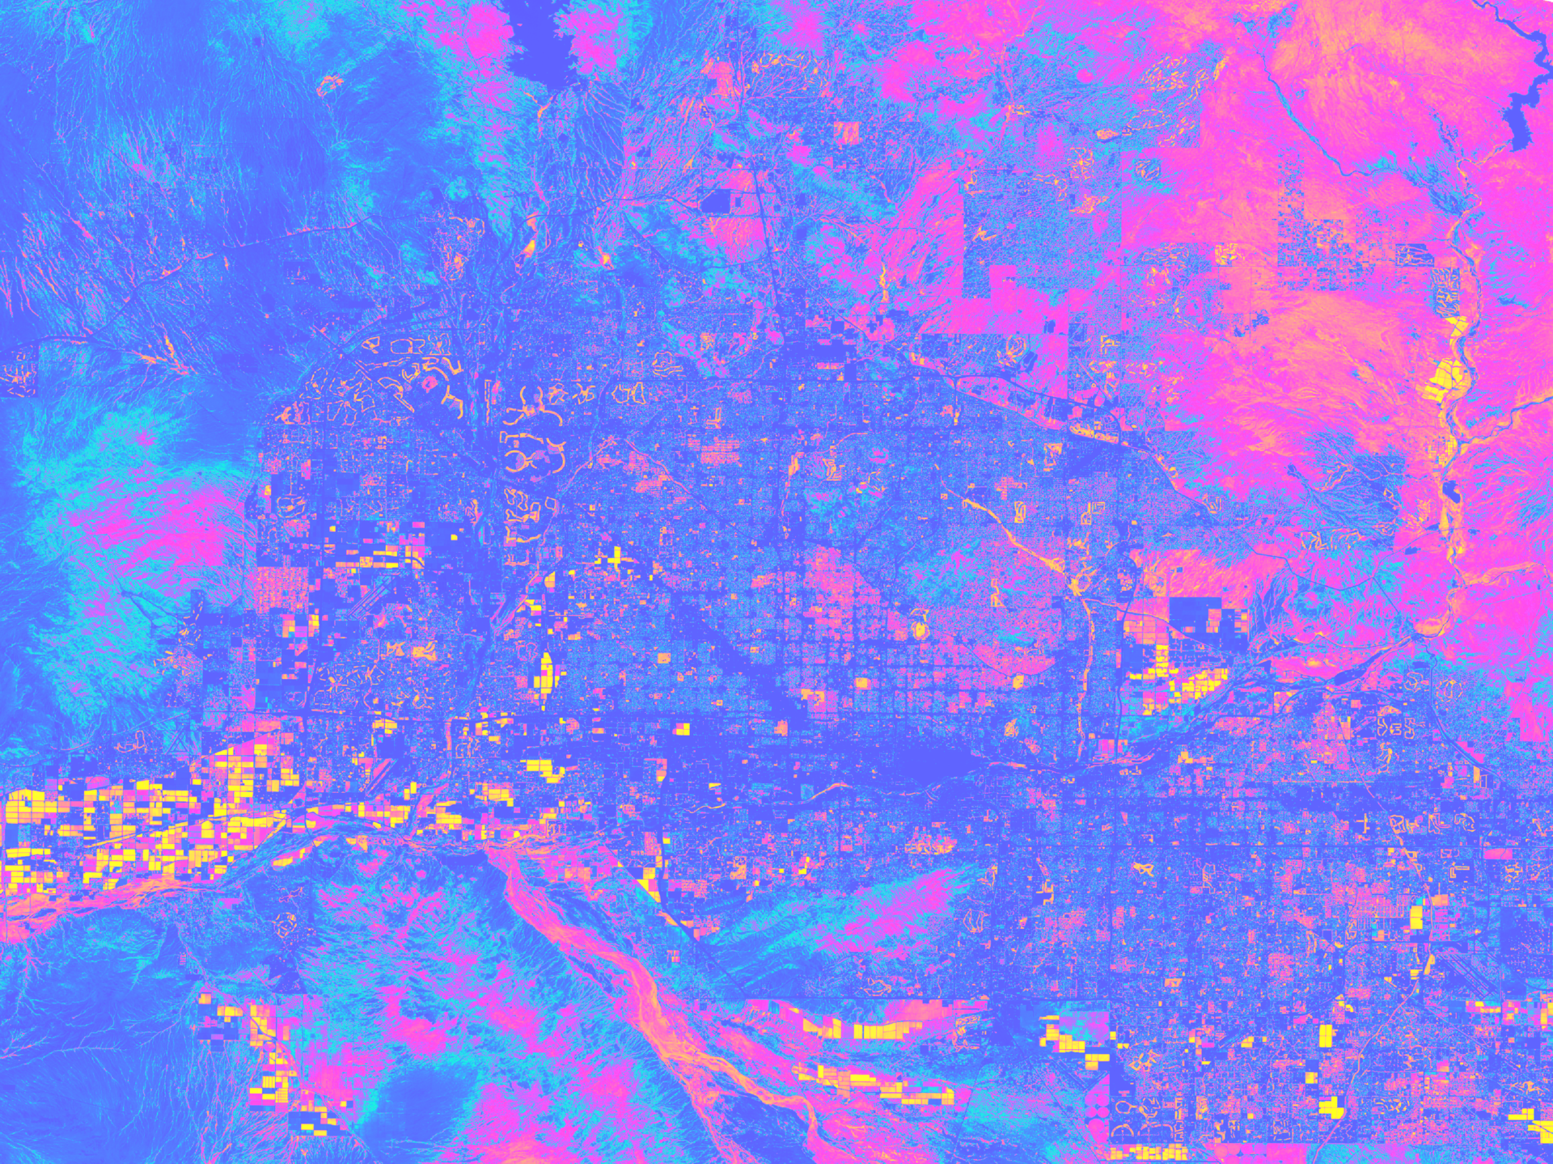
EXAMPLE
2
Phoenix Climate
Caption: NDVI-processed imagery from Landsat 8 OLI data. This composite image of Central Phoenix and surrounding cities was taken over the Summer of 2021. Shades of lighter blue, pink, and yellow indicate vegetated land surface, while darker blue areas show the built landscape and desert environment. Areas of low NDVI are more prone to high temperatures and are therefore of interest for the City of Phoenix’s residential tree planting program.
Metadata Tags: Ben Schafermeyer, Alison Bautista, Haley Stuckmeyer, Gloria Liu, Phoenix, urban heat, NDVI

Slide 8
EXAMPLE
2a
Duplicate:
Image with Label
Duplicate:
Image with Label
Phoenix Climate
Note the project short title label!
For each website image you submit, you must also include a duplicate that has a project short title label. This version of your website image will be used for the Website Image Bracket Challenge during the final weeks of the term on DEVELOP's Twitter and Facebook!
Add the exact text box shape from this slide to your duplicate image (Century Gothic, 18pt, Black Lighter 25%)
Do not adjust the height (0.42")
Adjust the width to fit your short title on one line
Ensure it is aligned to the bottom right corner and ordered to the front of your image

Slide 9
Delete this box and place image here.
1920 x 1440 (300+ dpi)
In the case you’d like to submit more than one image, duplicate this slide.
Please also include the raw image file (.png or .jpg) along with your submission.
Drop the raw image and your PowerPoint file in the Website Image subfolder of the Deliverable Submission folder.
Project Short Title Here
Caption: Make sure to include the NASA satellite(s)/sensor(s) and the date from which the image is derived. You should also include what the image is (EX: NDVI) and how it can be used for decision making. The caption needs to answer all the questions found on slide 5 of this template. 75 word limit.
Metadata Tags: List any keywords or project participant names that you would like to be included in the photo’s metadata.

Slide 10
Delete this box and place image here.
1920 x 1440 (300+ dpi)
In the case you’d like to submit more than one image, duplicate this slide.
Please also include the raw image file (.png or .jpg) along with your submission.
Drop the raw image and your PowerPoint file in the Website Image subfolder of the Deliverable Submission folder.
Duplicate:
Image with Label
Phoenix Climate
Note the project short title label!
Add the exact text box shape from this slide to your duplicate image (Century Gothic, 18pt, Black Lighter 25%)
Do not adjust the height (0.42")
Adjust the width to fit your short title on one line
Ensure it is aligned to the bottom right corner and ordered to the front of your image

