Slide 1
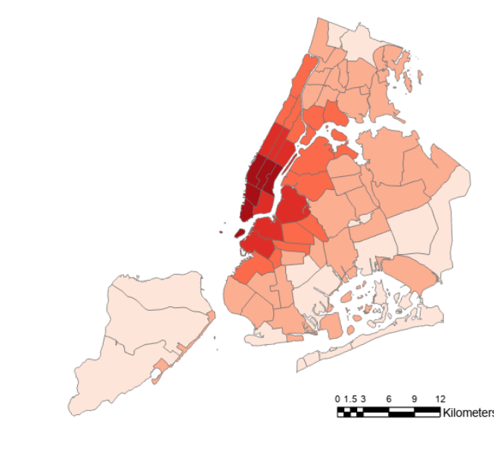
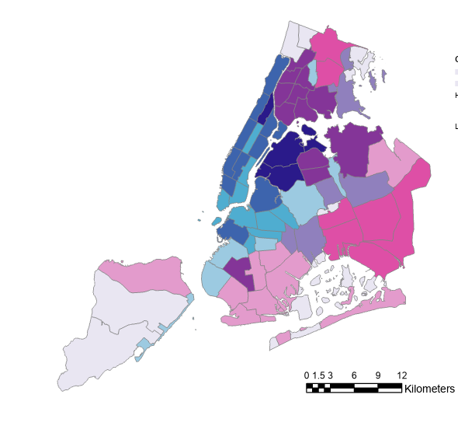
New York City Transportation & Infrastructure
Assessing Urban Heat Island Effects at Bus Stops in New York City to Support Cooling Interventions
What is the Urban Heat Island Effect?
Heat & Environmental Injustice
Urban areas experience hotter land surface temperatures than forested, natural areas due to the solar radiation absorbing capacity of building materials, such as asphalt and concrete.
Due to redlining and disinvestment, communities of color are disproportionately impacted by heat.
Extreme heat exposure can lead to dangerous health effects, and systemic barriers and discrimination make avoiding or recovering from heat exposure difficult.
Public transit riders experience additional heat exposure when traveling to and waiting for buses.
Daytime Urban Heat Island Factor
Bus riders in NYC are predominately lower income, elderly, and/or people of color and experience the environmental burden disproportionately.
By comparing land surface temperatures to nearby
rural areas during NYC’s hottest months, we can
see which areas experienced hotter
temperatures during our study
period of 2017 to 2022.
Transportation Alternatives will support communities where bus riders are especially vulnerable to heat through community engagement and advocating for cooling interventions, such as bus shelters and street trees.
This area experiences more urban heat island effect
This area experiences less urban heat island effect
Satellite imagery allows us to visualize where urban heat is experienced most severely, using observations from:
Hotter than rural reference
Cooler than rural reference
Landsat 8 TIRS
Landsat 9 TIRS-2
ISS ECOSTRESS
Potential Vulnerability Index for Bus Riders to Urban Heat
Bivariate Map of Vulnerability and LST
This map is at the community district scale. Darker reds indicate more vulnerable populations, while lighter reds represent less vulnerable populations.
UHI Factor
-1.93 - -0.87
Vulnerability
-0.86 - 0.09
0.10 - 1.21
This legend of this bivariate choropleth has the vulnerability index on the X-axis and UHI factor on the Y-axis The dark purple areas represent high urban heat and high vulnerability, and the light purple areas represent low heat and low vulnerability.
1.22 - 2.71
2.72 - 5.07
0
3
6
9
12
Kilometers
Transportation Alternatives will incorporate these results into Spatial Equity NYC, their geospatial data dashboard, helping to inform political advocacy and organizing.
Team Members
Acknowledgements
Special thanks to our:
Project Partners:
Philip Miatkowski, Transportation Alternatives
Em Friedenberg, Transportation Alternatives
Fellow:
Julianne Liu
Science Advisors:
Dr. Kenton Ross, NASA Langley
Lauren Childs-Gleason, NASA Langley
Dr. Medhi Heris, Hunter College
Thomas Schindelman
(Project Lead)
Emily Culling
Gianna Méndez Germán
Janna Chapman
Virtual Environmental Justice

