Slide 1
Arizona Health & Air Quality II
Enhancing Extreme Heat Intervention and Prevention Activities in Maricopa County Arizona
Dan Finnell (Project Lead)
Teresa Fenn
Richard Muench
Ashley Brodie

Slide 2
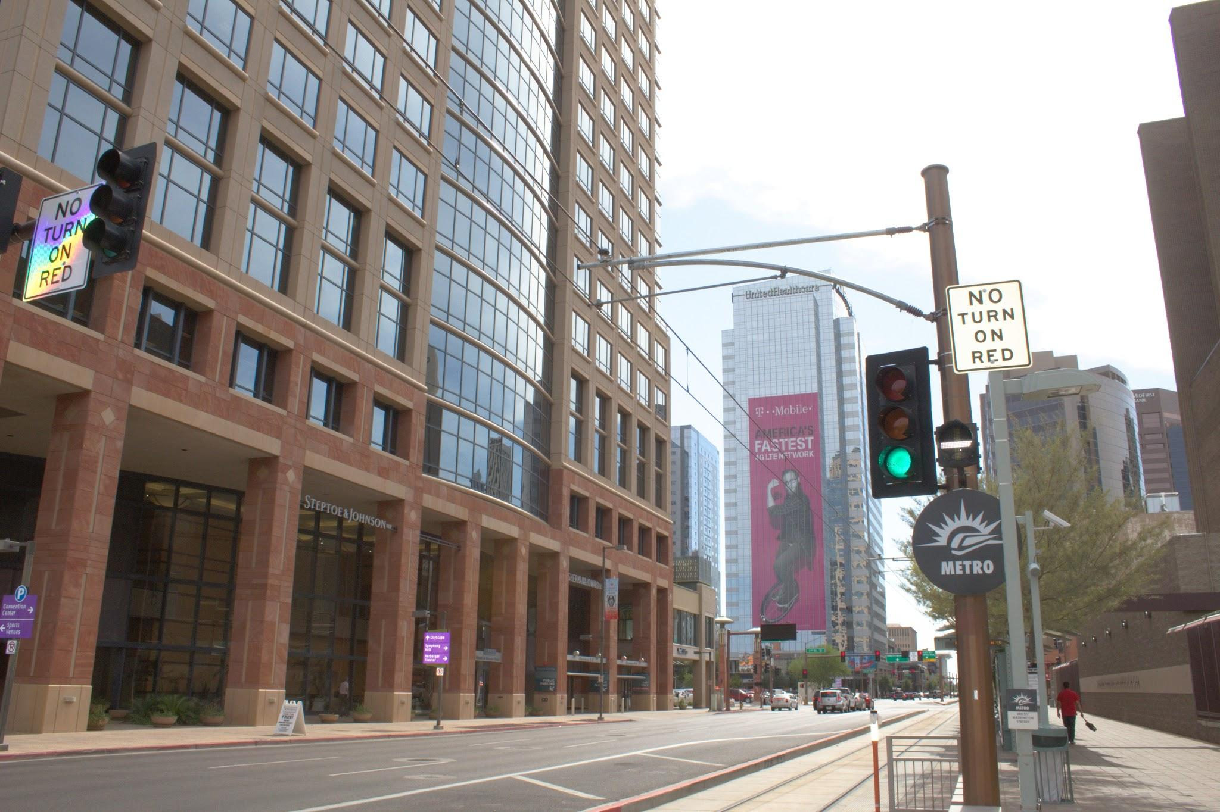
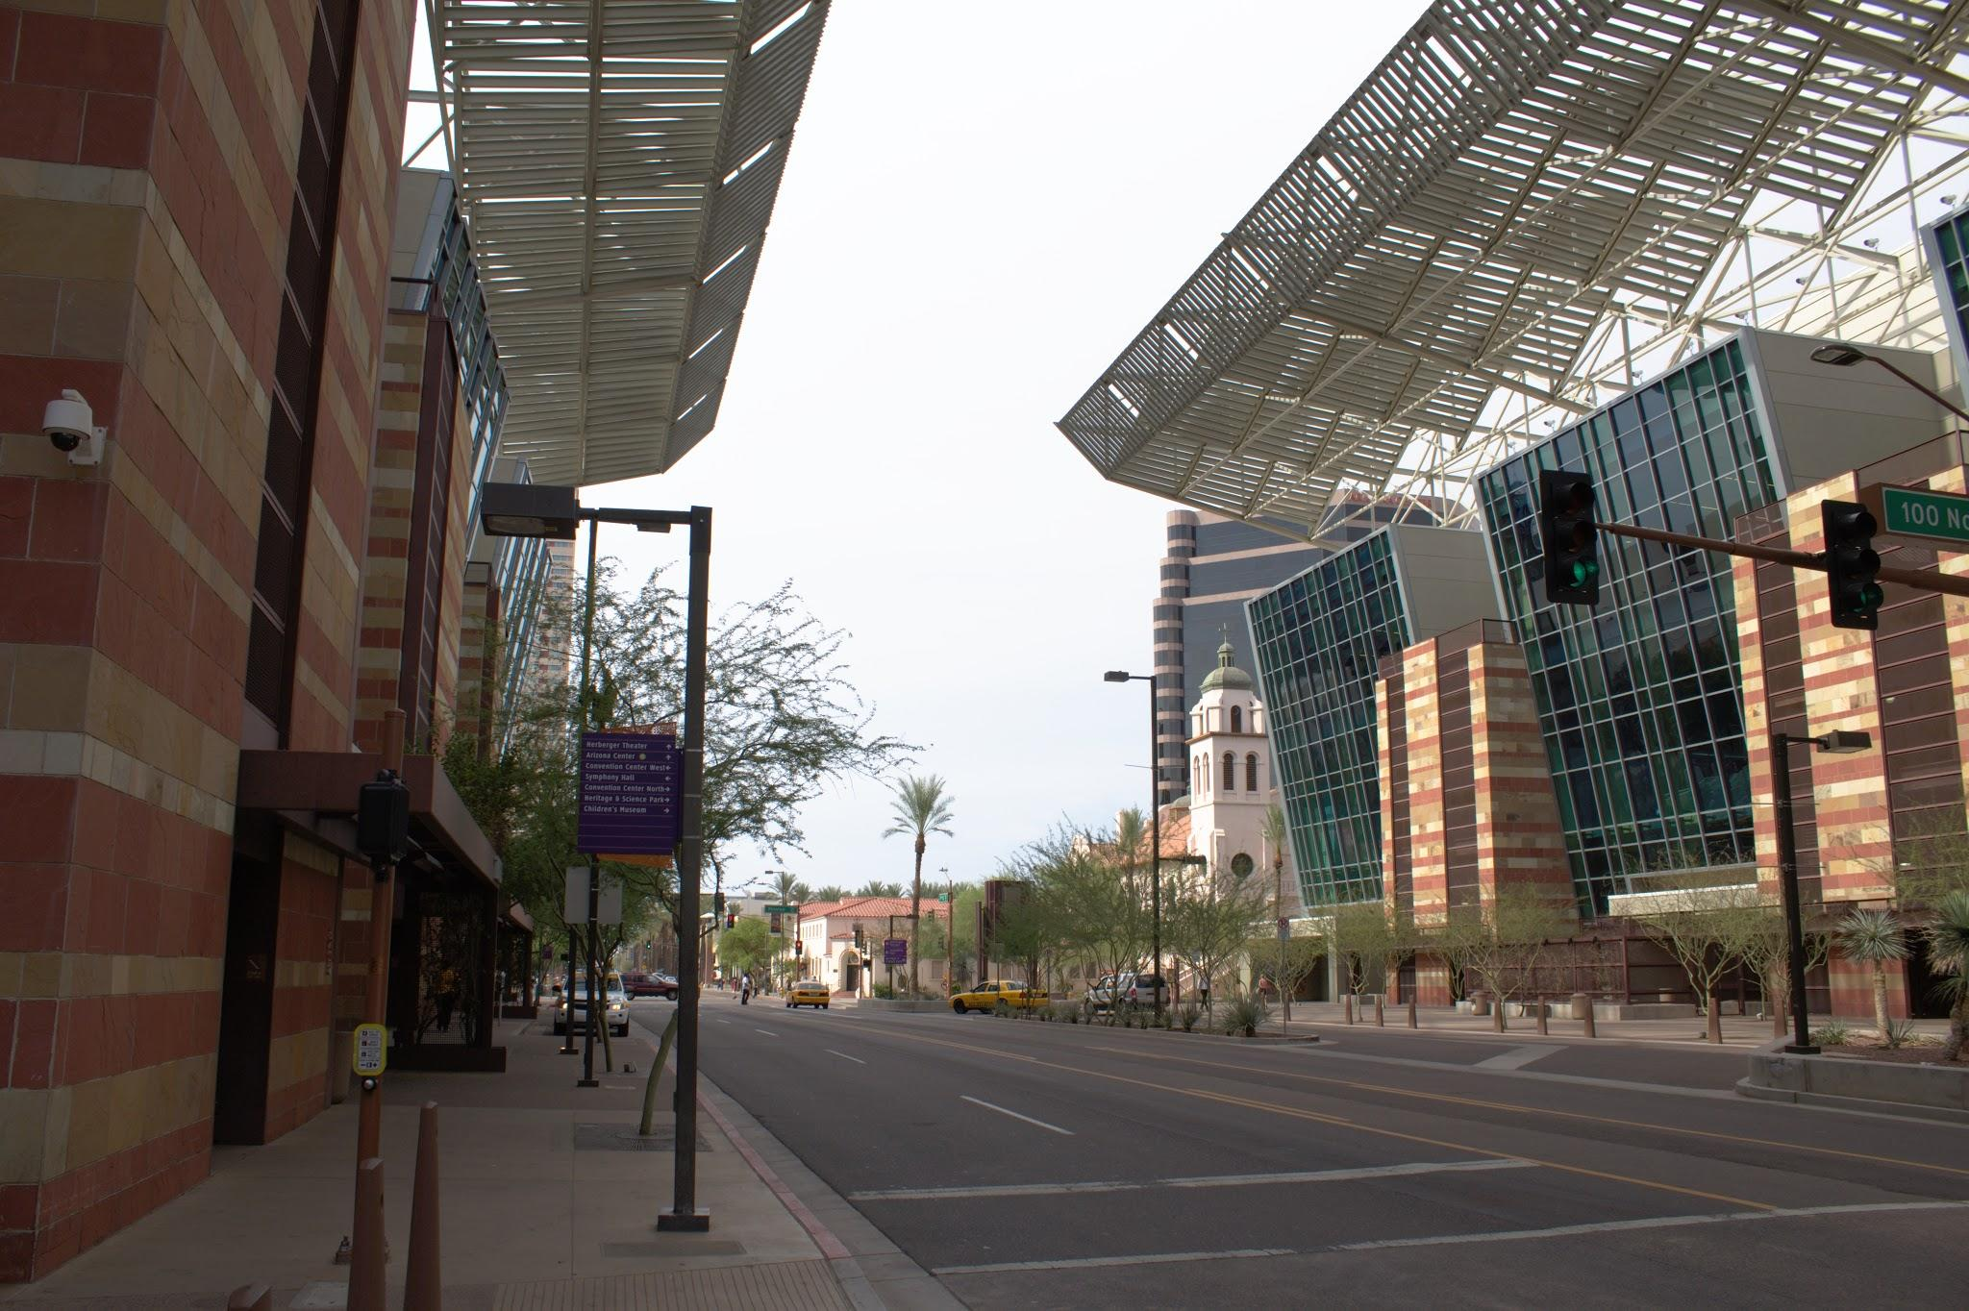
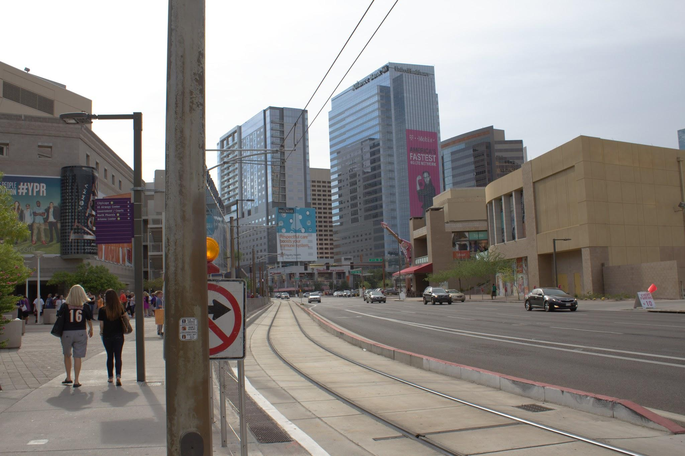
Study Area
Maricopa Co, AZ
Image Credit: Geordi Alm

Slide 3
Background
Periods of extreme heat in excess of 104°F
Suburban and Urban growth
Urban Heat Island (UHI)
Vulnerable populations include males, elderly, poor, homeless, socially isolated, and minorities
Image Credit: Dgustafson
Image Credit: Monet
Notes:
Image Credit: https://en.wikipedia.org/wiki/Sunnyslope_Mountain#/media/File:PhoenixDowntown.jpg

Slide 4
Objectives
Automation of a Python based decision support tool
Assist Maricopa Co. residents stay safe and cool during the intense summer heat
Gain near real-time access to imagery via OPeNDAP
Image Credit: Geordi Alm
Image Credit: Monet

Slide 5
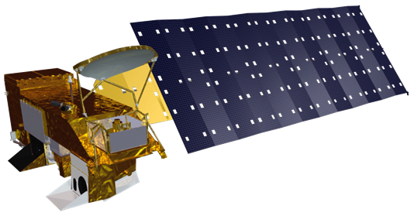
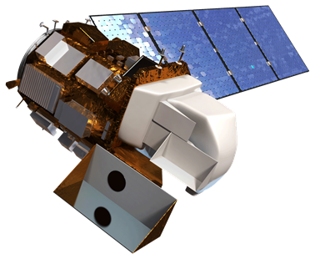
Earth Observations
Aqua Modis
Landsat8/OLI
Satellite Data
Python/R
Subset
Geodatabase
End-User Manipulation
Methods
Notes:
These notes should be thorough enough for someone not familiar with the project to clearly present the material.
Image Source: http://commons.wikimedia.org/wiki/File:Claude_Monet_-_The_Magpie_-_Google_Art_Project.jpg

Slide 6
Maps & Logos
Maps
Import the legend separately.
Make sure all text is legible and editable.
Cite base layer source in speaker notes.
Notes:
Image credit: http://fox41blogs.typepad.com/.a/6a0148c78b79ee970c019affb87142970d-500wi

Slide 7
Photos & Figures I
You may only use images taken by your team, provided by your partners (as long as you have permission from them), from a Federal Agency, from the new DEVELOP stock imagery collection on DEVELOP’s Flickr page, or Creative Commons images.
Obtain a media release form from all people in photos that your team has taken — no children!
All image sources should be cited using a consistent format and should be visible on the slide.

Slide 8
Photos & Figures II
Please do not include the image URL in the source text box but rather place it in the notes section below.
If you use a border for your images include it on all photographs to keep your presentation consistent.
Keep all images and text boxes editable, including individual elements of flowcharts.
Background images are discouraged. If you use one, make sure that your text remains clear and legible.

Slide 9
Advisors
Kate Goodin (Maricopa County Department of Public Health)
Dave Hondula (Arizona State University)
Dr. Kenton Ross (NASA DEVELOP National Program)
Lance Watkins (Arizona State University)
Partners
Arizona Department of Health Services (ADHS)
Phoenix Heat Relief Network
National Weather Service Phoenix Forecast Office
Center for Policy Informatics (CPI) at Arizona State University
Others

