Slide 1
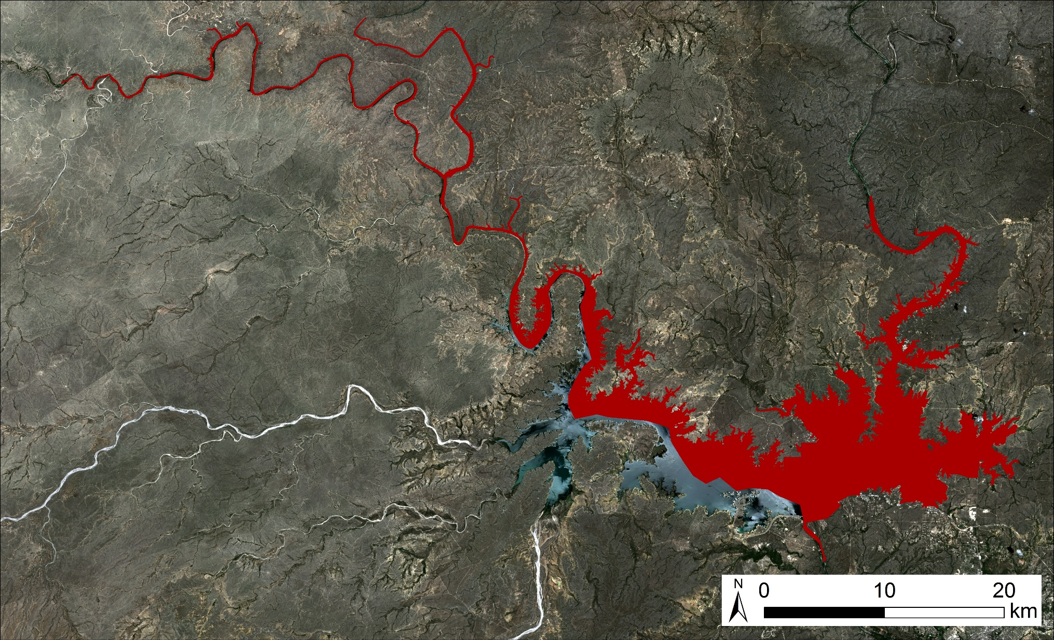
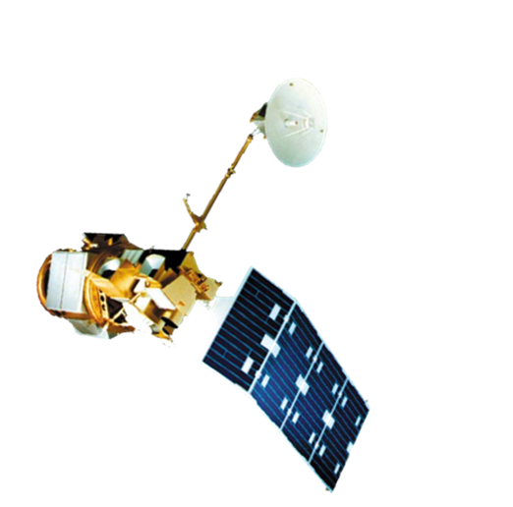
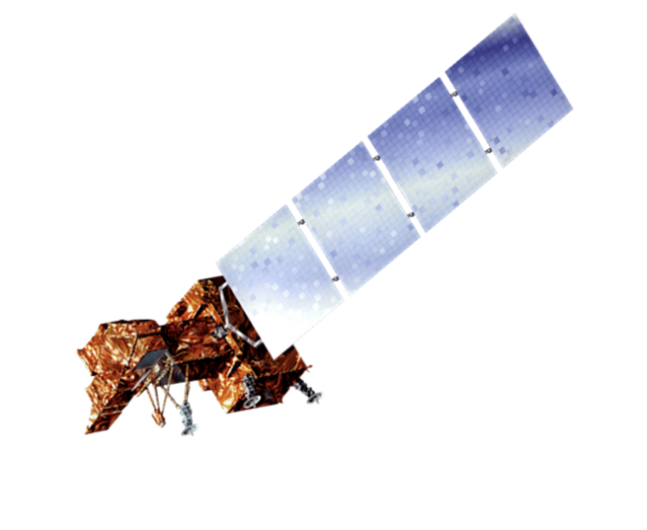
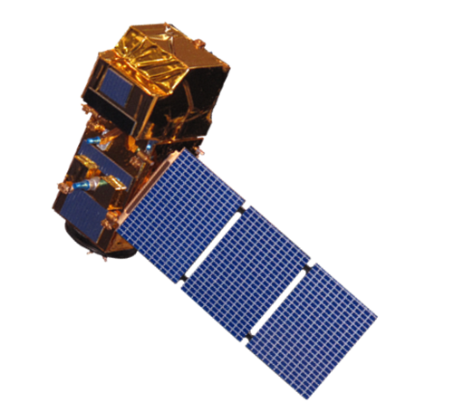
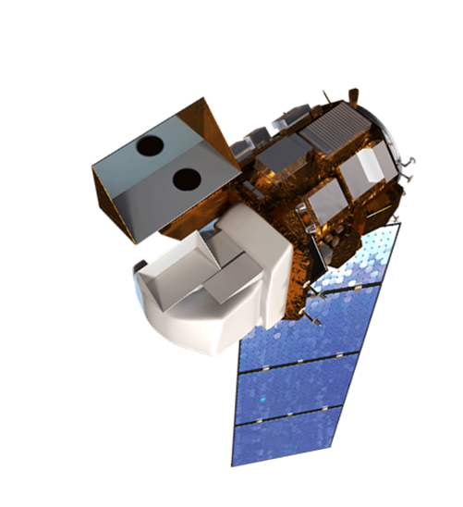
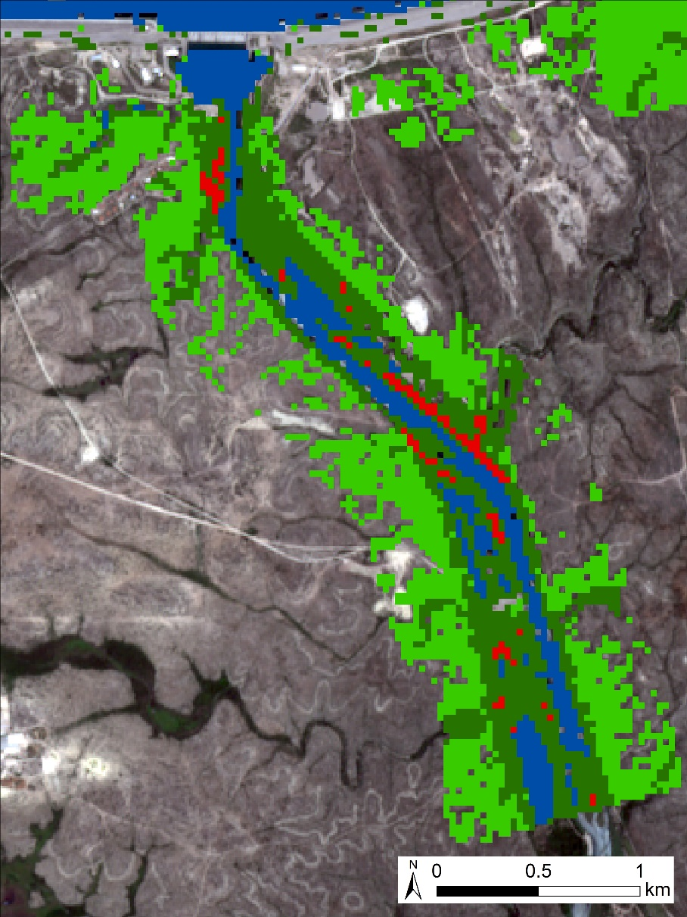
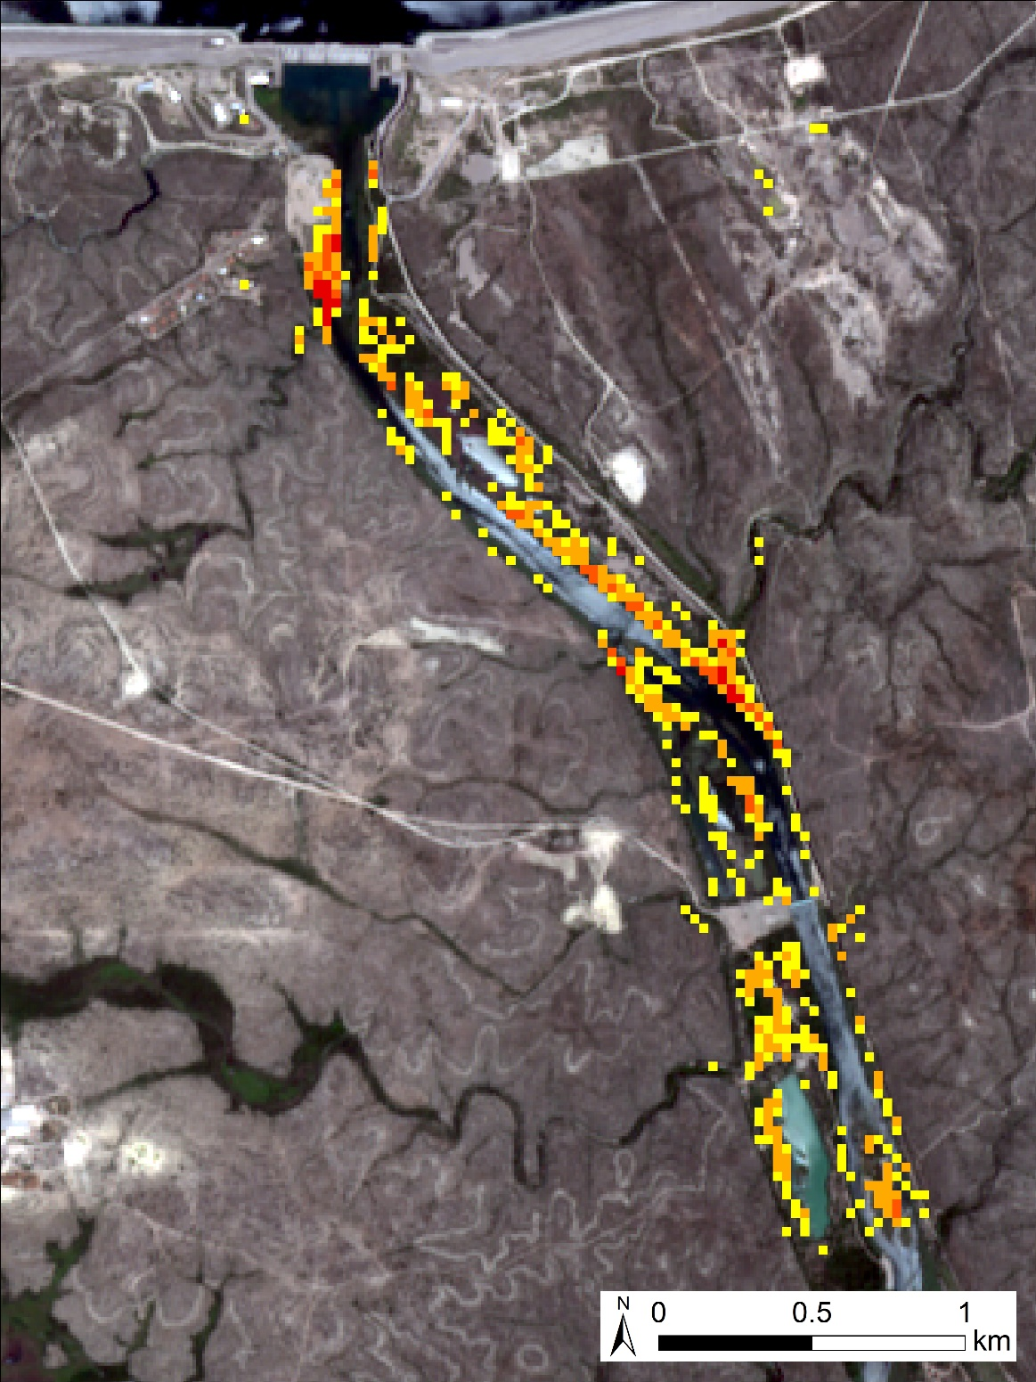
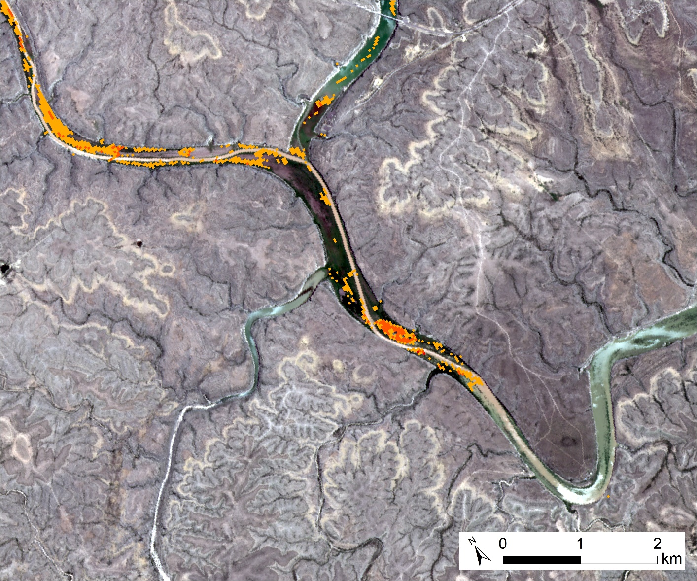
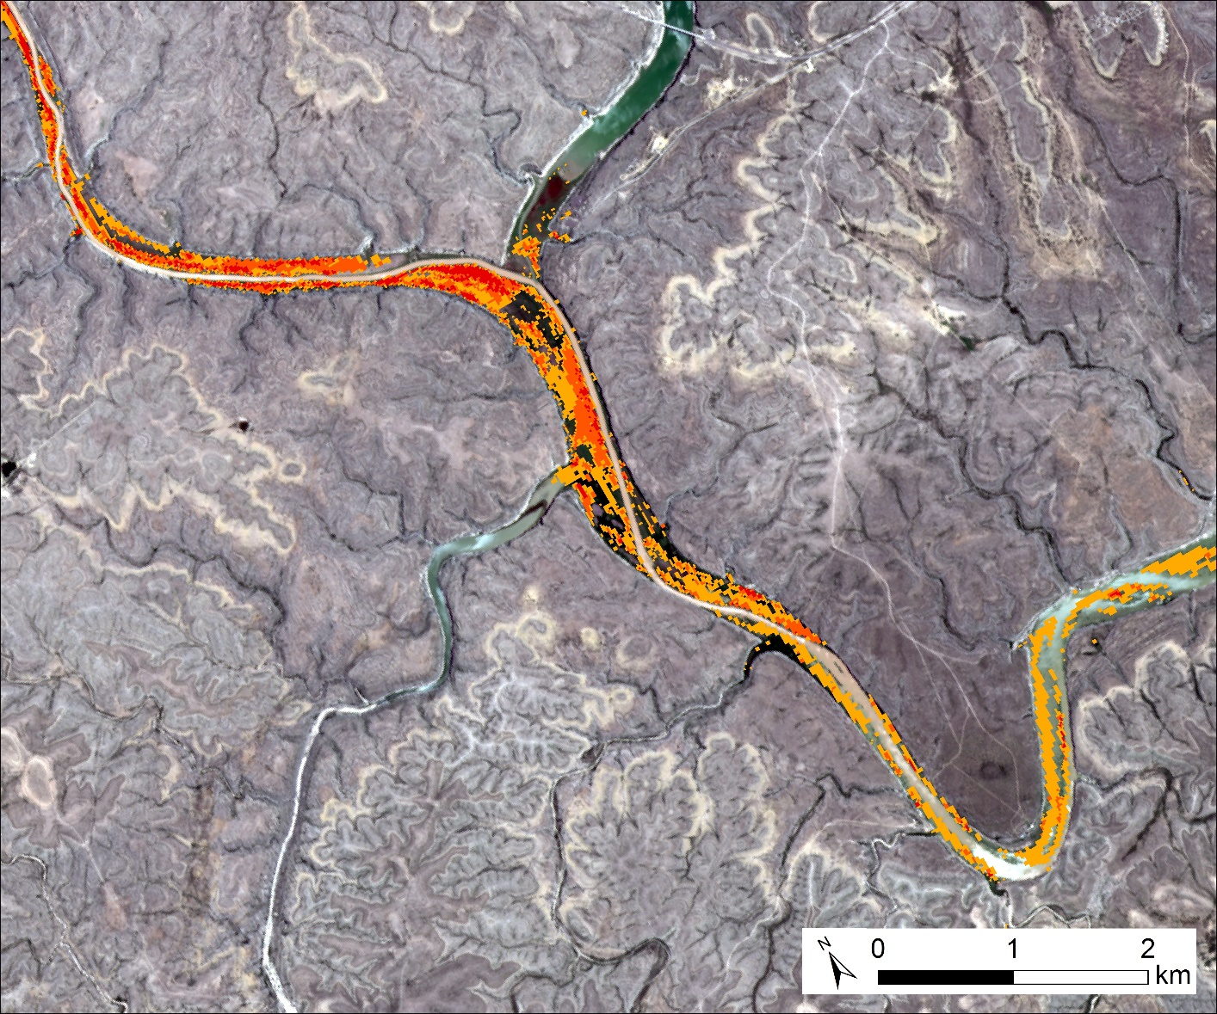
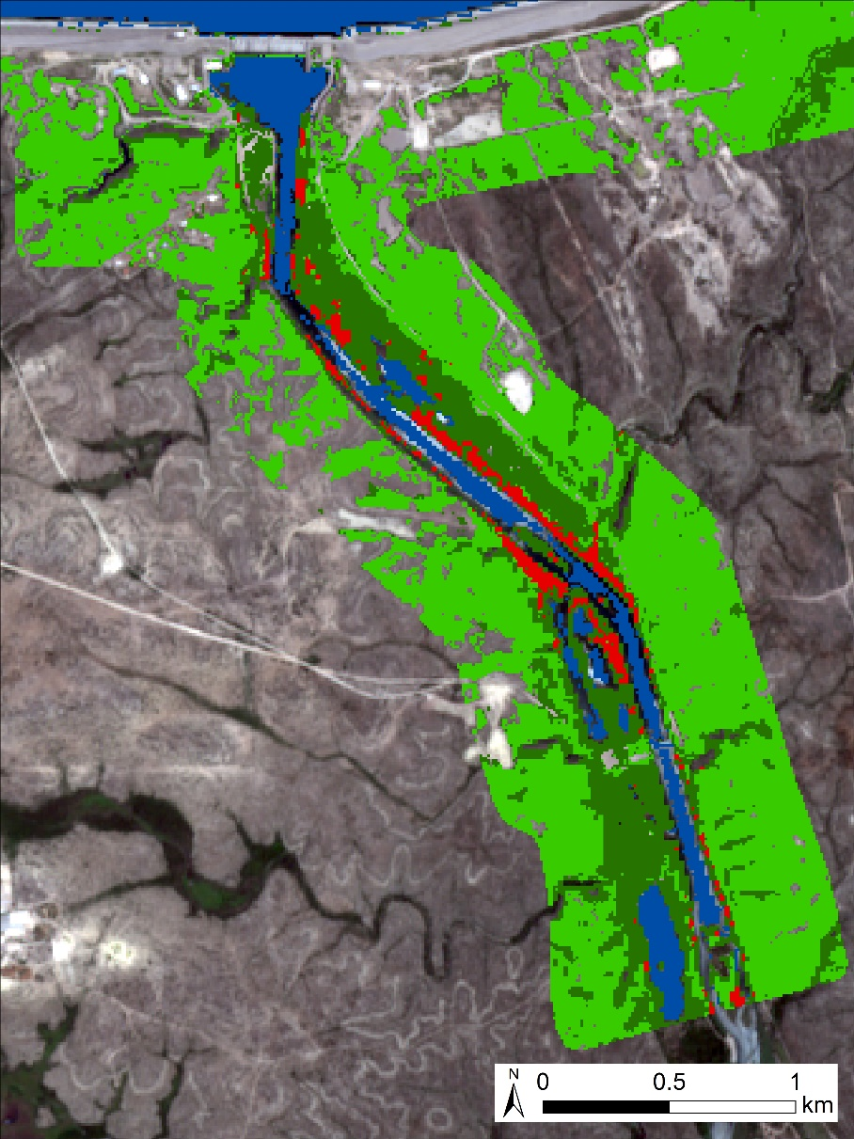
Using Landsat and Sentinel to Identify and Detect Giant Cane in Amistad National Recreation Area for Future Invasive Species Land Management
Abstract
Objectives
Portions of Amistad National Recreation Area (NRA) are threatened by the presence of an invasive grass species know as giant cane (Arundo donax), which drastically alters riparian habitats by out-competing native vegetation and depleting vital resources. Giant cane does not provide viable habitat or food for native species of wildlife, making it an important eradication target of land managers at the National Park Service (NPS). The NPS requires precise distribution maps of giant cane over the entire extent of Amistad NRA for effective land management, however their typical monitoring methods are ground based, labor intensive, and limited in scope. The Amistad Ecological Forecasting team created historic and current classified species distribution maps for the entire extent of Amistad NRA using Landsat 5 TM, Landsat 7 ETM+, Landsat 8 OLI, and Sentinel-2 MSI data for the years 1996 to 2018. Change analysis was then conducted on these classified images to differentiate between long-lasting and ephemeral stands of giant cane. Finally, the team forecasted species distribution and created predictive maps of giant cane extent through the year 2025 to help the NPS prioritize their future land management efforts.
Map current giant cane distribution in Amistad National Recreation Area
Generate historic giant cane distribution maps from 1996-2017
Differentiate ephemeral and persistent stands of giant cane
Analyze changes in giant cane distribution through time
Provide a reproducible giant cane monitoring method for the NPS
Study Area
Earth Observations
Landsat 5 TM
Sentinel-2 MSI
Landsat 7 ETM+
Landsat 8 OLI
Overview of Study Area
Methodology
Amistad National
Recreation Area
Acquire Landsat and Sentinel imagery
Preprocess imagery, composite bands, mosaic and clip images
Train the classifier to giant cane and other land cover types based on in situ vegetation data
Classify images via random forest method
Repeat classification for multiple years
Assess accuracy and refine training areas
Aggregate giant cane classifications to make persistence maps
Results
1996 Classified Image
Multiple
Classified
Images
1996-2000
Persistence Map
Compiled from 5 classified images spanning date range
2014-2018
Persistence Map
Compiled from 5 classified images spanning date range
Upland
Vegetation
1 Occurrence
1 Occurrence
Riparian
Vegetation
1996-2018
Persistence Map
Compiled from 14 classified images spanning date range
2 Occurrences
2 Occurrences
Water
3 Occurrences
3 Occurrences
Giant Cane
1 - 2 Occurrences
4 + Occurrences
4 + Occurrences
3 - 5 Occurrences
Persistence maps from different decades can be used to identify temporal change in the abundance of giant cane.
6 - 8 Occurrences
Conclusions
9 + Occurrences
NASA Earth observations provide a reproducible method for mapping the distribution of giant cane via random forest image classification.
Temporal trends in giant cane distribution can be assessed via historic imagery.
Total abundance of giant cane within Amistad NRA has not changed significantly over the last several decades, although the precise distribution of giant cane over the same period does vary.
Distinctly-persistent stands and variation in the distribution of giant cane can be identified through the aggregation of classified images from multiple years.
Variation in image quality, reservoir level, and other factors complicate the production of consistent distribution maps.
2018 Classified Image
Upland
Vegetation
Riparian
Vegetation
Water
Giant Cane
Team Members
Project Partners
Acknowledgements
Amistad National Recreation Area
Dr. Kenton Ross – NASA DEVELOP, Science Advisor
Sarah Howard – Amistad National Recreational Area, Biologist
Sean McCartney – NASA Goddard Space Flight Center
Amanda Clayton – NASA DEVELOP, Project Coordination Senior Fellow
Lauren Childs-Gleason – NASA DEVELOP, National Operations Lead
Patrick Frier
Project Lead
Kaitlyn Carter
Michaela Britt
Joseph Ladd
Amistad Ecological Forecasting
Virginia – Langley| Spring 2018

