Slide 1
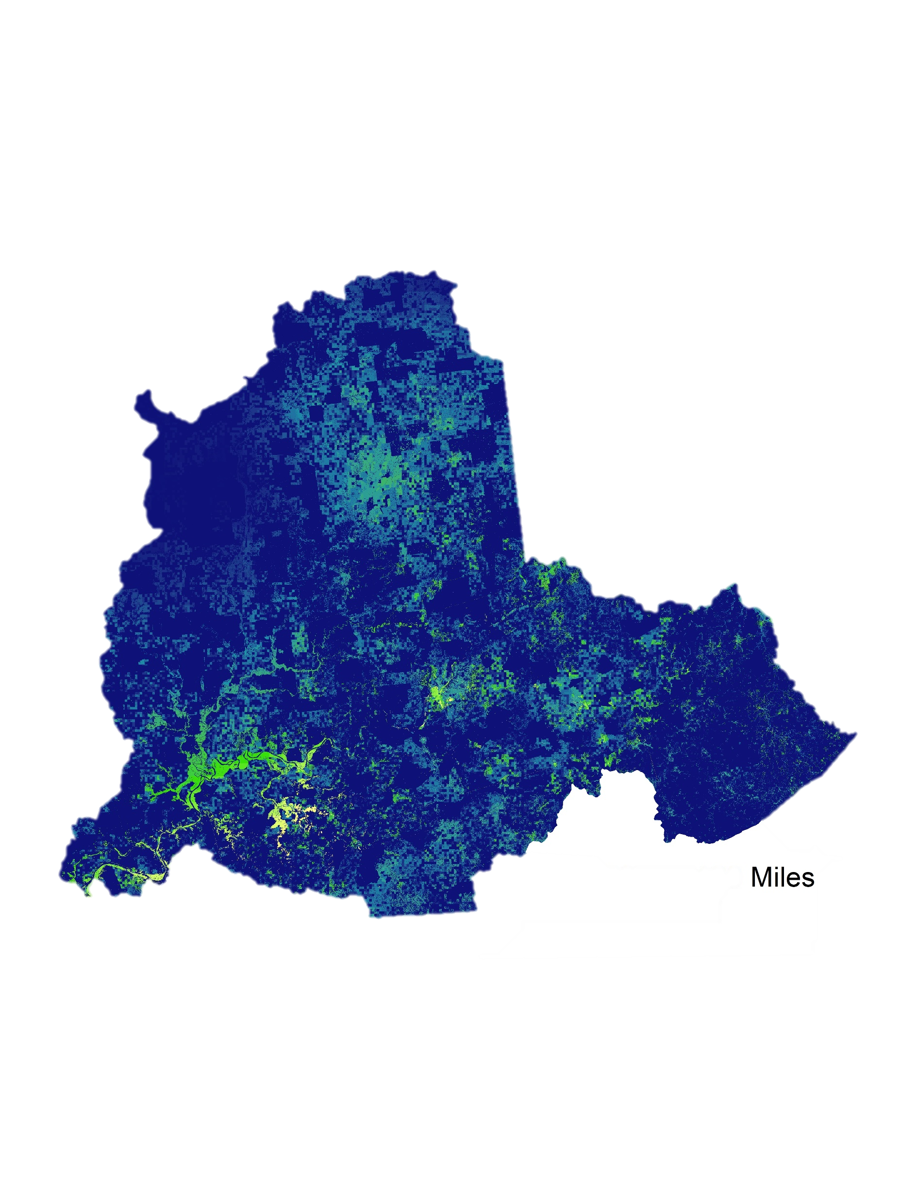
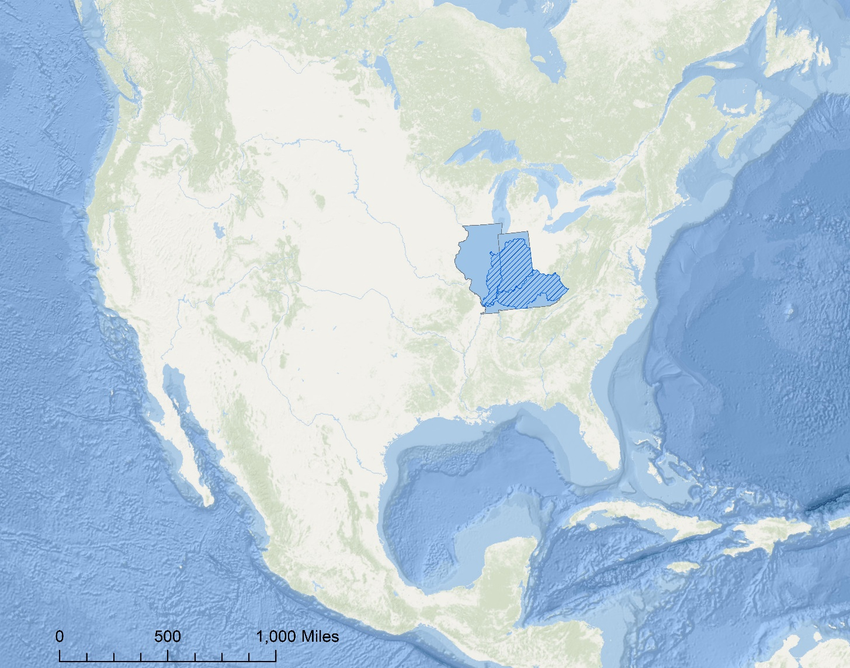
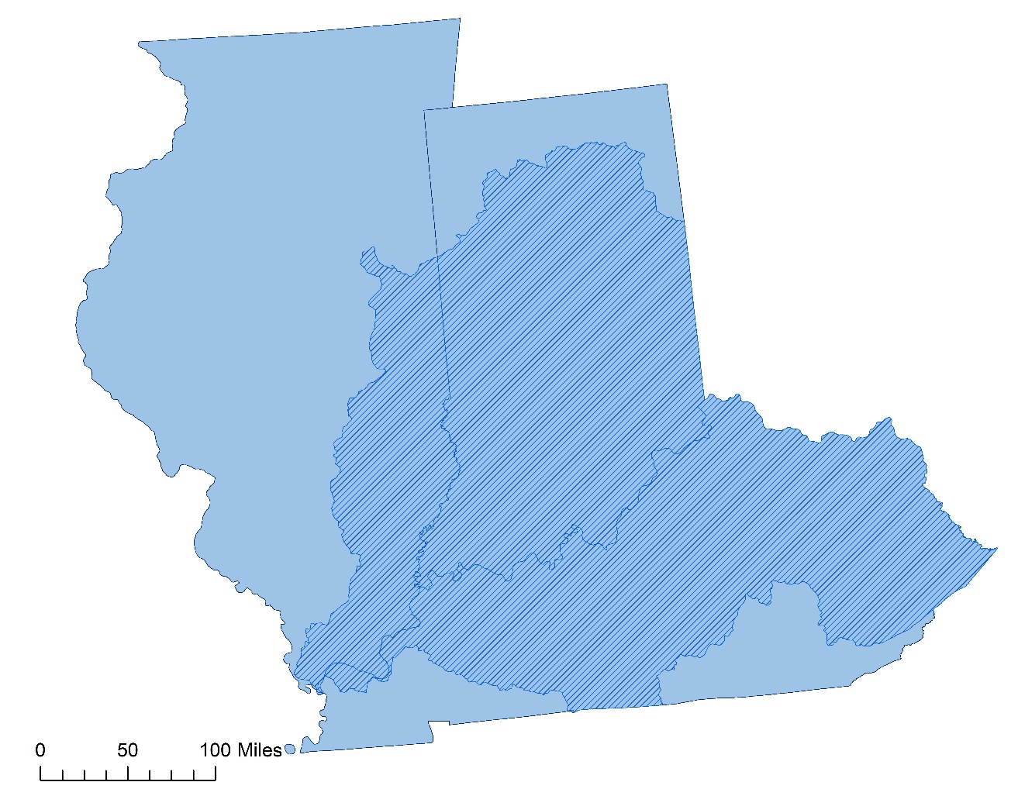
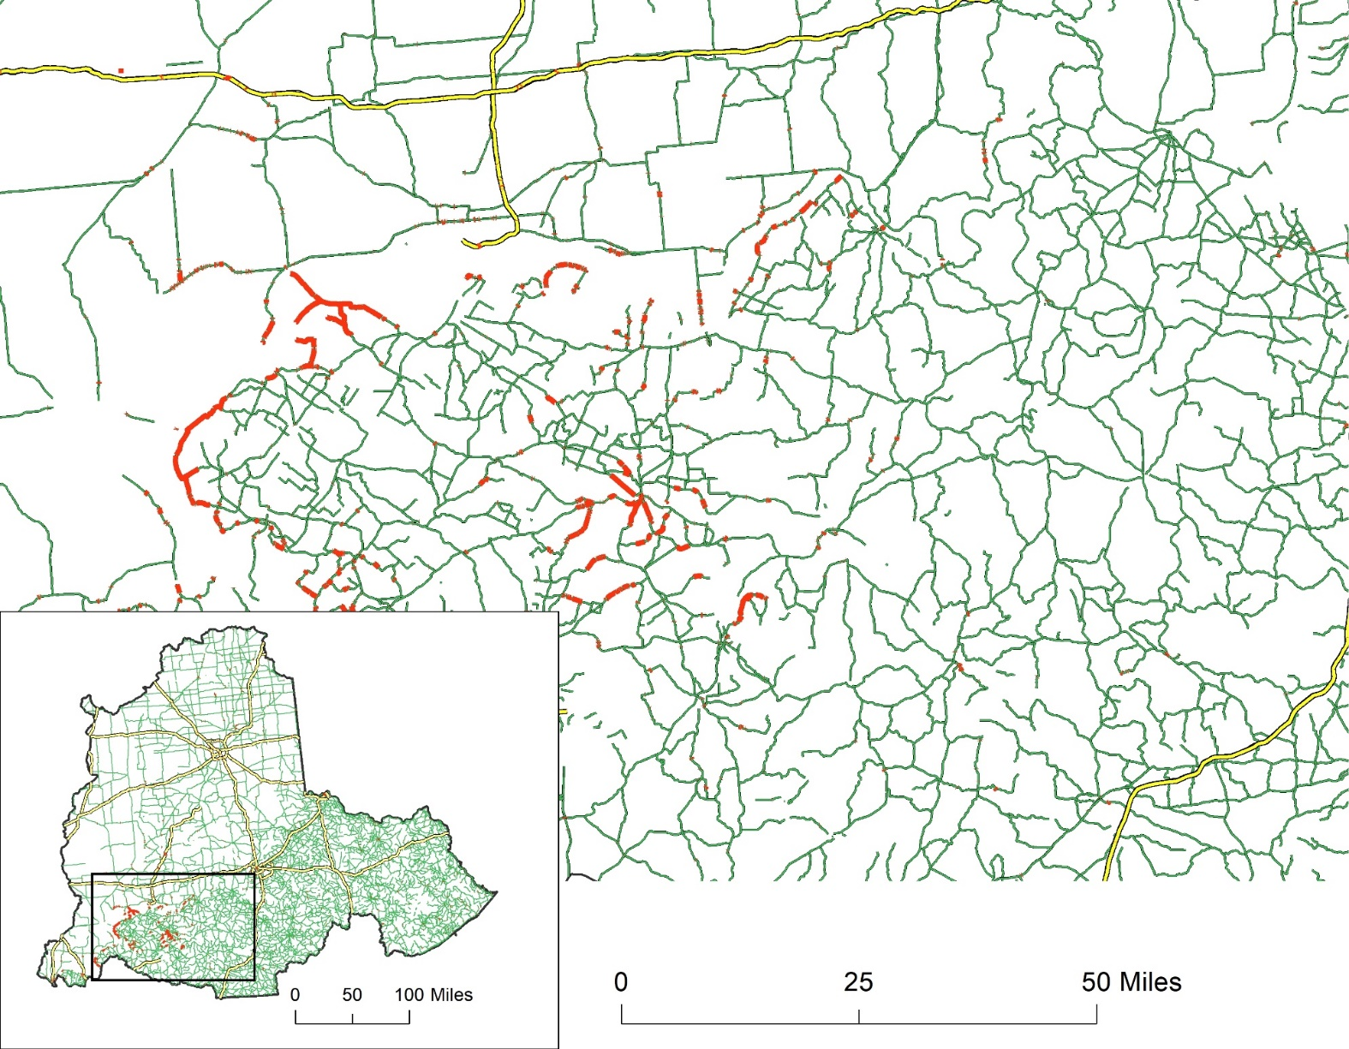
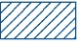

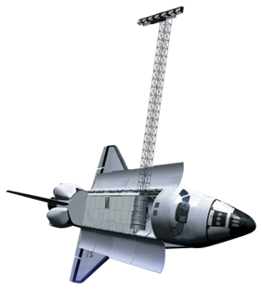
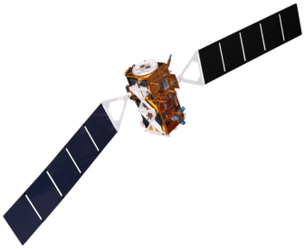
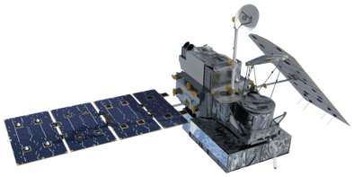

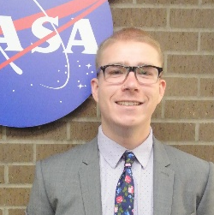
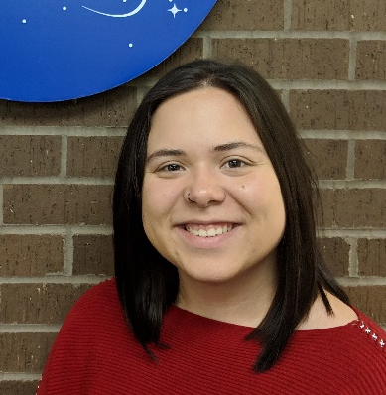
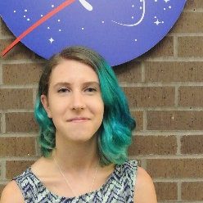
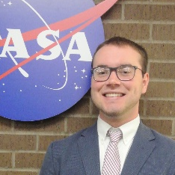
Utilizing Synthetic Aperture Radar and NASA Earth Observations to Identify Optimal Transportation Routes to Assist Emergency Responders after Flood Events in the Ohio River Valley
Abstract
Methodology
The Ohio River provides the 13-state region of the Ohio River Valley with economic and social benefits through power generation, industrial manufacturing, drinking water, and recreational uses. While the river is an important environmental and economic resource, the valley is prone to numerous flood events that damage the environment, residential areas, and important infrastructure. The fall 2018 NASA DEVELOP Ohio River Valley Transportation and Infrastructure team utilized Landsat 8 Operational Land Imager (OLI) and Sentinel-1 C-band Synthetic Aperture Radar (SAR) data to identify flood events and their intensities and develop flood risk maps of the area. The Global Precipitation Measurement (GPM) Integrated Multi-Satellite Retrievals for GPM (IMERG) and the Shuttle Radar Topography Mission (SRTM) provided precipitation and elevation data used in flood analysis. The team partnered with the Federal Emergency Management Agency, the NOAA National Weather Service Ohio River Forecast Center, the Kentucky Division of Water, and the NASA Short-term Prediction Research and Transition Center (SPoRT) to investigate flood risk throughout the Ohio River Valley, identify key infrastructure at risk, and provide favorable transportation routes during these events. The team found that during a 2018 flood event, 667 miles of major highways were impassible and 16% of all hospitals within the study area were inaccessible. The results of this project will assist forecasters and emergency responders by providing a detailed report of vulnerable populations, at risk infrastructure, and historical impassible route systems.
Data Acquisition
Data Processing
Data
Analysis
End
Products
  Sentinel-1 SAR
  Landsat 8 OLI
  SRTM v3
  GPM IMERG
  Ancillary Data
  Speckle Filtering
  Terrain Correction
  Calculate NDFI
  Calculate NDWI
  Resample and Clip
  Distance and Time Attributes
  Fuzzy logic
  Overlay and Intersect
  Network Analyst
  Ohio River Valley Flood Risk Map
  Disaster Response Optimal Road Map
  Infrastructure Impact Analysis
  “Bridge Over Troubled Water” ArcGIS Story Map
Project Partners
NOAA National Weather Service, Ohio River Forecast Center
Federal Emergency Management Agency
Kentucky Division of Water, Energy and Environment Cabinet
NASA Short-term Prediction Research and Transition Center (SPoRT)
Objectives
Results
Detect flood waters using the Normalized Difference Flood Index (NDFI) and the Normalized Difference Water Index (NDWI)
Identify regions and vulnerable populations prone to flooding
Provide optimal routes for emergency services during flood events to reduce emergency response times
Flood Risk Map
Derived from flood threat and vulnerability factors using fuzzy logic. Factors contributing to flood risk include population density, socioeconomic data, elevation, land cover, precipitation, distance to water, flood extents from 2018 and 2015, and soil hydrologic groups.
Study Area
Flood Risk
Illinois
Indiana
High Risk
Low Risk
Kentucky
Optimal Road Map
Provides routes that avoid flooded roads for disaster response organizations based on past flood events. This map and the methodology used can assist partners in reducing response times.
Earth Observations
Ohio River Basin
Landsat 8 OLI
SRTM
Blocked Roads
Interstate Roads
State Roads
Sentinel-1 C-SAR
GPM IMERG
Team Members
Infrastructure Impact Analysis
Shows key infrastructure impacted by flooding in 2018 to inform partners of services and facilities impacted during the flood event.
18
2015
16
2018
14
12
Percent Impacted
Kane Cook
Project Lead
Christine Evans
Sara Miller
Alex Younger
10
8
Acknowledgements
6
4
James Noel, NOAA National Weather Service, Ohio River Forecast Center
Brian Astifan, NOAA National Weather Service, Ohio River Forecast Center
Christopher Vaughn, Federal Emergency Management Agency
Carey Johnson, Kentucky Division of Water
Jordan Bell, NASA Short-term Prediction Research and Transition Center
Suravi Shrestha, NASA Short-term Prediction Research and Transition Center
Dr. Jeffrey Luvall, NASA Marshall Space Flight Center
Dr. Robert Griffin, University of Alabama Huntsville
Dr. Franz Meyer, University of Alaska Fairbanks
Maggi Klug, University of Alabama Huntsville
Leigh Sinclair, University of Alabama in Huntsville/Information Technology and Systems Center
Helen Baldwin, NASA DEVELOP
Kathrene Garcia, NASA DEVELOP
This material contains modified Copernicus Sentinel data (2017 - 2018), processed by ESA.
2
0
Law
Enforcement
Fire
Stations
Chemical
Plants
Water
Treatment
Public
Schools
Nursing
Homes
EMS
Hospitals
Daycares
Dams
Colleges
Airports
Private
Schools
Conclusions
NDWI and NDFI allows for an improved temporal resolution in flood-mapping.
Cities with the highest risk of flooding include Louisville, KY and Paducah, KY.
During the 2018 flood event, 667 miles of major roadways were inaccessible and 16% of hospitals in the study area were affected.
Ohio River Valley Transportation & Infrastructure
Alabama – Marshall| Fall 2018

