Slide 1
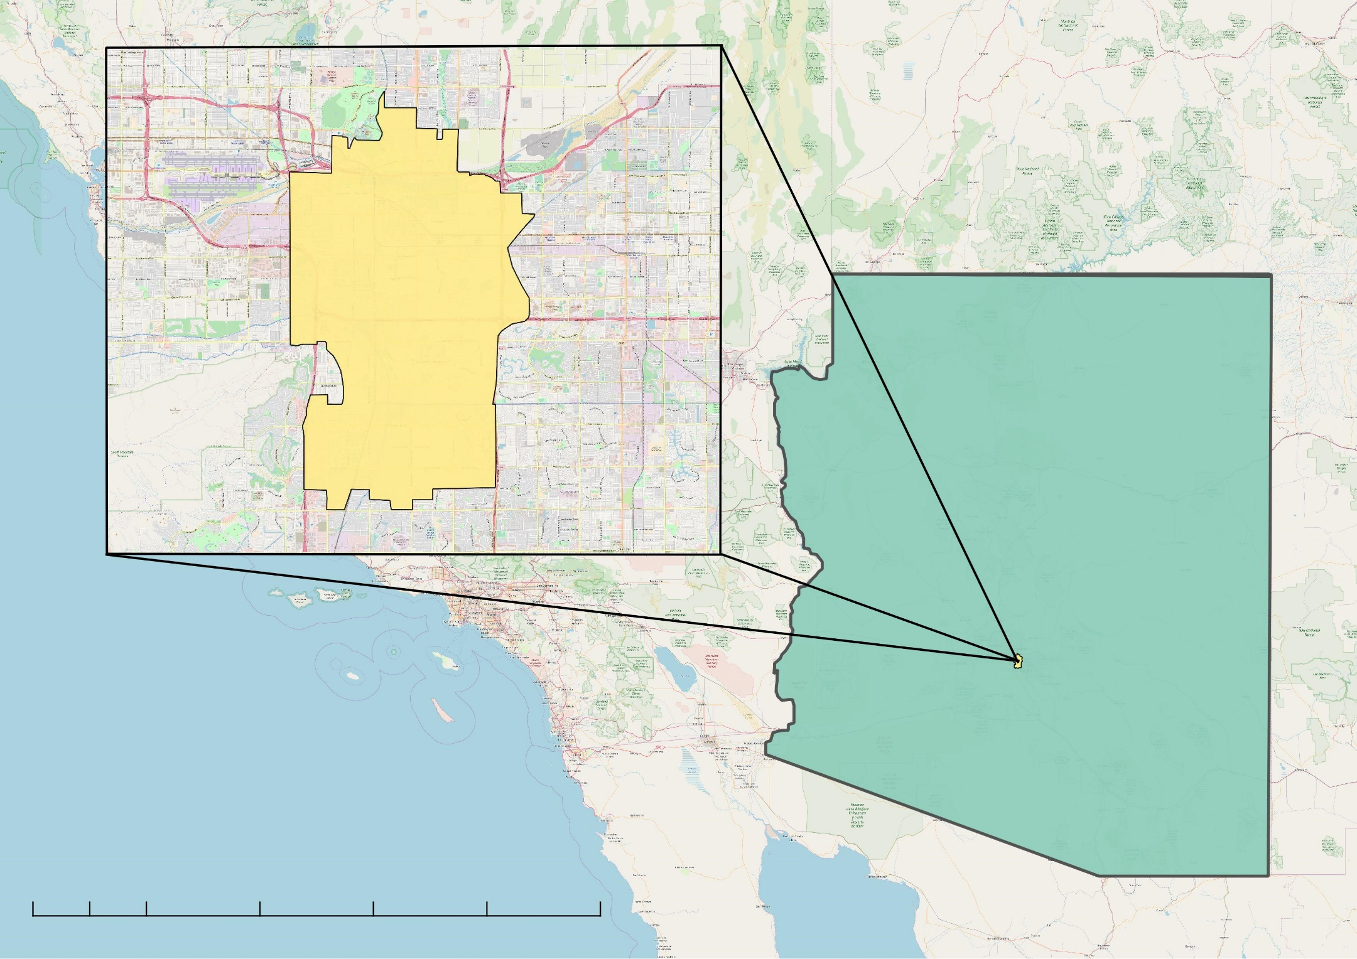
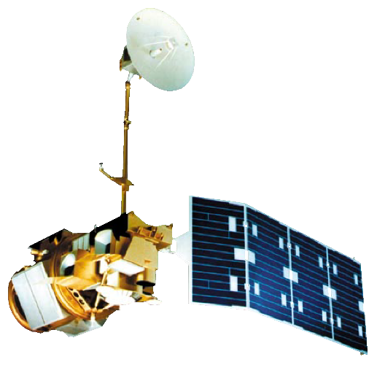
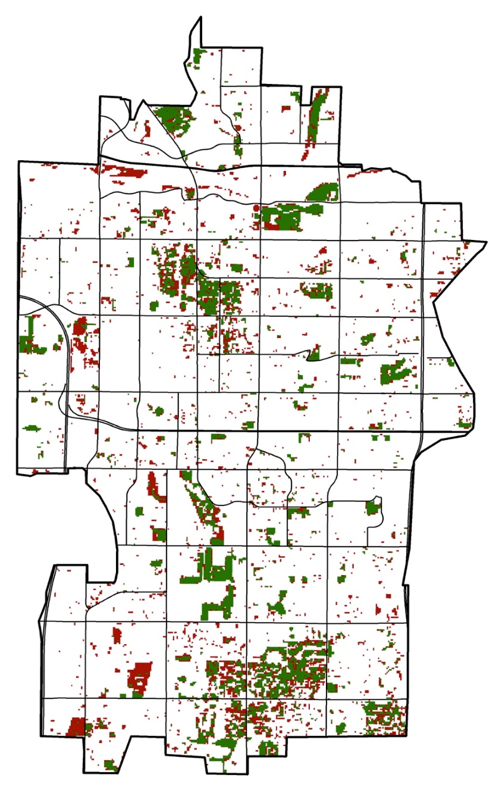
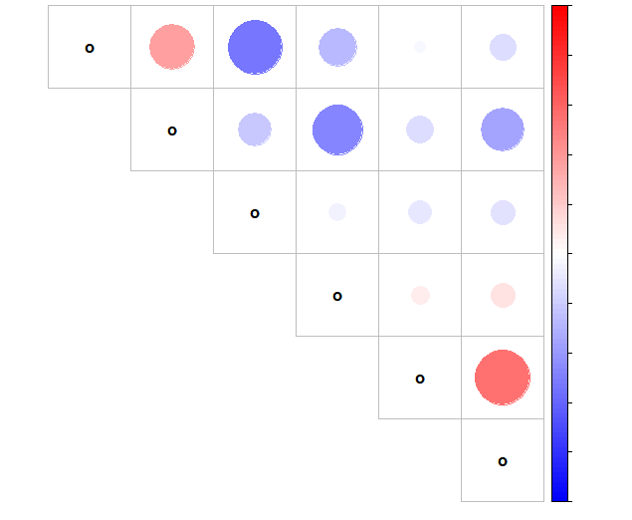
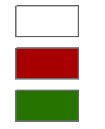
Utilizing NASA Earth Observations to Assess Thermal Landscapes and Prioritize Greening Initiatives in Tempe, Arizona
Abstract
Objectives
Located in the northern Sonoran Desert, Tempe, Arizona, regularly experiences extreme heat, with summer daily maximum temperatures reaching over 37°C. The rapid urbanization of the region in the last 50 years has caused a steady increase in the mean daily air temperature due to the urban heat island (UHI) effect. Recognizing that urban forestry has been documented to mitigate the effects of UHIs through the processes of evapotranspiration and shading, the City of Tempe created an Urban Forestry Master Plan (UFMP) in 2017 in an effort to improve the thermal environment of its parks and green spaces. In partnership with the City of Tempe and the Arizona State University (ASU) Urban Climate Research Center (UCRC), the fall 2018 Tempe Urban Development DEVELOP team used Landsat 5 Thematic Mapper (TM) and Landsat 8 Operational Land Imager (OLI) and Thermal Infrared Sensor (TIRS) satellite imagery to identify changes in the normalized difference vegetation index (NDVI) and land surface temperature (LST) from 1998 to 2018. Combined with United States Geological Survey (USGS) lidar tree point data and Central Arizona-Phoenix Long-Term Ecological Research (CAP LTER) Land Cover Classification data using National Agriculture Imagery Program (NAIP) imagery, the team examined the correlation between tree clustering, land cover, and LST in city parks. The City of Tempe can use these results to inform residents and developers about how investment in deliberate urban forestry improves the city’s thermal environment and helps mitigate extreme heat.
Provide the City of Tempe with information on how urban forestry can contribute to heat mitigation strategies
Assess the change in LST and vegetation cover in Tempe from 1998 through 2018
Investigate the effects that tree clustering and land cover have on the thermal environment
Study Area
Tempe
Methodology
Arizona
Data
Processing
Analysis
Landsat 5 TM
Landsat 8 OLI/TIRS
United States Geological Survey (USGS) Lidar tree point data
CAP LTER Land Classification using 2010 NAIP imagery
NDVI layers
LST Layers
Land cover classification
Tree density
NDVI Time Series
LST Time Series
Regression and correlation analysis (comparing tree density, land cover, & LST)
50
0
50
100
150
200 miles
Earth Observations
Results
Landsat 8 OLI/TIRS
Landsat 5 TM
Average LST (July 1998)
Average LST (July 2018)
Relative Change in LST from 1998 to 2018
Conclusions
There is a strong negative correlation between NDVI and LST, a strong positive correlation between the percentage of impervious land cover and LST, and a strong negative correlation between the percentage tree land cover and LST.
Decreasing the percentage of buildings and soil land cover and increasing the percentage grass land cover could improve the thermal comfort of parks.
In order to help mitigate the UHI effect, the City of Tempe could focus its efforts on the area west of the AZ Route 101 and north of US Route 60.
Planting more trees on areas with building land cover could help the City of Tempe achieve its goal of becoming a 20-minute walkable city.
Project Partners
29.6°C - 40.0°C
31.7°C – 47.0°C
Below Median
City of Tempe
Arizona State University, Urban Climate Research Center
40.1°C – 42.0°C
47.1°C – 49.0°C
Median
42.1°C – 53.8°C
49.0°C – 63.1°C
Above Median
Team Members
Change in NDVI from 1998 to 2018
Correlation Analysis
LST
Impervious
Trees per Acre
Lake
Grass
Tree
1
EXAMPLE
LST
0.8
Impervious
0.6
Hannah Bonestroo
Project Lead
Taylor Quinn
Elizabeth Swanson
Roger Alvarez
0.4
Lake
0.2
Acknowledgements
Change
Grass
0
None
-0.2
Bonnie Richardson – Urban Planner, City of Tempe
Braden Kay – Sustainability Director, City of Tempe
Ariana Middel – Assistant Professor, ASU School of Arts, Media and Engineering
David Hondula – Assistant Professor, ASU SGSUP
Negative
Trees per Acre
-0.4
Positive
-0.6
Tree
-0.8
-1
Tempe Urban Development
Arizona – Tempe| Fall 2018

