Slide 1
COSTA RICA & PANAMA
Ecological Forecasting II
Identifying Current and Future Areas of Environmental Concern in La Amistad International Park to Inform Resource Management
Kate Markham, Teodora Mitroi,
Eder Hernandez, Sharifa Karwandyar
Georgia – Athens
Notes:
We want to open this presentation by expressing our gratitude to our international partners, specifically SICA, for allowing up to apply NASA Earth observation addressing critical sustainability issues in Central America.
Image Credit: DEVELOP Team Generated

Slide 2
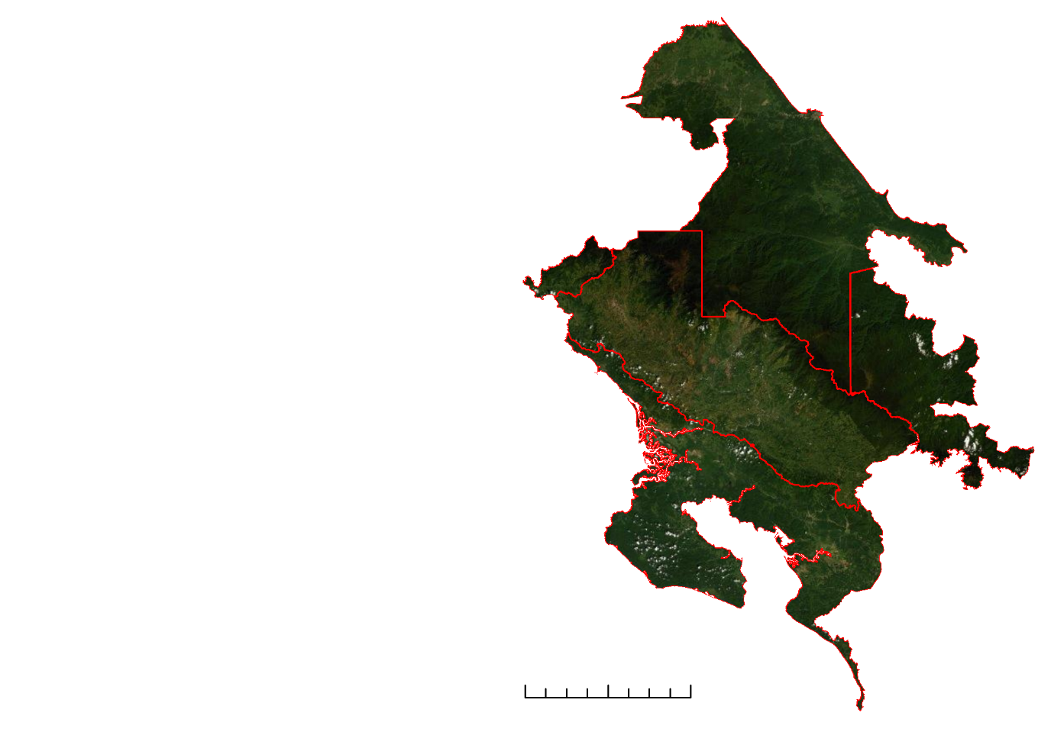
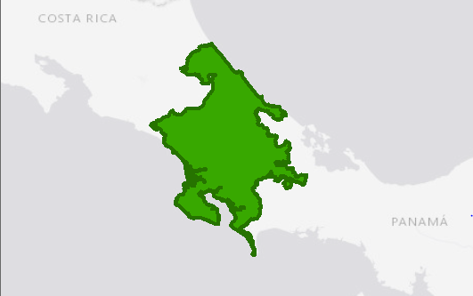
STUDY AREA
La Amistad Caribe
N
La Amistad Pacifico
La Amistad Panama
Osa
Osa
Osa
Study Area
0
25
50
Kilometers
Study Area boundaries
Notes:
Our project focused on a subsection of the Mesoamerican Biological Corridor in Central America, specifically between southern Costa Rica and northern Panama. The corridor was created by several Central American countries to solidify the goal to preserve biodiversity and establish sustainable land management between the countries. Inside the corridor is La Amistad International Park, the focus of our study. The park itself is zoned into three distinct areas, including La Amistad Caribe, La Amistad Pacifico within Costa Rica’s borders, and La Amistad Panama in Panama. Osa Peninsula in Costas Rica completes the full study area.
Basemap Layer: World Light Gray Canvas Base. Esri, HERE, Garmin, (c) OpenStreetMap contributors, and the GIS user community

Slide 3
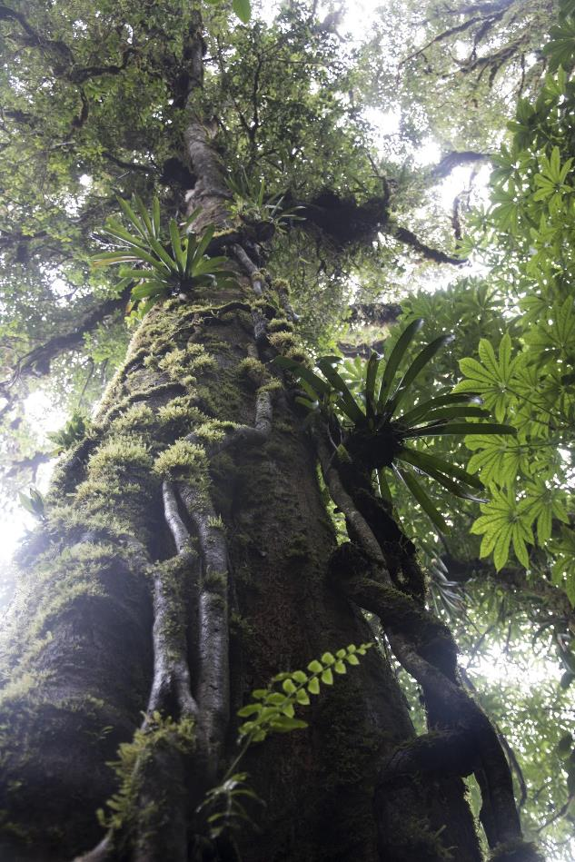
PROJECT PARTNERS
Costa Rica:
National Center for Geoenvironmental Information in the Ministry of Environment and Energy
Panama:
National Environmental Authority
Image Credit: Danforth1
Notes:
Our partners and the Central American Integration System, also known as SICA, are concerned about the ecological disturbances and conservation conflicts that may arise from the increase of development. This rise in urban and agricultural expansion has led to the deforestation of many habitats with vulnerable communities, including fauna and flora, and indigenous communities. Central America is home to 7% of the world’s life forms, thus the protection of biodiversity is a top priority for SICA. Indigenous populations are also being affected due to the officials not respecting the communities land rights.
Image Credit: “Panama en Costa Rica 173” by Danforth1
Image Source: https://www.flickr.com/photos/reneenmagda/36189798410/in/album-72157685145645320/(licensed under CC BY-NC-ND 2.0)

Slide 4
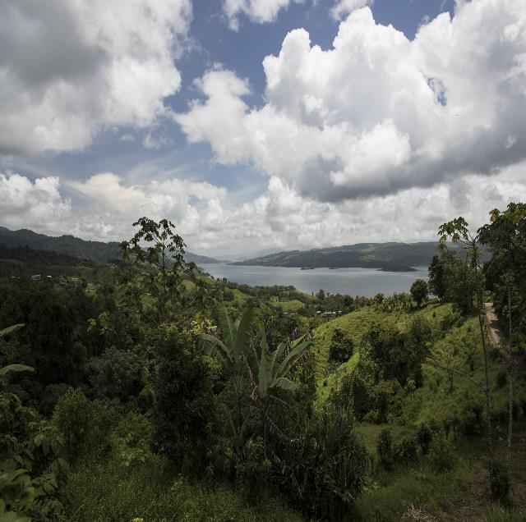
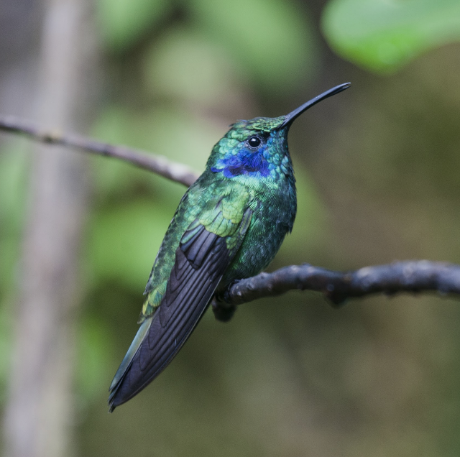
COMMUNITY CONCERNS
Impact of
Agricultural Development & Deforestation
Protection of
Biodiversity &
Indigenous Land Rights
Image Credits: Danforth1
Notes:
Our partners and the Central American Integration System, also known as SICA, are concerned about the ecological disturbances and conservation conflicts that may arise from the increase of development. This rise in urban and agricultural expansion has led to the deforestation of many habitats with vulnerable communities, including fauna and flora, and indigenous peoples. Central America is home to 7% of the world’s life forms, thus the protection of biodiversity is a top priority for SICA. Indigenous populations are also being affected due to the officials not respecting the communities land rights.
Image Credit: ‘Panama en Costa Rica 176’ by Danforth1
Image Source:https://www.flickr.com/photos/reneenmagda/36448735551/in/album-72157685145645320/ (licensed under CC BY-NC-ND 2.0)
Image Credit: ‘Panama en Costa Rica 195’ by Danforth1
Image Source:https://www.flickr.com/photos/reneenmagda/35751116214/in/album-72157685145645320/ (licensed under CC BY-NC-ND 2.0)

Slide 5
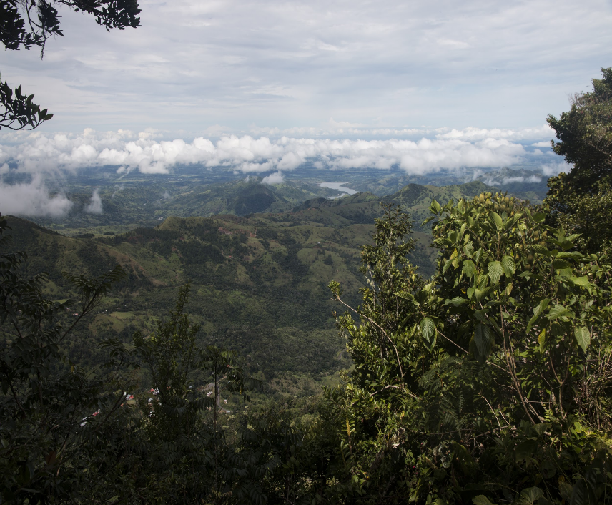
OBJECTIVES
Produce Land Use Conflict Identification Strategy (LUCIS) maps
Identify areas of biodiversity concern
Forecast potential conflict areas in land conservation
Monitor forest changes with Short-Term Forest Change (STFC) Tool
Image Credit: Danforth1
Notes:
In order to address these concerns from the Costa Rican and Panamanian community, the Georgia DEVELOP team developed some objectives. Our first goal was to produce a land use conflict identification strategy map, known as a LUCIS model. This method allows us to identify areas of concern to biodiversity, as well as forecast conservational risks.
Secondly, in order to monitor deforestation at any time, we created a Short-Term Forest Change Tool for the partners to understand the impact of agriculture and mass wasting events that impact forest coverage like landslides.
Image Credit: “Panama en Costa Rica 027” by Danforth1
Image Source:https://www.flickr.com/photos/reneenmagda/36189904930/in/album-72157687542082836/ (licensed under CC BY-NC-ND 2.0)

Slide 6
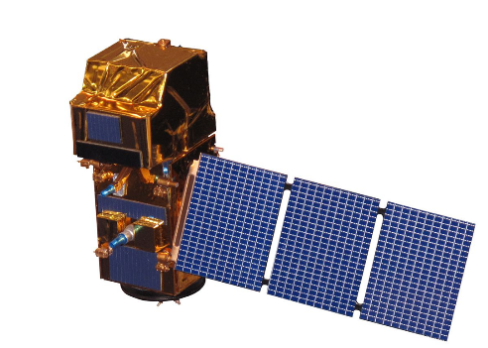
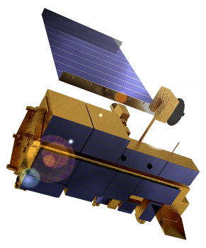
EARTH OBSERVATIONS
Landsat 8 OLI
30 m resolution
16-day cycle
Sentinel-2 MSI
10-60 m resolution
5-day cycle
Terra MODIS
250 m resolution
1-day cycle
Notes:
The satellite imagery used for accomplishing our objectives are displayed here. We used Landsat 8 Operational Land Imager for medium quality resolution of 30 m, and combined Sentinel 2 MultiSpectral Imager and Terra Moderate Resolution Imaging Spectroradiometer or MODIS for increased resolution and additional data. Since our tropical area is covered by clouds, we combined this imagery to minimize cloud cover and best estimate our calculations.
Image Source (“Landsat 8 OLI”): http://www.devpedia.developexchange.com/dp/images/c/c2/03_Landsat8.png; NASA (Retrieved from DEVELOPedia; Public Domain)
Image Source (“Sentinel-2 MSI”): http://www.devpedia.developexchange.com/dp/images/d/dd/24_Sentinel2.png; NASA (Retrieved from DEVELOPedia; Public Domain)
Image Source (“Terra spacecraft model”): https://commons.wikimedia.org/wiki/File:Terra_spacecraft_model.png; NASA (Retrieved from DEVELOPedia; Public Domain)

Slide 7
METHODS: SHORT-TERM FOREST CHANGE TOOL
Restrict
Restrict area to La Amistad International Park
Restrict dates from user input
Step One
Access Sentinel 2A MSI, Landsat 8 OLI, MODIS, Hansen imagery
Step Two
Mask clouds and shadows of satellite imagery
Step Three
Calculate Enhanced Vegetation Index (EVI)
Step Four
Calculate change in EVI & NDVI (end date – start date)
If negative value:
Possible tree loss – check Hansen map for confirmed tree cover
If positive value:
No change – end loop
If Tree Cover:
Mark red
If Not Tree Cover:
Mark yellow
Step Five
Create forest change map
Notes:
To start explaining our approach, we begin with a simple flowchart of the STFC Tool. After importing the Earth observations, we also accessed the Hansen Global Forest Change tool. The tool serves as a baseline for our canopy cover calculations, which eventually determine forest change or not. The earth observations are restricted to our study area and the dates specified by the user through the GUI. After the start and end dates are selected, the image gets cloud and shadow masked in preparation for the vegetation indices. We then calculate our vegetation indices, EVI and SAVI, which best suit the tropical environment and the search for forest change. Then, pixel by pixel, the tool compares it first to the treecover calculation in 2000 to check if there was a tree there in 2000. If no, then we see if there was a gain in tree since 2018. If there WAS a tree in 2000, we need to make sure that for the year specified by the dates, there wasn't a loss in the meantime. Once we have classified if a pixel has tree cover for that year, we calculate the EVI for the start image and subtract the pixel’s indices to evaluate the change. If the index has change ###, then they get classified as red, for most change, if it is below ###, minimal/no change.
Finally we created the GUI for the partners to input any two dates they wish, create the forest map by a click, and exporting the map as a tiff.

Slide 8
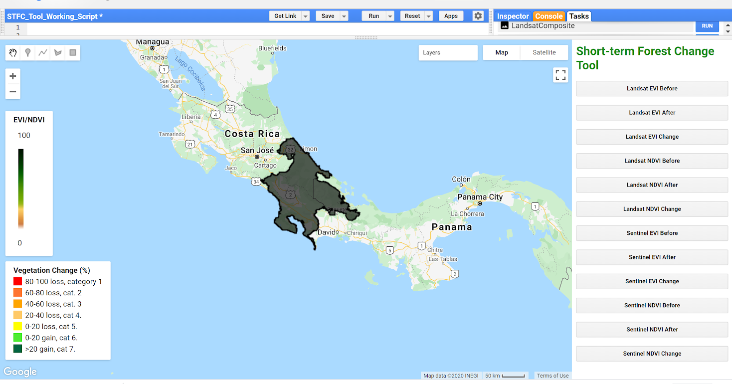
METHODS: SHORT-TERM FOREST CHANGE TOOL
METHODS: SHORT-TERM FOREST CHANGE TOOL
2
1
4
3
Graphic User Interface of Short-term Forest Change Tool.
Graphical User Interface of Short-term Forest Change Tool
Notes:
This is what the Short-term Forest Change Tool in Google Earth Engine looks for the user. Specifically, the user needs to complete the instructions in the script, where number 1 is labeled. There, they will be prompted to specify the date they wish to see and upload their shape file for their area of interest. After clicking Run, where number 2 is labeled, the script will create a before, after, and change map for each satellite and of the two vegetation indices, EVI and NDVI. Then on the right side panel where 3 is located, the user can click what map they wish to see and it will be displayed on the left. Finally, 4 represents the exports available, including the image and the averages of change in each region of La Amistad.
Image Source: DEVELOP Team Generated, Google Earth Engine

Slide 9
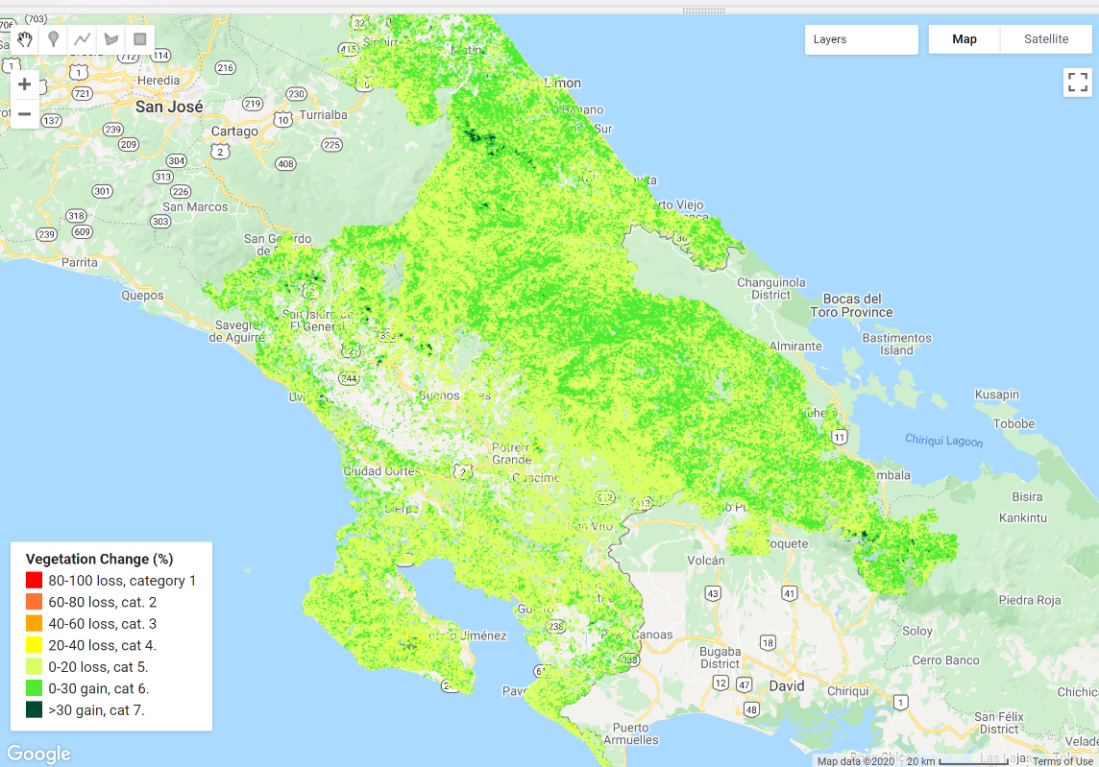
RESULTS: SHORT-TERM FOREST CHANGE TOOL
Forest change from 01/01/2015 1 to 12/31/2018 in the study area
Notes:
This is an example of a map from the Short-term Forest Change tool, showing the entirety of forest change in the our study area between the beginning of 2016 to the end of 2017. The legend on the left labeled “Vegetation Change” shows the categories of tree-cover loss and gain.The most loss is shown in red and dark green is most gain. Intact forest is shown in yellow and green, where moderate loss and gain is displayed.
Image Source: DEVELOP Team Generated, Google Earth Engine

Slide 10
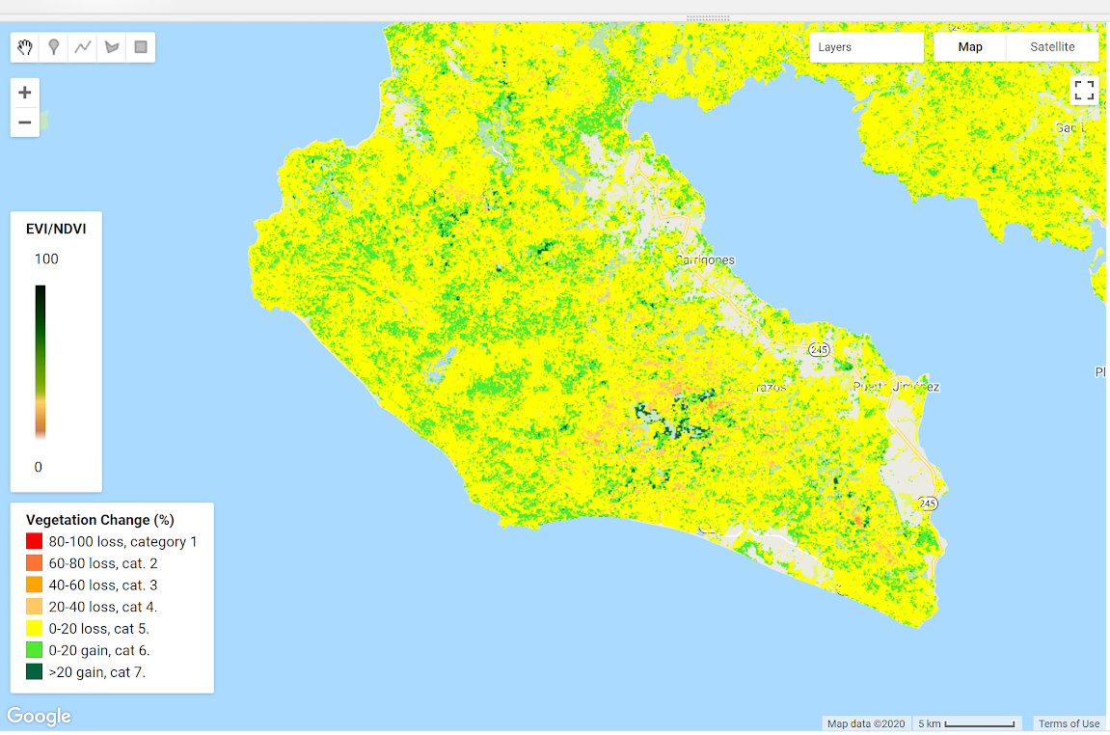
RESULTS: SHORT-TERM FOREST CHANGE TOOL
Forest change from 01/01/2016 to 12/31/2017 in Southern Costa Rica
Notes:
This is another example of a map from the tool. It displays the forest change for the same period of time as the previous figure, but this time, we zoom in on a peninsula in Southern Costa Rica, in the Osa Peninsula region. Here, we see more variation of loss, displayed in the different hues of orange, ranging from 0-80% loss.
Image Source: DEVELOP Team Generated, Google Earth Engine

Slide 11
LAND COVER MAPS – Costa Rica
Agriculture/Agricultura
Mangrove/Manglar
Water/Agua
Grassland/Pastizales
Bare soil/Suelo desnudo
Primary forest/ Boque primario
Secondary forest/ Boque secundario
Pineapple/Piña
Urban area/Urbanization
Misclassified/ Mal clasificado
2019 Land Cover
2029 Land Cover
Notes:
Much of the input data for conflict mapping was created based on land cover maps created using composite Landsat 8 imagery in Google Earth Engine with a random forest classification. Post-classification editing was done to remove obvious errors and misclassifications.
Forecasting to 2029 was done using TerrSet Land Change Modeler, using a Multi-Layer Perceptron neural network, allowing multiple land cover transitions to be modeled.
Image Source: Maps Created by DEVELOP Team

Slide 12
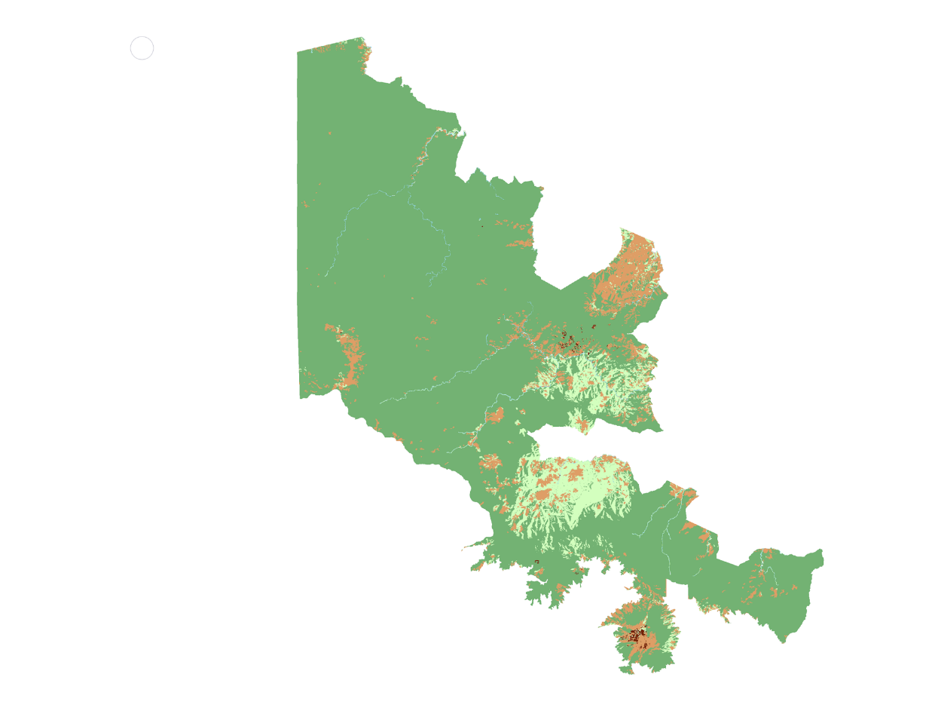
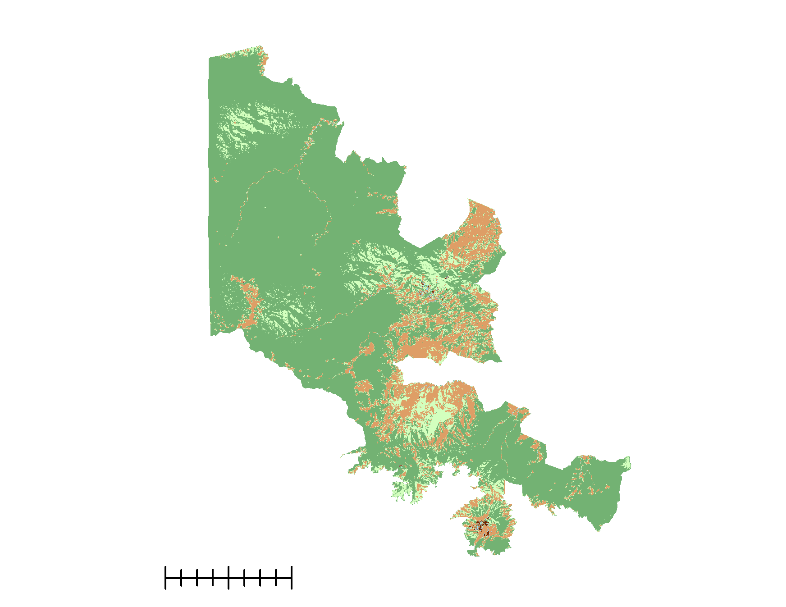
LAND COVER MAPS – Panama
LAND COVER MAPS – Panama
2019
Land Cover
2029
Land Cover
N
Primary Forest
Secondary Forest
Agriculture
0
10
25
kilometers
Water Bodies
Bare Soil / Urban
Notes:
For Panama we were unable to execute the LUCIS model but we did reassess the land cover maps from last term and produce higher accuracy maps for our partners to use in their management. Forecasting for 2029 was done using the Land Change Modeler tool in TerrSet Version 18.31. Land cover classes were based on classes used by the previous DEVELOP team, but these were updated since each year interval had a differing number of classes. Many classes had to be collapsed for each of the years. Forecasting was done for 2019 and 2029. The 2019 map was forecasted using the 2000 and 2012 land cover maps. The forecasted 2029 map was forecasted by using the 2012 and forecasted 2029 maps.
The 2019 land cover map was generated in TerrSet with an overall accuracy of 73 %. The most frequent transition was secondary forest to agriculture.
The 2029 and cover map was generated in TerrSet with an overall accuracy of 88 %. The most frequent transition was primary forest to agriculture.

Slide 13
METHODS: CONFLICT MAPS
Spatial data
acquired
Data standardized
and converted to raster format
Partners weigh objectives and goals according to
importance
Weights applied to corresponding spatial data and suitability maps created
Suitability
maps
overlaid
to identify areas of conflict
Partners identify goals, objectives and sub-objectives for LUCIS model
Notes:
As the first step of the Land Use Conflict Identification Strategy, or LUCIS model, partners identify their goals, objectives, and sub-objectives. The team acquires the relevant spatial data needed to model the goals, objectives, and sub-objectives. All data is then standardized and converted to raster format. Partners next supply weights to the goals and objectives according to their importance. Using the weights assigned by the partners, the team creates suitability maps which are the overlaid on one another to identify areas of potential conflict. These steps are done both for 2019 and 2029 conflict maps.

Slide 14
METHODS: CONFLICT MAPS
Original Data
Processing & Analysis
Results
Roads
Reclassify
Project &
Clip
Raster data
Suitability maps per objective
Forest cover
Pastures
Protected areas
Weighted Overlay
Palm plantation
Vector data
Suitability map per goal
Pineapple plantation
Flood areas
Euclidean Distance
Raster Calculator
Conflict maps
Urban areas
Notes:
All inputs were first projected and clipped to the study area. Any vector data was transformed into a raster by calculating the Euclidean Distance from the points/lines/polygons. All data were then reclassified by creating three suitability categories (most suitable 3, suitable 2, least suitable 1). A weighted overlay was then performed for each goal using weights provided by the partners. This created a suitability map for each goal. Finally, suitability maps were added to one another using raster calculator to create conflict maps. All of these steps were completed in ArcMap 10.7.

Slide 15
LUCIS GOALS – Costa Rica
Goals for Costa Rica
Agriculture:
Increase the agricultural area with environmentally sustainable practices
Ecological significance:
Identify potential areas for implementing ecosystem-based climate change adaptation and mitigation measures
Increase national forest cover to 60% by 2030
Urban
Promote sustainable urban growth consistent with land use capacity
Notes:
These were the goals partners identified for the LUCIS model for Costa Rica.

Slide 16
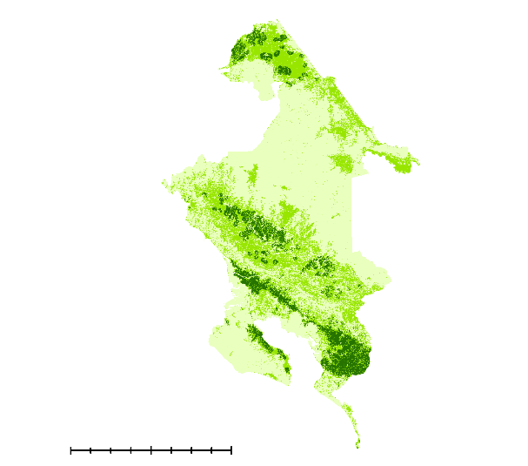
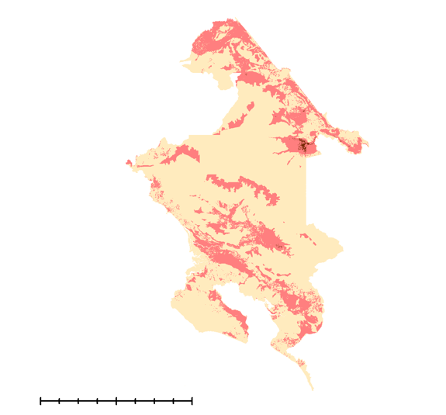
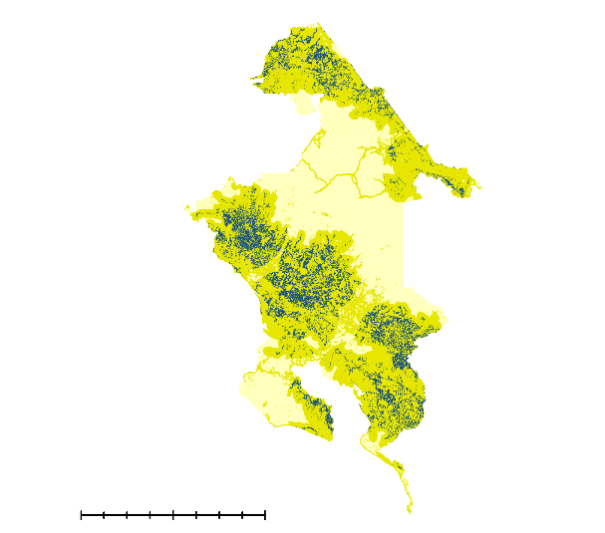
2019 SUITABILITY MAPS – Costa Rica
2019 SUITABILITY MAPS – Costa Rica
PLACEHOLDER- Urban Suitability Map
N
PLACEHOLDER- Urban Suitability Map
PLACEHOLDER- Urban Suitability Map
0
10
20
0
10
20
0
10
20
kilometers
kilometers
kilometers
Agriculture
Ecological
Urban
Low
Low
Low
Medium
Medium
Medium
High
High
High
Notes:
Shown are the three suitability maps for Costa Rica. From left to right: Agricultural suitability, Ecological suitability, and Urban suitability. For the partners’ agricultural goals, areas of high suitability, shown in dark green, can be found in the southeastern and northwestern portions of the study region. For the goal’s concerning ecological significance, areas of high suitability, shown in red, can be found in the Caribe portion of the study region. For the partners’ urban goals, areas of high suitability can be found Pacifico region of the study site, whereas the southwestern area is of low suitability, as indicated by the pale yellow.

Slide 17
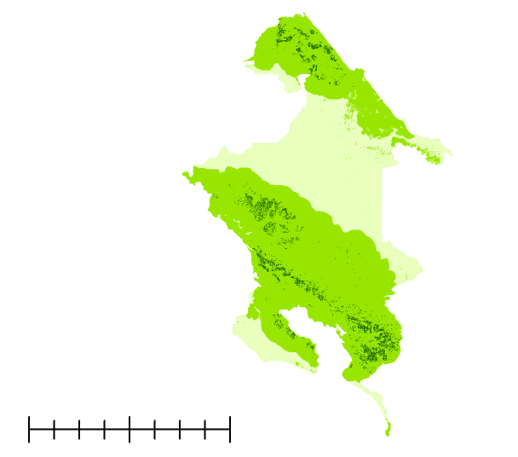
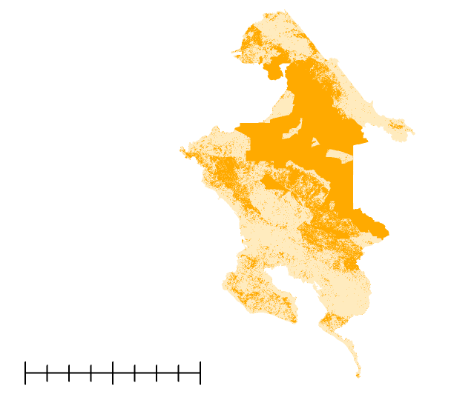
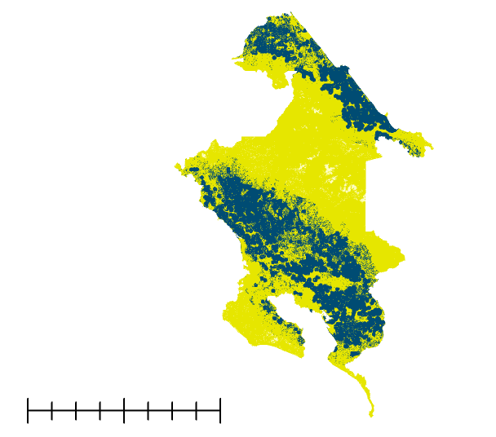
2029 SUITABILITY MAPS – Costa Rica
PLACEHOLDER- Urban Suitability Map
N
PLACEHOLDER- Urban Suitability Map
PLACEHOLDER- Urban Suitability Map
0
10
20
0
10
20
0
10
20
0
10
20
kilometers
kilometers
kilometers
kilometers
Agriculture
Ecological
Urban
Low
Low
Low
Medium
Medium
Medium
High
High
High
Notes:
Shown are the three suitability maps for Costa Rica. From left to right: Agricultural suitability, Ecological suitability, and Urban suitability. For the partners’ agricultural goals, areas of high suitability, shown in dark green, can be found in the southeastern and northwestern portions of the study region. For the goal’s concerning ecological significance, areas of high suitability, shown in red, can be found in the Caribe portion of the study region. For the partners’ urban goals, areas of high suitability can be found Pacifico region of the study site, whereas the southwestern area is of low suitability, as indicated by the pale yellow.

Slide 18
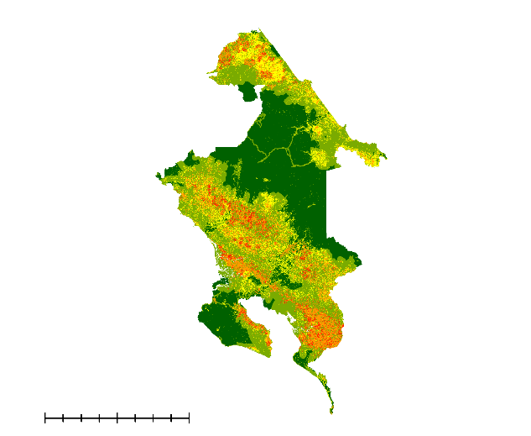
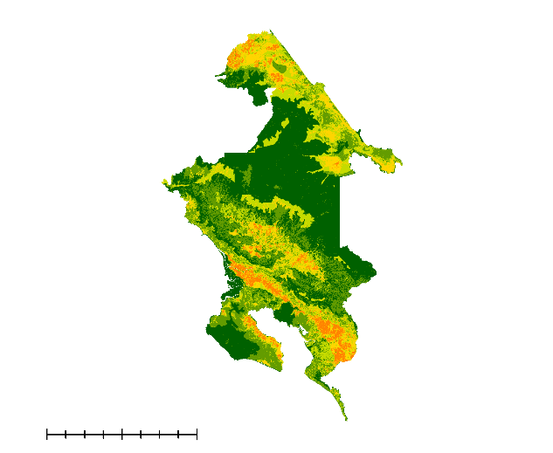
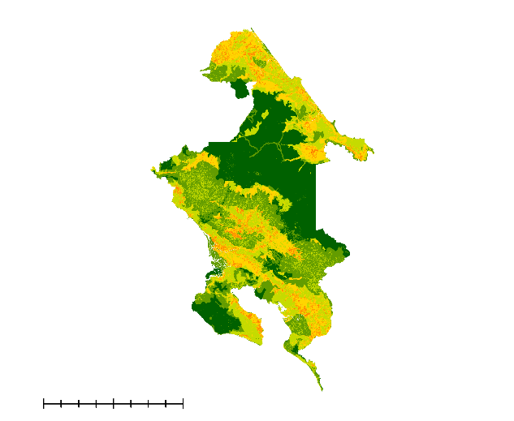
2019 CONFLICT MAPS – Costa Rica
2019 CONFLICT MAPS – Costa Rica
2019 CONFLICT MAPS – Costa Rica
PLACEHOLDER-Urban/Agriculture
N
PLACEHOLDER-Agriculture/Eco
PLACEHOLDER-Urban/Eco
High
Medium
Low
0
10
20
0
10
20
0
10
20
kilometers
kilometers
kilometers
Conflict between Urban and Agriculture
Conflict between Agriculture and Ecological Significance
Conflict between Urban and Ecological Significance
Conflict maps of study region with areas where greatest potential conflict shown in red - orange and areas with the lowest potential conflict shown in green.
Notes:
Shown are the three conflict maps produced for Costa RIca for 2019. From left to right: conflict between urban and agriculture, agriculture and areas of ecological significance, and urban and ecological significance. These maps were created by combining the suitability maps within each respective category and overlaying them on top of one another. Area that is highly suitable for both categories indicates a high likelihood of conflict. For example, in the map to the left the PLACEHOLDER region is both highly suitable for the urban goals and for the agricultural goals. Thus, this is an area, as indicated in red, where conflict is most likely to occur.
Image Source: Maps Created by DEVELOP Team

Slide 19
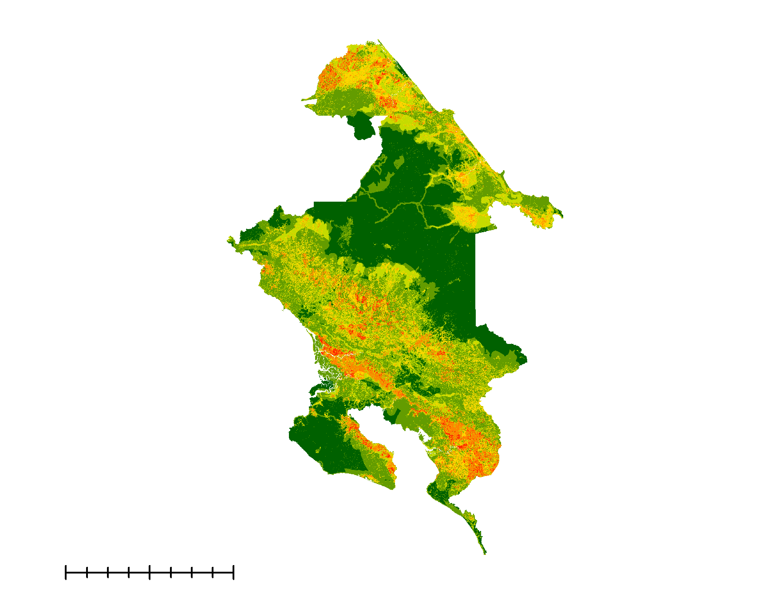
2019 CONFLICT MAPS – Costa Rica
2019 CONFLICT MAPS – Costa Rica
Areas of conflict around Osa and Caribe regions
19.5 % of study area is of high conflict
52.4 % of study area is of low conflict
N
High
Medium
Low
0
10
20
kilometers
Notes:
This is a conflict maps of Costa Rica, showing conflict between ecological significance, urban, and agriculture areas. Areas with the greatest potential conflict are shown in red – orange, and areas with the lowest potential conflict are shown in green. Areas of conflict are evident around the Pacifico and Osa region.

Slide 20
2029 CONFLICT MAPS – Costa Rica
High
Medium
Low
Conflict between Urban and Agriculture
Conflict between Agriculture and Ecological Significance
Conflict between Urban and Ecological Significance
Conflict maps of study region with areas where greatest potential conflict shown in red and areas with the lowest potential conflict shown in green.
Notes:
These are the three conflict maps for Costa Rica for 2029. As mentioned before, these maps were created by combining the suitability maps within each respective category and overlaying them on top of one another. Areas that are highly suitable for both categories are considered to be at high risk for conflict, as is indicated in red.
Conflict between agricultural and urban goals will likely be moderate for 64% of the study region. Conflict between ecological and urban goals will likely be moderate for 67% of the study area. For agricultural and ecological goals, this trend where the majority of the study area is in moderate conflict changes and 80% of the study area is predicted to be in low conflict between agricultural and ecological goals. In comparison to the conflict maps produced for 2019, there is less high conflict area for all three conflict maps.

Slide 21
Areas of conflict around Buenos Aires, San Isidro de General, and coastal area around Limon
12 % of study area is of high conflict
Less than 1% of study area is of low conflict
2029 CONFLICT MAPS – Costa Rica
Areas of conflict around Buenos Aires, San Isidro de General, and coastal area around Limon
12 % of study area is of high conflict
Less than 1% of study area is of low conflict
High
Medium
Low
N
0
20
40
80
kilometers
Notes:
This map for Costa Rica shows conflict between the goals for agriculture, ecology, and urban development in 2029. Areas where greatest predicted conflict are predicted shown in red and areas with the lowest predicted conflict are shown in green. Areas of predicted conflict can be observed around Limon as well as around Buenos Aires and San Isidro de General.

Slide 22
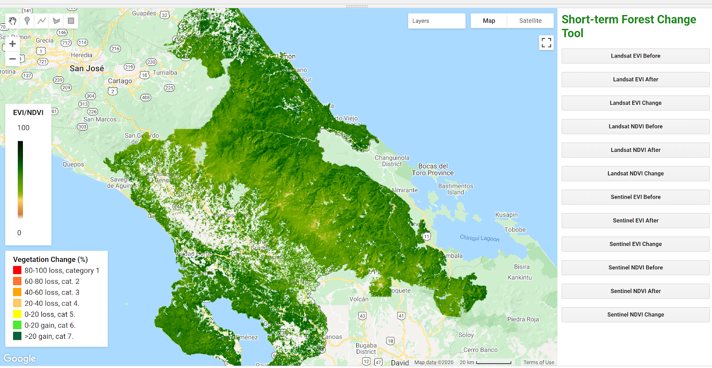
CONCLUSIONS – STFC Tool
Landsat EVI for 12/31/2017 in the study area
Notes:
In summary, the team was able to create a short term forest change tool that takes in user dates, study area, Hansen data to calculate vegetation in forested area. The tool displays not only the change in vegetation between the two dates, but also the start and end date maps. The tool is robust in including two different earth observations, Landsat 8 and Sentinel-2, as well as two indices: EVI and NDVI. Finally, the tool offers an easy interface for the users to choose which map they wish as buttons, and allows them to export the map of their choosing. and calculations, and creates various maps using 2 different indices and 2 different satellites. The tool calculates the average change from Earth observations and offers an easy interface to view and export data.

Slide 23
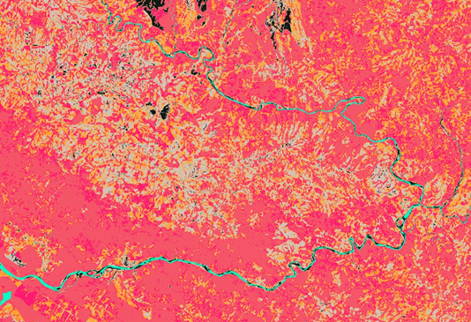
CONCLUSIONS – LUCIS
Agricultural growth compared to Ecological in 2019
Osa region as the highest conflict between ecological and agriculture suitability in 2019
Central and northern regions of Costa Rican study area have greatest conflict between ecological and agricultural suitability in 2029
Less high conflict area in 2029 but more medium-conflict area
Notes:
In summary, results from this DEVELOP project show shifting patterns of suitability and conflict for Costa Rica. When compared to 2019, there will be less high conflict area across the study map, but this may be due to changes in land cover predicted to occur (for example, agricultural land is expected to increase greatly). The amount of land classified as having medium-conflict is predicted to increase greatly in 2029. Thus the intensity of conflict may be less in some regions, but the distribution of conflict across the study are may widen.
In 2019, Costa Rica will face the most conflict for agriculture and ecological growth in the Osa region of the Study Area. The 2019 conflict maps indicate that although urban and ecological areas are of moderately low concern, agriculture and ecological goals show a lot of overlap, resulting in high conflict areas in much of the Osa and Caribe areas. Additionally, there will be a growth of Secondary Forest in 2029 and loss of Primary Forest. Panama will have an increase in Agriculture based on the predicted land cover map of 2029 and decrease in Primary Forest, which was generated using the forecasted 2019 map and the 2012 map. Land across much of Costa Rica will experience moderate conflict in 2029, but areas of high conflict can be found in central and north eastern Costa Rica, mainly around major cities.

Slide 24
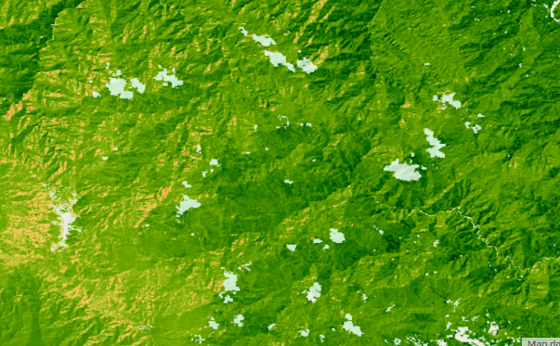
ERRORS AND UNCERTAINTIES
Short-term forest changes
Conflict mapping
Decrease in EVI does not mean deforestation
Seasonality
Different forest types
Cloud-free imagery
Accuracy of land cover maps
Data availability for 2029
Human uncertainty/error
Clouds in Landsat EVI map
Notes:
STFC Tool:
EVI is a measure of how green the pixel. A decrease in EVI does not necessarily mean deforestation occurred. For example, changes in precipitation could cause EVI values to decrease or increase without altering the forest cover. This related to our second point or seasonality. Naturally
occurring changes in phenology could result in the EVI value for a pixel decreasing not due to forest loss but due to natural changes in plant
growth. Different forest types may be more or less green, thus a change from one forest type to another could result in changes in EVI that
are not due to deforestation but due to changes in forest cover. Without robust, current forest cover data to compare changes in EVI to, this
introduces uncertainty. The study area is in the tropics, and obtaining cloud-free imagery was not always possible at the highest resolution.
Conflict mapping:
Many of the layers created for the conflict maps were based off of the classified map for 2019 and forecasted 2029 land cover map, and both
of these maps have their own issues with accuracy and precision. Data availability was also limited for the 2029 conflict maps. Additionally,
the LUCIS model relies on stakeholders to determine goals, objectives, sub-objectives, but also the weights of these goals and objectives and,
as such, weights may be biased depending on stakeholder experience and perspective.

Slide 25
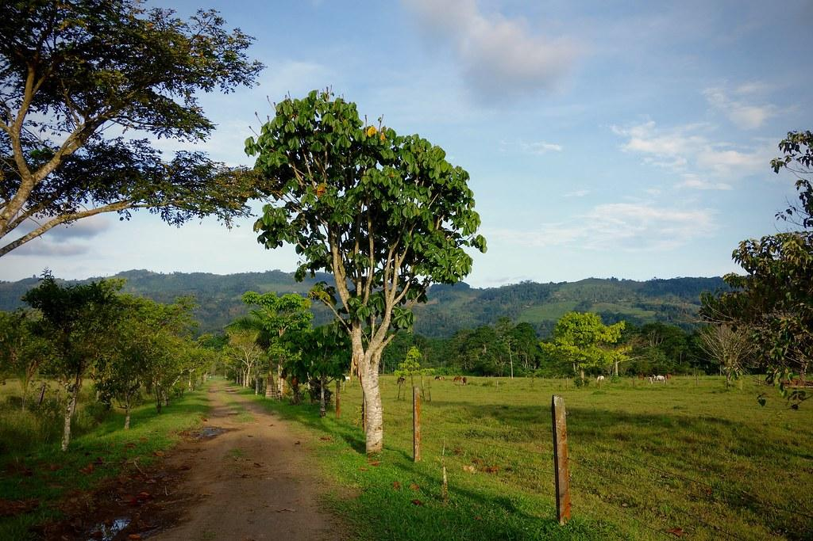
FUTURE WORK
Refine data points in land cover classification
Expand the extent of the study area
Enhance visualization of the Short-Term Forest Change Tool to identify hotspots
Image Credit: DerJoker
Notes:
More accurate data points addressing land cover classification would be useful in further refining the analysis of this project. Partners in Costa Rica would like to see a broader application of the LUCIS model to map the entirety of the country. At the Ministry of Energy and Environment, a great desire was expressed to focus on land cover classification using new data from February 2020 covering the extent of coffee and African Palm in the park.
For the Short-term Forest Change Tool, there are opportunities to make the display easier to visualize by creating code to conduct cluster analysis to identify hotspots. This data-mining process would group pixels of similar value and (placeholder statement).
Image credit: “Costa Rica” DerJoker
Image source: https://ccsearch.creativecommons.org/photos/5eac3d84-f366-4132-b1ff-24fd44589ae2 (licensed under CC-BY-NC-ND 2.0)

Slide 26
Science Advisors
Other Contributors
Partners & End Users
Dr. Marguerite Madden
University of Georgia, Department of Geography
Dr. Sergio Bernardes
University of Georgia, Department of Geography
Austin Stone
University of Georgia, Department of Geography
Sean McCartney
NASA
Rafael Monge Vargas, Sara Mora, Cornelia Miller, Heileen Agular, Christian Vargas, Iván Avila, Marilyn Ortega, Daniel Villaviencio and other colleagues
Ministry of Environment and Energy, National Center for Geoenvironmental Information, Costa Rica
Roney Samaniego
National Environmental Authority, Panama
Fellow
Translators
Shelby Ingram
NASA DEVELOP,
Georgia – Athens Node
Ellen Delgado
Researcher
Dr. Steve Padgett-Vasquez
NASA DEVELOP National Program
Past Contributors
Molly Azami, Kara Bissonnette, Mahsa Khodaee, Zachary Leslie, Shelby Ingram
This material contains modified Copernicus Sentinel data (2017-2020), processed by ESA.
Notes:
We would like to express our gratitude to SICA for their collaborating in utilizing NASA Earth observations to mitigate for forest conservation in Central America. Additionally, we would like to thank following individuals who helped us along the way. We appreciate everyone’s energy, enthusiasm and effort in this international project. Thank you.

