Slide 1
Malawi Disasters II
Applications of Flood Definitions and NASA Earth Observations to Create a Flood Forecasting Methodology
Andrew Kruczkiewicz (Project Lead)
Helen Cen
Brigitte Moneymaker
Notes:
This project aimed to produce a methodology for analyzing flood detection skill relative to flash floods, in order to inform a framework for better monitoring and forecasting in vulnerable areas.

Slide 2
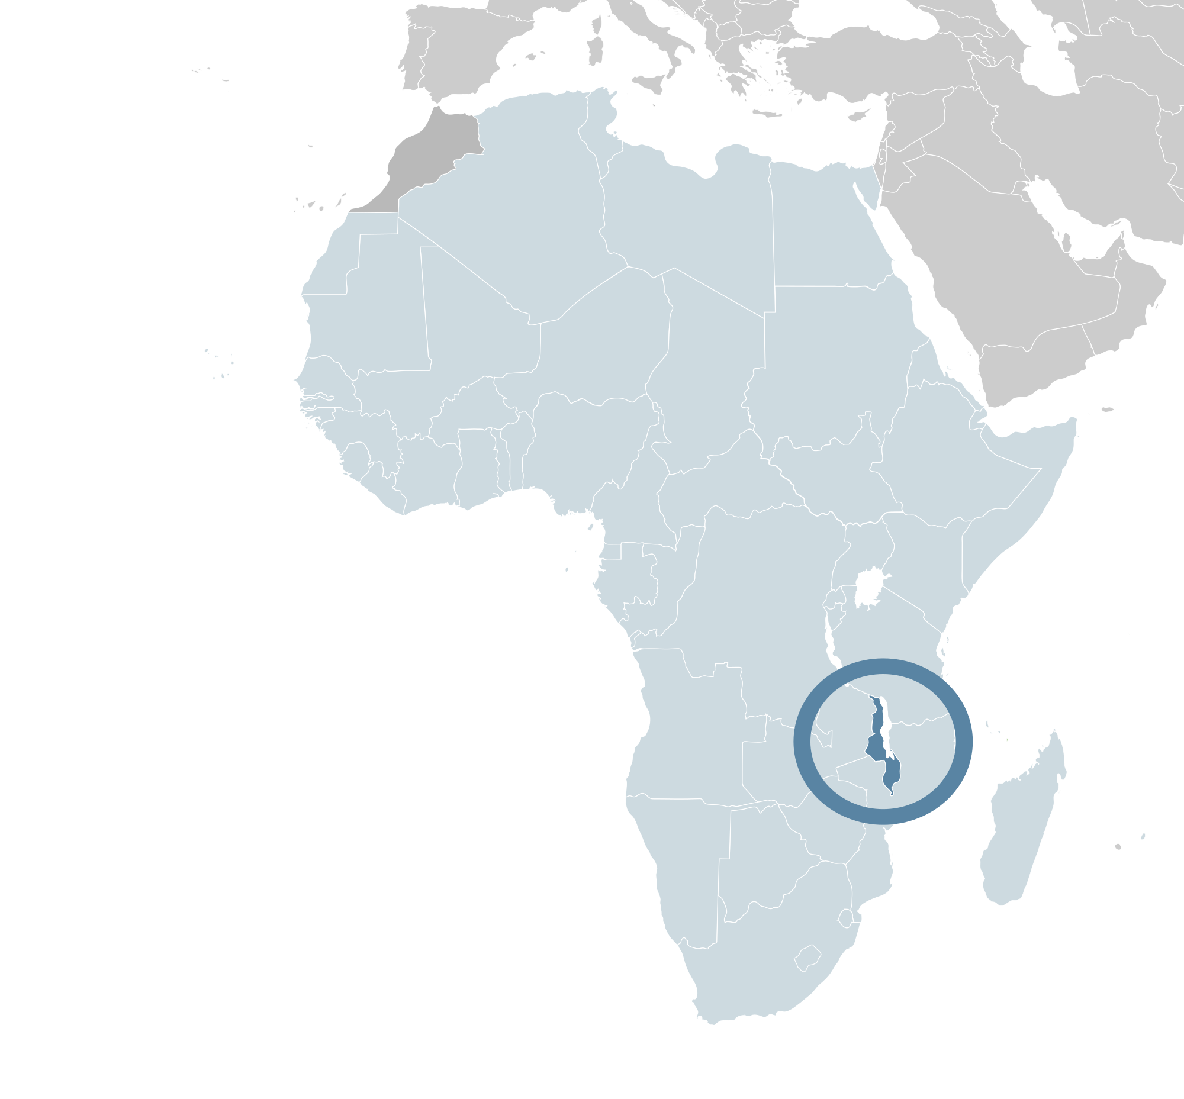
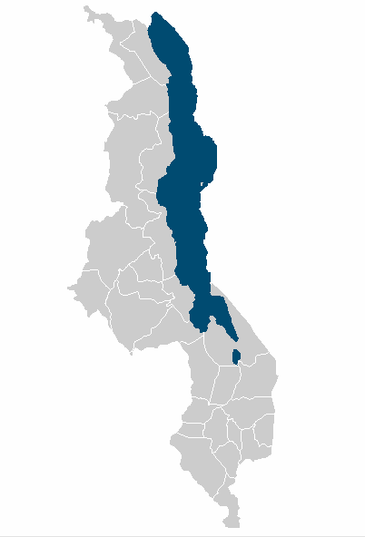
Study Area
Malawi, Africa
Image Credit: Alvaro1984 18
Image Credit: Natural Earth
Notes:
Demographics
3rd poorest country in the world (World Bank 2014)
GDP- $780
Life expectancy- 58
Water Availability
Lake Malawi ~ 20% of the land surface cover
“Has significant volumes of water in lake and rivers…”
“….however, water resources are declining” (UNEP 2013)
Climate change
Land degradation (deforestation)
Pollution
Considered water-stressed
Base Layer: Natural Earth
Image Credit: https://en.wikipedia.org/wiki/File:Location_Malawi_AU_Africa.svg
http://www.unpei.org/sites/default/files/e_library_documents/Malawi_Policy_Brief_Water_Resources_MSEOR.pdf
http://data.worldbank.org/indicator/NY.GDP.PCAP.PP.CD?order=wbapi_data_value_2013+wbapi_data_value+wbapi_data_value-last&sort=desc

Slide 3
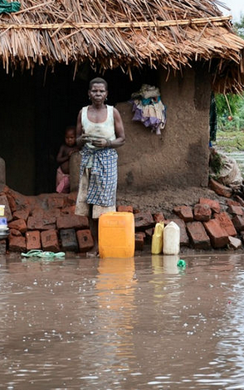
Malawi Vulnerability
Strong Seasonal Precipitation
Diverse Topography
Largely Poor Population
Image Credit: Arjan van de Merwe/UNDP
Notes:
Image credit: https://www.flickr.com/photos/unitednationsdevelopmentprogramme/16194370068/in/album-72157650093828759/
Malawi has both a high vulnerability and high risk of natural hazards, leading to a high risk for disasters.
The pictures show left- a flood, middle- a hand drawn map showing a synoptic weather map with an ITCZ location which leads to heavy rain and right- poor construction of homes and poor location of homes increases vulnerability
A region with sparse climatic and environmental data
Prone to flooding (occasionally leading to a national disaster)
Needs reliable time series of climatic and environmental data to analyze flood impact
Temporally and spatially

Slide 4
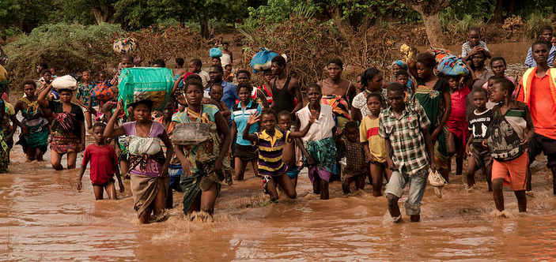
Image Credit: Arjan van de Merw UNDP
Image Credit: Arjan van de Merwe/UNDP
January 2015 Floods
Displaced over 230,000 residents
276 people reported dead or missing
Notes:
In January 2015, Malawi experienced a series of flood events that led to the displacement of over 200,000 residents, and left hundreds dead or missing. The Malawi floods were complex, consisting of both flash floods and riverine floods. This added difficulty to forecasting and monitoring efforts and subsequently, preparedness and response efforts.
Image: https://www.flickr.com/photos/unitednationsdevelopmentprogramme/16356020316/in/album-72157650093828759/

Slide 5
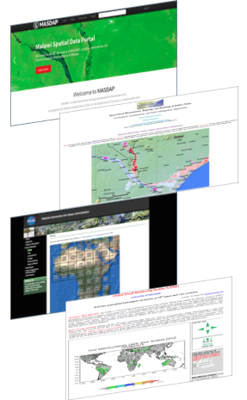
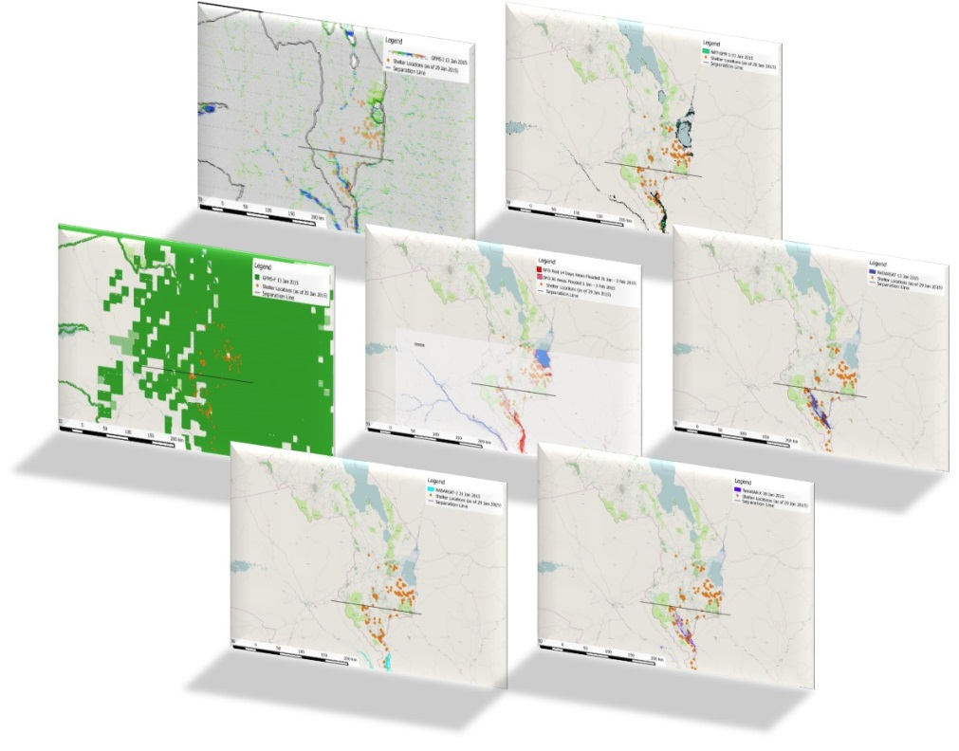
Previous Work
Comparison of flood detection products
Revealed large discrepancies in the accuracy of detecting different flood types
Notes:
This project builds on the previous term’s Project comparing techniques of inundation detection for January 2015 floods using NASA earth observationsA previous study of several inundation products provided insight into potential disparities between spatial distribution of flood signals relative to the specific type of flood.
The current project builds on this analysis of various EO flood detection products and incorporates specific flood definitions to better identify and evaluate flash floods versus riverine floods. These definitions will then be incorporated into a comprehensive framework to better monitor and forecast flash flood events in vulnerable areas. By incorporating flash floods into the analysis, this project aims to further assist our project partners, as well as other humanitarian agencies, to better monitor the spatial extent of different flood events and further improve disaster relief response.
_________
The Malawi Spatial Data Platform
TerraSAR-X, RADARSAT & RADARSAT-2
The Dartmouth Flood Observatory website
DFO
NASA Goddard’s Office of Applied Science’s NRT Global Flood Mapping website
NRT-GFM
University of Maryland’s Global Flood Monitoring System website
GFMS-FD & GFMS-I
All flood detection products were then added into QGIS for processing and visualization
-------
Analysis of product comparison
Qualitative spatial analysis of relationship between shelters and inundation products
Through visual comparison across all flood detection products, it was apparent that spatial coverage and accuracy differ approximately north of Chikwawa district and south of it. Hence, a black horizontal line was drawn to help analyze results. Above the line are areas prone to flash floods, and below the line areas are susceptible to riverine floods.
As shelters are usually located in close spatial proximity to inundated communities (usually within 10 km), we assume that inundation signals nearby shelters are valid. Further quantitative analysis will be completed in the next term
-----------

Slide 6
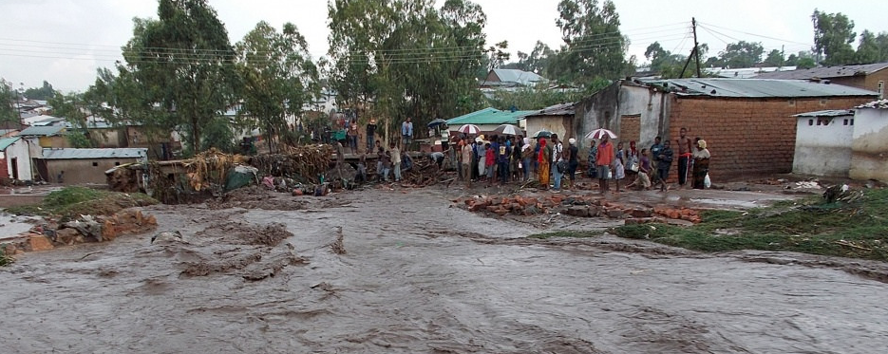
Objectives
Validate previous term’s results with new ground truth data
Produce a methodology for analyzing flood detection skill relative to flash floods
Image Credit: Arjan Merwe UNDP
Notes:
Newly provided ground truth from our project partners allowed us to validate the previous term’s results. The nex
The objective for this project is to build on the previous term’s results by incorporating new data provided by project partners, and use NASA EOS to produce a framework for analyzing flood detection skill relative to flash floods.
Image Credit: https://www.flickr.com/photos/unitednationsdevelopmentprogramme/16194370778/in/album-72157650093828759/

Slide 7
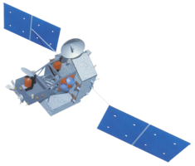
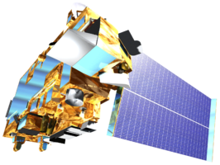
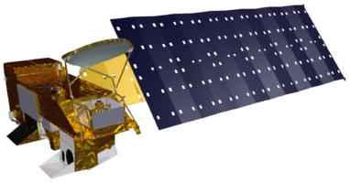
Earth Observations Utilized
NASA Earth Observations
  MODIS sensor aboard Terra and Aqua satellites
  TRMM, Aqua (AMSR-E & AMSU-A), & Defense Meteorological Satellite Program satellites
  European Space Agency (ESA)
  ASCAT Sensor (EUMETSAT METOP-A)
Other Earth observations
  Synthetic Synthetic Aperture Radar (SAR)
TRIMM
Terra
Aqua
Notes:
The EOs utilized in the project included:
MODIS sensor aboard Terra and Aqua satellites
DFO (Dartmouth Flood Observatory Flood Detection Product) & NRT-GFM (NASA Goddard’s Office of Applied Science’s NRT Global Flood Mapping product)
TRMM, Aqua (AMSR-E & AMSU-A), & Defense Meteorological Satellite Program satellites
GFMS-FD & GFMS-I (Global Flood Monitoring System’s Flood Detection and Inundation product))
Synthetic Aperture Radar (SAR)
TerraSAR-X (Germany),
RADARSAT (Canada) &
RADARSAT-2 (Canada)
https://nwpsaf.eu/monitoring/scatter/ascat.html

Slide 8
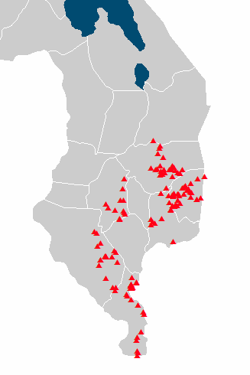

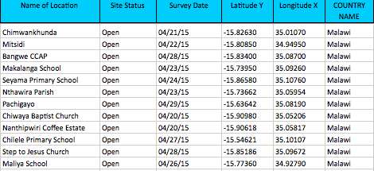
Project Methodology: Step 1
Ground truth data (shelter site locations) provided by Malawi Red Cross
Notes:
Base Layer: Natural Earth
The ground truth provided by Red Cross Red Crescent included the Lat/Long coordinate of each shelter site, along with the location of the village the majority of the displaced residents came from.

Slide 9
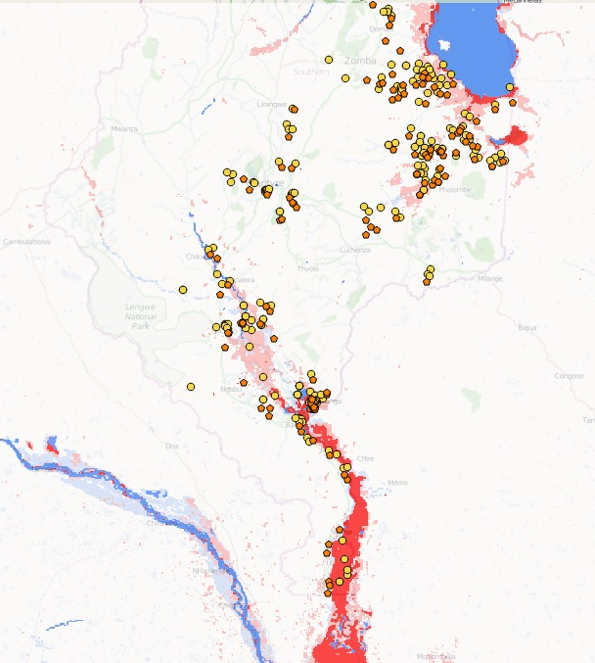
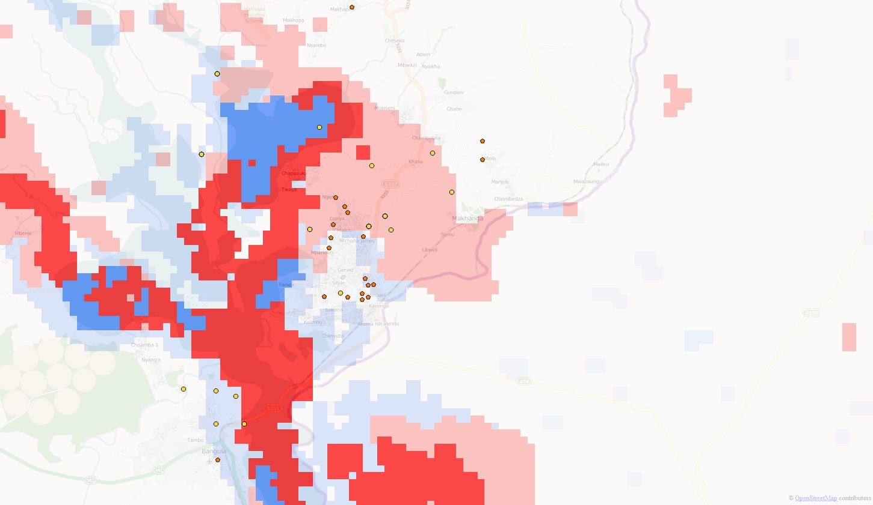
Dartmouth Flood Observatory
Flood Detection product
Flooded village
Shelter Sites
Analysis
Reprocess flood products with locations of flooded villages, provided by Malawi Red Cross
Notes:
Image Base Layer: OpenStreet Map
For each flood detection product used last term, the high resolution ground truth data allowed us to further explore the spatial extent of the flooding picked up by previous sensors at a more precise level.
This example shows the DFO flood product reprocessed with ground truth data

Slide 10
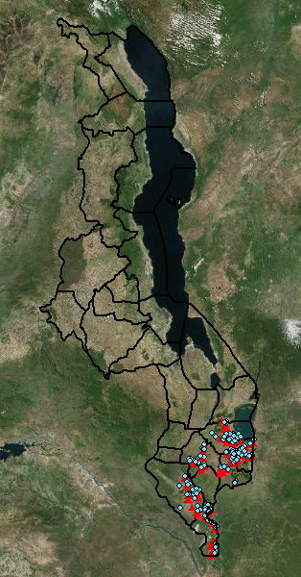
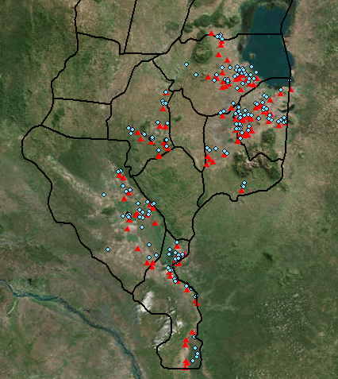
Project Methodology: Step 2
Collect and analyze soil moisture and precipitation products
Notes:
In the next step of the project, we acquired data from NASA and ESA satellites to analyze the relationship between antecedent flood conditions relative to the spatial and temporal distribution of flash floods and riverine floods. These variables include both precipitation and soil moisture.
Base Layer: ArcMap Imagery

Slide 11
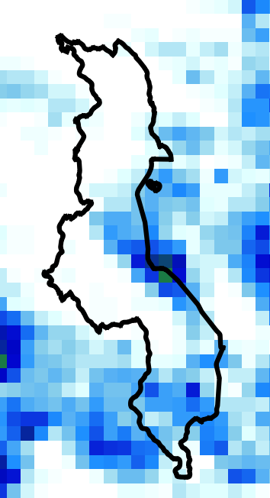
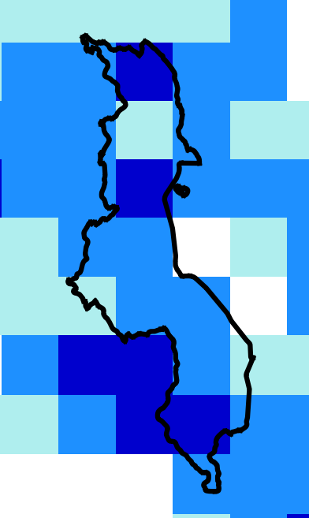
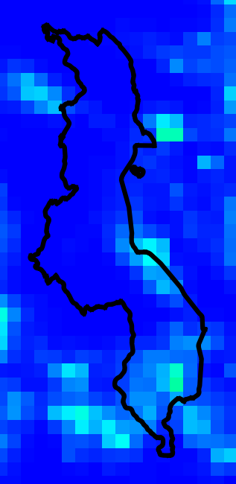
Precipitation Data
IFRC 6-day Extreme Forecast
TRMM
CMORPH
Notes:
The precipitation data sets included two monitoring products (TRIMM and CMORPH) , and one forecasting product (IFRC)
Base layer: Natural Earth

Slide 12
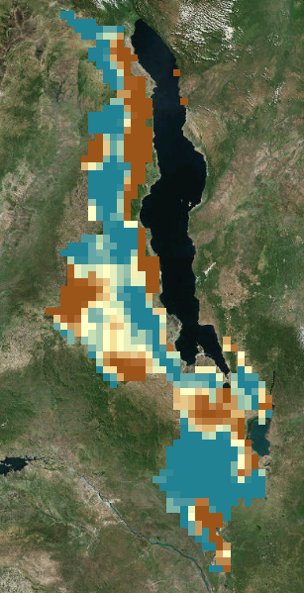
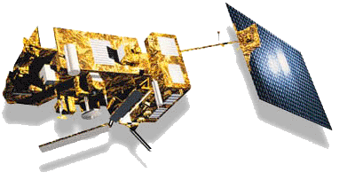
Soil Water Index
MetOp-A
Product of the European Space Agency
MetOp-A Satellite ASCAT Sensors
Notes:
The soil moisture was collected from the European Space Agency satellite, and ASCAT sensor
Base Layer: ArcMap Imagery

Slide 13
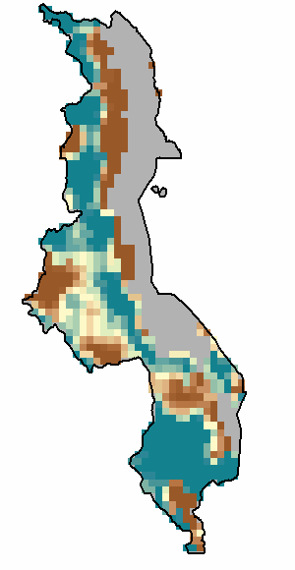
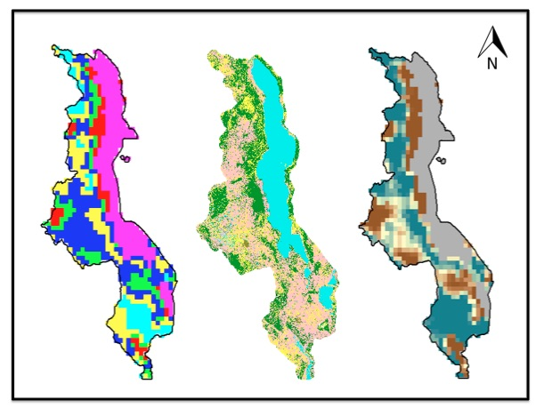
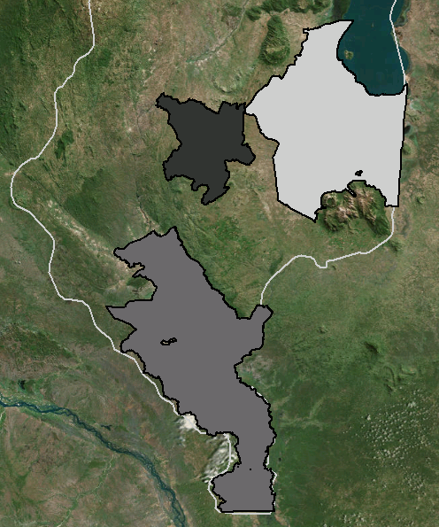
Project Methodology: Step 3
Conduct Iso Cluster Unsupervised Classification Analysis
2
1
1
3
2
3
Soil Moisture
Iso Cluster
Selected Regions
Notes:
To assess the potential predictive relationship of soil moisture and flooding, an iso-cluster analysis was conducted using ENVI geospatial imagery analysis software. Results determined that there are 3 distinct regions of soil moisture behavior in our study area during the time leading up to the floods.

Slide 14
Project Methodology: Step 3
Zonal statistical analysis
Mean precipitation and soil moisture for each selected region:
1
2
Phalombe Region
Blantyre Region
Shire River Region
3
Notes:
Zonal Statistics calculated with ArcGIS & QGIS
Mean precipitation and soil moisture for each region over study period

Slide 15
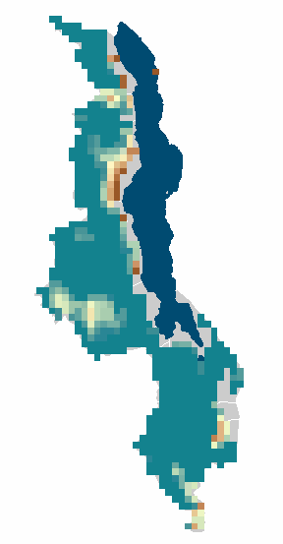
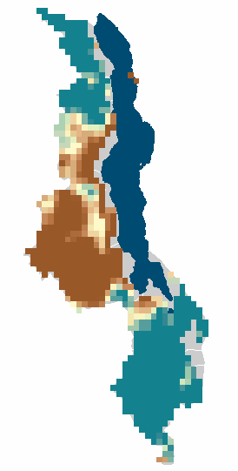
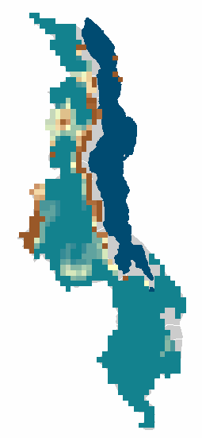
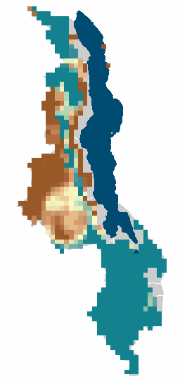

Project Methodology: Step 4
Jan 11, 2015
Jan 14, 2015
Calculated a time series for each region to visualize the relationship between precipitation and soil moisture
Notes:
A time series was calculated for each selected region, over the entire study period
Visual Time Series of Soil Moisture index, 0 is dry 200 is highly saturated.
Jan 11, Jan 12, Jan 13, Jan 14,
Base Layer: Natural Earth

Slide 16
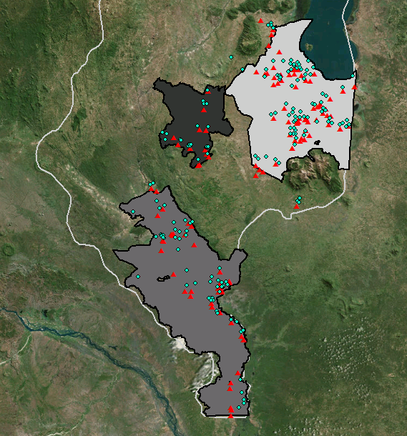
1
Results
2
Both flash &
  riverine floods
Flash floods
Riverine floods
1
2
3
3
Iso Cluster defined regions corresponded to 3 distinct flood behaviors in Malawi
Notes:
The results of the Isocluster analysis Results determined that there are 3 distinct regions of soil moisture behavior in our study area during the time leading up to the floods. The first selected region corresponded to the area in Malawi where both flash floods and riverine floods occurred, the second region had mostly flash floods, and the majority of the third region experienced riverine floods.
Base Layer: ArcMap Imagery

Slide 17
Results
Time Series
Notes:
Potentially 3 separate slides if there are too many images
Reprocess FP layers
Put in new Shelter Data Red Cross Red Crescent
IDP information,
Soil Moisture Analysis
3. Extreme Rainfall Analysis

Slide 18
Results
Time Series:
Notes:
Potentially 3 separate slides if there are too many images
Reprocess FP layers
Put in new Shelter Data Red Cross Red Crescent
IDP information,
Soil Moisture Analysis
3. Extreme Rainfall Analysis

Slide 19
Results
Time Series
Elevated soil moisture before occurrence of flash floods
Notes:
Time series for Blantyre Region shows increase soil moisture during known flash flood events

Slide 20
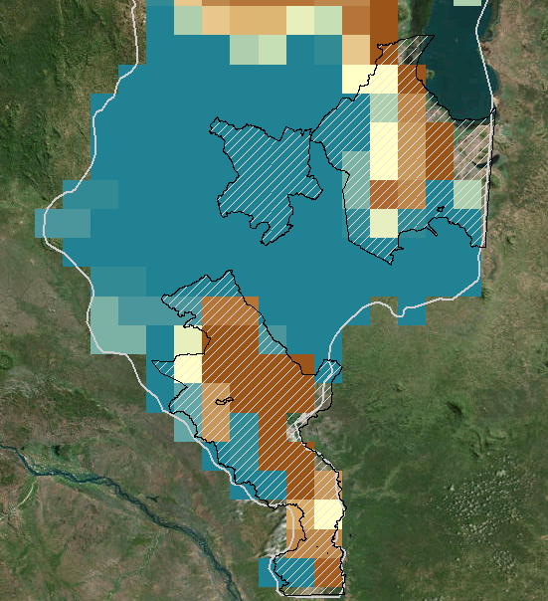
Conclusions
Elevated
soil moisture values
Long duration of
elevated values
Potential increased
risk of flash flooding
Notes:
Our analysis revealed that the relationship between soil moisture, rainfall and flooding is similar for the 2 regions which included riverine floods. However, within the region where flash floods occurred, soil moisture was elevated at an earlier date for a longer period of time. This may be indicative of the soil moisture in this area being at or near saturation for a longer period of time, which may be a sign of increased risk of flash floods.
Base Layer: ArcMap Imagery

Slide 21
Conclusions cont.
Increase Monitoring
Differentiate between flood types (Flash and Riverine)
Disaster Relief
Efforts
Better allocation of aid
Humanitarian
Organizations
Faster disaster response
Notes:
16_ AK: It is expected that the results of this study will increase the ability to monitor different types of flood events, directly benefitting organizations involved with disaster relief efforts in Malawi; and potentially allowing for a faster response and better allocation of emergency flood relief efforts.

Slide 22
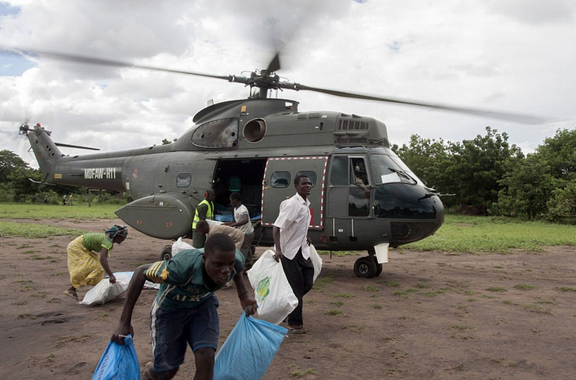
Next Steps
Developing an early warning system for flash floods
Identify areas of increased risk on short timescales
Explore thresholds related to risk
Link directly to emergency preparedness actions
Image Credit: Arjan van de Merwe/UNDP
Notes:
17_ AK: The next steps after this project include developing an early warning system for flash floods, with the goal of identifying areas of increased flash flood risk, exploring the thresholds related to this risk, and linking these directly to emergency preparedness actions.

Slide 23
Advisors
Dr. Pietro Ceccato, Lead Environmental Monitoring Program, IRI
Partners
Erin Coughlan de Perez, Red Cross/Red Crescent Climate Centre
Hastings Kandaya, Malawi Red Cross Society
Others
Alex Sweeney & Jerrod Lessel, Past Project Contributors

