Slide 1
Indonesia Disasters By Alex Sweeney & Jerrod Lessel (IRI)
Tested new methodology for mapping burn scars
Project partners = IPB and CIFOR
Remotely sensed products are crucial in the monitoring of forest fires
Notes:
Over the past several weeks, Jerrod Lessel and I tested a new methodology for mapping burn scars in Central Kalimantan, Indonesia.
We collaborated with the University of Agriculture (IPB) in Bogor, Indonesia as well as the Center for International Forestry Research or CIFOR.
Mapping of burn scars is important to understand the impact of fire on the ecosystem as well as to help estimate the amount of carbon that has been released into the atmosphere from these fires.
Methods based off of remotely sensed products are critical in monitoring fires and burn scars because ground-based methods are not viable for exhaustive information on a spatially and temporally relevant scales.
Base layer source.
Natural Earth. (2015). Admin 0 - Countries, Available from: http://www.naturalearthdata.com/downloads/10m-cultural-vectors/10m-admin-0-countries/ (Accessed 01 June 2015)

Slide 2
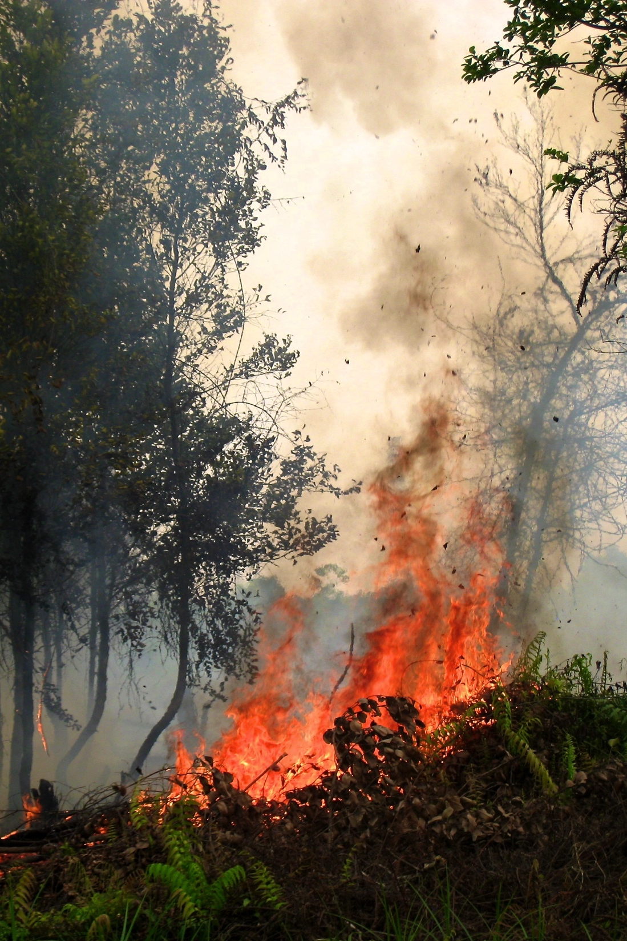
Community Concerns
1989-2008 - fires dominate deforestation
  93% forest loss
  69% of net C emissions
Adversely affects
  Air quality
  Human health
  Biodiversity
  Productivity
Credit: Rini Sulaiman, CIFOR
Notes:
Indonesia experiences extensive deforestation due to different land conversion activities such as agricultural expansion, establishment of palm and pulp plantations, and peatland alteration, mostly as a result of fires.
Between 1989-2008, fire was the dominant cause of deforestation, accounting for 93% of forest loss, as well as 69% of total carbon emissions in Indonesia [Carlson et al., 2012].
Fires adversely affect air quality, human health, biodiversity, and productivity, which is why it is so crucial to monitor them.
Image Credit: Rini Sulaiman for CIFOR, Flickr Creative Commons

Slide 3
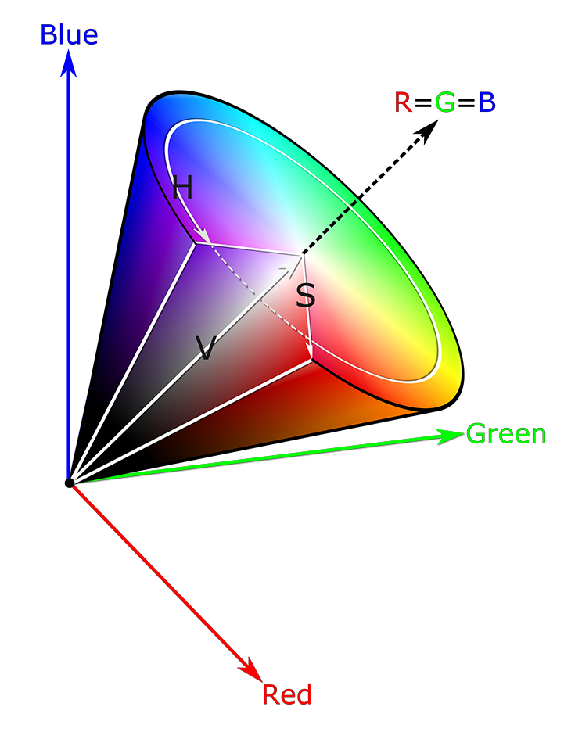
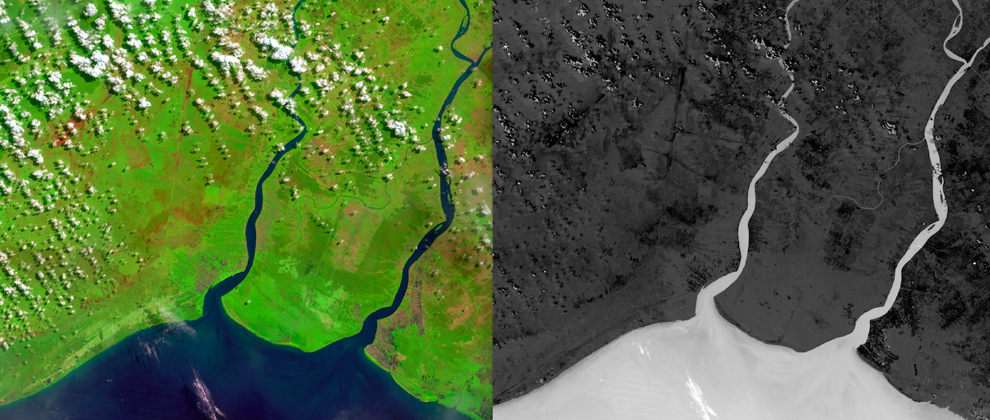
Objectives
Color transformed RGB color space to HSV space
Isolate hue range of burn scars
Credit: Pekel et al. (2011)
Red (MIR), Green (NIR), Blue (Red) false color composite
Hue image depicting land cover types
Notes:
Test the technique of transforming Red Green Blue (RGB) color space into Hue Saturation Value (HSV) space
Basically it’s using a color composition of middle-infrared, near-infrared, and the red into a Red, Green, Blue color composite and to convert that space, 3 dimensional space, into a new space the Hue Saturation Value.
Where the hue will show the colors, either of vegetation or the water bodies or the burn scars. And with this new method we hope to improve the detection of the burn scars, using the hue, the colors, as the threshold to detect them.
Image credit: Modified from Pekel et al. (2011).
The advantage of using this color transformation technique is that by converting the normal RGB color space into an HSV space, we are able to isolate the hue from the saturation and the value. This in turn, when applied to a false color composite consisting of shortwave infrared, near infrared, and red wavelengths allows for a superior discrimination between vegetation, soil, and water [Pekel et al., 2011]. This enhanced classification between the various land covers aids in the identification of burn scars at high spatial resolution.

Slide 4
Objectives
Color transformed RGB color space to HSV space
Isolate hue range of burn scars
Credit: Pekel et al. (2011)
Red (MIR), Green (NIR), Blue (Red) false color composite
Hue image depicting land cover types
Notes:
Test the technique of transforming Red Green Blue (RGB) color space into Hue Saturation Value (HSV) space
Basically it’s using a color composition of the near-infrared, middle-infrared, and the red into a Red, Green, Blue color composite and to convert that space, 3 dimensional space, in a new space the Hue Saturation Value.
Where the hue will show the colors, either of vegetation or the water bodies or the burn scars. And with this new method we hope to improve the detection of the burn scars, using the hue, the colors, as the threshold to detect the burn scars.
Image credit: Modified from Pekel et al. (2011).
The advantage of using this color transformation technique is that by converting the normal RGB color space into an HSV space, we are able to isolate the hue from the saturation and the value. This in turn, when applied to a false color composite consisting of shortwave infrared, near infrared, and red wavelengths allows for a superior discrimination between vegetation, soil, and water [Pekel et al., 2011]. This enhanced classification between the various land covers aids in the identification of burn scars at high spatial resolution.

Slide 5




Satellite Data
194 Landsat 5 & 7 scenes
MODIS Active Fire Product
June - November, 2006
Notes:
We used 194 Landsat 5 and 7 scenes, over Central Kalimantan for 12 different path/row combinations.
We used bands 5, 4, and 3
These bands had a spatial resolution of 30 m, Scenes were acquired for the year 2006 over the months of June through November.
In order to cross-reference burn scars, we used the MODIS Active Fire Product over the southern part of Central Kalimantan, which coincided with two Landsat scenes
Base layer source.
Natural Earth. (2015). Admin 0 - Countries, Available from: http://www.naturalearthdata.com/downloads/10m-cultural-vectors/10m-admin-0-countries/ (Accessed 01 June 2015)
Landsat Tiles Source.
United States Geological Society (USGS). (2013). Path/Row Shapefiles, Available from: http://landsat.usgs.gov/tools_wrs-2_shapefile.php (Accessed 23 June 2015)

Slide 6
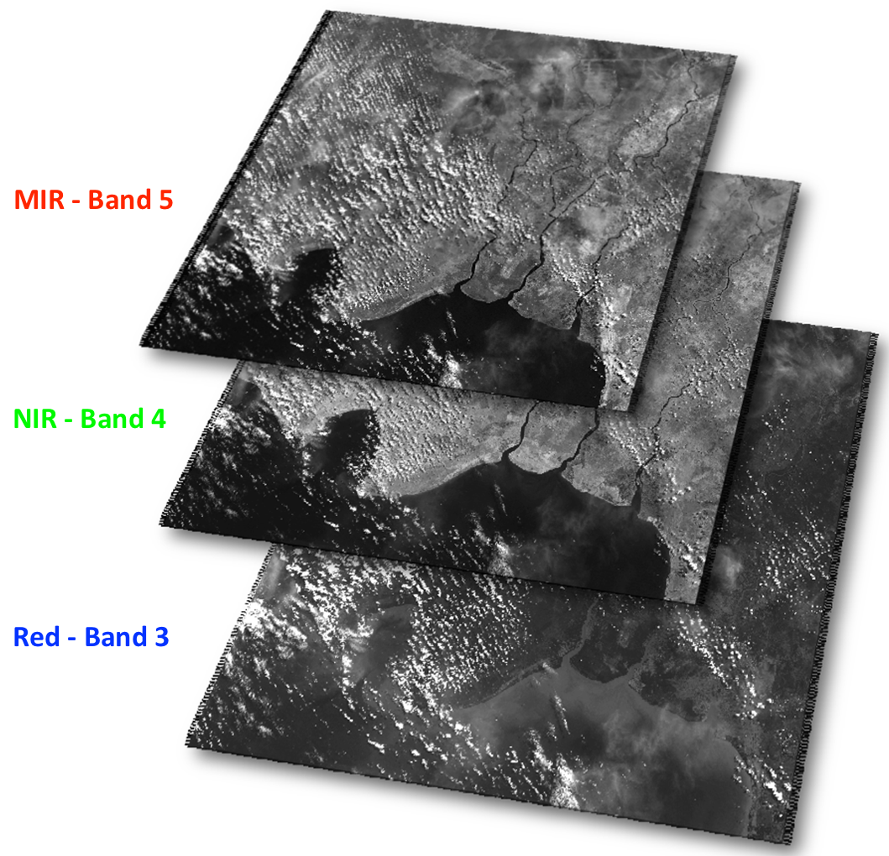
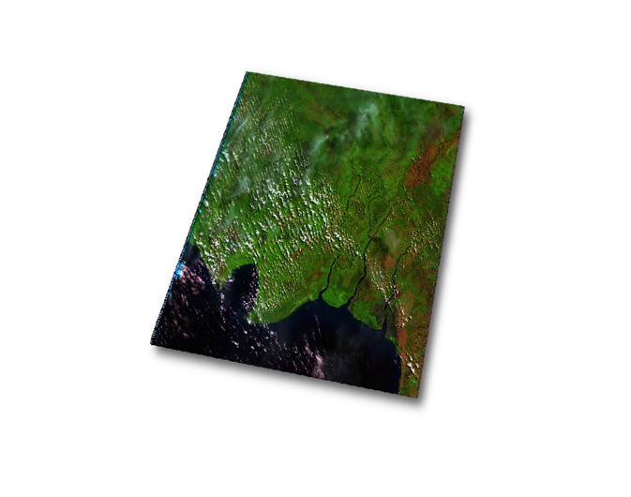
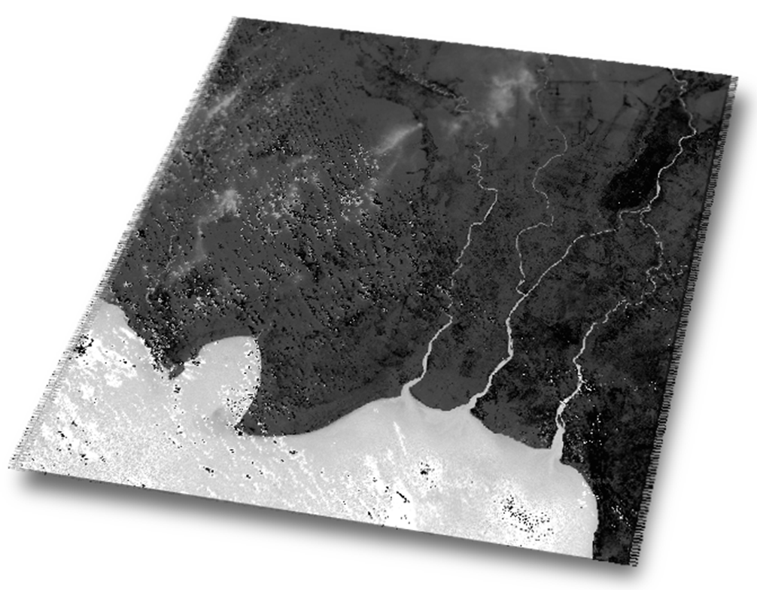
Methodology
False color RGB created using bands 5 (MIR), 4 (NIR), and 3 (Red)
ENVI for color transformation
Model builder to isolate hue values
5
4
3
Landsat Bands
RGB Composite
HSV
Notes:
Red, Green, and Blue, false color images using bands 5 (Middle Infrared- MIR), 4 (Near Infrared - NIR), and 3 (Red) were created using ENVI and subsequently the null values were removed from each scene
The false color images were then transformed from RGB color values to HSV using the RGB to HSV transformation technique within ENVI.
After the color transformation was completed the Hue values for each scene were isolated and exported for use within ArcMap.
In ArcMap, a model builder was established to isolate Hue values that pertain to soil, these pixels were then extracted from the images.

Slide 7
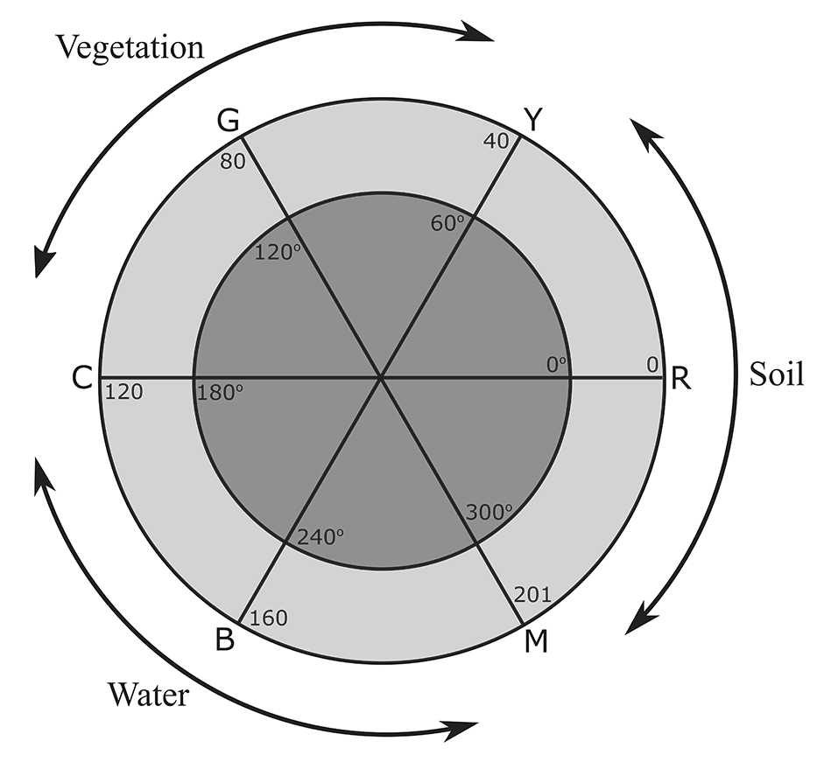
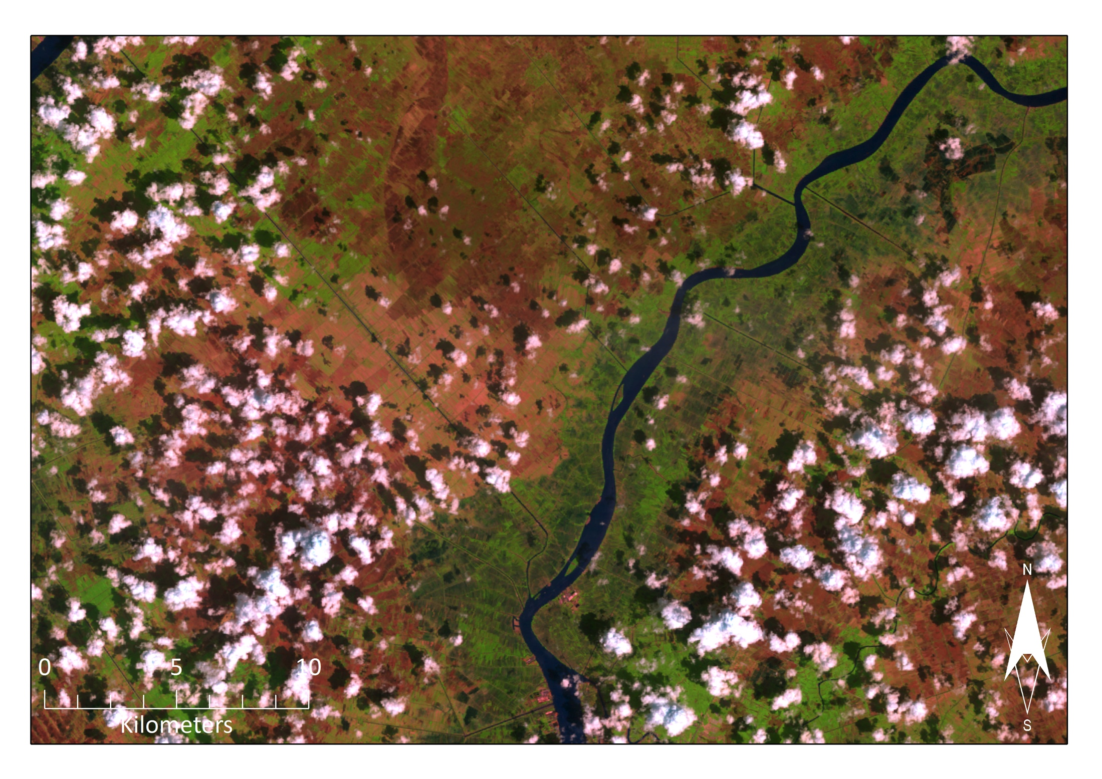
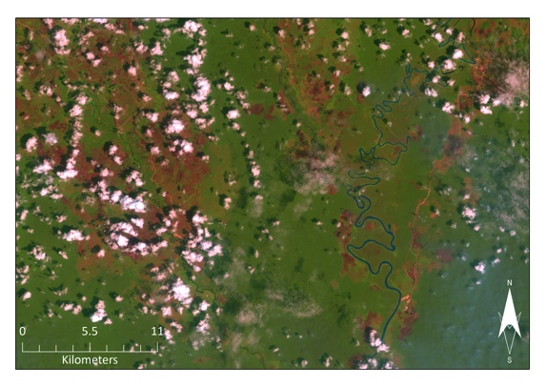
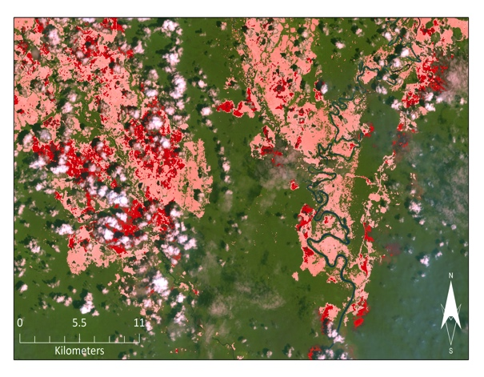
Methodology
Soil hue values = 200-255 and 0-40
Clouds and haze presented problems
Ag fields in soil hue range
Reddish Clouds
Hue + Sat eliminated cloud noise
Notes:
Hue values that pertain to soil occupy the range between 200-255 and 0-40. This range not only includes burn scars, but also fallow agricultural areas as well as bare ground in cities and elsewhere.
Clouds and haze presented problems when merely identifying burn scars by their hue values. In many images the cloud edges were higher in the MIR range, causing the clouds to appear reddish in color in the RGB false color composites, which consequently caused their hues to fall within hues that are associated with burn scars.
An important distinction between bare soil, such as fallow agricultural fields, and burn scars is the irregularity of shapes that burn scars exhibit as well as their proximity by canals - due to land conversion to palm plantations

Slide 8
Methodology
Clouds and haze presented problems
Isolated hue + saturation values
3D graph of clouds (blue) and burn scars’ (red) reflectance's in Red (MIR), Green (NIR), and Blue (Red)
Ag fields in soil hue range
Reddish Clouds
Hue + Sat eliminated cloud noise
Notes:
Clouds and haze presented problems when merely identifying burn scars by their hue values. In many images the cloud edges were higher in the MIR range, causing the clouds to appear reddish in color in the RGB false color composites, which consequently caused their hues to fall within hues that are associated with burn scars.
So, we looked at the reflectance's of the clouds versus the burn scars in the RGB composites and found they have different reflectance's in the red (MIR), meaning if we pulled saturation values that were associated with burn scars, it would allow for a superior discrimination between burn scar and clouds when used in concert with hues
We found that by isolating hues that also had saturation values between 150 and 240, we were able to diminish some of the cloud noise.

Slide 9
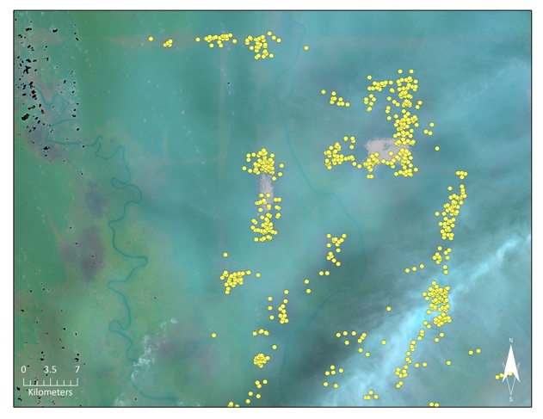
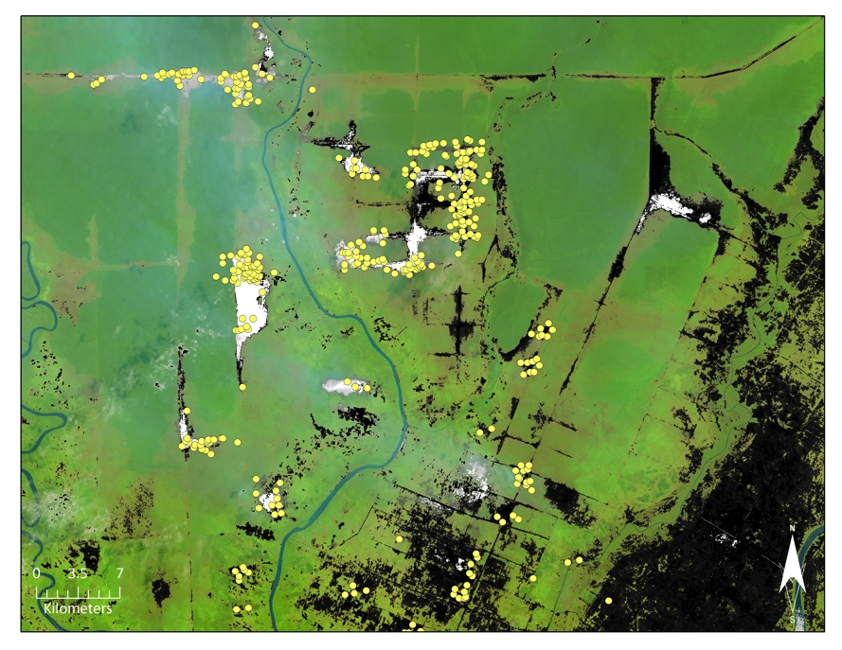
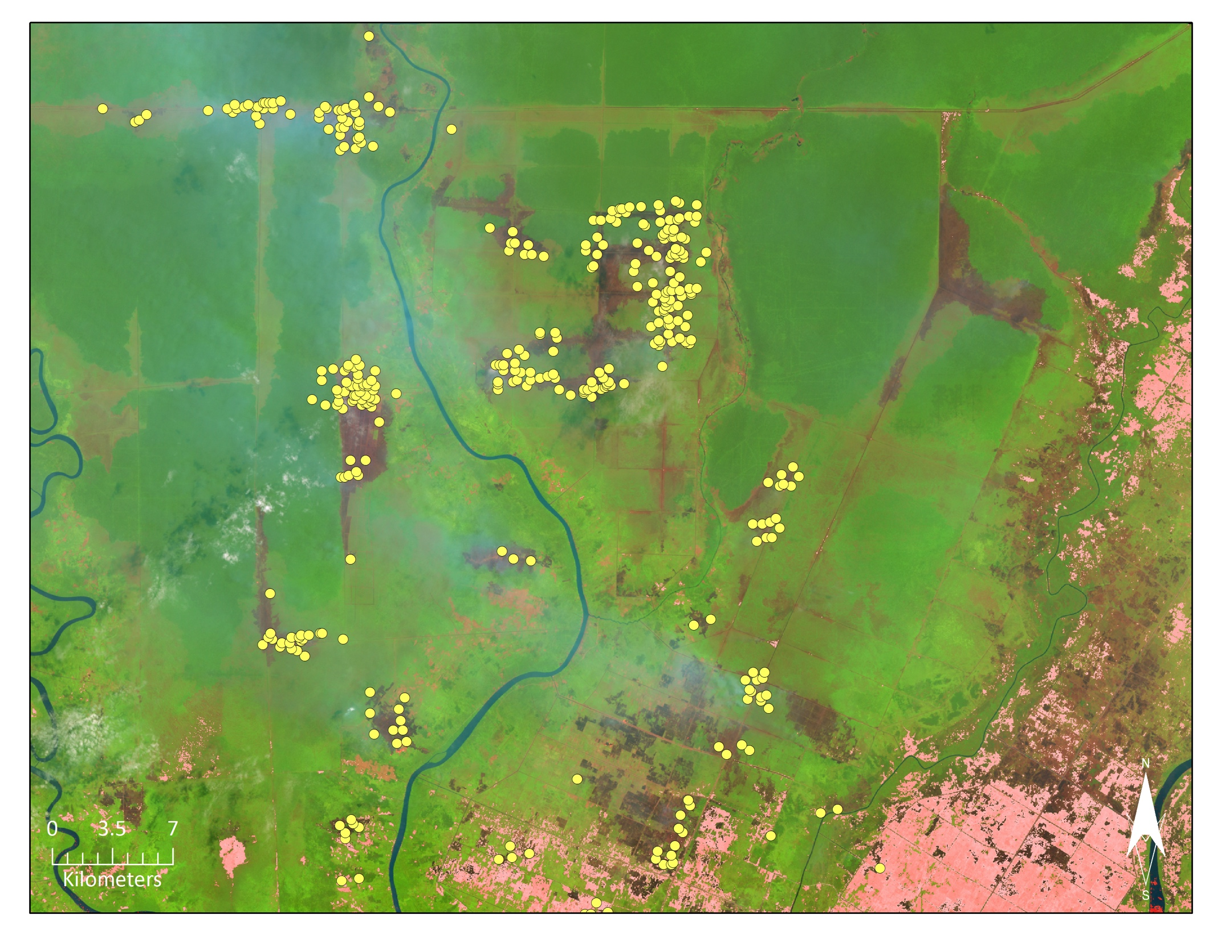
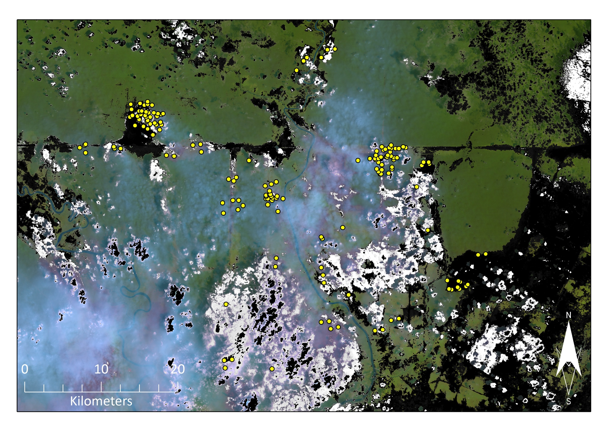
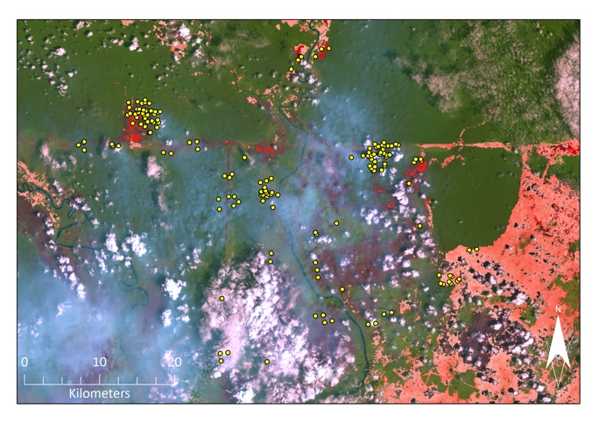
Yellow dots = MODIS Active fire product. Images of extracted hue values (greyscale) and hue + sat (red-scale)
Results
Hazy images had difficulties identifying burn scars
Hue = commission errors
Hue + Sat = omission errors
Notes:
However, our results indicated that when isolating hue and saturation in hazy images, burns scars could still not be recovered from the images.
We found that by isolating just the hues of soil, and therefore burn scars, it resulted in commission errors, where it picked up the wrong signal, for example clouds.
Whereas when we isolated both hue and saturation values pertaining to burn scars, it resulted in omission errors, where it left burn scars unidentified.
The burn scars picked up in our analysis were mostly fresh burn scars that happened on the order of days from satellite passover, while older burn scars were not picked up in these images because their hue values were not within the soil range. But exhibited hue values in the vegetation range.

Slide 10
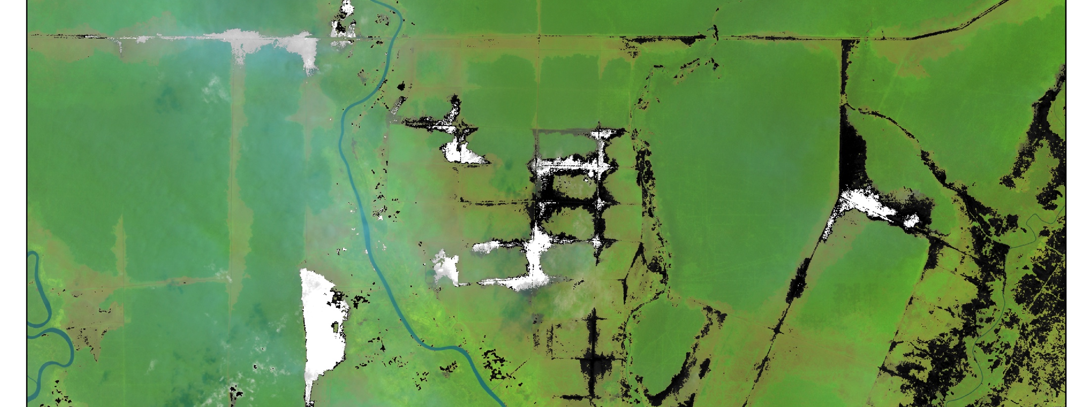
Conclusions
Both methods resulted in commission errors
Detected fresh burn scars
Methodology to aid project partners in future
Notes:
Both methods resulted in commission errors with regards to other soil types as well as agriculture.
However, it did not identify older burn scars that were still present in the landscape, and had seen a regrowth in vegetation.
This methodology could help our project partner to narrow down the search for burn scars but visual inspection would still be required after performing the procedure and further research could build upon and enhance this methodology for effectively mapping burn scars at higher spatial resolution.

