Slide 1
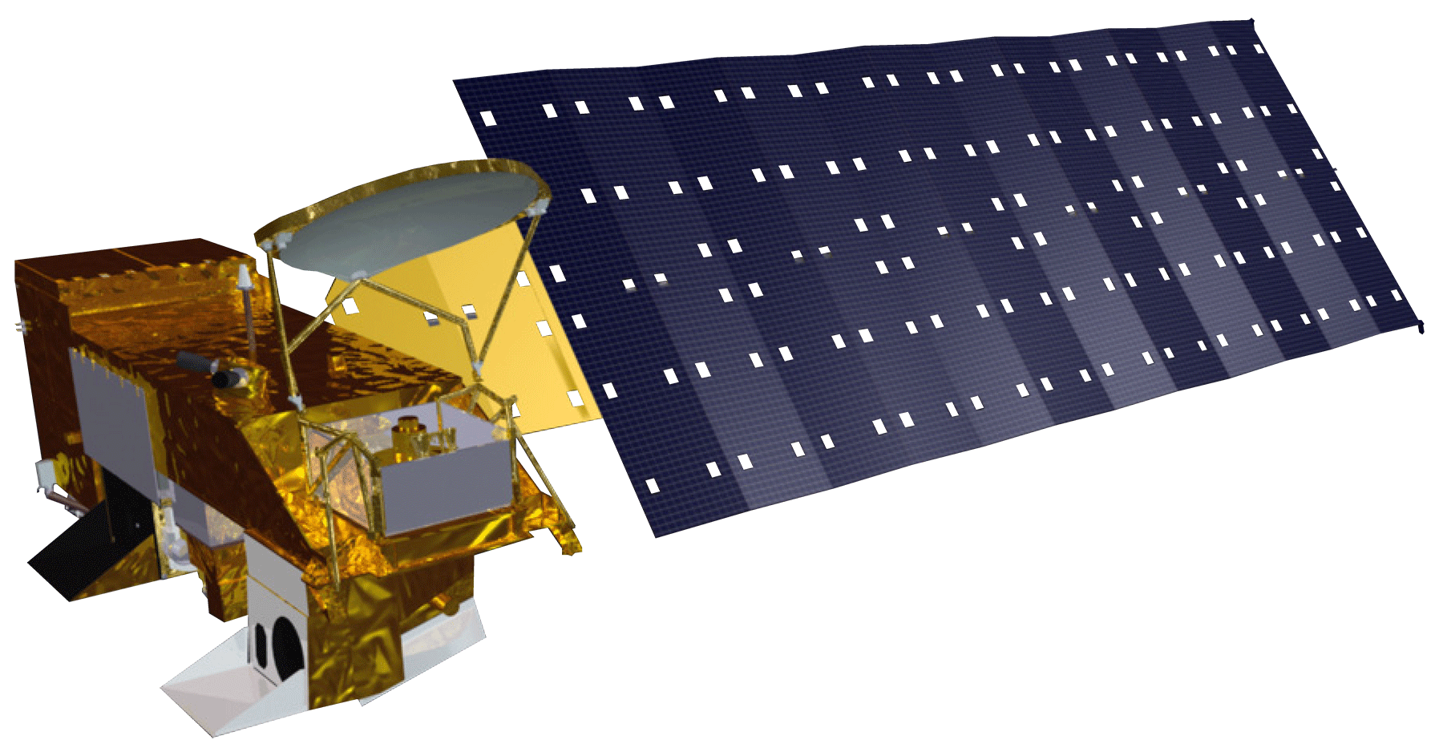
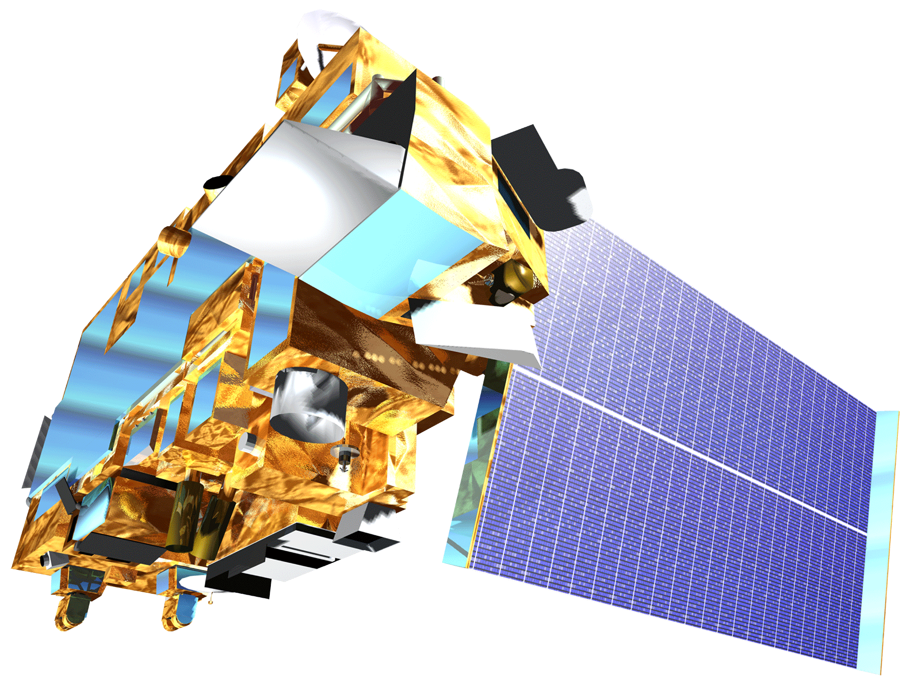
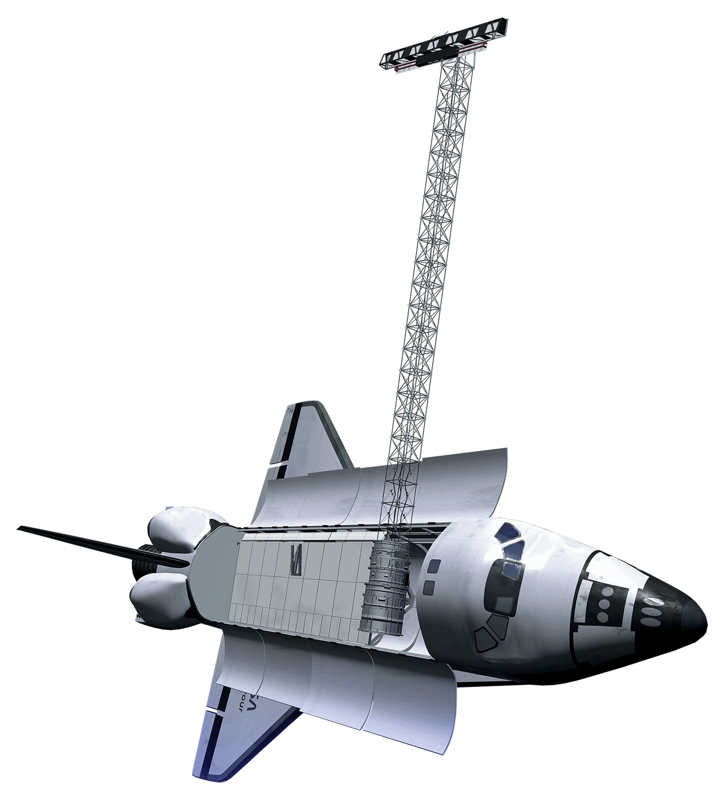
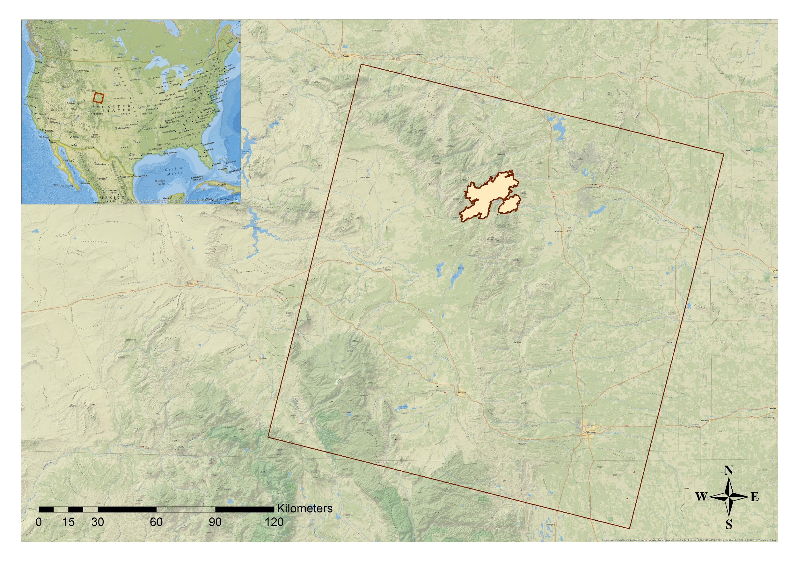
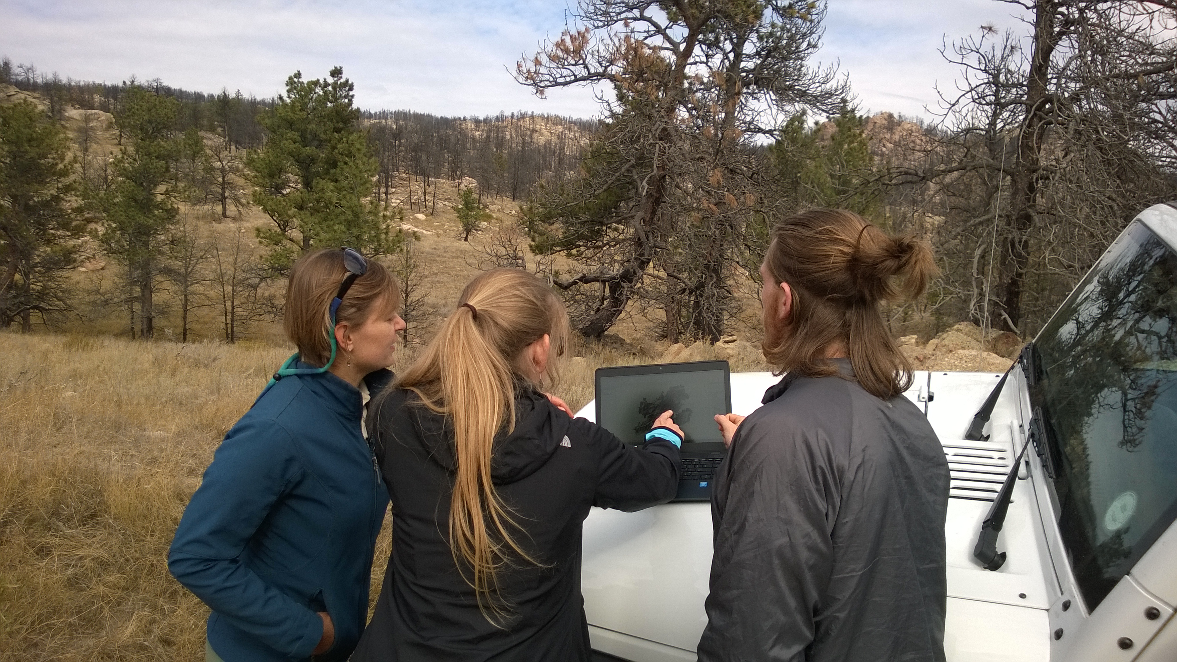
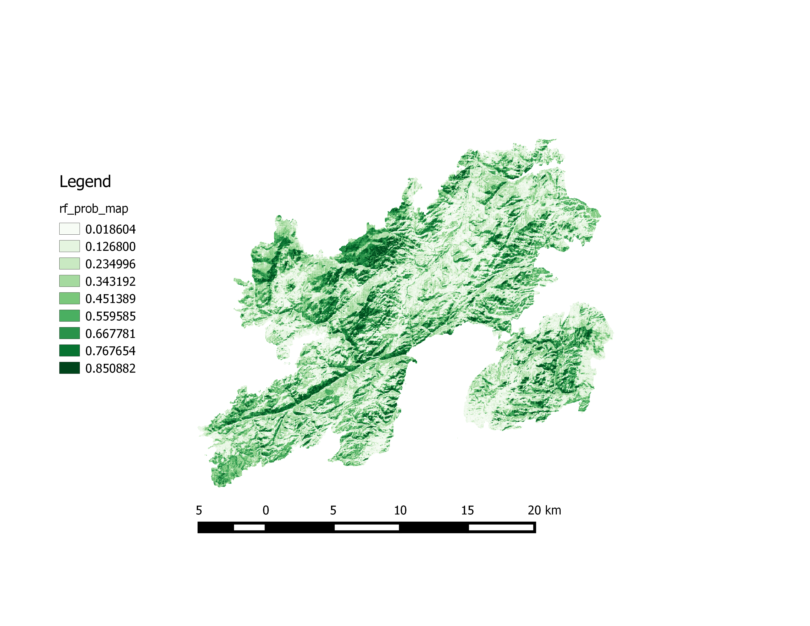
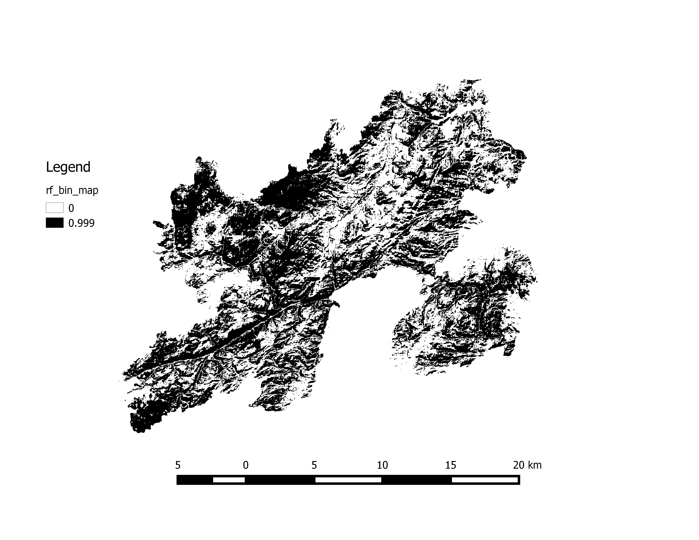
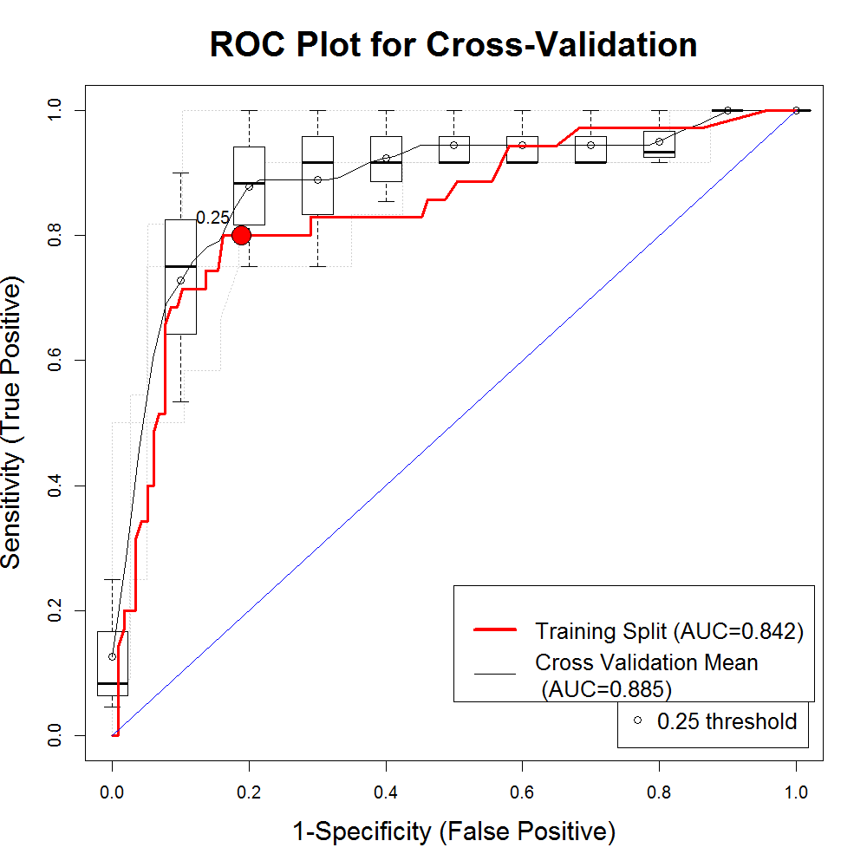
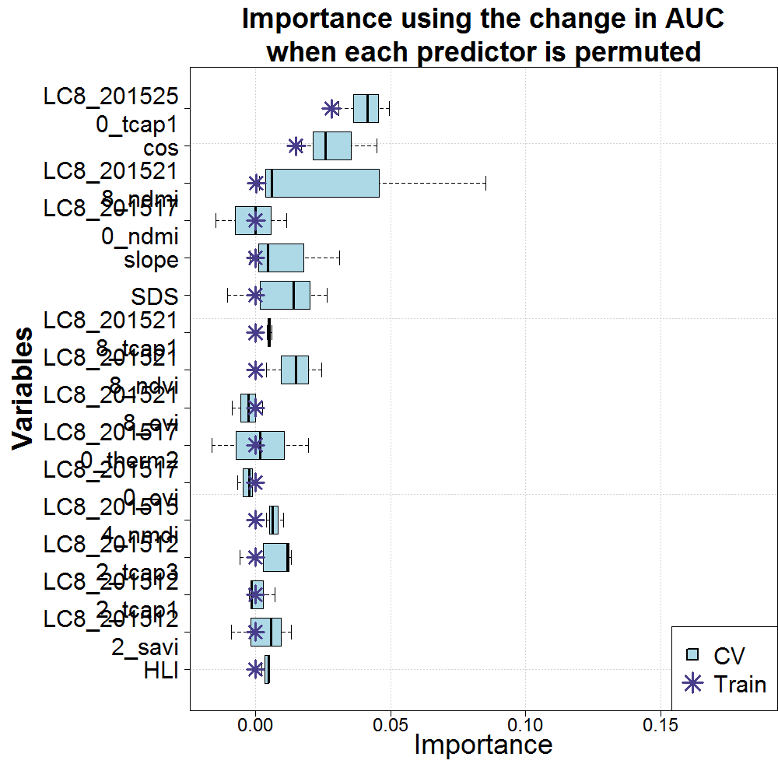
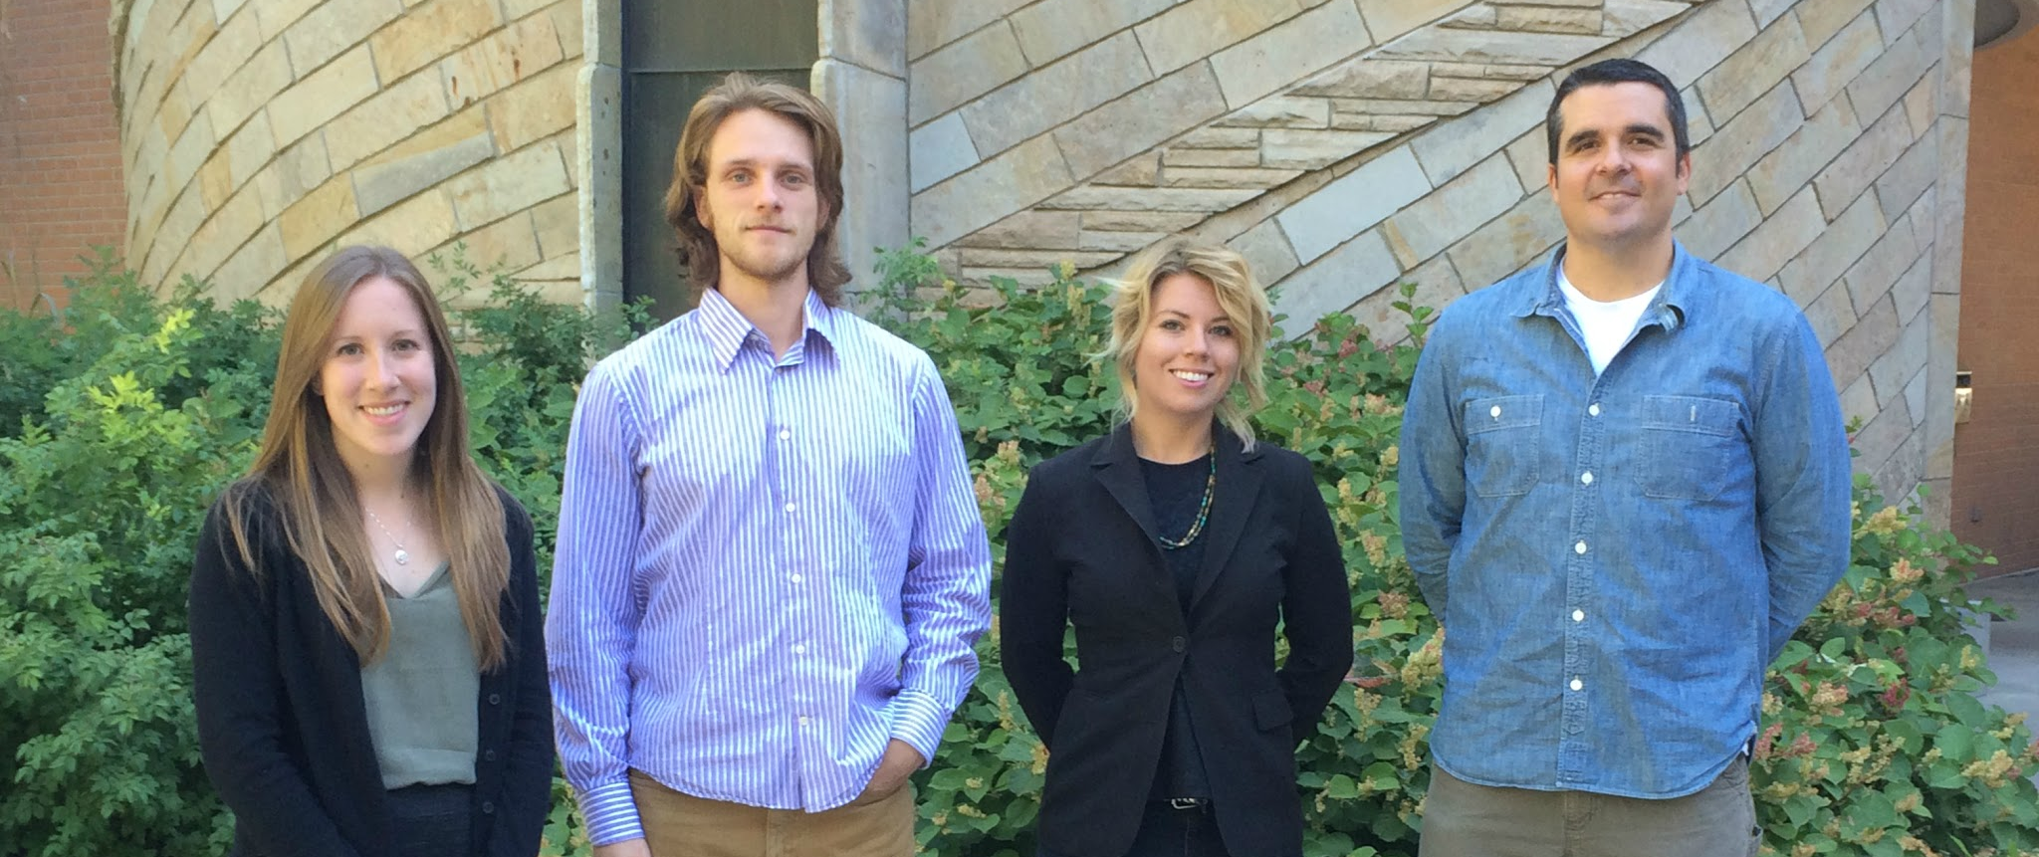
Wyoming Ecological Forecasting
Mapping cheatgrass distribution and phenology in a post-wildfire landscape
Darin Schulte (Project Lead), Chandra Fowler, Stephanie Krail, Oliver Miltenberger
NASA DEVELOP National Program at USGS Colorado State University
Abstract
Coming soon!
Objectives
Earth Observations
Identify cheatgrass distribution within the 2012 Arapaho Wildfire extent
Produce a cheatgrass cover map for the study area
Characterize phenological patterns in areas of known cheatgrass populations
Landsat OLI and TIRS
MODIS Aqua
MODIS Terra
Shuttle Radar Topography Mission (SRTM)
Study Area
Methodology
Data Acquisition
Data
Processing
Modeling
Results
Landsat 8
OLI and TIRS
Vegetation Indices
Species Distribution
Model
Cheatgrass
Cover Map
SRTM
Topographic Indices
Wyoming Ecoforecasting team member (right) Oliver Miltenberger discusses model results with (left) Project Partner Katherine Haynes (USFS) and (center) Project Mentor Amanda West (NREL).
MODIS
Phenology Product
Clip to
Study Area
Phenological Characterization Map
Legend
Arapaho Wildland Fire Boundary
Outline of Path 34 Row 31
Results
Probability Map
Binary Map
Model Diagnostics
[Complete legend and map description to be included in Final Draft]
[Complete legend and map description to be included in Final Draft]
[Complete legend, figure formatting and description of model diagnostics to be included in Final Draft]
Conclusions
Coming soon!
Team Members
Project Partners
Acknowledgements
Wyoming Game and Fish Department
U.S. Forest Service
Natural Resource Ecology Laboratory, Colorado State University
We would like to thank Dr. Paul Evangelista and Dr. Amanda West, Natural Resource Ecology Laboratory (NREL), Colorado State University (CSU).
We would also like to thank Ryan Amundson, Wyoming Game and Fish Department and Katherine Haynes, U.S. Forest Service as well as Ryan Anderson NREL, CSU his help with conducting field work.
[Additional names of those collecting field data to be included in final draft]
From left to right: Stephanie Krail, Oliver Miltenberger, Chandra Fowler, Darin Schulte
USGS at Colorado State University

