Slide 1
Perú Climate II
Monitoring and Forecasting Shifting Climate and Land Change Impacts in Perú’s Parque de la Papa for Enhanced Agricultural Management
Caren Remillard (Project Lead)
Brandon Hays
Benjamin Page
Adam Salway
Sam Weber
Xuan Zhang
Notes:
This is a continuation of a Fall 2015 project started at Langley Research Center.

Slide 2
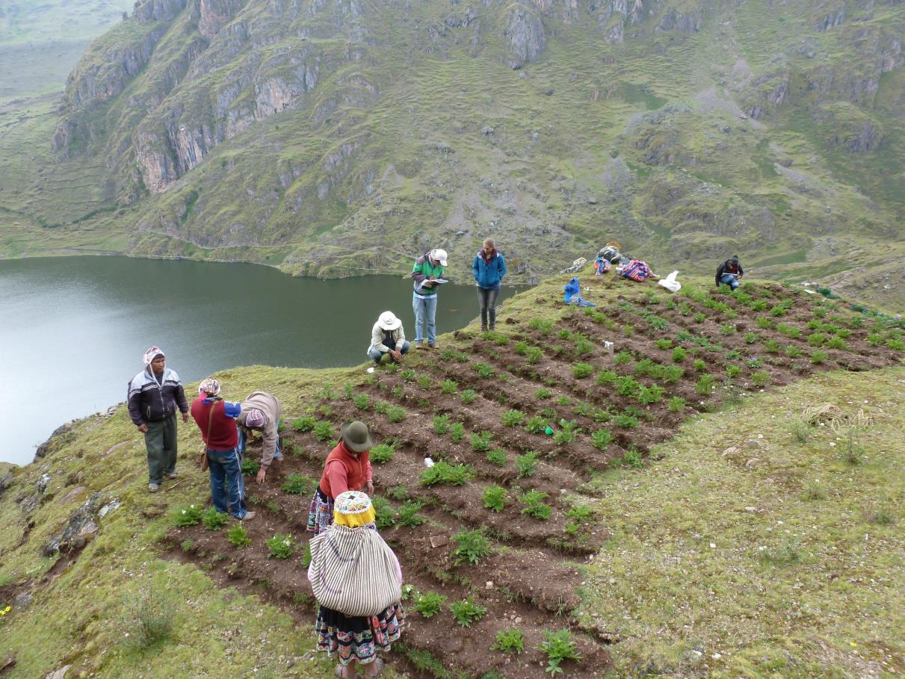
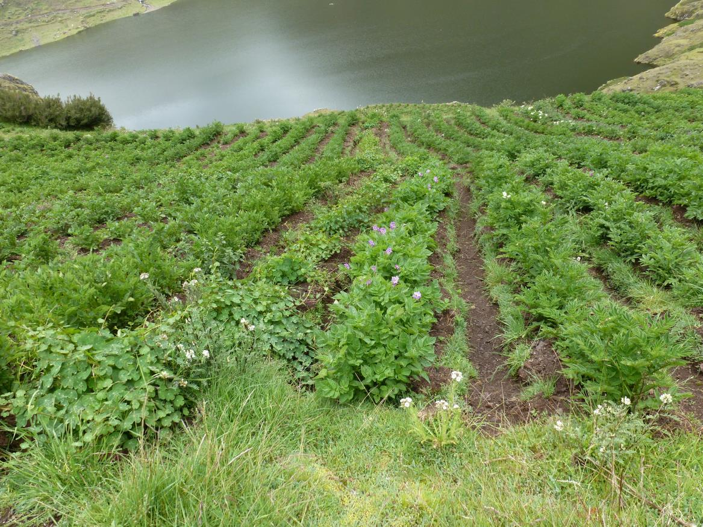
Background
Climate change is increasingly affecting agriculture around the world
Tropical montane areas are particularly vulnerable
The livelihoods of people in these areas are threatened
Image Credits: David Ellis
Notes:
Shifting precipitation patterns and increases in average global temperatures due to climate change are likely to impact agricultural systems around the world. Tropical montane regions such as the Andean Highlands will be especially affected.

Slide 3
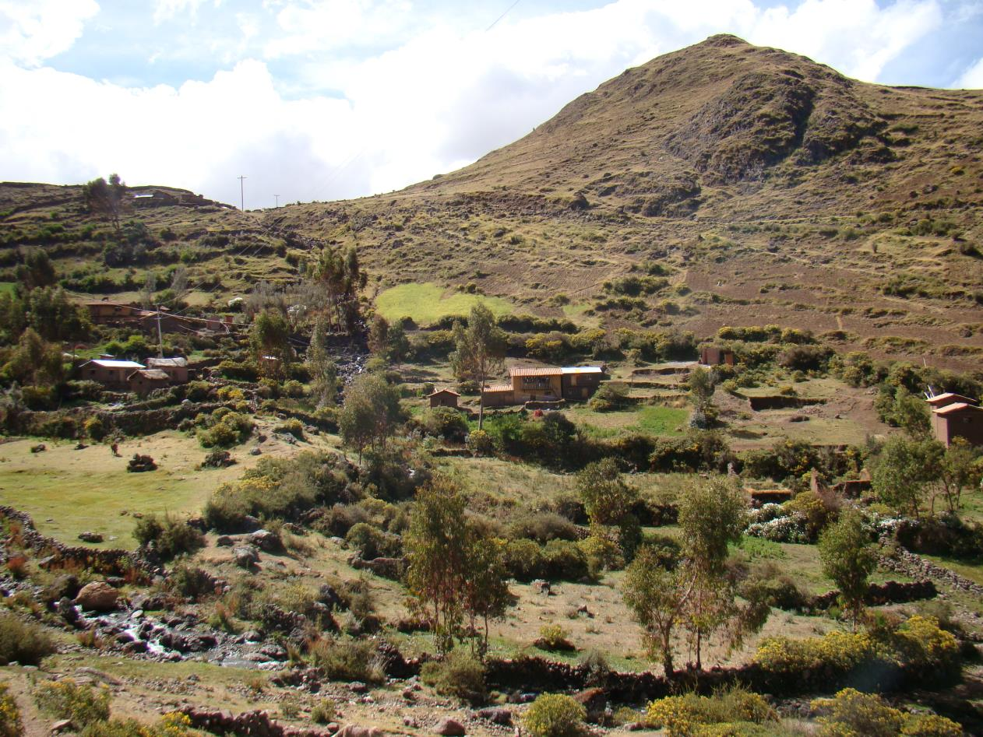
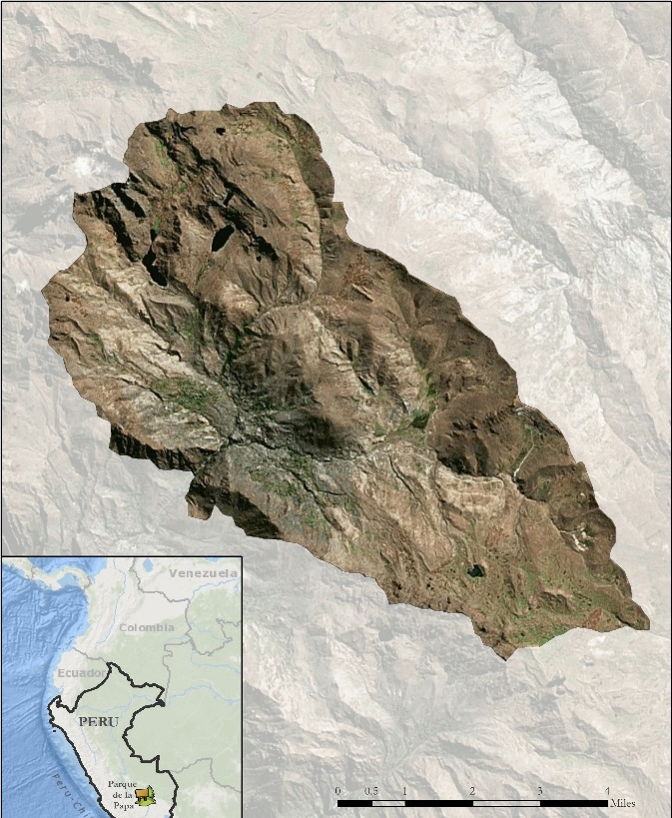

Study Area
Parque de la Papa, Perú
8,661 hectares
3,200-5,000 meters above sea level
Indigenous biocultural heritage area
Some 7,000 people in 6 indigenous Quechua communities
Climate: 1980-2015
Land Cover: 1989-2015
Image Credit: David Ellis
Notes:
This project was conducted in the Parque de la Papa located in the Cusco region of Southeastern Perú. The Parque de la Papa is an Indigenous Biocultural Heritage Area collectively owned by six local communities belonging to the Quechua people. The park is managed by the local communities with input from two NGO’s: the International Center for Potatoes (CIP) and Association for Nature and Sustainable Development (ANDES). The primary objective is to preserve the cultural and agricultural traditions of the indigenous people living within the park.

Slide 4
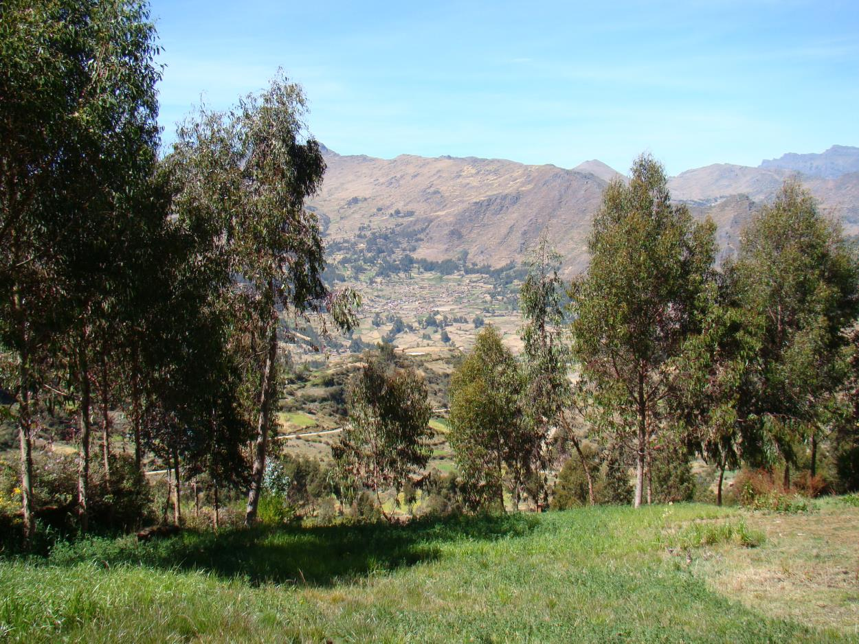
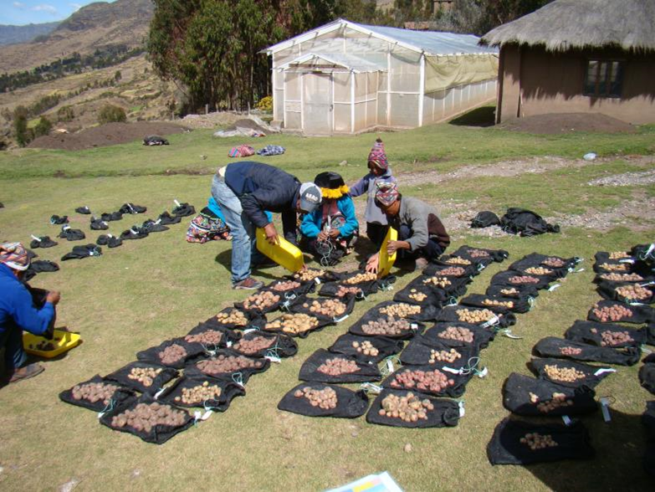
Partner Organizations
Centro Internacional de la Papa (CIP)
Asociación para la Naturaleza y el Desarrollo Sostenible (ANDES)
Image Credits: David Ellis
Notes:
We collaborated with ANDES and CIP. These NGO’s work with the indigenous communities within the Parque de la Papa and help them to translate field data and scientific research into management plans that they can implement.

Slide 5
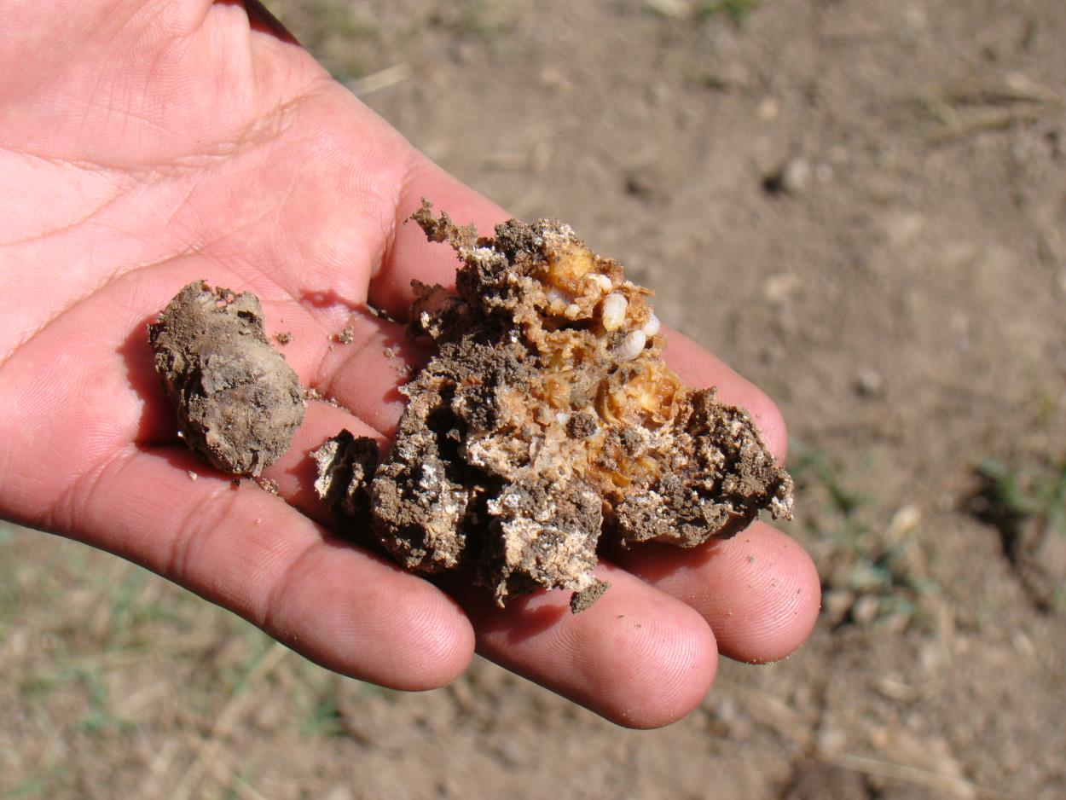
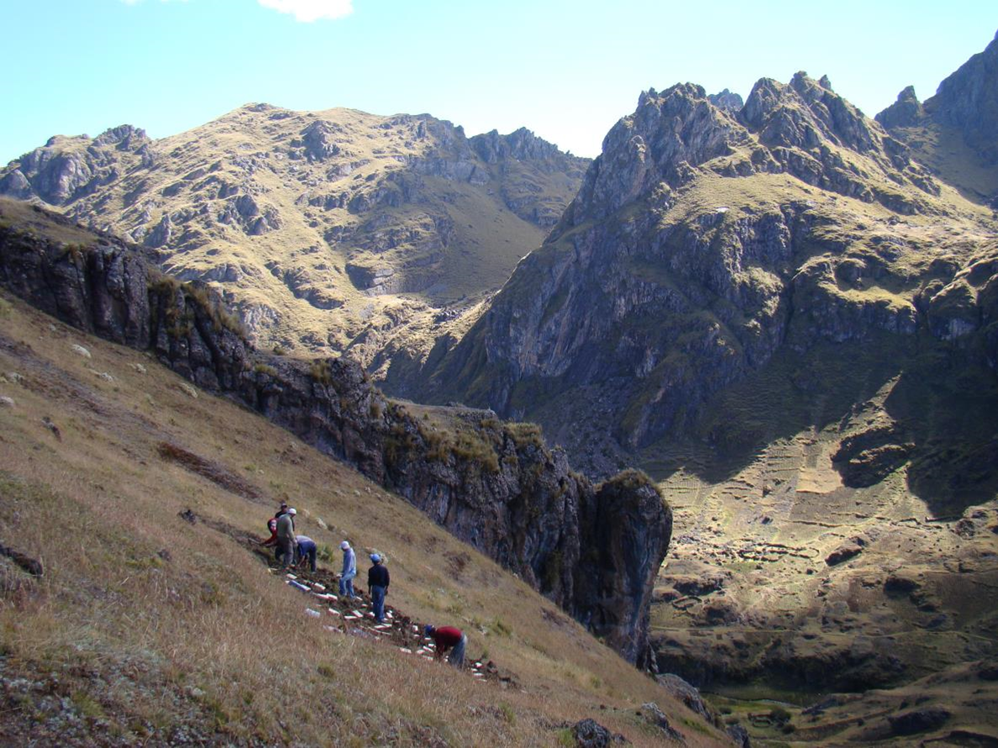
Community Concerns
Anecdotal evidence of potatoes being steadily pushed up to higher elevations
Increased predation by crop pests
Traditional agricultural practices and way of life being threatened
Image Credits: David Ellis
Notes:
The indigenous Quechua farmers have moved their potato crops to higher elevations in the face of increasing temperatures at lower elevations and increasing crop predation by weevils. Because they are determined not to resort to pesticides and to continue traditional farming practices, their way of life is becoming increasingly imperiled.

Slide 6
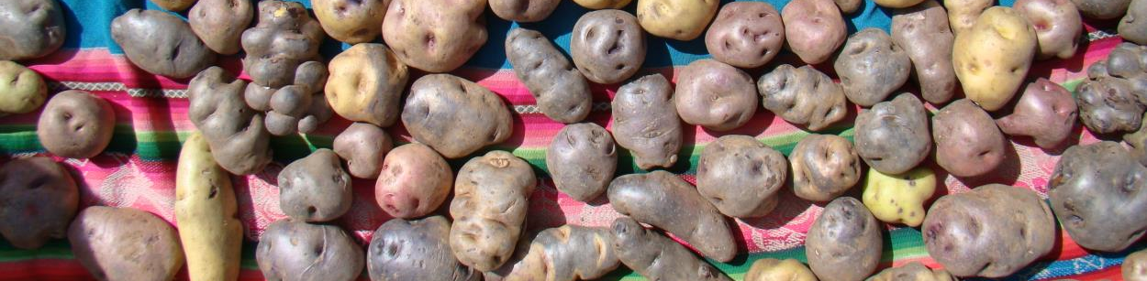
Objectives
Identify changes in growing patterns in Parque de la Papa
Quantify changes in climatic patterns in Parque de la Papa
Develop a predictive model to assess areas for optimal potato cultivation
Aid indigenous communities in continuing to use traditional agricultural methods
Image Credit: David Ellis
Notes:
Our objectives were identify and quantify any changes in climatic patterns within the park as well as any potentially associated changes in growing patterns. From this we would create a predictive model to assess areas for optimal potato cultivation which could be of practical use to the Quechua communities living in the park.

Slide 7
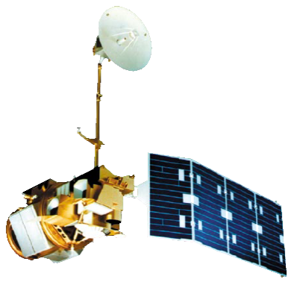


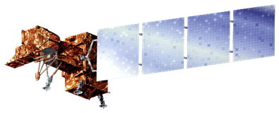
Data Acquisition
Multispectral imagery from NASA EOS was used to create classification
Weather station from multiple data source were used for climate analysis
Landsat 5, TM
Landsat 8, OLI
Terra, ASTER
Landsat 7, ETM+
Notes:
Level 1 GeoTIFF imagery for Landsat 5 Thematic Mapper (TM), 7 Enhanced Thematic Mapper+ (ETM+), and 8 Operational Land Imager (OLI) were downloaded from the United States Geological Survey (USGS) GloVis server for path 4, row 69. All imagery was collected for the month of May, just before the harvest and, therefore, a time of maximum reflective vegetation. If more than 10% of the study area was covered with clouds, the image was excluded.
We also acquired climate data from 1980 to 2015 from NOAA and the National Weather Service and Hydrology of Peru.
Our partners shared data from HOBO micro weather stations so that we could validate this climate data.

Slide 8
Data Processing – Climate
Data Source: CIP HOBOs Units
Data obtained during the growing season from HOBO units stationed across the park show daily temperature variability
Notes:
Temperature data were collected from the National Climatic Data Center’s (NCDC) Global Summary of the Day (GSOD) interface. The weather station used was located at the Teniente Alejandro Velasco Astete International Airport in Cusco, located at 3310 m above sea level and 25 km away from the park. Temperature, light intensity, relative humidity and dew point data were also provided by the CIP partners from HOBO data logging units placed at different locations throughout the park. These units, from which hourly weather data were extracted, are placed at higher elevations than the airport. The HOBO data falls within distinct time ranges from 2012-2013, 2013-2014 and 2014-2015 .

Slide 9
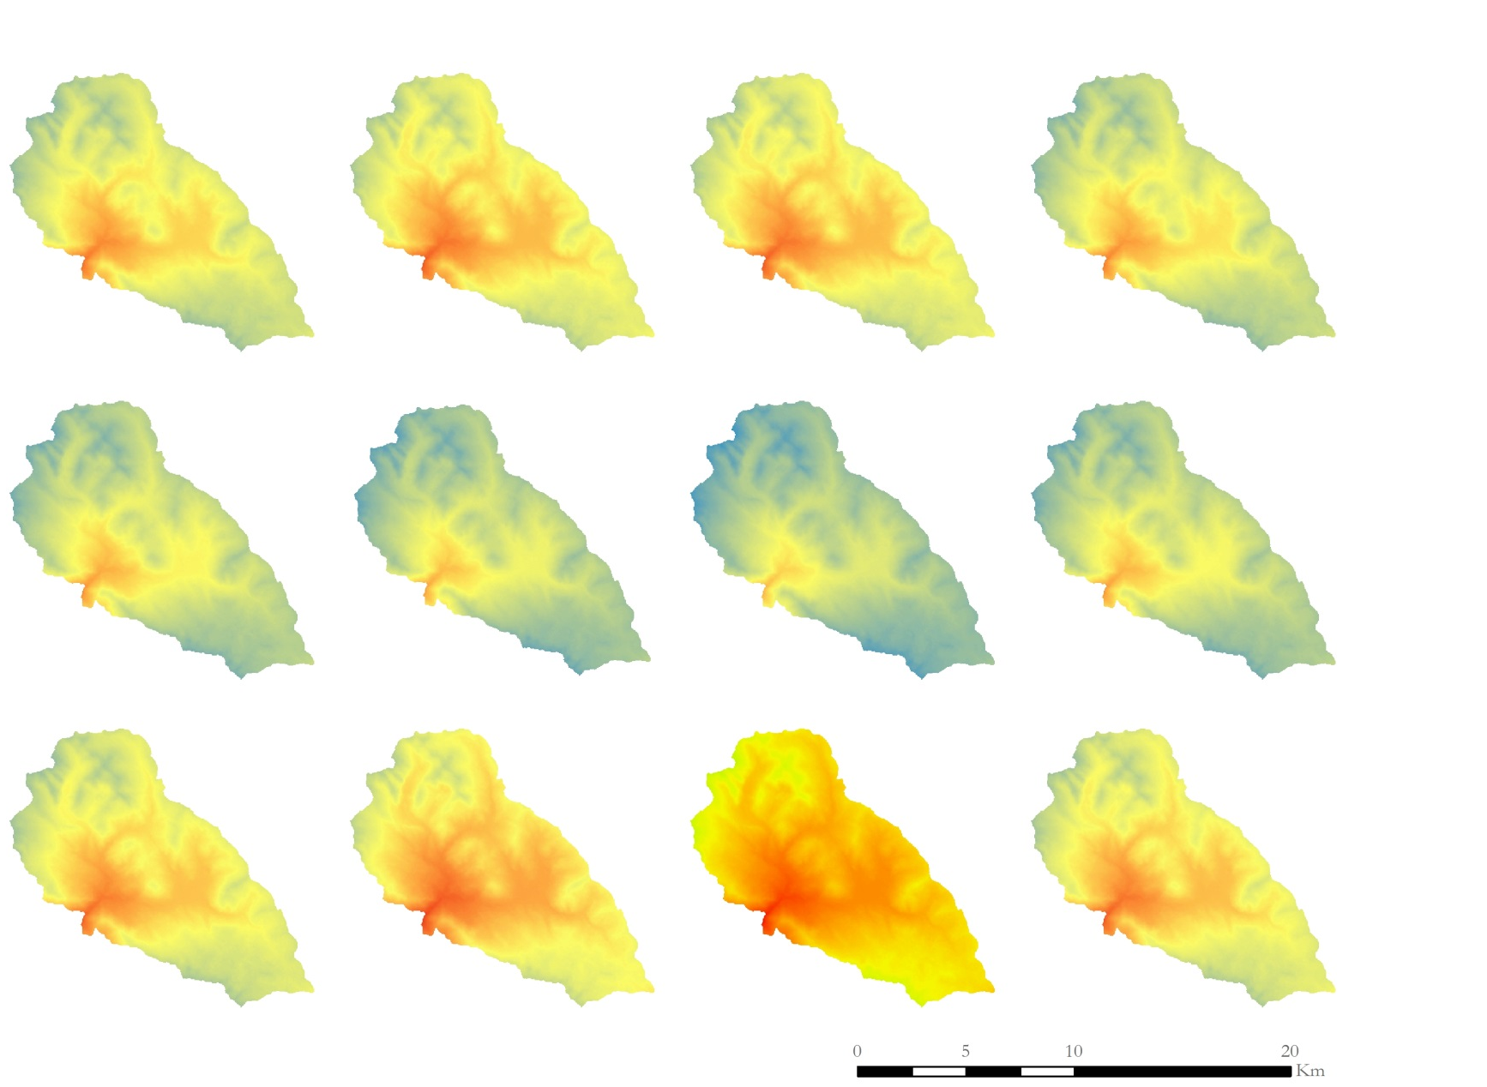
Data Processing – Climate
Monthly Temperature Variation in the Parque de la Papa
January
February
March
April
May
June
July
August
September
October
November
December
2015
Temperature
High:
14.5 ⁰C
Data Source: NOAA National Climate Data Center (NCDC)
Calculated using Environment Lapse Rate
Low:
2.0 ⁰C
Notes:
Monthly average temperature was calculated from the data collected at Cusco airport. Using a standard environmental lapse rate equation, temperature changes were mapped to elevation and extrapolated to the park.

Slide 10
Data Processing – Classification
Ground Control
Supervised Classification
QuickBird Validation
Notes:
Two sets of classifications were performed.
A time series of classifications were created using ground-control points and local knowledge from project partners in conjunction with high resolution QuickBird imagery from 2007. These data were used to classify Landsat imagery from 1989 and 2007 in attempt to identify changes in agricultural cultivation.. The classification scheme was then validated by the QuickBird imagery.
For the suitability model, an unsupervised classification was performed on the most recent available Landsat 8 imagery. The 14 initial classifications were then grouped into 3 different classes : unsuitable, marginally suitable, and most suitable.

Slide 11
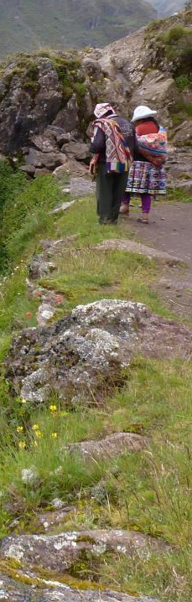
Data Processing – Crop Suitability Model
DEM
Collect DEM Data
Fill Sinks
Land Cultivation
Atmospheric Correction
Pixel-Based Classification
Climate
Validate with In-Situ Data
Extrapolate to Park
Collect Landsat Data
Collect Weather Data
Derive Slope
Elevation and Slope
Land Cover
Temperature
Image Credit: David Ellis
Crop Suitability
Notes:
All of these parameters were filtered to isolate optimal potato growing conditions. Elevations, temperatures, and land classes unsuitable for growing potatoes were excluded. The remaining information was combined in a model which assigned mathematical values to each parameter according to its biophysical importance. The resulting model was then used to predict optimal potato growing areas within the Parque de la Papa.

Slide 12
Results – Climate
Notes:
Annual average temperatures have increased since 1980, however it is impossible to say if this is due to long term global climate shifts or more localized mesoscale climate events. Five year average temperatures have remained largely the same.

Slide 13
Results – Climate
Notes:
Annual average temperatures have increased since 1980, however it is impossible to say if this is due to long term global climate shifts or more localized mesoscale climate events. Five year average temperatures have remained largely the same.

Slide 14
Results – Climate
Notes:
It is noteworthy that temperature variation between months has increased, particularly at the beginning and end of the year during the growing season.

Slide 15
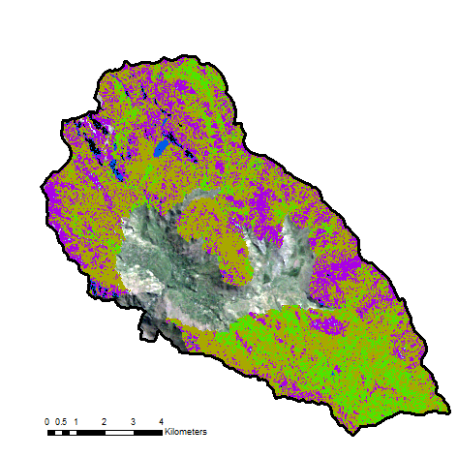
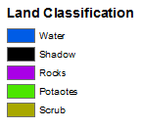
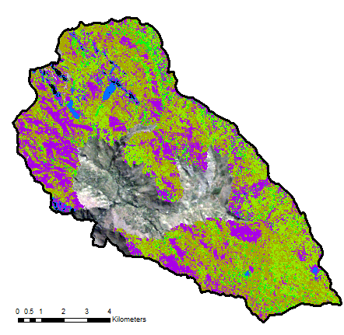
Results – Classification
Classification of 1989 Landsat 5 Image
Classification of 2007 Landsat 5 Image
Notes:
Several land cover classification techniques were explored in an attempt to create the most accurate classification maps. This slide displays land cover for 1990 and 2007. Planting patterns within the park have greatly varied over the past few decades, and show a general increase in cultivated land elevation and extent

Slide 16
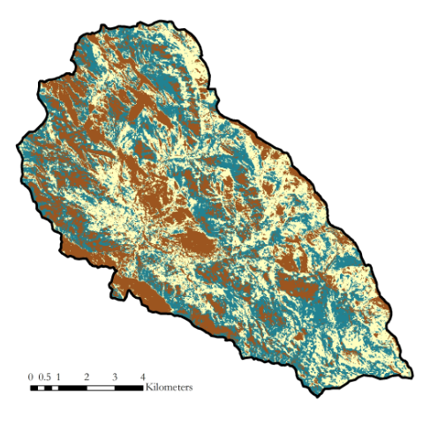
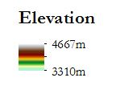
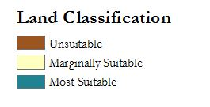
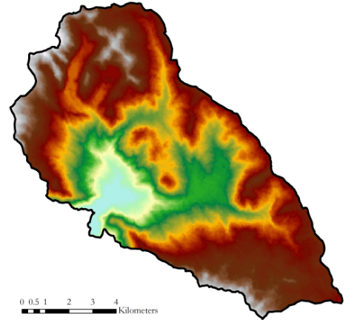
Results – Crop Suitability Model
Weighted overlay combining elevation, slope, temperature, and classified land suitability
Each input layer was reclassified for preference ranking
Notes:
Elevation, slope, temperature, and classified land input layers were reclassified according to preference ranking.

Slide 17
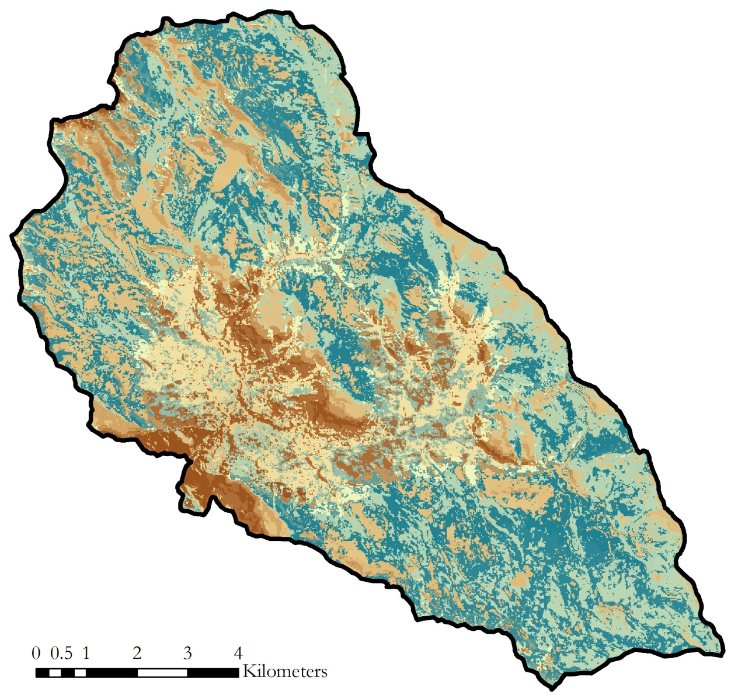
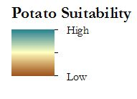
Results – Crop Suitability Model
Low suitability in lands with extreme slope
Low suitability in lands that already cultivated
High suitability in northern and southern portions of the park
Great spatial diversity and dispersion in the park
Notes:
The resulting crop suitability model was then used to identify optimal potato growing areas within the Parque de la Papa.

Slide 18
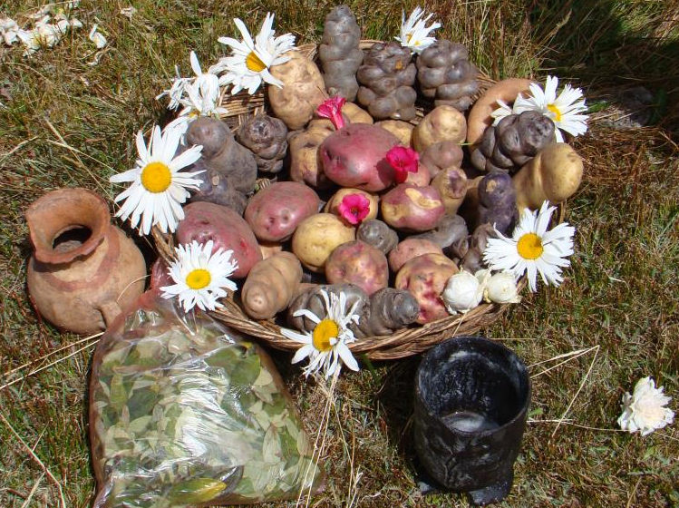
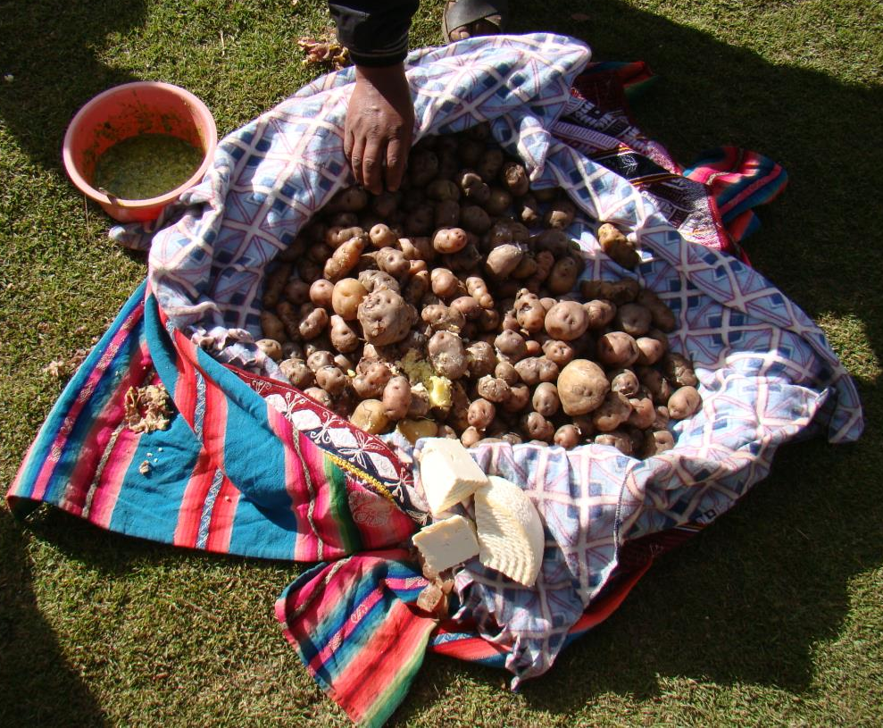
Conclusions
Planting patterns within the park have greatly varied over the past few decades
There has been approximately a one degree Fahrenheit increase in temperatures over the last 35 years
The model identified potentially suitable areas for potatoes in the Parque de la Papa that were distributed throughout the park
Image Credits: David Ellis
Notes:
The model identified potentially suitable areas for potatoes in the Parque de la Papa that were distributed throughout the park. Finding suitable areas for potatoes above the elevation that pests thrive and below the elevation that frost occurs will be key for the longevity of the potato’s diversity and the survivorship of the park’s indigenous agricultural practices.

Slide 19
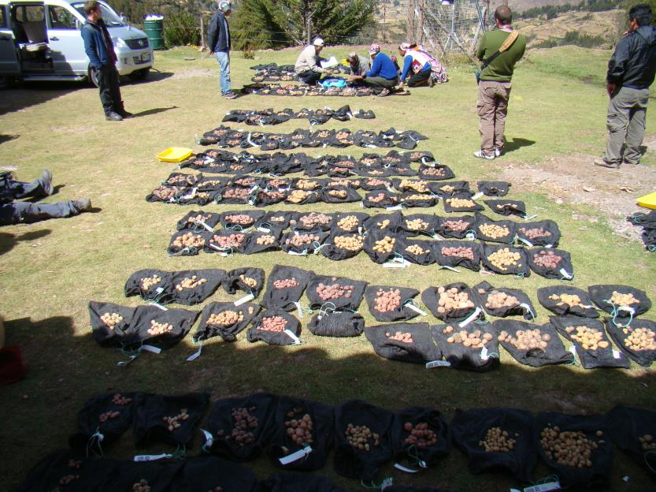
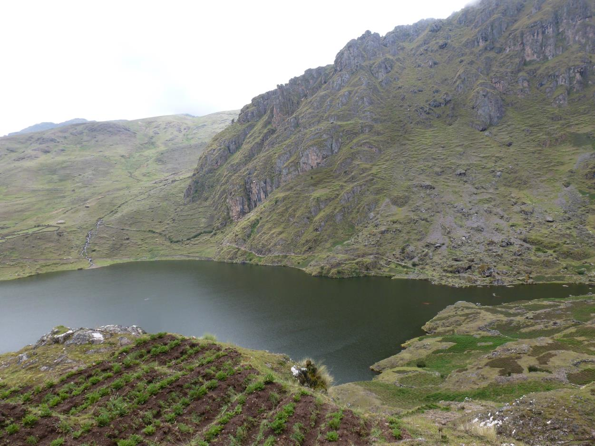
Errors & Uncertainties
Sparse weather station network
Small study area limited low spatial resolution remote sensing products
Difficult to isolate potato fields
Limited images during peak greenness
Image Credits: David Ellis
Notes:
The HOBO data logging units used had a limited temporal resolution. The weather station used was located at the Teniente Alejandro Velasco Astete International Airport in Cusco, located at 3310 m above sea level and 25 km away from the park and had to be extrapolated to the study area.

Slide 20
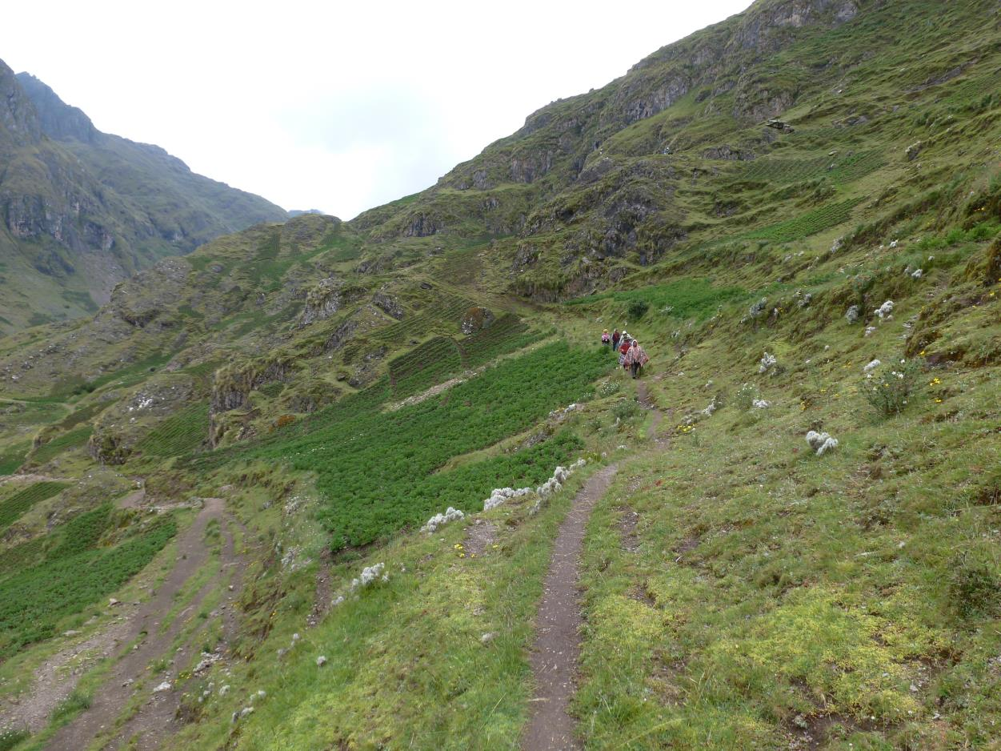
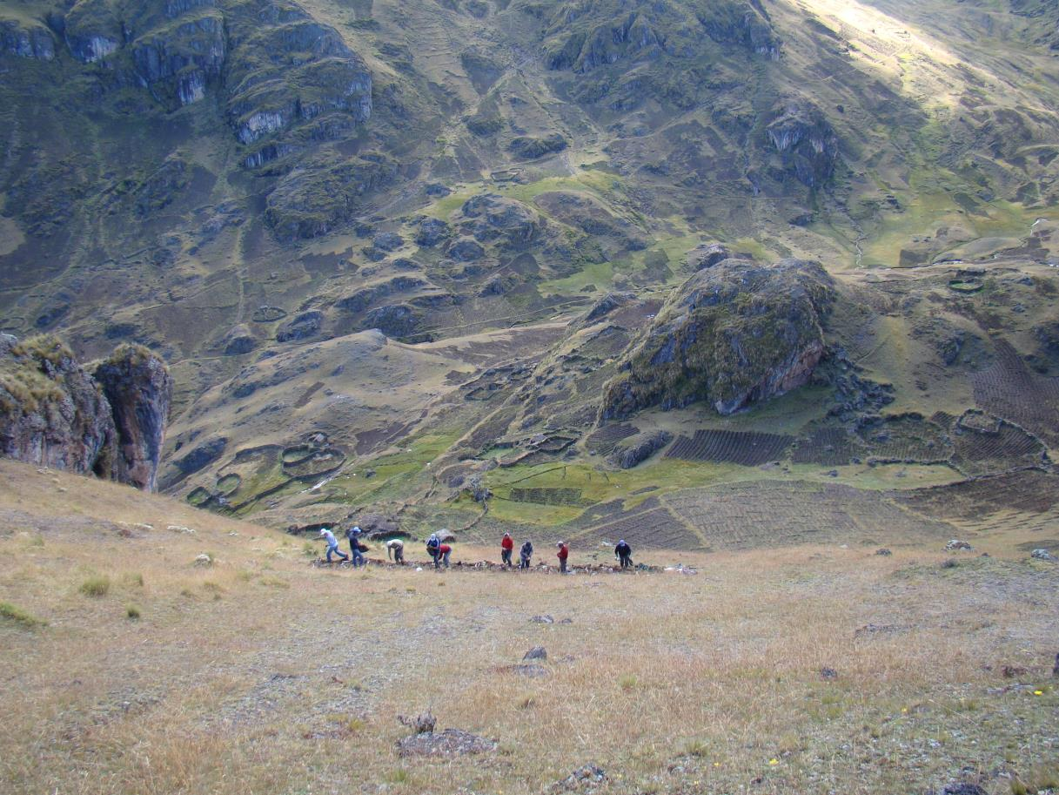
Future Work
Refine classification with high resolution imagery and training sites
Consider other drivers for potato suitability for additional model inputs
Develop future suitability model for potatoes based on projected climate conditions
Image Credits: David Ellis
Notes:
This project will continue during DEVELOP’s summer 2016 term, in which its results will be used as building blocks to create current and future suitability maps for the park’s potatoes. Integrating projected climate conditions will help identify locations that may become more suitable for farming potatoes in the future. We hope that our results and suitability maps will enable Parque de la Papa to successfully adapt to changing climates, and maintain indigenous ways of life.

Slide 21
Advisors
Dr. Marguerite Madden, UGA Center for Geospatial Research
Dr. Kenton Ross, NASA DEVELOP National Program
Partners
Genesis Abreu and Alejandro Argumedo, ANDES
Noelle Barkley, David Ellis, Rene Gomez, and Henry Juarez, CIP
Center Support
Christopher Cameron, NASA DEVELOP
David Cotten, UGA CGR
Others
We would also like to acknowledge the contributions of the Perú Climate I team: Rebekke Muench, Kayla McDonald, Michael Sclater, Richard Rose, and Dajon Begin.

