Slide 1
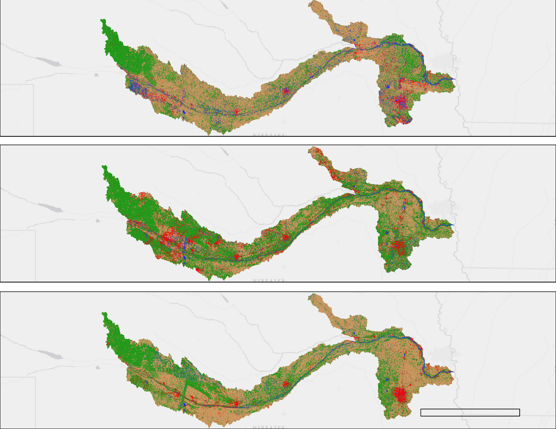
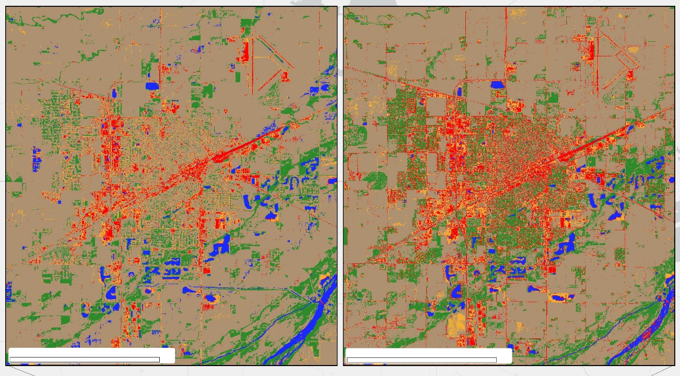
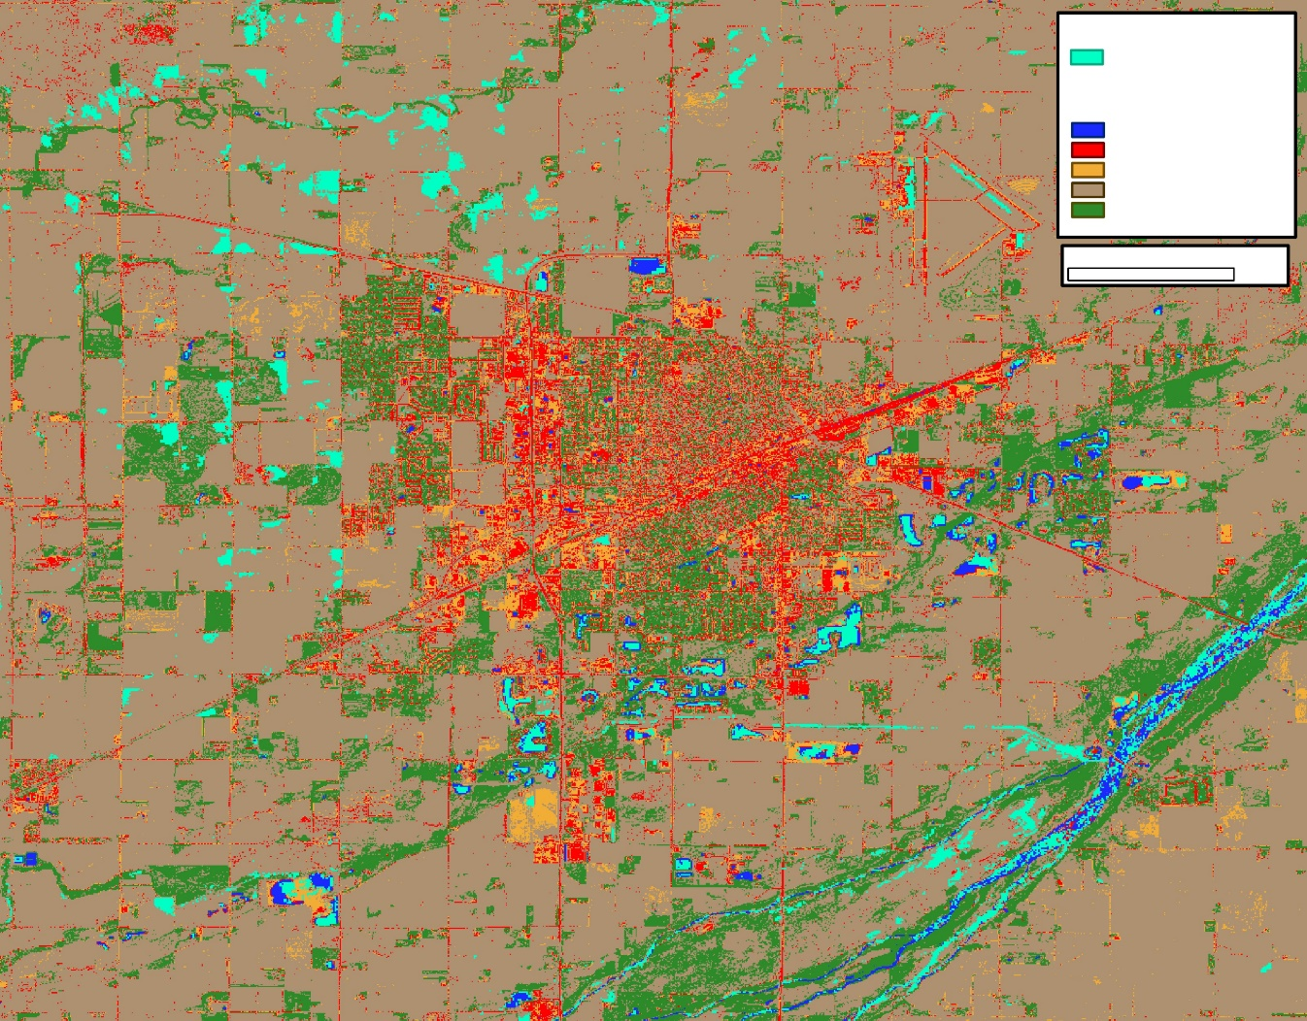
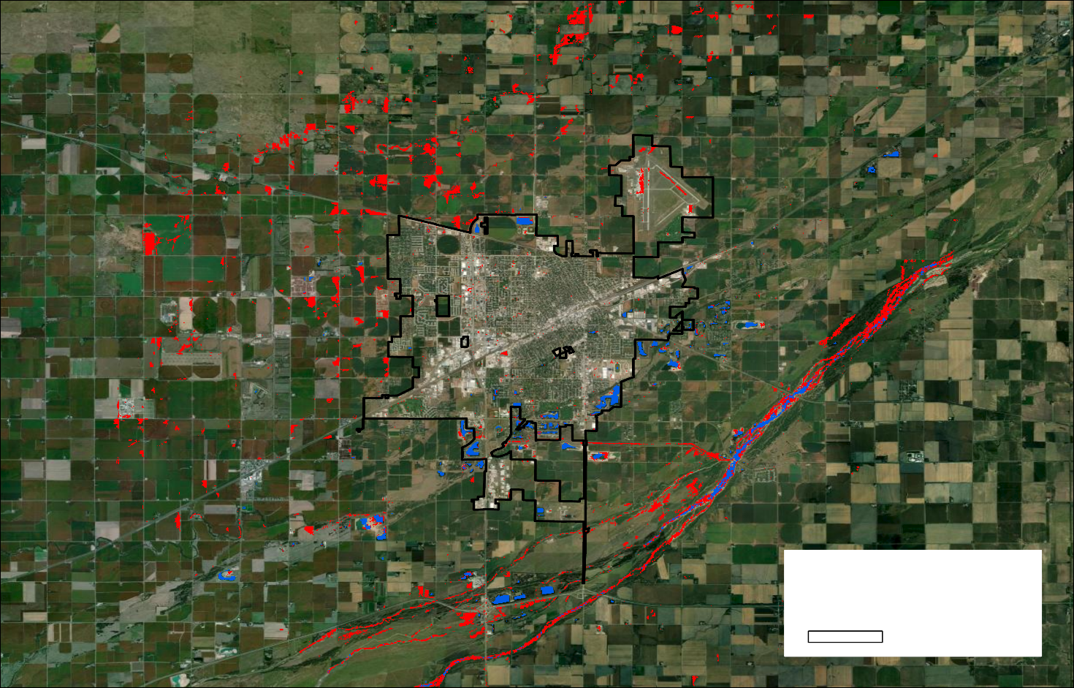
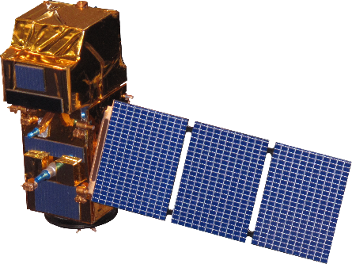
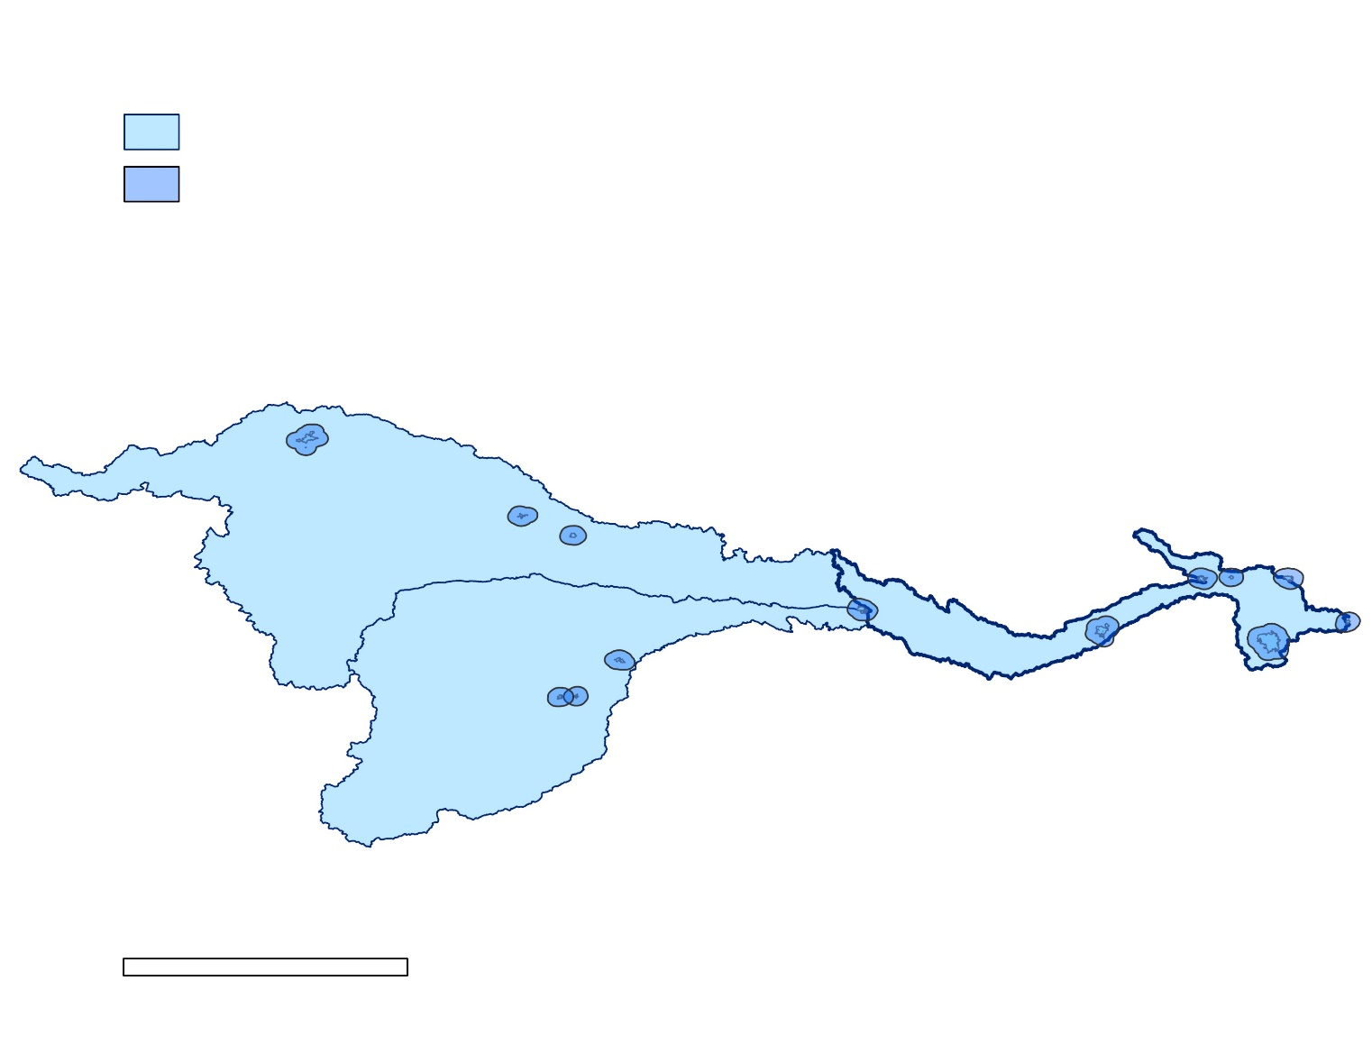
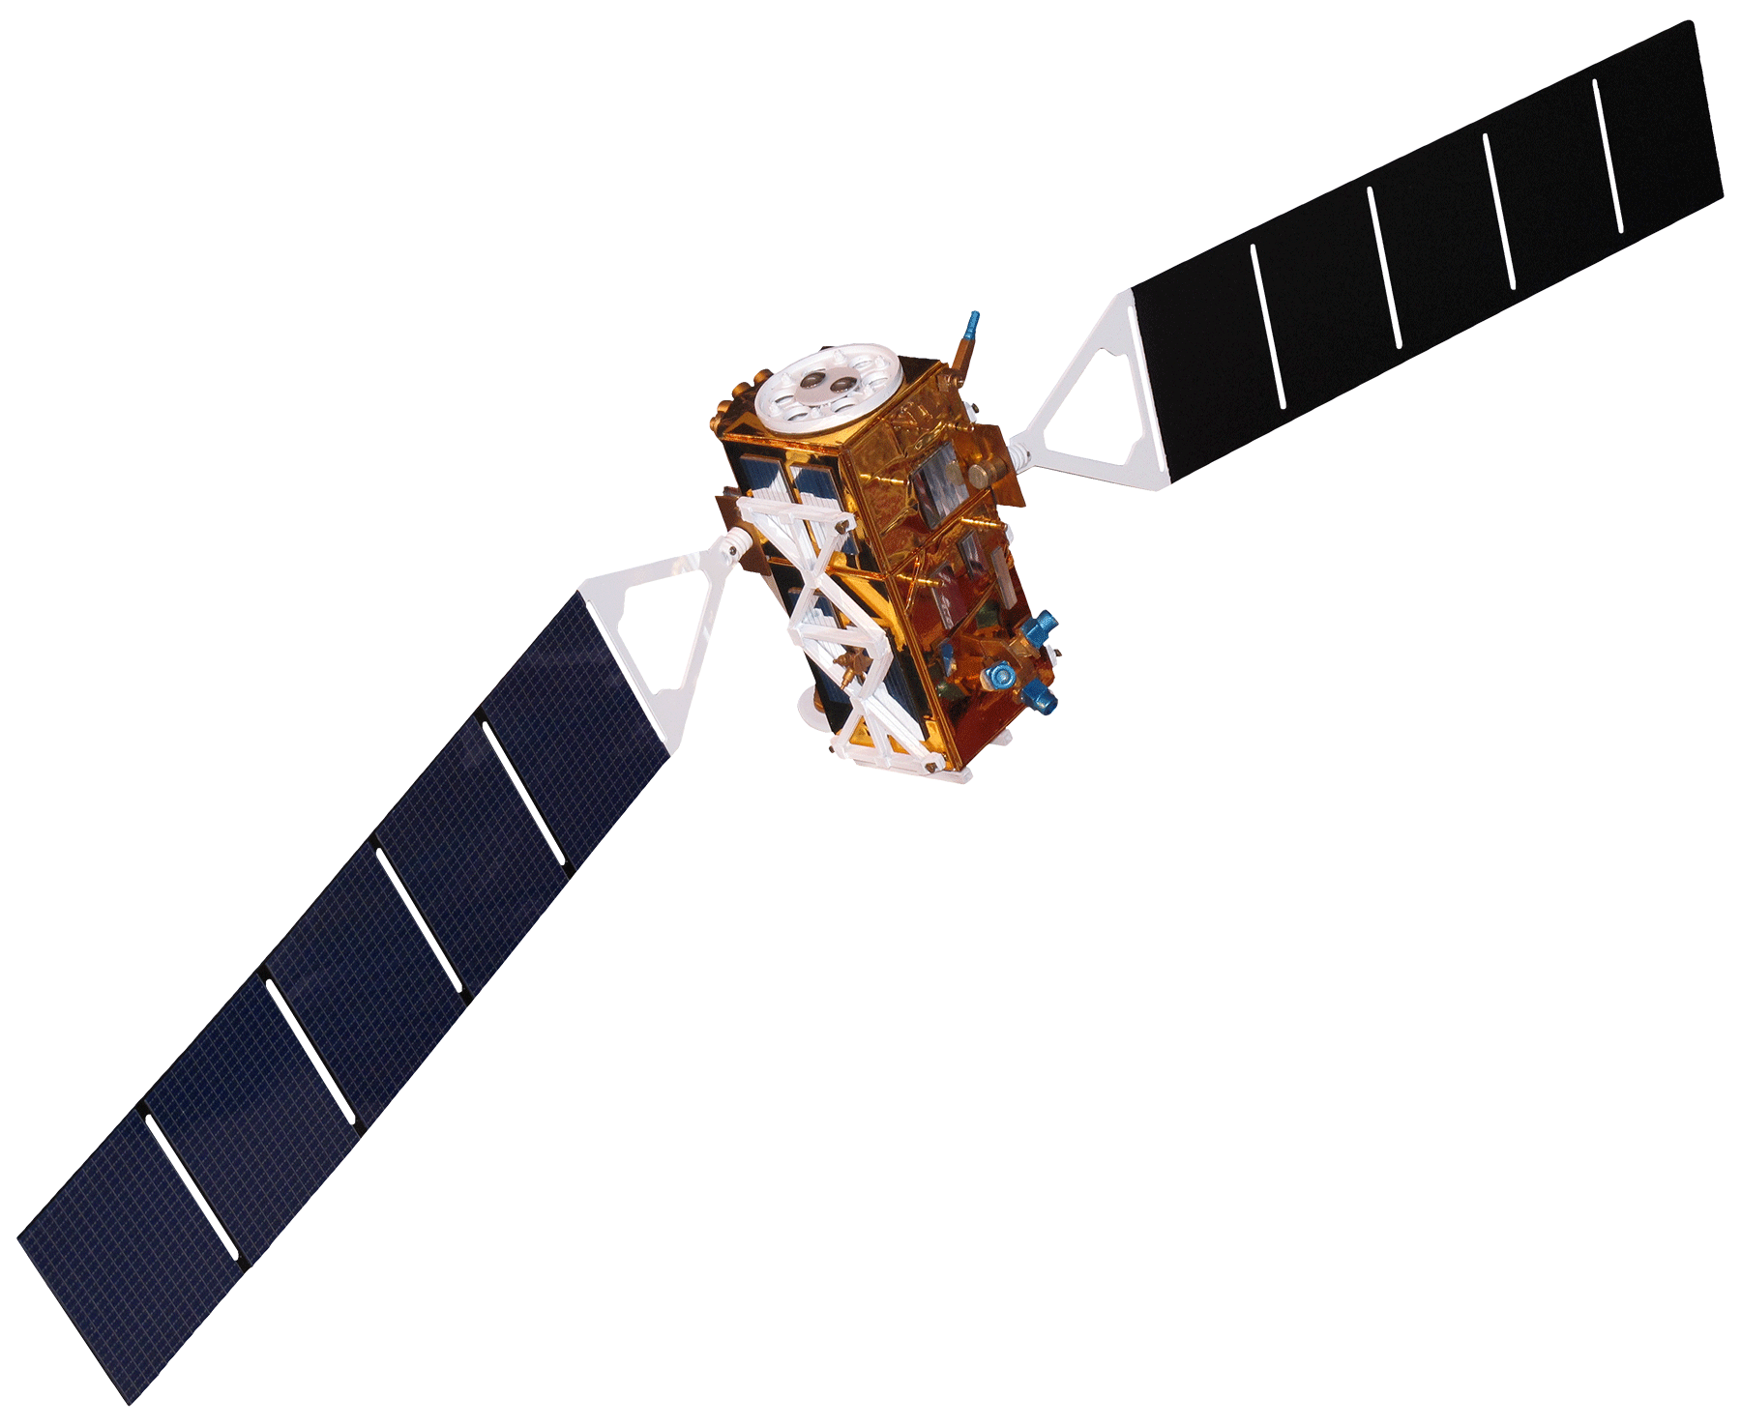
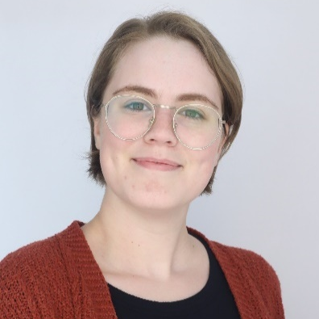
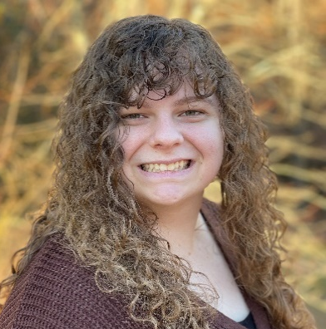
Platte River Basin Water Resources
Assessing Urban Flood Vulnerability to Select Restoration Sites for Urban Woods and Prairies in the Great Plains
Project Synopsis
Results
In the Platte River Basin, wetlands play a crucial role in providing ecosystem services such as flood mitigation and wildlife habitat. However, increasing urban development in the area has impacted natural floodplain processes, leading to a decline in wildlife habitat and an elevated flood risk for nearby communities. To address this issue, Audubon Great Plains’ Urban Woods and Prairies Initiative focuses on restoring vital habitats within urban areas to protect bird species and reduce flood hazards. Our project used remotely sensed data, including Landsat 8 Operational Land Imager (OLI), Sentinel-2 Multi-spectral Instrument (MSI), and Sentinel-1 C-band Synthetic Aperture Radar (C-SAR), to assess land use and land cover from 2013 to 2023, as well as flood extent. These data aided Audubon Great Plains in identifying potential restoration sites in key cities.
Land Cover Type
Land Cover Type
Open Water
Open Water
Developed
N
Developed
Agriculture
Barren Land
Agriculture
Vegetation & Grassland
Forest & Wetland
2013
2018
0
5
10
2019
0
5
10
2023
Miles
Miles
2.6
1.8
1.4
4.8
N
11.6
2.5
2019 (%)
11.7
3.1
2023 (%)
Objectives
2023
0
100
200
Miles
80.2
77.6
Visualize land use land cover changes in 13 focal cities from 2013 - 2023
Evaluate flood risk in urban areas
Pinpoint potential restoration sites under the Urban Woods and Prairies Initiative
Figure 1.1 Landsat 8 OLI Timeseries (2013-2018-2023) on Central Platte Basin
Figure 1.2 Sentinel-2 MSI change detection (2019-2023) for Grand Island
Flood Risk Map
Flooded areas
Land Cover Type
Open Water
Developed
Barren Land
Agriculture
0
Forest and Wetland
5
10
Project Partner
Miles
Audubon Great Plains
Audubon Great Plains is a regional office of the National Audubon Society serving Nebraska, North Dakota, and South Dakota. Their Urban Woods and Prairies (UWP) Initiative aims to incorporate nature-based solutions into vulnerable urban areas to mitigate flooding impacts on communities and enhance habitat quality and connectivity for bird species.
Permanent Water
N
0
Flood
N
1
2
Miles
Study Area & Earth Observations
Figure 2.1 Sentinel-2 MSI random forest classification for Grand Island combined with a flood risk map
Figure 2.2 Flood Risk Map (30m) in Grand Island capturing a major flood event on March 14th, 2019
13 Cities LULC
United States of America
City Flood Extent Map
Conclusions
Sentinel-2
Multi-Spectral Instrument (MSI)
Sentinel-1
C-Band Synthetic Aperture Radar (SAR)
A combination of Landsat 8/Sentinel-2 classifications and flood risk mapping identifies possible wetland restoration sites for the Urban Woods and Prairies Initiative.
The random forest classification with the flood risk overlay is depicted in figure 2.1, and it effectively correlates land use with flood risk.
High-resolution machine learning classifications in targeted cities aid in understanding the relationship between urban growth, wetland delineation, and other LULC variables​. This approach leads to increased impact on the highlighted community concerns provided by the partner.
Platte River Basins
North Platte Basin
South Platte Basin
Focal Cities (13)
Central Platte Basin
Platte Basin River System
Central Platte LULC
N
0
100
200
Miles
Landsat 8
Operational Land Imager (OLI)
Acknowledgements
The team would like to extend their sincere gratitude to Melissa Mosier (Audubon Great Plains), Joanna Grand (Audubon Society Science Team), Zachary Posnik (Audubon Society Science Team), Dr. Zhenghong Tang (University of Nebraska – Lincoln), Dr. Marguerite Madden (University of Georgia), and Megan Rich (DEVELOP) for their insight, time, and support.
This material contains modified Copernicus Sentinel data (2017- 2023), processed by ESA.
Methodology
Data Acquisition
Tools
Outputs
Google Earth Maxar
NAIP
(reference imagery)
Training Data
10-year Landsat & 5-year Sentinel-2 LULC Classification
Team Members
Sentinel-2 MSI
2019, 2023
Random Forest Classification
Trend Analysis
Landsat 8 OLI
2013, 2018, 2023
NDVI, NDBI, NDWI
Sentinel-1 C-SAR
HYDRAFloods
Flood Extent Map
Jennifer Mathis
Project Lead
Jackie Encinas
Olivia Kirkland
Emma Vail
Georgia – Athens | Spring 2024

