Slide 1
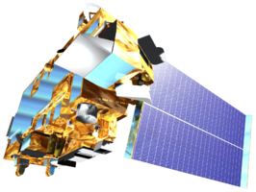
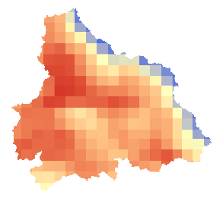
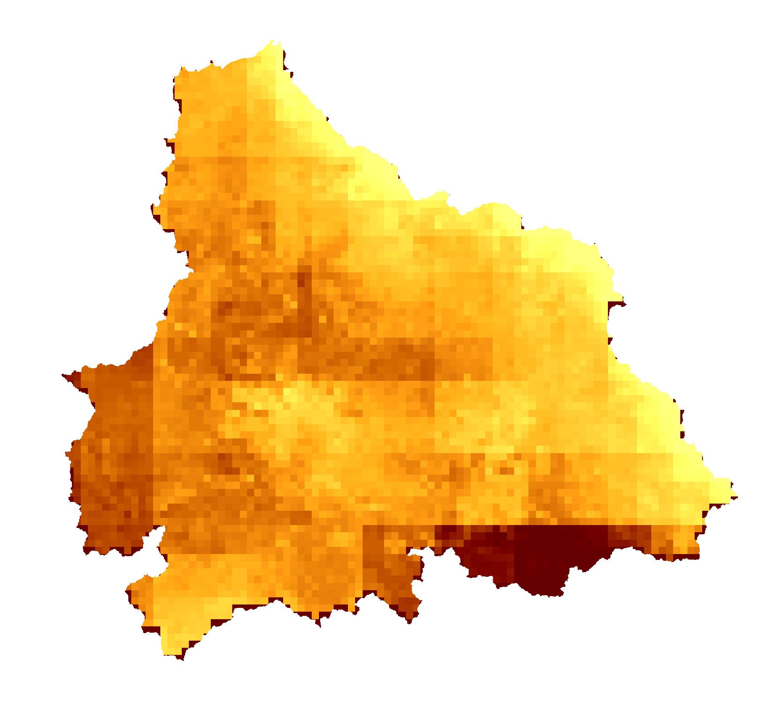
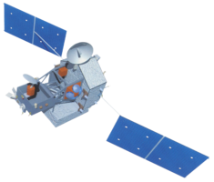
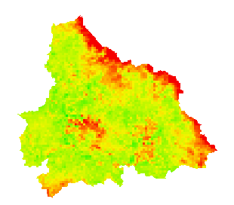
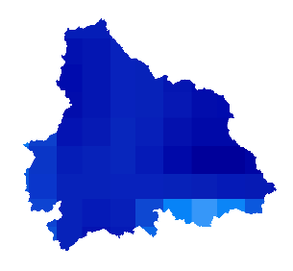
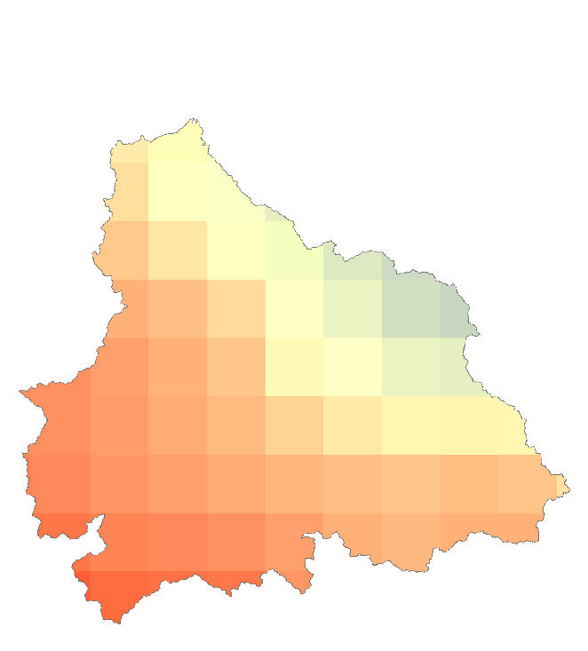
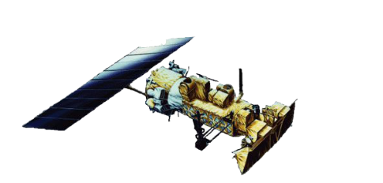
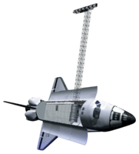
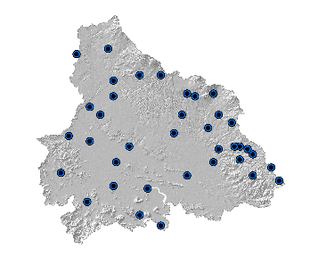
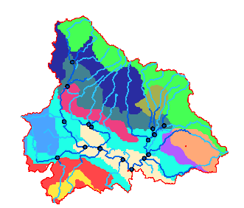
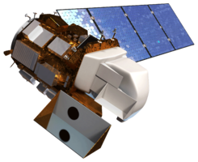
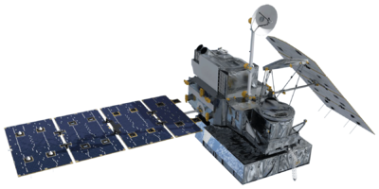
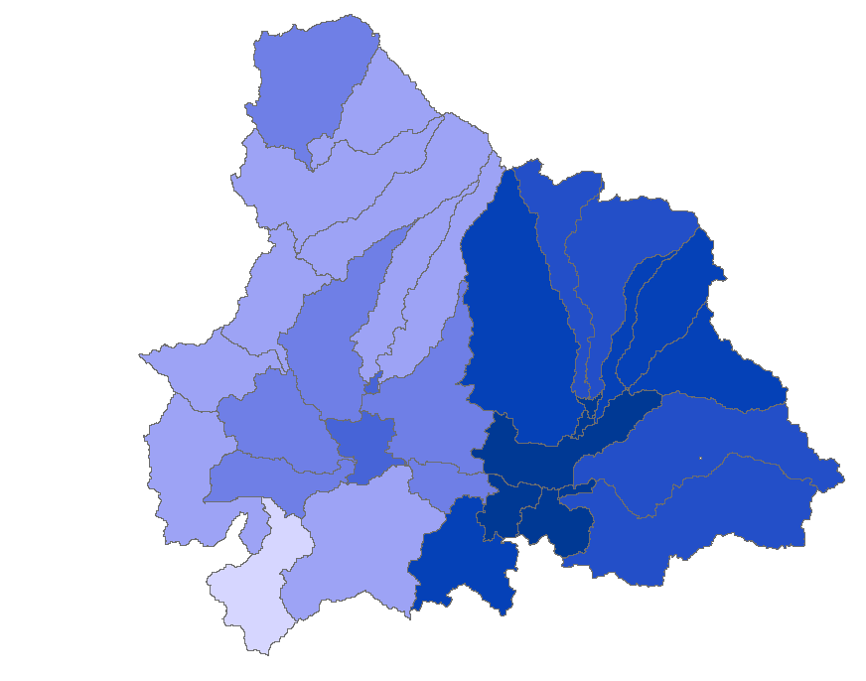
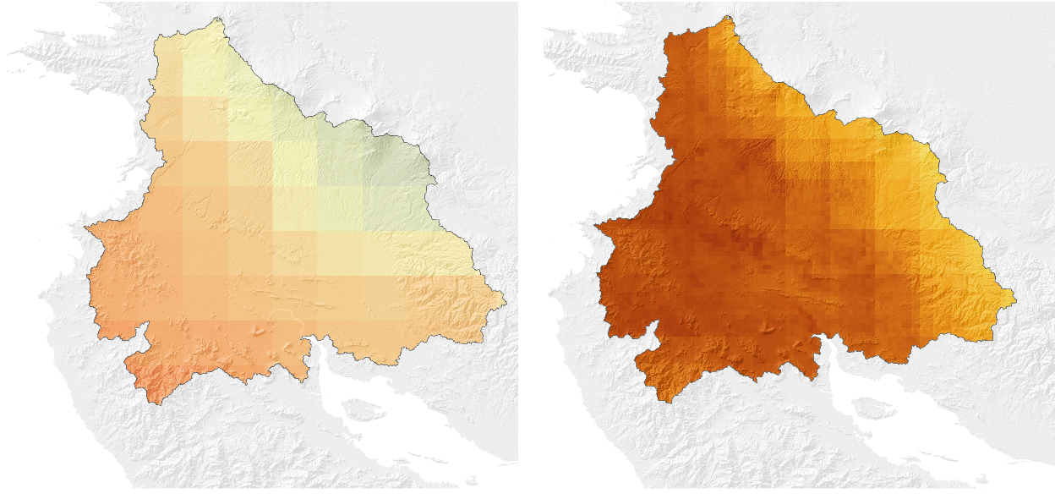
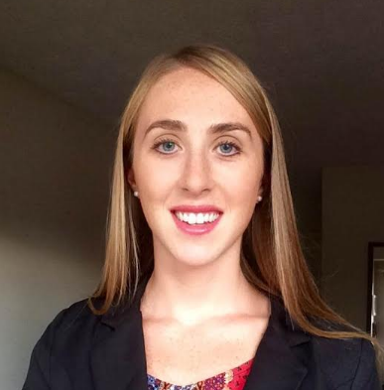
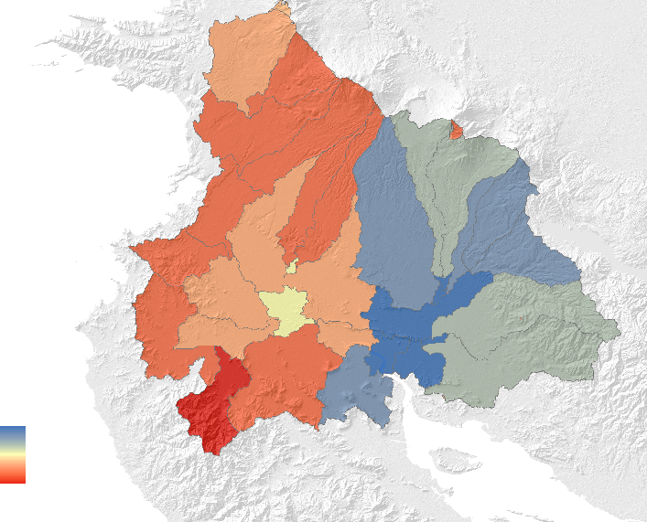
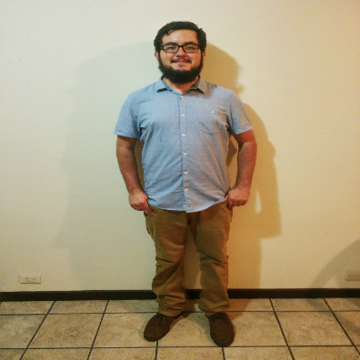
Monitoring Drought and Water Balance in the Guanacaste Province to Enhance Decision Making and Response Planning in Costa Rica
Abstract
The Arenal-Tempisque watershed in northwestern Costa Rica has experienced severe drought conditions during the last four years, complicating water management and agricultural production. Additional information for response planning and management is required to tackle the consequences of drought. In partnership with the Costa Rica Ministry of Environment and Energy (MINAE), Costa Rica National Service of Underground Water, Irrigation, and Drainage (SENARA), the University of Costa Rica (UCR) and the Costa Rican Embassy in Washington, D.C, the NASA DEVELOP team used data from various Earth observing satellites (Landsat 8, Terra MODIS, GPM, AVHRR, and TRMM) and in situ stations to analyze and monitor the current state of meteorological and agricultural drought across the Arenal-Tempisque watershed using two indices. The Standardized Precipitation Index (SPI) was used to monitor meteorological drought and the Scaled Drought Condition Index (SDCI) was used to monitor agricultural drought. The team also created information for water balance assessment using the Soil Water Assessment Tool (SWAT) model by combining NASA Earth observations, ancillary data sources, and in situ data. Upon receiving the hydrological data and tools, project partners at SENARA and MINAE will be able to replicate the project’s methods to continuously update their understanding of watershed conditions. These results will allow project partners to make a more efficient water management plan, benefitting the local inhabitants and stakeholders.
Methodology
Objectives
Terra MODIS
NDVI and LST
0.05° Spatial Resolution
Level 3 product
LST
SDCI
1-month
temporal
resolution
Develop a time series for the meteorological and agricultural drought indexes for the Arenal-Tempisque watershed using the Standardized Drought Condition Index and Standardized Precipitation Index.
Create a near-real time drought monitoring tool for the Arenal-Tempisque watershed for partners to utilize in the future.
Analyze local water systems using ArcSWAT to produce results that will be incorporated into a water balance assessment toolset for the Arenal-Tempisque watershed.
TRMM- PR
Daily Precipitation (mm)
0.25° Spatial Resolution
3B43 Level 3 Product
NDVI
Precipitation
Radar Data
Resampled to
0.1°-spatial
resolution
SPI
1-month
Temporal
Resolution
Study Area
Earth Observations
eMODIS & AVHRR
Land Cover
Classification
Local
Weather
Data
Arenal-Tempisque Watershed
Costa Rica
Terra MODIS
NDVI and LST
0.05° Spatial Resolution
Level 3 Product
TRMM-PR
Terra MODIS
SRTM C-Band
Soil and
Watershed
Assessment
Tool
Evapotranspiration and Superficial Flow
Costa Rica Water Resources
SRTM v-2 C-Band
90m Spatial Resolution Digital Elevation Model
Landsat 8 OLI
GPM IMERG
HWSD
Land Cover Classification
Results
Photo credit: European Space Agency
Drought Anomaly in December 2015
Monthly Drought Indices for Estación de Pelon de La Bajura Guanacaste Province: January 2000- March 2016
Project Partners
Drought condition begins when SDCI ≤ 0.5
Embassy of Costa Rica to the United States
Costa Rica Ministry of Energy and the Environment (MINAE)
Costa Rica’s National Service of Underground Water, Irrigation, and Drainage (SENARA)
University of Costa Rica
SPI
SDCI
3
1
-3
0
In December 2015, both indices show a drought anomaly from the time series plot at for the Pelon de la Bajura Station, located in the central area of the Arenal-Tempisque watershed. The index maps at this time substantiate these conditions throughout the study area.
Drought condition begins when SPI ≤ -0.5
Team Members
Maps of each index were analyzed in a series at a monthly scale to interpret the spatial extent of drought in the Arenal-Tempisque watershed. Time series plots were analyzed for any of the meteorological stations in the study area to compare the indices. This allowed us to identify drought anomalies.
Evapotranspiration Rates Identified by the SWAT Model
The ArcSWAT analysis created a model of climactic conditions in the area, which will aid in drought monitoring and provide water availability in the Arenal-Tempisque watershed. Land use was input as a parameter to the ArcSWAT model and indicated the water availability of areas of varying land cover.
María José Rivera
Project Co-Lead
Rachel Durham
Project Co-Lead
Madison Davis
High
Low
Conclusions
Nelson Venegas
Luis Quesada
Diyang Cui
SPI monitored meteorological drought from precipitation measurements and SDCI monitored agricultural drought. These results analyzed in a one month temporal resolution and plotted in a time series, which will provide partners with water resource management decisions in the future.
A near-real time drought monitoring tool for SDCI was produced, aiding partners with the most up-to-date information on drought in their area.
The ArcSWAT analysis provided outputs of evapotranspiration and superficial flow. Understanding the effects of various land uses on water availability will aid partners in future regulations in this area.
Acknowledgements
Dr. Marguerite Madden, University of Georgia, Department of Geography
Dr. Sergio Bernardes, University of Georgia, Department of Geography
Dr. Adam Milewski, University of Georgia, Department of Geology
Dr. Angelica Gutierrez, National Oceanic and Atmospheric Administration
Any opinions, findings, and conclusions or recommendations expressed in this material are those of the author(s) and do not necessarily reflect the views of the National Aeronautics and Space Administration. This material is based upon work supported by NASA through contract NNL11AA00B and cooperative agreement NNX14AB60A.
University of Georgia – Summer 2016

