Slide 1

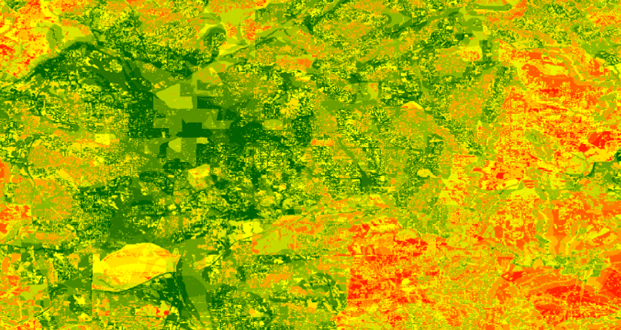
Identifying Key Urban Areas to Reduce Stormwater Runoff and Maximize Conservation Efforts in Metropolitan Atlanta
Christopher Cameron (Project Lead)
ATLANTA WATER RESOURCES II
Ike Sari Astuti
Mark Beatty
Natalia Bhattacharjee
Manasi Parkhi
Alex Smith

Slide 2
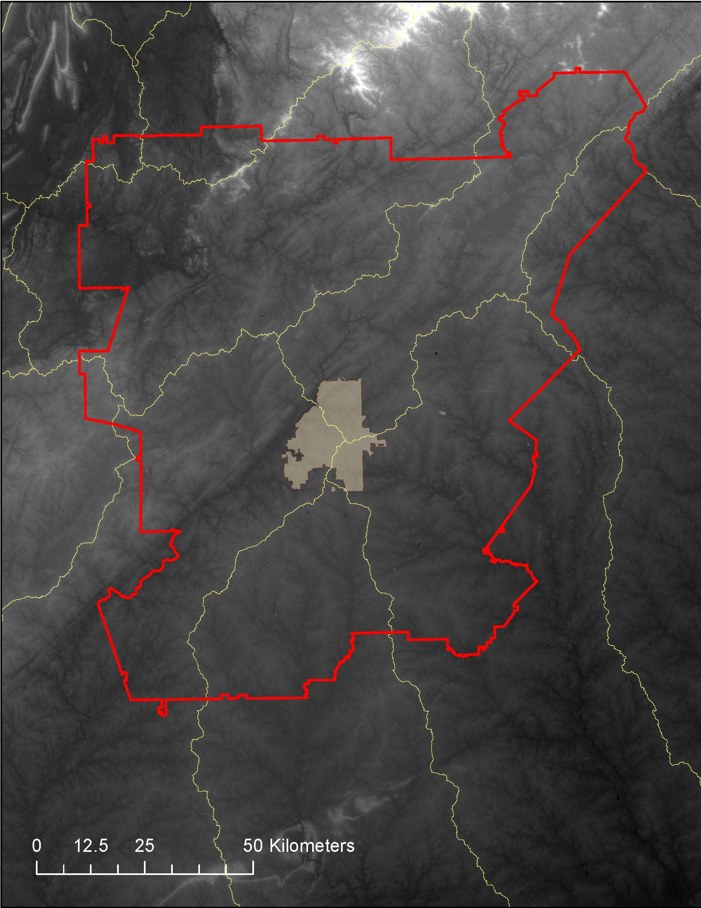
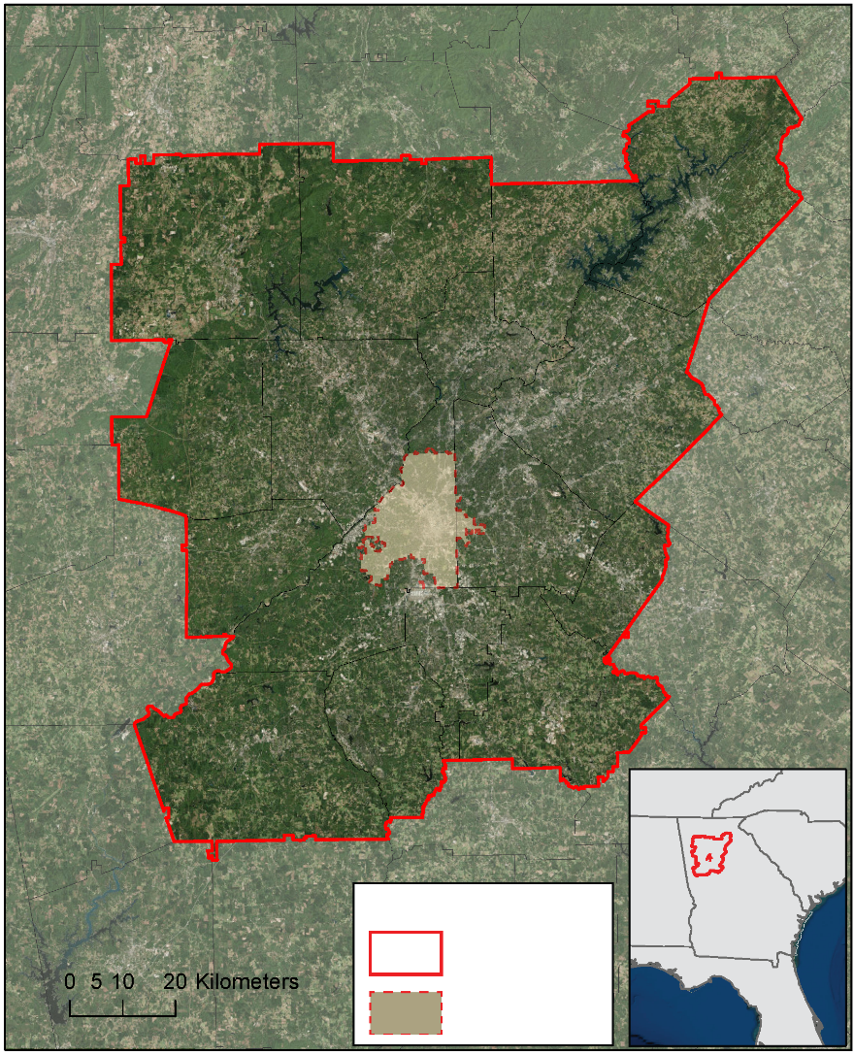
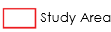
Study Area & Period
Metropolitan North Georgia Water Planning District (MNGWPD)
  15 counties
  9 major watersheds
Time Period: 2001 - 2015
Contains the greater Atlanta area
  Population of approximately 5.2 million (U.S. Census, 2010)
Study Area
MNGWPD
Notes:
The study area focused on the Metropolitan North Georgia Water Planning District (MNGWPD) (approx. 12k km²), which was composed of the following 15 counties in GA: Bartow, Cherokee, Clayton, Cobb, Coweta, DeKalb, Douglas, Fayette, Forsyth, Fulton, Gwinnett, Hall, Henry, Paulding, and Rockdale. Nine major watersheds that cross/are contained in the MNGWPD are: Upper Chattahoochee, Middle, Chattahoochee, Upper Ocmulgee, Flint, Upper Tallapoosa, Etowah, Upper Oconee, Coosawattee, and Oostanaula.
It is notable to mention that our study area also contained the city of Atlanta , as it is one of the largest and most populated cities in the USA.
Our study period spans from 2001- 2015 . This timeframe allowed us a sufficient data collection period, and it also documented the pattern in Atlanta’s growth around and after the time of the 2008 national recession.

Slide 3
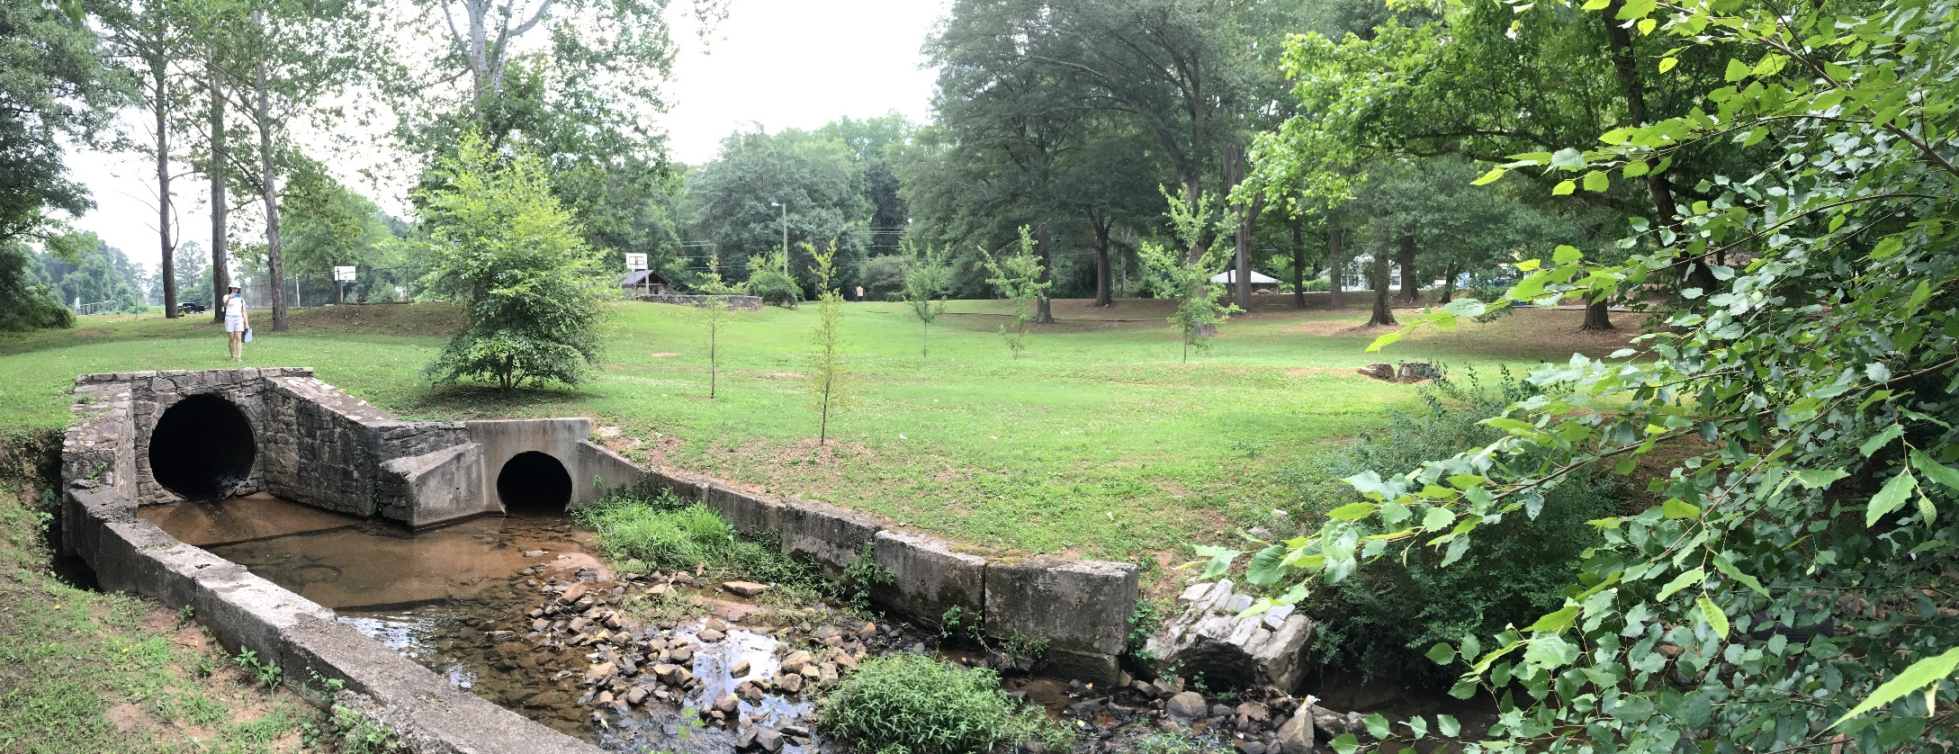
Objectives
Identify reforestation targets to help reduce harmful stormwater runoff
Analyze watershed processes using the Soil Water Assessment Tool (SWAT)
Model multiple land allocation scenarios for reforestation purposes using the Land Use Conflict Identification Strategy (LUCIS)
Image Credit: Natalia Bhattacharjee
Notes:
The objectives of this project were designed to assist The Nature Conservancy with their on-going work in the Atlanta region and to provide a spatial analysis for their proposed reforestation efforts. We accomplished our objectives by identifying prime reforestation targets to help reduce harmful stormwater runoff and by modeling multiple land allocation scenarios for reforestation purposes using the Land Use Conflict Identification Strategy, or LUCIS model.
Initially, we intended to simulate and characterize the hydrological processes of the MNGWPD watershed and identify at- risk/ vulnerable areas within our study area with a Soil and Water Assessment Tool, or SWAT model. However, due to difficulties in obtaining the necessary data, the SWAT model will be implemented in the next term.

Slide 4
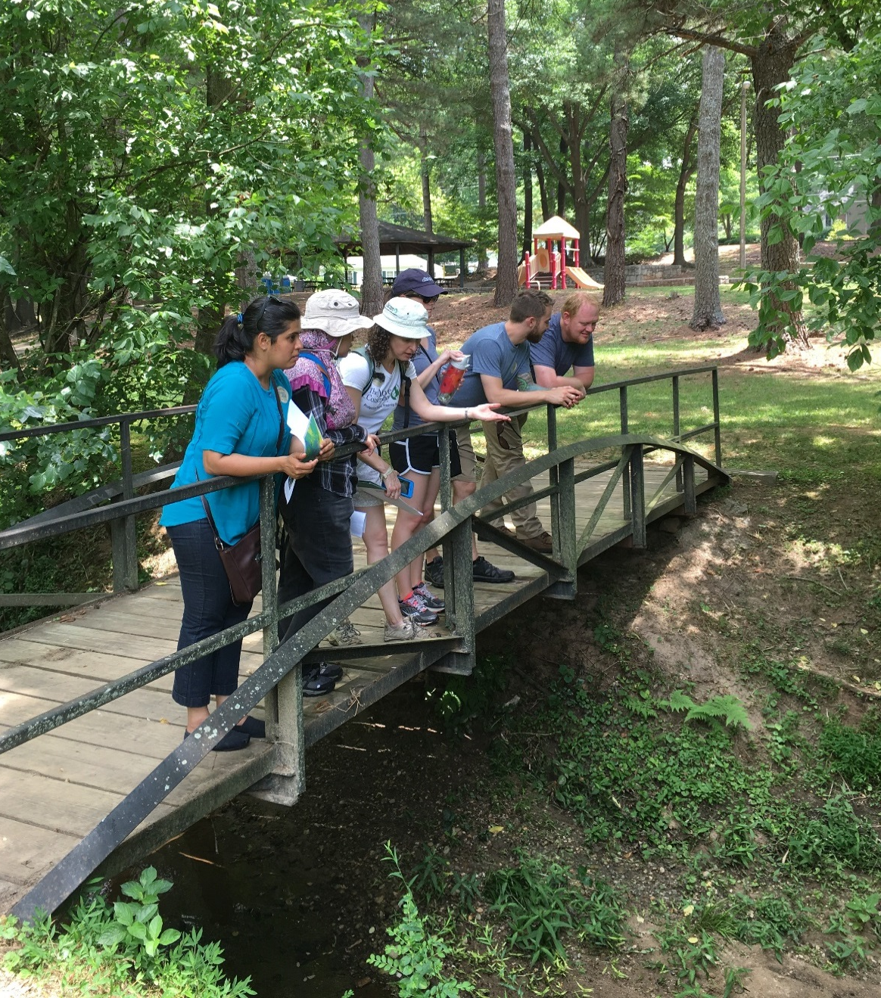
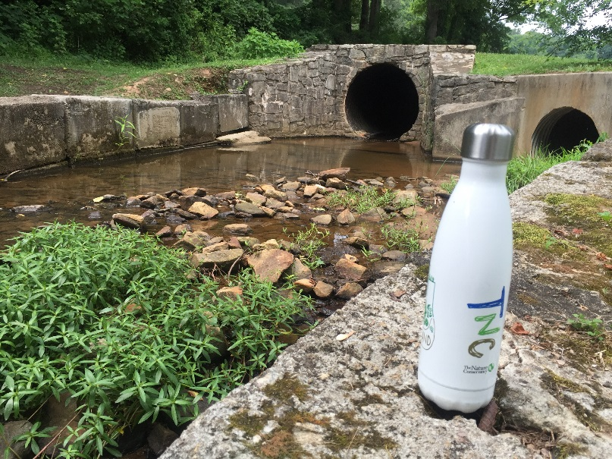
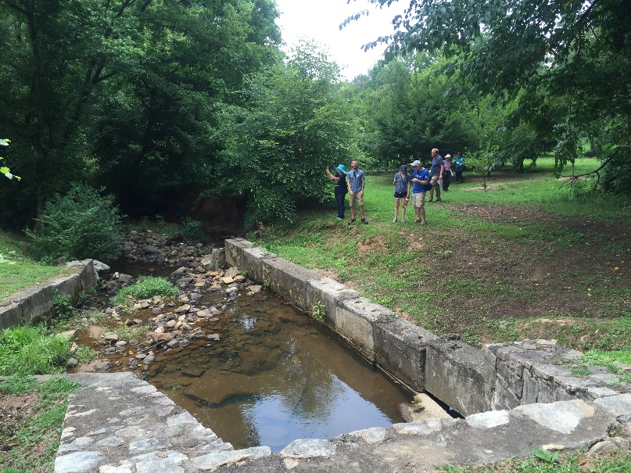
Community Concerns
Rising cost of municipal water management in metro Atlanta
Growth of Atlanta exacerbates stormwater management problems
Increased impervious surface cover could mean more pollution enters waterways through runoff
Image Credit: Natalia Bhattacharjee
Image Credit: Sara Gottlieb
Image Credit: Sara Gottlieb
Notes:
Atlanta is one of the fastest growing cities in the nation, and it is considered a key player when it comes to Georgia’s regional water resource use discussions for two reasons: (1) Atlanta is Georgia’s largest city (2) The Chattahoochee river, which supplies this region and neighboring areas with most of its water, flows through the heart of the city. As of late, the costs of municipal water management in the metropolitan Atlanta area are rising due to an increased demand of infrastructure required to handle stormwater runoff. This predicament is expected to worsen as rapid, continued development in the city of Atlanta and its suburbs will expand areas of impervious surface cover, exacerbating stormwater management problems. In an attempt to relieve the extensive stormwater volumes that tax existing infrastructure, the Nature Conservancy suggested implementing green infrastructure in Atlanta and its surrounding areas.

Slide 5


NASA Earth Observing Systems
Landsat 8, OLI
Terra, ASTER
Landsat 8 and Terra satellites were utilized in this project to produce land cover and topographic datasets
Notes:
To address the needs of the Nature Conservancy, we decided to implement a Land Use Conflict Identification Strategy or (LUCIS) model and a Soil and Water Assessment Tool or (SWAT) model. For these models’ input datasets, we obtained cloud-free Landsat 8 OLI images from October, 2015. Images were obtained for 2 Landsat scenes corresponding to the coverage of the MNGWPD by path-row. We also downloaded 30m ASTER DEMs for elevation data.
Both datasets were acquired through the USGS EarthExplorer website.

Slide 6
Methodology
Landsat 8 OLI imagery
US Census
ASTER DEM
Soil & Watershed Assessment Tool (SWAT)
Soils & Geology
Topography
National Hydrography Dataset
Global Weather Data
USGS Streamflow & Water Quality
gSSURGO
Land Cover & Land Use
Climate
Input Data
National Land Cover Dataset
Stormwater Infrastructure
Proximity to Waterways
Green Spaces
Community Impact
Soil Permeability
Proximity to Forests
Canopy Cover
Pollution Sources
Open Spaces
Proximity to Waterways
Associated Land Cover
Proximity to Waterways
Slope
Minimize Untreated Stormwater Flow from Impervious Surface
Protect existing green infrastructure and identify opportunities for conservation
Identify lands with a high potential to impact water quality
Suitability Analysis
Land Use Conflict Identification Strategy (LUCIS)
Land Use Prioritization
Notes:
This graph represents flow chart of our analysis. We used LUCIS and SWAT for identifying important sites for water quality and conservation purposes. All ancillary and project-generated datasets were utilized based on goals and objectives (marked in green) corresponding to three primary land use types (urban, agriculture and conservation). These objectives were used to perform suitability and perform land use prioritization. We integrated the SWAT and LUCIS models, and produced in-depth land use prioritization and allocation scenarios with the help of project partners.

Slide 7
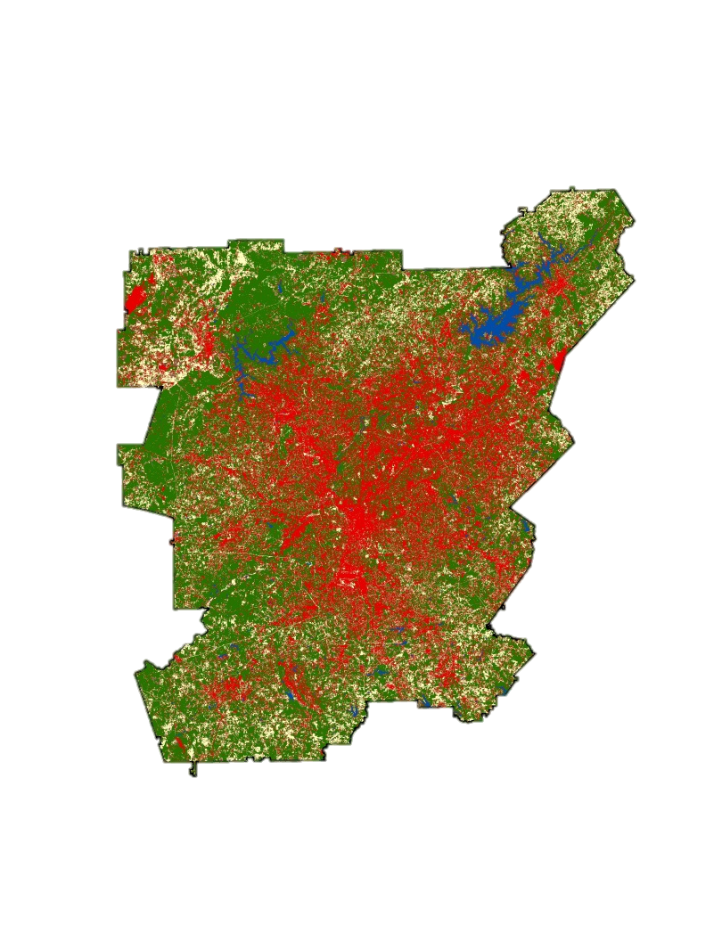

Land Cover Classification
Processing
Mosaic
Atmospheric Correction
Classification
Training Sets
Maximum Likelihood Classification
Urban
Validation
Agriculture
Water
Accuracy Assessment
Confusion Matrix
Forest
Bare
End-Product
0
40
Km
Supervised 2015 Land Cover Classification
Notes:
The supervised land cover classification was performed in ENVI on our Landsat 8 images. This classification scheme is meant to reflect the major land use allocations in LUCIS. The accuracy assessment was done by generating 150 random points and interpreting them using NAIP imagery.

Slide 8
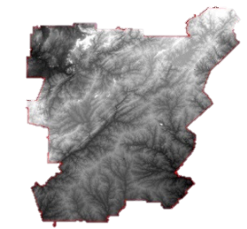
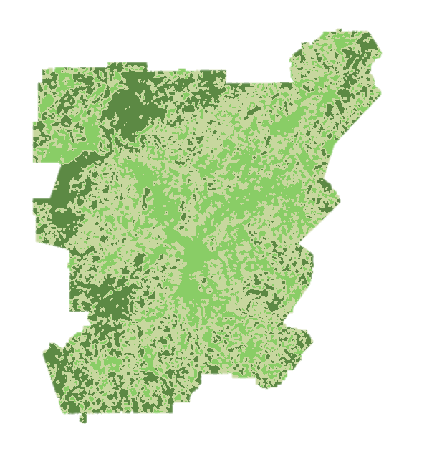
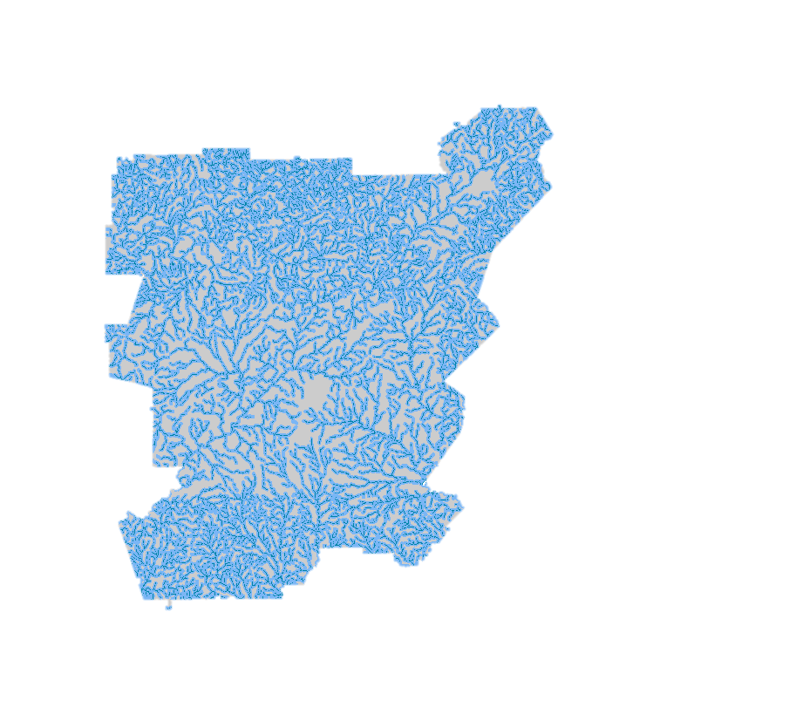
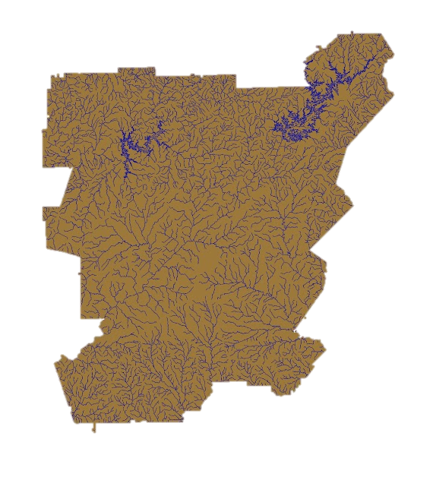
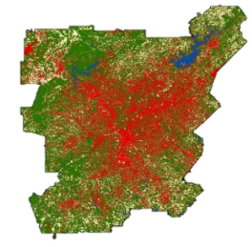
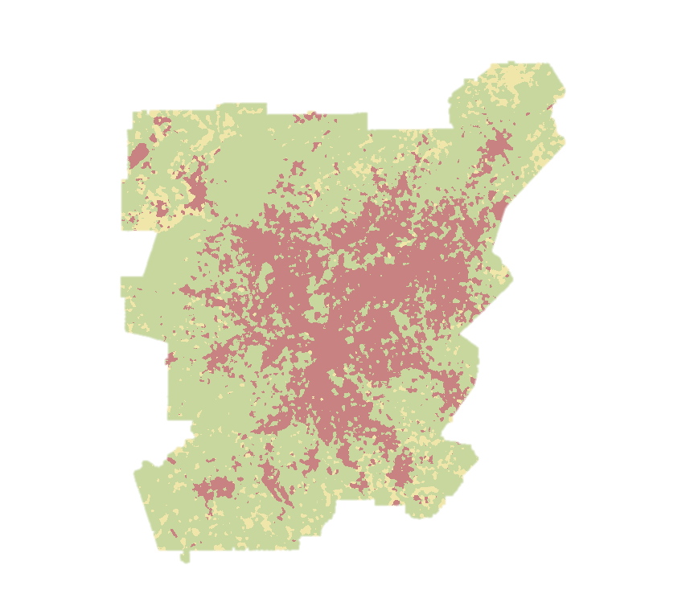
Land
Use
Conflict
Identification
Strategy (LUCIS)
Suitability Analysis
Integrates input datasets to create suitability data layers based on defined goals and objectives
Locates areas of potential land use conflict based on suitability prioritization and ranking
Produces flexible land use allocation scenarios based on goals and objectives that can be easily adapted
Notes:
LUCIS was developed by Carr and Zwick at the University of Florida. It was previously used in the UGA DEVELOP Miami Ecological Forecasting project (2014). LUCIS is a flexible model that can account for variations in stakeholder and local interest groups as it relates to land use allocation.
LUCIS Integrates a broad range of input datasets to create suitability data layers based on defined goals and objectives for primary land use categories (urban, agriculture, and conservation)
LUCIS Produces flexible land use allocation scenarios based on goals and objectives that can be adapted to a range of stakeholder and community preferences

Slide 9
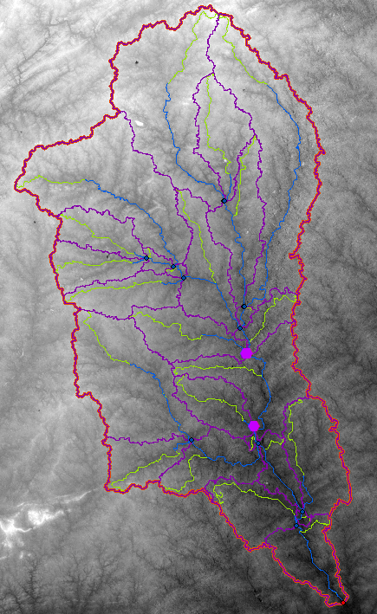
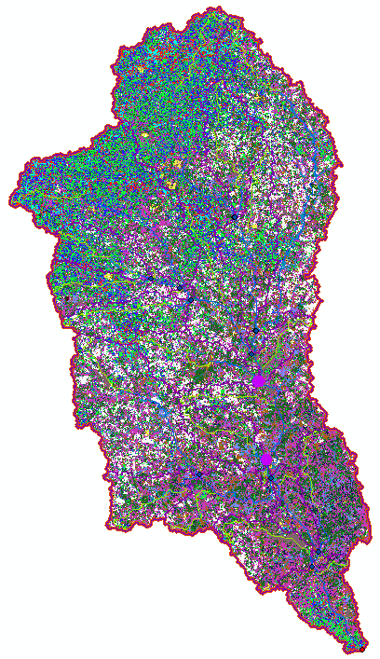
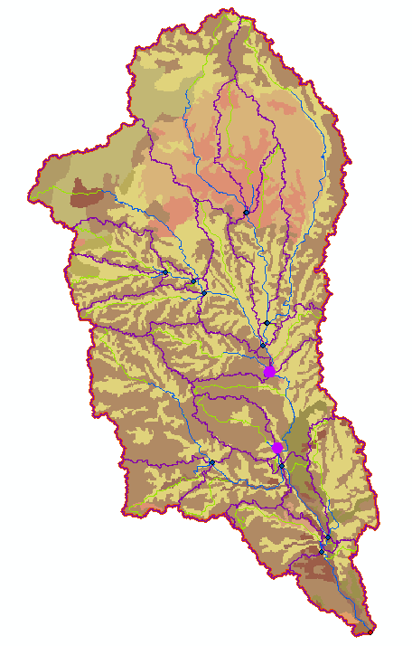
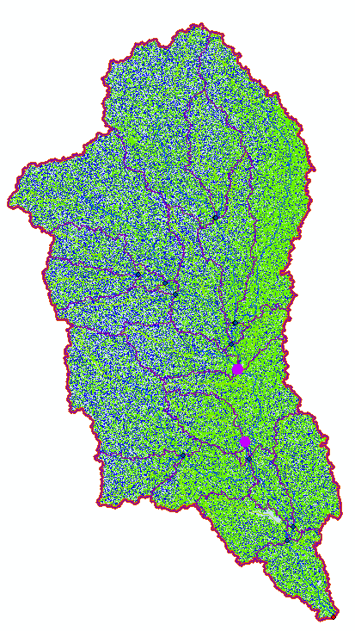
Soil
Water
Analysis
Tool (SWAT)
Delineates watersheds and their sub basin from chosen location utilizing a DEM
Incorporates soil data to best model the interaction between soil properties and precipitation.
Produces hydrological model of water-related processes in watersheds
Quantifies the effect of land use and management on ecosystems to inform best management practices
Notes:
Soil Water Analysis Tool (SWAT) ArcGIS 10.2 was developed at the Texas A&M University. SWAT has been widely applied for modeling water-related processes in watersheds and quantifying the effect of land management on ecosystems to inform best management practices and policies. The SWAT model was used to assess the impact of different land management practices, pollutions sources, and contaminants on local watersheds.

Slide 10
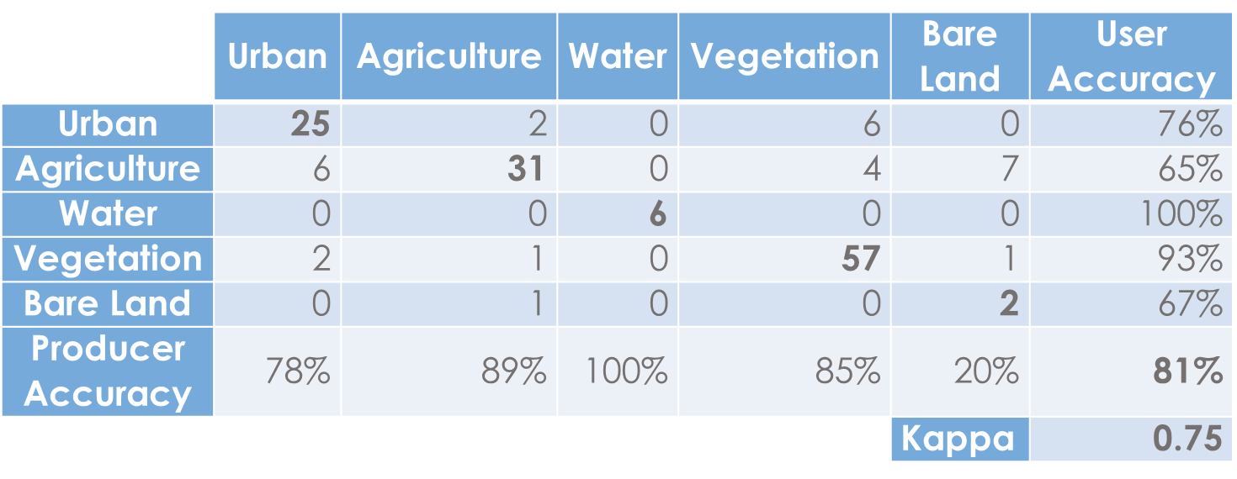
Results: Land Cover
Accuracy Assessment
From 2001 to 2015, approximately one-third of this area (4,000 km²) experienced a change in land cover
Almost half of all land cover change was deforestation
Notes:
This is the confusion matrix for our 2015 Landsat-based classification. Kappa measures the strength of classification on a 0 to 1 scale- a 0.75 value is considered substantially accurate. The majority of misclassification came from the bare land class. This is likely due to the low number of accuracy assessment points (total of 3) compared to the other classes. Comparing the 2001 NLCD to our 2015 classification showed some trends: 32% of the study area changed its land cover type. Of this change, 47% of it is loss of forested land.

Slide 11
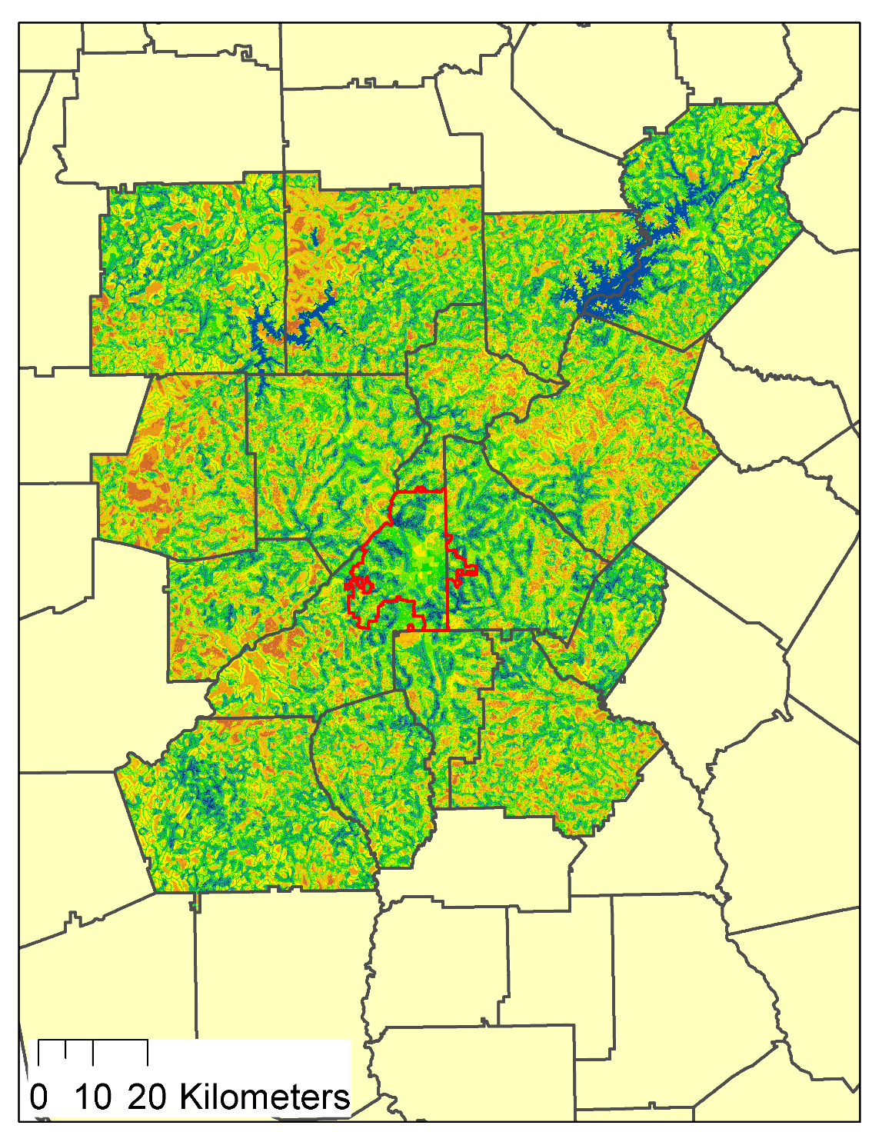
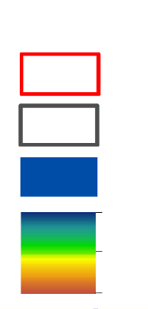
Results: LUCIS
Land-Use Prioritization Identification Strategy
Our model spatially analyzes the metropolitan region of Atlanta to designate prioritization values based on a locations suitability for conservation efforts.
Based on a scale of 2.35 – 5.85, The Nature Conservancy can use this to guide their efforts in land acquisition strategies.
MNGWPD
Counties
Water Bodies
High: 5.85
Low: 2.35
Prioritization Map

Slide 12
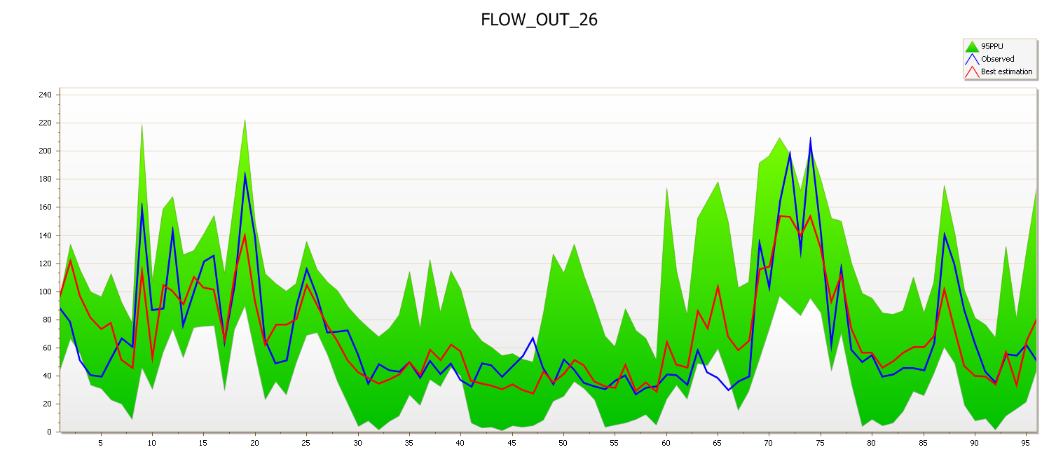
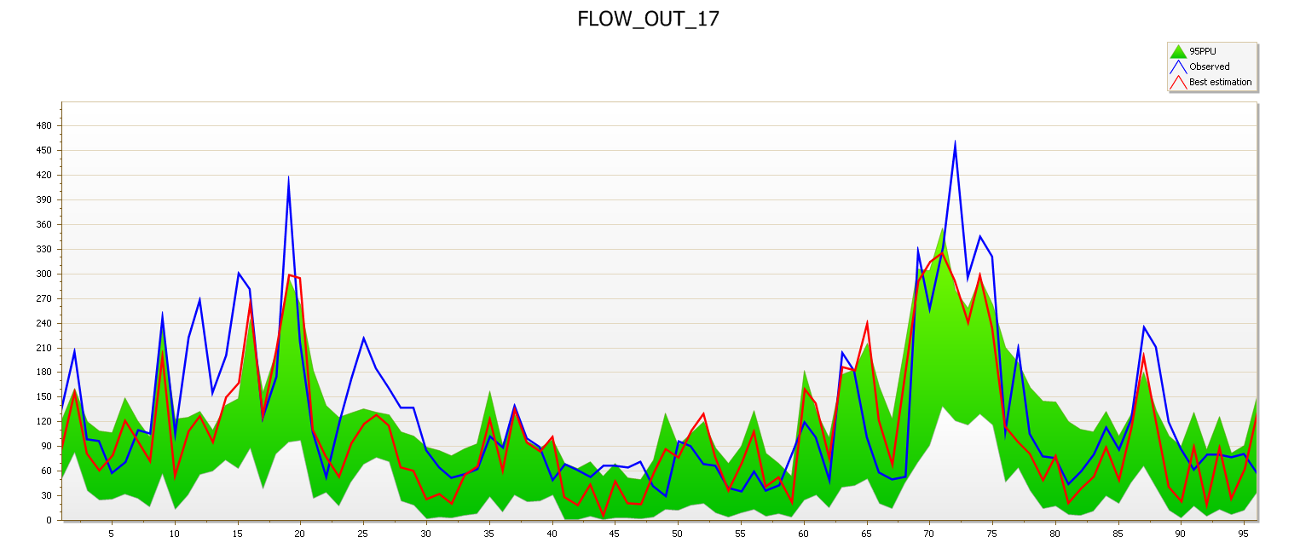
Results: SWAT & SWAT-CUP
SWAT Flow Rate Calibration
Upper Chattahoochee
  R² = 0.69
  NSE = 0.69
  p-factor = 0.96
Cubic Meters per Second
Middle Chattahoochee
  R² = 0.65
  NSE =0.5
  p-factor = 0.96
Months
Cubic Meters per Second
Months
Notes:
The R² value represents a statistical measurement of how close the data are to the fitted regression line (a.k.a. our models observed flow rate calculations).
The Nash-Sutfliffe efficiency (NSE) coefficient is sued to assess predictive power of hydrologic models. In general, model simulation can be judged as satisfactory if NSE > 0.50.
Our results for surface water flow rate in the Upper Chattahoochee, Middle Chattahoochee, Upper Ocmulgee, and Etowah watersheds have proven to be scientifically satisfactory with R² and NSE values above 0.50.
(The range of the p-factor and the r-factor vary from 0-1. A p-factor value close to 1 indicates a very high model performance and efficiency. The r-factor refers to the thickness of the PPU envelope. The p- and r-factors are closely related to each other, which indicates that a large p-factor can be achieved only at the expense of a higher r-factor.)

Slide 13
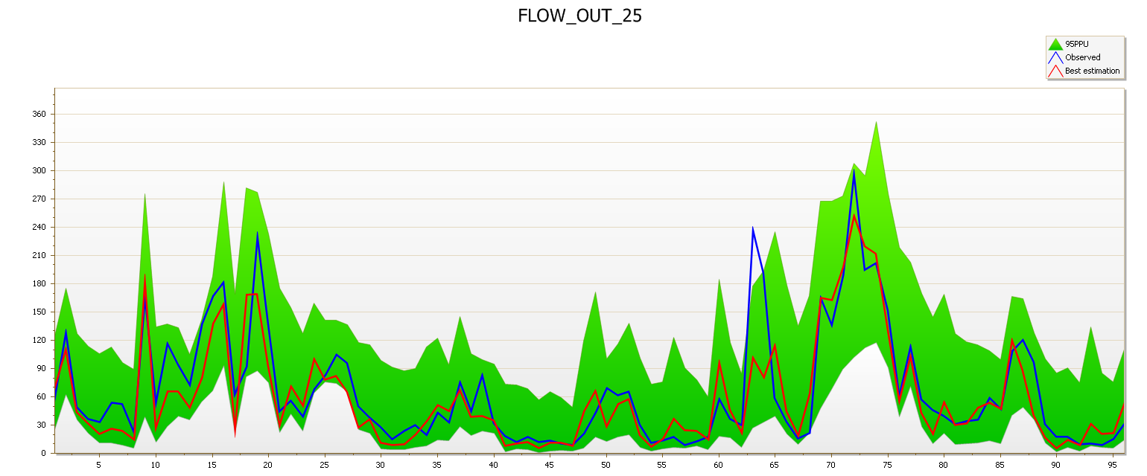
Results: SWAT & SWAT-CUP
SWAT Flow Rate Calibration
Upper Ocmulgee
  R² = 0.77
  NSE =0.76
  p-factor = 0.99
Cubic Meters per Second
Etowah
  R² = 0.78
  NSE =0.78
  p-factor = 0.92
Months
Cubic Meters per Second
Months
Notes:
The R² value represents a statistical measurement of how close the data are to the fitted regression line (a.k.a. our models observed flow rate calculations).
The Nash-Sutfliffe efficiency (NSE) coefficient is sued to assess predictive power of hydrologic models. In general, model simulation can be judged as satisfactory if NSE > 0.50.
Our results for surface water flow rate in the Upper Chattahoochee, Middle Chattahoochee, Upper Ocmulgee, and Etowah watersheds have proven to be scientifically satisfactory with R² and NSE values above 0.50.
(The range of the p-factor and the r-factor vary from 0-1. A p-factor value close to 1 indicates a very high model performance and efficiency. The r-factor refers to the thickness of the PPU envelope. The p- and r-factors are closely related to each other, which indicates that a large p-factor can be achieved only at the expense of a higher r-factor.)

Slide 14
Results: Arc SWAT
Upper Chattahoochee Boundary map
MNGWPD
Upper Chattahoochee Flow Rate
Cubic Meters per Second
Months
Notes:
The R² value represents a statistical measurement of how close the data are to the fitted regression line (a.k.a. our models observed flow rate calculations).
The Nash-Sutfliffe efficiency (NSE) coefficient is sued to assess predictive power of hydrologic models. In general, model simulation can be judged as satisfactory if NSE > 0.50.
Our results for surface water flow rate in the Upper Chattahoochee, Middle Chattahoochee, Upper Ocmulgee, and Etowah watersheds have proven to be scientifically satisfactory with R² and NSE values above 0.50.
(The range of the p-factor and the r-factor vary from 0-1. A p-factor value close to 1 indicates a very high model performance and efficiency. The r-factor refers to the thickness of the PPU envelope. The p- and r-factors are closely related to each other, which indicates that a large p-factor can be achieved only at the expense of a higher r-factor.)

Slide 15
Results: Arc SWAT Estimates
SWAT Flow Estimates
Notes:
The R² value represents a statistical measurement of how close the data are to the fitted regression line (a.k.a. our models observed flow rate calculations).
The Nash-Sutfliffe efficiency (NSE) coefficient is sued to assess predictive power of hydrologic models. In general, model simulation can be judged as satisfactory if NSE > 0.50.
Our results for surface water flow rate in the Upper Chattahoochee, Middle Chattahoochee, Upper Ocmulgee, and Etowah watersheds have proven to be scientifically satisfactory with R² and NSE values above 0.50.
(The range of the p-factor and the r-factor vary from 0-1. A p-factor value close to 1 indicates a very high model performance and efficiency. The r-factor refers to the thickness of the PPU envelope. The p- and r-factors are closely related to each other, which indicates that a large p-factor can be achieved only at the expense of a higher r-factor.)

Slide 16
Results: Arc SWAT estimates
SWAT Sediment Estimates
Notes:
The R² value represents a statistical measurement of how close the data are to the fitted regression line (a.k.a. our models observed flow rate calculations).
The Nash-Sutfliffe efficiency (NSE) coefficient is sued to assess predictive power of hydrologic models. In general, model simulation can be judged as satisfactory if NSE > 0.50.
Our results for surface water flow rate in the Upper Chattahoochee, Middle Chattahoochee, Upper Ocmulgee, and Etowah watersheds have proven to be scientifically satisfactory with R² and NSE values above 0.50.
(The range of the p-factor and the r-factor vary from 0-1. A p-factor value close to 1 indicates a very high model performance and efficiency. The r-factor refers to the thickness of the PPU envelope. The p- and r-factors are closely related to each other, which indicates that a large p-factor can be achieved only at the expense of a higher r-factor.)

Slide 17
Results: Arc SWAT estimates
SWAT Phosphorus Estimates
Notes:
The R² value represents a statistical measurement of how close the data are to the fitted regression line (a.k.a. our models observed flow rate calculations).
The Nash-Sutfliffe efficiency (NSE) coefficient is sued to assess predictive power of hydrologic models. In general, model simulation can be judged as satisfactory if NSE > 0.50.
Our results for surface water flow rate in the Upper Chattahoochee, Middle Chattahoochee, Upper Ocmulgee, and Etowah watersheds have proven to be scientifically satisfactory with R² and NSE values above 0.50.
(The range of the p-factor and the r-factor vary from 0-1. A p-factor value close to 1 indicates a very high model performance and efficiency. The r-factor refers to the thickness of the PPU envelope. The p- and r-factors are closely related to each other, which indicates that a large p-factor can be achieved only at the expense of a higher r-factor.)

Slide 18
Results: Arc SWAT estimates
SWAT Nitrogen Estimates
Notes:
The R² value represents a statistical measurement of how close the data are to the fitted regression line (a.k.a. our models observed flow rate calculations).
The Nash-Sutfliffe efficiency (NSE) coefficient is sued to assess predictive power of hydrologic models. In general, model simulation can be judged as satisfactory if NSE > 0.50.
Our results for surface water flow rate in the Upper Chattahoochee, Middle Chattahoochee, Upper Ocmulgee, and Etowah watersheds have proven to be scientifically satisfactory with R² and NSE values above 0.50.
(The range of the p-factor and the r-factor vary from 0-1. A p-factor value close to 1 indicates a very high model performance and efficiency. The r-factor refers to the thickness of the PPU envelope. The p- and r-factors are closely related to each other, which indicates that a large p-factor can be achieved only at the expense of a higher r-factor.)

Slide 19
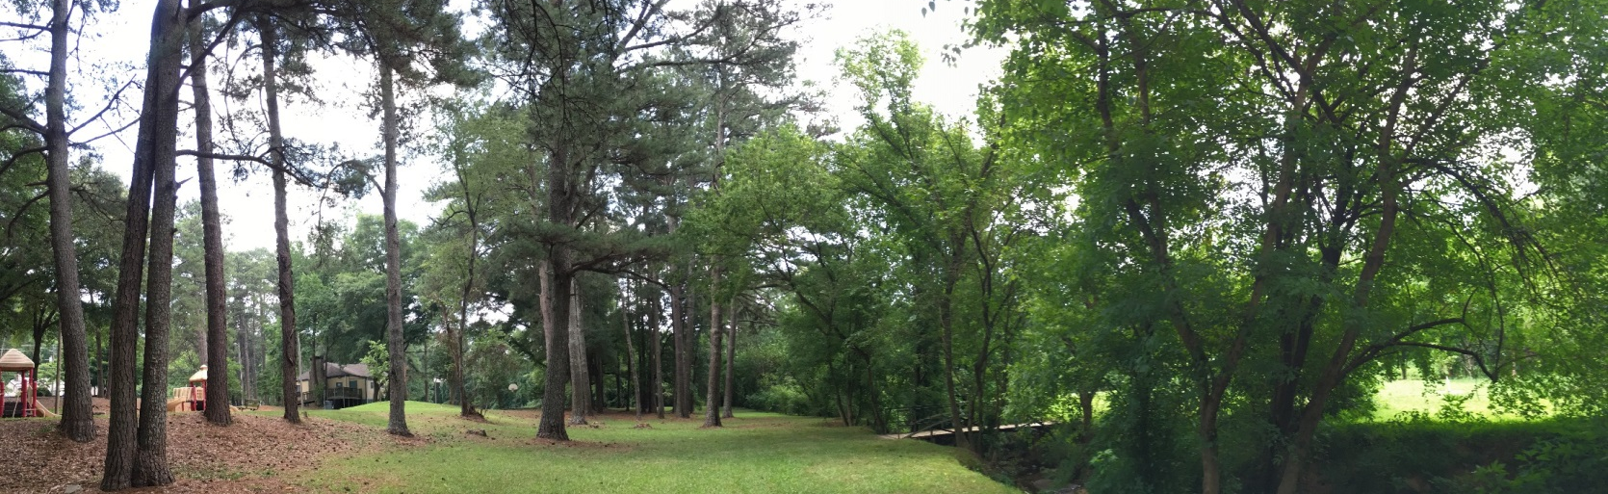
Errors and Uncertainties
Some datasets are incomplete
Land cover classification errors
LUCIS criteria weights should reflect the priorities of local stakeholders
Community preferences must be determined in order to identify conflict in land use allocation scenarios
SWAT model calibration must continue to include surface water nutrient data in order to accomplish the full range of partner interests
The SWAT model will enhance the investigation of land management practices and water quality
Image Credit: Natalia Bhattacharjee
Notes:
NoData values in existing datasets (such as soil permeability) can have a huge effect on model outputs
Misclassification of land cover in the 2015 Landsat 8 imagery occurred primarily in the bare land class
LUCIS weights will be refined/determined through communicating with The Nature Conservancy

Slide 20
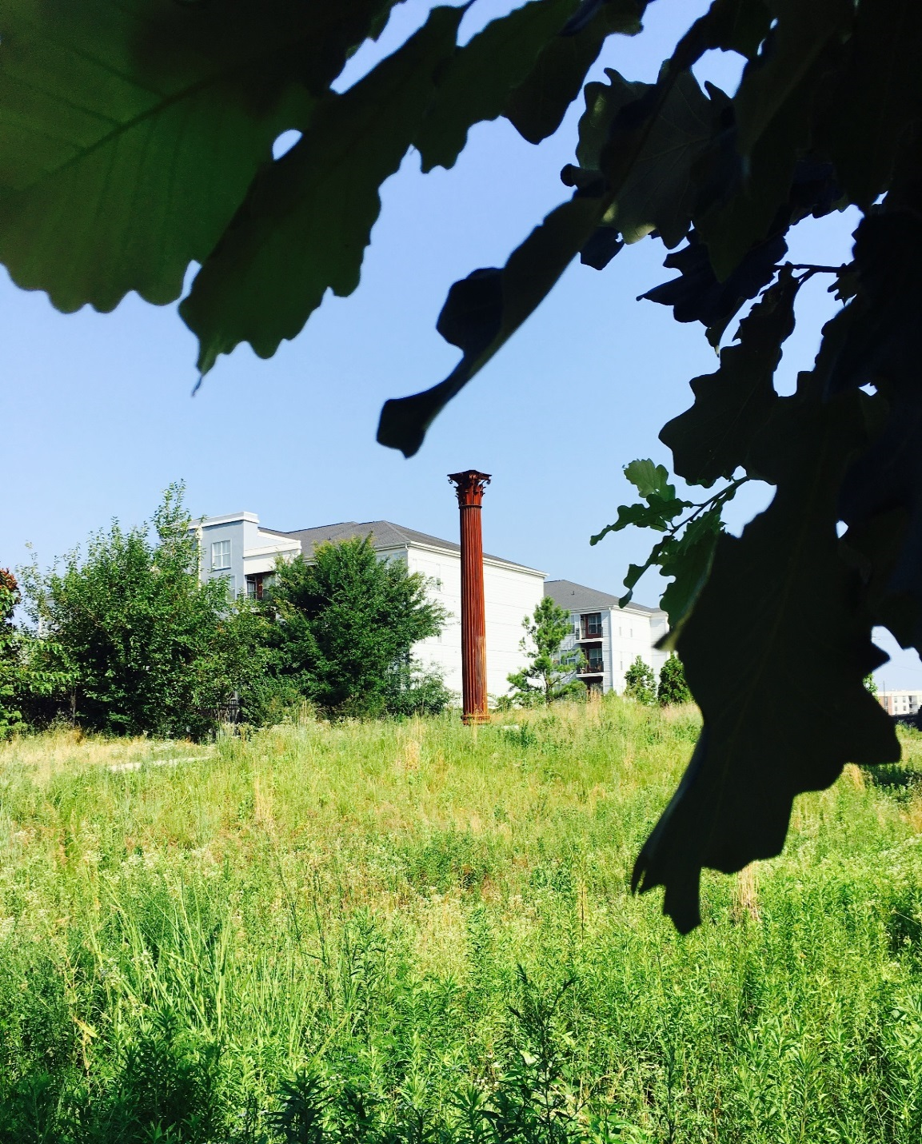
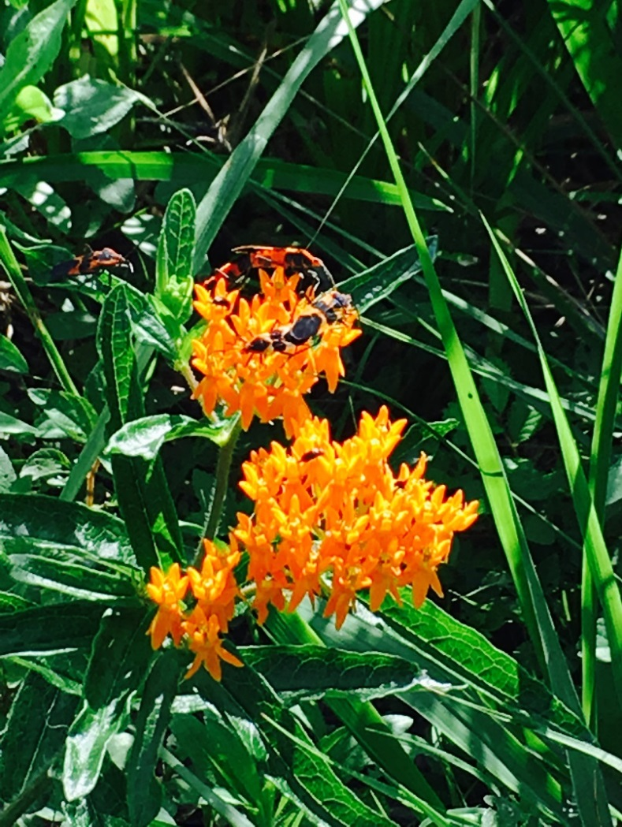

Conclusions
NASA datasets were successfully integrated with ancillary data to assess three water resource management goals:
The LUCIS model provided detailed designations of areas with high impact or potential to affect local water quality
The SWAT model provided a detailed analysis of water flow processes in the five focus watersheds to integrate into the land use prioritization model.
Image Credit: Manasi Parkhi
Image Credit: Sara Gottlieb
Image Credit: Natalia Bhattacharjee
Notes:
The results of the LUCIS model analysis will provide project partners with an understanding of potential land use conflicts from a spatial and stakeholder perspective. This model shows that there are significant opportunities for reforestation and green space expansion to assist stormwater management around Atlanta.
These results will allow The Nature Conservancy to identify lands for future conservation efforts relating to reforestation.

Slide 21
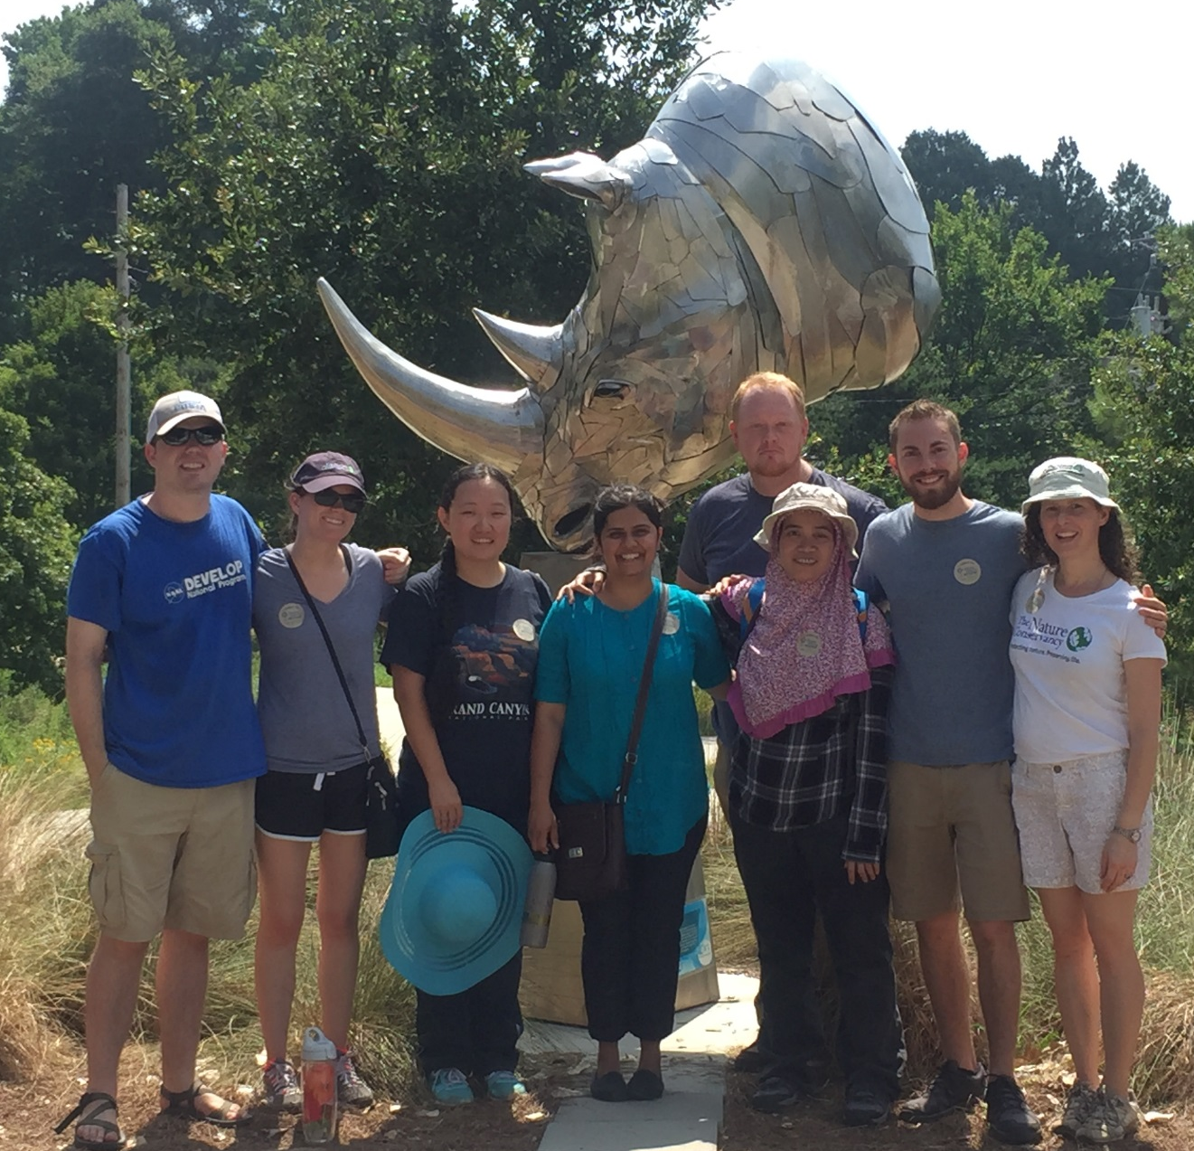
Future Work
Continue calibration of SWAT results in all watersheds.
Implement SWAT model methodology on remaining watersheds located within our study area: Etowah, Flint, and Ocmulgee.
Combine final LUCIS and SWAT results for the entire study area for a comprehensive analysis of the region.
Act further with the Nature Conservancy to integrate our results with their overall goals for the metropolitan region.
This project will continue in the next term, Fall 2016.
Image Credit: Caren Remillard
Notes:
The Atlanta Water Resources Project is scheduled to have a third term this upcoming Fall semester. In the summer term, DEVELOPers will take make a more in-depth analysis of land use prioritization, allocation scenarios and run the SWAT model for watershed characterization and contaminant mapping.

Slide 22
Advisors
Dr. Marguerite Madden, UGA Center for Geospatial Research Director
Dr. Rosanna Rivero, UGA College of Environment and Design Assistant Professor
Partners
Sara Gottlieb, The Nature Conservancy Conservation Planner
Whitney Palanci, The Nature Conservancy Conservation Strategy Specialist
Myriam Dormer, The Nature Conservancy Community Engagement Coordinator
Others
Caren Remillard, NASA DEVELOP UGA Center Lead
Dr. Adam Milewski UGA Geology Department Assistant Professor
Past Contributors (Atlanta Water Resources Team Members Spring 2016)
Beatriz Avila Veronica Fay Jason Reynolds Jacob Spaulding Wenjing Xu
Notes:
We would like to take the time to thank our Science Advisors Dr. Marguerite Madden and Dr. Rosanna Rivero for their guidance and continued support.
We would also like to thank our project partners Sara Gottlieb, Whitney Palanci and Myriam Dormer of The Nature Conservancy, who are here with us today. They have had a very interactive role with this project, whether it be providing helpful ancillary datasets for the model or providing insightful feedback, which will help shape the project in the second term.
Lastly, we would like to acknowledge Dr. Adam Milewski for his expertise on the SWAT model and UGA Center Lead Caren Remillard for her support.

