Slide 1
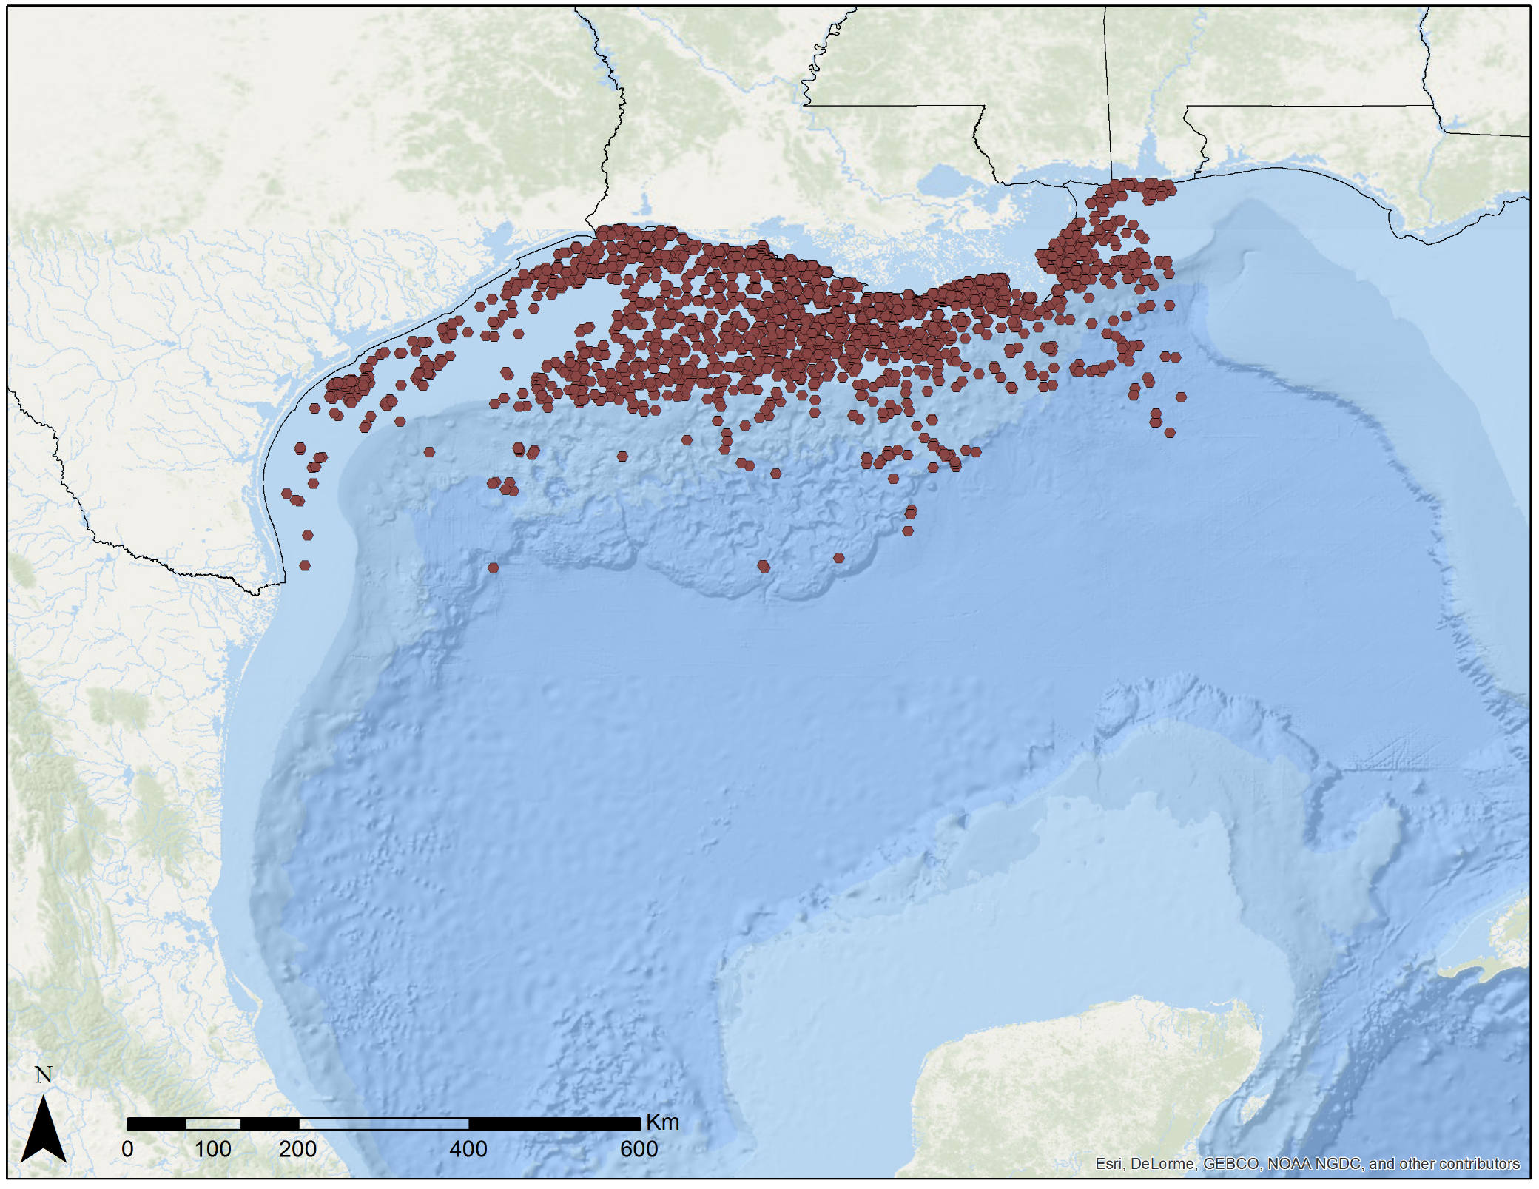
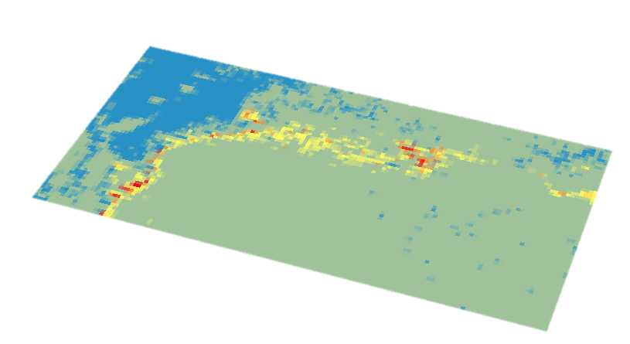
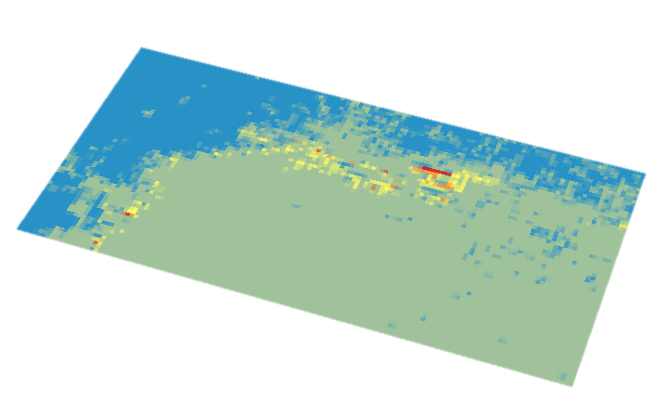
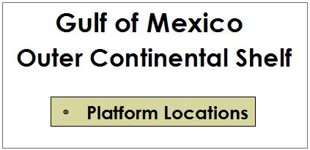
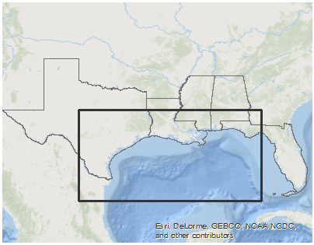
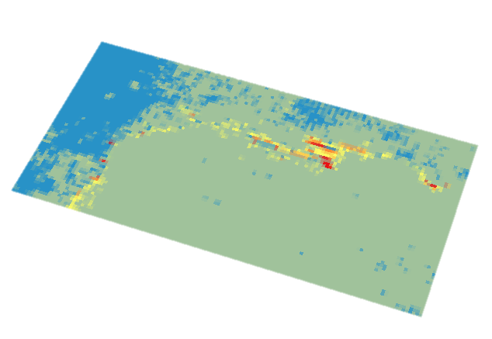
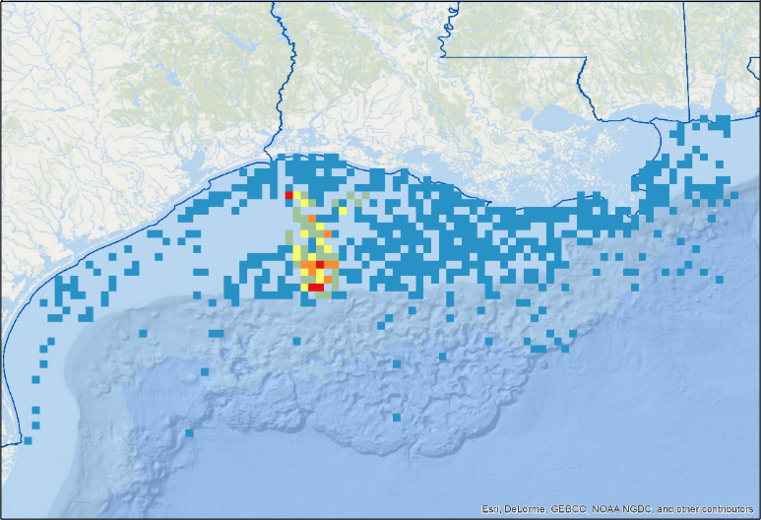
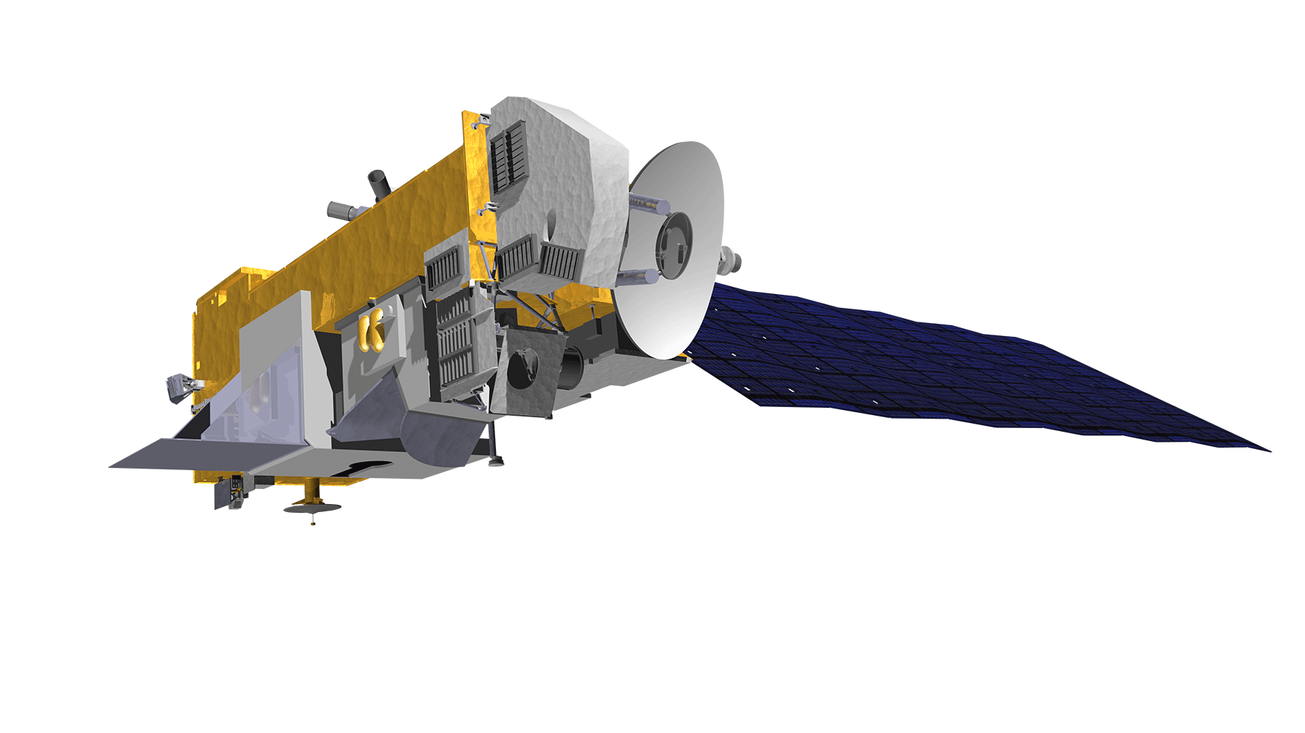
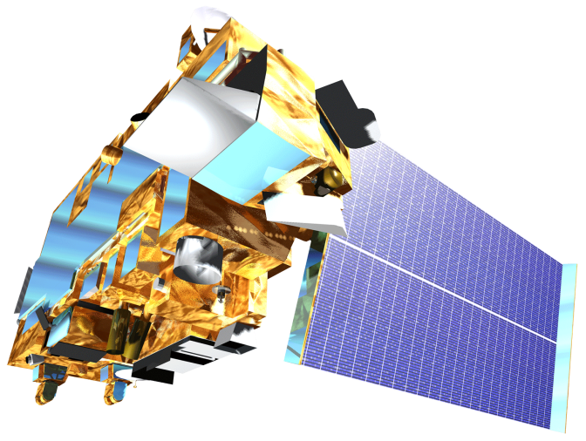
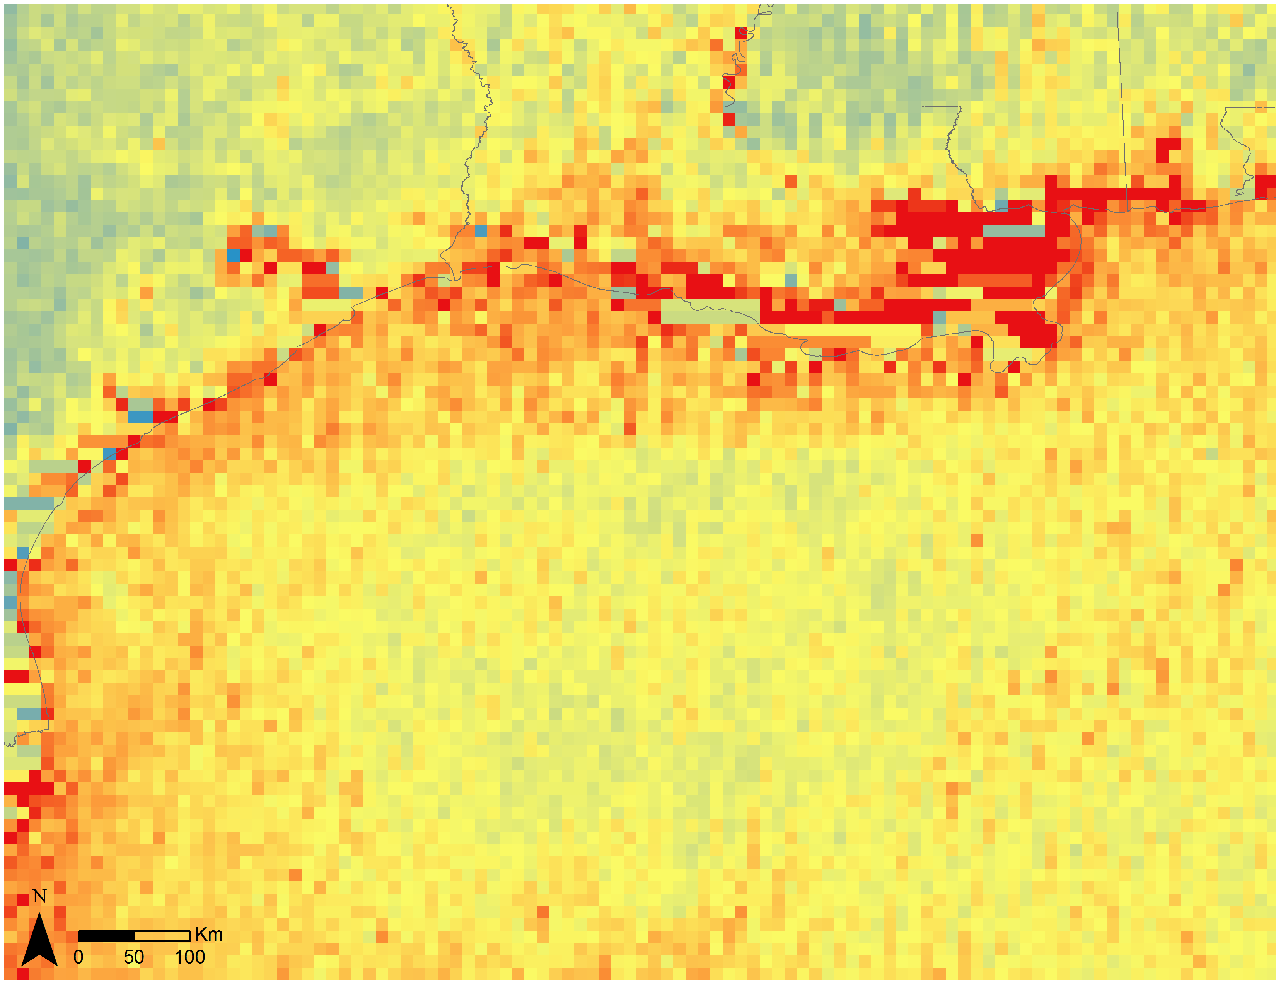
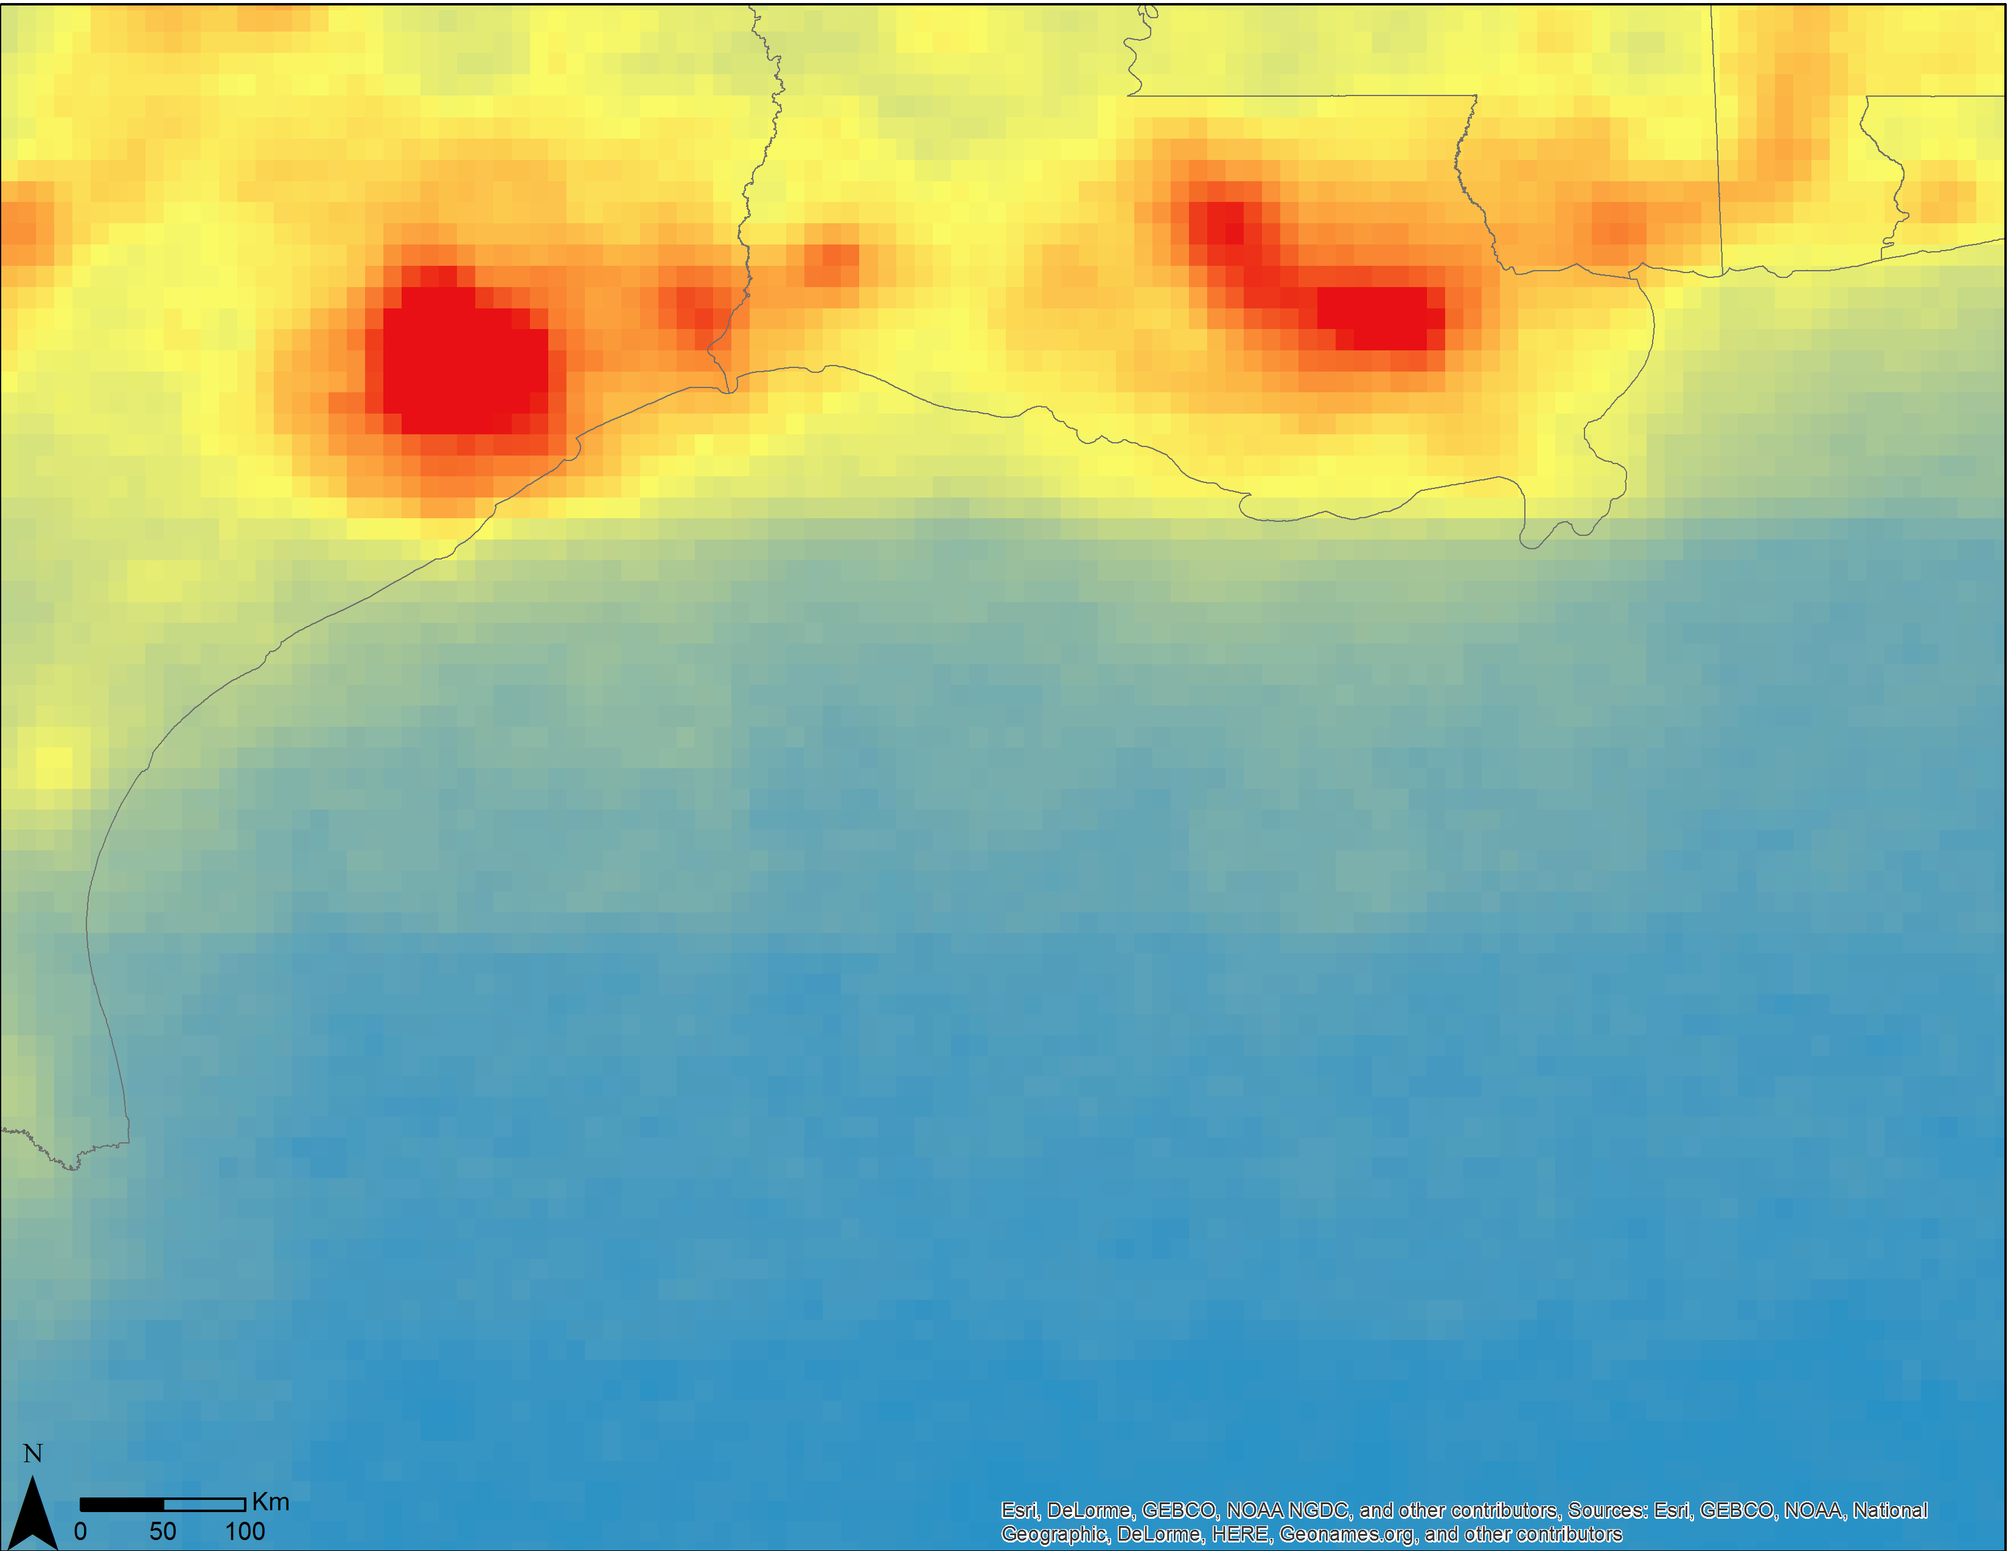
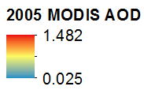
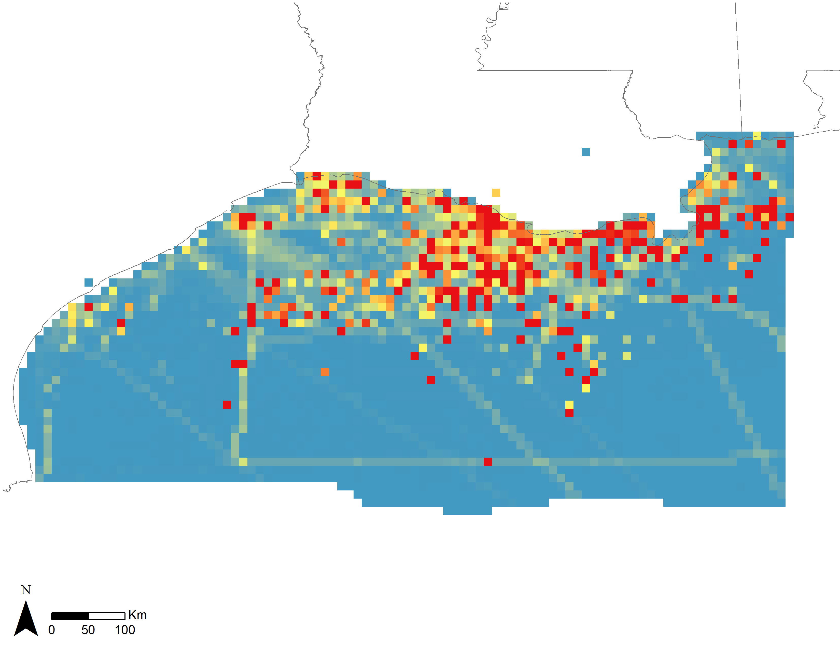
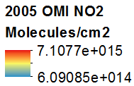
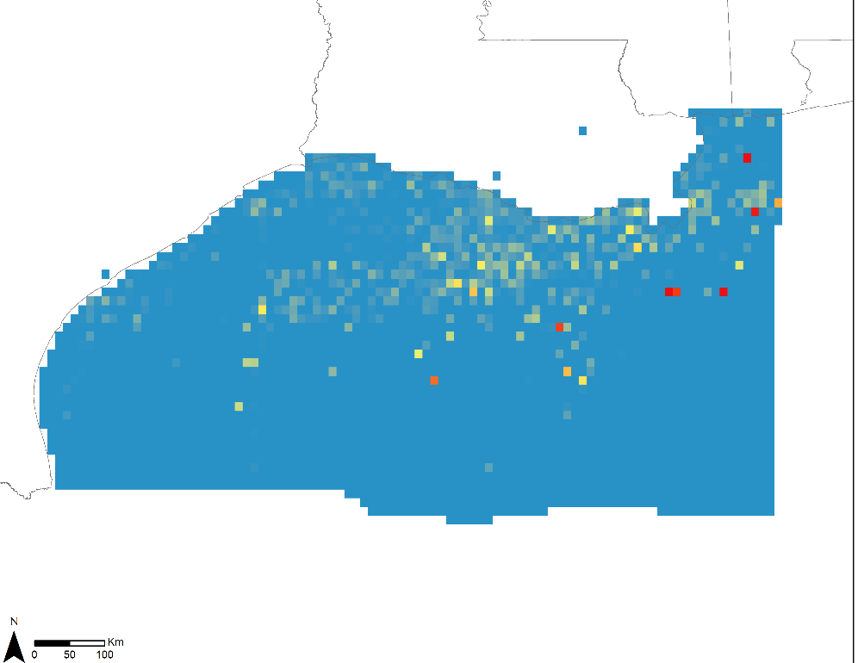
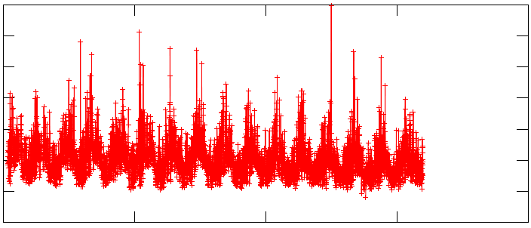
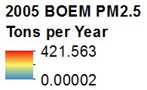
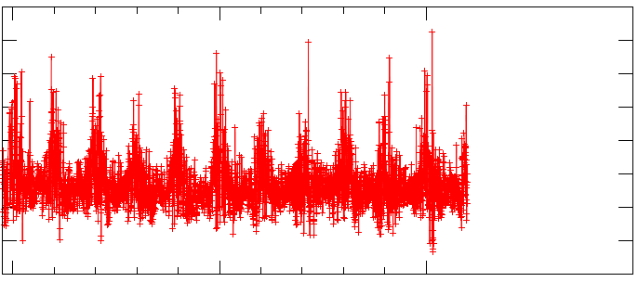
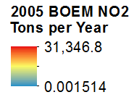
Gulf of Mexico Health & Air Quality
Utilizing NASA Earth observations to manage air quality and pollutants over the Gulf of Mexico
Amanda Clayton (Project Lead), Lori Mandable
DEVELOP National Program at NASA Goddard Space Flight Center
Abstract
Objectives
The Outer Continental Shelf (OCS) of the Gulf of Mexico houses over 3,000 offshore oil and gas production facilities. These facilities emit criteria pollutants that are known to have both human health and environmental impacts. The Bureau of Ocean Energy Management (BOEM) is tasked with monitoring the onshore impacts of these emissions under federal regulations. Current practice requires that facility operators collect monthly emissions inventory data that is used to model air quality. NASA Earth observations were utilized to produce a long-term, regional study in the Gulf of Mexico to monitor changes in air quality. Terra Moderate Resolution Imaging Spectroradiometer (MODIS) and Aura Ozone Monitoring Instrument (OMI) data were used to create emissions profiles for particulate matter of 2.5 microns in diameter (PM_{2.5}) and nitrogen dioxide for the Gulf of Mexico. Time series and time-averaged maps were created to illustrate emissions over the 2000-2015 timeframe. Lastly, satellite data were extracted and correlated with data provided by BOEM’s platform sites to identify areas where emissions levels exceeded average annual thresholds. The project methodology allows BOEM to incorporate satellite data for monitoring atmospheric plumes associated with offshore drilling by oil and natural gas platforms to address future environmental concerns in the Gulf of Mexico.
Map and analyze remotely sensed airborne pollutant concentrations of PM_{2.5} and nitrogen dioxide (NO₂)
Obtain in situ data from BOEM to determine correlations between pollutants and primary emission sources
Develop methodology for continuing emissions monitoring utilizing NASA Earth observations
Methodology
Study Area
Giovanni Visualization: Preliminary Regional Analysis
Texas
Louisiana
Mississippi
Alabama
BOEM Gulfwide Emissions Inventories
L2 Terra MODIS and Aura OMI
In situ emissions measurements at platform and non-platform sites
2005, 2008, & 2011 survey years
Extract monthly data for PM_{2.5} and NO₂
Aggregate and grid point data to 0.1 degree raster
Monthly and annual aggregates of gridded L2 data products
Time series graphs
Earth Observations
Collocate & Correlate
In situ vs. satellite emissions measurements
Aura
Results
Terra
Aerosol Optical Depth / PM_{2.5}
Nitrogen Dioxide
NO₂
Conclusions
Terra’s MODIS and Aura’s OMI instruments successfully provided AOD and NO₂ emission data to analyze patterns on a regional scale over a time span of 10+ years.
No significant correlation existed between BOEM’s Emission Inventory data for the years 2005, 2008 and 2011 and corresponding satellite data for AOD and NO₂.
Process improvement includes adding BOEM’s 2014 Emissions Inventory when it becomes available in the summer of 2016, utilizing CALIPSO’s CALIOP LiDAR data to augment AOD measurements, and examining additional pollutants such as sulfur dioxide, methane, carbon monoxide, and volatile organic compounds for correlation.
1
0.6
0.2
-0.2
MODIS – Terra AOD
7e + 15
5e + 15
3e + 15
1e + 15
-1e + 15
OMI – Aura NO₂
1/cm2
2000 2005 2010 2015
2005 2010 2015
* Example result for year 2005
Project Partners
Acknowledgements
Team Members
Dr. Robert Levy
Dr. Bryan Duncan
Dr. Nickolay Krotkov
Dr. Pawan Gupta
Dr. Lok Lamsal
Lori Mandable and Amanda Clayton
NASA Goddard Space Flight Center

