Slide 1
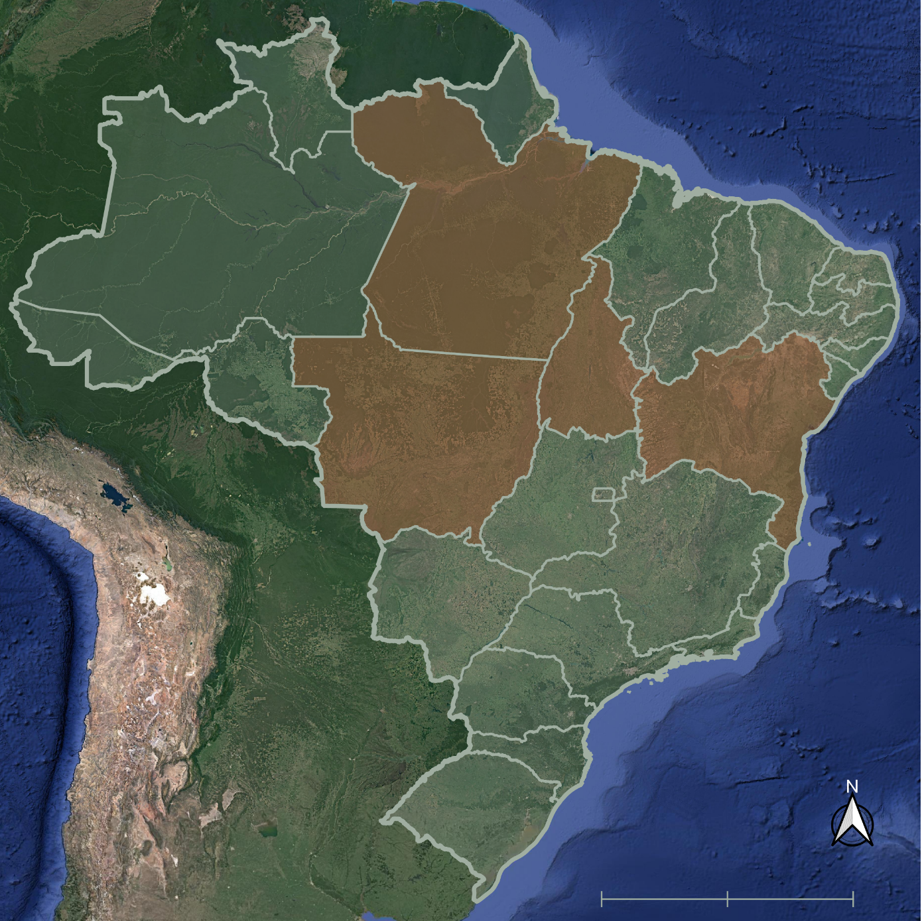
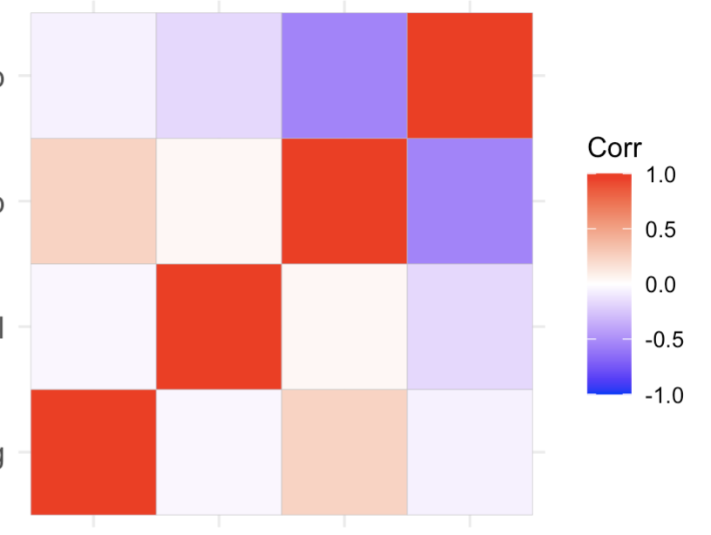
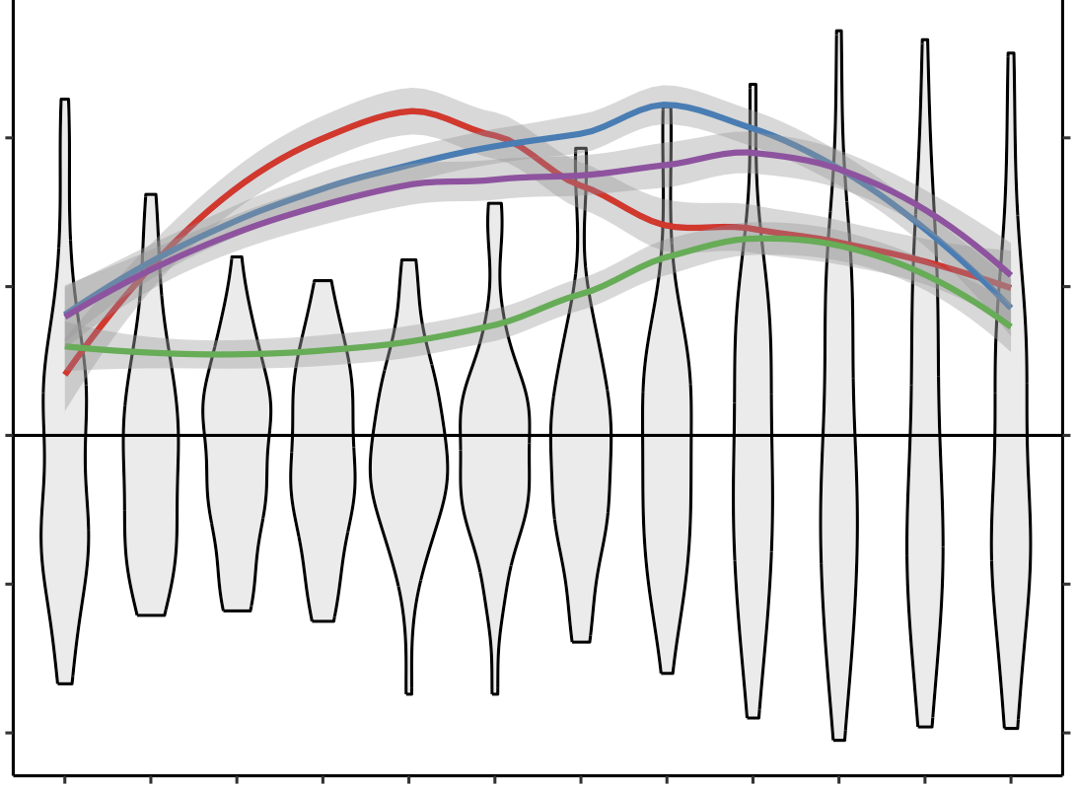
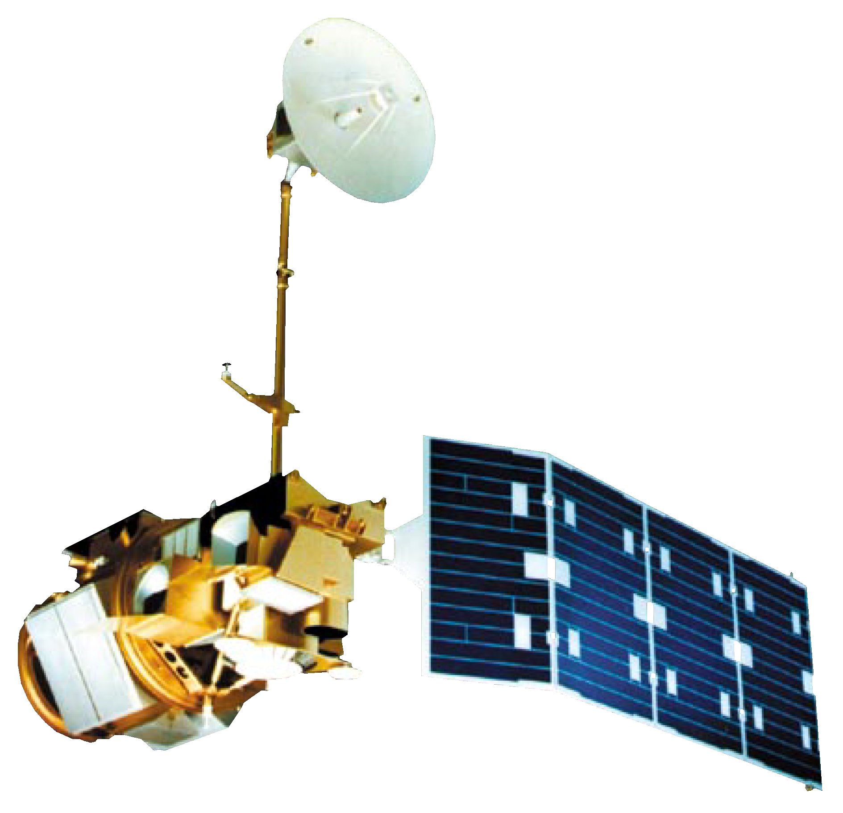
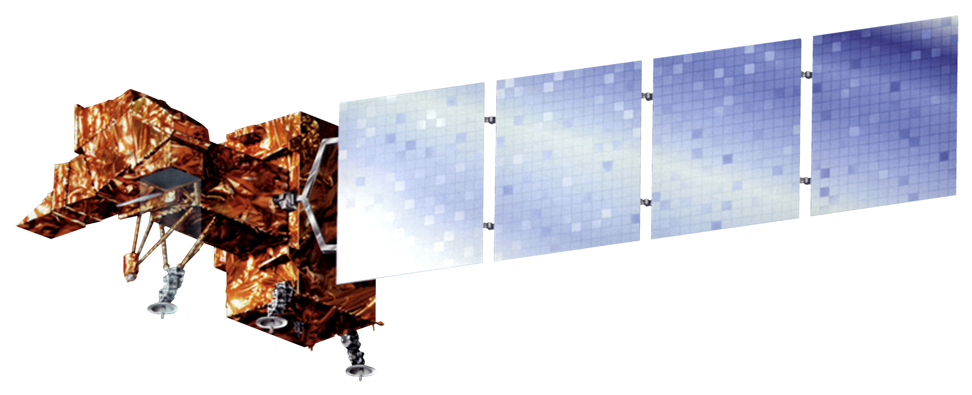
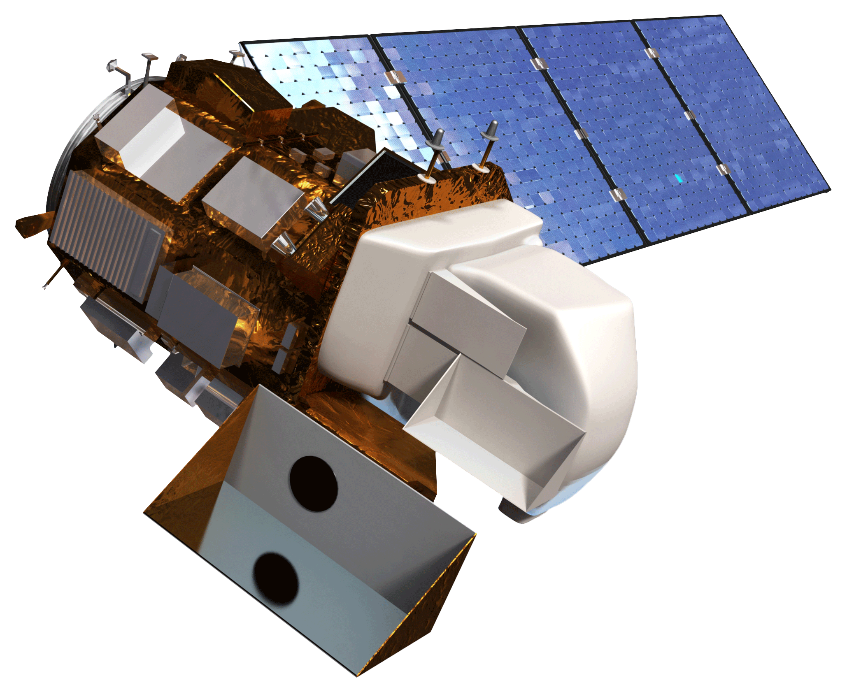
Northern & Central Brazil Agriculture
Measuring Soybean Yields in Northern Brazil During El Niño-Southern Oscillation Conditions to Evaluate Trends in Agricultural Production and Support Crop Forecasting, 1984 – 2023
Project Synopsis
Study Area
Brazil, one of the largest agricultural exporters in the world, holds a significant role in the world's food supply. Crop productivity in Brazil is heavily influenced by El Niño-Southern Oscillation (ENSO), which in northern Brazil is associated with drier than normal conditions and lower than normal rates of precipitation, that drives spatially heterogenous effects on growing conditions of crops, including soybean. In recent years, crop production has expanded towards the northern and central interior of Brazil. This project focused on understanding the relationship between ENSO conditions and soybean productivity from 1984 to 2023 in four states: Pará, Mato Grosso, Tocantins, and Bahia. The results of this project will be used by the United States Department of Agriculture Foreign Agriculture Services to inform crop productivity forecasting.
This project focused on four states in Brazil: Pará, Mato Grosso, Tocantins, and Bahia. These states were selected in cooperation with project partners who identified this region as of particular interest. This region, which exhibits both tropical and savanna climates, accounts for the largest soybean production in the country, which are extremely important to both the country of Brazil and global agriculture.
PA
MT
TO
BA
Objectives
Study area
Examine the relationship between soybean production yield, normalized difference vegetation index (NDVI), and precipitation, temperature, and ENSO conditions.
Produce a time series analysis from 1984 to 2023 comparing crop yield and environmental conditions during ENSO phases.
Conduct conduct statistical analysis to examine relationships between soybean crop yield, NDVI, and temperature, precipitation, and ENSO conditions.
Brazil
0
500
1,000km
Base map: Google Satellite Imagery
Results
Correlation Coefficient Matrix
PCA analysis on the correlation between variables. Little to no correlation exists between NDVI and the 8-month ENSO lag, however there are positive correlations between NDVI and temperature, and ENSO and temperature. Meanwhile, there are negative correlations between temperature and precipitation. There is also a slight negative correlation between ENSO and precipitation.
Precipitation Anomaly
-0.06
-0.17
-0.55
1.0
Correlation
Temperature Anomaly
0.24
0.04
1.0
-0.55
1.0
0.5
Methodology
NDVI Anomaly
-0.04
1.0
0.04
-0.17
0
-0.5
ENSO Anomaly (8-month lag)
1.0
-0.04
0.24
-0.06
-1.0
MapBiomas Annual LULC Classification
Mask soybean pixels
Calculate monthly mean NDVI
Sum NDVI for each soybean growing season
by state
Cumulative annual growing season NDVI for soybean planted areas by state
ENSO Anomaly (8-month lag)
NDVI Anomaly
Temperature Anomaly
Precipitation Anomaly
Monthly Soy* NDVI and ENSO Anomaly (8-Month Lag)
Landsat 5,7,8
Filter dataset annually for cloud-free pixels
Detrended annual soybean crop yield by state
Soybean NDVI and ENSO anomalies do not correspond well with one another, suggesting a seasonal disconnect between the local effects of ENSO and soy NDVI.
2
0.2
Soybean Crop Yield
Detrend Annual Yield Data
NDVI Maps
1
0.1
Correlation Analysis
ENSO SST Anomaly
NDVI
Correlation Analysis
Correlation Analysis
0
0
ENSO SST temperature anomalies
Correlation Analysis
Climatic Time Series Analysis
State
El Niño 3.4 Dataset
Bahia
-1
-0.1
Mato Grosso
ERA5 Data
Filter by study states
Measure monthly total precipitation and temperatures
Mean monthly precipitation and temperature
Pará
-2
-0.2
Tocantins
10
11
12
01
02
03
04
05
06
07
08
09
CHIRPS
Gap-fill data
Measure total precipitation and temperature
Aggregate into monthly means
Mean monthly
temperature
Conclusions
Month
*Soy crop mask by MapBiomas
Correlation and time series analysis with earth observation data can provide unique insights into the relationship between crop yields and climatic conditions such as ENSO, precipitation, and temperature.
Given the complex, temporal relationship between soy production and climatic conditions, the impact of ENSO on soy NDVI in this study area is unclear.
Based on our data and methodology, we did not find a correlation between ESNO anomalies and soy NDVIs for forecasting crop production yield.
Earth Observations
Acknowledgements
Landsat 5 Thematic Mapper
Landsat 7 Enhanced Thematic Mapper
Landsat 8 Operational Land Imager
The team would like to thank everyone who made this project possible:
Partners: Dr. Sunita Yadav-Pauletto (USDA Foreign Agricultural Services International Production Assessment Division), Dr. Mark Brusberg (USDA Office of Chief Economist and World Agriculture Outlook Board)
Advisors: Dr. Garrett Graham (NCEI), Dr. Boyin Huang, (NOAA), Molly Wolosyzn (NOAA)
Lead: Katie Caruso (DEVELOP NCEI)
Image Credit: NASA
Team Members
Project Partners
Devon V. Maloney
Project Lead
Manpreet K. Singh
Grayson Shanley Barr
Sofya Goncharenko
We collaborated with the following partners:
USDA Foreign Agricultural Service International Production Assessment Division​
USDA Office of the Chief Economist and World Agriculture Outlook Board
North Carolina – NCEI | Spring 2024

