Slide 1
Project Video Outline
Cite everything TWICE
  Once in the video and again in the credits
  Know your creative commons licensing
  ASK if you are questioning a source
You need a media release from for anyone in the video
Everyone on your team is not required to be seen or heard in the video
(It is recommended to show some type of team photo with names so you can receive credit where credit is do)
Video does not need to contain results, but you are encouraged to incorporate them
MUST HAVES: can put on any slide
Partners
Current decision making and management
Location/study area
Objectives
NASA Earth observations used
Solution/ end products
Partner benefit
Practice speaking your script!
Have Fun! But stay professional, you may show this to your next employer
Climax
Concern
Solution
Tone
Audience
Setting

Slide 2

Opening
Insert Photo
Script
Visuals | DEVELOP Introductory clip fade to white Title page
Estimated Time
Insert Photo

Slide 3
Setting
Insert Photo
Script
Visuals
Estimated Time
Insert Photo

Slide 4
Concern
Insert Photo
Script
Visuals
Estimated Time
Insert Photo

Slide 5
Climax
Insert Photo
Script
Visuals
Estimated Time
Insert Photo

Slide 6
Solution
Insert Photo
Script
Visuals
Estimated Time
Insert Photo

Slide 7
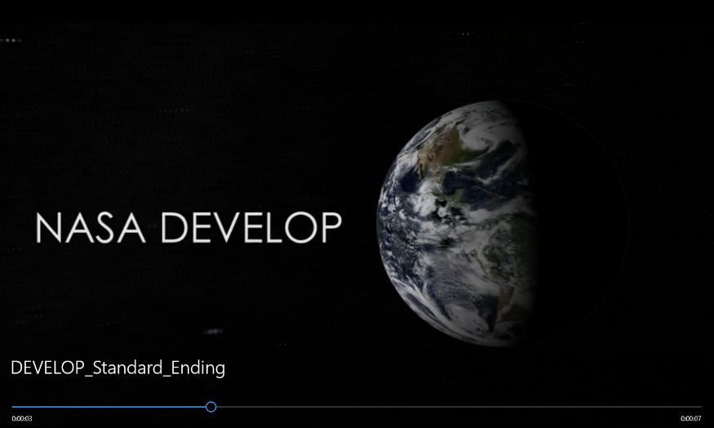
Closing
Insert Photo
Script
Visuals | The following three statements must be included in the credits (before the DEVELOP closing clip) of every VPS video: This material is based upon work supported by NASA through contract NNL16AA05C. Any opinions, findings, and conclusions or recommendations expressed in this material are those of the author(s) and do not necessarily reflect the views of the National Aeronautics and Space Administration (NASA). NPR 2200.2C D.6.4.1: Trade names and trademarks are used in this report for identification only. Their usage does not constitute an official endorsement, either expressed or implied, by the National Aeronautics and Space Administration. DEVELOP closing clip
Estimated Time
Insert Photo

