Slide 1
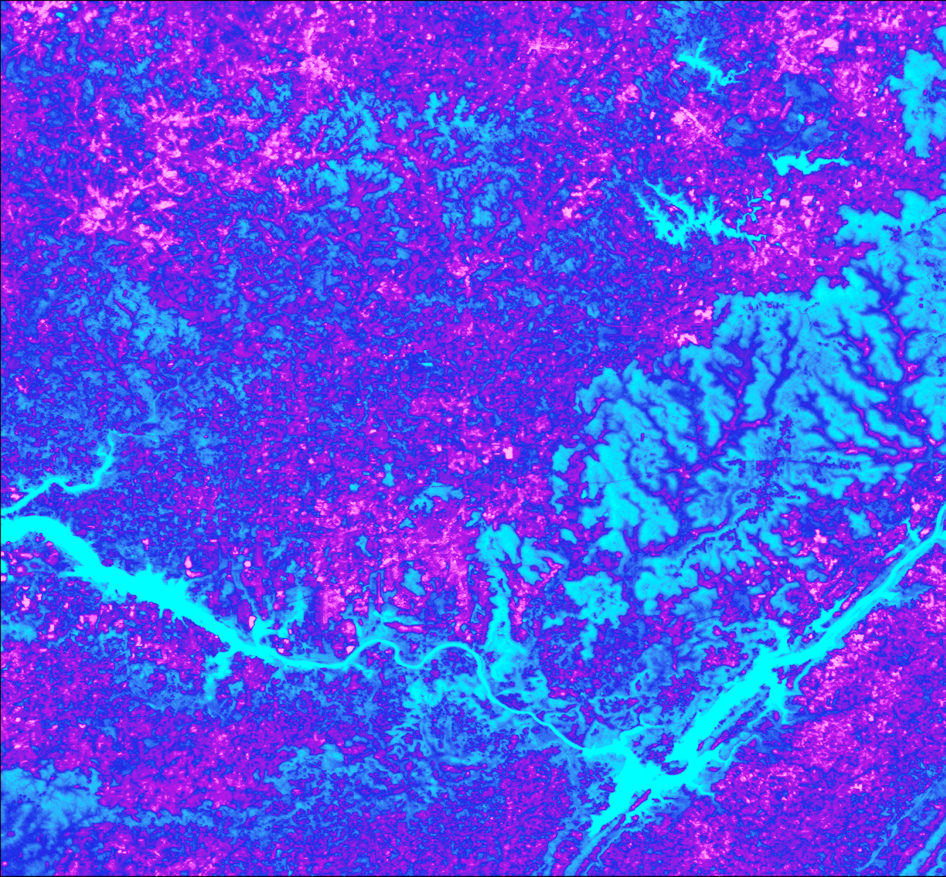
TENNESSEE VALLEY ENERGY
Assessing the Hydrothermal Outputs of Nuclear Power Plants Along the Tennessee River with NASA Earth Observations
Jessica Ding
Samuel Tatum
Rachel Smith
Lisa Dong
Alabama – Marshall | Fall 2019
Notes:
*Rachel*
Hi everyone! We are the Tennessee Valley Energy Team. We are Lisa Dong, Samuel Tatum, Jessica Ding and Rachel Smith. Our project focused on the feasibility of using NASA Earth Observations to measure water surface temperature along the Tennessee River.

Slide 2
TENNESSEE VALLEY AUTHORITY (TVA)
Image source: Dong, L.
Notes:
*Rachel*
The TVA partnered with NASA DEVELOP at the Marshall Space Flight Center to assess the feasibility of incorporating Earth observations with their in situ data to enhance the understanding of water temperature fluctuations near nuclear power plant discharge monitoring zones.
The DEVELOP team processed thermal infrared data using 3 sensors from 2013 to 2019 with goals to highlight spatial and temporal variation in water surface temperature using a spatial extent of 5 miles downstream and 13 miles upstream from Browns Ferry. The team created a collection of maps to visualise seasonal and yearly water temperature variation. These visualizations provide new perspectives on the behavior of thermal effluent at different locations along the Tennessee River as well as spatial insights concerning the impact of the uprate on the water temperature near Browns Ferry.
Image source: Lisa Dong (media release forms signed by TVA)

Slide 3
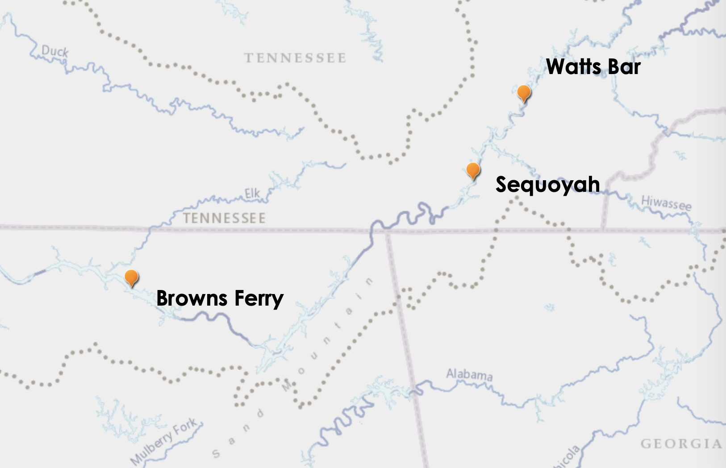
THE TVA & NUCLEAR POWER
N
Three nuclear power plants
Located along the Tennessee River
TVA’s combined generating capacity is over 7,500 megawatts
0
20
40
Miles
Image source: Smith, R.
Notes:
*Rachel*
The Tennessee Valley Authority (TVA) operates three nuclear plants along the Tennessee River, leading the way for nuclear power generation throughout seven of the southeastern United States. The TVA is a federal corporation created in 1933, providing holistic solutions to energy generation and resource management.
TVA's three nuclear power plants: Browns Ferry, Sequoyah, and Watts Bar are positioned along the Tennessee River. These plants have a combined generating capacity of over 7,500 megawatts!gawatts!

Slide 4
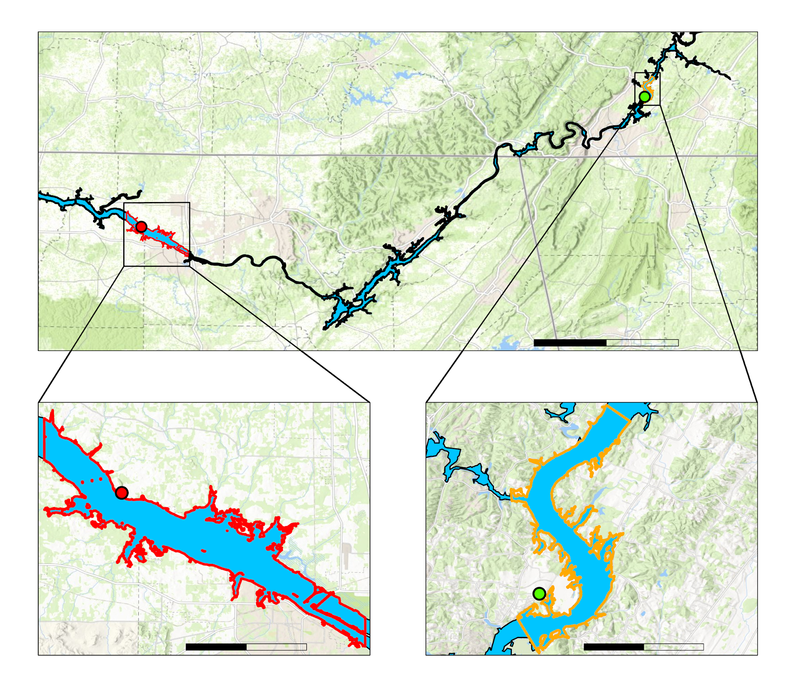
STUDY AREA
Study Area: BFNP & SNP
Time Period: 2013 - 2019
N
Tennessee
Alabama
Georgia
Tennessee River
Browns Ferry Study Area
0
20
40
Miles
Sequoyah Study Area
BFNP
SNP
0
3
6
0
2
4
Miles
Miles
Image Source: NASA; Dong, L.
Notes:
*Rachel*
The TVA manages three nuclear plants along the Tennessee River - Browns Ferry, Sequoyah, and Watts Bar. One of the TVA’s concerns regarding its nuclear plants is thermal pollution of the river due to water discharged from the plants’ cooling systems. We used data from in situ temperature stations and the TVA’s Delft3D model, as well as thermal remote sensing data, to evaluate the water surface temperature of the Tennessee River from 2013 to 2019. Our project focused on the Browns Ferry plant, however, we also applied our methodology to the Sequoyah plant in order to test applicability to the rest of the Tennessee River watershed. We chose not to include Watts Bar because the facility uses less water, and therefore does not collect as much data to monitor water temperature.
[If questions are asked on why we chose 2013, we will say that 2015-2016 were dry years and 2018 was a very wet year. In order to have a better representation of the system, we went a few more years back and chose to start in 2013.]
Images: Lisa Dong

Slide 5
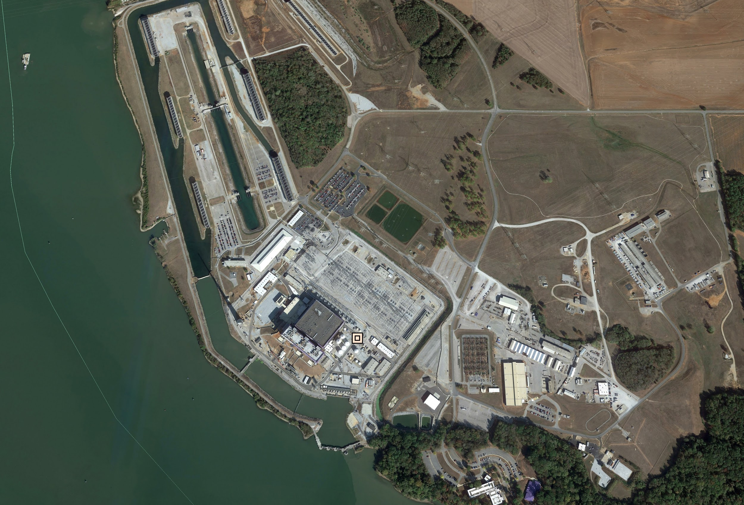
BFNP: EXTENDED POWER UPRATE
Completed in 2019
Increased power output of each unit by 120%
Uprate coincides with predicted increase in surrounding water temperature of the Tennessee River
Image source: Google Earth
Notes:
*Rachel*
In 1974, TVA opened Browns Ferry in Athens, Alabama. Browns Ferry contains three units capable of generating 4,000 megawatts of combined electricity. Today, Browns Ferry is the largest and most productive of TVA's three Nuclear plants, producing roughly 10 percent of TVA's power. For the TVA, keeping a close eye on increasing water temperatures became particularly important in 2019, following an Extended Power Uprate at Browns Ferry. This uprate increased the power output of each of Browns Ferry's units to 120% of the plant's originally licensed thermal power. This increase in power output was accompanied by the predicted increase in mean water temperature in the surrounding Tennessee River.

Slide 6
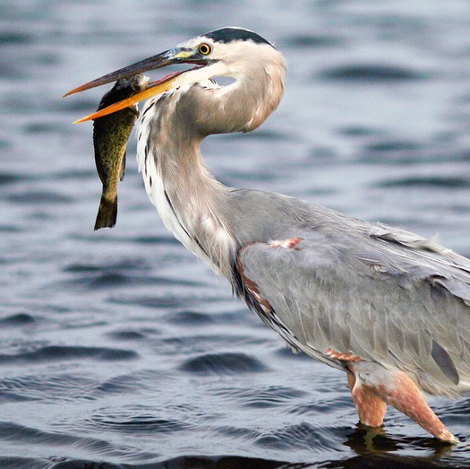
COMMUNITY CONCERNS
Image source: CC BY-SA, Ding, J.
Notes:
*Jessica*
The main concern regarding thermal effluent is its effect on the biodiversity and species distribution of the surrounding ecosystem. Changes in the water temperature surrounding nuclear plants could result in a loss of locally adapted species, leading to changes in species distribution and habitat ranges of aquatic organisms (Beitinger, Bennett, & McCauley, 2000; Ficke, Myrick, &Hansen, 2007; Kim, Jeong, Kim, Dahms, & Han, 2017). A study conducted by Madden, Lewis, & Davis found that the Tennessee River basin is especially vulnerable to species loss, due to its high level of aquatic biodiversity and the prevalence of once-through cooling systems (2013). In order to minimize the environmental impact of thermal pollution, the EPA sets regulations that the TVA must adhere to. Compliance with these regulations can result in financial loss to the TVA.
Images from left to right: Creative Commons, Jessica Ding

Slide 7
PROJECT OBJECTIVES
Visualize yearly and seasonal water surface temperatures through time-series maps to identify surface temperature spatial variation over time
Compare satellite performance between BFNP and SNP
Analyze river flow rate, air surface temperature, and power output impacts on water surface temperatures through statistical analyses
Improve the TVA’s Delft3D model by showing spatial variation in river surface temperature
Illustrate the feasibility of using NASA Earth observations to monitor water surface temperatures through a tutorial
Wrap up project through a story map
Notes:
*Jessica & Rachel*
Our objectives for the project were included: to create seasonal & yearly time series maps, comparing the satellite performances at BFNP and SNP, seeing if other variables affected water surface temperatures, improving the TVA’s effluent model by comparing it to satellite images, explaining methodologies through a tutorial, and finally wrapping up everything in a story map.

Slide 8
REGULATIONS
Image source: EPA, Scarce, HKA Design, TVA
Notes:
*Rachel*
The Clean Water Act (CWA), administered by the Environmental Protection Agency (EPA), manages
pollution discharge of the United States’ surface waters. The standards in the CWA are supplemented with
regulatory standards by a National Pollutant Discharge Elimination System (NPDES) permit.
Regulatory guidelines regarding the discharge of thermal effluent are stated in section 316(a) of the Clean
Water Act (CWA). This law requires each point source to have a National Pollutant Discharge Elimination
System (NPDES) permit, which is specific to each source and is administered by state environmental agencies
(Madden et al., 2013).
Images cited from left to right:
https://www.epa.gov
https://www.scarce.org/event/anniversary-clean-water-act/2019-10-18/
http://hka-design.com/wp-content/uploads/NPDES_basic_1-170x170.png
TVA

Slide 9
TEMPERATURE THRESHOLDS
93 °F
1- Hour average threshold
90 °F
Daily Average threshold
Daily average limit relative to ambient
10 °F
Notes:
*Rachel*
The NPDES permit for the Browns Ferry Nuclear Plant (BFNP) limits thermal
discharge as detected at a depth of 5 feet (ft), 2400 ft downstream of the discharge source (McGinty, 2007).
This permit states that BFNP 1-hour average temperatures cannot exceed 93 °F, daily average temperatures
cannot exceed 90 °F, and daily average temperature rise relative to ambient cannot exceed 10 °F (Tennessee
Valley Authority, n.d.).

Slide 10
COOLING SYSTEM
“OPEN MODE”
Heat Exchanger
Pump
Heat Exchanger
Discharge
Intake
Pump
Discharge
Intake
ONCE-THROUGH COOLING SYSTEM
“HELPER MODE”
COOLING TOWERS
Image Source: CC BY-SA
Notes:
*Jessica*
The BFNP draws water from Wheeler Reservoir on the Tennessee River in its cooling systems, which are outlined in this slide (McGinty, 2007). In “open mode”, water from the reservoir is pumped into the turbine generator condensers, then discharged back into the reservoir via three submerged diffuser pipes. If the temperature of the water is within one degree of the NPDES hourly limit, “helper mode” is employed. The water is directed to the cooling towers, which help further cool the water before it is discharged into the reservoir. If “helper mode” is insufficient to keep river temperature from reaching the NPDES limit, the TVA reduces power output, or is forced to shut down one or more units, in order to remain in compliance (McGinty, 2007).
Image URLs from left to right:
Left:"Water Texture" by freefotouk is licensed under CC BY-NC 2.0
Right:"Water Texture" by freefotouk is licensed under CC BY-NC 2.0

Slide 11
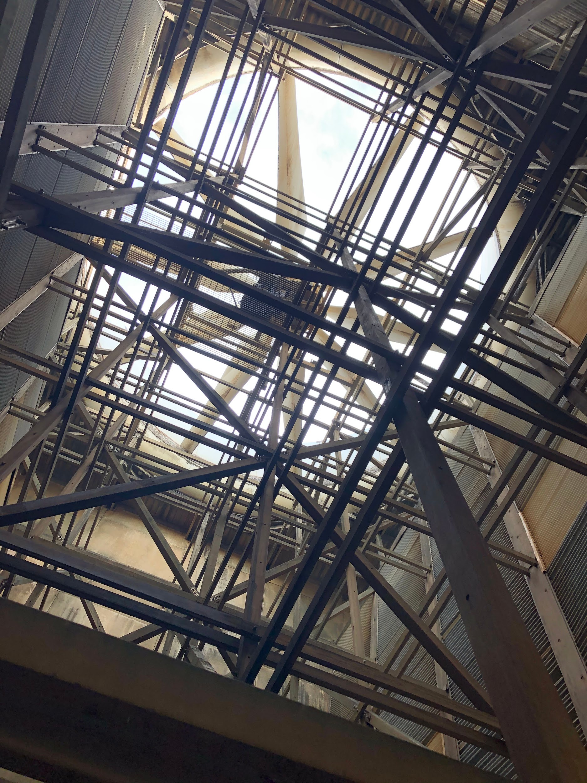
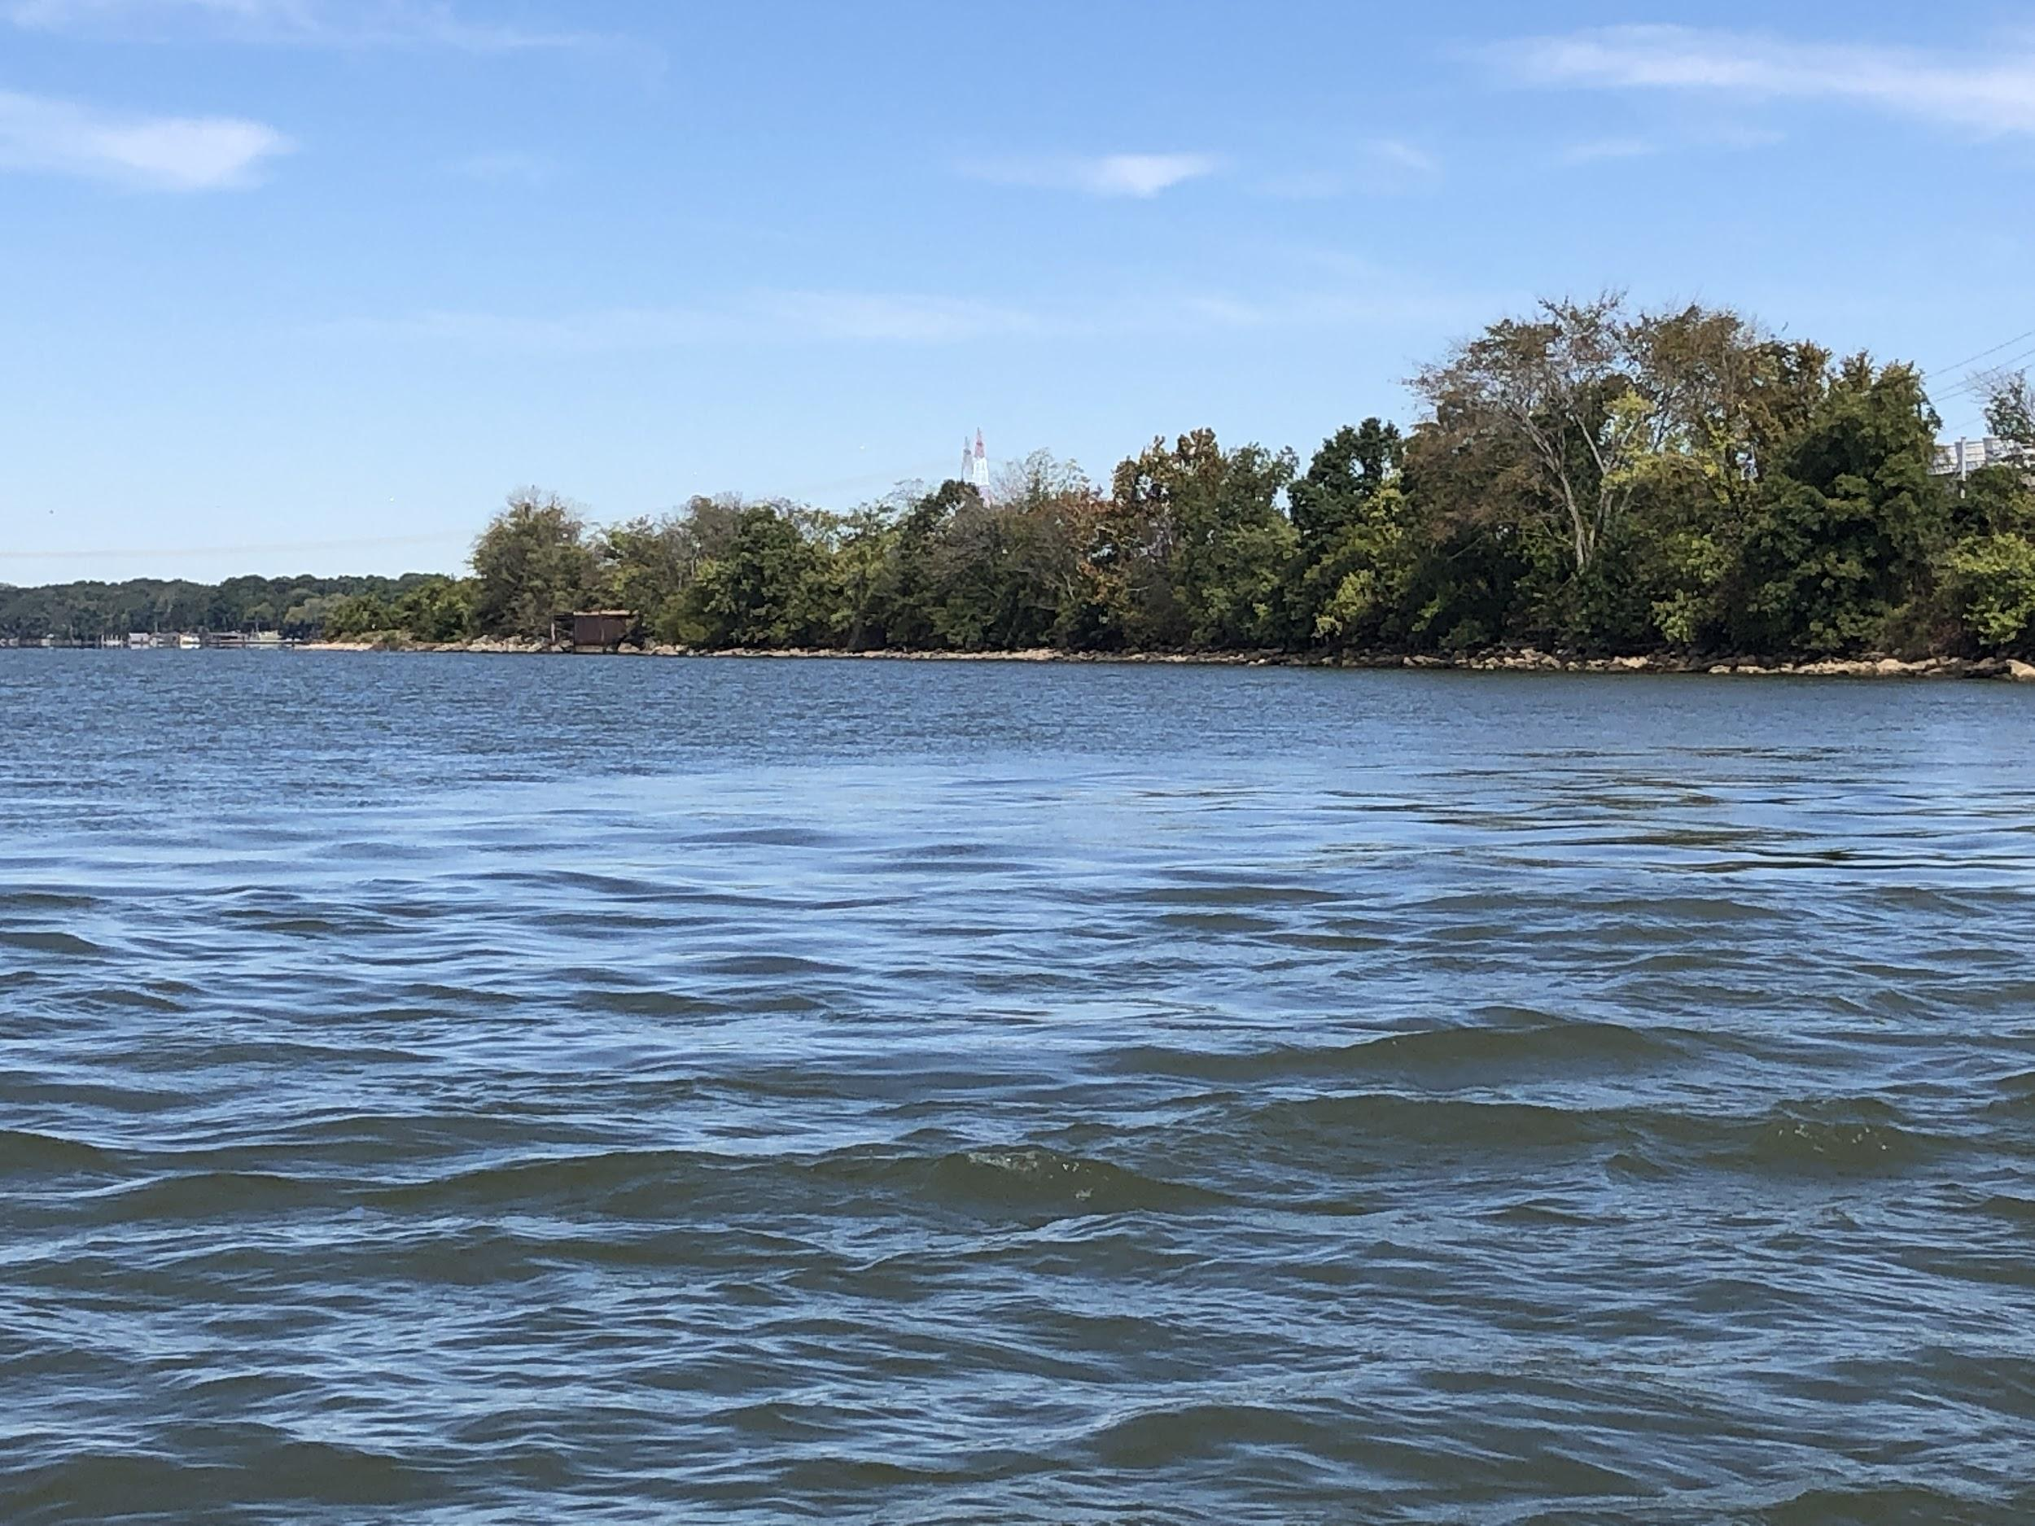
Inside cooling tower at BFNP
Mixing Zone at Browns Ferry
Image Source: Ding, J.
Notes:
*Jessica*
The left picture was taken inside one of the cooling towers at BFNP. “Helper mode” represents an additional cost to the TVA due to the electricity required to power the fans in the cooling towers. The right picture shows the end of the mixing zone - you can see that the area covered by the mixing zone (bottom half) is smoother because the warm water is mostly homogenous.
Images: Jessica Ding

Slide 12
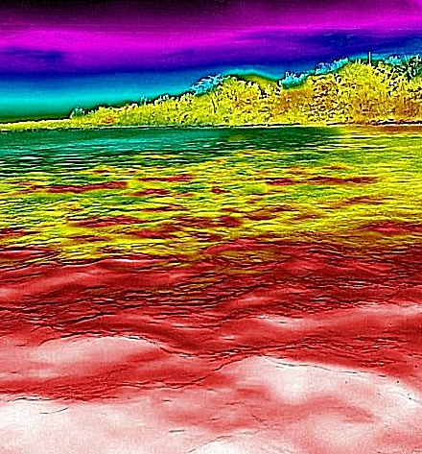
Mixing Zone at Browns Ferry
Image Source: Ding, J.; Luvall, J.
Notes:
*Jessica*
The right picture is a thermal image of the same area of the mixing zone. As you can see, the red and yellow parts demonstrate the extent of the mixing zone, and the green portion in the background shows where the mixing zone ends and the water is cooler.
Images: Jessica Ding, Dr. Jeffrey Luvall

Slide 13
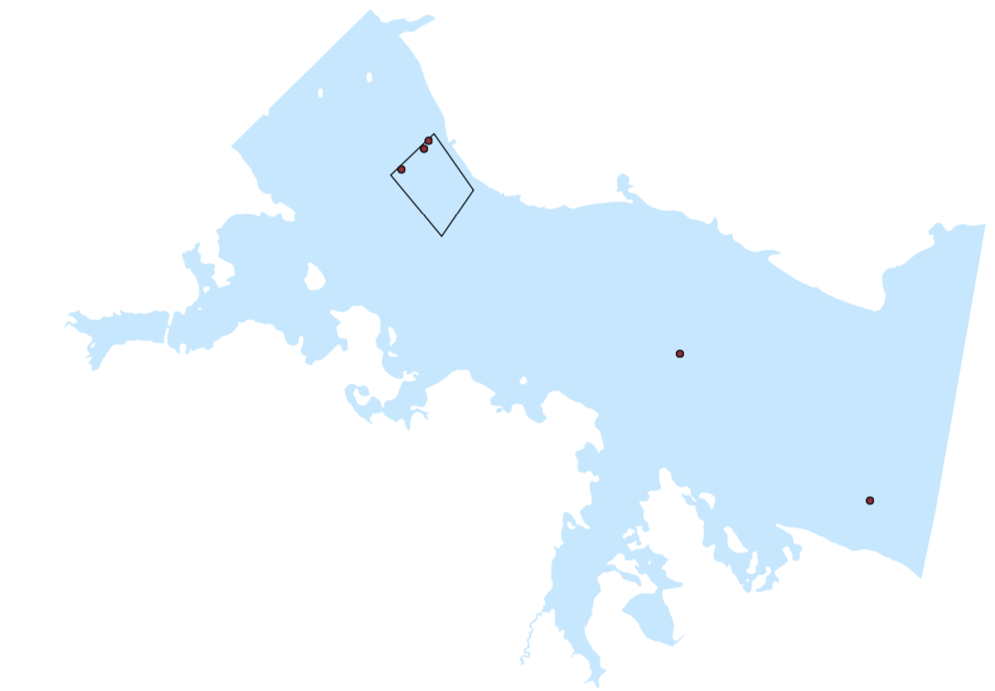
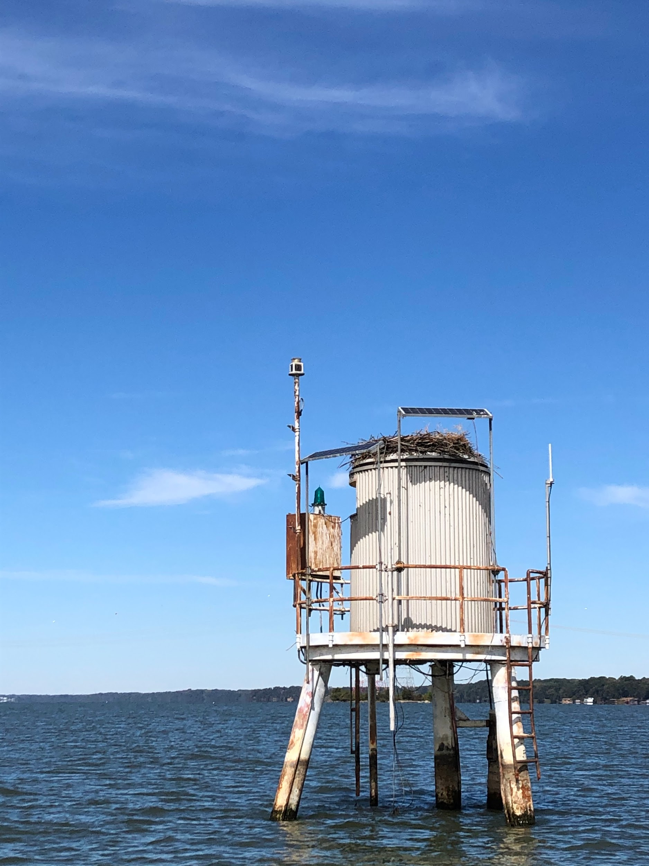
Thermistor
IN SITU MONITORING
Browns Ferry Nuclear Plant
Tennessee River
Temperature Stations
Mixing Zone
Temperature Station
N
0
1
2
Miles
Image source: Dong, L.; Ding, J.
Notes:
*Sam*
Current monitoring methods at the BFNP involve taking in situ water temperature measurements from five thermistors (two upstream and three downstream), with readings taken every hour and averaged from depths of 3, 5, and 7 ft due to thermal stratification. The bottom picture depicts temperature station 1 at BFNP, while the top picture shows the instrument that collects in situ water temperature data.
Images top to bottom: Lisa Dong, Jessica Ding

Slide 14
SATELLITES & SENSORS
ISS ECOSTRESS
Terra ASTER
International Space Station Ecosystem Spaceborne Thermal Radiometer Experiment on Space Station
Advanced Spaceborne Thermal Emission and Reflection Radiometer
Landsat 8 TIRS
Landsat 8 Thermal InfraRed Sensor
Image source: Luvall, J.; NASA
Notes:
*Sam*
Ecostress Satellite Image: Provided by Dr. Jeffrey Luvall
Other Images URL: http://www.devpedia.developexchange.com/dp/index.php?title=List_of_Satellite_Pictures
We used ECOSTRESS, Landsat 8 TIRS, and Terra ASTER to obtain level 2 land surface temperature raster images. ECOSTRESS has a 70 meter resolution with dates from approximately August 2018 onwards. Landsat 8 TIRS has a 100 meter resolution which is resampled to 30 meter resolution from which we retrieved dates from January 2013 onwards. Lastly, Terra ASTER has a 90 meter resolution in which we obtained images from January 2013 onwards as well.
ECOSTRESS is a sensor on the International Space Station. The acronym stands for Ecosystem Spaceborne Thermal Radiometer Experiment on Space Station. We considered ECOSTRESS data because of its thermal sensing capacity, spatial resolution (70 m), and temporal resolution (3 to 5 days). Level 2 land surface temperature and emissivity ECOSTRESS products were gathered from NASA's Application for Extracting and Exploring Analysis Ready Samples (AppEEARS). AppEEARS converted L2_LSTE from HDF5 files into GeoTiff format, which eliminates the need for conversion scripts. AppEEARS also allows the user to select for desired layers, so that only relevant data can be downloaded to reduce download time.
Landsat 8 is a satellite launched in 2013. Landsat 8 carries both the Operational Land Imager (OLI) and Thermal Infrared Sensor (TIRS). We chose Landsat 8 in order to utilize the TIRS sensor’s two spectral bands with Two spectral bands, 10 and 11 both of which have 100m spatial and 16 day temporal resolutions. Landsat imagery was accessed from USGS EarthExplorer. The parameters for searching the imagery were "Landsat 8 OIL TIRS," with less than 20% cloud cover. These images were filtered prior to download, then sorted and filtered post download. The images were selected based on proximity to the study area and the lowest percentage of cloud cover. The imagery was then input into ArcPro and scaled using an equation (x 0.1) to determined water temperature. The scaled images were then converted from Kelvin to Fahrenheit using a ArcPro’s raster calculator.
ASTER is a sensor on the Terra satellite that was launched in 1999. We downloaded ASTER data from Earthdata. These were level 2 products in which the images were already atmospherically corrected, and temperatures were calculated using the Planck’s Law. The images obtained by ASTER have a 90 meter by 90 meter resolution.

Slide 15
ANCILLARY DATA
In situ | Specifications
Temperature Station Data | Water temperature measurements taken at depths of 6 in, 3 ft, 5 ft, and 7 ft. Temperatures reported hourly.
Meteorological Station Data | Air temperature data collected by TVA meteorological stations. Temperatures reported hourly.
Power Output Data | Power output by BFNP. MW generated reported at 15-minute intervals
Model | Specifications
Delft3D Images | Images from Deltares Delft3D model predicting water surface temperature. Available from May-Present 2019
Delft3D Flow Data | Hourly flow rate past BFNP in cubic feet per second, calculated by Deltares Delft3D Model.
Notes:
*Sam
We used in situ water temperature data, flow rate release data as taken by the dams, air temperature data, and Browns Ferry Power output data. Temperature station data was used to evaluate thermal image accuracy for image pixels that contained gage stations. The TVA’s flow data was used consider temperature spatial distribution at varying flows. Air temperature and BFNP power output were also considered with flow rate to see which variable had the greatest effect on the change in water temperature between upstream and downstream temperature gages. We also received model images that predicted water surface temperature (we compared this to our predicted satellite temperatures). All data was provided by the TVA.

Slide 16
METHODOLOGY
Data Acquisition
Image Processing
Statistical Analysis
End Products
AppEEARS
Earthdata
EarthExplorer
Georeference
Values to ºF
Raster Calculator
Model Builder
ANOVA
Tukey’s HSD
Regression
Pearson’s Correlation
One-tailed
t-test
Seasonal & Yearly Time-Series Maps
Facility Comparison
Model Comparison
Story Map
Tutorial
Notes:
*Lisa
For data acquisition, as we mentioned before, we acquired level 2 data from Terra ASTER, Landsat 8 TIRS, and ISS ECOSTRESS. These were all temperature ready data in which some had to be scaled and then converted from kelvin to Fahrenheit. We also had some ECOSTRESS images in which we georeferenced because the images were shifted. For the yearly maps, we used the raster calculator to calculate the change in temperature from a different time of the year over several years. Then we used several statistical analyses such as ANOVA, Tukey’s HSD, Regression, and One-tailed test to test for significant differences, correlations, and trends. Our end products are the seasonal time series maps, yearly maps (one day images over years), model comparison, story map, and a tutorial.

Slide 17
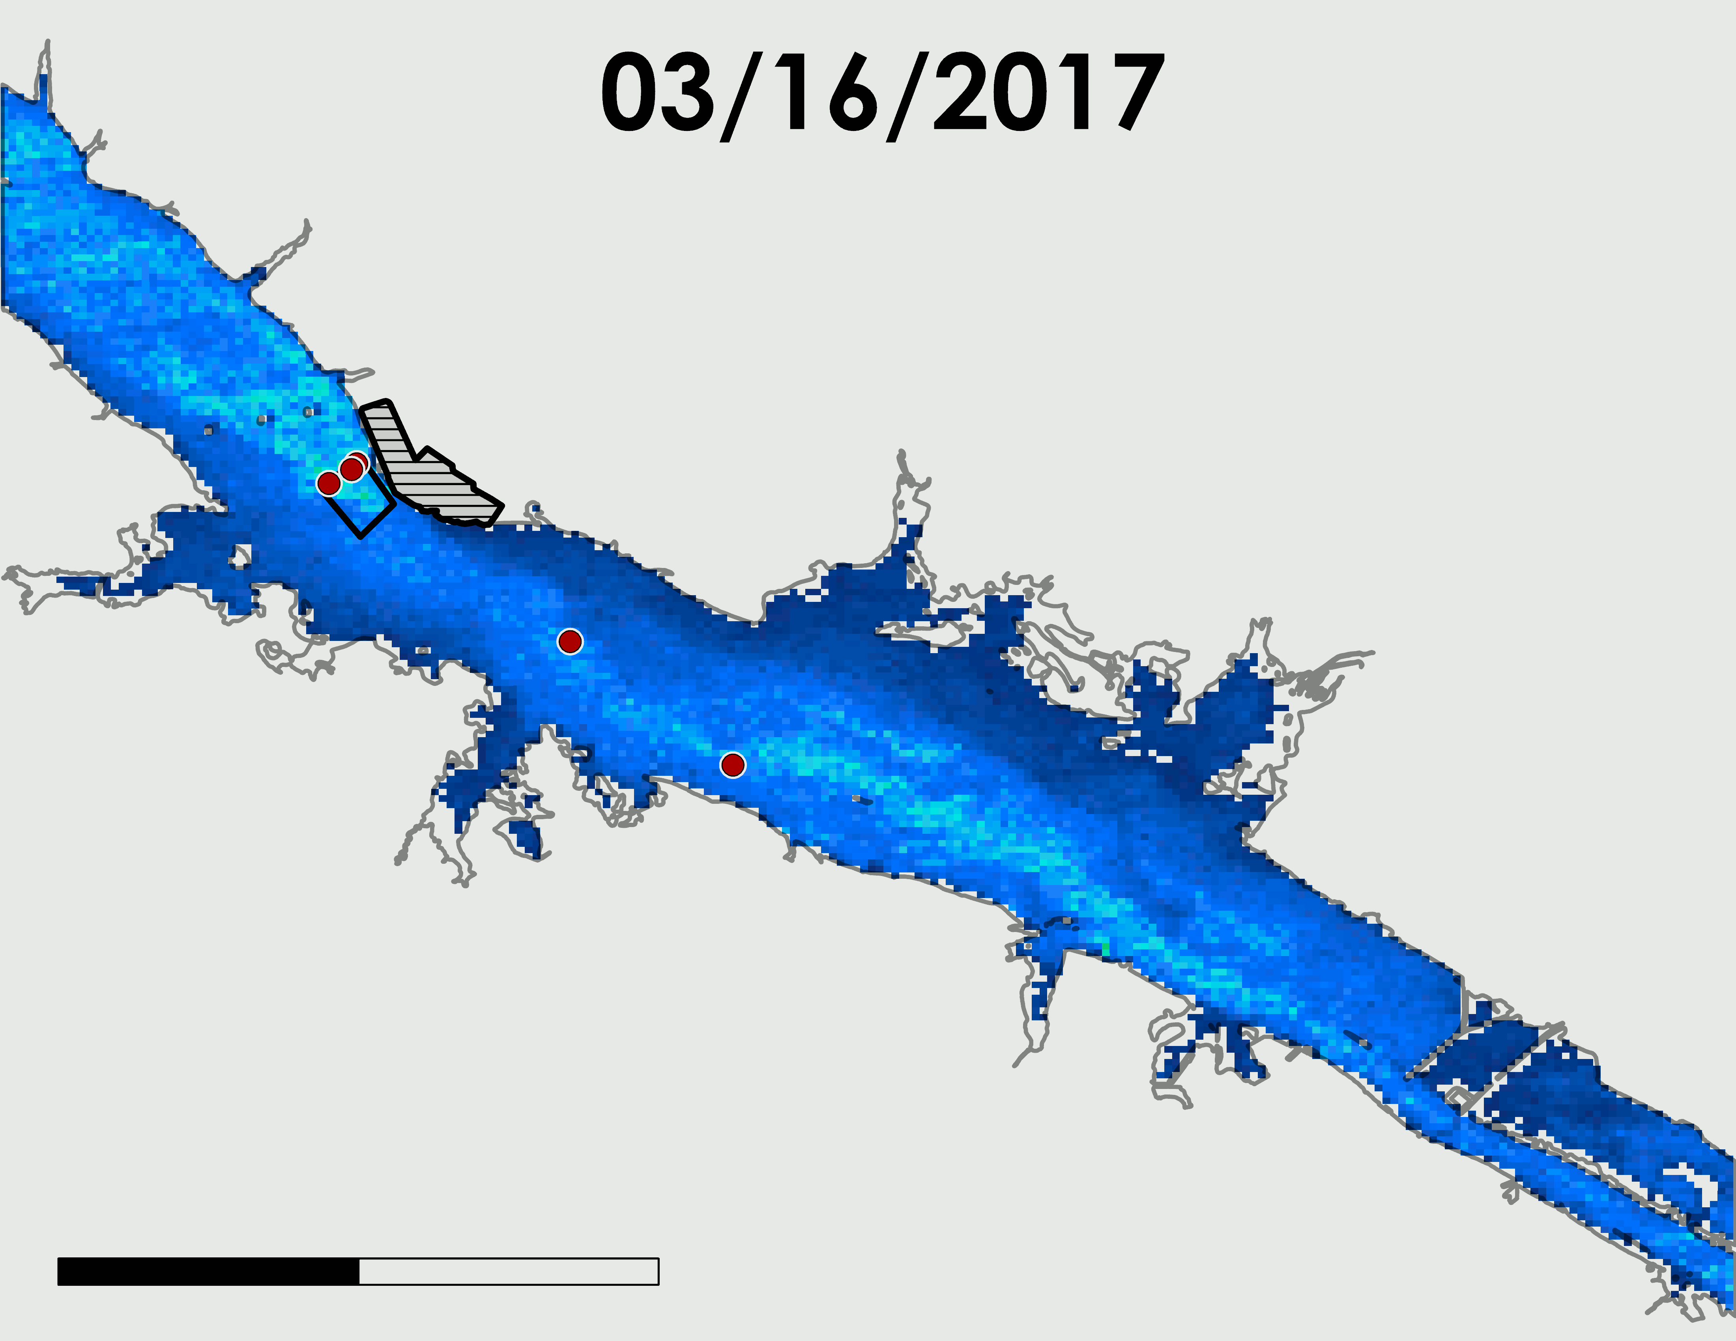
ASTER: SEASONAL TIME-SERIES MAP
N
Date, GMT | Flow (cfs) | Air Temperature (°F)
3/15/2017, 3:56 | 49775 | 32
5/19/2017, 3:56 | 38414 | 73
10/25/2017, 3:50 | 27963 | 51
11/19/2017, 3:56 | 48306 | 34
Browns Ferry Nuclear Plant
Mixing Zone
85°F
Temperature Stations
45°F
0
3
6
Miles
Image source: Lisa Dong
Notes:
*Lisa*
Here are our seasonal maps taken with ASTER. We have four images taken throughout the year at relatively the same time. Throughout the year, you can see that March was the coolest, May was the warmest, it cooled down in October and cooled even more in November. To your right is a table with the respective flow rates and air temperatures. What I would like you all to pay attention to is the downstream effluent area. A part of the TVA’s compliance is based on Delta T which is the temperature difference between upstream and downstream. In the downstream area, you can see that in respect to the rest of the river the water is warmer which makes sense since that is where the effluent is discharged.
ASTER:
03/16/17 3:56
05/19/17 3:56
11/20/17 3:50
10/26/17 3:56

Slide 18
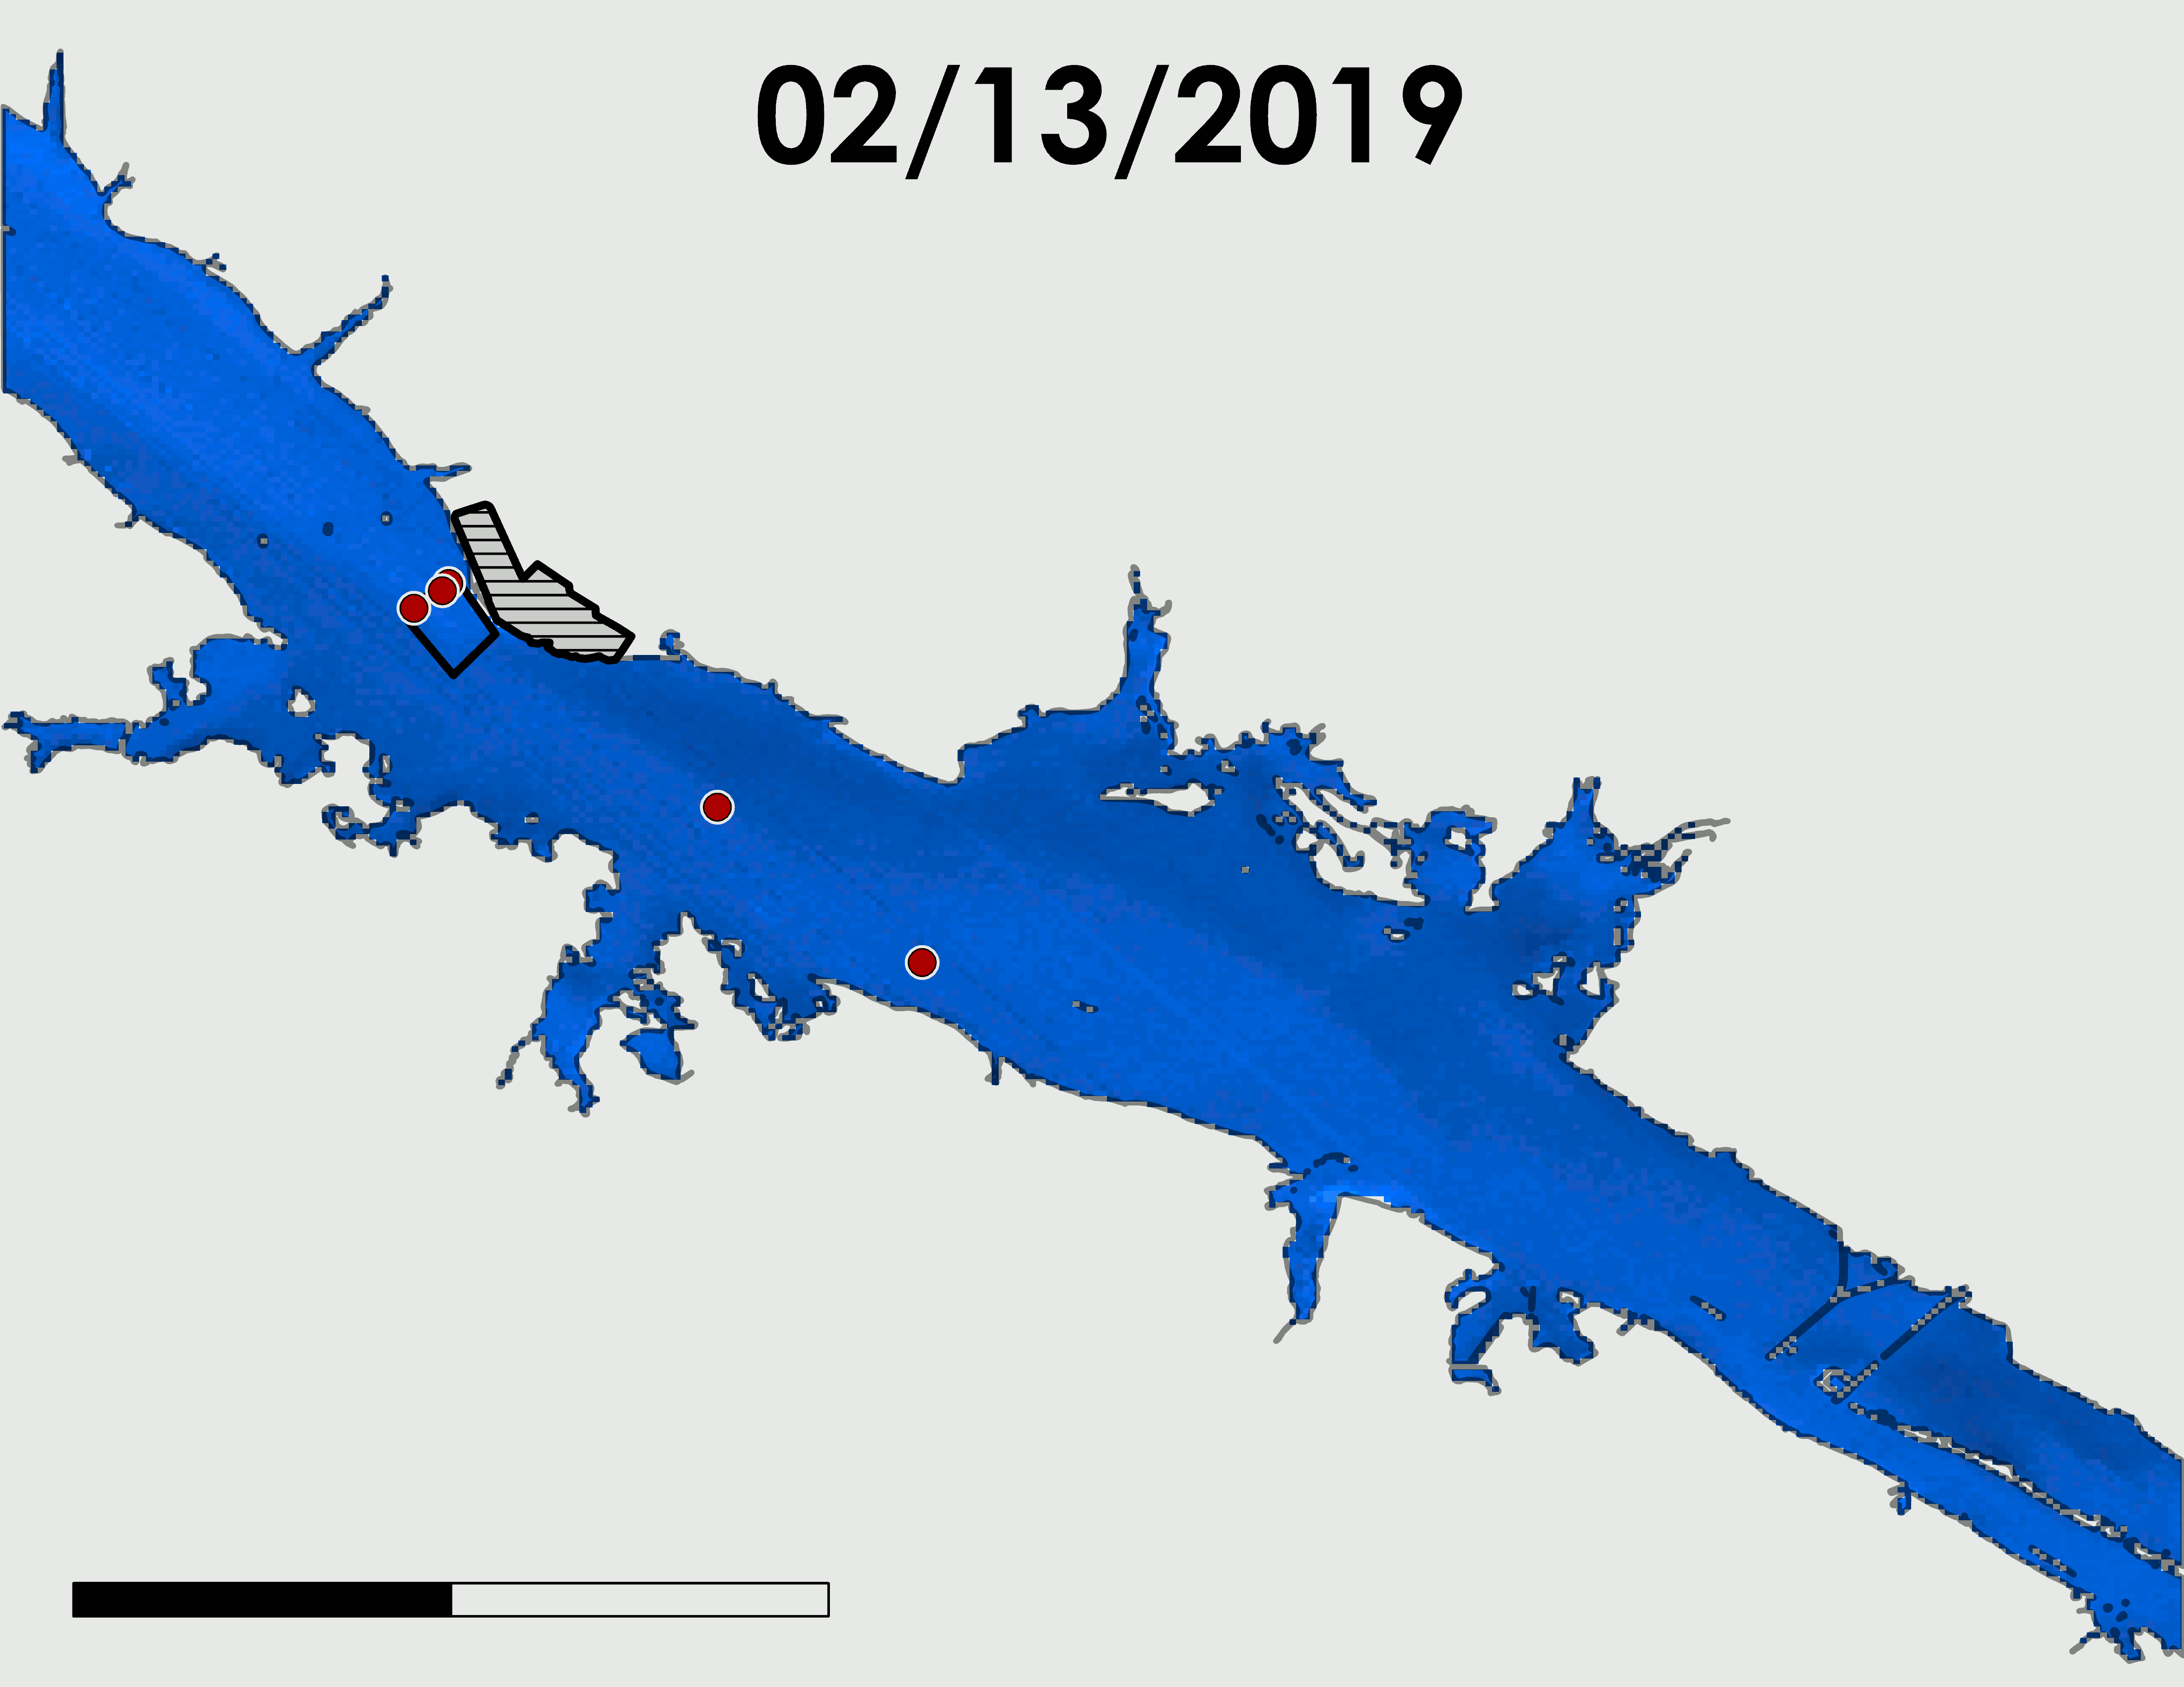
ECOSTRESS: SEASONAL TIME-SERIES MAP
N
Date, GMT | Flow (cfs) | Air Temperature (°F)
2/13/2019, 3:28 | 100440.0 | 40.9
8/30/2019, 4:18 | 25677.0 | 77.2
Browns Ferry Nuclear Plant
Mixing Zone
90°F
Temperature Stations
40°F
0
3
6
Miles
Image source: Lisa Dong
Notes:
*Lisa*
Here is our Winter and Summer comparison with ECOSTRESS. In addition to the large temperature differences- blue and red at two extremes of cold and hot, what’s interesting is that the winter had approximately 4 times faster flow. This can be seen here in August where warmer water from the effluent had spread and in February, you can see the water pushing down in a dark blue stream.
{Winter vs. summer (define the months included),
ECOSTRESS (GWT):
2/13/2019 3:28 PM
8/30/2019 4:18 PM

Slide 19
SUMMER VS. WINTER STATISTICS
EOS vs. in situ
1:1 line
EOS vs. in situ
1:1 line
EOS Mean (°F) | in situ Mean (°F) | Mean Flow (cfs)
84.9 | 86.5 | 35913.9
EOS Mean (°F) | in situ Mean (°F) | Mean Flow (cfs)
49.2 | 49.4 | 67692.0
Notes:
These maps show how well EO preformed in the summer and winter through linear regressions. Summer satellite vs in situ is on the left and winter satellite vs in situ is on the right. From these graphs, EO seems to perform between in the winter rather than the summer. This may be a result of higher flow rates in the winter or more homogenous surface temperature distribution.

Slide 20
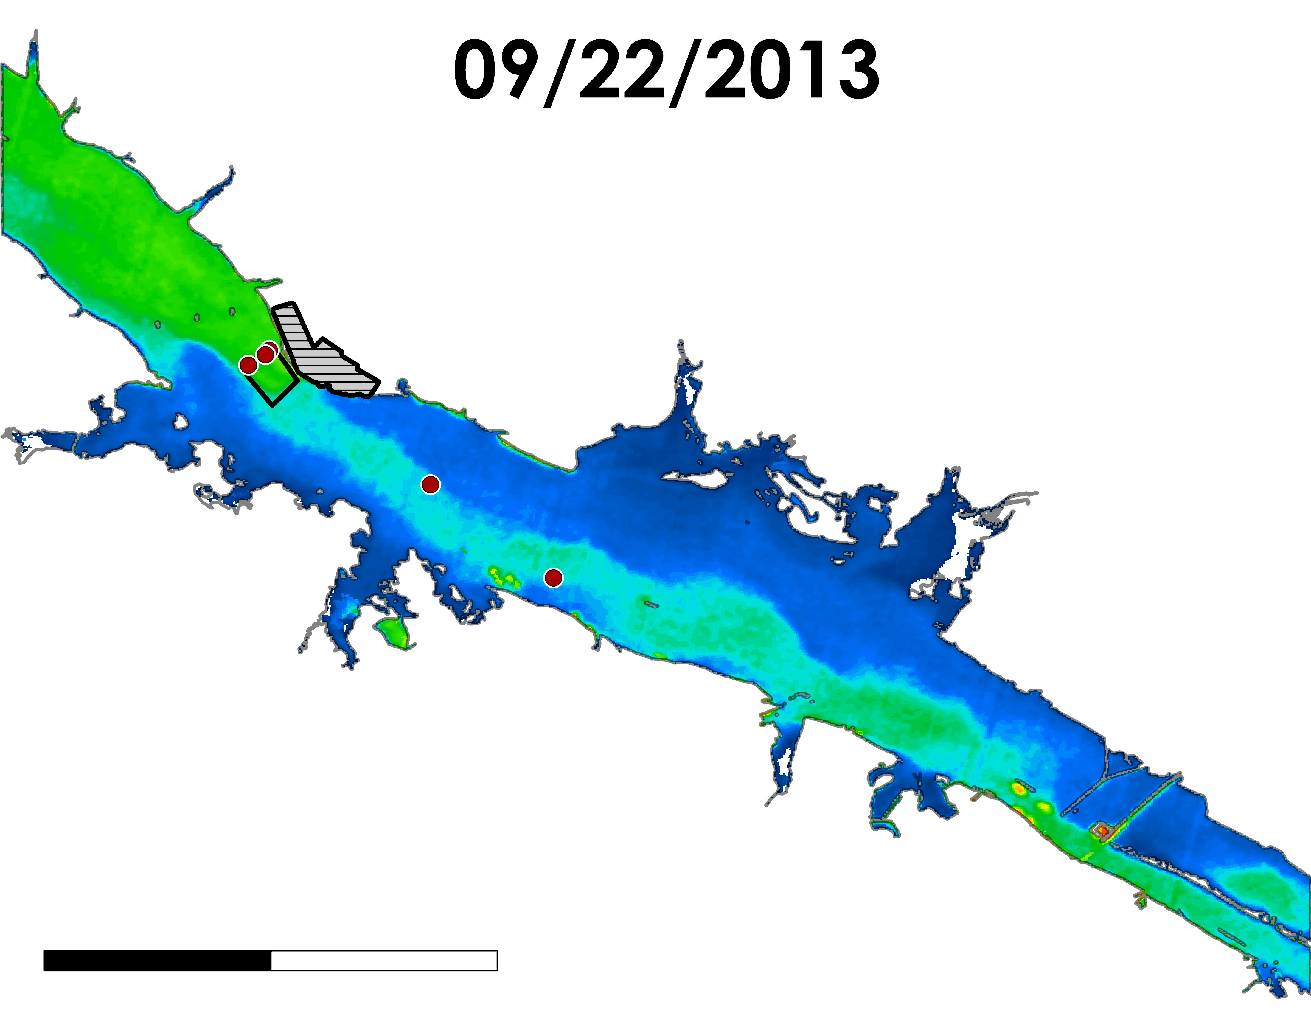
LANDSAT: REPEATED MEASURES
N
Date, GMT | Flow (cfs) | Air Temperature (°F) | Power (MW)
9/22/2013, 6:58 | 26602 | 56.93 | 3362
9/20/2018, 8:05 | 17401 | 72.95 | 3218
9/07/2019, 5:55 | 20596 | 78.98 | 3760
Browns Ferry Nuclear Plant
95°F
Mixing Zone
Temperature Stations
75°F
0
3
6
Miles
Image source: Lisa Dong
Notes:
Here we looked at images taken from 2013, 2018, 2019. There was one image for each year that were taken at relatively the same times of the year. The table to the left shows the air temperature in addition to flow rate of each year as well. As seen here, 2013 had the coolest water temperature with high a higher flow rate than the other two years. You can see the cooler water pushing into the effluent area.

Slide 21
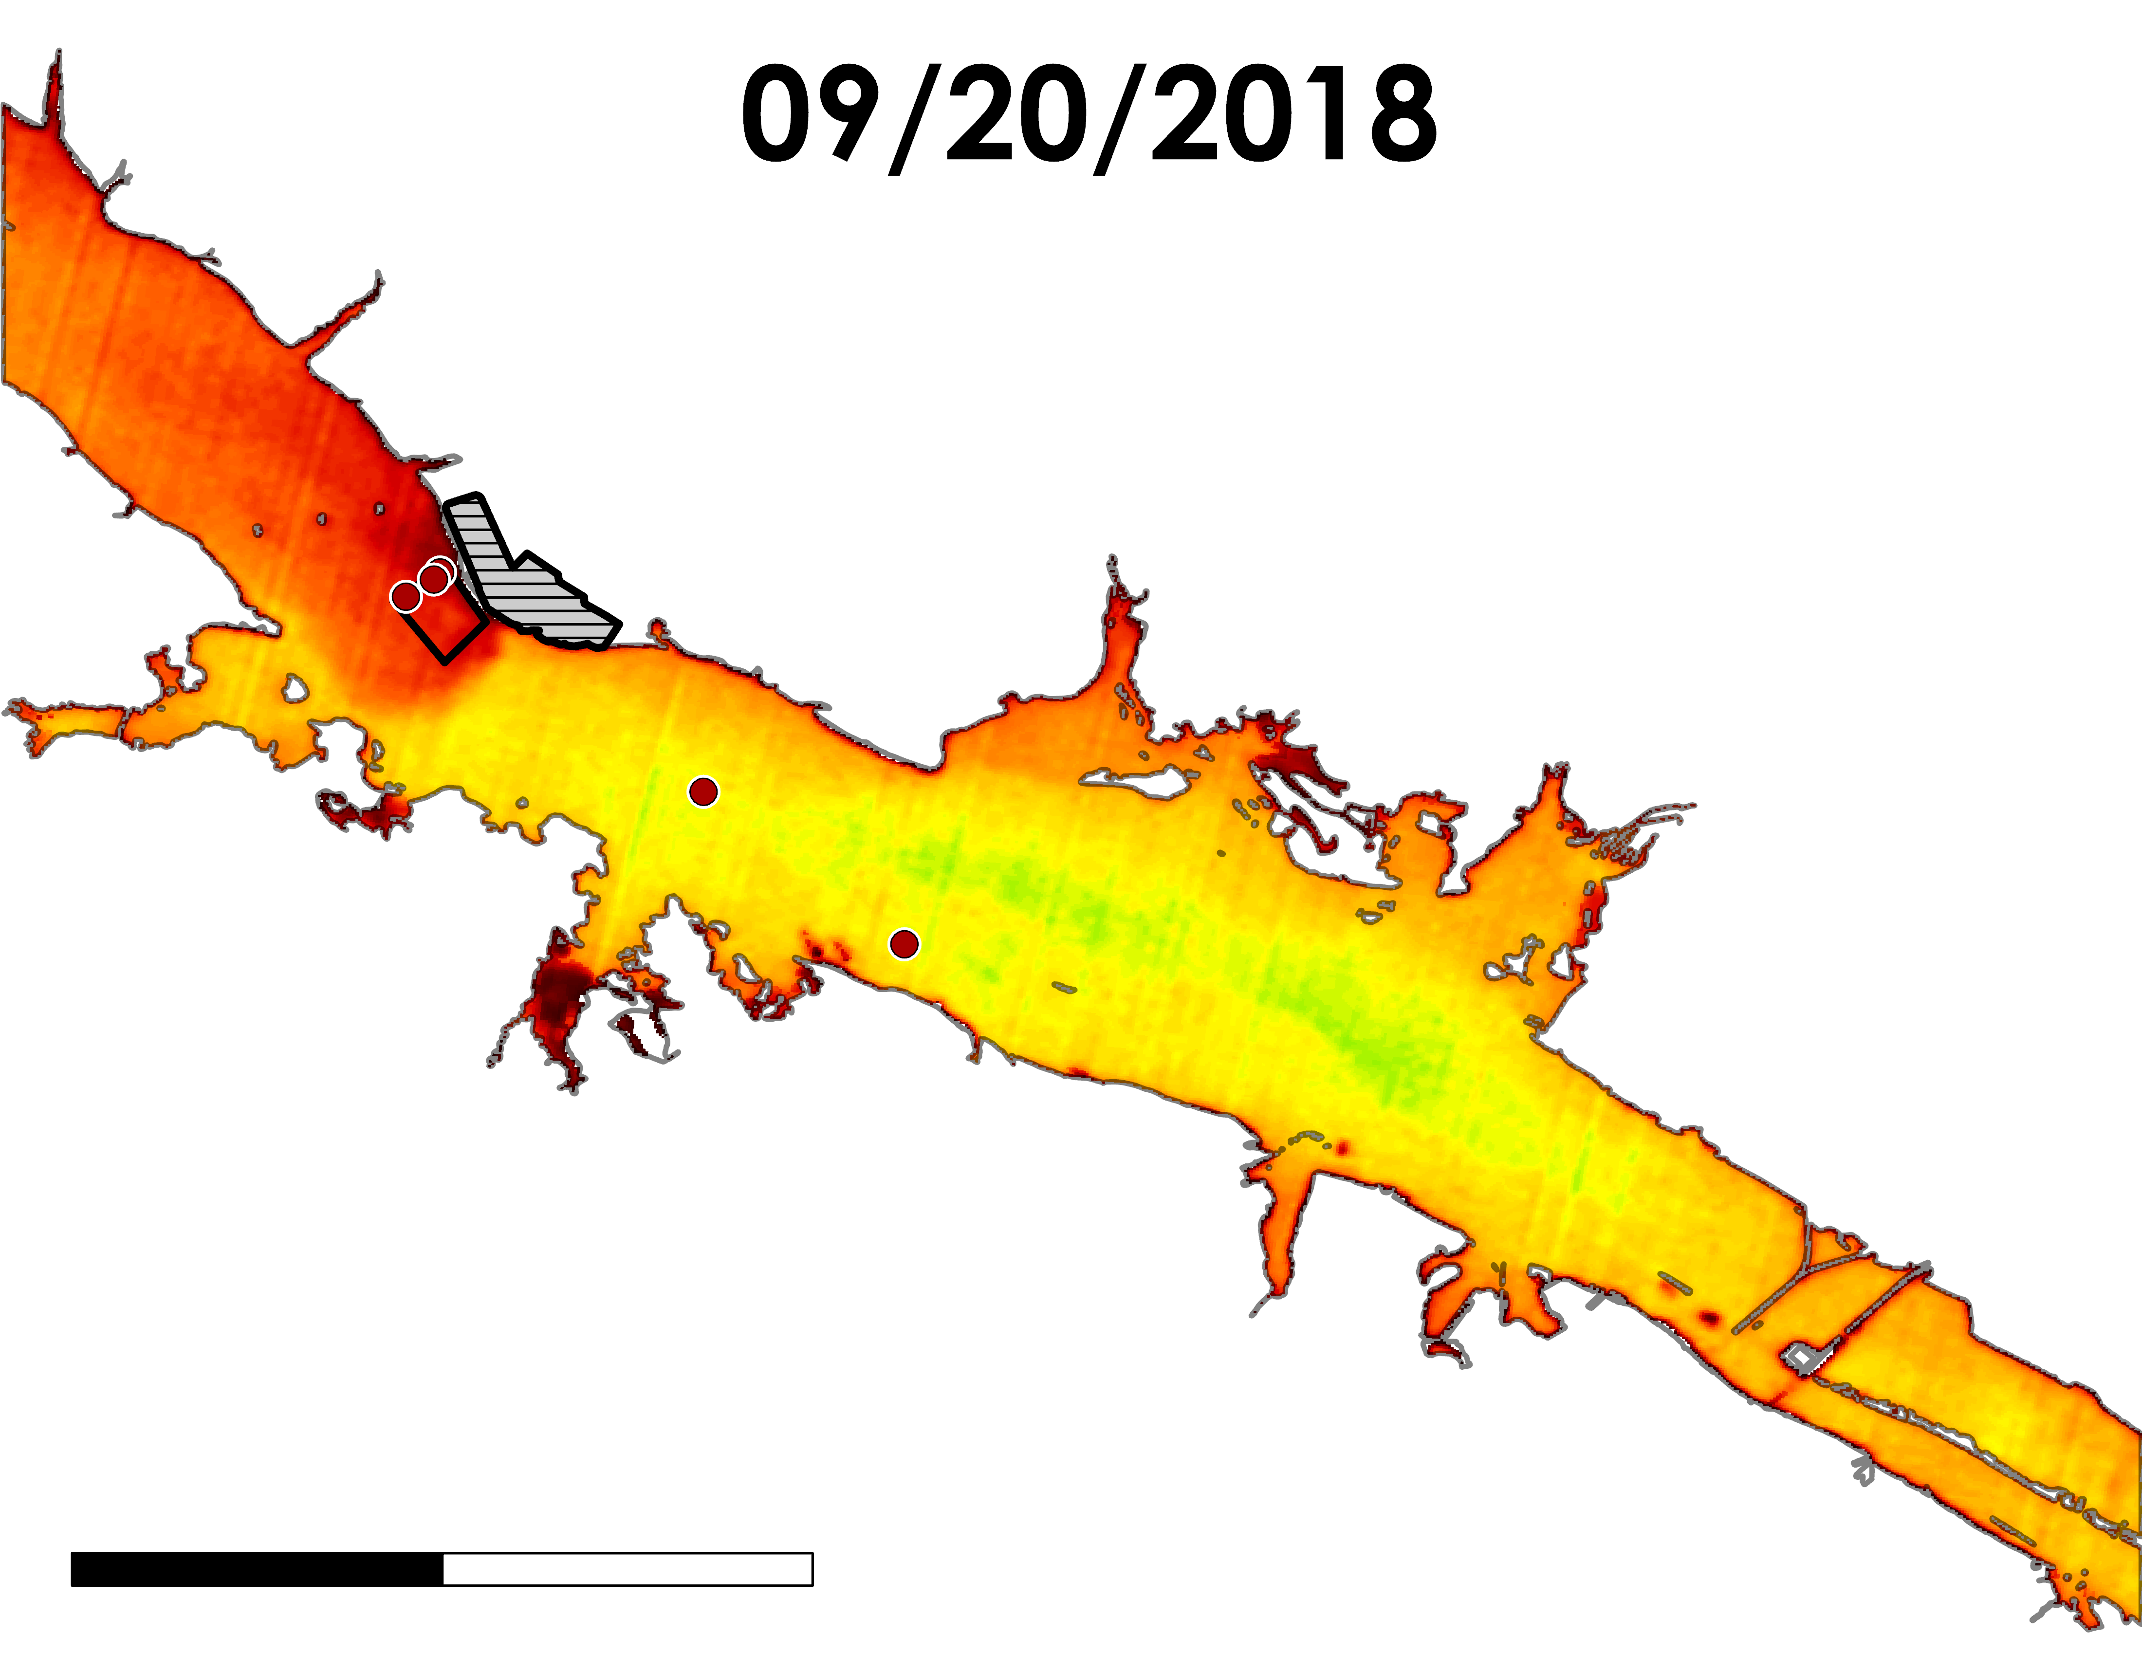
LANDSAT: REPEATED MEASURES
N
Date, GMT | Flow (cfs) | Air Temperature (°F) | Power (MW)
9/22/2013, 6:58 | 26602 | 56.93 | 3362
9/20/2018, 8:05 | 17401 | 72.95 | 3218
9/07/2019, 5:55 | 20596 | 78.98 | 3760
Browns Ferry Nuclear Plant
95°F
Mixing Zone
Temperature Stations
75°F
0
3
6
Miles
Image source: Lisa Dong
Notes:
Here in 2018, we see that the water was a lot warmer than in 2013. We can also see that the downstream effluent had greater spread over a greater area.

Slide 22
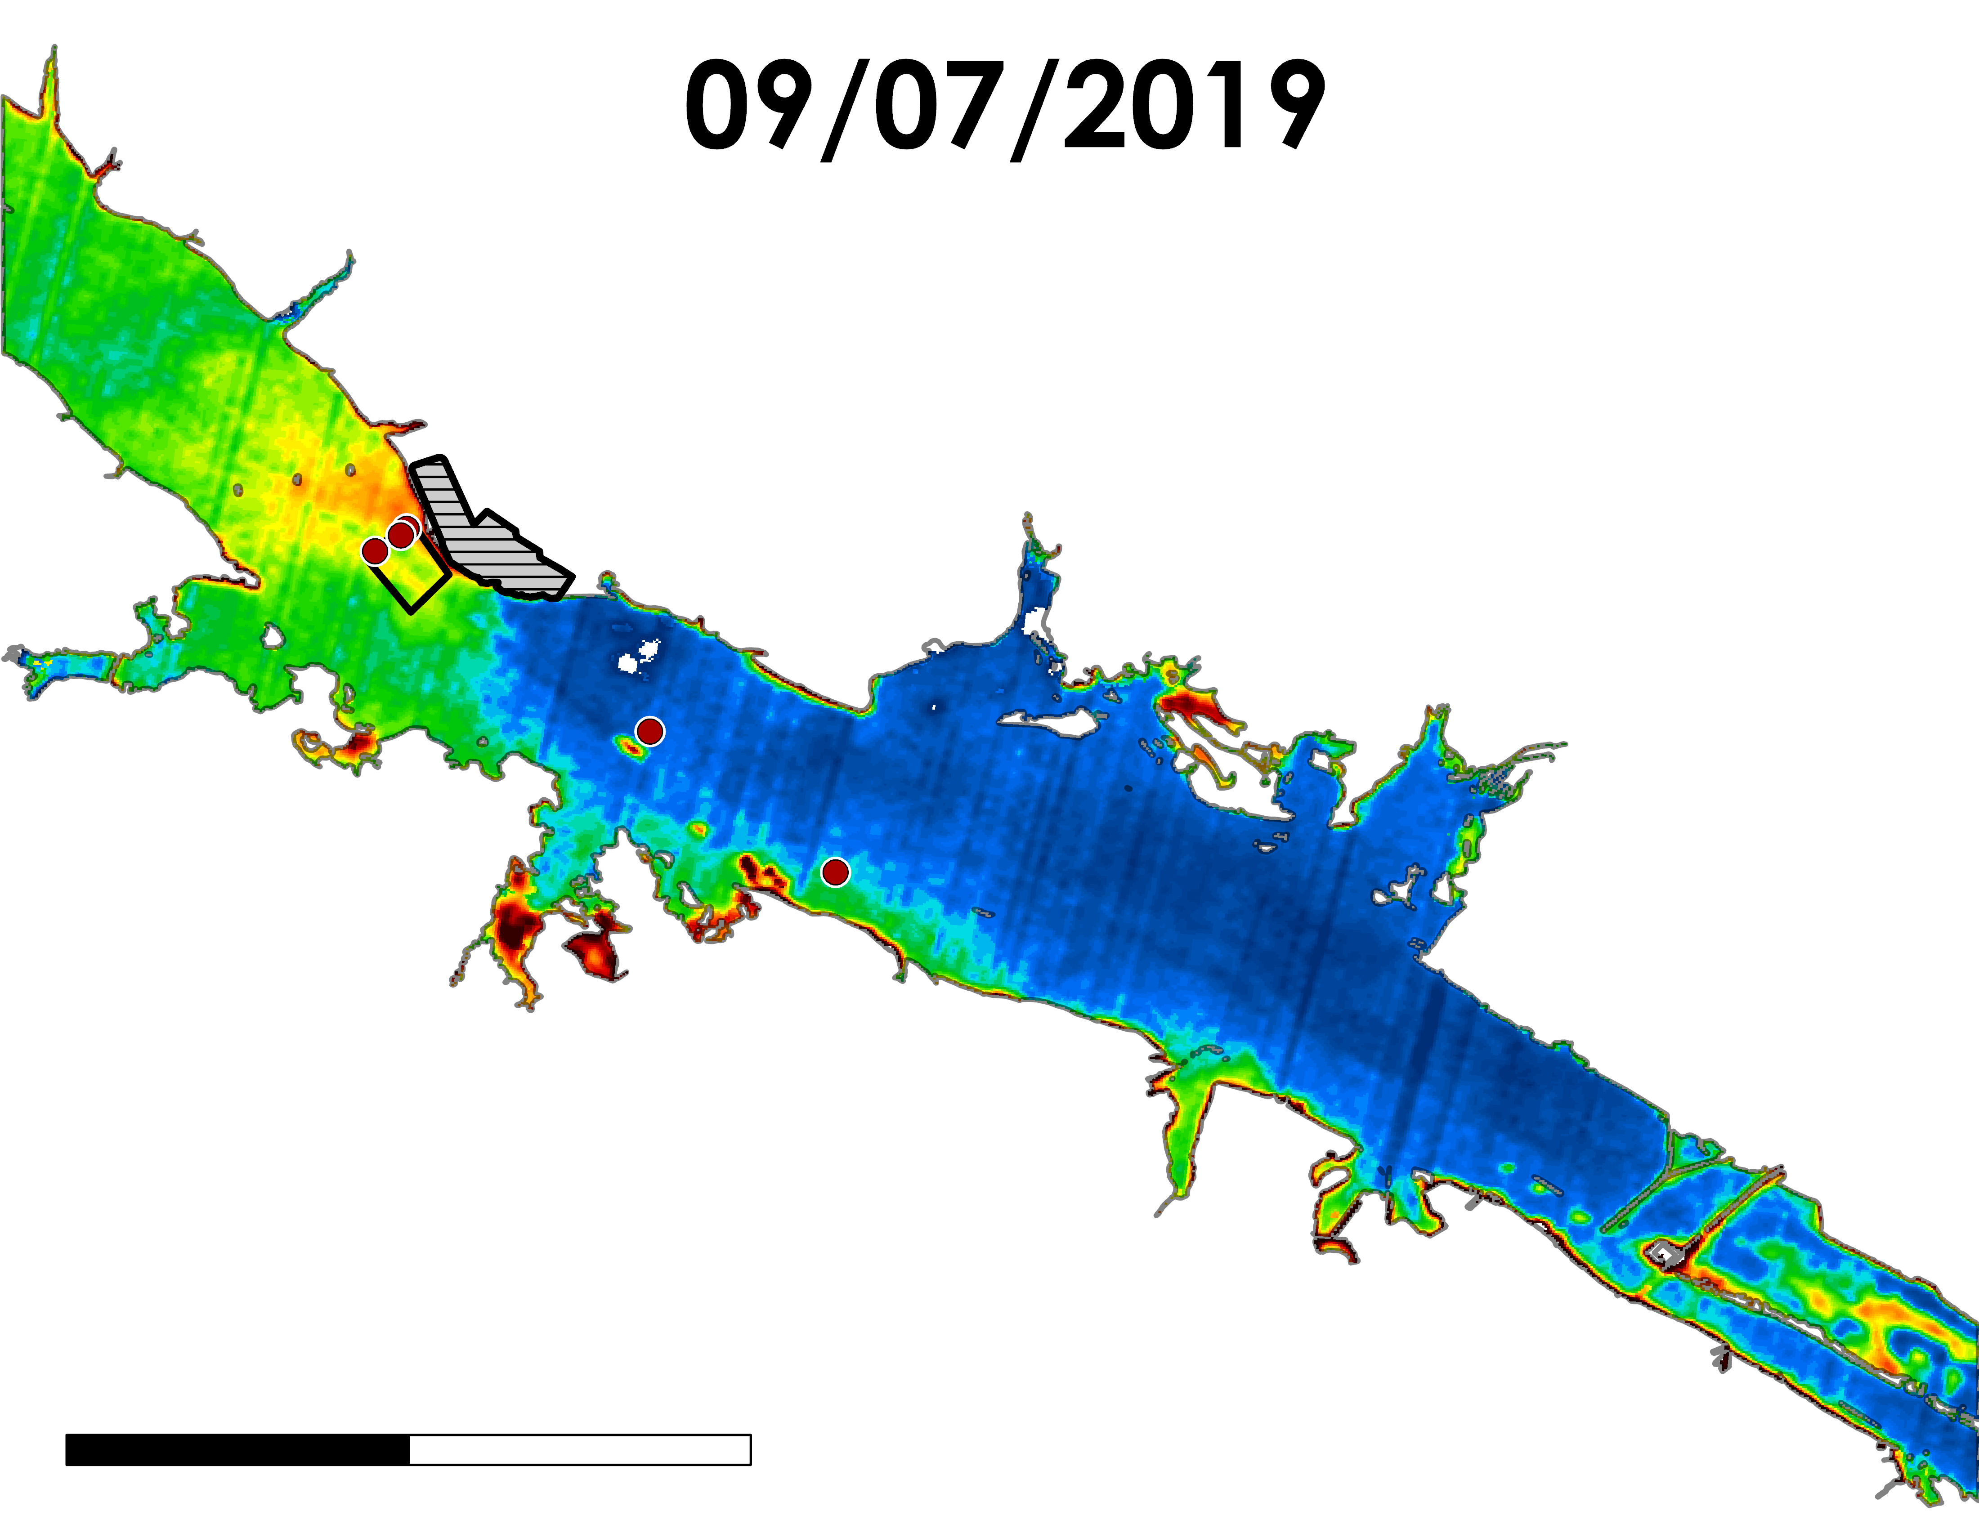
LANDSAT: REPEATED MEASURES
N
Date, GMT | Flow (cfs) | Air Temperature (°F) | Power (MW)
9/22/2013, 6:58 | 26602 | 56.93 | 3362
9/20/2018, 8:05 | 17401 | 72.95 | 3218
9/07/2019, 5:55 | 20596 | 78.98 | 3760
Browns Ferry Nuclear Plant
95°F
Mixing Zone
Temperature Stations
75°F
0
3
6
Miles
Image source: Lisa Dong
Notes:
In 2019, we can see that the waters were cooler than 2018 even though 2019 had higher air temperature.

Slide 23
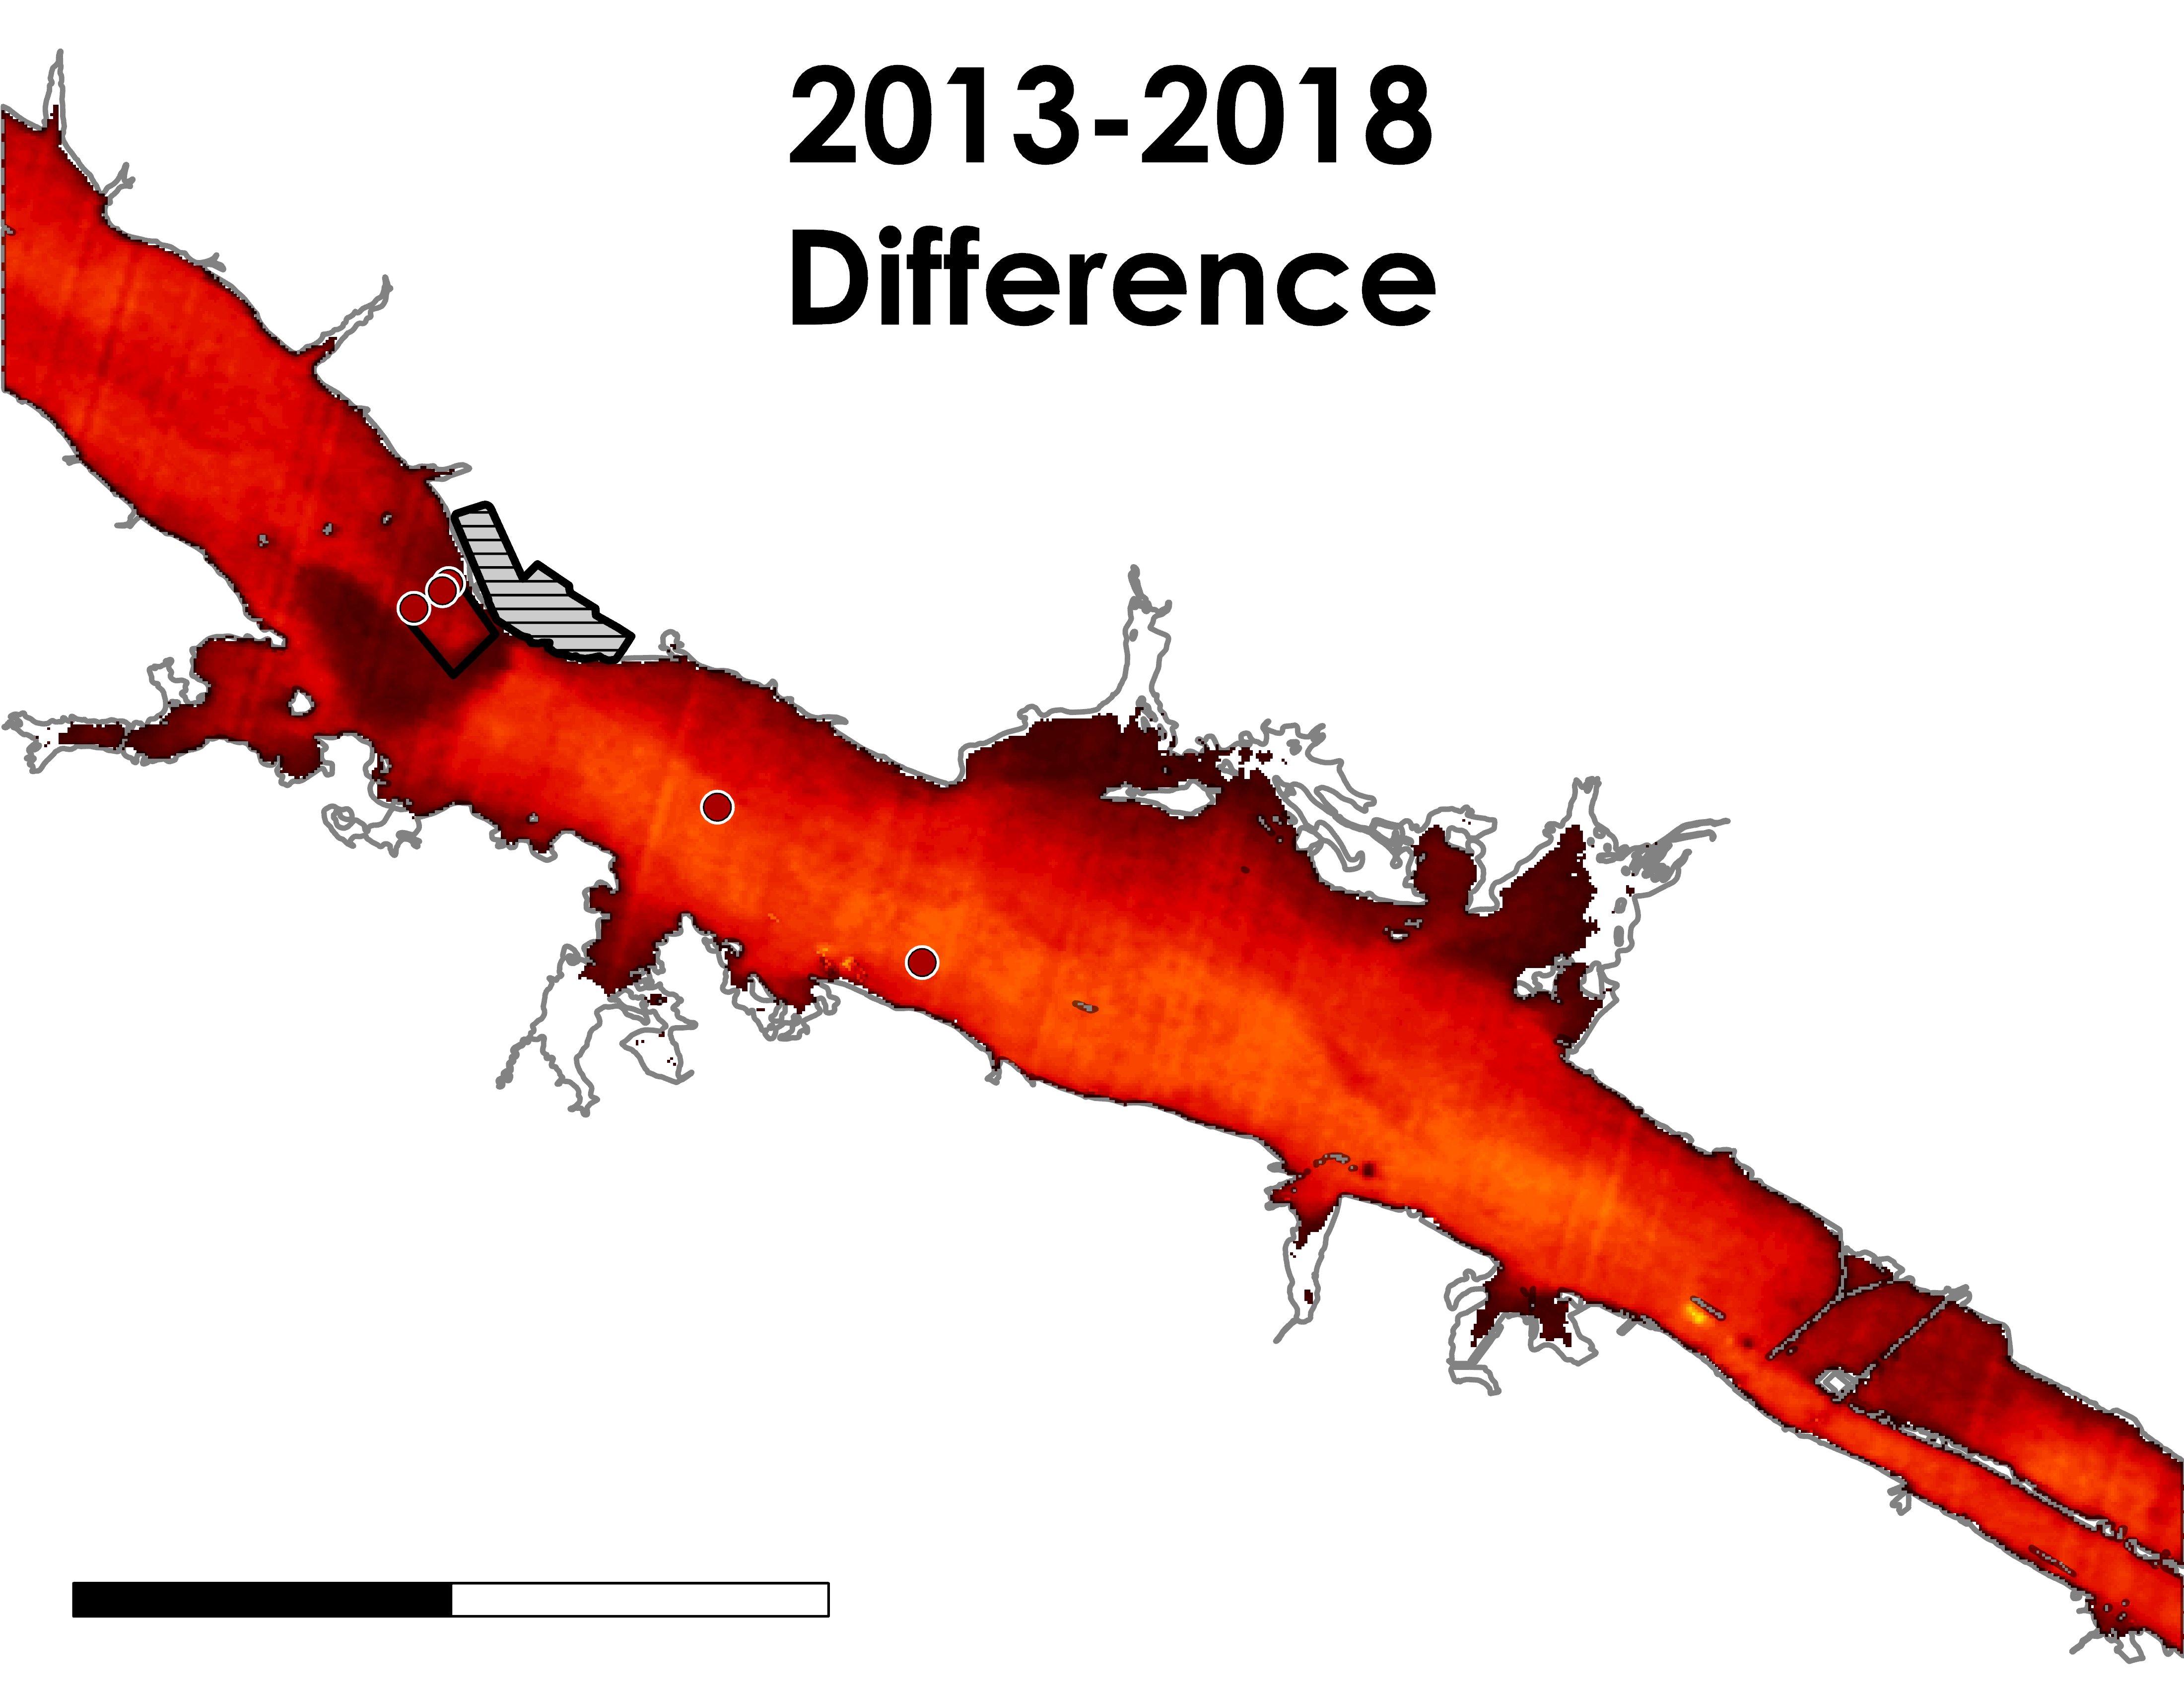
LANDSAT: REPEATED MEASURES
N
Date, GMT | Flow (cfs) | Air Temperature (°F) | Power (MW)
9/22/2013, 6:58 | 26602 | 56.93 | 3362
9/20/2018, 8:05 | 17401 | 72.95 | 3218
9/07/2019, 5:55 | 20596 | 78.98 | 3760
Browns Ferry Nuclear Plant
12°F
Mixing Zone
Temperature Stations
-12°F
0
3
6
Miles
Image source: Lisa Dong
Notes:
*Lisa*
Here we see a temperature difference map between the images taken from 2013 and 2018. As seen downstream, there is a greater increase in temperatures relative to upstream temperatures. The darker red pattern that you see in the effluent area makes sense due to the difference in flow that caused the different spatial pattern.

Slide 24
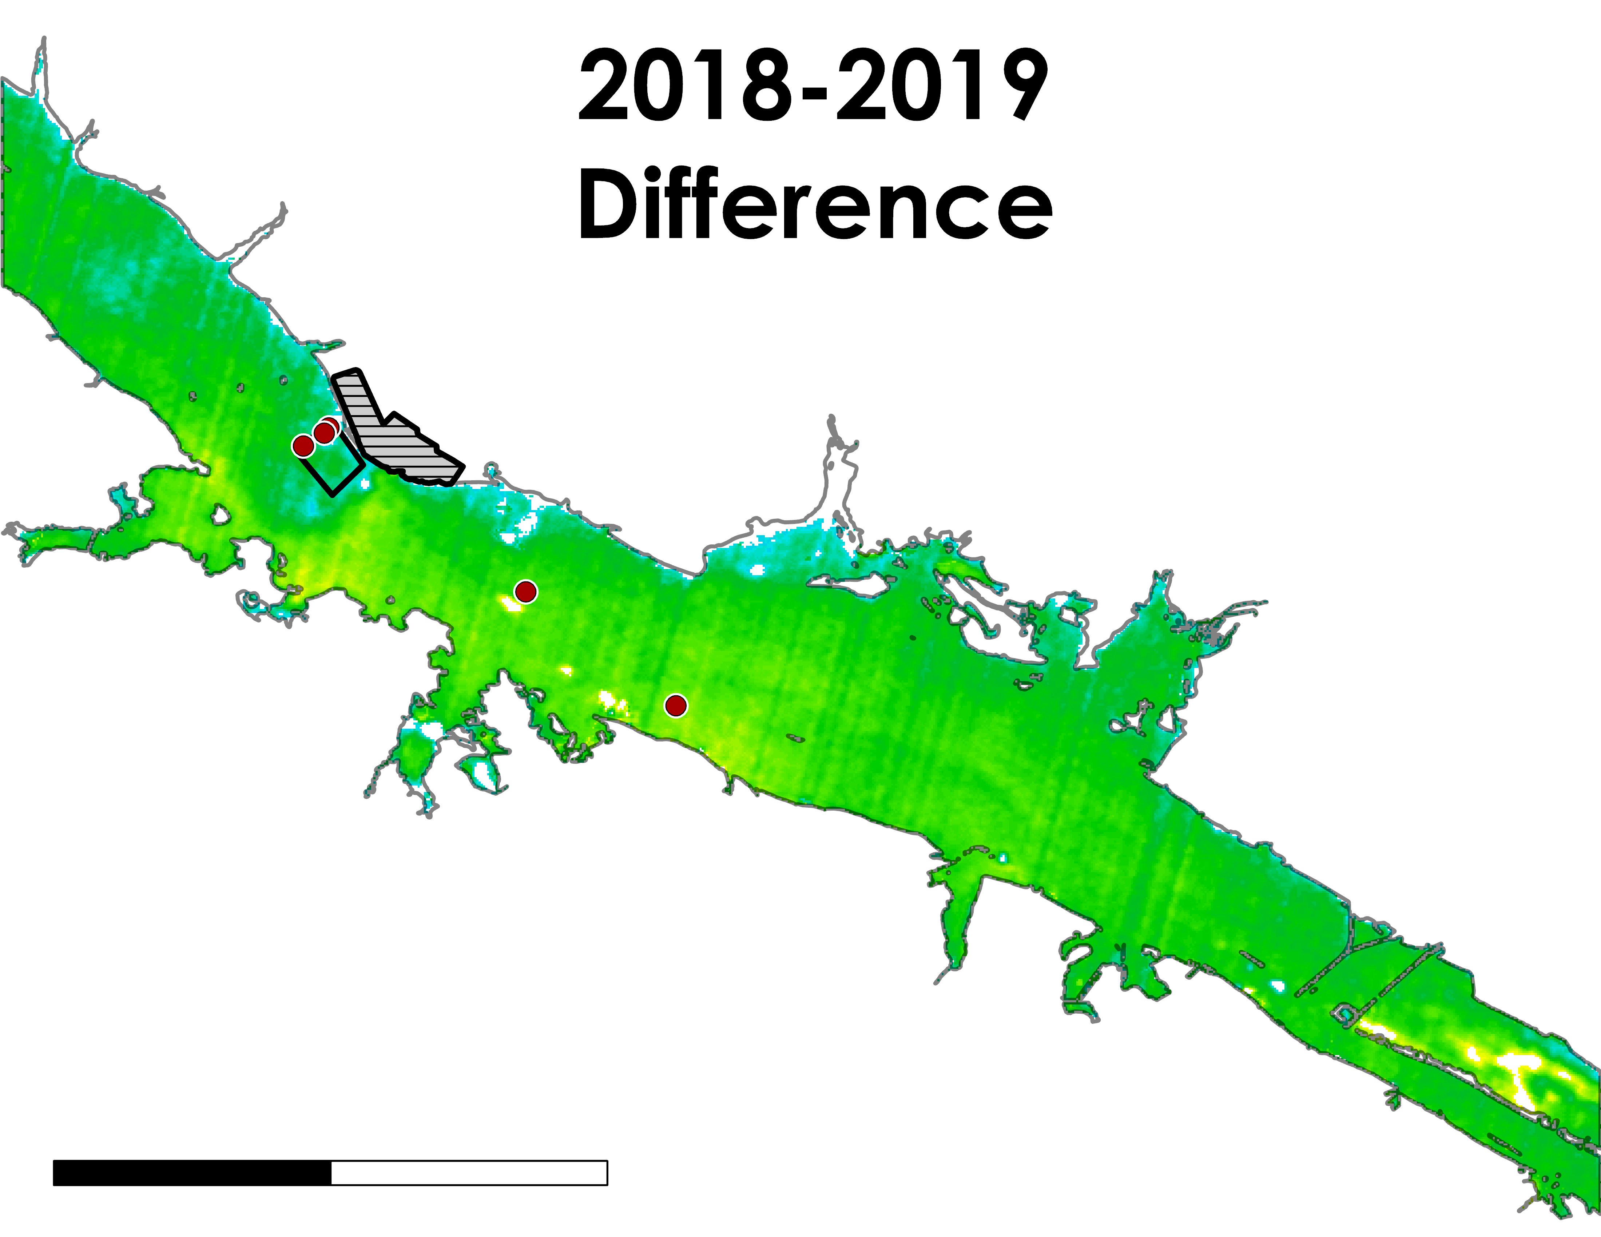
LANDSAT: REPEATED MEASURES
N
Date, GMT | Flow (cfs) | Air Temperature (°F) | Power (MW)
9/22/2013, 6:58 | 26602 | 56.93 | 3362
9/20/2018, 8:05 | 17401 | 72.95 | 3218
9/07/2019, 5:55 | 20596 | 78.98 | 3760
Browns Ferry Nuclear Plant
12°F
Mixing Zone
Temperature Stations
-12°F
0
3
6
Miles
Image source: Lisa Dong
Notes:
*Lisa*
Here we see the temperature difference between the two images from 2018 and 2019. As seen here, relative to the color ramp, there was a decrease in temperatures overall. However, as you can see here in the downstream effluent area, the darker green symbolizes a greater decrease relative to upstream temperatures. This is interesting because even though 2019 had greater power output relative to 2018, there was a decrease in delta t.

Slide 25
REPEATED MEASURES ANALYSIS
Year, GWT | Mixing Zone T (°F) | ∆T (°F) | ANOVA
9/22/2013, 6:58 | 81.722 | +2.178 | F value = 135.506 p-value < .00001
9/20/2018, 8:05 | 90.926 | +5.724
9/07/2019, 5:55 | 84.724 | +3.504
Tukey’s HSD
Treatment Pairs | p-value | Significance
2013 vs 2018 | 0.001005 | ** p<0.01
2018 vs 2019 | 0.001005 | ** p<0.01
Notes:
*Jessica
As seen in these figures, we used ANOVA to calculate whether change in delta t between downstream and upstream temperature stations were statistically significant over the years. We compared images from 2013, 2018, and 2019. Our results showed that the delta t was statistically significant. As you can see here, delta t was 2.178 in 2013. It went up to 5.724 in 2018 and dropped to 3.504 in 2019. 2013 was prior to the Browns Ferry expansion so a lower delta t is expected. However, 2019 was after the Browns Ferry Expansion, but had a lower delta t than in 2018. This did not support our hypothesis in that delta t should have been even greater in 2019.

Slide 26
MULTIPLE REGRESSION
Variables | p-value | R²
Flow Rate | 0.003509 | 0.4598
Air Temperature | 0.119401
Power Output | 0.823066
Notes:
*Jessica
We also analyzed the impact of flow rate, air temperature, and power output on water surface temperature by performing a multiple regression. As you can see from the p-values, the only variable that had a significant impact on water surface temperature was flow rate. This is also demonstrated through the multiple regression plot.

Slide 27
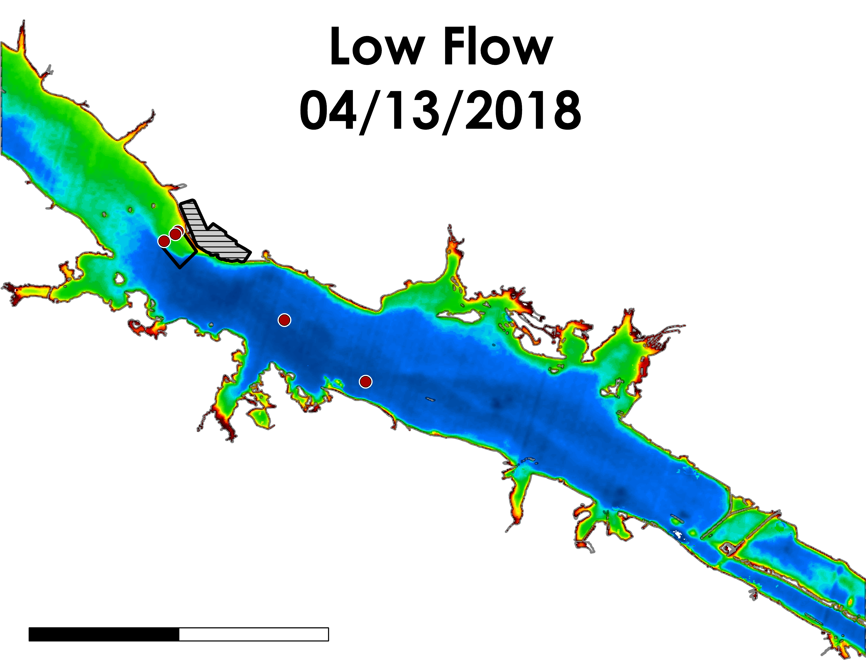
LANDSAT: RIVER FLOW COMPARISON
N
Date, GMT | Flow (cfs) | Air Temperature (°F)
4/13/2018, 18:16 | 40538.0 | 72.3
4/29/2018, 16:04 | 107671.0 | 56.2
Browns Ferry Nuclear Plant
Mixing Zone
80°F
Temperature Stations
60°F
0
3
6
Miles
Image source: Lisa Dong
Notes:
*Lisa*
This comparison showed times when river flow was high and when river flow was low. We expect different temperature spatial variations based on the degree of flow. As you can see here, for the high flow day, the cold water was pushing forward downstream faster and prevented the effluent from spreading. However, if you look at low flow, the downstream area has wider range of spread from the thermal effluent.

Slide 28
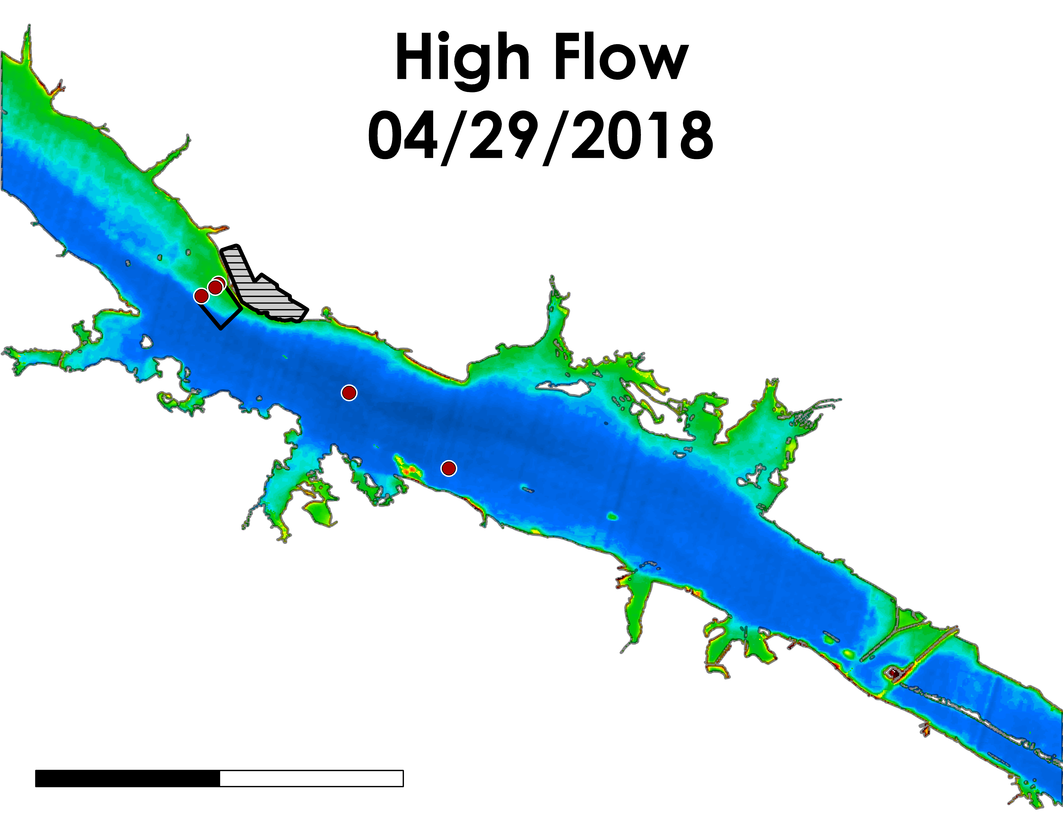
LANDSAT: RIVER FLOW COMPARISON
N
Date, GMT | Flow (cfs) | Air Temperature (°F)
4/13/2018, 18:16 | 40538.0 | 72.3
4/29/2018, 16:04 | 107671.0 | 56.2
Browns Ferry Nuclear Plant
Mixing Zone
80°F
Temperature Stations
60°F
0
3
6
Miles
Image source: Lisa Dong
Notes:
*Lisa*
This comparison showed times when river flow was high and when river flow was low. We expect different temperature spatial variations based on the degree of flow. As you can see here, for the high flow day, the cold water was pushing forward downstream faster and prevented the effluent from spreading. However, if you look at low flow, the downstream area has wider range of spread from the thermal effluent.

Slide 29
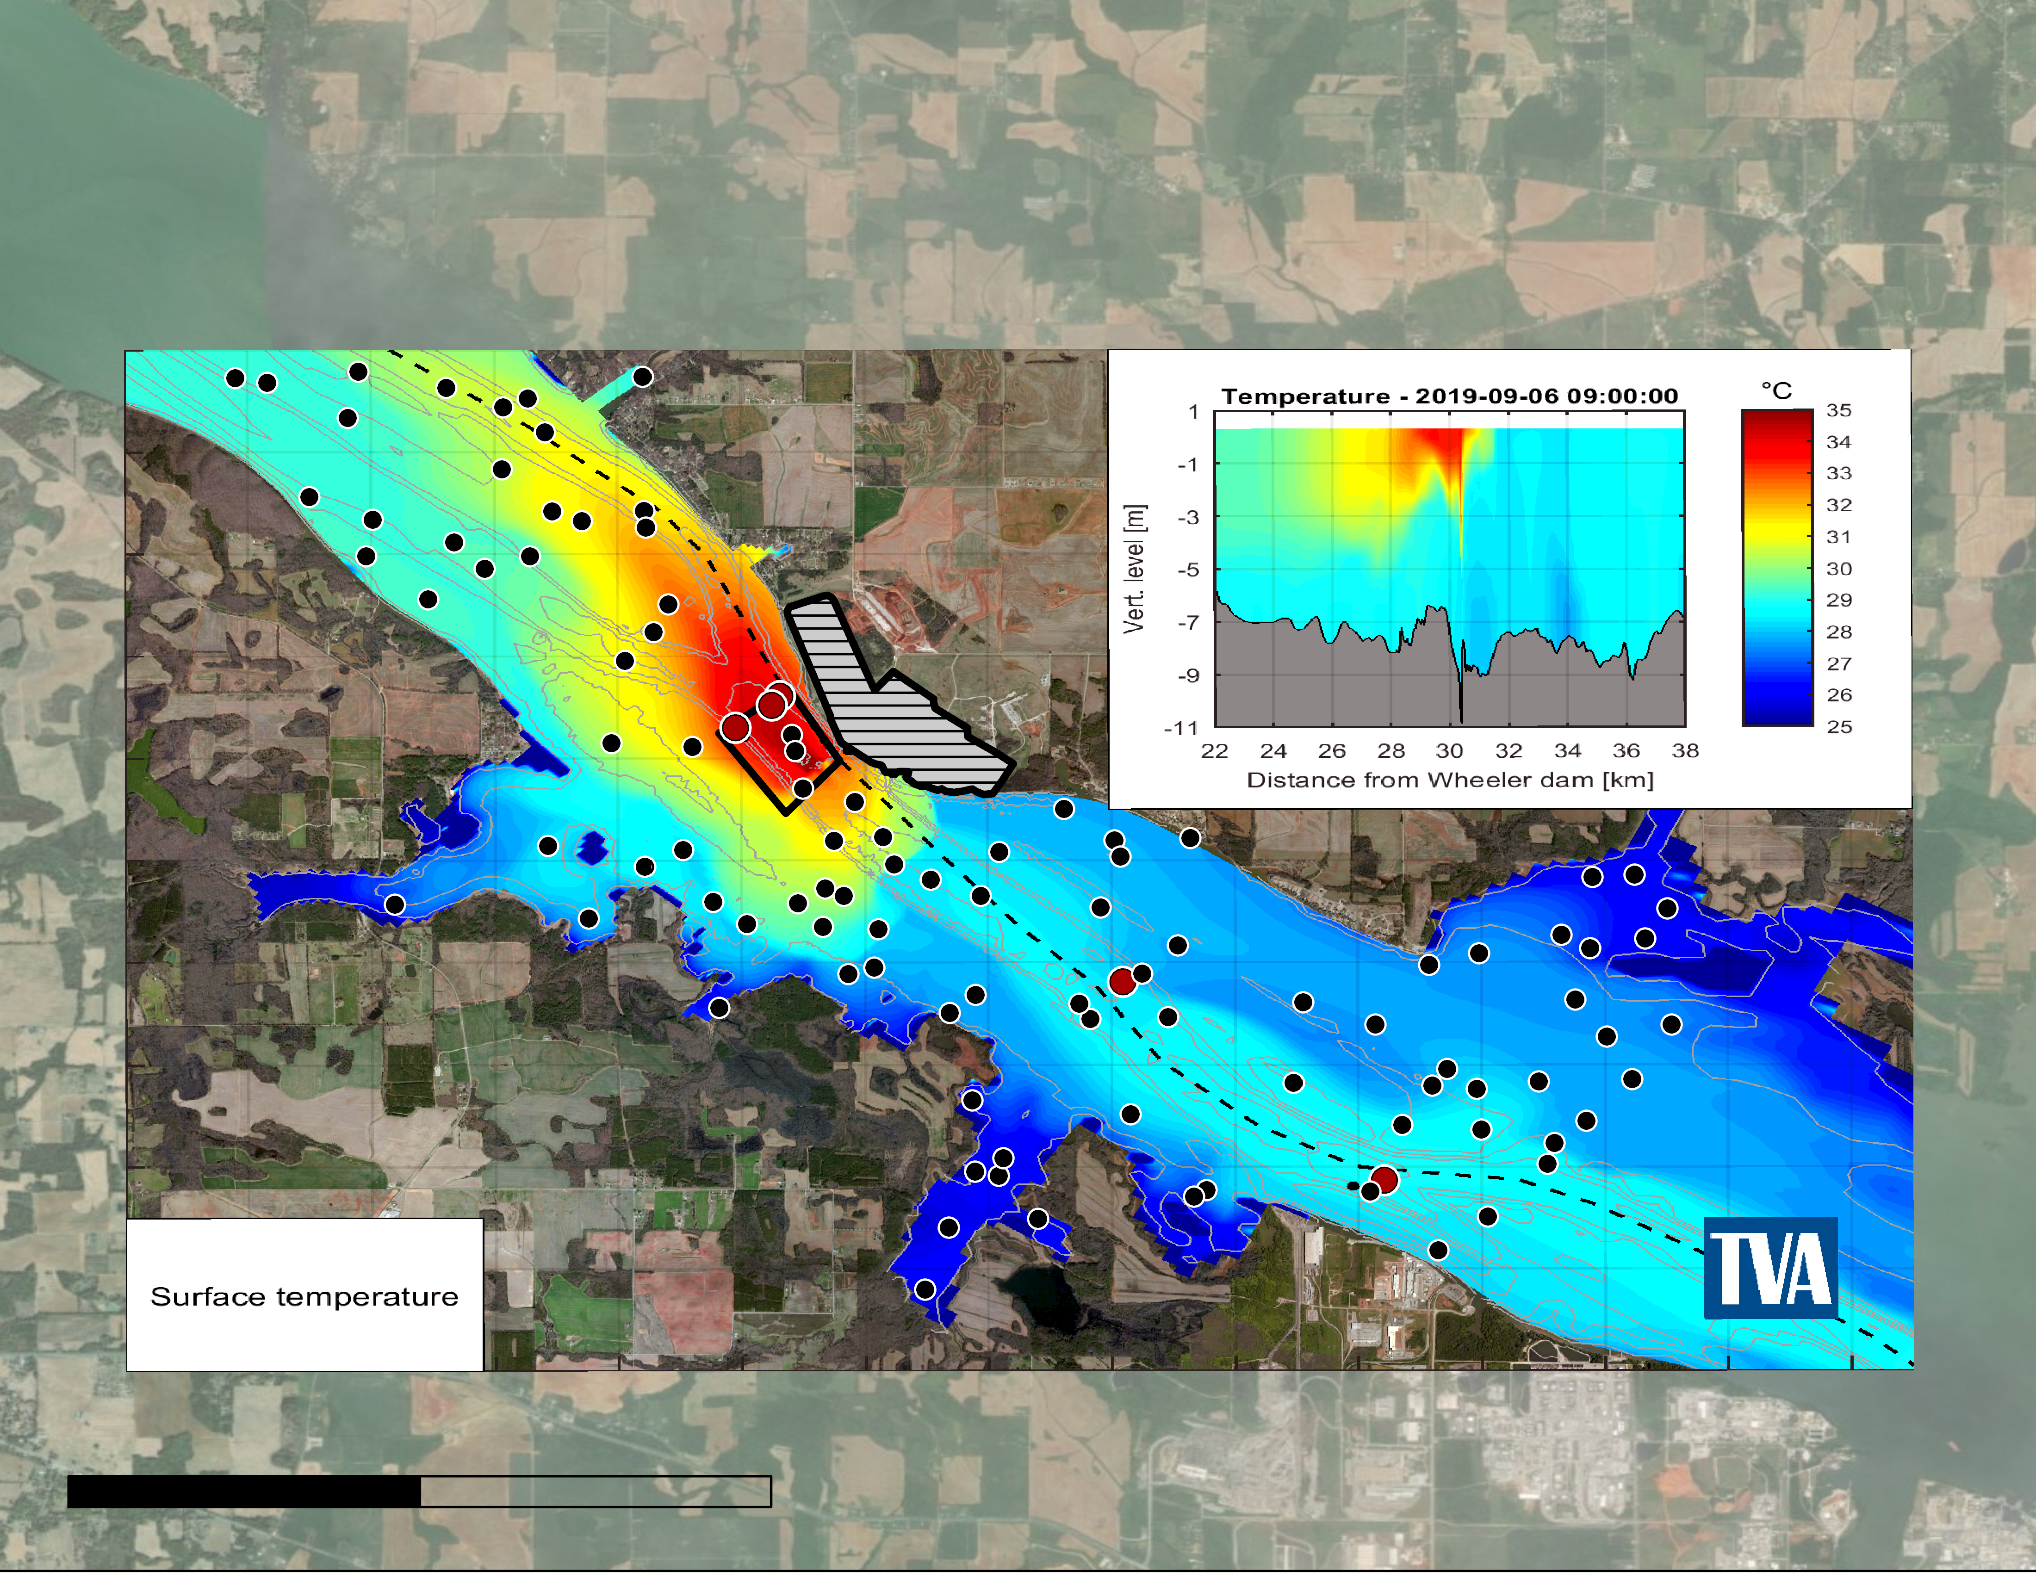
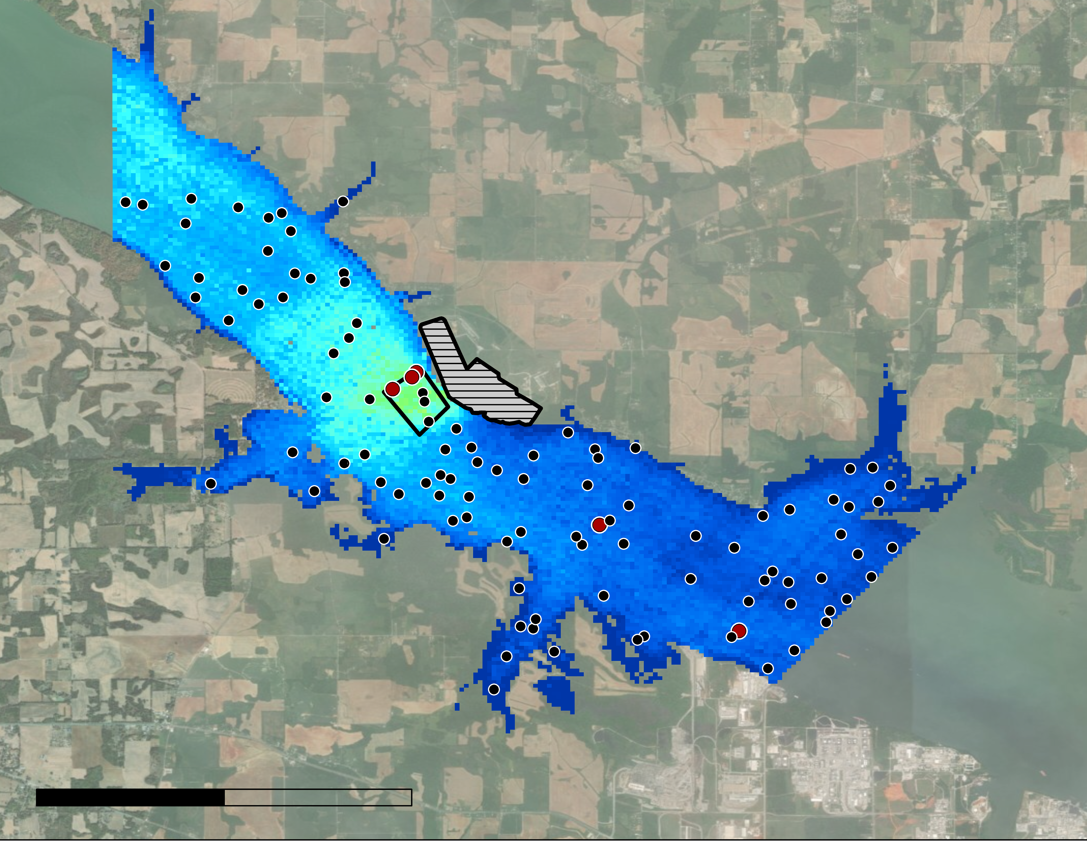
ECOSTRESS: MODEL COMPARISON
Model 09/6/2019 2:00 pm
N
ECOSTRESS 09/6/2019 1:49 pm
35°C
25°C
0
2
4
0
2
4
Browns Ferry Nuclear Plant
Miles
Miles
Mixing Zone
Temperature Stations
Random Points
Image source: Lisa Dong
Notes:
*Lisa*
Here is our model comparison where we compared one image from the model and from ECOSTRESS. These two maps here show that the temperatures predicted by ECOSTRESS were cooler than the model. We generated random points for the model and satellite comparison for the statistical analyses. Jessica will talk about this.

Slide 30
ECOSTRESS: MODEL VS. SATELLITE
Notes:
*Jessica*
This graph shows water temperatures sampled from the 100 random points. The red line represents the temperatures predicted by the Delft3D model, while the purple line represents the temperatures measured by ECOSTRESS. As you can see, the model consistently predicted higher temperatures compared to ECOSTRESS at the same points. On average, temperatures from the model image were 3.6 degrees F higher than temperatures measured by ECOSTRESS. We found this difference to be statistically significant by conducting a one-tailed t-test on this data.

Slide 31
EARTH OBSERVATIONS VS. IN SITU
Combined R² = 0.97
Notes:
*Sam
These figures show how well NASA Earth observations temperatures matched river gage temperatures at Browns Ferry Nuclear Power Plant and Sequoyah Nuclear Power Plant. The figure on the left shows a histogram of in situ and satellite temperature difference at BFNP. 95% of EO thermal values (or 2 standard deviations) are within -5.71 and 4.87 °F of in situ data (mean = -0.42, s = 2.6).
The table on the right shows the histogram of in situ and satellite temperature difference at SNP. 95% of EO thermal values (or 2 standard deviations) are within -9.8 and 6.5 °F of in situ data (mean = -1.6, s = 4.1).
Earth Observations did not perform as well at SNP as they did at BFNP when compared with in situ gage data. One explanation for this discrepancy is that SNP has temperature gages near the shore in contrast to BFNP. Since SNP gage locations were near the riverbank, it is likely that the satellite pixel that contained the gage station was mixed with land and water surfaces. This was not a problem at BFNP, where gage locations are sufficiently far from the river banks.

Slide 32
FACILITY COMPARISON
Temperature Accuracy at SNP
Notes:
*Sam
These figures show how well NASA Earth observations temperatures matched river gage temperatures at Browns Ferry Nuclear Power Plant and Sequoyah Nuclear Power Plant. The figure on the left shows a histogram of in situ and satellite temperature difference at BFNP. 95% of EO thermal values (or 2 standard deviations) are within -5.71 and 4.87 °F of in situ data (mean = -0.42, s = 2.6).
The table on the right shows the histogram of in situ and satellite temperature difference at SNP. 95% of EO thermal values (or 2 standard deviations) are within -9.8 and 6.5 °F of in situ data (mean = -1.6, s = 4.1).
Earth Observations did not perform as well at SNP as they did at BFNP when compared with in situ gage data. One explanation for this discrepancy is that SNP has temperature gages near the shore in contrast to BFNP. Since SNP gage locations were near the riverbank, it is likely that the satellite pixel that contained the gage station was mixed with land and water surfaces. This was not a problem at BFNP, where gage locations are sufficiently far from the riverbanks.

Slide 33
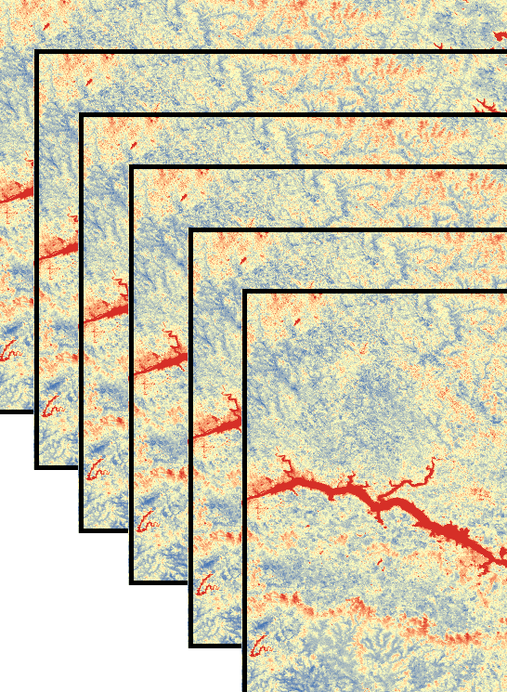
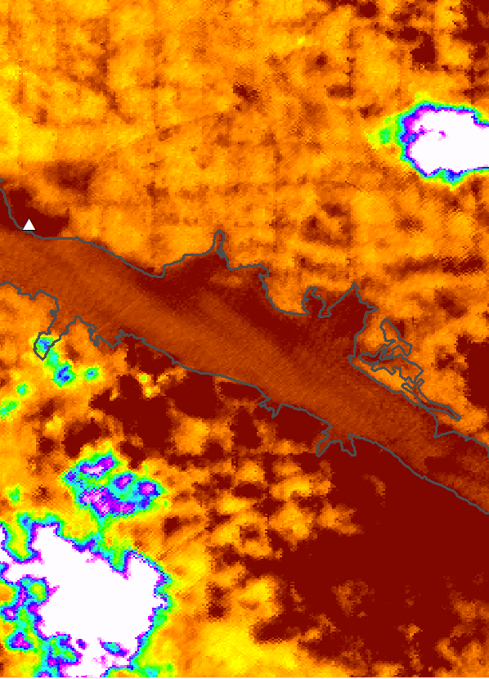
LIMITATIONS
Sparse Temporal Resolution
Course Spatial Resolution
Limited Data
Clouds
Image Source: Dong, L.; Tatum, S.
Notes:
*Sam
Course spatial resolution: A piece of our project was comparing sensor temperature with satellite pixel temperature. The discrepancy between the point temperature values and area temperature values likely introduced error.
Sparse Temporal resolution: To meet regulation the TVA records river temperatures every 15 minutes. Satellite monitoring cannot match this temporal resolution.
Limited Available Data: At browns ferry plant there are only 5 gage stations or points to compare sensor accuracy with.
Clouds: Certain times of the year were omitted because of excessive cloud cover. Lightly clouded images also introduced error into some of our statistics.
Image sources: Lisa Dong, Samuel Tatum

Slide 34
CONCLUSIONS
River flow rate has a significant impact on water surface temperature. Earth observations can demonstrate spatial trends at varying flow rates.
NASA Earth Observations can benefit thermal effluent model calibration.
Satellite imagery cannot replace in situ temperature reporting for compliance due to low temporal & spatial resolutions.
Notes:
*Rachel*
NASA Earth observations may be useful in helping to confirm that the TVA’s temperature model is able to capture temperature variations. However, due to low spatial resolution, low temporal resolution, and earth observation errors, it cannot help the TVA report temperatures for compliance.
In addition, we did see that river flow rate has a significant impact on river surface temperature whereas flow increased, delta t decreased. Flow rates is also one of the main factors that affect spatial trends in temperature.

Slide 35
FUTURE WORK
Conduct additional analysis comparing Delft3D temperature predictions with NASA Earth Observation temperatures
Predict growth of aquatic vegetation using Sentinel
Incorporate data on abundance and distribution of wildlife species upstream and downstream of TVA nuclear plants
Notes:
*Rachel*
Moving forward, the TVA and NASA DEVELOP are actively making plans to experiment with other applications using NASA's Earth observations to enhance and supplement monitoring for environmental and ecosystem impacts near Browns Ferry.
Examples of future work include, but are not limited to:
-Comparing temperatures predicted by the Delft3D model with NASA Earth observation temperatures. This can help the TVA see if their model is able to capture temperature spatial variations.
-The TVA struggles with overgrowth of aquatic vegetation clogging their intake. The team can use Sentinel to mitigate this problem by predicting the growth of aquatic vegetation
-Finally, Earth observations can be useful to measure the spatial distribution and abundance of wildlife both upstream and downstream from TVA’s various nuclear plants

Slide 36
STORY MAP: GO WITH THE FLOW
Notes:
*RACHEL*
The TVA and other sources of power generation get a bad rap due to harm to environment as well as economic strain. However, through the team’s exploration of the temperature values and interaction with TVA’s hydrothermal team, we wanted to highlight the positive efforts the TVA is making towards responsible ecological decision making. To engage the public and to encourage positive engagement with the TVA’s efforts we created a story map to showcase both the TVA’s work in nuclear power as well as the incorporation of NASA’s earth observations in supplementation of TVA’s goals. This will be available to the TVA to promote both NASA and Nuclear energy in the future.

Slide 37
SCIENCE ADVISORS
MENTORS
PARTNER CONTACTS
Dr. Jeffrey Luvall
NASA Marshall Space Flight Center
Dr. Robert Griffin
The University of Alabama in Huntsville
Madison Murphy
NASA Marshall Space Flight Center
Cole Krehbiel
Innovate! Inc., Contractor to the U.S. Geological Survey (USGS)
Christine Evans
The University of Alabama in Huntsville
Helen Baldwin
NASA SERVIR
Maggi Klug
The University of Alabama in Huntsville
Colleen Montgomery
Tennessee Valley Authority
Lana Bean
Tennessee Valley Authority
Dr. Matthew Boyington
Tennessee Valley Authority
Jessica Brazille
Tennessee Valley Authority
Daniel P. Saint
Tennessee Valley Authority
Notes:
*Rachel*
We would like to thank our science advisors, fellow, mentors and end users for their contributions and assistance to this project.

