Slide 1
VPS Outline: Things to Remember
This is the most publicly viewed deliverable
Cite everything TWICE
Once in the video and again in the credits
Know your creative commons licensing
ASK if you are questioning a source
You need a media release from for anyone in the video
Everyone on your team is not required to be seen or heard in the video
(It is recommended to show some type of team photo with names so you can get credit where credit is do)
Video does not need to contain results, but if you have them you are encouraged to incorporate them
You do not have to follow the exact order of the outline
Have fun! You may show this to your next employer.

Slide 2
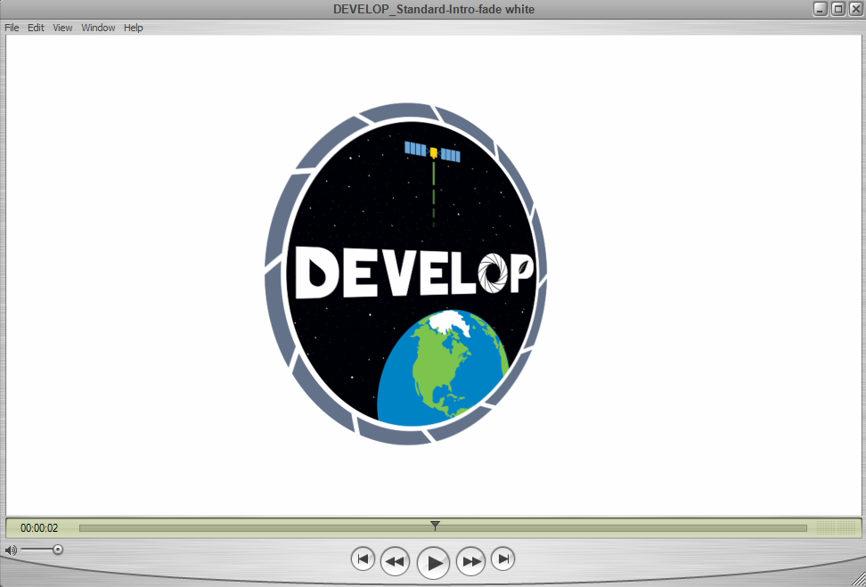
Opening
Scene Elements
Script: | Official DEVELOP introductory clip
Visuals: | DEVELOP introductory clip fade to white from DEVELOPedia
Estimated Scene Duration: | 8 seconds

Slide 3
Community Concerns
Why is this project important? What are the community concerns?
Found In
Proposal: Community Concerns
Project Summary: Community Concerns
Scene Elements
Script: | Chile’s stark geographical differences across latitudes presents a spectrum of agricultural conditions throughout the entire country. Chile is vulnerable to drought and reliant on irrigation practices in many sub-regions. Balancing the management of supply and demand of water across the country proves a difficult task for the Ministry of Agriculture which works to reduce vulnerability to drought and other agriculture-climate events by disseminating response information that serves as an early warning for decision-makers and stakeholders of the agriculture industry.
Visuals: | Show stock photos of Chile, maybe a fly through with GEE
Estimated Scene Duration:

Slide 4
Team / Project Objectives
What are the objectives of this project?
Found In
Proposal: Project Synopsis
Project Summary: Objective Overview
Scene Elements
Script: | The Chile Water Resources team at Ames research center partnered with the Ministerio de Agricutura to incorporated hydrological and agricultural data derived from NASA EO into Chile’s drought monitoring and decision-making processes using Google Earth Engine.
Visuals: | Picture of team with names flying on the screen, Photos of Ministerio de Agricutura maybe their flag. Then PowerPoint with objectives.
Estimated Scene Duration:

Slide 5
Partners
What is the project partner’s current decision-making process and how will the incorporation of NASA EOs help improve this process?
Found In
Proposal: End-User’s current Decision-Making Process
End-User’s Capacity to Use NASA Earth Observations
Project Summary: Current Management Practices & Policies
Scene Elements
Script: | Currently Chile utilizes existing Climate Data Library (CDL) to serve as a drought observatory for the country and agricultural community. Using information derived from the CDL the Ministry informs farmers and stakeholders of the best irrigation practices for their specific geographic regions. Although some of this information is derived from remote sensing the Ministry seeks to enhance their dataset by incorporating soil moisture, snow cover, and snow water equivalent collected from NASA EOs.
Visuals: | Potential interview with partners, Images of CDL, stock footage of farmers and Chile ag, NASA satellites orbiting world.
Estimated Scene Duration:

Slide 6
End Products / Sensors Used
What end product(s) will be produced during this project and what Earth observations will be used? How will these Earth observations be used?
Found In
Proposal: End Products, Earth Observations
Project Summary: Earth Observations & Parameters
Scene Elements
Script: | This project produced a Google Earth engine decision support tool that incorporates NASA Earth observations to enhance the current decision making processes. This tool incorporated data from SMAP and Sentinel-1 to estimate soil moisture across Chile, Aqua and Terra MODIS snow algorithm output was used to estimate snow cover and supplement hydrological data in the CDL, and AMSR2 was used to analyze snow water equivalent. All data is hosted and processed by GEE and made ready for analysis by the Ministry of Agriculture in Chile.
Visuals: | Pictures of team working on GEE <no code> or animation of GEE + EO. Then show animations of satellites and have word of what they will do fly onto screen. Transition to every satellite. Graphic of SMAP + Terra MODIS + AMSR2 = GEE tool
Estimated Scene Duration:

Slide 7
Partner Benefits / Conclusion
How will these end products help improve partner decision-making?
Found In
Proposal: End-User Benefits
Project Summary: N/A
Scene Elements
Script: | Remotely-sensed datasets used in this project provide Chile with an increased temporal and spatial resolution of hydrological and agricultural observations with regards to drought monitoring. The three indices explored in this project will allow for more robust decision making for the agriculture industry.
Visuals: | Interview or satellite imagery/initial results
Estimated Scene Duration:

Slide 8
Mandatory Credits
Found On
DEVELOPedia
Scene Elements
Script: | When in doubt, use all three statements
Visuals: | The following three statements must be included in the credits (before the DEVELOP closing clip) of every VPS video: This material is based upon work supported by NASA through contract NNL16AA05C and cooperative agreement NNX14AB60A. Any opinions, findings, and conclusions or recommendations expressed in this material are those of the author(s) and do not necessarily reflect the views of the National Aeronautics and Space Administration (NASA). NPR 2200.2C D.6.4.1: Trade names and trademarks are used in this report for identification only. Their usage does not constitute an official endorsement, either expressed or implied, by the National Aeronautics and Space Administration.
Estimated Scene Duration:

Slide 9
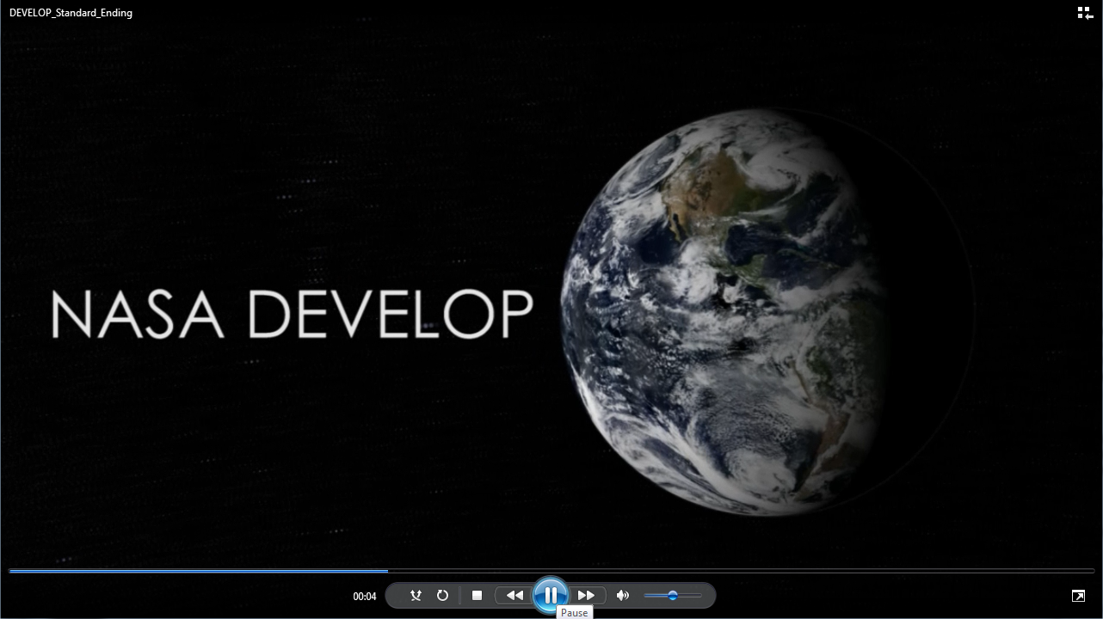
Ending
Scene Elements
Script: | Official DEVELOP ending
Visuals: | Official DEVELOP ending from DEVELOPedia
Estimated Scene Duration: | 11 seconds

