Slide 1
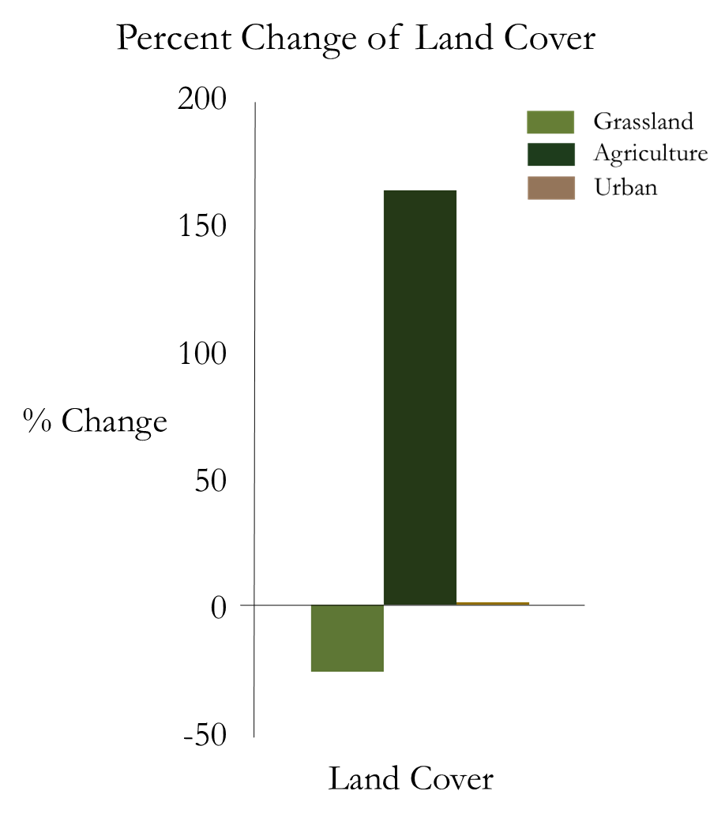
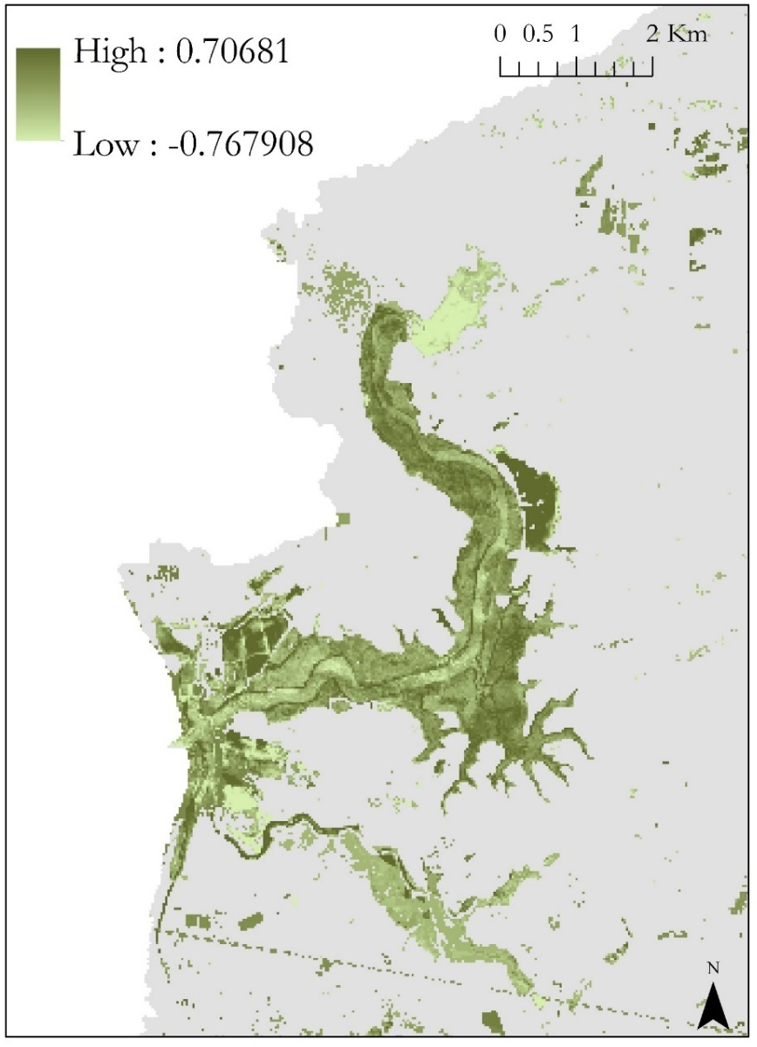
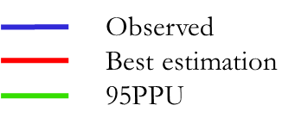
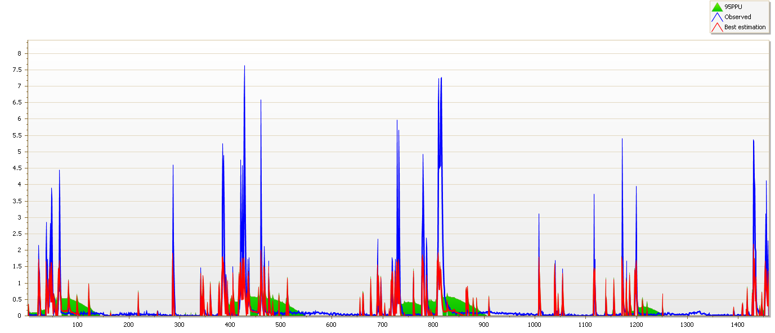
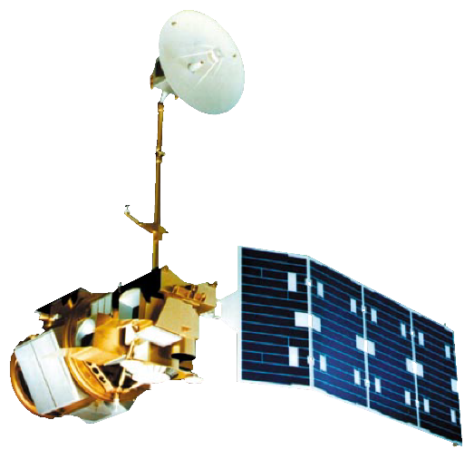
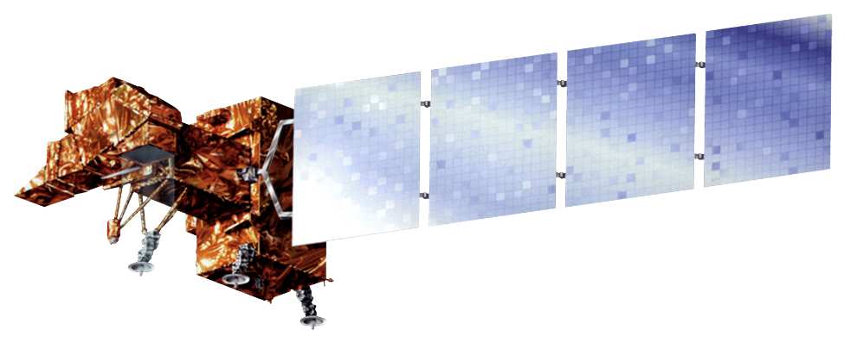
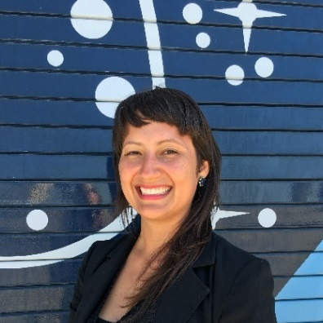
Detecting Eutrophication Sources, Hotspots, and Nutrient Levels in a Central California Estuary to Support Watershed Management Decisions
Abstract
Methodology
Elkhorn Slough in Monterey, California has experienced substantial nutrient loading and eutrophication over the past 21 years as a result of fertilizer-rich runoff from nearby agricultural fields. This study seeks to identify and track spatial patterns of eutrophication hotspots and their correlation to land use changes, possible nutrient sources, and general climatic trends using remotely sensed and in situ data. Threats of rising sea level, subsiding marshes, and increased eutrophication hotspots demonstrate the necessity to analyze the effects of increasing nutrient loads, relative sea level changes, and sedimentation within Elkhorn Slough. The Soil & Water Assessment Tool (SWAT) model integrated specified inputs to assess nutrient and sediment loading and their sources. TerrSet’s Land Change Modeler (LCM) forecasted the future potential of land change transitions for various land cover classes around the slough as a result of nutrient loading, eutrophication, and increased sedimentation. TerrSet’s Earth Trends Modeler (ETM) provided a comprehensive analysis of image time series to rapidly assess long-term eutrophication trends and detect spatial patterns of known hotspots. Results from this study will inform future coastal management structures and provide greater spatial and temporal insight into Elkhorn Slough eutrophication dynamics.
Inputs
Models
Outputs
Study Area
McClusky
Elkhorn
Tembladero
Moro Cojo
Gavilan
Figure 2. Flowcharts of project methodology employed in this study. Inputs on the left depict required
datasets while outputs on the right illustrate a subset of the results.
Results
Figure 1. Elkhorn Slough watershed delineation (yellow) and stream
network (blue) from SWAT in Monterey
County, CA.
LCM
Percent Change of Land Cover
Figure 3. Land cover transition potential for 2000 – 2020 show a 161% increase for agriculture.
ETM
% Change
Elkhorn Slough Ecological Forecasting
SWAT
Land Cover
Validation Hydrograph for SWAT
Objectives
Discharge
m³/s
Identify and track patterns of eutrophication from 1995 – 2016 through the Floating Algal Index (FAI) and the Normalized Difference Turbidity Index (NDTI).
Assess land use/land cover changes within the study period and forecast future land use practices around Elkhorn Slough.
Detect and quantify primary contributors of nutrient and sediment loadings by sub-basin and Hydrologic Response Units.
Observations
Figure 5. Linear regression of floating algal trends for 1995 – 2016 show likeliness of eutrophication hotspots in the upper sub-basins.
Figure 4. 2009 – 2012 SWAT validation results: R² = 0.60, NS (model efficiency coefficient) = 0.46. Observed discharge peaks are higher than modeled data peaks.
Conclusions
Muted tidal exchange areas experience the highest levels of floating algal mats according to satellite imagery analysis.
Land change forecasting for the year 2020 indicates substantial agricultural conversion within the watershed. These potential future changes can be primarily attributed to the rapid expansion of the agricultural industry within the region.
Results obtained from SWAT may be underestimated due to a model setup that represents simplified dynamics and/or do not account for all the processes taking place in the watershed. More robust in situ datasets may yield more suitable model outputs with less uncertainty.
The McClusky sub-basin contributes the highest levels of total N and sediment loadings, causing an increase in eutrophic conditions. Results from ETM time series validate SWAT modeling outputs.
Earth Observations
Landsat 7 ETM+
Landsat 5 TM
Landsat 8 OLI
Project Partners
Elkhorn Slough National Estuarine Research Reserve (ESNERR)
Monterey Bay Aquarium Research Institute (MBARI)
Acknowledgements
Team Members
Dr. Juan Torres-Pérez and Dr. Sherry Palacios
Bay Area Environmental Research Institute, Project Advisors
Chippie Kislik, Vickie Ly, and Martha Sayre
NASA DEVELOP Ames Research Center
Chase Mueller
Bay Area Environmental Research Institute
Any opinions, findings, and conclusions or recommendations expressed in this material are those of the author(s) and do not necessarily reflect the views of the National Aeronautics and Space Administration. This material is based upon work supported by NASA through contract NNL11AA00B and cooperative agreement NNX14AB60A.
Irma Caraballo Álvarez
Abigail Childs
Kirsten Jurich
NASA Ames Research Center – Summer 2016

