Slide 1
North Mexico Ecological Forecasting
Using NASA Earth Observations to Monitor and Manage Ocelot Habitat Loss in North Mexico
Ryan Schick (Project Lead)
Leigh Sinclair
Padraic Conner
Maggi Klug
Notes:
Hello, my name is Ryan Schick,
I’m Leigh Sinclair,
I’m Padraic Conner,
And I’m Maggi Klug
Our project this term involves using NASA Earth Observations to monitor habitat loss of ocelots in North Mexico.

Slide 2
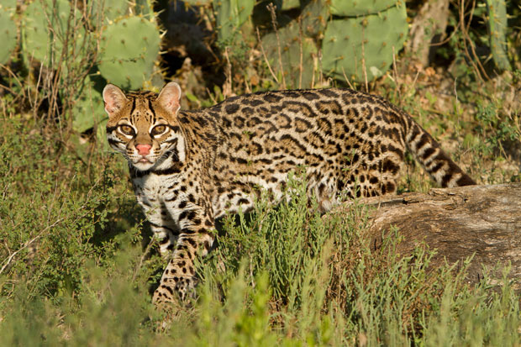
Image credit: USFWS
Background
Ocelots are a medium sized, nocturnal wild cat
Have a range from Argentina up to the southern tip of eastern Texas
Live in areas such as thornscrub, tropical forests, and wetlands
Notes:
Ocelots are a medium-sized, nocturnal wild cat that can be found as far south as Argentina and as far north as extreme southern Texas and Arizona. Ocelots live in a variety of habitats, including thornscrub, tropical forests, mangrove swamps, and other areas of dense vegetation.
Image from USFWS: http://www.fws.gov/news/blog/index.cfm/2015/2/9/Private-Landowners-Help-the-Ocelot-and-the-Aplomado-Falcon

Slide 3
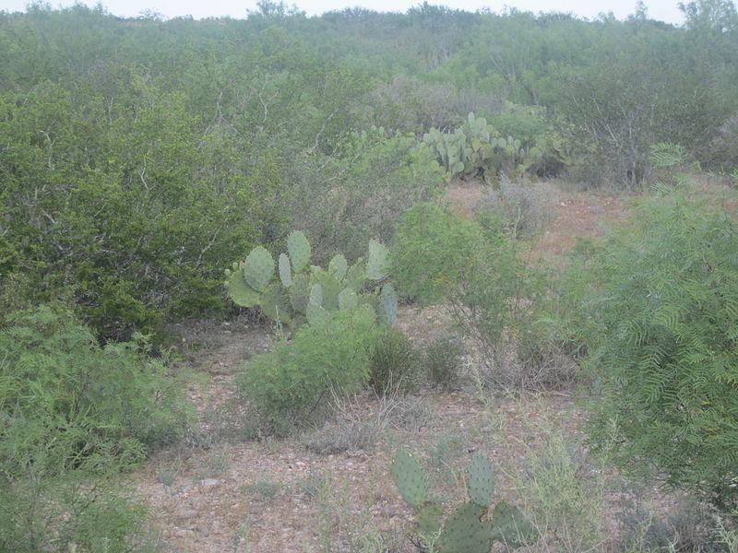
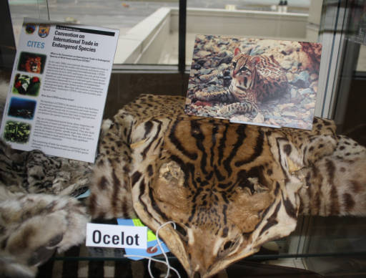
Community Concerns
Ocelots are listed on the Endangered Species Act
Rapid urban development leads to isolation and inbreeding
Over 95% of Tamaulipan brushland habitat in northeastern Mexico has been eliminated
Image credit: Wikimedia Commons – Billy Hathorn
Image credit: USFWS
Notes:
Ocelots are listed on the Endangered Species Act. Rapid urban development lead to isolation of populations through habitat fragmentation, which leads to inbreeding. Over 95% of Tamaulipan brushland habitat in northeastern Mexico has been eliminated in recent years.
Image from USFWS: http://digitalmedia.fws.gov/cdm/singleitem/collection/natdiglib/id/12489/rec/3

Slide 4
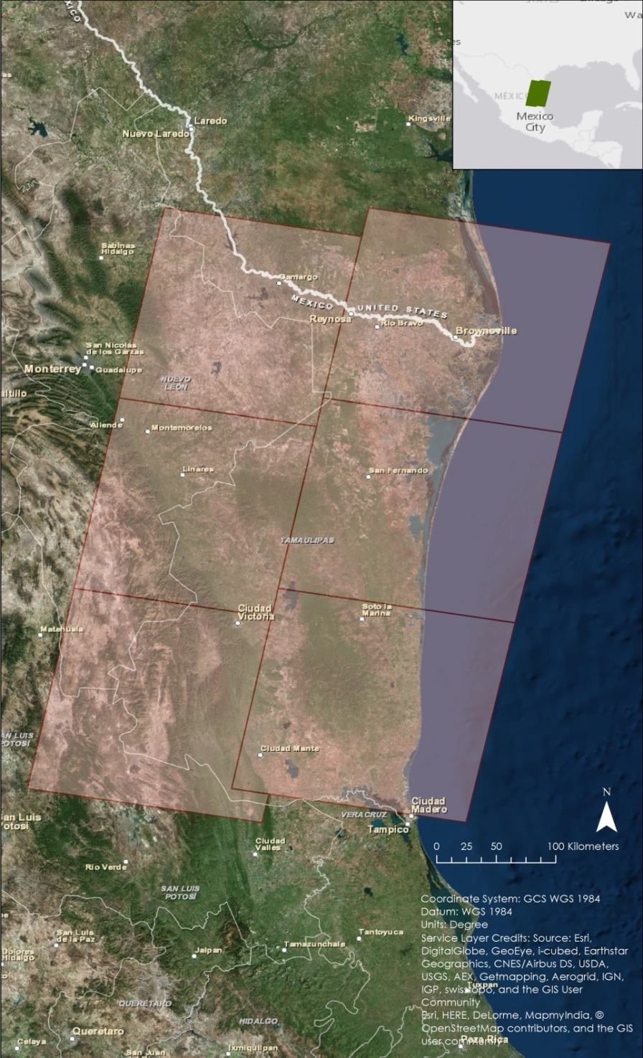
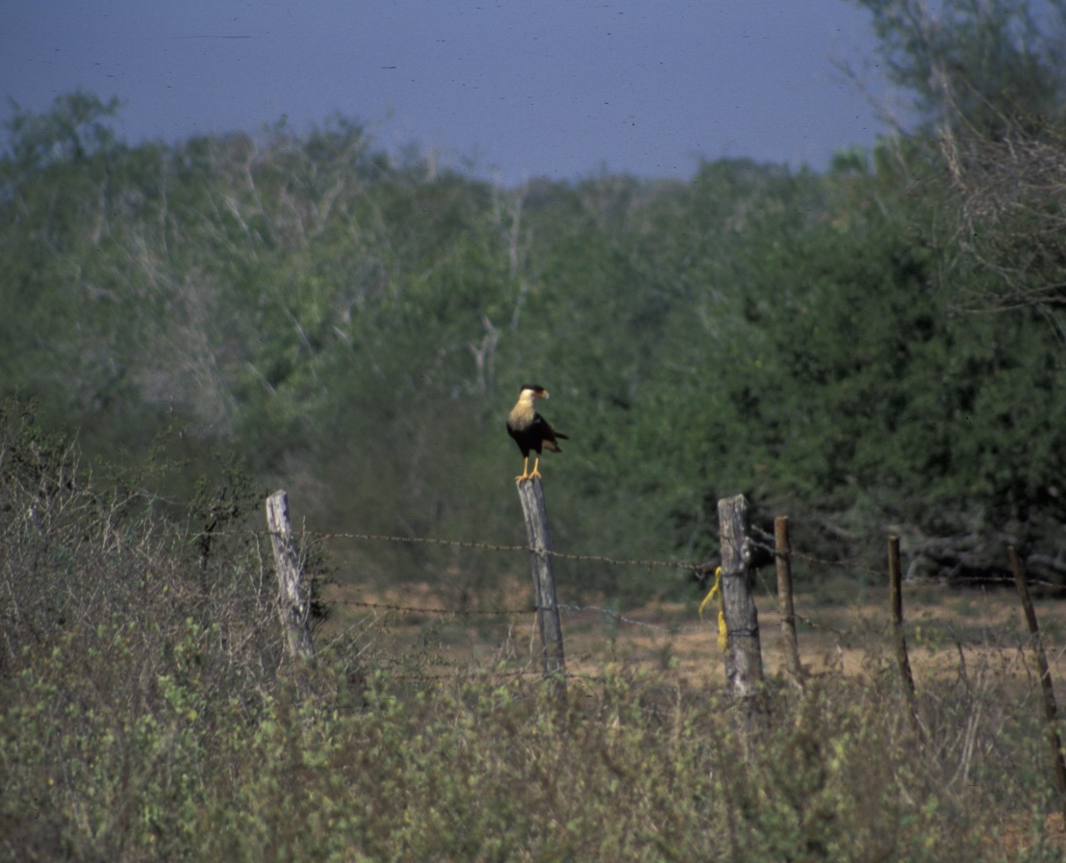
Study Area
Northeast Mexico
Tamaulipas
Nuevo Leon
San Louis Potosi
Image credit: Marcel Holyoak
Image credit: Leigh Sinclair
Notes:
The study area is in northeastern Mexico, path and rows 26/42, 26/43, 26/44, 27/42, 27/43, and 27/44. This area consists of dense woody vegetation, low tropical forest, and ebony-grassland communities.
https://www.flickr.com https://creativecommons.org/licenses/by-nc-nd/2.0/ Image has been cropped.

Slide 5
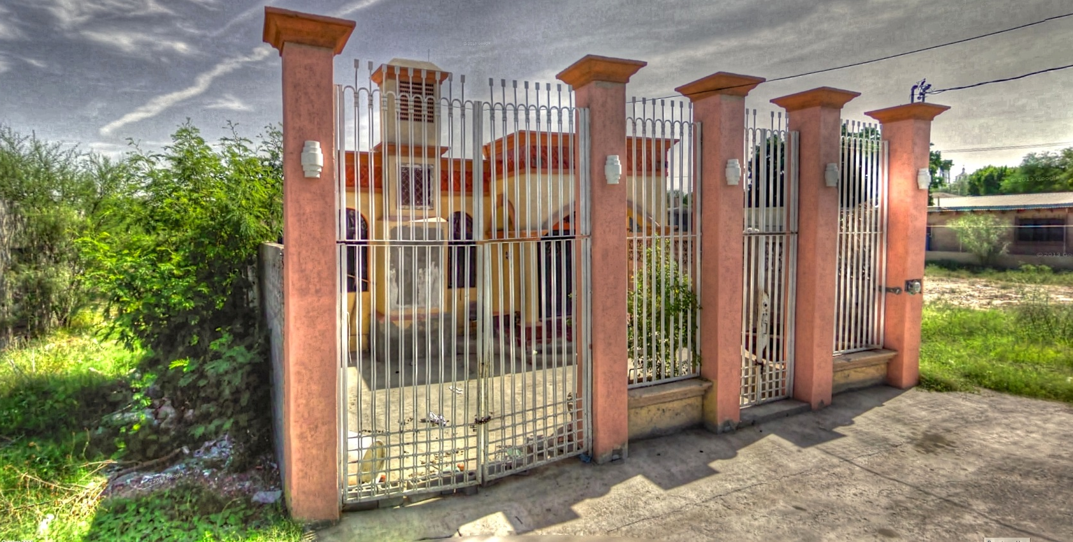
Study Period
1996
2004
2014
Image credit: Kevin Dooley
Notes:
The study period for this project focused on the years 1996, 2004, and 2014. These years were selected to show how urbanization and agricultural areas have grown and/or changed in the past 20 years. Data was downloaded from January to March, the dry season in this area, so that cloud cover would be at a minimum. This way data would show the least amount of vegetation available that would be suitable for an ocelot.
https://www.flickr.com https://creativecommons.org/licenses/by/2.0/ Image was cropped.

Slide 6
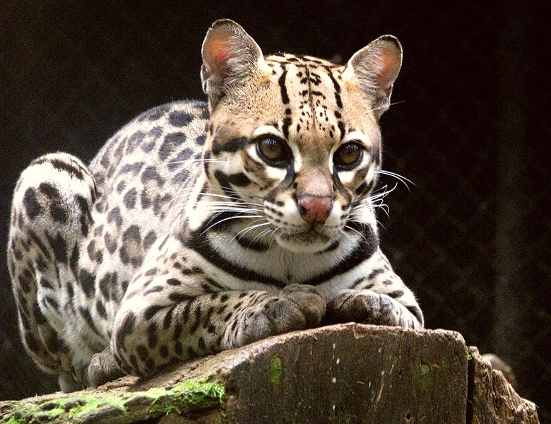
Image credit: Wikipedia Commons – Ana Cotta
Objectives
Create a Percent Cover Map to assess the current extent of the ocelot habitat
Create a Habitat Probability Map to show areas most likely to be inhabited by breeding populations
Create Future Habitat Map predicting future ocelot habitat based on urban growth
Notes:
There were three primary objectives for this project. One, to create a percent cover map to assess current ocelot habitat. Two, create a habitat predictability map to find areas most likely to be inhabited by ocelots. Three, create a future habitat map to predict ocelot habitat growth or loss based on predicted urban growth.
Image from Wikipedia Commons: https://commons.wikimedia.org/wiki/File:Ocelot_(Leopardus_pardalis)-8.jpg

Slide 7
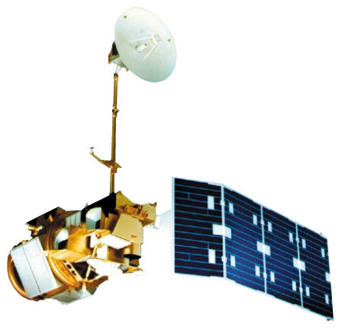
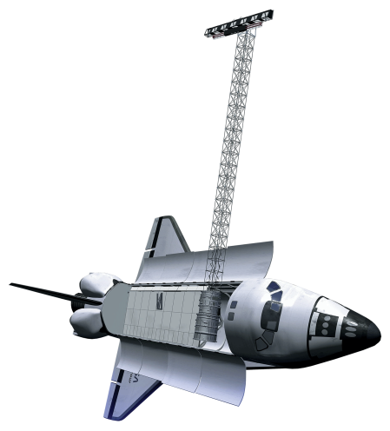
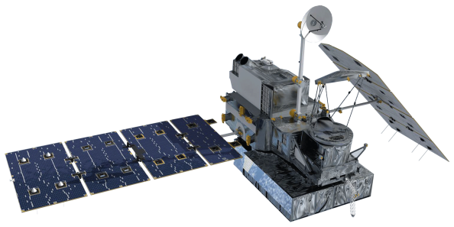
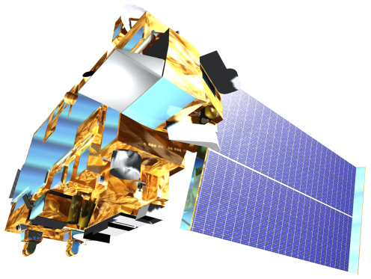
Satellites and Sensors
Landsat 5
SRTM-v2
Suomi NPP
Landsat 8
Terra
Notes:
Landsat 5 Thematic Mapper and Landsat 8 Operational Land Imager Level 1 data were downloaded from the USGS EarthExplorer website to create land cover classification and Normalized Difference Vegetation Index maps. Terra’s MODIS 250 meter resolution data were downloaded from the USGS GloVIS website to compensate for cloud cover in the Landsat data. Digital Elevation Model data were downloaded from the USGS Earth Explorer website using Shuttle Radar Topography Mission Version 2 (SRTM-V2) void-filled 90 meter resolution from February 2011. Finally Suomi NPP VIIRS data were downloaded to determine land cover change and spectral vegetation indices.

Slide 8
Methodology
Fuzzy Memberships
TBD
Fuzzy Overlay
Variables
Distance to Roads
Distance to Streams
Areas of Forest and Scrub Brush
Protected Areas
Distance to Gap
Distance to Urban Areas
Maximum Entropy Model
Habitat Percent
Cover Map
Habitat Probability Map
Road Networks
Variables
Slope
Land Cover Classifications
Protected Areas
Urban Areas
Road Networks
Hillshade
SLEUTH
Model
Future Habitat Map
Notes:
Variables such as distance to roads and streams, areas of forest and scrub brush, and distance to urban areas were fed into the Princeton University Maximum Entropy model, as well as Fuzzy Logic memberships to create a habitat percent cover map. This map was then overlaid with a road network map to generate a habitat probability map. Variables such as slope, land classification, urban and protected areas, and road network were put into the University of California, Santa Barbra’s Slope, Land use map, Excluded area, Urban area, Transportation map, Hillside area Model or SLEUTH model to create a future habitat map.

Slide 9
Results
TBD

Slide 10
Conclusions
TBD

Slide 11
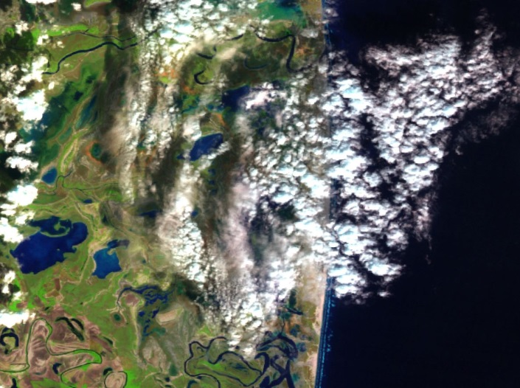
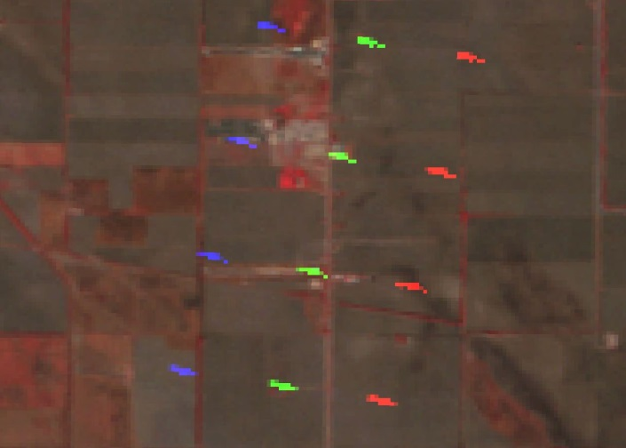
Errors and Uncertainties
Clouds
Repeating dashes of erroneous data
TBD
Notes:
Uncertainties were caused by clouds in the Landsat images. This caused some of the data to be misclassified or no be classified at all. There were also repeating dashes of errouneous data in some of the Landsat imagery, leading to further errors in the land classifications.

Slide 12
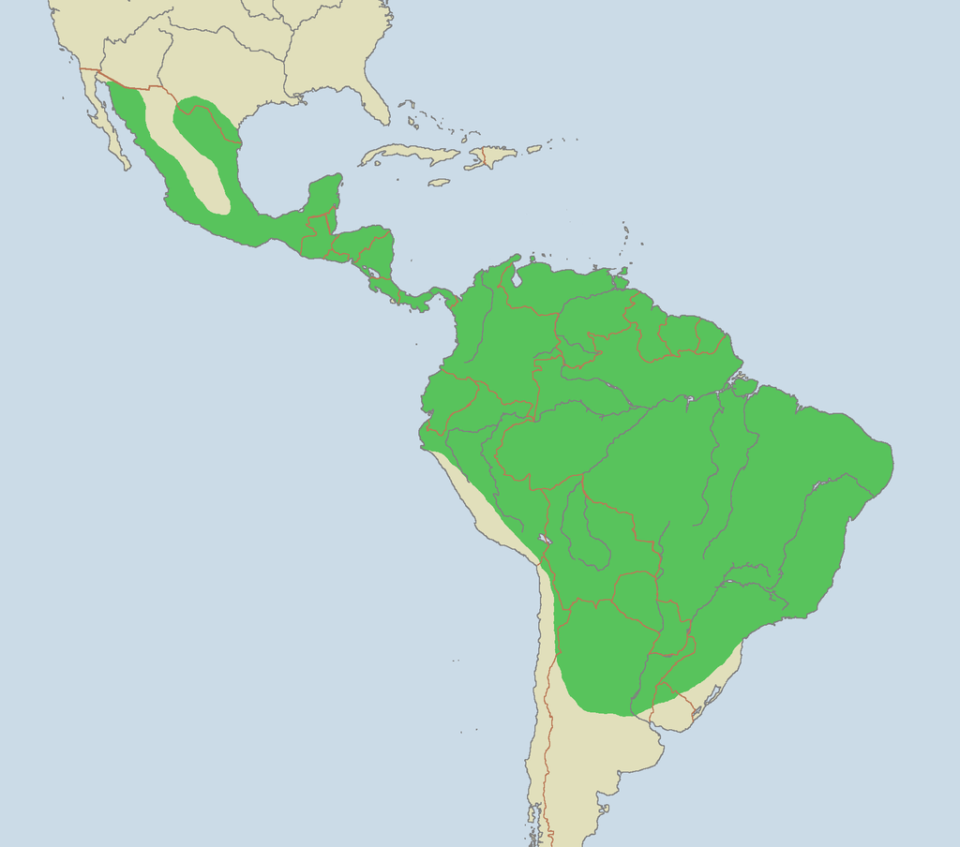
Future Work
Expand study area to Central America
Location of additional ocelot habitat will aid translocation
Habitat restoration efforts
Image credit: Wikipedia Commons – Laurascudder
Notes:
Future work for this project will include using the habitat percent and probability maps to asses ocelot habitat in Central America. This area includes countries such as Belize, Guatemala, El Salvador, Honduras, Nicaragua, Coast Rica, and Panama where the ocelot populations are more prominent.
Image from Wikipedia Commons: https://commons.wikimedia.org/wiki/Leopardus_pardalis#/media/File:Ocelot_range.png

Slide 13
Advisors
Dr. Jeffrey Luvall, NASA at NSSTC
Dr. Robert Griffin, University of Alabama in Huntsville
Partners
Ken Kaemmerer, Pittsburg Zoo & PPG Aquarium
Dr. Josh Gaspard, Pittsburg Zoo & PPG Aquarium
Michael Tewes, Caesar Kleberg Wildlife Research Institute at Texas A&M University-Kingsville
Dr. Humberto Perotto, Caesar Kleberg Wildlife Research Institute at Texas A&M University-Kingsville
Nanette Bragin, The Denver Zoo
Mitch Sternberg, South Texas Refuge Complex
Dr. John Young Jr, Texas Department of Transportation
Dr. Arturo Caso, SEMARNAT
Dr. Arturo Flores-Martinez, SEMARNAT
Dr. Tyler Campbell, East Wildlife Foundation
Others
Daryl Ann Winstead, NASA DEVELOP
Christina Fischer, NASA DEVELOP
Amberle Keith, DEVELOP Alumni
Kaushik Narasimhan, DEVELOP Alumni
Timothy Klug, University of Alabama in Huntsville GRA

Slide 14
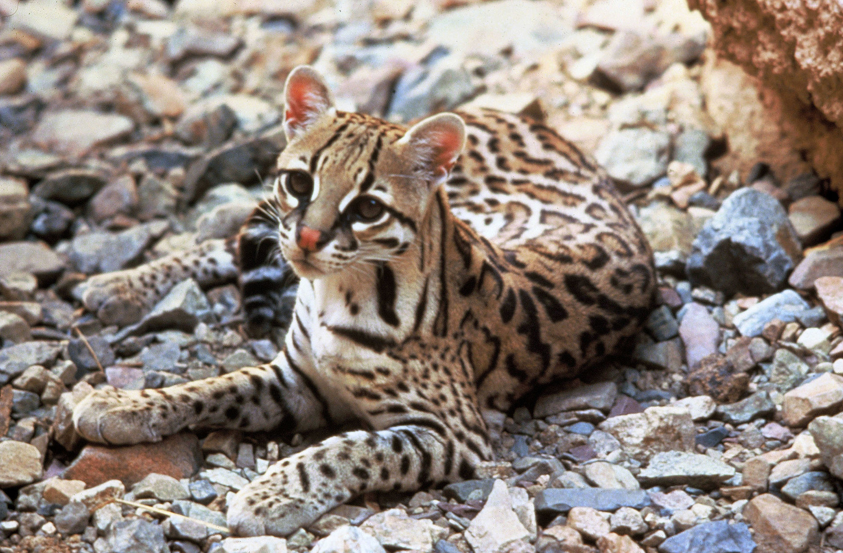
Questions?
Image credit: Wikipedia Commons –Tom Smylie
Notes:
Are there any questions at this time?
Image from Wikipedia Commons: https://commons.wikimedia.org/wiki/Leopardus_pardalis#/media/File:Ocelot.jpg

