Slide 1
DEVELOP National Program
Center Lead Overview
2016 Summer

Slide 2
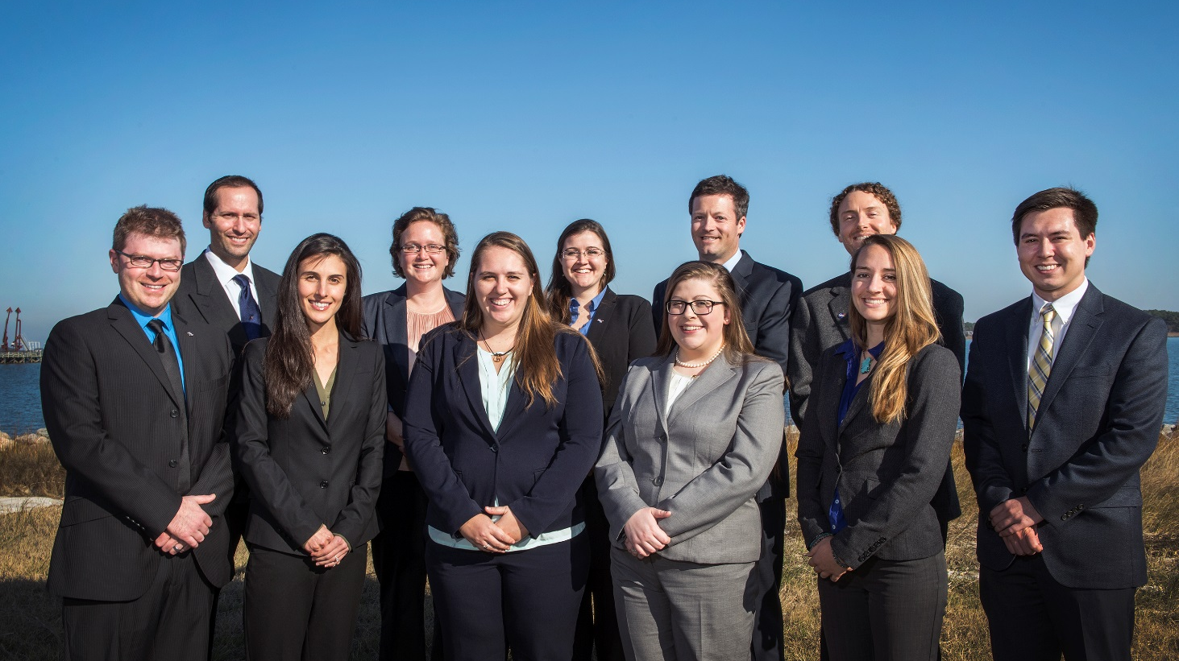
What is a Center Lead?
An integral piece of the leadership team in the DEVELOP model.
People who assume this role are responsible for managing the majority of the day-to-day operations at their individual nodes, providing guidance and direction to their teams, and supporting strategic planning for their node and the program as a whole.

Slide 3
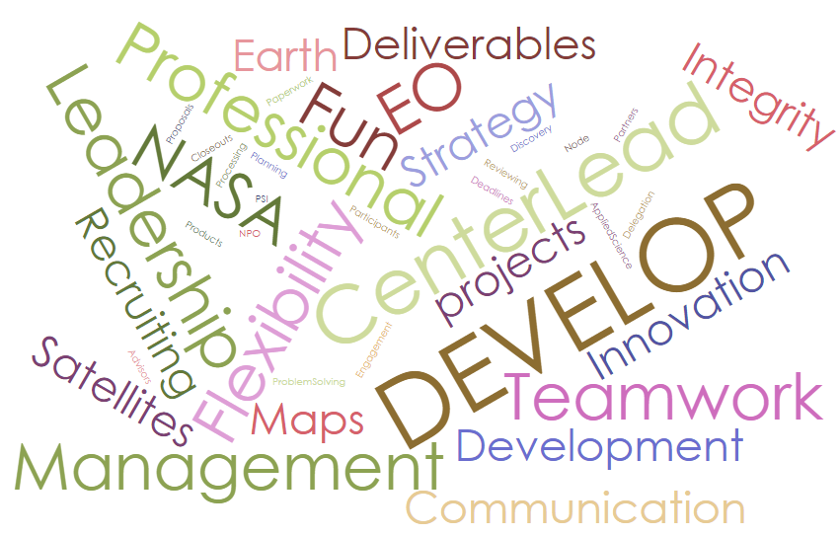
General Responsibilities
Office Management
Communicating with NPO, Participants, Advisors & Partners
Recruiting
Participant Review & Selection
Project Management
Team Building
Personal & Professional Development activities
Formulating & Writing Project Proposals
Budget Planning
Presentations
Closeout Event Planning
Conference Preparation & Attendance
Deliverable Submission
Ensuring Scientific Integrity
Submitting PSI Scores
Processing Paperwork
Problem-solving
Strategic Planning
Reporting to NPO (Telecons, Quadcharts & Annual Report)
Lead Publications for Node
Coordinating Resources (Office Space, Computers, Software)
Giving Orientations
Ensure Projects are Appropriately Submitted to Export Control & Software Release (when required)
And anything else that contributes to the success of the node and DEVELOP!

Slide 4
Opportunities
Benefits of serving as a Center Lead:
Project Management: Project idea generation, proposal writing, technical editing, deliverable creation and review, dissemination of results.
Leadership: Opportunities for early career leadership, working with diverse teams.
Communication: Writing skills, presentations, telecon communication, meeting organization, working with diverse groups.
Increased Personal & Professional Awareness: Personality tests & assessments, and critical feedback and skill strengthening.
Shaping the Future of Your Node: Leading innovative projects and activities, and strategic planning for the node.
Other opportunities:
Networking: Meet & Greets with NASA and partner organizations’ leadership, representing DEVELOP at meetings, workshops and conferences (as funds and opportunities arise).
Shaping the Future of DEVELOP: Participation in leadership and strategic planning retreats, national discussions, etc.

Slide 5
Annual Timeline
JAN
FEB
MAR
APR
MAY
JUN
JUL
AUG
SEP
OCT
NOV
DEC
Performance Reviews, Spring Term Begins, Fall Partner Surveys
Summer Term Begins, Alumni Survey
FY Budget Planning, Summer Participant Selections
CL Selections (some nodes)
Spring Term ends, Fall Proposals, Spring Partner Surveys
PSI, Spring Annual Report, Performance Reviews
Fellow Class Selections, CL Selections (some nodes), Fall Participant Selections
Summer Showcase at HQ, Summer Term Ends, PSI, Summer Annual Report, Summer Partner Surveys
Fall Term Begins, Spring Proposals, Performance Reviews
New Fiscal Year Begins, CL Selections (some nodes)
Fall Term Ends, Fall Annual Report, PSI, Summer proposals, Spring Participant Selections
Retreat, State of the Node, AGU Fall Meeting

Slide 6
Eligibility
Required:
US Citizenship
Minimum 3.0 GPA (at current/most recent academic institution)
At least one term with DEVELOP (current term counts)
Ability to spend 20-40 hrs/week in the position
Proficient knowledge and understanding of DEVELOP
Desired:
Ability to travel on behalf of DEVELOP
More than one term with DEVELOP when possible
Strong leadership and communication skills
Ability to generate project ideas and start/maintain partnerships

Slide 7
Logistics & Considerations
The Center Lead term length is one year (ex. Start of Fall 2016 to end of Sum 2017 Interim)
Candidates are limited to 2 terms as Center Lead (two years total; does not matter if there is a gap)
The position is re-competed annually with the application window during the term before contract starts
There are three CL application periods per year - during the spring, summer, and fall terms; not all nodes are competed during each application period
Pay rate is $2/hr increase above the base pay scale (based on participant classification and degree held/in progress) and begins at the start of the official CL term
Students can be Center Leads as long as they can spend a minimum of 20 hrs/wk in the office working with the teams and complete deliverables on time
Performance reviews will provide key feedback opportunities and are conducted during interims
If a CL leaves DEVELOP before their year term is completed, there are two courses of action:
The position will be competed during the next CL application period (if timing allows), or
An acting CL will be selected and serve until the next application period allows for the competed selection of a CL (acting CLs do not receive the pay rate increase)

Slide 8
Competition
Nodes accepting applications in summer 2016: ARC, AZ, FC, GSFC, ID, JPL, LaRC, MCHD
Timeline
Application deadline: June 24th
Application review & interviews: June 24th – July 22nd
Selections: August 1st
Position Acceptance: August 5th
Publicly Announced: August 10th (at NASA HQ)
Submit applications to: Lauren.M.Childs@nasa.gov and Karen.N.Allsbrook@nasa.gov

Slide 9
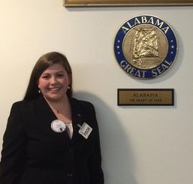
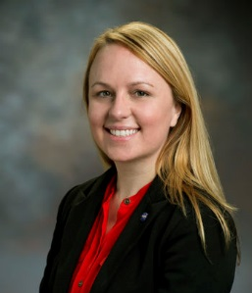
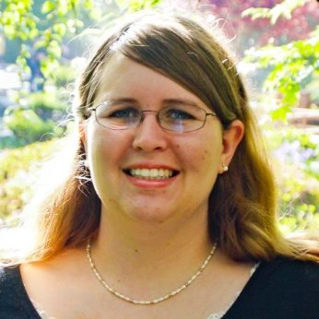
??? Questions ???
Caren Remillard
UGA Center Lead
Fall 2013 – Present
Leigh Sinclair
MSFC Center Lead
Fall 2014 – Present
Michael Brooke
Wise Center Lead
Spring 2016 – Present
Lauren Childs-Gleason
SSC Center Lead
Fall 2006 – Spring 2009
Georgina Crepps
MCHD Center Lead
Fall 2014 – Summer 2015

