Slide 1
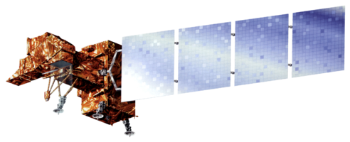
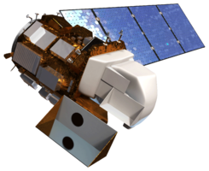
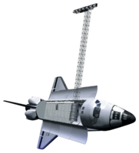
Alto Orinoco Health & Air Quality
Utilizing NASA Earth Observations to Locate Remote Yanomami Villages in the Alto Orinoco Municipality for Targeted Eradication of River Blindness Disease
Goddard Space Flight Center: Amanda Rumsey (Project Lead), Timothy Larson, Kyle Sowder
Wise County and City of Norton Clerk of Court’s Office: Rajkishan Rajappan (Project Lead), Annabel White, Zachary Tate
Marshall Space Flight Center: Sara Amirazodi
NASA DEVELOP National Program
Abstract
Objectives
Provide The Carter Center with accurate locations of targeted villages for efficient planning of missions for eradication of Onchocerciasis.
Develop a suitability model to assist The Carter Center in identification of Yanomami settlements.
Investigate the migratory patterns of the Yanomami.
Study the vegetation and soil properties of the study area.
Study Area
Methodology
Pixel-by-Pixel Composting Technique
Data Processing All data processed with Spatial Analyst toolbox in ArcGIS.
Image coming soon
Elevation
Processing Flow
Landsat 8 Scenes
Composite Images
Final Cloud-free Composite Image
Input Data
Cloud Pixel Classification
Cloud Pixel Replacement
Slope
Classification and Analysis
NDVI
K-means Classified Image
Locating Yanomami Villages using Worldview-3 Imagery
dNBR
Layer
Stacking
Identifying Soil Classes
Distance to Streams
Earth Observations
Results
Fuzzy Membership
Landsat 7 ETM+ Landsat 8 OLI/TIRS SRTM
Village Location Shapefile
Population Estimate
Regression
Analysis
Suitability Model
Results
Conclusions
Team Members
Project Partners
Acknowledgements
Use a professional-looking photo.
Individual headshots are ok, if they aren’t pixelated and are all the same size.
Include a caption that states the team members’ names.
Should we do separate headshots or three different node group photos?
The Carter Center
Kel Markert (Mentor & Science Advisor)
Dan Irwin (SERVIR Collaborator)
Leigh Sinclair (Center Lead, Marshall Space Flight Center)
Amberle Keith (Assistant Center Lead, Marshall Space Flight Center)
Dr. Kenton Ross (NASA DEVELOP)
Dr. John D. Bolten (NASA Goddard Space Flight Center)
Dr. Jeff Luvall (NASA at National Space Science and Technology Center)
Dr. Robert Griffin (University of Alabama in Huntsville)
Dr. Jim Tucker (NASA Goddard Space Flight Center)
Katie Melocik (NASA Goddard Space Flight Center)
Dr. Thomas Unnasch (University of South Florida)
Melanie Salyer (Mentor, Wise County)
Jordan Bates (Center Lead, Wise County)
Kiersten Newtoff (Center Lead, NASA Goddard Space Flight Center)

