Slide 1
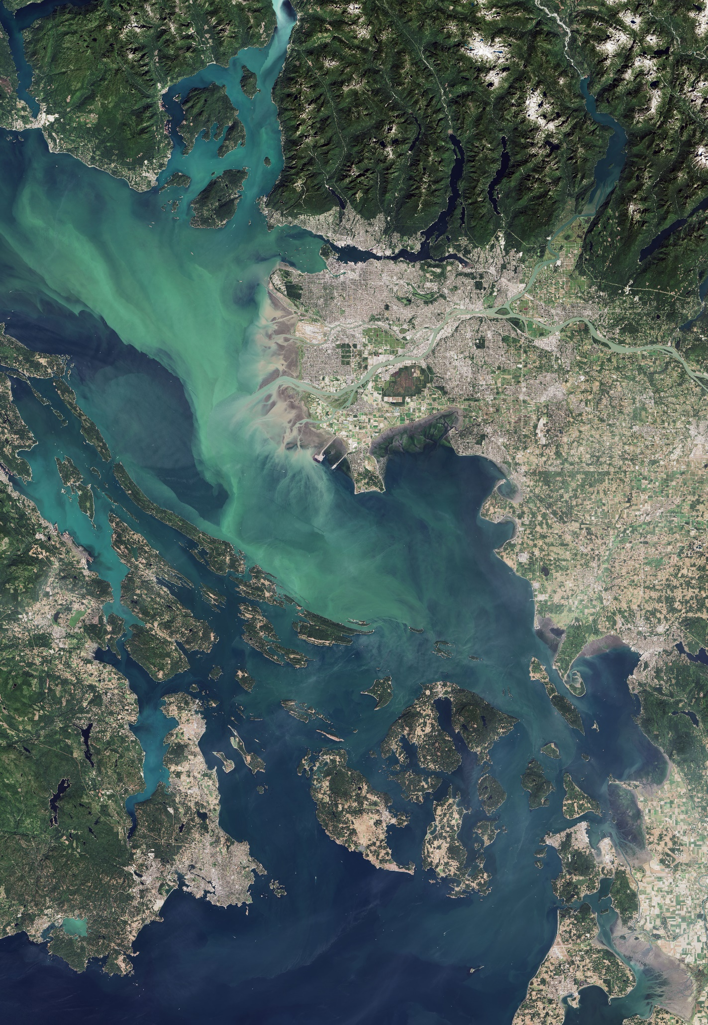
DEVELOP National Orientation (2021)
Module 7. Opportunities

Slide 2
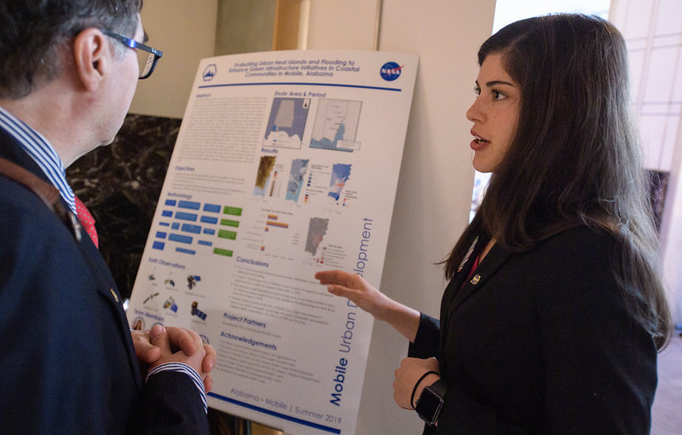
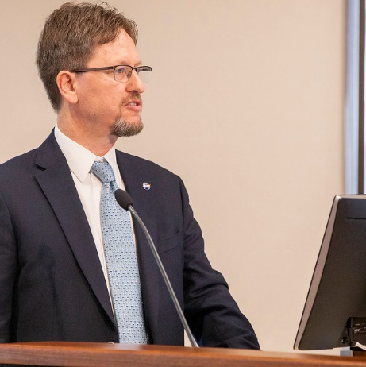
Publications
& Presentations

Slide 3
OPPORTUNITIES
Presenting & Publishing Your Work
For the purposes of ensuring appropriate export control review, performance metric tracking, and reporting to NASA HQ, any and all presentations or publications related to DEVELOP (projects or the program in general) must be communicated to, and content shared with, NPO before submission of the presentation or publication.
Submitting work for presentation or publication is encouraged; however, ALL research is shared property of NASA; therefore, you must have permission prior to submitting your research anywhere.
Coordinate with your Fellow, and, if approved at your node, send a simple email with your ideas before the presentation or publication to Amanda.L.Clayton@nasa.gov and Karen.N.Allsbrook@nasa.gov with the following information:
  Description of the activity – conference, presentation to a class, publication, etc.
  Timeline for the activity – when the event is or deadline for publication, etc.
  Cost estimate (if applicable)

Slide 4
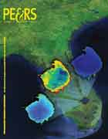
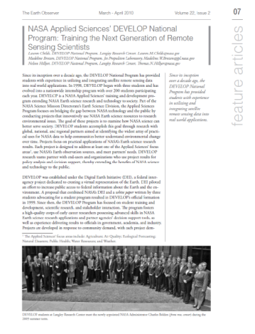
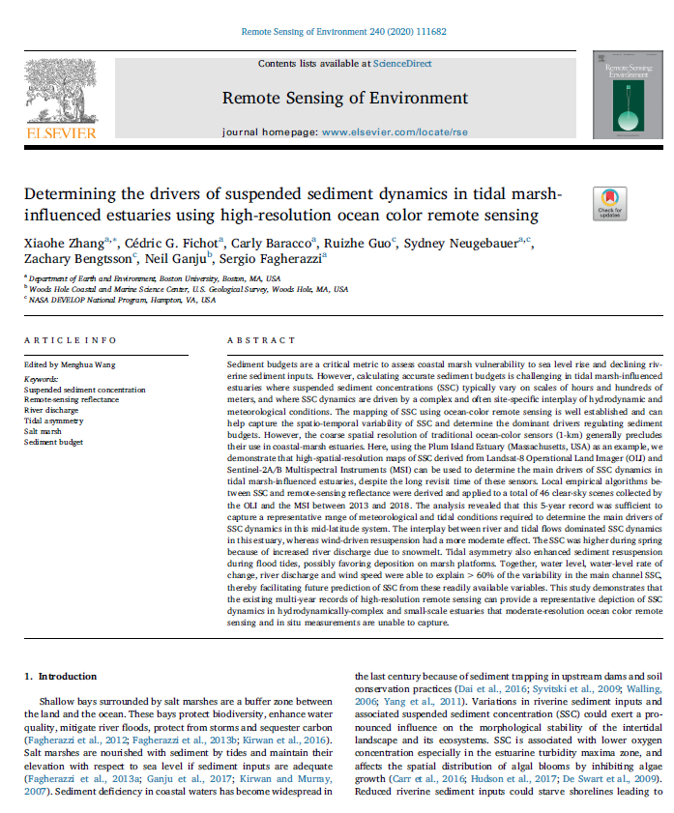
OPPORTUNITIES
By The Way
DEVELOP publishes in both peer-reviewed venues and in “gray literature” venues! You can see all of the publications on the DEVELOP website’s Media Page.
Publications
Publications are a great avenue for getting the word out about the great research you are a part of with DEVELOP!
DEVELOP is working on increasing the number of its peer-reviewed publications and has seen 3-5 each per year the past couple years.
Publications can be pursued by motivated DEVELOPers, however, they are not a metric of project success!
If you are interested in working your project toward a potential publication, contact your Lead and Amanda.
Reminder: All publications must be approved by NPO and NASA’s Export Control process before submission! This means before you ever send a draft to the publisher!

Slide 5
OPPORTUNITIES
By The Way
If the decision to publish occurs before the technical paper FD is submitted, you can ask the PC Team about using the journal’s style for your tech paper.
If the decision to publish occurs after the term, the person leading the effort must ensure that all team members are aware, involved to the extent they want to be, and listed as co-authors.
Publication Process
Discuss with your Fellow and Science Advisor
Select publication venue
Contact Amanda
Draft the manuscript
Submit draft to NPO for review
NPO and project team go back-and-forth with edits to create a final version
NPO submits this pre-print version into export control – NASA Export Control takes about 1-4 weeks
Once approved, the content can be submitted to publication venue
Keep Amanda in the loop with any and all edits from the publisher
The final-final version must be resubmitted to NASA Export control

Slide 6
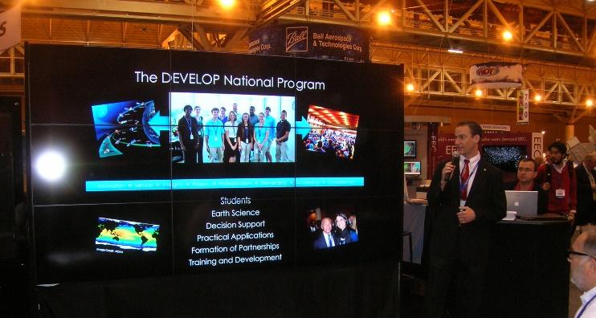
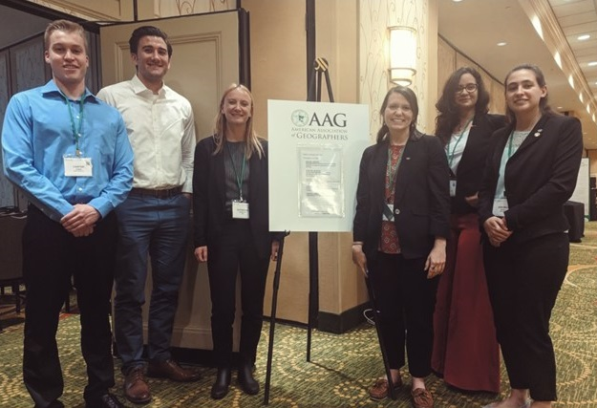
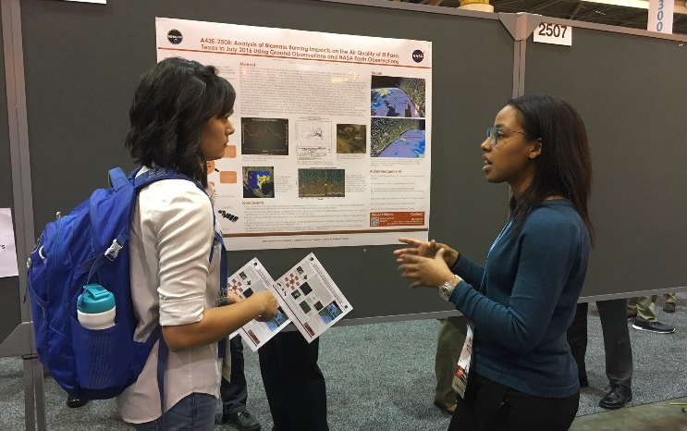
OPPORTUNITIES
Conferences
DEVELOP presents projects at over 30 conferences each year.
If you have an idea for a conference you’d like to attend (virtual or in-person), discuss with your Fellow and together reach out to NPO.
There is a small travel pot provided to each node to support some travel, however those funds may already be accounted for at any specific time.
Ways to attend cost-effectively:
  Choose a conference that is virtual or local (once travel resumes).
  Present DEVELOP work at a conference you already are planning to attend either for school or personally.
  Pursue school-funding opportunities.
  Apply for travel grants offered by professional societies.
  Look for opportunities to volunteer in exchange for registration or travel costs.
  Look for competitions like the AGU Data Visualization & Storytelling Contest.
By The Way
Many virtual conferences are free to attend – take advantage of this! Look at opportunities like: AmeriGEO Week, Society for Conservation GIS, Esri User Conference (plenary is free), etc.

Slide 7
OPPORTUNITIES
Professional DEVELOPment Week
Networking and professional development are two critical aspects of DEVELOP which can be harder to focus on while working in a virtual environment. So, we came up with dedicating a week of the term to providing you these resources!
Occurs during Week 4 and features skill-building activities, guest speakers, and other professional development opportunities.
  Guest speakers - Dr. Nancy Searby
  Node buddy events (resume roundtable)
  Skill-building workshops (grad school tips & tricks, cartography tips & tricks)
  Career panel
By The Way
Be on the lookout for more information! A flyer and agenda will be sent out at the start of the term.
All of these events are optional and your project work should take priority.

Slide 8
RESOURCES
Dr. Ross Office Hours & Science Corner Discussions
Dr. Ross Office Hours
Continuing from the summer, a weekly block of time is set aside for participants (and Fellows) to drop in and ask questions to Dr. Ross. This is open to any projects, not just those that he is directly advising. Lauren creates the calendar invites and shares with Fellows. Please share with your teams as a resource. There is a sign-up sheet linked in the invite for people to sign up for 15-minute increments (you can sign up for more than one!). Fall office hours are Wednesday 1-3p ET.
Science Corner Discussion
Beginning this fall, Dr. Ross, Lauren, and Amanda are starting the Science Corner Discussions. This is a weekly meeting to discuss remote sensing and other topics related to the field, as well as pose questions to the group. Discussion for each week will focus on topics introduced in a specific video (linked in the invite). This is a great opportunity for folks to learn more about remote sensing and network within the program. Discussions will take place Wednesdays at 5p ET.

Slide 9
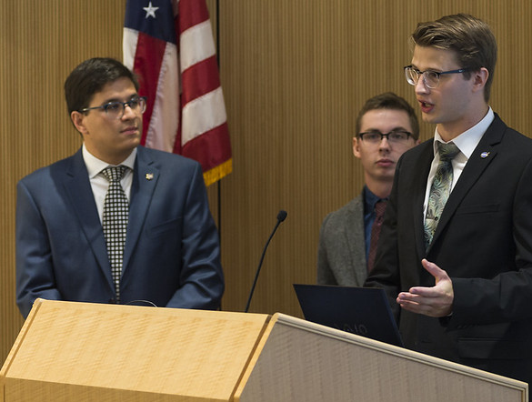
Enhanced Capacity Building Opportunities

Slide 10
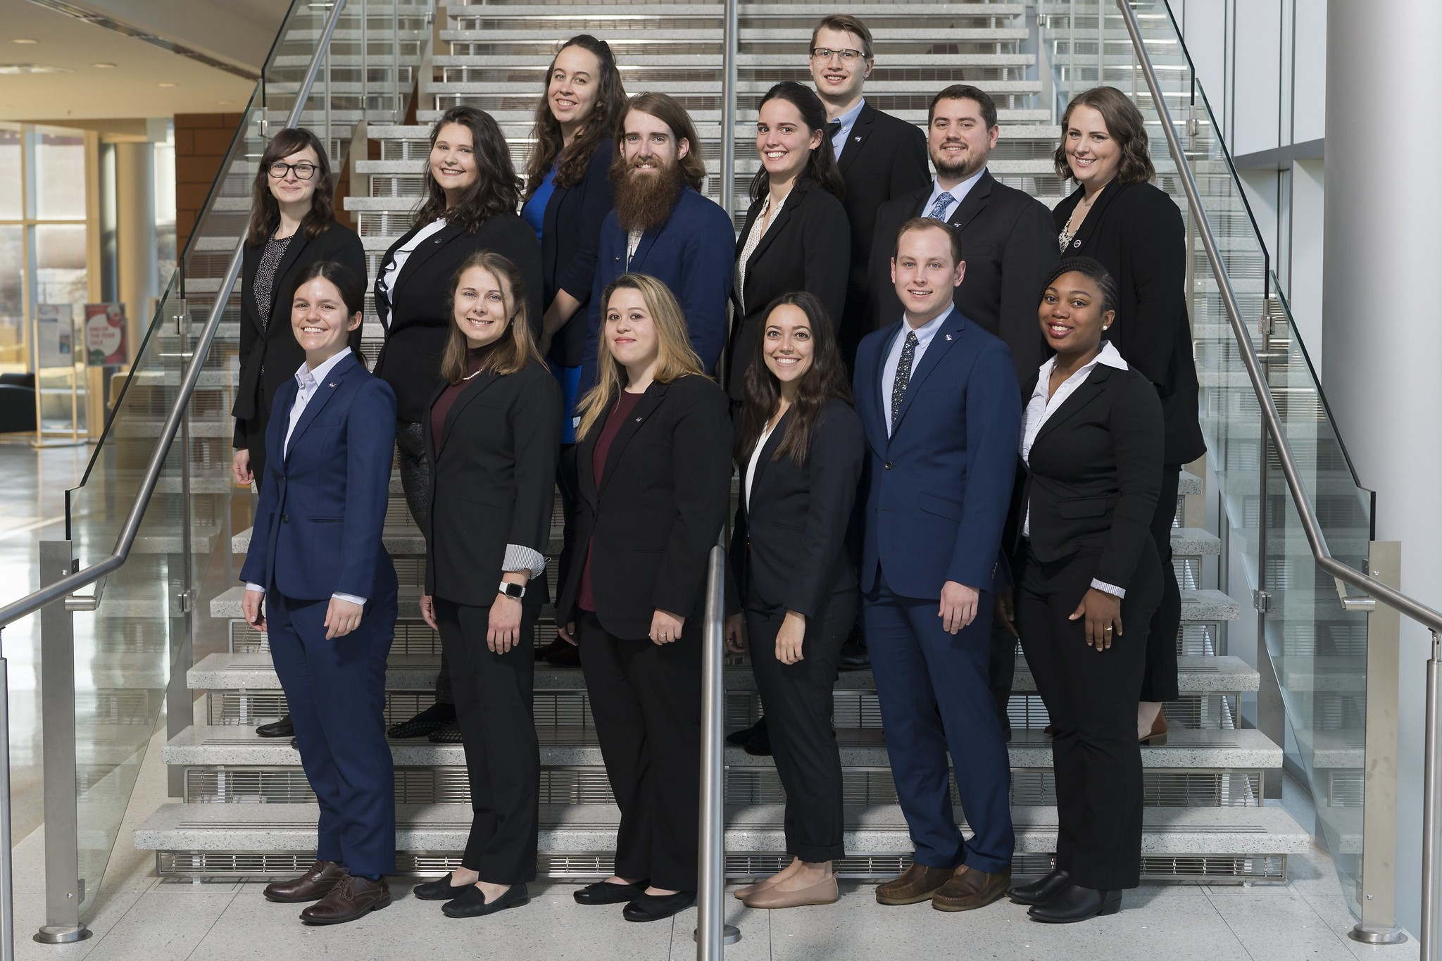
OPPORTUNITIES
DEVELOP Fellows
What is a DEVELOP Fellow? The DEVELOP Fellow is an integral piece of the leadership team in the DEVELOP model. The people who assume this role are responsible for managing the majority of the day-to-day operations at their individual nodes, providing guidance and direction to their teams, supporting strategic planning for their node, and providing program-level NPO support.
Eligibility Requirements:
  US Citizenship is required for all Fellow positions
  College degree with minimum 3.0 GPA
  One+ terms with DEVELOP
  Open to Recent Graduate and Early/Transitioning Career Professional applicants
  Ability to begin the position in early January
  Ability to work 40 hours/week during typical business hours
  Proficient knowledge and understanding of DEVELOP
  Strong leadership and communication skills
By The Way
Three nodes are competing a Lead/Fellow position this fall and with a start date in early January. There will also be additional opportunities for element fellows and to lead virtual projects. More information and the application will be on DEVELOPedia by week 3!

Slide 11
OPPORTUNITIES
DEVELOP Senior Fellows
What is a DEVELOP Senior Fellow? The DEVELOP Senior Fellow is a highly-experienced DEVELOPer who previously served in an elevated role (Senior Fellow, Fellow, Center Lead or Assistant Center Lead) or has been with the program for multiple terms (see eligibility below) and has been selected to continue their personal and professional development with the program. Senior Fellows have elevated responsibilities focused on support to the NPO & Applied Sciences Program, leading the Fellows, and contributing to the program as a whole.
Eligibility Requirements:
Must have participated in the program:
  As a Senior Fellow, Lead/Fellow, or Assistant Lead
  Served 3 or more terms with the program at one location and can provide a letter of recommendation from a DEVELOP Advisor or Lead/Fellow
  Served 2 or more terms with the program at different locations and can provide a letter of recommendation from a DEVELOP Advisor or Lead/Fellow
U.S. Citizenship is required all Senior Fellow positions
College degree with minimum 3.0 GPA
Ability to begin the position in early September
Ability to work 40 hours/week during typical business hours
Proficient knowledge and understanding of DEVELOP
Strong leadership and communication skills
By The Way
Four Senior Fellow positions will be competed this summer. The application opens in June. More information is available on DEVELOPedia.

Slide 12
Program Elements
Each Lead/Fellow, Senior Fellow, and Assistant Fellow is part of at least one of these teams
Communications
Geoinformatics
Impact Analysis
Project Coordination
Social Media
Project & Promotional Videos
Recruitment
Ambassador corps
Newsletter
Alumni Engagement
Graphic Design
GIS & Remote Sensing
Programming & Coding
Software Release
Collection and Management of Internal Code
Maintenance of the DESC
Project, Partner, & Participant Tracking
Project Strength Index
Partner Reports & Highlights
Personal Growth Assessments & Exit Survey
Indicator Tracking
Deliverable Coordination & Review
Proposal Review
DEVELOPedia Maintenance
Project Tracking
Deliverable Templates
Publications

Slide 13
Quiz Time!
What’s the first step if you want to publish?
What should you do if you want to attend a conference?
Does any content that would be published or presented need to gain export control approval prior to submission/presentation?
Are Fellow positions full-time employees working 40 hrs/wk?
Where can you find more information about which nodes are accepting Fellow or Senior Fellow applicants for any given term?

Slide 14

Thank You.
Your DEVELOP experience is what you make it.
What opportunities are right for you?

