Slide 1
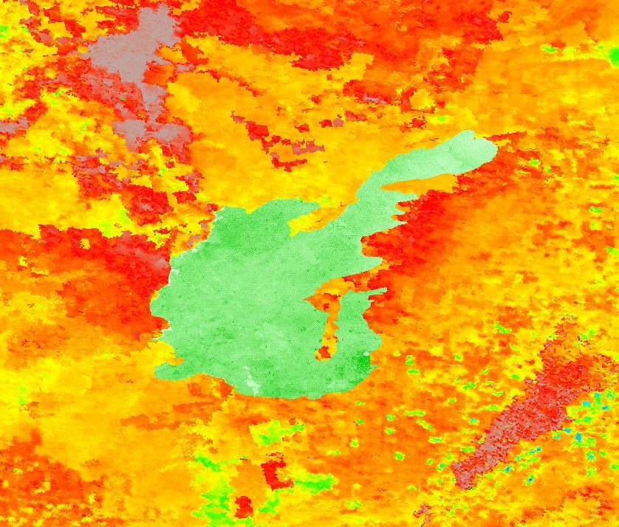


SOUTHERN IDAHO DISASTERS
Enhancing Pre- and Post-Wildfire Vegetation Type Characterization Using NASA Earth Observations
Austin Counts
Cassidy Quistorff
Nicholas Olsen
Caitlin Toner
Courtney Ohr
BLM at Idaho State University GIS TReC
2017 Summer

Slide 2
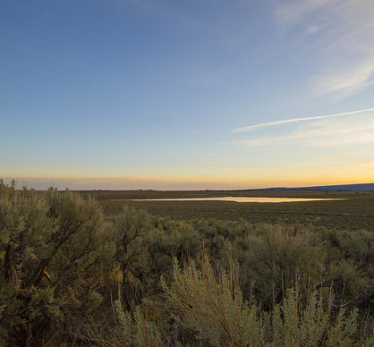
Background
Sagebrush steppe ecosystem
Economic and recreational benefits
Increasing wildfire frequency
Image Credit: BLM
Image Credit: Dawn Ellner
Notes:
The Big Desert landscape termed, flagship of the West, offers important economic and recreational opportunities. These rangelands provide grazing ground for cattle, aiding in the ranching economy of the West. Although vast and resilient, this ecosystem is becoming increasingly fragile due to invasive species and changing wildfire regimes. The Big Desert, where the 2006 Crystal Fire occurred, is common hunting land which brings in recreational value as well as economical.
Cheatgrass (Bromus tectorum) has taken over much of the once-sagebrush dominated landscape. As an invasive, non-native annual, Cheatgrass has disturbed sagebrush communities by outcompeting native vegetation. In addition, cheatgrass easily burns and still has the ability to recover more quickly than native species, promoting more frequent wildfires. This, along with cheatgrass replacing critical food and habitat sources, is a calamitous threat to the sagebrush-steppe of the Big Desert.
Suggested Readings
Balch, J. K., Bradley, B. A., D’Antonio, C. M., & Gómez-Dans, J. (2013). Introduced annual grass increases regional fire activity across the arid western USA (1980-2009). Global Change Biology, 19(1), 173–183.
Coates, P. S., Ricca, M., Prochazka, B., Dohery, K., Brooks, M. L., & Casazza, M. L. (2015). Long-term effects of wildfire on greater sage-grouse -Integrating population and ecosystem concepts for management in the Great Basin: U.S. Geological Survey Open-File Report.
Image URL: https://www.flickr.com/photos/blmoregon/27052674041/in/photolist-Hdy2uv-KNLbqs-HgDLqh-K9Nz4L-J3in9B-JU3Gz5-KqqpKQ-yL71W-oCmGUn-5NgfUs-pt3AGm-pdzwhR-Vzsnxs-ozjuKu-qTSvTb-6iNJqq-UuChxX-UuCq8B-V8UVs1-VWVhVp-fP2znW-UryqmE-V8UVcm-VJ8GCZ-fNKE7z-7mgjSo-fP3dnY-UuCrkg-7aUSfN-rDXYj4-UuBYWe-fNMAU2-opUS7Y-UncJB2-UfZGdA-UXm42W-ozB9Mg-fNXquy-exWTgQ-o6ehyq-VJ8Gn8-9U8GZa-fKHepm-V8UVHb-UuCiTn-VJ8CJX-Vzsnz1-fJZWcW-X4us8y-VEyhrh

Slide 3
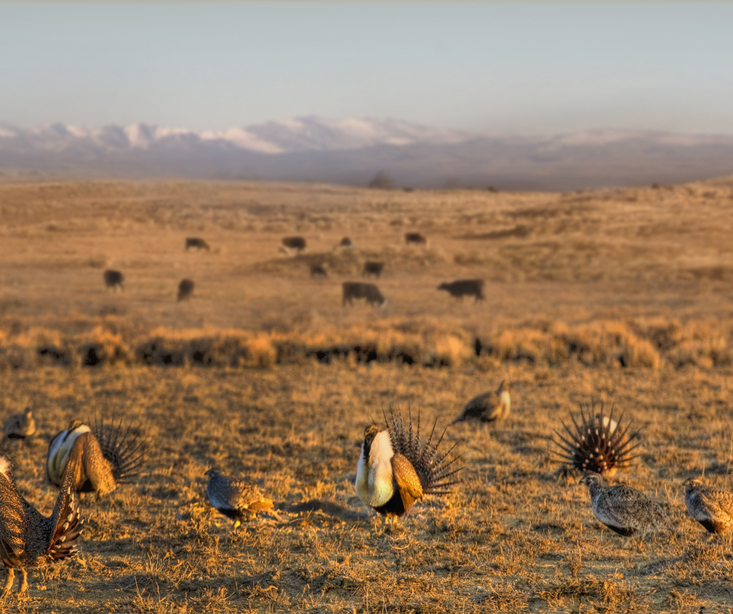
Community Concerns
Hindering sagebrush recovery
Land manager resource use
Unknown Variables of recovery
Image Credit: U.S. Department of Agriculture
Notes:
These habitats are crucial for the conservation of the native wildlife, including the Greater Sage-grouse, a species found nowhere else in the world.
When adding together the costs of wildfires- fighting the fire itself, the labor and equipment involved, recovery efforts afterwards such as reseedings, suppression efforts towards invasive species, and then the cost of surveying and monitoring the land to see if it actually is recovering- the costs can easily exceed millions of dollars.
Most recovery efforts are restricted to three year monitoring efforts due to funding, therefore long-term recovery of sagebrush steppe ecosystems still needs further study.
Despite this variables that are most important to wildfire recovery remain unknown
Image Url: https://www.flickr.com/photos/usdagov/14012304248/in/photolist-nmdHSy-bNU1eg-bNTtFT-bzZrbJ-bNUb3r-bzZq6A-bzZ3Um-bNTPCt-bNTFep-bNU2nt-TCx358-SK1dR5-q1AZxk-X8C3WU-bzYTCU-bzYMU5-bzZsny-bMaV5H-bzYY7A-bzZa1q-bzZ1pb-bNTVG2-bzZkLJ-bzZeLq-bNUc9p-bMaWv2-bNTCR6-bNTUrx-6CH1iL-bNTuM6-bNTydr-bzYVP7-UEyNtK-TCx6gP-cpBX5E-V8UVHb-UuCiTn-WsdHiW-SK1hHd-WSHoCd-UncJB2-ktpkTR-UmGWdN-efi9g3-VJ8GCZ-p7mvaR-UpLmXH-UryiYQ-WFHrN6-rcE2Qp

Slide 4


Partners
Bureau of Land Management
  Karen Kraus, Pocatello Field Office
USDA Agricultural Research Service, Northwest Watershed Research Center
  Dr. Patrick E. Clark
Idaho Department of Fish and Game
  Scott Bergen Pocatello Office
  Ryan Walker, Upper Snake Region
NASA RECOVER Science Team
  Keith Weber
Notes:
We have several project partners for this project. Some of our partners, such as the Bureau of Land Management, work on native plants returning to habitat and minimizing the regrowth of invasive species such as cheatgrass. Other partners, such as Idaho Department of Fish and Game, are looking for when ungulates, such as cattle and mule deer, can sustainably return to a burn site. The team is very excited to work with our partners and use NASA Earth observations to help them with their organization’s goals.

Slide 5
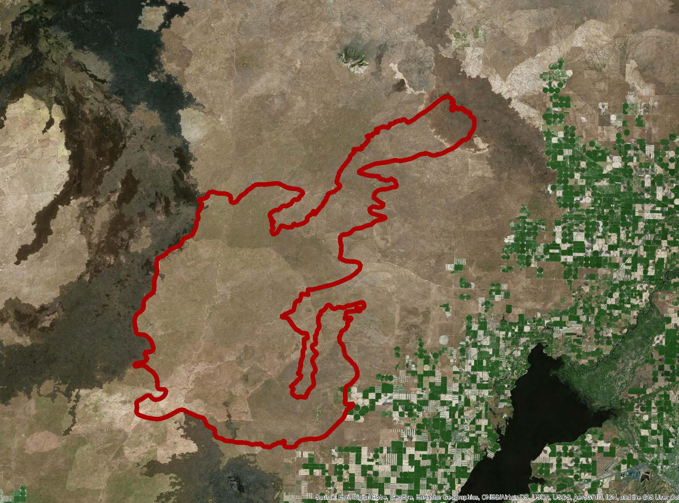
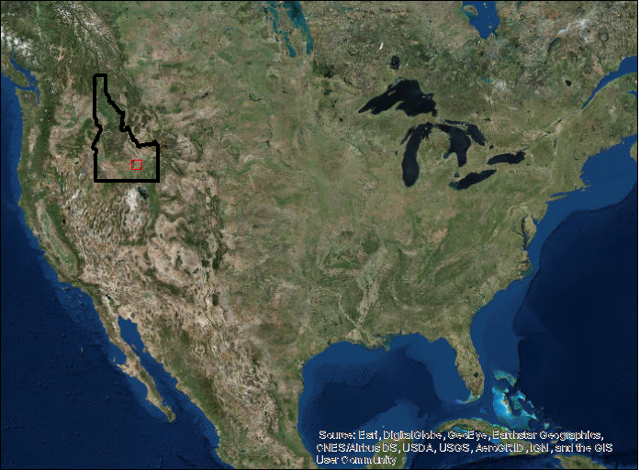
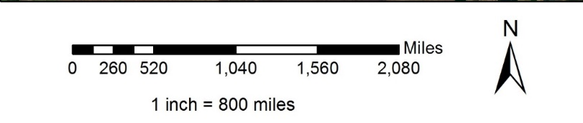
Study Area
Big desert sagebrush steppe
2006 Crystal wildfire burned over 220,000 acres
Study period: 2001-2016
Craters of the Moon National Monument
Crystal Fire Boundary
Notes:
During the first tem of the Souther Idaho Disasters project, we focassed of the 2001 Crystal wildfire, which occurred Northwest of Pocatello ID. At the time, the Crystal fire was the largest fire to have hit this area, burning 220,000 acres, ~200,000 acres of which beng BLM land. Landsat imagery and MODIS products were utilized to assess the study area between 2001 and 20016

Slide 6
Objectives
Discern whether the vegetation within the Crystal Fire perimeter has reached pre-fire biomass conditions
Determine if post-fire recovery favors native vegetation vs. cheatgrass and whether re-seeding efforts have increased overall recovery and native vegetation
Identify key variables responsible for post-fire recovery
Establish where targeted grazing could have helped or hindered wildfire recovery (next term)
Calculate carbon sequestration change over time and estimate it’s associated monetary value
Notes:
Discern whether the ecosystem within the Crystal Fire perimeter has reached pre-fire biomass conditions.
Determining if post-fire recovery maintains native vegetation and if re-seeding efforts increased overall recovery and native vegetation retention.
Identifying key variable responsible for post-fire recovery.
Simulating where targeted grazing could have helped or hindered wildfire recovery.
Establishing carbon sequestration change over time and estimate it’s associated monetary value.

Slide 7
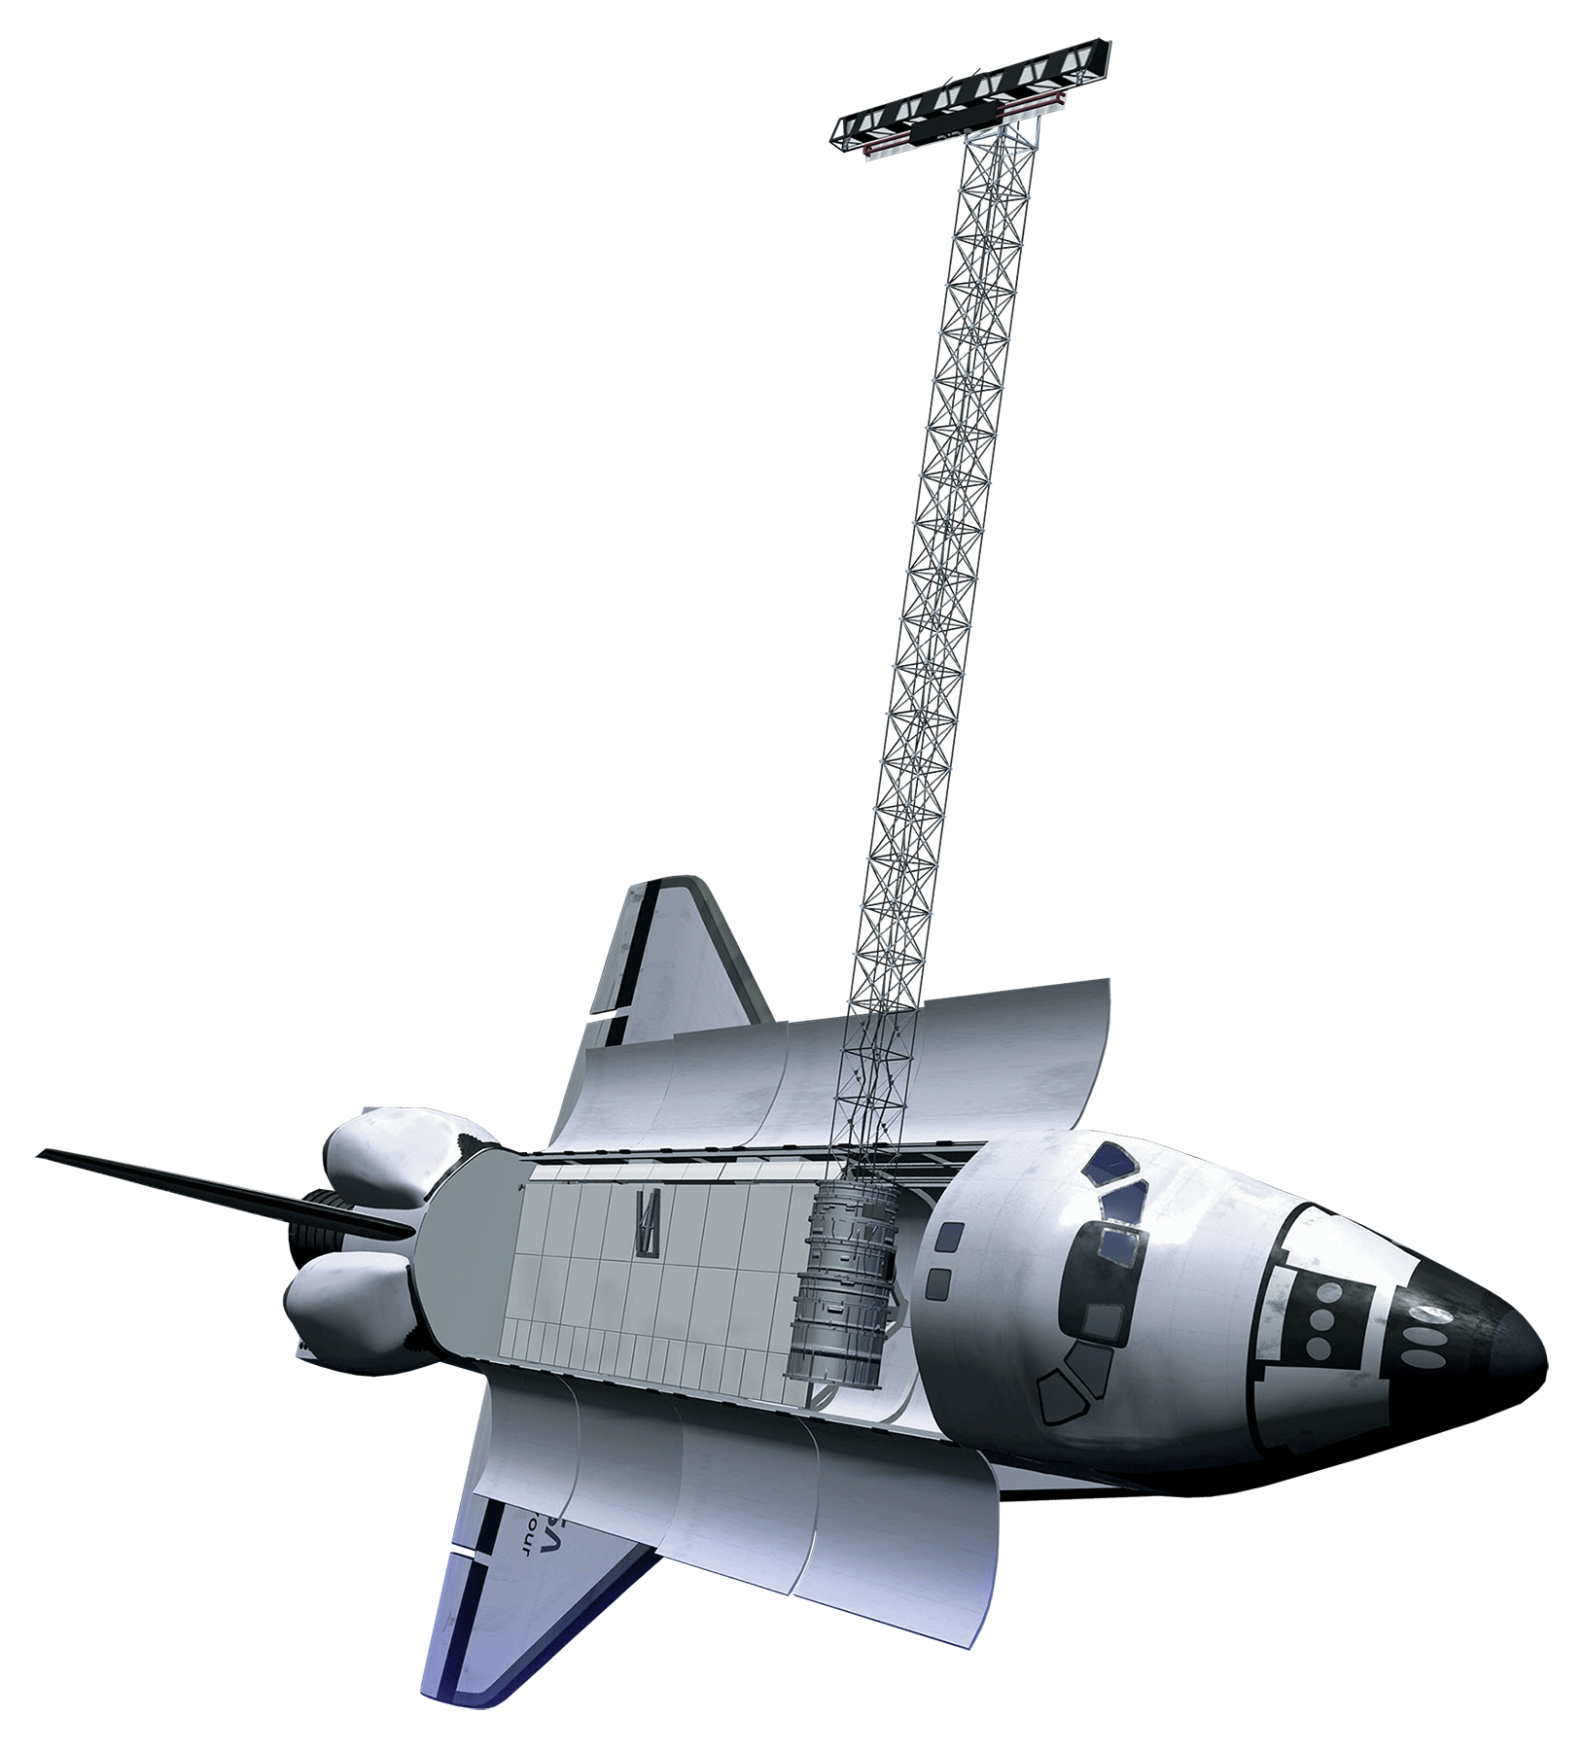
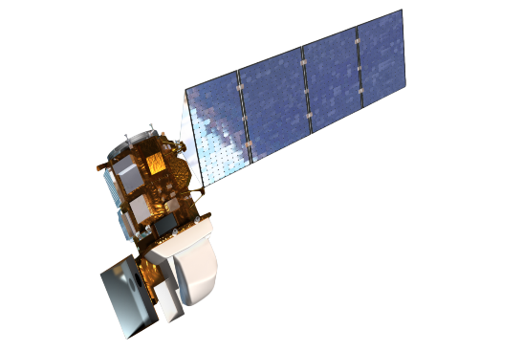
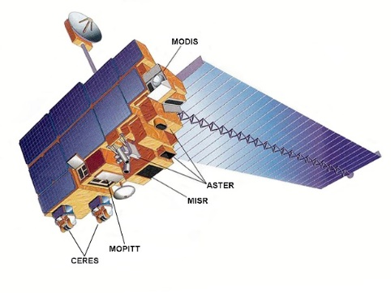
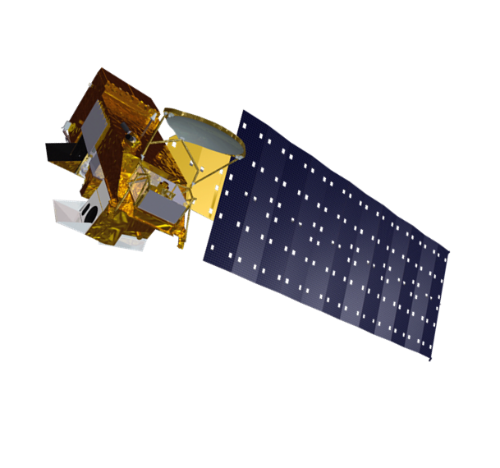
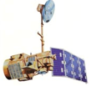
Earth Observations
Landsat 8 OLI
Shuttle Radar Topography Mission (SRTM)
Terra MODIS
Landsat 5 TM
Aqua MODIS
Notes:
Terra Satellite: On board the Terra Satellite is the Moderate resolution imaging spectroradiometer. MODIS offers a view of Earth’s surface every 1-2 days and collects data with 36 spectral bands. Using bands at 500 m resolution for fPAR we are able to get an accurate idea of what is occurring in our study area. Also using MODIS is the ForWarn dataset which we used to … at 250 m resolution.
Landsat 5 & Landsat 8: Landsat 5 Thematic Mapper ceased in November 2011. Landsat 8 data was used from 2013-2016. MSAVI2 for each Landsat scene
SRTM: The Shuttle radar topography mission was an eleven day mission in 2000 aboard NASA’s Space Shuttle Endeavour. The data collected was used to make the first near-global topographical map of Earth (nearly 80% of Earth’s land surfaces were mapped). Using the collected information, our study used variables such as slope, elevation, and aspect to determine if they have a high influence/impact on wildfire recovery.

Slide 8
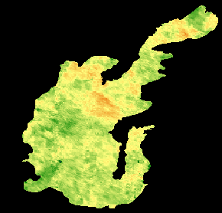


Methodology
2007-2009 Proportional MODIS NDVI
NDVI and MSAVI2 from MODIS and Landsat data values were compared to pre-wildfire vegetation values to detect recovery.
Pre- and post-wildfire MODIS NDVI phenology maps were compared to detect changes in vegetation cover type.
Multiple regression analyses were used to detect correlation between recovery rates and precipitation, elevation, slope, and aspect.
Proportional NDVI
0.5
1.0
1.5
0
5
10
20 Kilometers
Notes:
While Landsat, Terra, and SRTM collected the remote sensing data, we retrieved our temperature and precipitation data from the Aberdeen Agrimet weather station.
We were looking at the months April-August, the peak growing season from the satellite images. We used the ForWarn data for the forest change products that used NDVI to determine peak vegetation growth pixels. The average vegetation patterns from 2002-2005 were compared to the average vegetation patterns from 2013-2016 to determine if there was a similar growing cycle to find signs of recovery.
Post wildfire seed treatment areas were compared to average vegetation patterns from 2013-2016. These were compared at two levels: 1. looking at the treatments that used sagebrush and grassland seeds and comparing to the treatment that used only sage plugs, and 2. comparing different methods of reseeding techniques, such as aerial and drill seeding.
In order to determine if the recovery of the ecosystem was native or invasive dominated, we looked at phenology peaks. Cheatgrass vegetation peaks much earlier than native grasses to the region. Cheatgrass peaks are in late March-April, and native vegetation typically peaks in June/July. Using ForWarn products that graphed the number of pixels that had maximum NDVI growth on each day, along with MSAVI2 which has the ability to compensate for soil background.
Multilinear Regression analysis within the terrset program was used to detect a correlation between the determined independent variables and the growth rate of vegetation between 2006-2016.
Maps were made using TerrSet and ArcMap
InVEST modeling was used to find carbon and price something…

Slide 9
Methodology
Processed Data
Used NDVI and MSAVI2 to identify vegetation and growth productivity
Temporal Analysis
Monitored vegetation indices over time, specifically pre- and post- wildfire
Regression Analysis
Identified key variables (slope, aspect, rainfall, temperature, growing degree days, previous fire exposure) necessary for ecosystem recovery and how their affects on productivity over time
Notes:
While Landsat, Terra, and SRTM collected the remote sensing data, we retrieved our temperature and precipitation data from the Aberdeen Agrimet weather station.
We were looking at the months April-August, the peak growing season from the satellite images. We used the ForWarn data for the forest change products that used NDVI to determine peak vegetation growth pixels. The average vegetation patterns from 2002-2005 were compared to the average vegetation patterns from 2013-2016 to determine if there was a similar growing cycle to find signs of recovery.
Post wildfire seed treatment areas were compared to average vegetation patterns from 2013-2016. These were compared at two levels: 1. looking at the treatments that used sagebrush and grassland seeds and comparing to the treatment that used only sage plugs, and 2. comparing different methods of reseeding techniques, such as aerial and drill seeding.
In order to determine if the recovery of the ecosystem was native or invasive dominated, we looked at phenology peaks. Cheatgrass vegetation peaks much earlier than native grasses to the region. Cheatgrass peaks are in late March-April, and native vegetation typically peaks in June/July. Using ForWarn products that graphed the number of pixels that had maximum NDVI growth on each day, along with MSAVI2 which has the ability to compensate for soil background.
Multilinear Regression analysis within the terrset program was used to detect a correlation between the determined independent variables and the growth rate of vegetation between 2006-2016.
Maps were made using TerrSet and ArcMap
InVEST modeling was used to find carbon and price something…

Slide 10
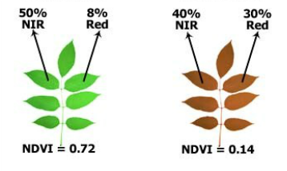


Vegetation Indices
Second modified soil-adjusted vegetation index
MSAVI2
$$MSAVI2=\frac{2×NIR+1−\sqrt{\left.{\left(2×NIR+1\right)}^{2}−8×(NIR−RED\right)}}{2}$$
NDVI
Normalized difference vegetation index
$$NDVI=\frac{NIR−RED}{NIR+REd}$$
Notes:
MSAVI2 is a long-term vegetation index dataset that is able to show changing temporal and spatial vegetation dynamics. MSAVI2 uses red and near-infrared bands. The higher the value, the more the vegetation. We used this alongside NDVI to improve accuracy of the project.
NDVI: Using near infrared and red bands from satellites, creates a way to assess whether or not the land contains live vegetation.
Green plants reflect most of the near infrared light and very little red light, while brown plants reflect more red light and less near infrared light. By taking the ratio of red and near infrared reflectance, vegetation greenness can be defined. NDVI values range from 0 to 1. A low NDVI value indicates the plant is brown, while a high NDVI value indicates the plant is green. F
Source: http://www.ece.montana.edu/seniordesign/archive/SP15/OpticalWeedMapping/ndvi.html

Slide 11
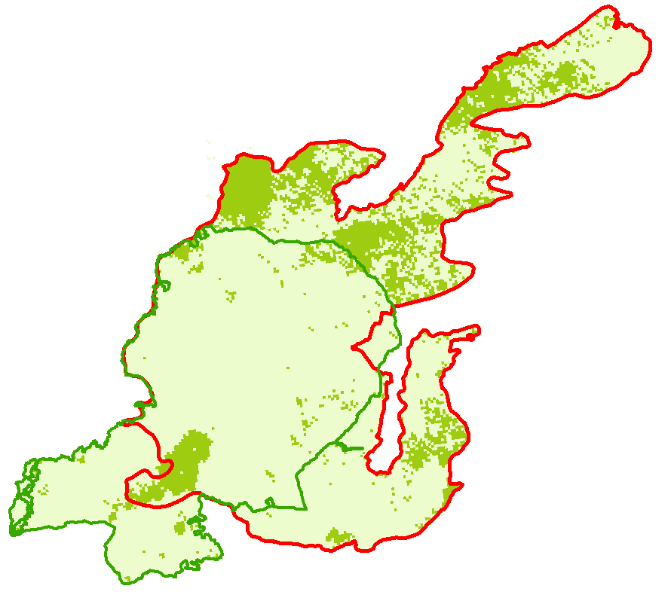
ForWarn System
MODIS-Based Phenology Tracking Product
  Event Response
  Temporal Drift
  Cheatgrass detection
2013
Peak NDVI Before Day 140
Peak NDVI After Day 140
Crystal Fire Boundary
Mule Butte Fire Boundary
0
5
10
20 Kilometers
Notes:
The ForWarn dataset utilized MODIS data in order to provide yearly phenology maps before and after the 2006 Crystal fire. These phenology maps show which areas produced their max NDVI values during certain portions of the year. This is especially useful as cheatgrass experiences its maximum green-up earlier than most native vegetation, allowing the detection of cheatgrass cover change after the Crystal fire.

Slide 12
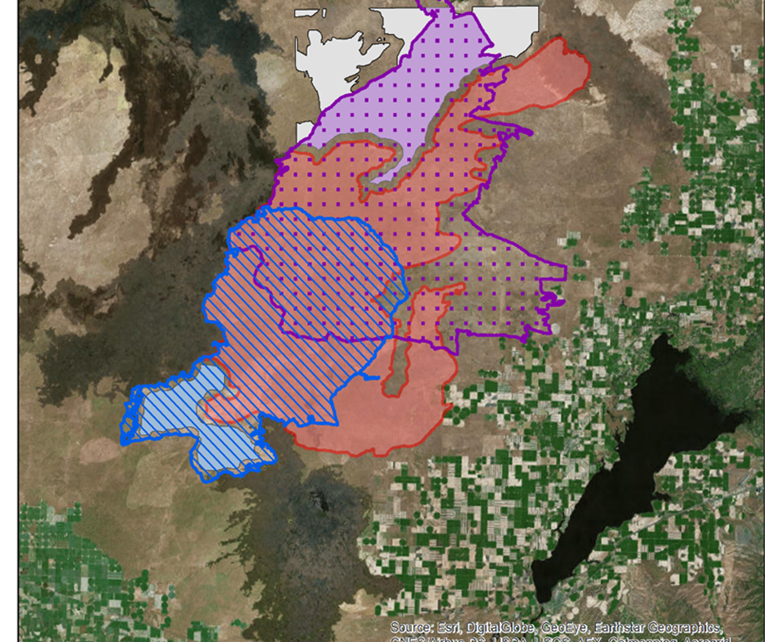
Wildfire History
2006 Crystal Fire
1999 Mule Butte Fire
1996 Cox’s Well Fire
Seeding treatments
Wildfire Perimeters and
Control Areas
Mule Butte (1999)
Mule Butte Control
Cox Well Fire (1996)
Cox Well Control
Crystal Fire (2006)
No Burn Control
Notes:
In order to best analyze the 2006 Crystal fire area, the team separated the fire boundaries into multiple different sections.
The 1999 Mule Butte fire boundary, over half of which had again burned during the crystal fire, showed visible differences when compared to the rest of the Crystal fire. These areas were shown to have greater cheatgrass densities, shown by cheatgrass cover maps from 2015.
Seed treatment areas were run separately to detect if differences in variable dependence existed in comparison to untreated areas

Slide 13
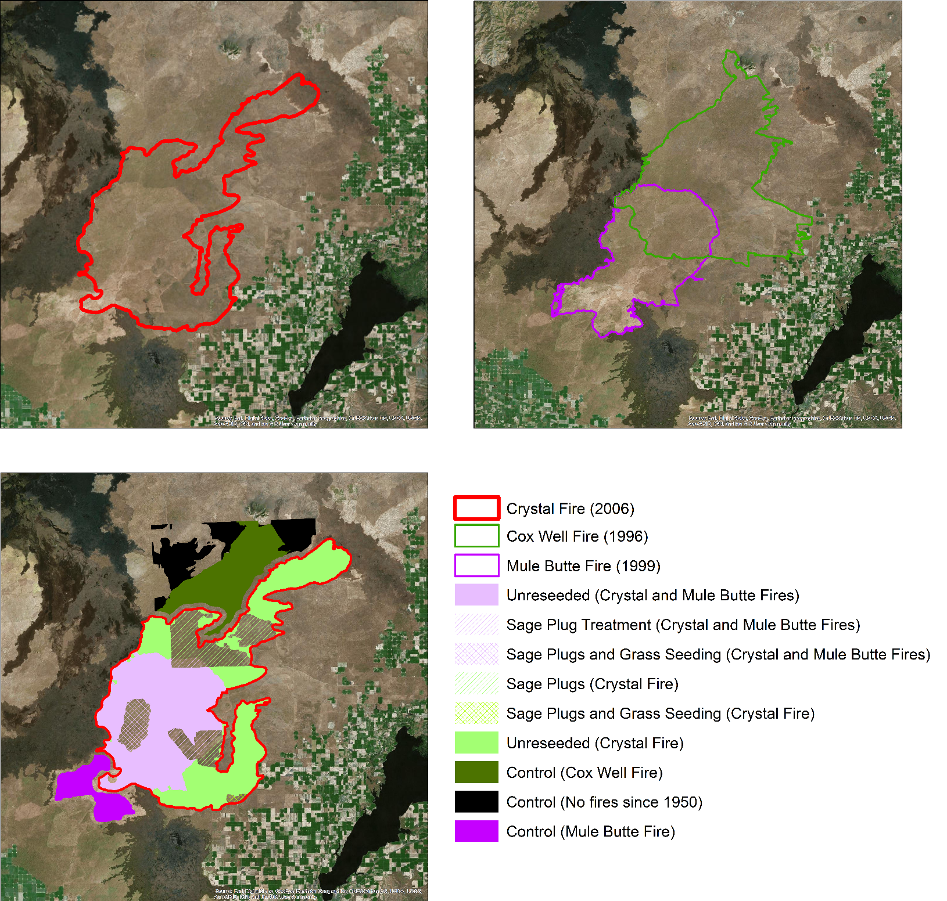
Recovery Results
Crystal Fire (2006)
Cox Well Fire (1996)
Mule bure Fire (1999)
Unreseeded (Crystal & mule Butte Fires)
Sage Plug treatment (Crystal & mule Butte Fires)
Sage plugs and Grass Seeding (Crystal & Mule Butte Fires)
Sage plugs (Crystal Fire)
Sage Plugs and Grass Seeding (Crystal & Mule Butte Fires)
Unreseeded (Crystal Fire)
Control (Cox Well Fire)
Control (No Fires since 1950)
Control (Mule Butte Fire)
Crystal Fire (2006)
Cox Well Fire (1996)
Mule bure Fire (1999)
Crystal Fire (2006)
Notes:
These maps indicate the progression of our thoughts on the Crystal wildfire. Initially our analyses were limited to the Crystal Fire boundary but the large discontinuity, visible in the first map that divided the northern and southern regions of the fire was found to correspond to the 1999 Mule Butte Fire (shown in purple). The green boundary is the 1996 Cox Well fire that also may have influenced a large part of the Crystal Fire region. The third map illustrates the nine final regions that the study area was broken down into. They are based on fire history and reseeding treatment after the crystal fire.

Slide 14
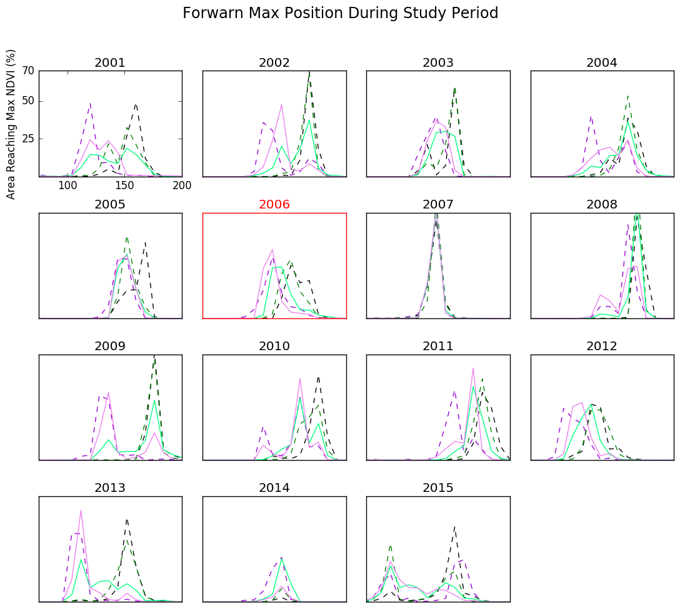
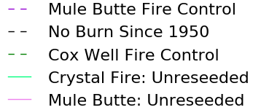
Forwarn Max Position During Study Period
2001
2002
2003
2004
Pixels at Peak NDVI (%)
2005
2006
2007
2008
2009
2010
2011
2012
2013
2014
2015
Mule Butte Fire Control
No Burn Since 1950
Cox Well Fire Control
Crystal Fire: Unreseeded
Mule Butte: Unreseeded
Notes:
The graphs indicate the percentage of pixels at peak NDVI for each day of the growing season. We hypothesize that due to its ealier bloom, pixels that are cheatgrass dominated will show an earlier peak NDVI than those that are not. Bimodality of peaks may indicate coexistence of cheatgrass dominated pixels and native dominated pixels. In the post fire years we can see that there is a general trend of increased early peaking in areas affected by the Crystal fire. The no burn since 1950 control area has the lowest bimodality of all of the curves showing almost exclusively late season peaking.

Slide 15
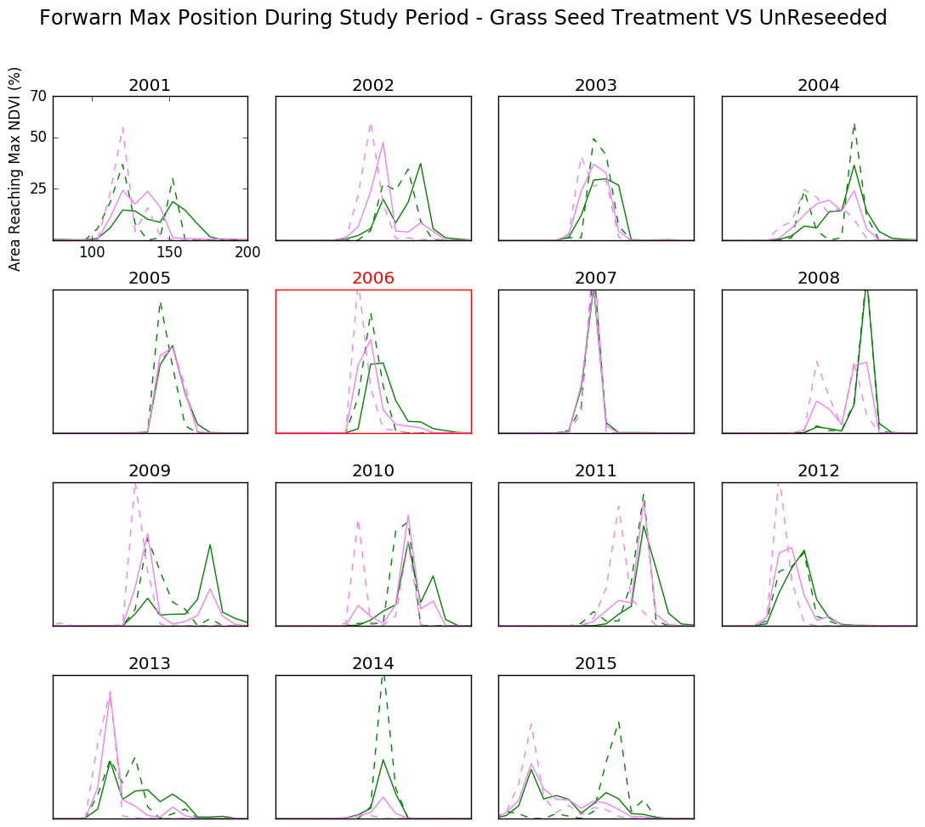
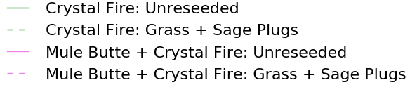
Forwarn Max Position During Study Period: Grass Seed Treatment Vs Unreseeded
2001
2002
2003
2004
Pixels at Peak NDVI (%)
2005
2006
2007
2008
2009
2010
2011
2012
2013
2014
2015
Crystal Fire: Unreseeded
Crystal Fire: Grass + Sage Plugs
Mule Butte + Crystal Fire: Unreseeded
Mule Butte + Crystal Fire: Grass + Sage Plugs
Notes:
These graphs also show the max position NDVI dataset, this time comparing the unreseeded regions to the regions that were treated with grass seeds and sage plugs. In the post fire years there is no convincing trend that the reseeding treatment was effective.

Slide 16

Regression Analysis
Dependent variable
  Proportional vegetation values
Independent variables
  Topographic
  Elevation
  Slope
  Aspect
  Years since last fire
  Distance from Road
$$Proportional value=\frac{Postfire Vegetation Index}{Prefire Vegetation Index}$$
  Climatic
  Growing Degree Days
  Temperature
  Precipitation
Notes:
In order to determine key variables responsible for recovery a regression analysis was performed
This detects the relationship between ecological variables and recovery by measuring the corresponding dependent and independent values
These relationships can be shown, for example, as precipitation increases in a given year vegetation growth also increases that year.
Our dependent variable during the regressions was the proportional vegetation index’s. This value compared pre-fire NDVI or MSAVI2 values to pre-fire values pixel by pixel.
Climatic variables put into the regression were spatially interpolated across the study area. This approximates the special differences in precipitation. These variables included Growing Degree Days, median temp, mean temp, and yearly precip.
Elevation and elevation derivatives, such as slope and aspect, were used as they can determine the amount of water a given area can utilize.
Topographic variables

Slide 17
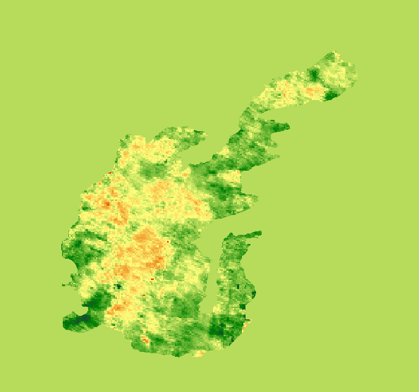

Regression Results
2013-2015 Climatic Residuals
Topographic variables resulted in little predictive capabilities
Climatic variables, primarily maximum temperature, were shown to have the larger prediction capability
-0.3
0.4
0
5
10
20 Kilometers
Notes:
After running a multiregression analysis through the TerrSet program, we discovered that climatic variables are the main drivers for vegetation regrowth.
Topographic variables yielded results too small to deem reliable, or that they play a huge role.
Maximum temperature was shown to have the most pronounced correlation with wildfire recovery. Maximum temperature was shown to have a high negative value in association with wildfire recovery, meaning a higher maximum temperature was a good predictor for less vegetation. Precipitation yielded high positive results, but were too scattered and unreliable to place confidence in their prediction capability
For now, these are all the results for regression that we are confident in. Next term will dive more into regression analyses, and what they mean for wildfire recovery.

Slide 18
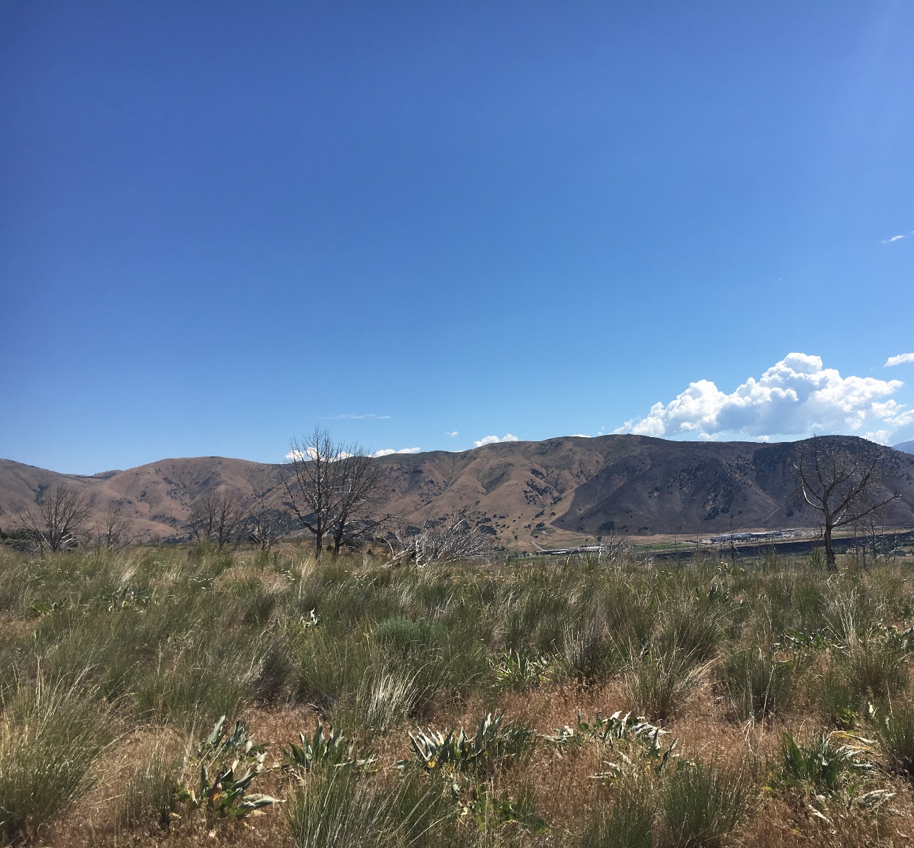
Conclusion
Full recovery to pre-fire conditions has not yet occurred
Cheatgrass became further established in the combined Mule Butte/Crystal Fire area
Variables have very low correlation to recovery in the Crystal fire study area
Image Credit: DEVELOP Idaho node
Notes:
After looking at the vegetation peaks captured by MODIS data, the charts suggest that cheatgrass has been strongly present since after the fire. The ecological variables investigated by the team appears to be have an impact on recovery. When looking at native vegetation, it appears to continue to grow after a wildfire event.
The magnitude and timing of paired vegetation responses suggest that invasive cheatgrass had increased in the years following the fire and became further established in the combined Mule Butte/Crystal Fire area.
Statistical analyses helped to show how ecological variables affect vegetation growth and recovery in the burn area
Native vegetation in the initial study area is still recovering from burn damage.
ForWarn MODIS NDVI phenology data was useful for assessing burn impacts, such as post fire cheat grass invasion

Slide 19
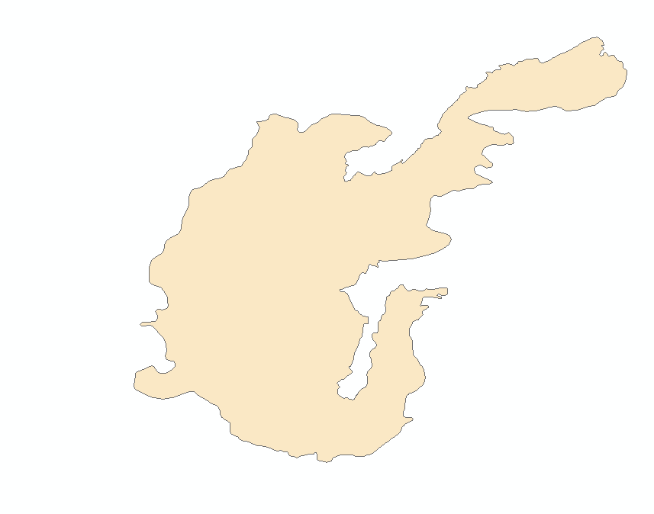
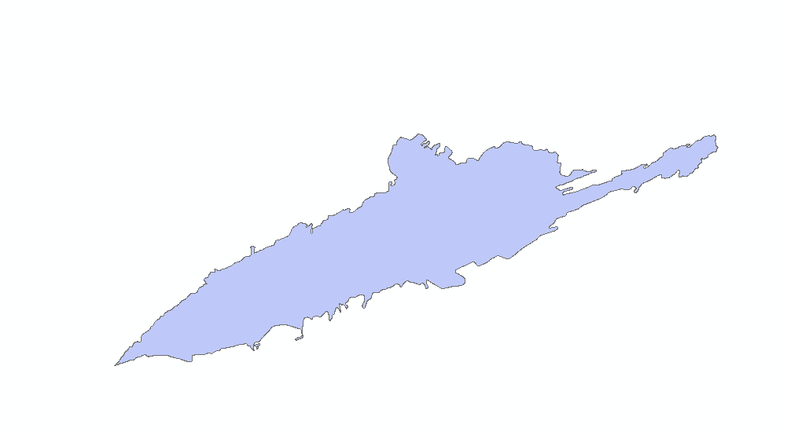
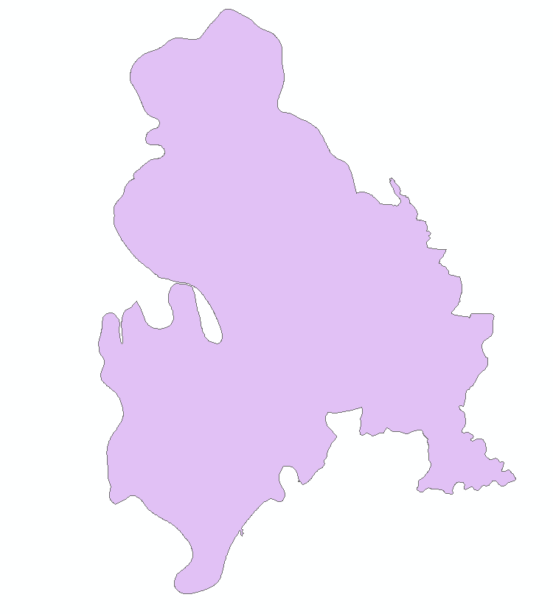
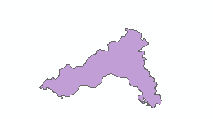
Future Work
Idaho Disasters II
  Analyze the recovery of the Jefferson, Soda, and Henry’s Creek wildfires
  Post-fire vegetation recovery variables will be assessed to determine spatio-temporal trends
  Help determine when areas could be available for livestock grazing and wildlife habitats
Crystal (2006)
Jefferson (2010)
Soda (2015)
Henry’s Creek Fire (2016)
Notes:
These fires will be compared to the Crystal wildfire in terms of severity, recovery rates, and the recoveries dependence on ecological variables determined in this project. This will show if spatial differences in wildfire recovery’s response to independent variables, such as precipitation, exist between the sites.
analyze the recovery of the Jefferson, Soda, and Henry’s Creek wildfires to detect recovery and compare recovery between high and low severity burns. These fires will be compared to the Crystal wildfire in terms of severity, and recovery rates
Build upon regression techniques to better detect dependent variables and compare the importance of variables between sites
Determine when areas would be available for grazing and natural habitats.

Slide 20
Acknowledgements
Science Advisors:
Keith Weber (GIS Training and Research Center at ISU)
Joseph Spruce (NASA Langley Research Center)
Partners:
Karen Krause, BLM Natural Resource Specialist
Patrick E. Clark, USDA Range Scientist
Scott Bergen, IDFG Principal Wildlife Research Biologist
Ryan Walker, IDFG Biologist
Idaho DEVELOP node:
Courntney Ohr, Center Lead
Caitlin Toner, Assistant Center Lead
Notes:
What is good in the hood?

Slide 21
Questions
?
?
?
?
?
?
Notes:
What is good in the hood?

Slide 22
Supporting Figures
Notes:
What is good in the hood?

Slide 23
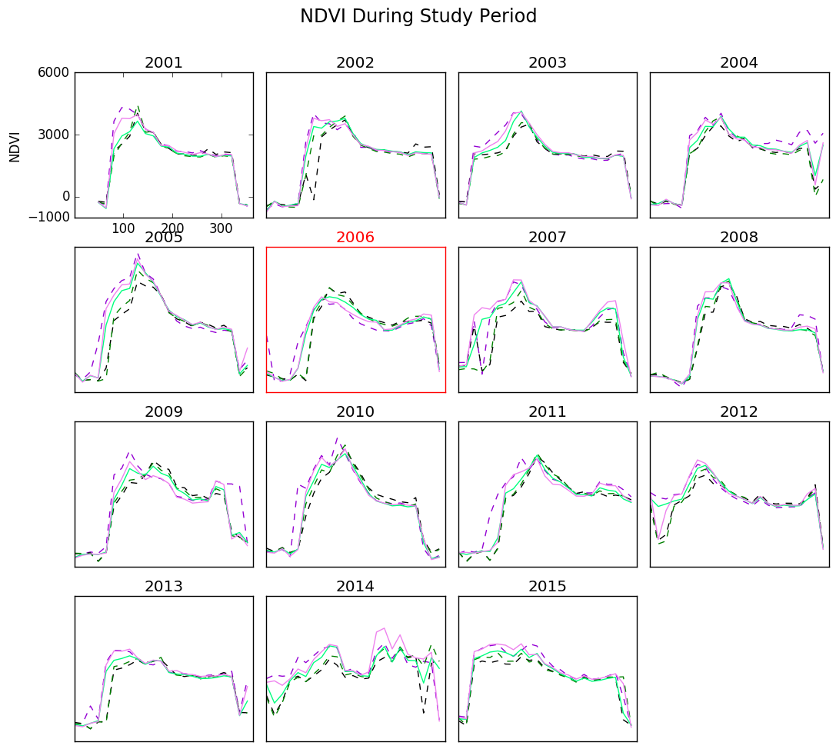
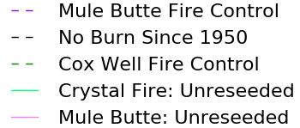
NDVI During Study Period
.6
.3
0
2001
2002
2003
2004
NDVI
2005
2006
2007
2008
2009
2010
2011
2012
2013
2014
2015
Mule Butte Fire Control
No Burn Since 1950
Cox Well Fire Control
Crystal Fire: Unreseeded
Mule Butte: Unreseeded
Notes:
This graph show for each year the NDVI for the entire year.

Slide 24
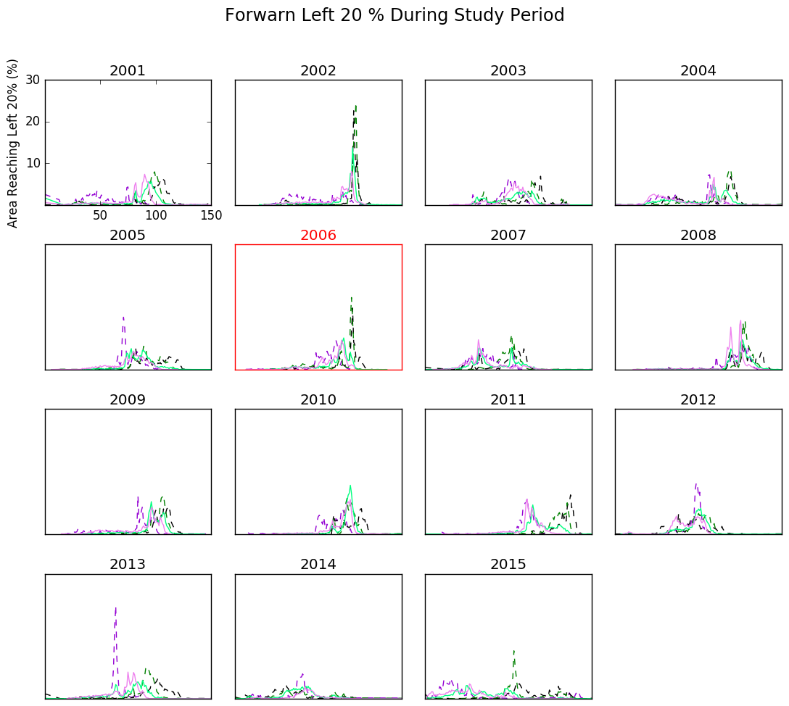
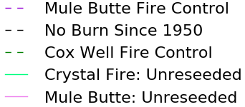
Forwarn 20% of Greenup During Study Period
2001
2002
2003
2004
Pixels at 20% of Peak NDVI (%)
2005
2006
2007
2008
2009
2010
2011
2012
Mule Butte Fire Control
2013
2014
2015
No Burn Since 1950
Cox Well Fire Control
Crystal Fire: Unreseeded
Mule Butte: Unreseeded
Notes:
This graph shows the day of the growing season when 20% of the maximum NDVI of that year was reached.

Slide 25
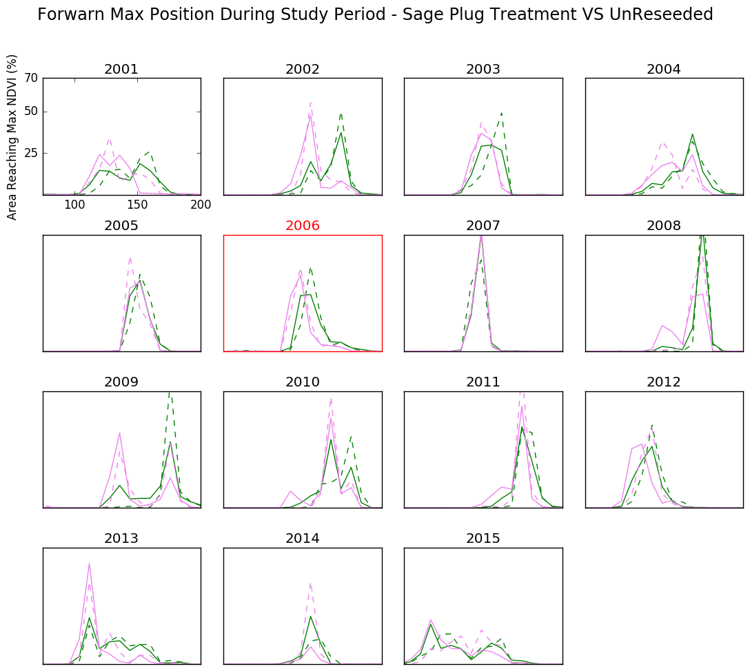
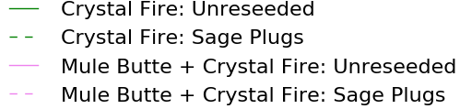
Forwarn Max Position During Study period: Sage Plug Treatment Vs Unreseeded
2001
2002
2003
2004
Pixels at Peak NDVI (%)
2005
2006
2007
2008
2009
2010
2011
2012
2013
2014
2015
Crystal Fire: Unreseeded
Crystal Fire: Sage Plugs
Mule Butte + Crystal Fire: Unreseeded
Mule Butte + Crystal Fire: Sage Plugs
Notes:
These graphs also show the max position NDVI dataset, this time comparing the unreseeded regions to the regions that were treated with sage plugs only.

Slide 26
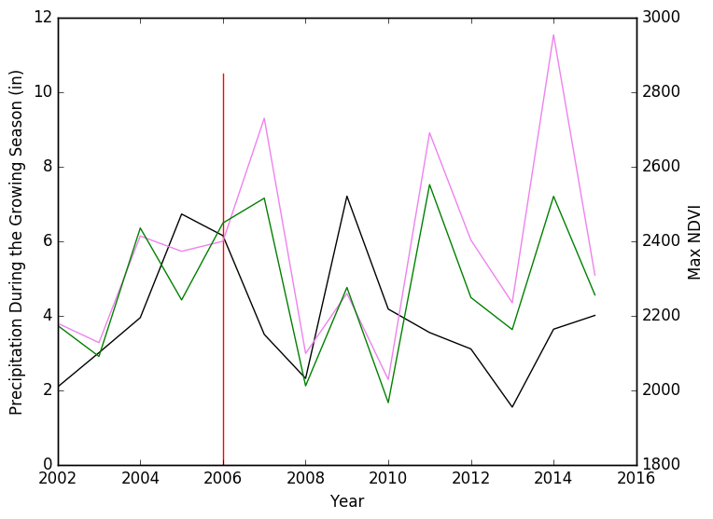

Mule Butte + Crystal Fire:
Unreseeded
Crystal Fire: Unreseeded
Precipitation

Slide 27
Regression Statistics
Crystal Wildfire V2 Mask |  |  | Cox Control V2 Mask |  |  | Crystal-Grass/sage V2 Mask |  |  | Crystal-Sage V2 Mask |  |  | Crystal-Unseeded V2 Mask |  |  | MuleButte Control V2 Mask
Mean | 0.26 |  | Mean | 0.10 |  | Mean | 0.25 |  | Mean | 0.29 |  | Mean | 0.22 |  | Mean | 0.17
Standard Error | 0.04 |  | Standard Error | 0.02 |  | Standard Error | 0.071 |  | Standard Error | 0.019 |  | Standard Error | 0.04 |  | Standard Error | 0.056
Median | 0.29 |  | Median | 0.11 |  | Median | 0.19 |  | Median | 0.30 |  | Median | 0.24 |  | Median | 0.11
Mode | #N/A |  | Mode | #N/A |  | Mode | #N/A |  | Mode | #N/A |  | Mode | #N/A |  | Mode | #N/A
Standard Deviation | 0.10 |  | Standard Deviation | 0.06 |  | Standard Deviation | 0.18 |  | Standard Deviation | 0.051 |  | Standard Deviation | 0.10 |  | Standard Deviation | 0.14
Sample Variance | 0.01 |  | Sample Variance | 0.00 |  | Sample Variance | 0.036 |  | Sample Variance | 0.0026 |  | Sample Variance | 0.011 |  | Sample Variance | 0.022
Kurtosis | -1.40 |  | Kurtosis | -2.16 |  | Kurtosis | 4.89 |  | Kurtosis | -0.55 |  | Kurtosis | -1.12 |  | Kurtosis | 4.66
Skewness | -0.49 |  | Skewness | 0.01 |  | Skewness | 2.14 |  | Skewness | -0.89 |  | Skewness | -0.60 |  | Skewness | 2.10
Range | 0.28 |  | Range | 0.15 |  | Range | 0.55 |  | Range | 0.13 |  | Range | 0.27 |  | Range | 0.43
Minimum | 0.11 |  | Minimum | 0.03 |  | Minimum | 0.11 |  | Minimum | 0.20 |  | Minimum | 0.068 |  | Minimum | 0.052
Maximum | 0.38 |  | Maximum | 0.19 |  | Maximum | 0.66 |  | Maximum | 0.34 |  | Maximum | 0.34 |  | Maximum | 0.48
Sum | 1.80 |  | Sum | 0.72 |  | Sum | 1.79 |  | Sum | 2.03 |  | Sum | 1.56 |  | Sum | 1.20
Count | 7 |  | Count | 7 |  | Count | 7 |  | Count | 7 |  | Count | 7 |  | Count | 7

