Slide 1
Garrett McGurk (POC)
Mariana Webb
Billy Babis
CHILE WATER RESOURCES
Integrating NASA Earth Observations into the Google Earth Engine Platform to Enhance Drought Monitoring in Chile
NASA Ames Research Center
Moffett Field, CA
2017 Spring
Notes:
Presented by Billy Babis and Garrett McGurk

Slide 2
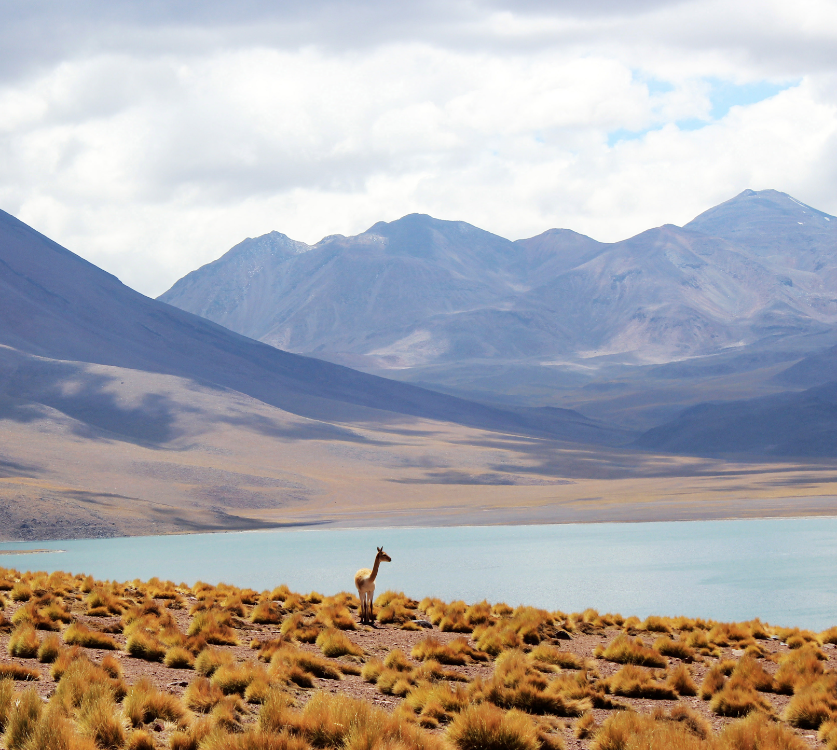
Outline
Part I: Background
1. Chilean Climate
2. Chilean Agriculture
3. Drought in Chile
Part II: Introduction
Project Goals
Project Parameters
Part III: Project Components
NASA Earth Observations Used
Methodology
Part IV: Results and Conclusion
Results
Discussion
Image Credit: Good Free Photos
Notes:
This is an outline showing the topics we will be discussing today.
Image Credit: Good Free Photos https://www.goodfreephotos.com/chile/other-chile/landscape-of-mountains-clouds-desert-lake-in-chile.jpg.php

Slide 3
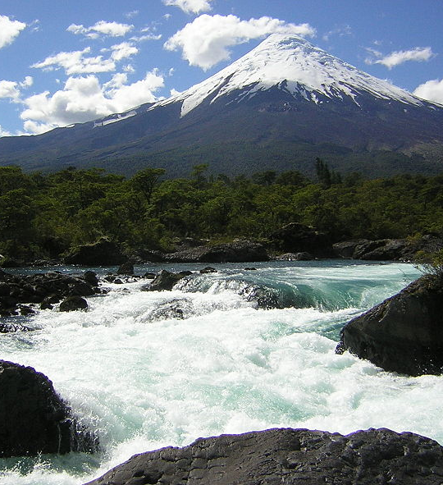
Background: Chilean Climate
Atacama Desert: one of the driest places on Earth
~4200km
Wikimedia Commons
Los Rios Region:
>2.5 meters of annual rainfall
Increasing precip. with lat. & long.
ENSO Variability
Wikimedia Commons
Wikimedia Commons
Notes:
Chile spans roughly 4200km, which is about the same distance from San Francisco, California to New York, New York. The northernmost region is one of the driest places on earth, in contrast to the wet southern regions, which experience upwards of 2.5 meters of annual rainfall. As a general pattern, rainfall increases with latitude and altitude. There is also rainfall variation from year to year due to the effects of El Nino/ La Nina events (ENSO) and more localized climate phenomenon like the Bolivian Winter in the Atacama Desert.
----------------------------------------------------
Bolivian Winter Definition: thermal air currents above the Bolivian side of the Andes form large rain clouds that then drift down back into Chile and deposit heavy, but short, rain showers over the area, often accompanied by loud thunder and lighting. This also brings snow fall to higher elevations in the Andes Mountains
image sources: https://commons.wikimedia.org/wiki/File:Paisajes_cerca_de_Calama,_Chile,_2016-02-01,_DD_84.JPG
https://commons.wikimedia.org/wiki/File:Mapa_de_Chile.svg
https://commons.wikimedia.org/wiki/File:Volcano_Osorno_and_Petrohu%C3%A9_waterfalls.JPG

Slide 4
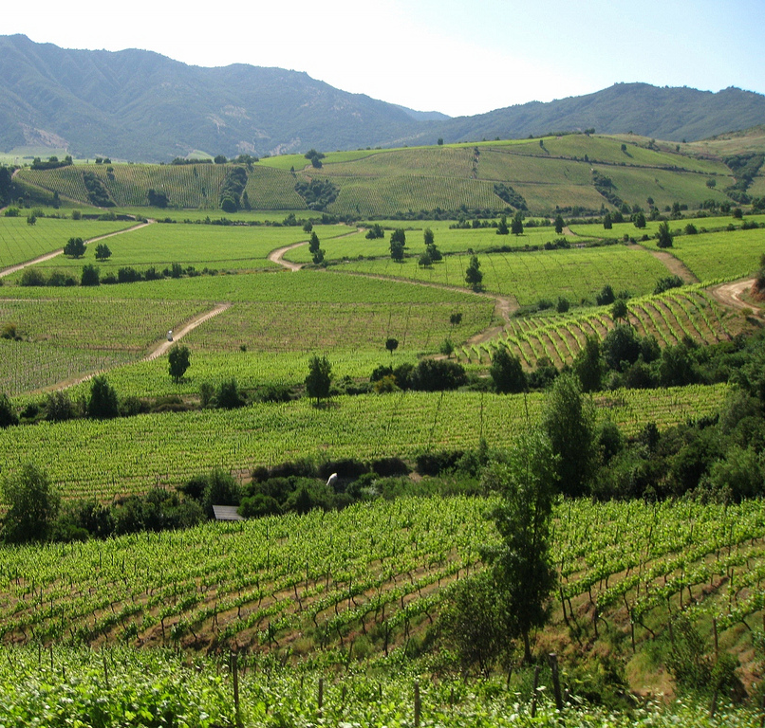
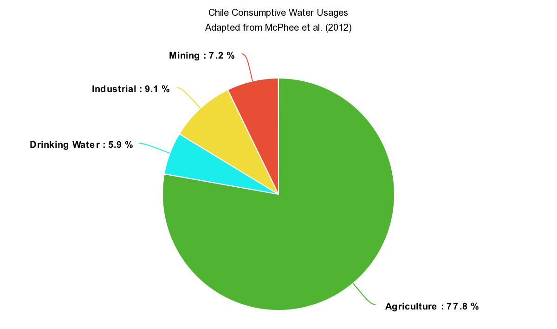
Background: Chilean Agriculture
Mining: 7.2%
Chile Consumptive Water Usages
Industrial: 9.1%
Drinking Water: 5.9%
Agriculture: 77.8%
Image Credit: Flickr
Image Credit: Pixabay
Notes:
Chile’s economy is dominated by agricultural production. Almost 80% of consumptive water rights are held by the agricultural sector and by 2022 the government intends to increase the amount of irrigated land by 57%.
image sources: http://www.ytravelblog.com/what-to-do-in-santiago-chile/
https://pixabay.com/en/photos/bunch%20of%20grapes/
https://pixabay.com/en/apple-fruit-food-1105467/
https://pixabay.com/en/wheat-grass-nature-growth-yellow-576264/
https://pixabay.com/en/corn-food-maize-plant-agriculture-296957/

Slide 5
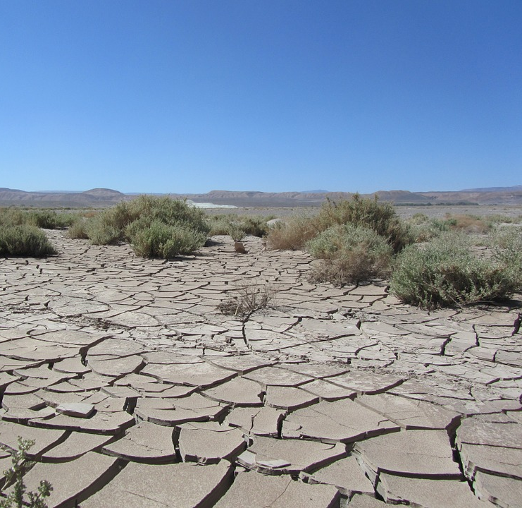
Background: Drought in Chile
Sources of Water Resource Stress:
Increased human demand and lack of infrastructure to transport water
Longer and more extreme dry periods
Rising 0 degree C isotherm
Current Drought Monitoring Tools:
Agroclimate Observatory in Chile Climate Data Library
UNESCO Latin America Flood and Drought Monitor tool
Image Credit: Pixabay
Notes:
Drought and agriculture have become very pressing issues in Chile. A number of compounding factors have resulted in over 75 separate water usage restrictions between 2008 and 2015.
Current Drought Monitoring tools used by the Ministry of Agriculture do not provide the ministry with the capability to monitor water resources to the extent that they wish.
About two years ago, NASA DEVELOP began talking to the Agricultural Office of the Chilean Embassy about how NASA Earth observations could be used to address drought monitoring efforts in Chile. This conversation has since evolved into a two-term DEVELOP project in collaboration with the Chilean Ministry of Agriculture.
Image Source: https://cdn.pixabay.com/photo/2014/07/14/19/40/atacama-393339_960_720.jpg

Slide 6
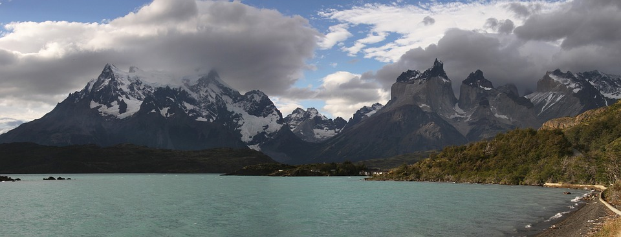
Introduction: Project Goals
“Incorporate NASA Earth observation derived soil moisture, snow cover, and snow water equivalent data into Chile’s drought monitoring and decision making processes using the Google Earth Engine Platform”
Image Credit: Pixabay
Notes:
Image Source: https://cdn.pixabay.com/photo/2015/12/06/16/22/torres-del-paine-1079690_960_720.jpg
Therefore, the Ministry is looking to implement a more technologically advanced drought monitoring platform that will can grow with the Ministry of Agriculture as they increase water resource monitoring efforts. This includes incorporating new Earth observations such as SMAP and AMSR –E and 2 into the drought monitoring and decision making process.

Slide 7
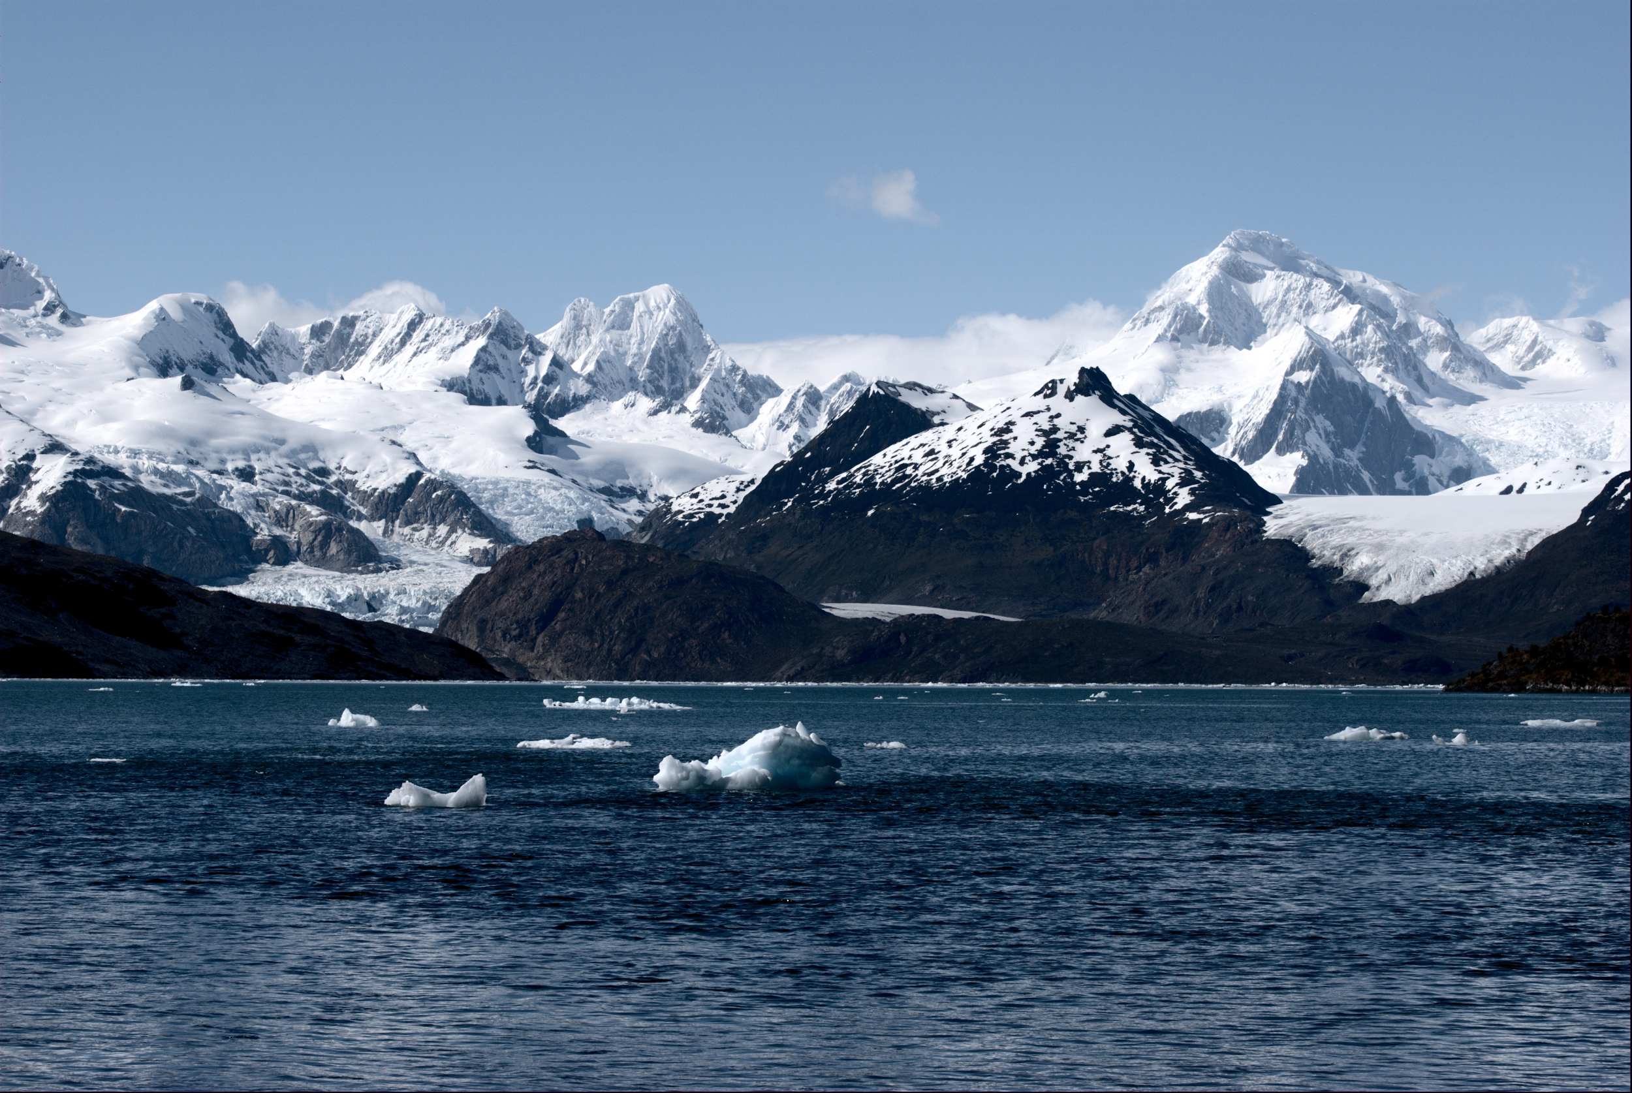
Introduction: Project Parameters
Study Area
Chile
Study Period
2001 to present
Project Partners
Chile Ministry of Agriculture
Agricultural Office of the Chilean Embassy to the United States
Image Credit: Wikimedia Commons
Notes:
The study period for this project was 2001 to present. We studied the entire country of Chile and partnered with Chile’s Ministry of Agriculture and the Agricultural Office of the Chilean Embassy to the United States.
Image Source: https://upload.wikimedia.org/wikipedia/commons/2/28/Ainsworth_bay_and_Marinelli_Glacier.jpg

Slide 8
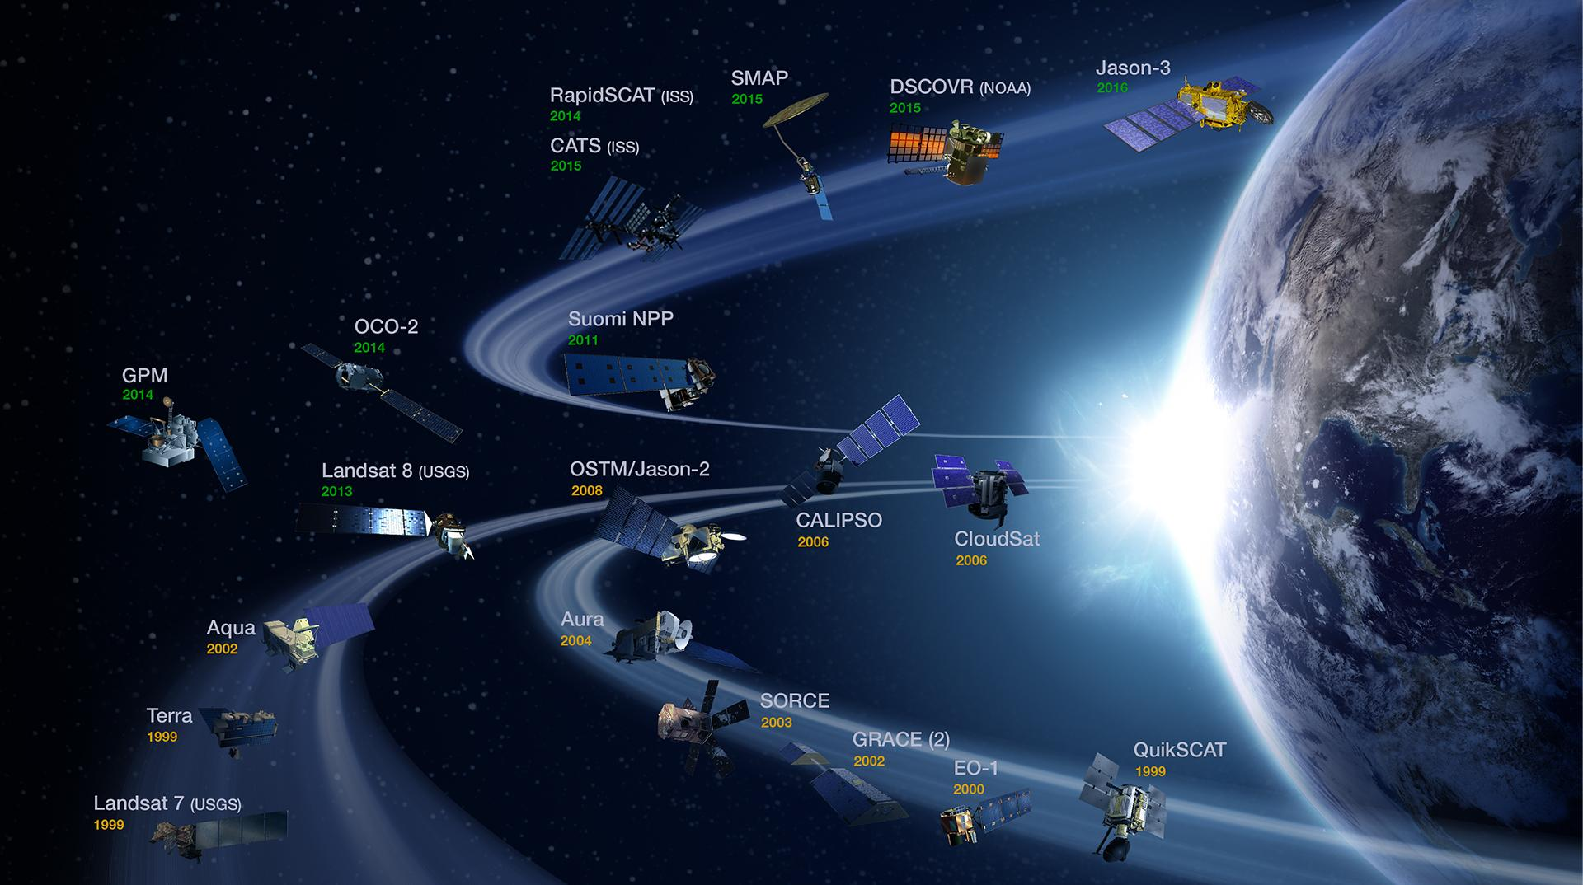
NASA Earth Observations Used
Snow Cover
TERRA MODIS daily (2001-present)
Snow Water Equivalent
Aqua AMSR-E (2001-2011)
JAXA GCOM-W1 AMSR2 (2012-present)
Soil Moisture
SMAP Radiometer (2015-present)
NASA
Notes:
The Earth Observations used in this project were TERRA MODIS, Aqua AMSR-E and JAXA GCOM-W1 from the Japanese space agency, and SMAPs radiometer sensor.
Image Source: https://eospso.nasa.gov/

Slide 9
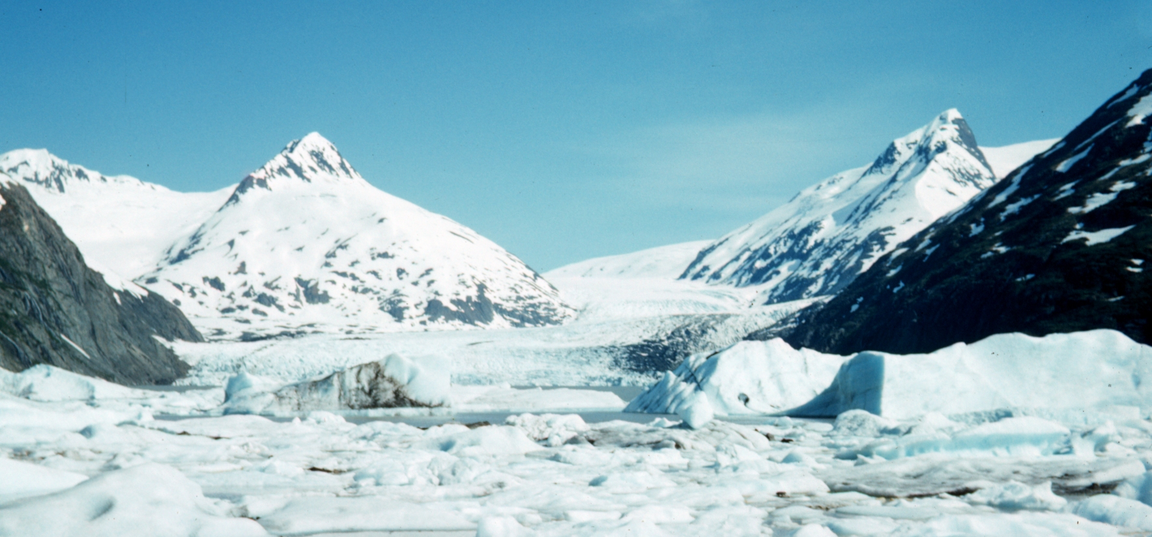
Methodology
Ingest
Imagery
Google Cloud Storage
DAAC
Upload NASA datasets into a shared GEE Repository
Visualize Data
Monitor
Drought
Use GEE Code Editor to compute and display data
Analyze hydrologic data
Image Credit: WhizzbangStudios
Notes:
This is our simplified flow-chart to portray the ingestion process. The public GEE data catalog hosts many satellite datasets that can be easily accessed and visualized in GEE Code Editor. One of our parameters (the MODIS version 6 Snow Cover) became publically available for our use. For the AMSR-E, AMSR2, and SMAP datasets, we had to undergo a rigorous pipeline to analyze and visualize the data in GEE. The datasets must be downloaded from the DAAC’s (Distributed Active Archive Center - where NASA Earth observations are hosted), processed as a GeoTiff, uploaded to Google Cloud Storage and then uploaded to Google Earth Engine using the GEE Python API and Command Line tool.

Slide 10
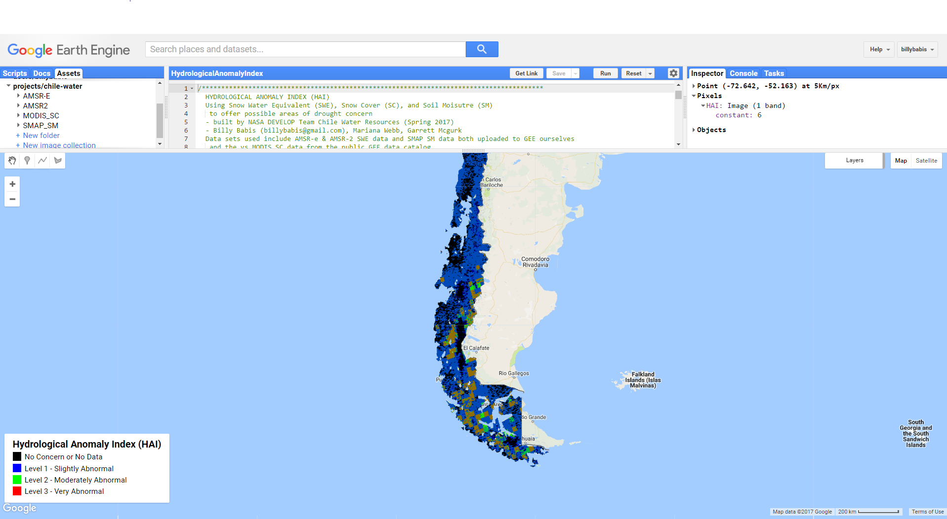
Results
Hydrological Anomaly Engine (HAE)
Shared dataset asset repository
Shared GEE script repository
Hydrological Anomaly Index (HAI)
Data Ingestion Tutorial
Hydrological Anomaly Index (HAI)
No Concern or No Data
Level 1 – Slightly Abnormal
Level 2 – Moderately Abnormal
Level 3 – Very Abnormal
Notes:
The Hydrological Anomaly Engine is the entire GEE product built for the Ministry of Agriculture. Included in this product is:
1) a shared asset folder with AMSR-E, AMSR2, SMAP, and MODIS datasets containing SC, SWE, and SM data.
2) a shared repository with javascript files to demonstrate the processing and visualization capabilities of these datasets. Included in this is the HAI, a fairly primitive model for assessing hydrological conditions integrating SC, SM, and SWE data.
3) an in depth tutorial that explains the data ingestion process, including a python script for fetching and uploading important metadata with these datasets.

Slide 11
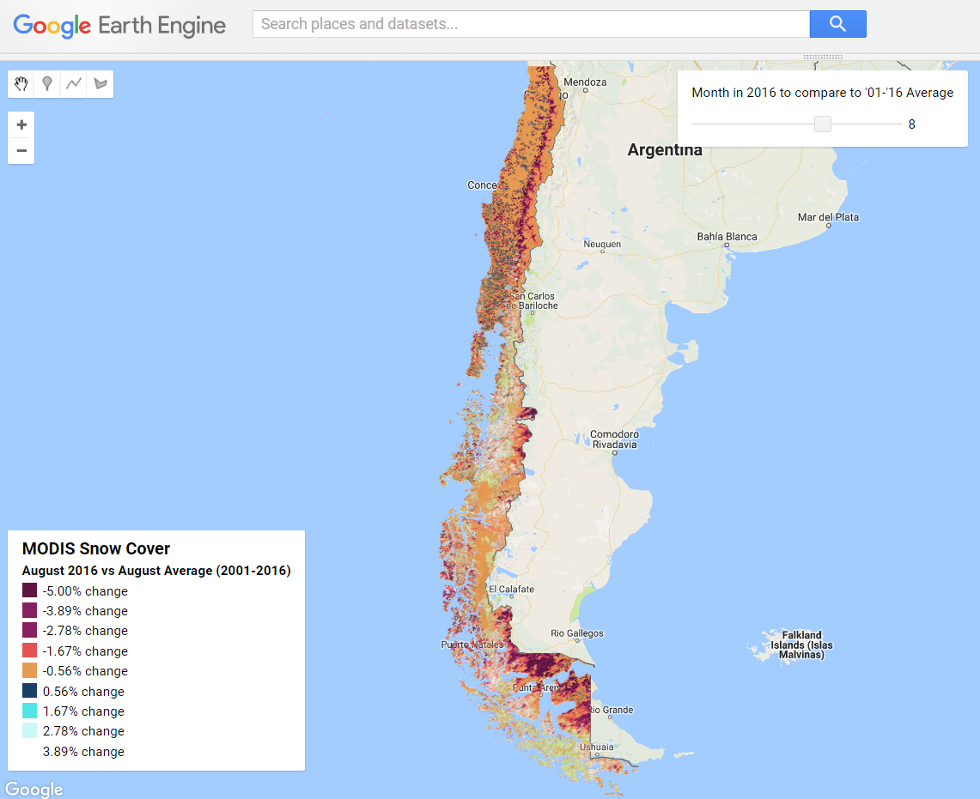
Sample Visualization: MODIS Snow Cover
August 2016 vs August Average (2001-2016)
-5.00% change
-3.89% change
-2.78% change
-1.67% change
-0.56% change
0.56% change
1.67% change
2.78% change
3.89% change
Snow Cover Percent Change - August 2016 vs August average (2001-2016)
Notes:
The NASA Software Release process does not allow us to share the tool we created at this time, but these are examples of what the scripts we developed within Google Earth Engine will do. Once the software release process is complete, these scripts will be made available to our project partners in addition to the public. They are open source which allow end-users to modify the scripts as necessary to suit their needs.

Slide 12
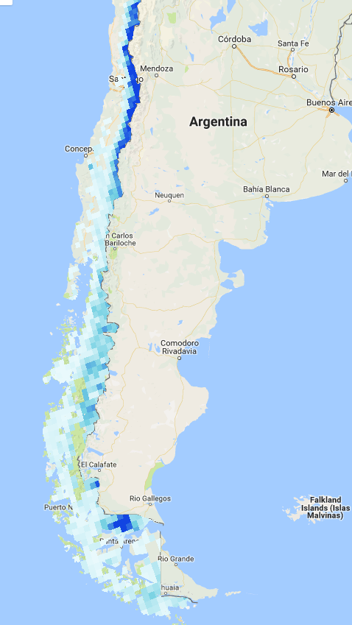
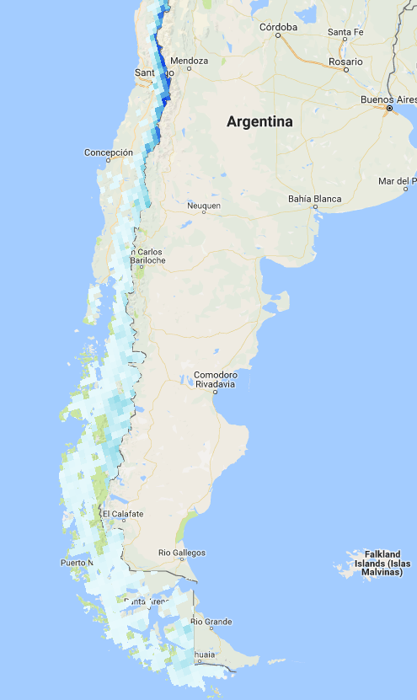
Sample Visualization: Snow Water Equivalent
Snow Water Equivalent
0mm
40mm
2002
2016
Notes:
This visualizations shows a comparison of SWE between 2002 and 20016. SWE is a measurement of snowpack. Think of it as the depth of water that would theoretically result if you melted the snowpack instantaneously (USDA Natural Resources Conservation Services Oregon).
https://www.nrcs.usda.gov/wps/portal/nrcs/detail/or/snow/?cid=nrcs142p2_046155

Slide 13
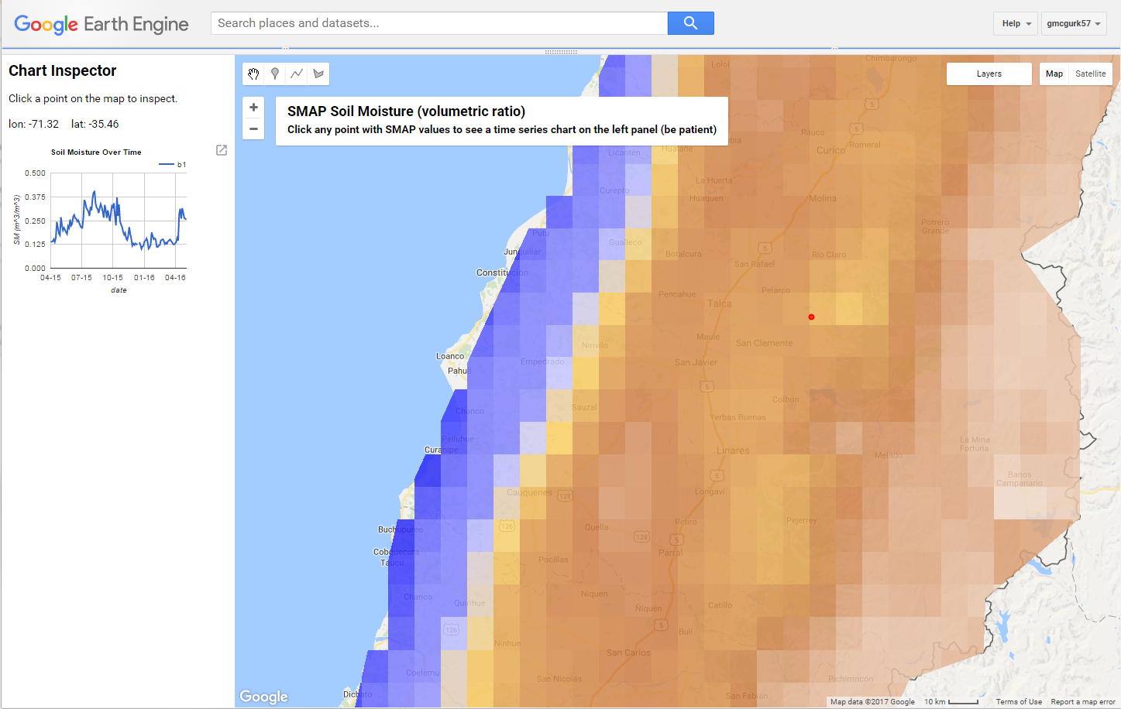
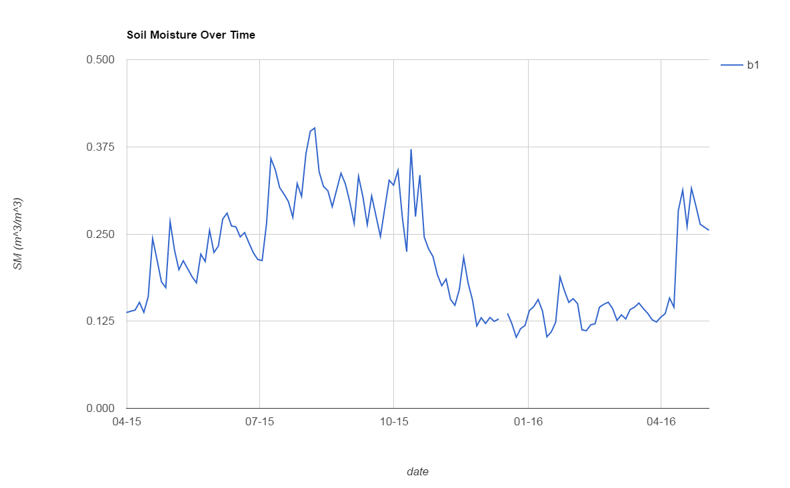
Sample Visualization: Soil Moisture
Soil Moisture Over Time
0.500
0.375
0.250
SM (m^3/m^3)
0.125
0.000
04-15
07-15
10-15
01-16
04-16
Date
SMAP Soil Moisture with Soil Moisture Over Time Graph
Notes:
Displays the ability of the HAE tool to produce histograms for further analysis. This visualization is showing changes in Soil moisture from April 2015 to 2016.

Slide 14
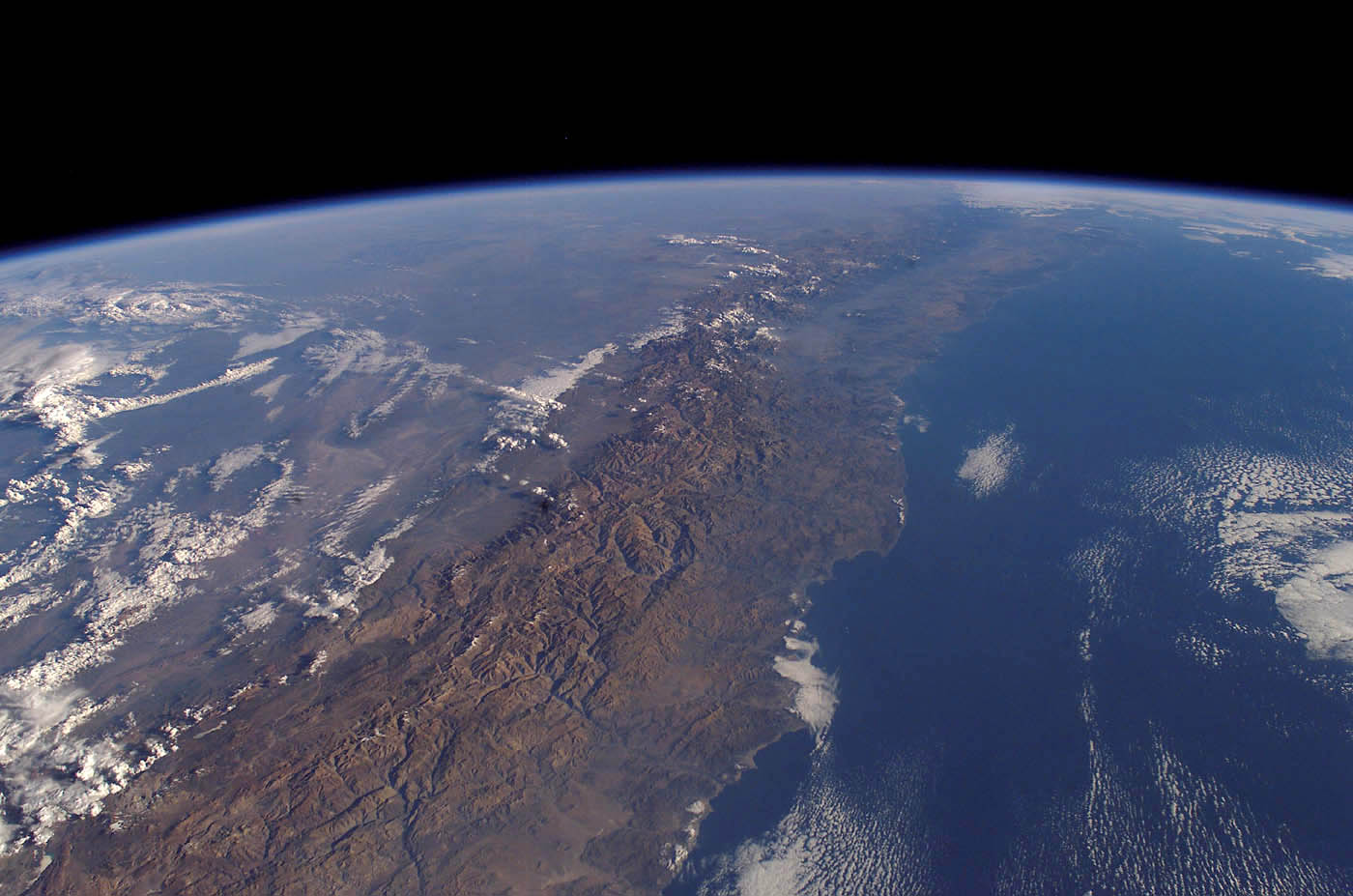
Discussion
Advantages
Consolidated, efficient, customizable
No monetary fees for users
Challenges
Uploading batch data with metadata
Downloading GeoTiff’s with projection
Good Free Photos
Notes:
Advantages:
-The interface is very easy for importing and assessing diverse remotely-sensed datasets.
-The server-side processing capabilities are immense and powerful.
-The documentation is clear and accessible.
-The file structure is organized and sharable.
-There is already a large amount of data available to the public that can be combined with in-situ data to perform analysis.
-It is free to use, which is unheard of for a program that that has this much processing power. Additionally, information is processed using Google servers, so the only limiting parameter for processing speed is the users internet connection.
Disadvantages:
The product is still a work in progress. Uploading datasets with appropriate metadata is a bit challenging. One particular challenge is explaining the bands with proper name, units, and descriptions. The only really important metadata piece for us was date, which we had to develop an unorthodox workaround to import. Uploading the data with the proper projection and scale is important as well, and can be a bit of a challenge along the multi-tier pipeline.
However, there are many resources to help users overcome these challenges including an online Google Earth Engine Developer forum that Google employees regularly answer user questions in.
Image Source: https://www.goodfreephotos.com/albums/chile/other-chile/chile-from-space.jpg

Slide 15
Future Work
Chile Water Resources Part II
Validation of Google Earth Engine API decision support tool
Quantify Glacier mass in Aconcagua region
Notes:
The second term of the NASA DEVELOP Chile Water Resources research project has two main objectives, the
first of which is to validate the Google Earth Engine API decision support tool created during
the previous term. The second objective is to determine glacier mass balance estimates from
the glaciers surrounding the Aconcagua region of Chile. These glaciers provide a largeamount of the water supply of agricultural lands. Water availability estimates will be derived
from these glacier-related calculations. Outcomes of this project aim to benefit the Ministry
of Agriculture in Chile by enhancing their decision-making process and better inform
agricultural practices, including irrigation recommendations. Satellites utilized will include Soil
Moisture Active Passive (SMAP), Moderate Resolution Imaging Spectroradiometer (MODIS),
GCOM-W1, SRTM, and the Landsat suite.

Slide 16
Advisors
Dr. Juan Torres-Perez, Bay Area Environmental Research Institute
Dr. Eduardo Bendek, NASA Ames Research Center
Dr. Kenton Ross, NASA Langley Research Center
Brittany Zajic, NASA DEVELOP
Jenna Williams, NASA DEVLOP
Nicholas Clinton, Google Earth Engine
Project Partners
Agricultural Office of the Chilean Embassy to the United States
Chile Ministry of Agriculture
Questions regarding this project should be directed to Garrett McGurk: gmcgurk57@gmail.com
Notes:
We would like to thank the above for their help throughout the lifecycle of this project.

