Slide 1
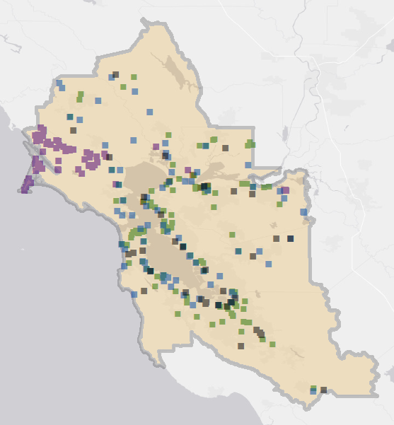
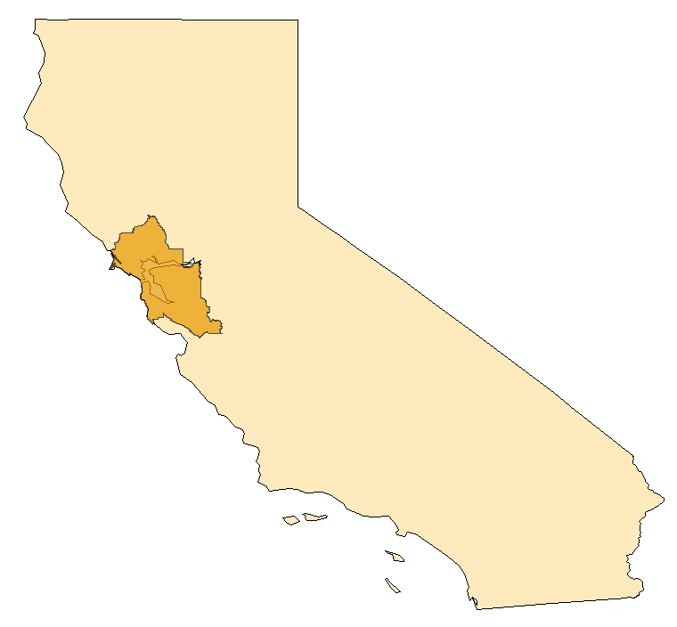
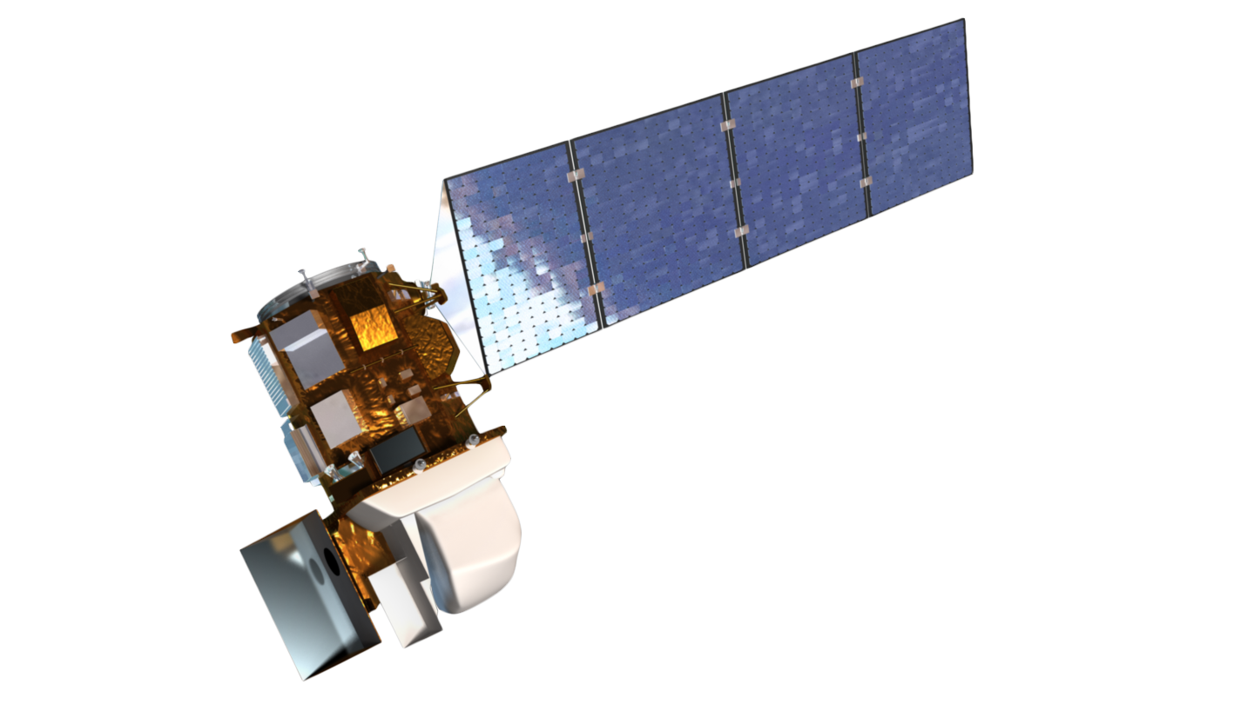
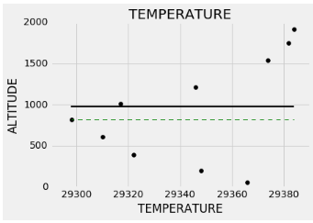
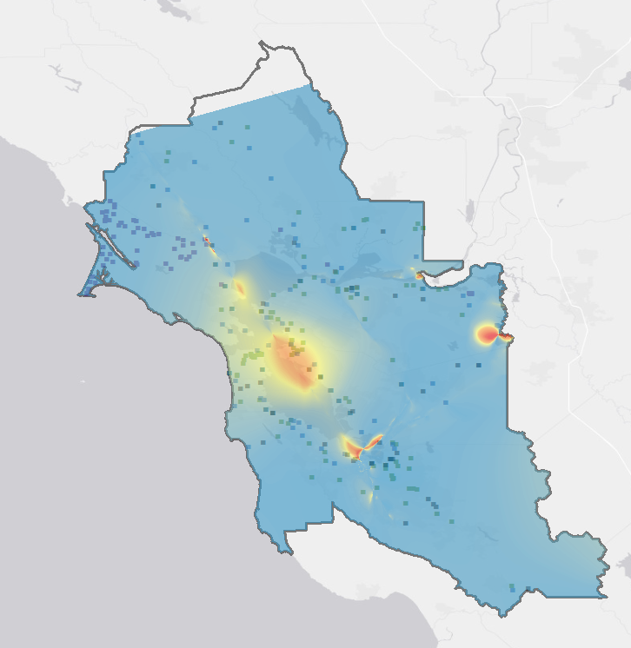
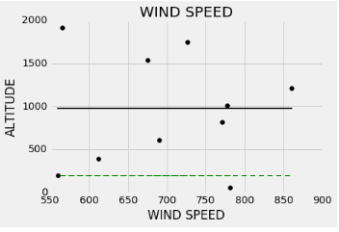
Using Aircraft and Ground-Based Observations to Monitor Methane and Improve a Greenhouse Gas Inventory Network for the San Francisco Bay Area
Abstract
Objectives
Methane (CH₄) is a potent greenhouse gas. According to the Environmental Protection Agency (EPA), one ton of methane emissions can absorb almost twenty- five times as much energy as one ton of carbon dioxide emissions over a one hundred year timescale. A majority of these emissions can be attributed to livestock farms, landfills, and wastewater treatment plants. The Bay Area Air Quality Management District (BAAQMD) regulates these and other stationary sources of air pollution in the nine counties surrounding San Francisco Bay, an area with a diverse array of landforms and emissions sources. BAAQMD traditionally estimates emissions using a bottom-up approach, combining emissions factor and activity data to estimate source emissions per sector. However, recent literature suggests that these bottom-up approaches are underestimating CH₄ emissions by nearly 50% in many regions of California. Therefore, there is interest in characterizing the ground-level distribution of methane within the urban region of the San Francisco Bay Area and comparing the top-down measurements with the bottom-up spatial emissions inventories utilized by the BAAQMD. Though Earth-observing satellites can effectively monitor mid-to-upper tropospheric CH₄ on a global scale, current instrumentation is limited in its capacity to accurately measure near-surface CH₄ on a local scale. This project used sub-Planetary Boundary Layer aircraft measurements from the NASA Alpha Jet Atmospheric eXperiment (AJAX) to create a comprehensive spatially-resolved CH₄ map. Locations of “hotspots” (classified as significantly elevated CH₄ concentrations) were investigated using US Geological Survey (USGS) High-Resolution Orthoimagery (HRO) and trajectory analysis. Furthermore, NASA Landsat 8 imagery and HRO were used to classify the types of indicated emission sources and infer other points of concern not included in the current BAAQMD emissions inventory. These findings help pinpoint specific sites for further investigation by the upcoming BAAQMD Mobile GHG Measurement Network; furthermore, this project suggests future sites for coincident data collection by various top-down methods.
Develop comprehensive spatially-resolved CH₄ map for the San Francisco Bay Area using NASA AJAX data
Locate and investigate CH₄ “hotspots” using anomalies detected by AJAX to pinpoint specific sites for further monitoring via upcoming BAAQMD Mobile GHG Measurement Network
Classify high-emissions sources using NASA Landsat 8 and US Geological Survey (USGS) High-Resolution Orthoimagery (HRO)
Study Area
Landfill
Water treatment plant
Power plant
Refinery
Dairy
Figure 2: Locations of current BAAQMD greenhouse inventory sites. The shaded region marks the BAAQMD boundary.
Methodology
AJAX CH₄ Flight Data
Determine PBL For Each Flight
Identify Areas of Elevated CH₄
CH₄ Hotspot Map
Earth Observations
Updated BAAQMD CH₄ Inventory
USGS High Resolution Orthoimagery
BAAQMD GHG Spatial Inventory
Landsat 8 OLI Imagery
NASA AJAX
San Francisco Bay Area Health & Air Quality
Landsat 8 OLI
Conclusions
Although Earth-observing satellites can effectively monitor mid-to-upper tropospheric CH₄ on a global scale, current instrumentation is limited in its capacity to accurately measure near-surface CH₄ on a local scale.
Airborne in situ greenhouse gas concentration data from below the planetary boundary layer (PBL) can be utilized in understanding near-surface CH₄ concentrations.
The San Francisco Bay Area has many CH₄ “hotspots” downwind of dairies, landfills, and areas of oil and gas production. A number of these sources are missing from the current BAAQMD bottom-up emissions inventory. Possible emissions sources can be classified using high-resolution Earth imagery.
Local Meteorological Data
Source-specific CH₄
Trajectory Analysis
Figure 1: Flowchart describing data acquisition (green) and processing (blue). Final products in red.
Project Partners
Results
Bay Area Air Quality Management District
Dr. Abhinav Guha, Senior Air Quality Engineer
Dr. Phil Martien, Air Quality Engineering Manager
Ms. Abby Young, Climate Protection Manager
NASA Alpha Jet Atmospheric eXperiment
Dr. Laura Iraci, Dr. Josette Marrero,
Dr. Emma Yates, & Mr. Warren Gore
A)
B)
C)
High: 2.663
Low: 1.8275
Acknowledgements
NASA Ames Research Center
Ms. Chippie Kislik, DEVELOP Center Lead
Ms. Vickie Ly, DEVELOP Assistant Center Lead
Any opinions, findings, and conclusions or recommendations expressed in this material are those of the author(s) and do not necessarily reflect the views of the National Aeronautics and Space Administration. This material is based upon work supported by NASA through contract NNL11AA00B and cooperative agreement NNX14AB60A.
Team Members
Figure 3: A) AJAX flight paths over the San Francisco Bay Area; BAAQMD jurisdiction outlined in black. B) Temperature and wind speed profiles for AJAX Flight 98 (September 10th, 2013); PBL (as defined by algorithm) marked in red. C) Comprehensive CH₄ map for BAAQMD jurisdiction.
Maya Midzik
Project Lead
Joseph
Abbate
Garima
Raheja
NASA Ames Research Center - Summer 2016

