Slide 1
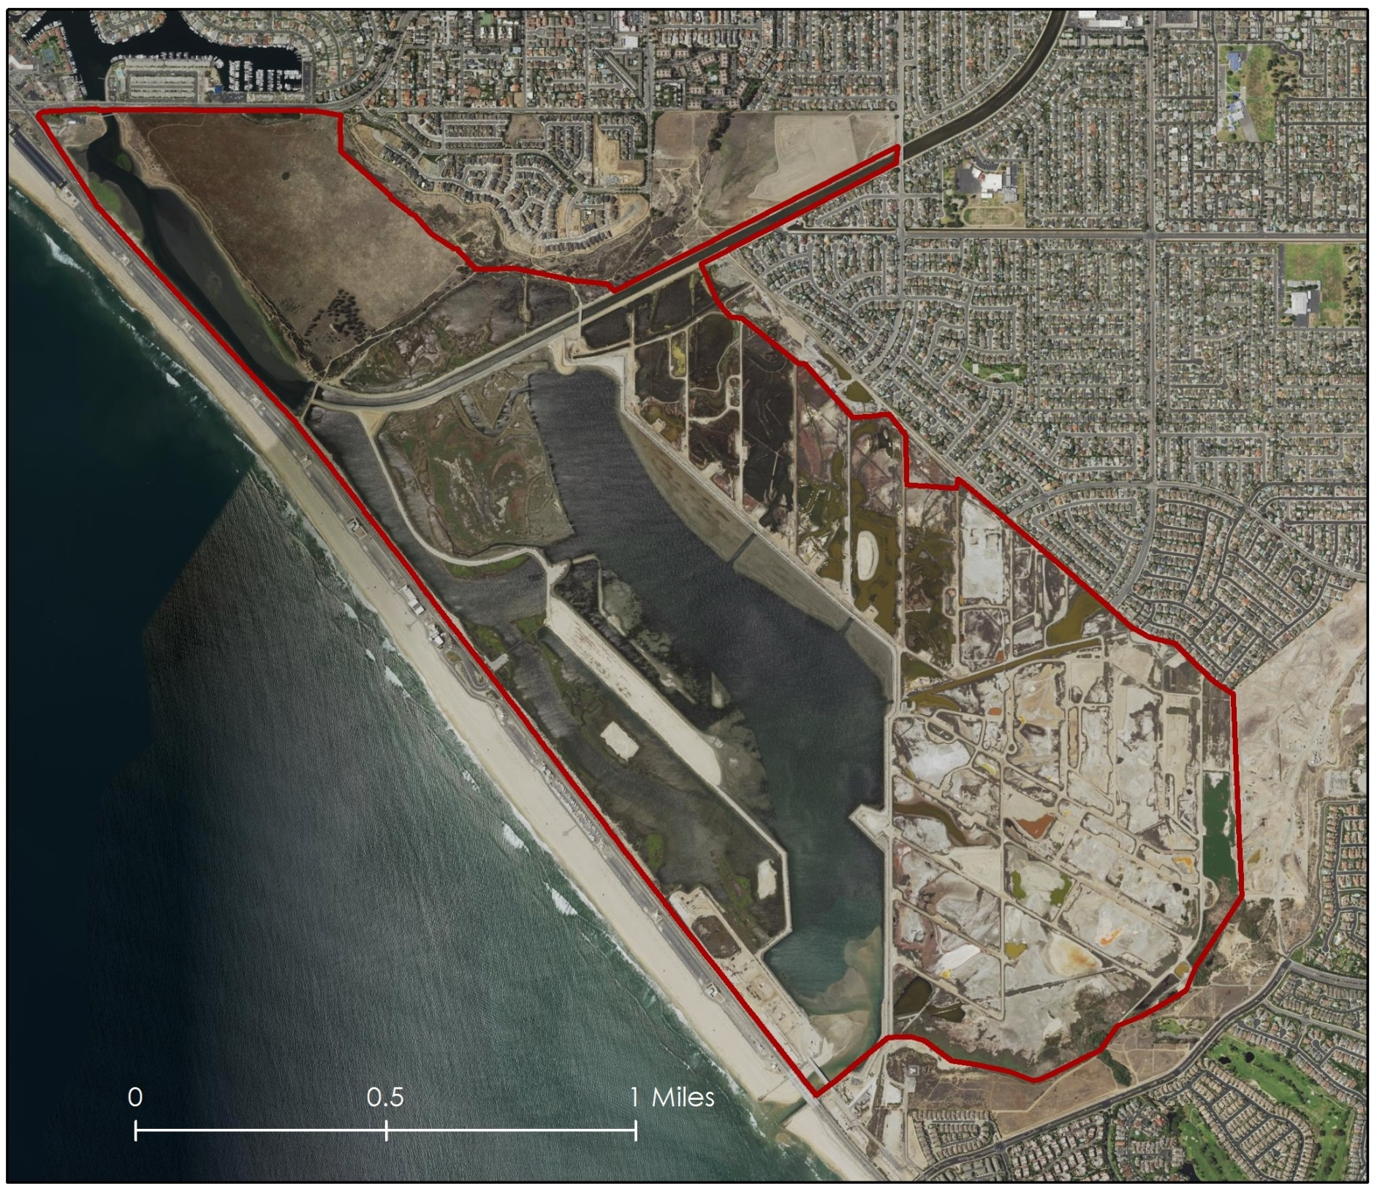
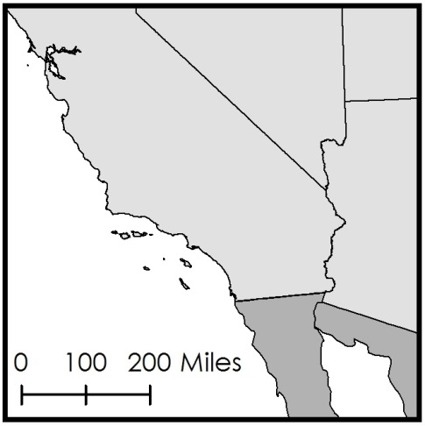
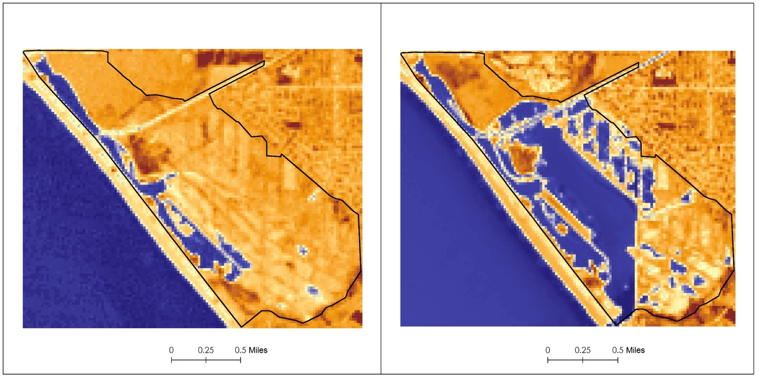
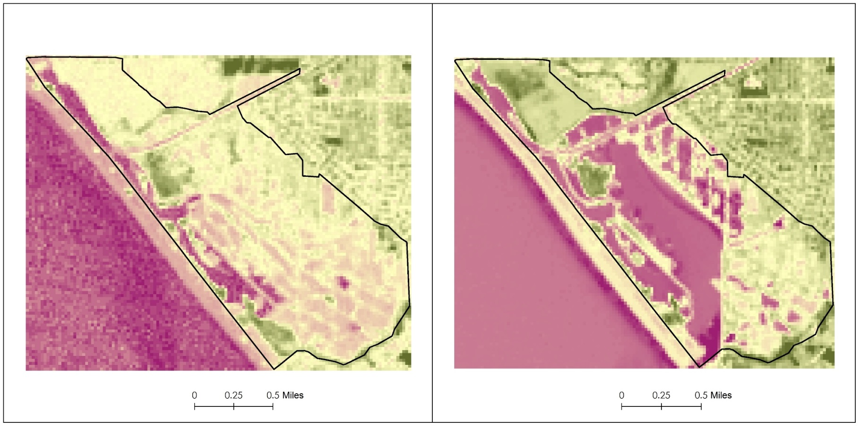
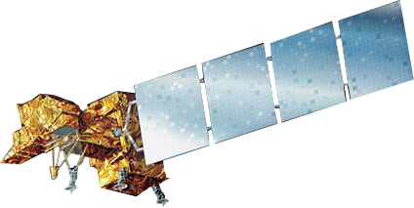
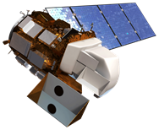
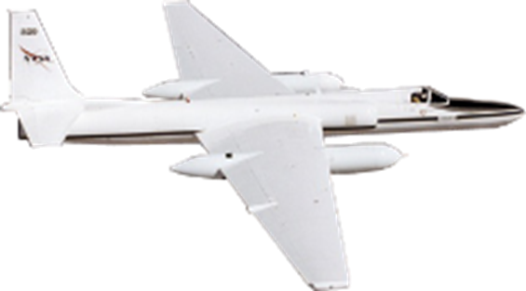
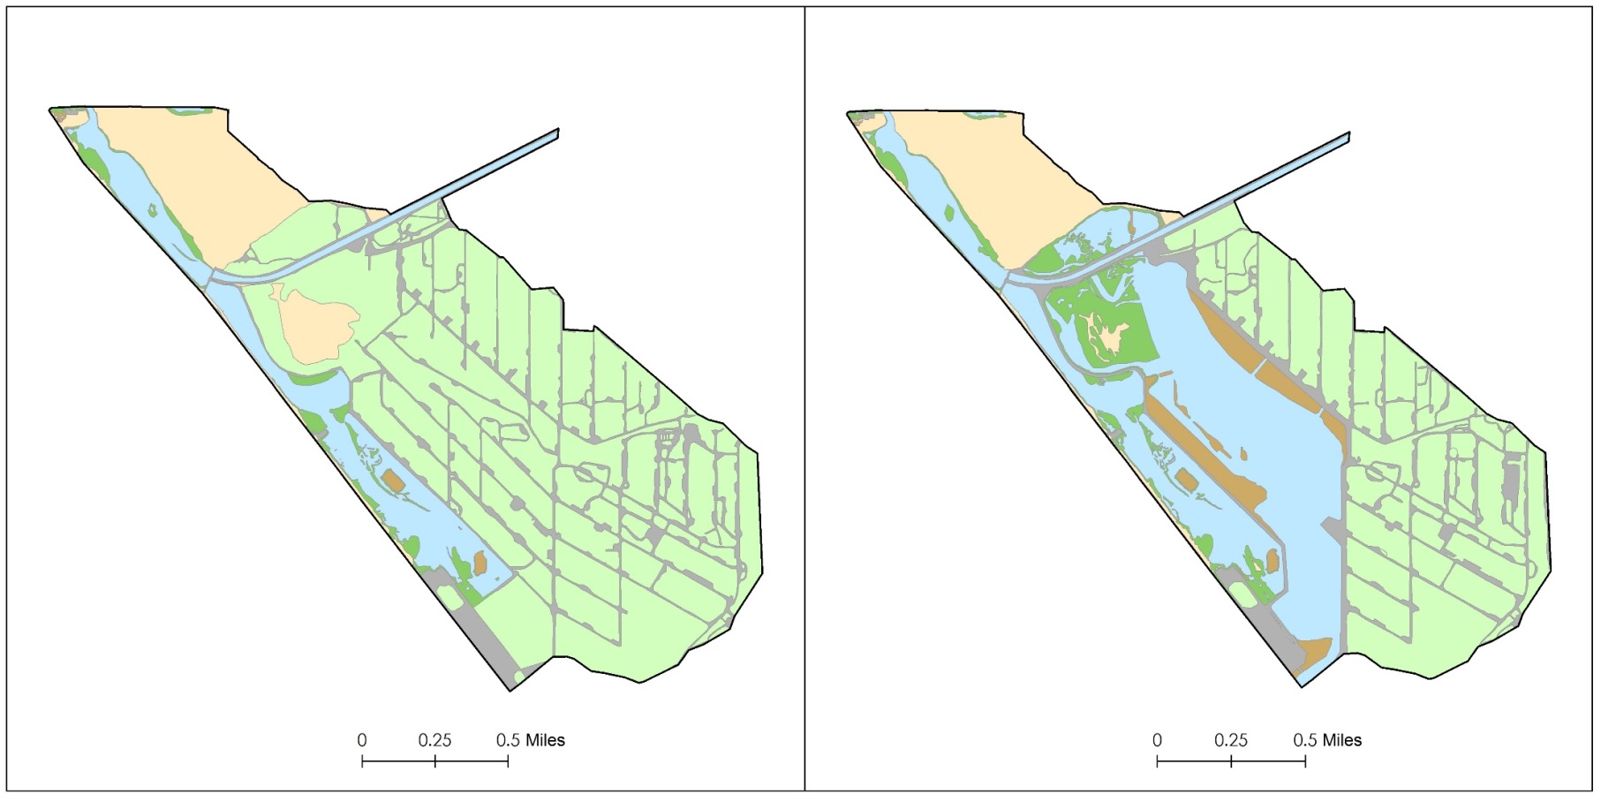
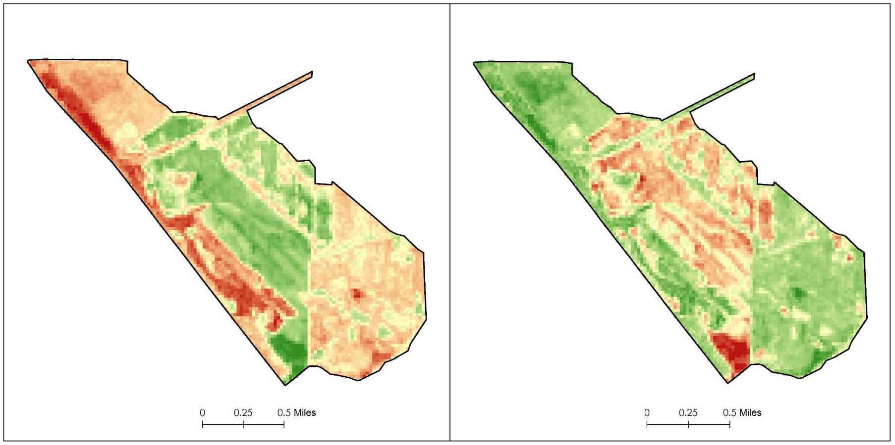
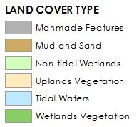
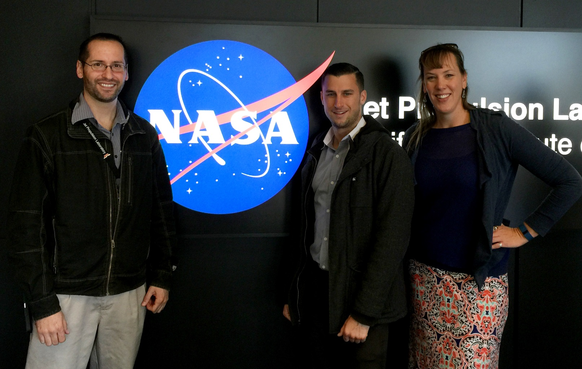
Bolsa Chica Ecological Forecasting
Analyzing the Success of the Bolsa Chica Wetland Restoration Using Multi-Spectral NASA Earth Observations
Christine Elowitt (Project Lead), Steven Kerns, Nick Rousseau
DEVELOP National Program at NASA Jet Propulsion Laboratory
Abstract
Objectives
ER-2 AVIRIS
Expand the Amigos de Bolsa Chica’s education and outreach program by creating an interactive online map resource for public use.
Create a time-series analysis to demonstrate Bolsa Chica wetland restoration success from 1984-2015.
Determine the location of specific plant species in inaccessible regions using NASA remote sensing technologies.
Synthesize existing biological data, project results, and satellite images in order to provide a new framework in which to view wetlands success.
The Bolsa Chica Ecological Reserve in Huntington Beach, California, consists of 1550 acres of undeveloped coastal wetland and is home to several endangered species, including Rallus longirostris levipes and Sterna antillarum browni, which fly along the Pacific flyway. Since the 1800’s, farming, land subsidence, resource extraction, and land development have impacted these wetlands, affecting the habitat’s biodiversity. The Amigos de Bolsa Chica advocacy group has made a 40-year effort to preserve, restore, and maintain the wetlands through volunteer work and public outreach, impacting public policy and management practices. However, there has been no previous attempt to assess the success of the restoration using aerial imagery. This project utilized NASA Earth observations, USDA National Agriculture Imagery Program (NAIP) imagery, USGS High Resolution Orthoimagery and Digital Orthographic Quadrangles, and GIS analysis and statistics to highlight the changes in habitat and tidal water extent from 2002 to 2015, with a specific focus on the changes that ensued from the opening of a channel connecting the site to the ocean in 2006. Our results show a 164% increase in wetlands vegetation, a 146% increase in tidal waters, and a 37% decrease in man-made features and non-tidal wetlands. Using a before and after time series based off of our analysis and vegetation maps of the current site, the Amigos de Bolsa Chica will be able to enhance their education and outreach, create more effective tools to engage the community, and strengthen their management of the wetlands to better prioritize areas of future concern.
Study Area
Methodology
Bolsa Chica Ecological Reserve, Huntington Beach CA
Acquire
Analyze
Produce
Study Area
AVIRIS Imagery
(2015)
Classify land cover types
(ENVI)
Land cover classification
Landsat Imagery
(2002, 2015)
Calculate NDVI and NDWI indices (QGIS)
Index and index change maps
USDA NAIP and USGS Imagery
(2003, 2005, 2014)
Panchromatically sharpen images (ArcGIS)
Land cover maps and statistics
NOAA Coastal Change Analysis
(1996 to 2010)
Create land cover vector layers (ArcGIS)
Graphics for the Amigos’ website and brochures
Results
Study Period: 2002 - 2015
Earth Observations
Landsat 7 ETM+
Landsat 8 OLI
ER-2 AVIRIS
Normalized Difference Water Index (NDWI) Maps, 2002 and 2015
Normalized Difference Vegetation Index (NDVI) Maps, 2002 and 2015
Project Partners
The Amigos de Bolsa Chica
Acknowledgements
Ben Holt (JPL), NASA DEVELOP Mentor
Cedric Fichot (JPL), Science Advisor
Joana Taveras-Reager, Vic Leipzig and Jerry Donohue of the Amigos de Bolsa Chica advocacy group
Bruce Chapman (JPL) and David Thompson (JPL)
Brittany Zajic, Emily Beck, Erika Higa, Rebecca Trinh and Gwen Miller of NASA DEVELOP
Land Cover Categorization Maps, 2002 and 2015
Change in NDWI and NDVI from 2002 to 2015
Team Members
Land Cover Change Statistics from 2002 to 2015
Conclusions
From left to right: Nick Rousseau, Steven Kerns, and Christine Elowitt (Project Lead)
Full tidal inflow was restored to the site.
Wetlands vegetation increased by 164% and tidal waters by 146%.
The extent of man-made features and non-tidal wetlands decreased by 37%.
With restoration still in progress, we established a baseline to which to compare the future state of the site.
Output graphics and statistics add scientific rigor to the Amigos’ outreach efforts.
NASA Jet Propulsion Laboratory

