Slide 1
Sierra Nevada Water Resources
A Quantitative Assessment of Wildfire Severity and its Effects on Snow Water Equivalent In the Sierra Nevada
Sean Cunningham (Project Lead)
Justin Anzelc
Vishal Arya
Nolan Cate
Clayton Sodergren
Notes:
Please ignore the minor formatting issues as they will be fixed, i.e. the heading placement on each slide (should be the same)

Slide 2
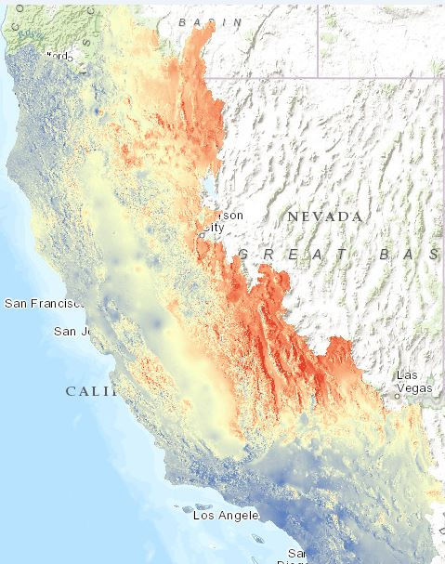
Background
CA Water Resources
Snowpack is a crucial component of California water supply.
Management and fire suppression policies are increasing wildfire frequency and severity.
Little research exists quantifying effects of wildfire severity on snowpack.
2014 BCM projected change in winter minimum temperature, 2070-2099 vs. 1981-2010 using MIROC ESM rcp 8.4
Notes:
Sierra Nevada Ecosystem Services
Carbon sequestration, water filtration and purification, snowpack and snowmelt, etc..
CA Water Resources
Snowpack is a crucial component of California water supply.
Adversely affected by climate change and other factors..
Management and fire suppression policies are increasing wildfire frequency and severity
Little data quantifying effects of wildfire severity on snowpack
How are ecosystem services and water resources affected?

Slide 3
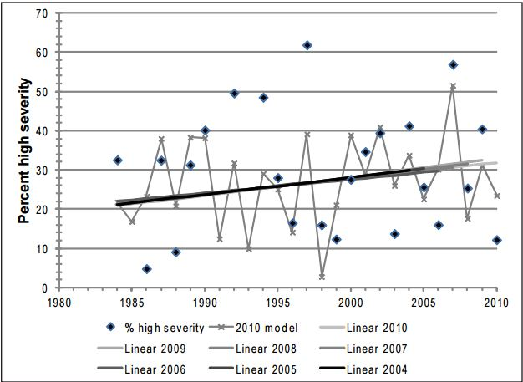
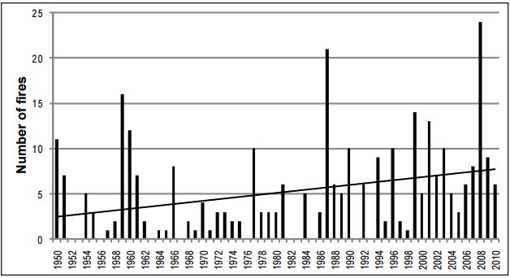
Background
A Qualitative Understanding
Sierra Nevada (SN) forest ecosystems adapted to, and require, low-moderate severity wildfire to remain healthy.
High-severity wildfire negatively impacts soil quality/structure, aquatic ecosystems, stand structure, surface albedo, etc.
Temporal trends in percentage of high-severity fire for yellow-pine-mixed-conifer (YPMC) forest types in fires ≥400 ha in the study area between 1984 to 2010
Linear trend line for years 1950 to 2010 is significant at P = 0.019
Notes:
A Qualitative Understanding
Strict enforcement of 1930’s federal fire suppression policies → divergence from historical fire regimes → increase in fuel load/ vegetation density → increase wildfire frequency/ severity
SN forest ecosystems adapted to and require low-moderate severity wildfire to remain healthy
High-severity wildfire negatively impacts soil quality/ structure, aquatic ecosystems, stand structure, surface albedo
Affect on water resources needs to be quantified

Slide 4
Community Concerns
Snowpack in the SN is a major source of drinking water.
Wildfire size, severity, and frequency are increasing in the SN.
Current forest management practices and policies cause deviations from natural fire regimes.
Notes:
Will be edited to add some kind of imagery

Slide 5
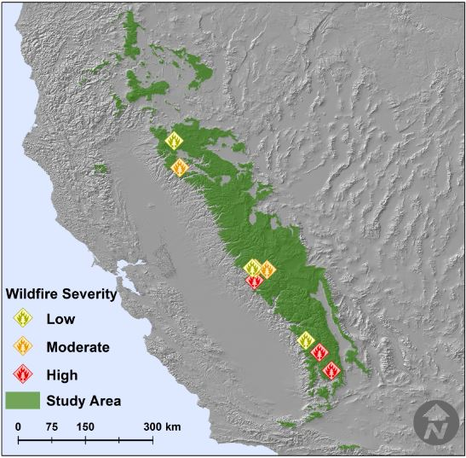
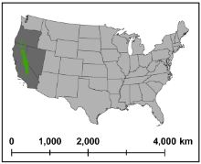
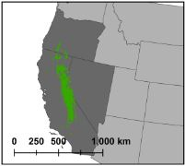
Study Area
Notes:
Confined to M261 watersheds
Elevation > 1500 m and wilderness areas mask
Nine Wildfires:
High: 2000 Manter, 1990A_Rock, 2007 Grouse
Moderate: 2004 Hetchy, 2009 Wildcat, 2000 Storrie
Low: 2005 Wapama, 2009 Fairfield, 1995 Castle

Slide 6
Objectives
Map snow and vegetation cover from 1984-2015
Quantify the effect of wildfire burn severity on BCM variables
Land-surface temperature (LST)
Snowmelt (SM) timing
Soil water storage (SWS)
Conduct seasonal trend analysis
Notes:
Use Landsat data to map snow and vegetation cover from 1984-2015 within the area of nine wildfires and quantify the effect of wildfire burn severity on snow cover.
Quantify the effect of wildfire burn severity on land-surface temperature (LST), snow melt timing and snow water equivalent (SWE) using the California 2014 Basin Characterization Model (BCM).
Conduct seasonal trend analysis to quantify changes in the seasonality of snow cover in relation to wildfire burn severity.

Slide 7
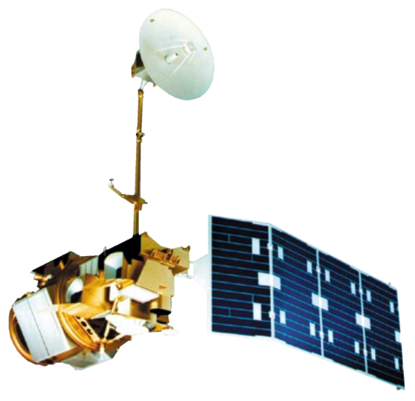
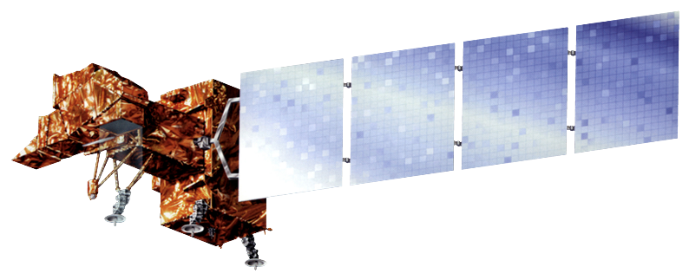
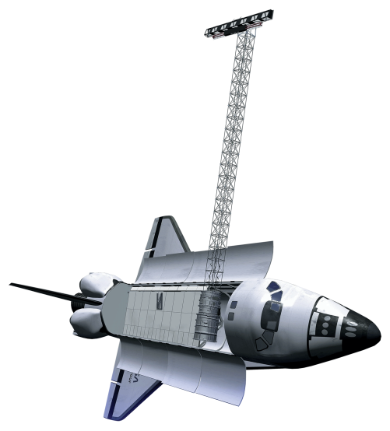
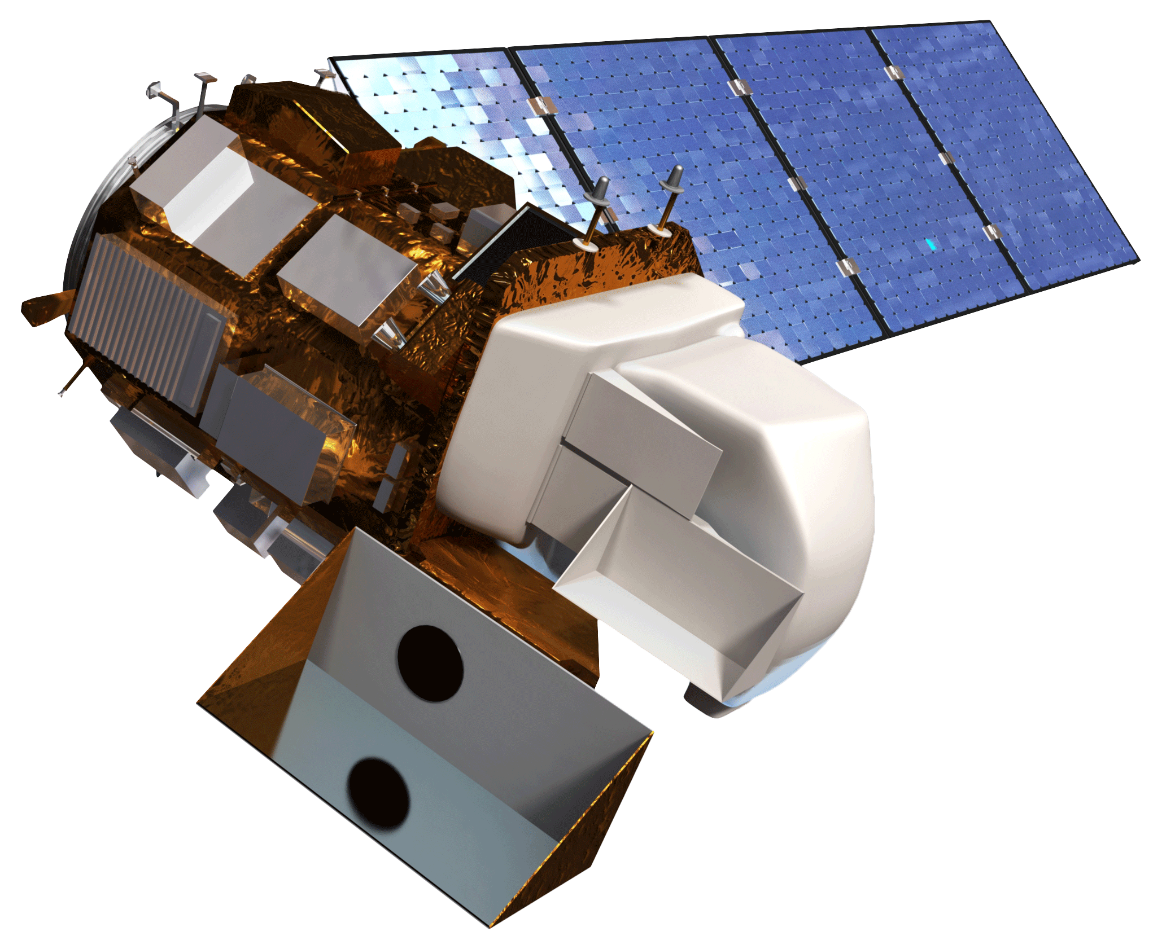
Earth Observations
Landsat 4-5 (TM)
Landsat 7 (ETM+)
Landsat 8 (OLI)
SRTM

Slide 8
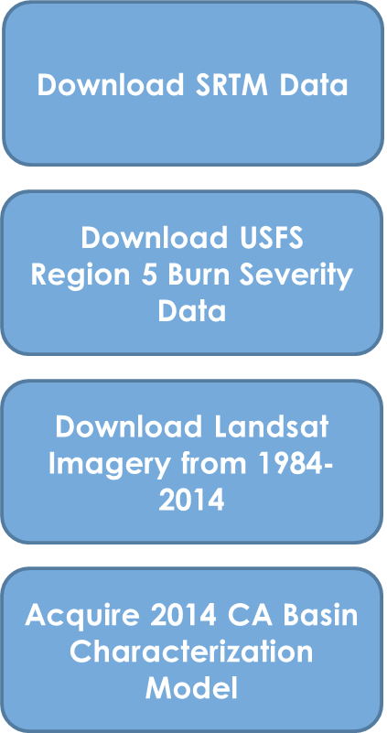
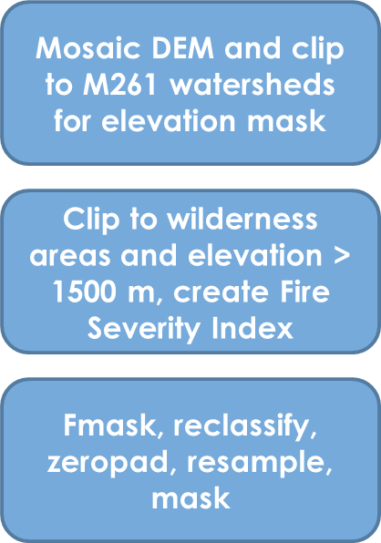
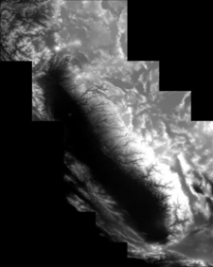
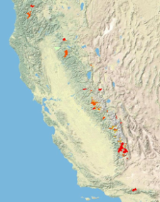
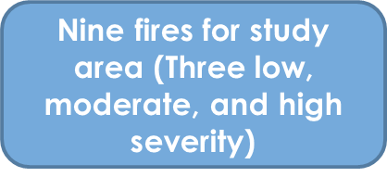
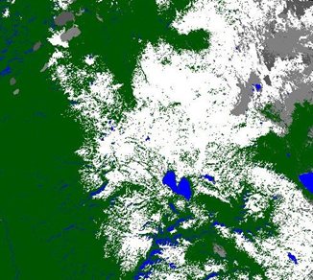
Methodology
Initial Data
Preprocessing
Final Analysis
+
FINAL IMAGE HERE

Slide 9
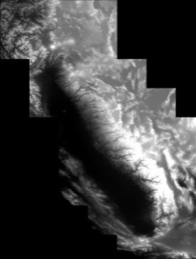
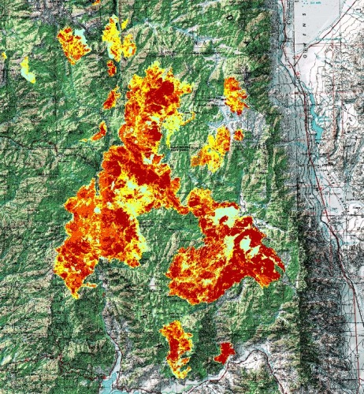
Methodology
SRTM
Region 5 Burn Severity Data
+
+
Notes:
Will be edited with different imagery for SRTM

Slide 10
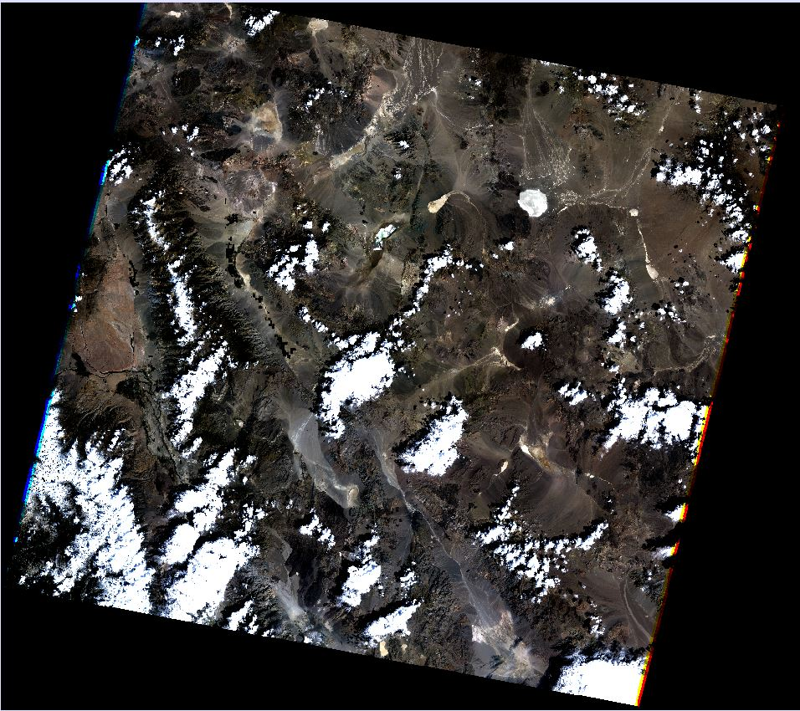
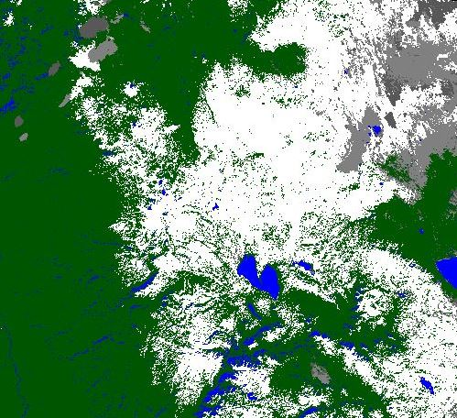
Methodology
Landsat Image
Landsat Fmask
For presentation final Landsat images need to be from the same tile
Notes:
Will be edited with additional text and different imagery

Slide 11
Methodology
Landsat NDVI
Landsat NDSI
Notes:
Will be edited with additional text and different imagery

Slide 12
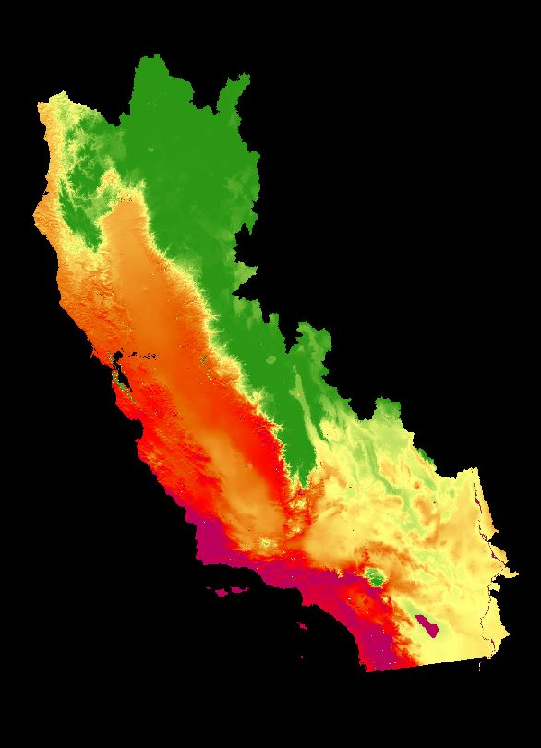
Methodology
BCM Land Surface Temperature
Notes:
Will be edited with additional text and different imagery

Slide 13
Methodology
Image Showing Results
Nine fires for study area
Seasonal trend analysis
Notes:
Will be edited with additional text and different imagery

Slide 14
Results
Notes:
Will be edited with additional text and different imagery

Slide 15
Conclusions
Notes:
Will be edited with additional text and different imagery

Slide 16
Uncertainties & Limitations
Notes:
Will be edited with additional text and different imagery

Slide 17
Future Work
Notes:
Will be edited with additional text and different imagery

Slide 18
Acknowledgements
Advisors
Dr. Marc Meyer, USDA Forest Service
Andrew Nguyen, DEVELOP National Program, NASA Ames Research Center
Partners
Dr. Marc Meyer, USDA Forest Service
Jim Roche, National Park Service
Others
Chippie Kislik, DEVELOP National Program, NASA Ames Research Center
This material is based upon work supported by NASA through contract NNL11AA00B and cooperative agreement NNX14AB60A.

Slide 19
References
Notes:
Will be edited with additional text and different imagery

Slide 20
Backup/ Extra Slides
Notes:
Will be edited with additional text and different imagery

