Slide 1
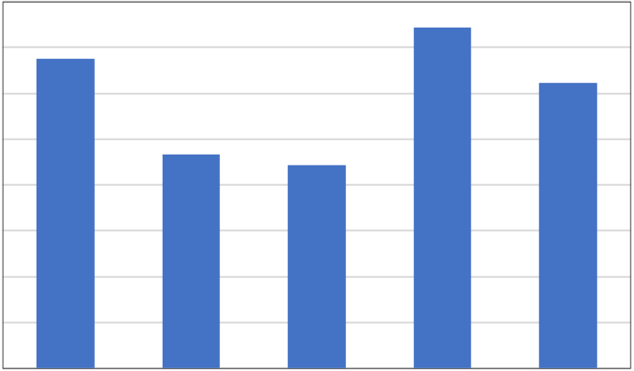
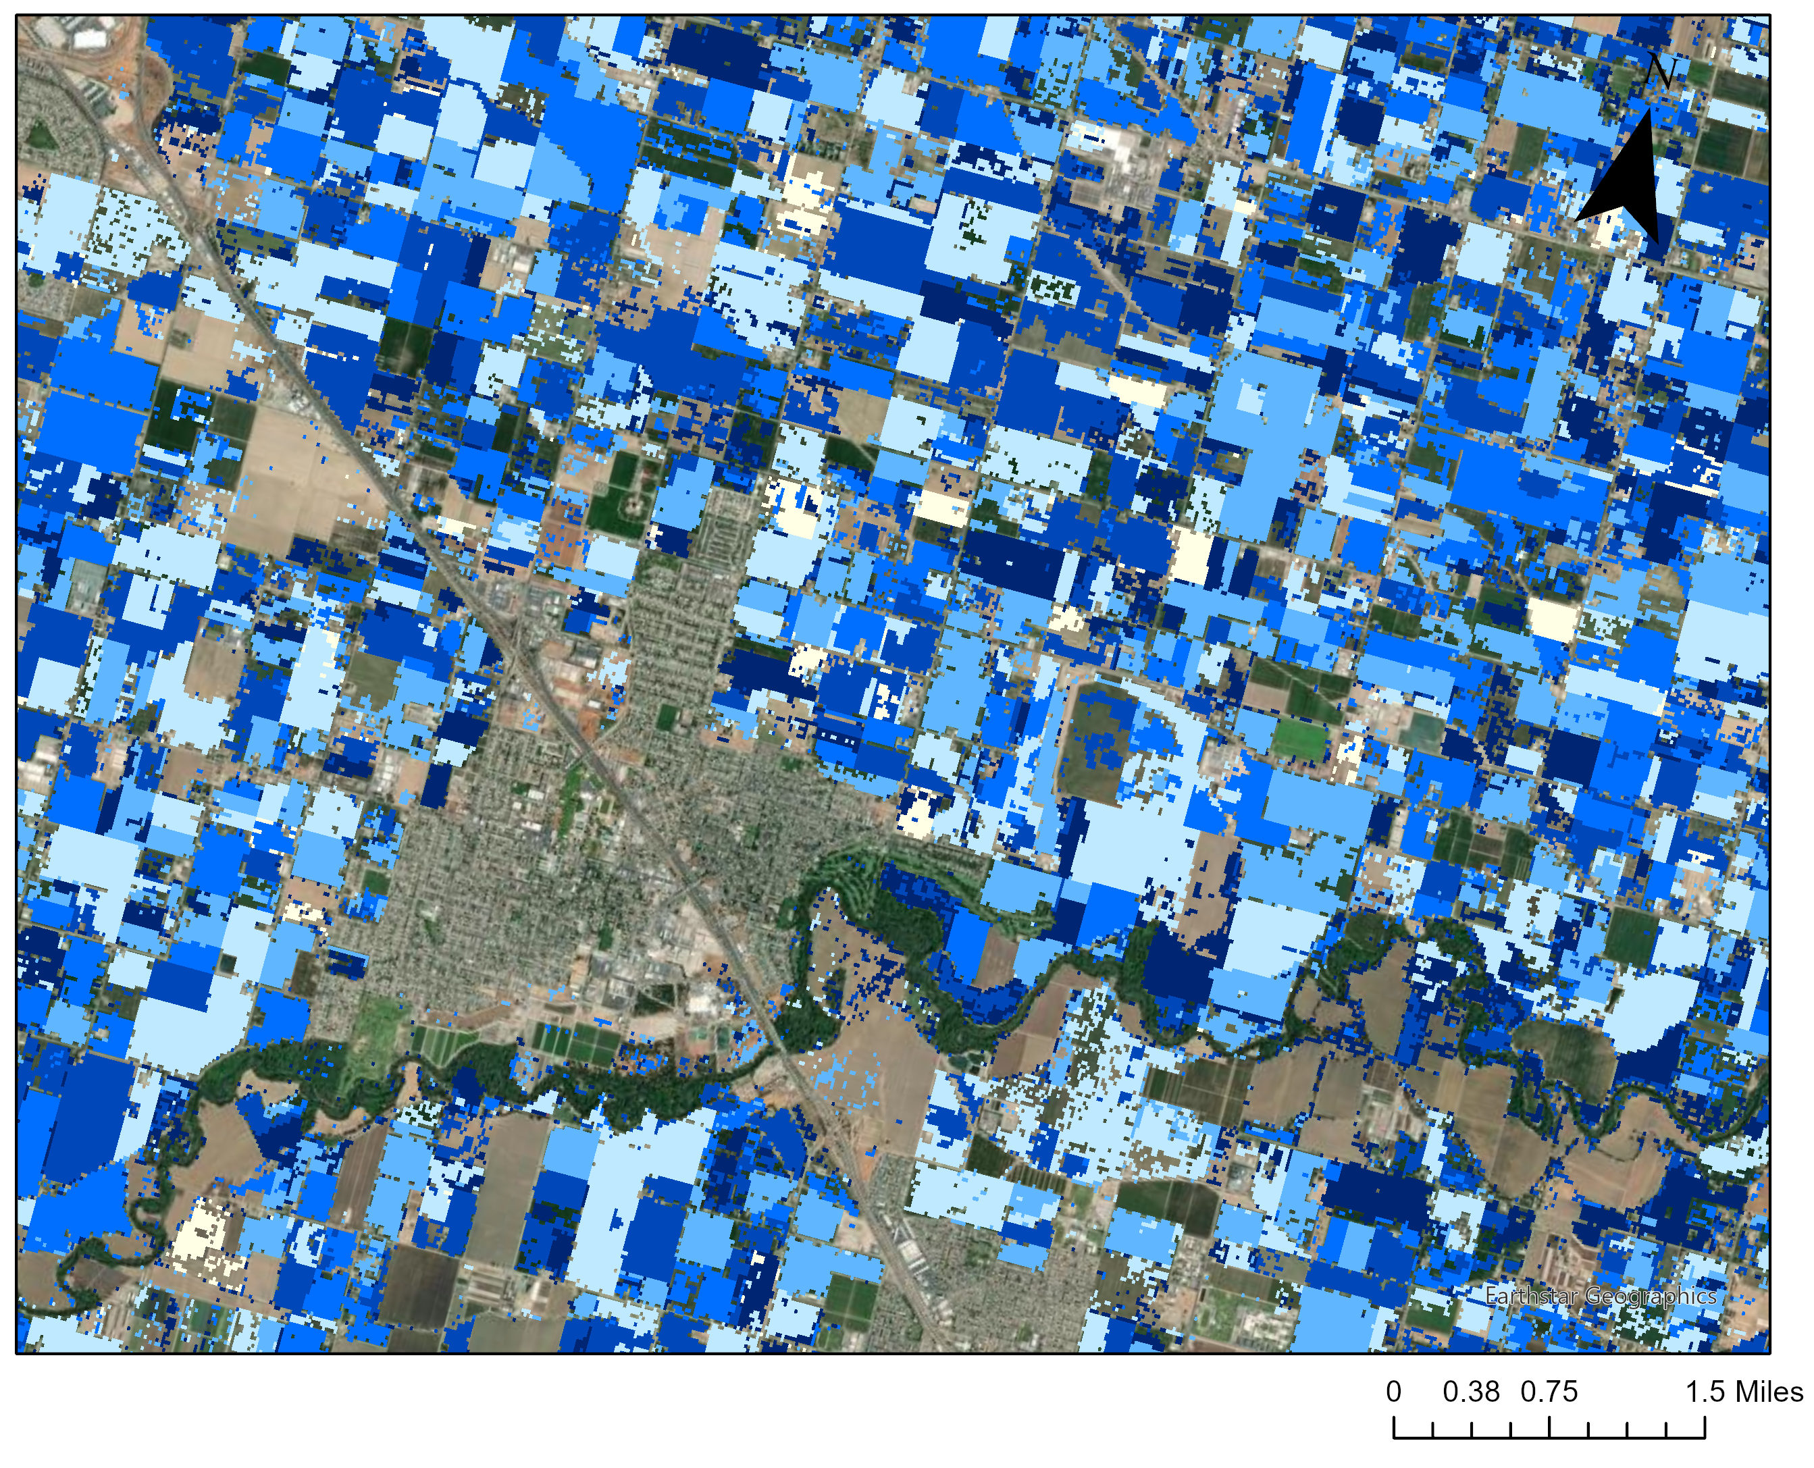
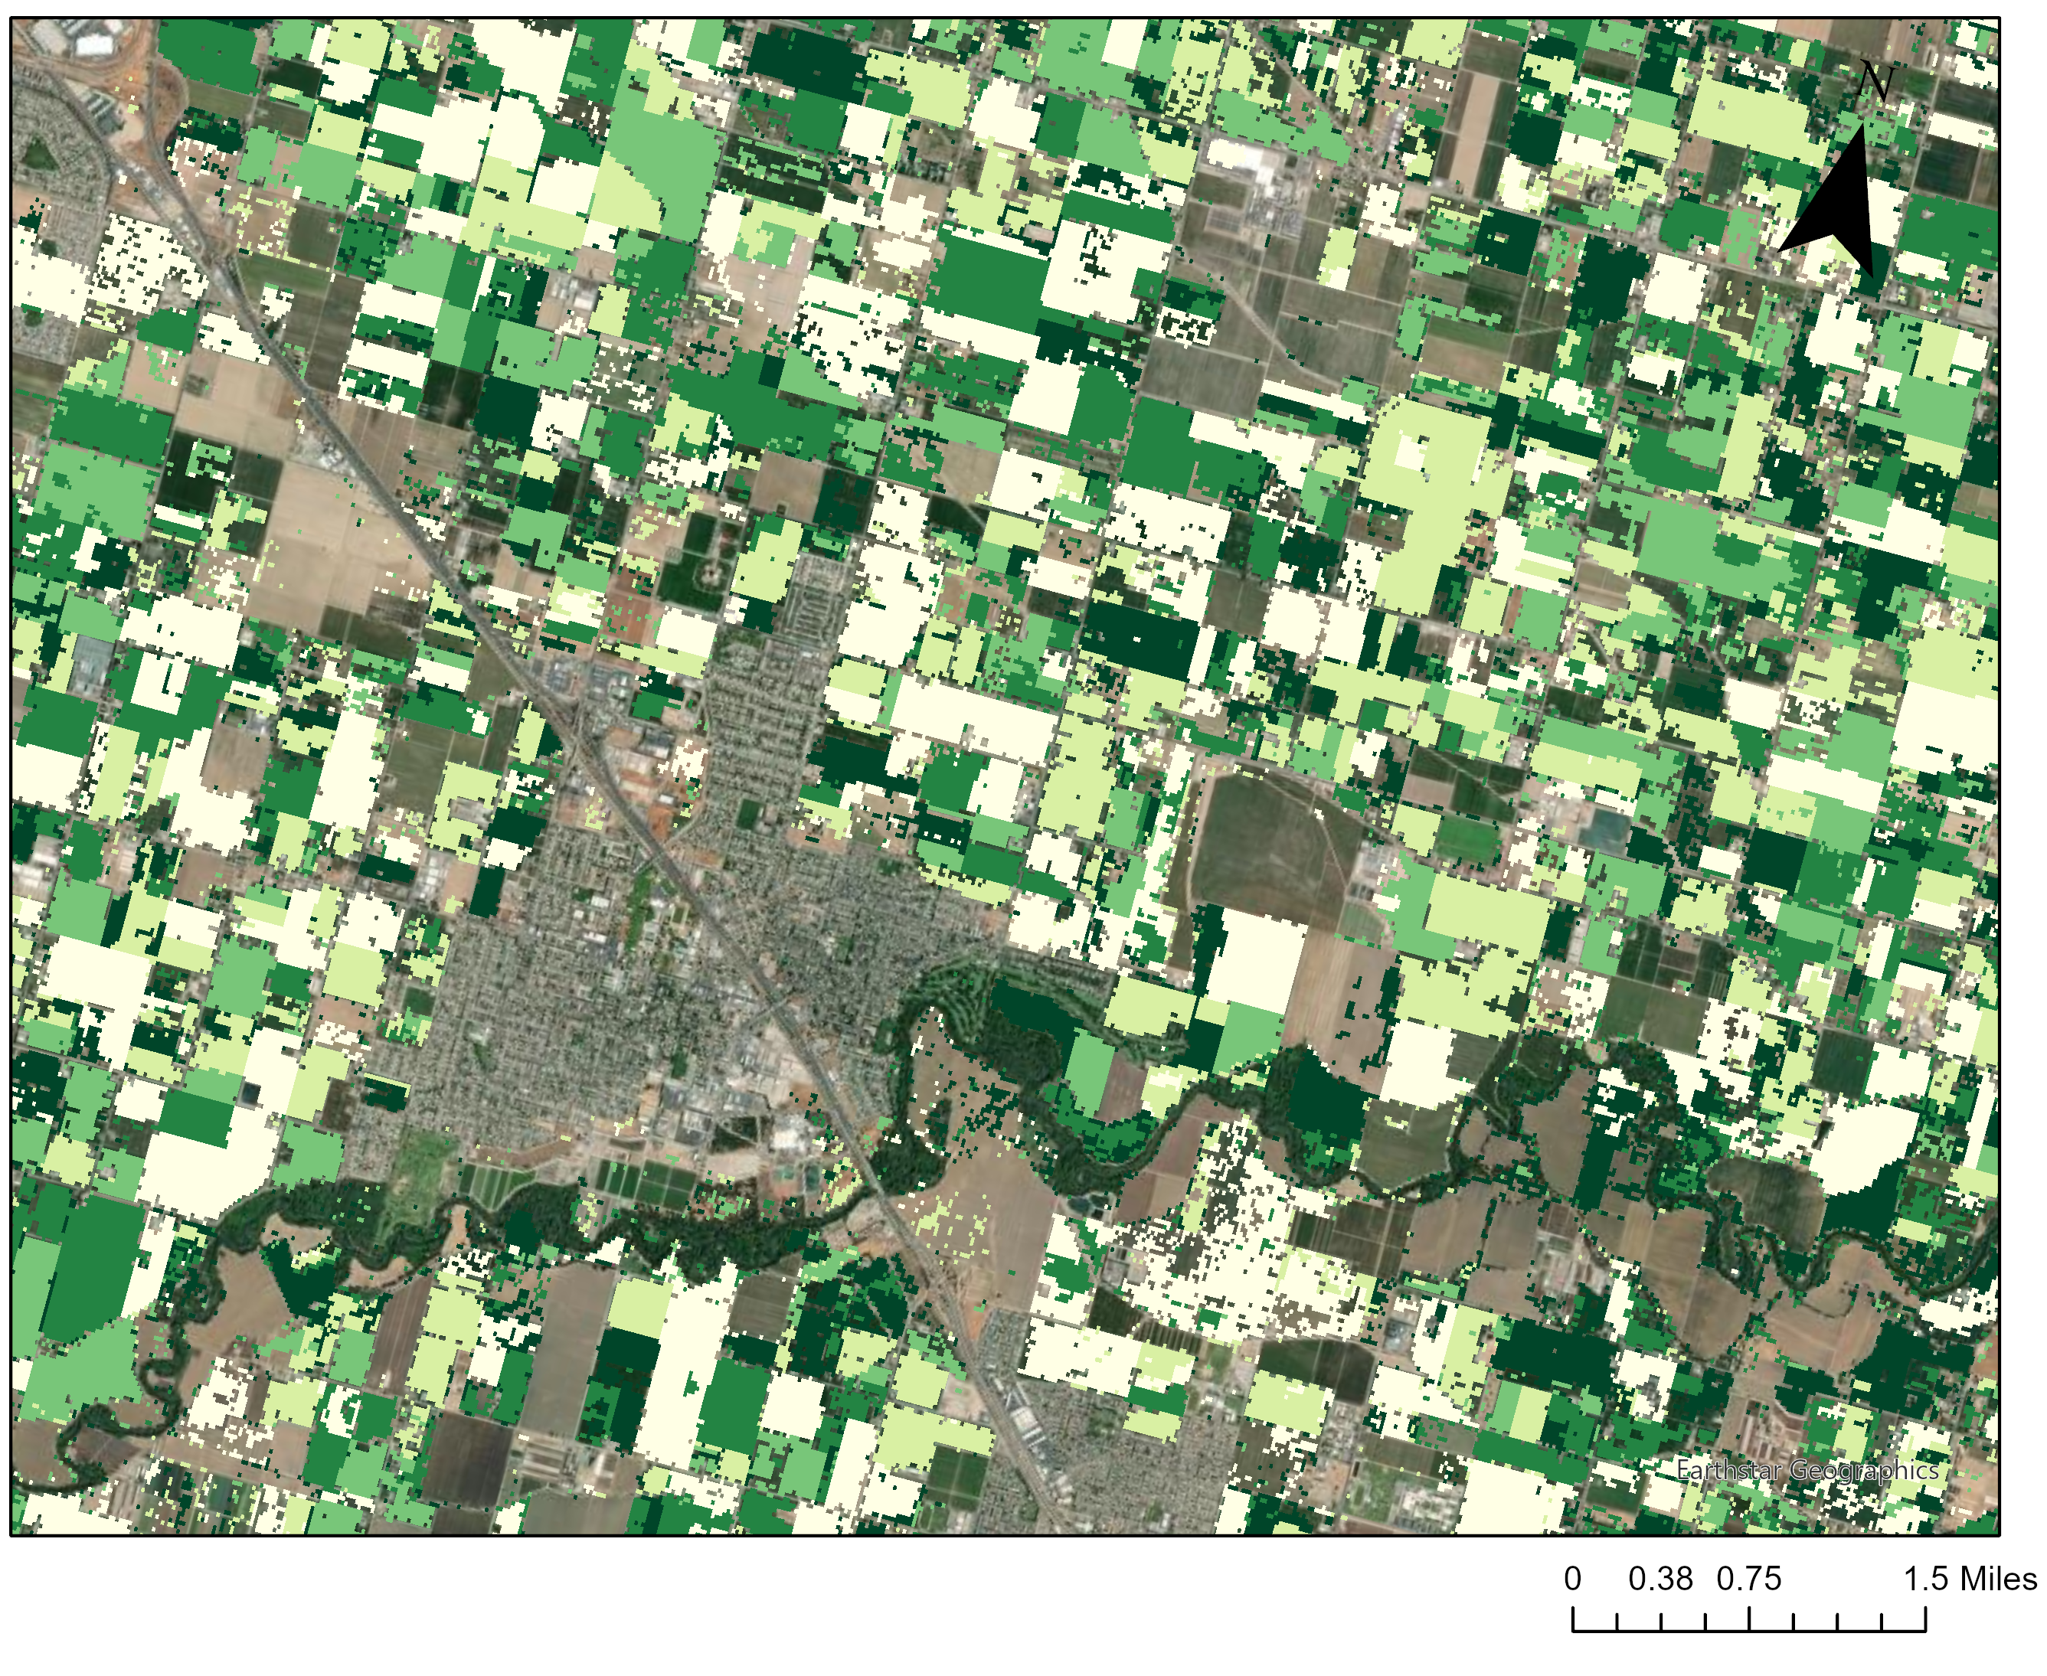
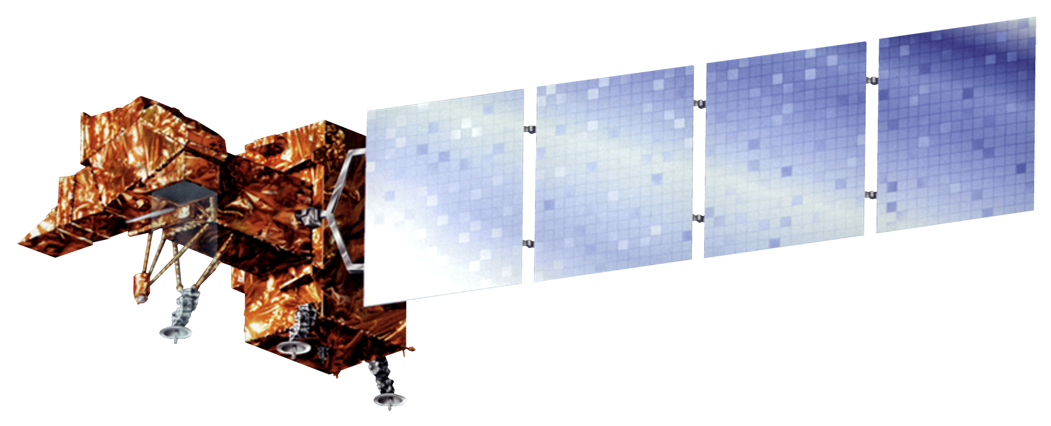
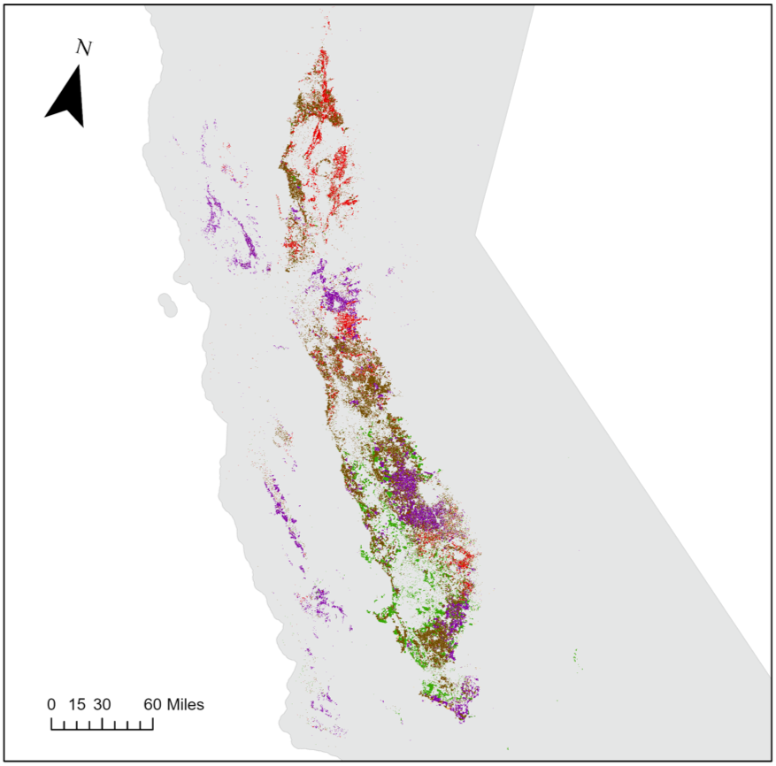
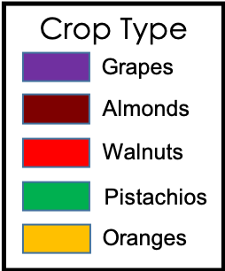
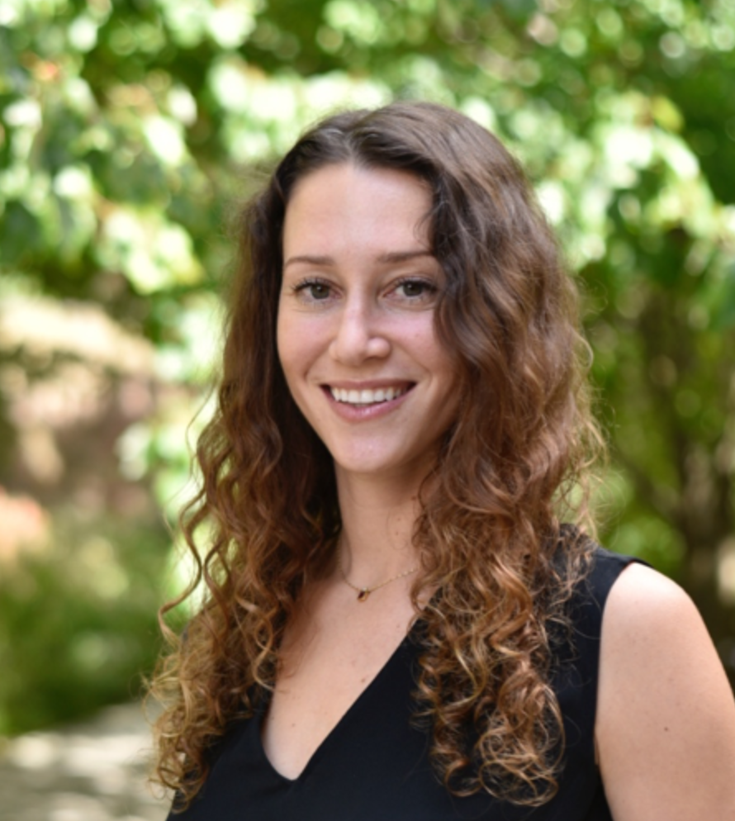
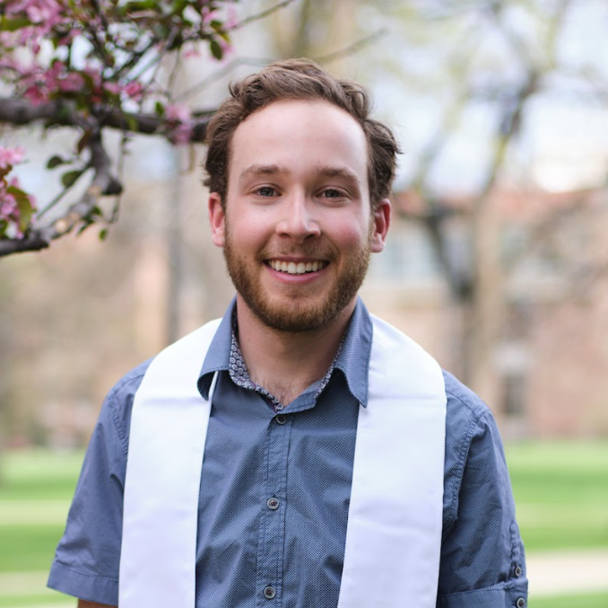
Using Earth Observations to Estimate the Age and Carbon Stock of Perennial Agriculture
Abstract
Methodology
California Agriculture
California seeks to become a carbon neutral state by 2045. To track progress toward this goal, it is important to quantify the amount of carbon stored by various landcover types across the state. Vineyards and orchards make up a large portion of California's agricultural landcover and store considerable amounts of carbon. For this project, NASA DEVELOP partnered with the California Air Resources Board to estimate the age and carbon stock of crop-specific agricultural regions across California between 1984 and 2021. The DEVELOP team created the Perennial Agriculture Age and Carbon Estimation Tool (PAACET), a Google Earth Engine tool that employs Earth observation from the Landsat 5 Thematic Mapper (TM), Landsat 7 Enhanced Thematic Mapper Plus (ETM+), and Landsat 8 Operational Land Imager (OLI) to estimate the age and carbon stock of vineyards and almond, walnut, pistachio, and orange orchards. The team used an ocular sampling accuracy assessment consisting of 53 sample vineyards and orchards and found that on average, PAACET estimated ages within ±4.3 years of their actual age. The tool estimated that vineyards and walnut orchards are the oldest woody croplands, and almond orchards store the largest total carbon.
Time series stack
Landsat 5, 7, & 8
Mean μ
(of max NDVI values over 37 years of study period)
1984
Z score
$$zi=\frac{xi− μ}{σ}$$
Planting Year
Z score < -2
Orchard Age
(Current year – planting year)
2021
Std σ
(of max NDVI values over 37 years of study period)
Max NDVI $xi$
(by orchard type)
Assess accuracy using ocular sampling
Carbon Stock
(Inputting age estimates into allometric equations)
Results
Oranges
0.06 Tg C
0.08%
16
Mean Age by Crop Type
Grapes
3.46 Tg C
4.89%
Project Partners
14
Pistachios
9.30 Tg C
13.15%
The NASA DEVELOP team partnered with the California Air Resources Board (CARB), which is one of six boards, departments, and offices under the umbrella of the California Environmental Protection Agency. CARB is California's lead agency on climate change and is responsible for planning a roadmap to achieve the state's climate change goals and implementing programs to reduce greenhouse gas emissions.
12
10
Walnuts
11.58 Tg C
16.38%
8
Almonds
46.32 Tg C
65.50%
6
4
2
Objectives
0
Grapes Oranges Pistachios Walnuts Almonds
Develop a Google Earth Engine tool to map crop age and biomass of perennial agriculture in California
Estimate the total carbon stock of California’s vineyards and almond, pistachio, walnut, and orange orchards
Compare the carbon stock and ages of the different crop types
Fig. 2. Distribution of mean age by crop type in 2021.
Fig. 3. Distribution of carbon stock by crop type in 2021.
Age (years)
Carbon stock
(kg/m²)
38
13,000
Earth Observations
1
1,000
Landsat 7 ETM+
1999 – Present
Fig. 4. PAACET cropland age estimates near Modesto, California in 2021.
Fig. 5. PAACET cropland carbon stock estimates near Modesto, California in 2021.
Landsat 5 TM
1984 – 2012
Landsat 8 OLI
2013 – Present
Conclusions
Study Area & Period
PAACET can detect the planting years of most orchards and vineyards in California.
The accuracy of the tool is limited by Landsat data availability (starting in 1984) and the accuracy of the USDA-NASS Cropland Data Layer in defining orchard boundaries.
The accuracy of the tool may be improved by incorporating satellite imagery with better spatial resolution.
Crop-specific agricultural regions of California
March 1984 – December 2021
Acknowledgements
The team would like to thank everyone who made this project possible:
Partners: California Air Resources Board
Advisors: Dr. Juan Torres-Pérez (NASA ARC), Dr. Kenton Ross (NASA LaRC)
Fellows: Britnay Beaudry (DEVELOP ARC), Hayley Pippin (DEVELOP ARC)
Special thanks: Dr. Lee Johnson (NASA ARC), Dr. Forrest Melton (NASA ARC)
Team Members
Rachael Ross
Project Lead
Rachael Ross
Project Lead
Alex Posen
Alex Posen
Shreya Suri
Shreya Suri
Stefanie Mendoza
Fig. 1. Map of study area including vineyards and almond, walnut, pistachio, and orange orchards in 2021.
Stefanie Mendoza
California – Ames

