Slide 1
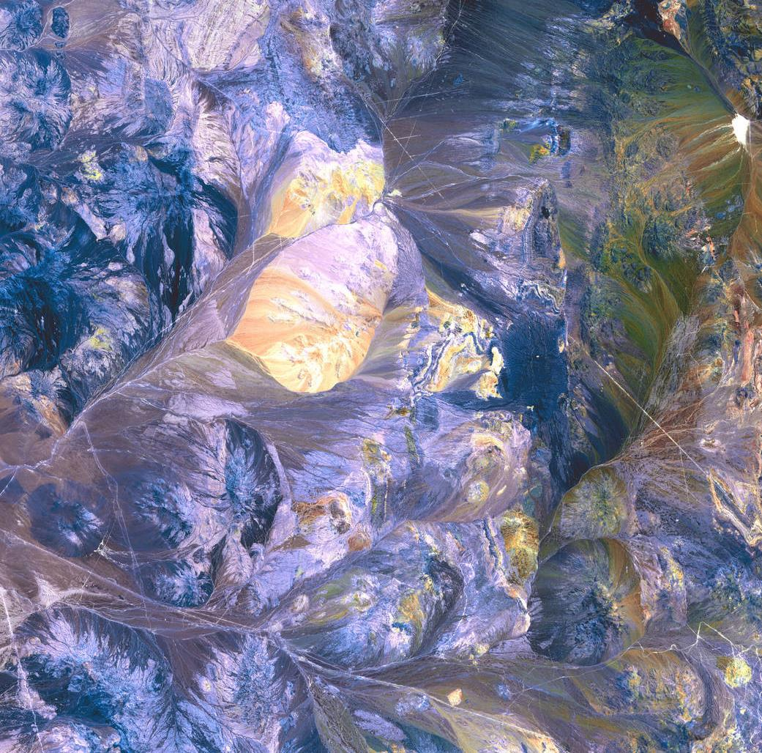
2019 Fall Term
DEVELOP
Proposal Bootcamp
Part 1
Notes:
Your project Website Image should be placed behind the hexagon grid. An example image has been placed in this position for your reference. Delete the example image, insert your image, right click your image and select the “Send to Back” option. Position and adjust the size of your image so that it lines up with the provided margin rulers.

Slide 2
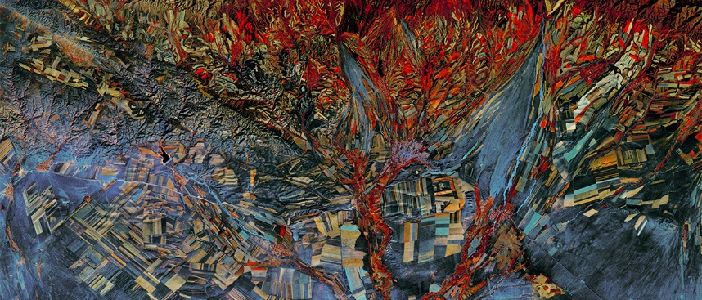
Introduction
Project Characteristics
Requirements
Process
Timeline
Partner Types
Partner Engagement

Slide 3
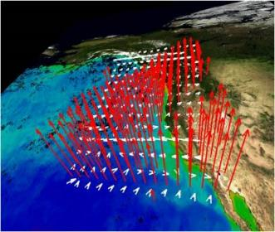
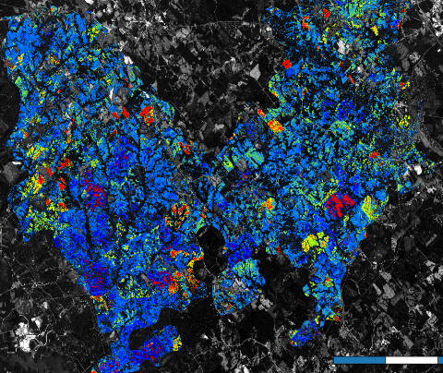
Project Characteristics
All DEVELOP projects share these core characteristics:
Highlight the applications and capabilities of NASA Earth observations
Address actionable real-world environmental issues
Partner with decision-making organizations
Create a comprehensive set of deliverables (Project Summary, Poster, Presentation, Technical Report, Video, Imagery, Shapefiles)
Align with one of the 8 ASP application areas
Does not develop or prescribe policy – other agencies and organizations use the data and scientific results in their policy analysis and decision development
Conducted by interdisciplinary teams under guidance of DEVELOP Science Advisors in just 10 weeks
Notes:
The foundation for the DEVELOP Program began in the summer of 1998 when three student interns at the Langley Research Center co-authored a research paper titled The Practical Applications of Remote Sensing (Bauer et al., 1998). Concurrently, the Digital Earth Initiative, a federal interagency project dedicated to furthering humans' understanding of the planet, initiated an effort to increase public access to federal information about the Earth and the environment. With the shared focus of these two ventures, a proposal was submitted to combine the mission of NASA's Digital Earth Initiative and the Langley students' paper. This set the stage for the creation of a new student internship program within NASA, and in 1999 the DEVELOP Program was officially formed.

Slide 4
Project Requirements
Address a real and actionable community concern involving an environmental issue
Partner directly with at least one end user (decision-making individual/institution) who could benefit from using NASA EO to enhance their decision making
Focus on meaningful use of NASA Earth observations (note: NCEI has an additional mandate to use NOAA EO/CDRs)
Scoped appropriately for 10 weeks – resolution of sensors, study area size, team size, amount of work to be accomplished, etc.
Fits within one of the 8 Applied Sciences’ application areas
Notes:
The foundation for the DEVELOP Program began in the summer of 1998 when three student interns at the Langley Research Center co-authored a research paper titled The Practical Applications of Remote Sensing (Bauer et al., 1998). Concurrently, the Digital Earth Initiative, a federal interagency project dedicated to furthering humans' understanding of the planet, initiated an effort to increase public access to federal information about the Earth and the environment. With the shared focus of these two ventures, a proposal was submitted to combine the mission of NASA's Digital Earth Initiative and the Langley students' paper. This set the stage for the creation of a new student internship program within NASA, and in 1999 the DEVELOP Program was officially formed.

Slide 5
Proposal Process
Project Idea Submission: a first call for titles and a few supporting details comes from NPO ~1 month before proposal submission deadline – includes short title, subtitle, study area, partners, EO, actionable decision, end products, and an international checklist (if non-US study area)
Idea Review: NPO does first round of review – telling the node which projects are approved to move on to the proposal writing phase: by email or phone
Proposal Writing: Writing commences using the NPO-provided template for that term
Proposal Submission: Proposals are submitted to Amanda/Project Coordination by Fellow
NPO Review: PC & NPO review
Proposal Edits & Feedback Returned: Edited proposals are returned with feedback to Fellow
Final Version Creation: Fellow responds to feedback, creates a final “clean” draft without comments and resubmits to NPO
Proposal Compilation: NPO compiles all proposals by application area, sends to NASA HQ PMs for their review
NASA HQ Review: PMs review, NPO sets discussion appointments to get their feedback
Final Portfolio: NPO takes HQ approved proposals and coordinates with nodes to identify if proposals align with number of participants allotted to the node, downselects if needed; Project portfolio finalized and shared
Notes:
The foundation for the DEVELOP Program began in the summer of 1998 when three student interns at the Langley Research Center co-authored a research paper titled The Practical Applications of Remote Sensing (Bauer et al., 1998). Concurrently, the Digital Earth Initiative, a federal interagency project dedicated to furthering humans' understanding of the planet, initiated an effort to increase public access to federal information about the Earth and the environment. With the shared focus of these two ventures, a proposal was submitted to combine the mission of NASA's Digital Earth Initiative and the Langley students' paper. This set the stage for the creation of a new student internship program within NASA, and in 1999 the DEVELOP Program was officially formed.

Slide 6
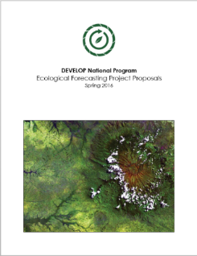
Project Lifecycle Timeline
Spring Term
Fall Ideas
Summer Proposal FD
Spring Deliverables
Summer Selections
Summer Term
Fall Proposal FD
Summer Deliverables
Fall Selections
Fall Term
Spring Proposal RD/FD
Summer Ideas
Fall Deliverables
Spring Selections
Spring Interim
Fall Proposal RD
Summer Preview
Partner Forms
Spring PSI
Fall Interim
Spring Ideas
Fall Preview
Partner Forms
Winter Interim
Summer Proposal RD
Spring Preview
Partner Forms
Retreat
Notes:
The foundation for the DEVELOP Program began in the summer of 1998 when three student interns at the Langley Research Center co-authored a research paper titled The Practical Applications of Remote Sensing (Bauer et al., 1998). Concurrently, the Digital Earth Initiative, a federal interagency project dedicated to furthering humans' understanding of the planet, initiated an effort to increase public access to federal information about the Earth and the environment. With the shared focus of these two ventures, a proposal was submitted to combine the mission of NASA's Digital Earth Initiative and the Langley students' paper. This set the stage for the creation of a new student internship program within NASA, and in 1999 the DEVELOP Program was officially formed.

Slide 7
Spring 2020 Proposal Timeline
Idea & International Checklist Submission | Aug 28
NPO Feedback | Sept 12
Proposal Submission | Sep 27
NPO Returns Edits | Nov 1
Node Addresses Comments & Submits Final Version | Nov 27
NPO Sends Compiled Proposals to HQ | Nov 25 – 29
HQ Review & Approval | Dec
Final Approval | Jan
Preview | Jan 22
Term Begins | Jan 27

Slide 8
Partner Engagement
Set clear expectations of timeline and approval process
Share the timeline & expectations: proposal deadline, process for approvals, term start and end dates, pre & post forms
Set clear expectations with partners for “how it works” if project is accepted:
Ideal outcome: they take the results & methods and use them for decision making
Only a 10 week term! Make sure they know the term dates
No funds transferred and no formal agreements
The DEVELOP team is funded through NASA and the team sits at the node
Team will hand-off project results & methodologies at end of the term – however, code cannot be handed off until approved through NASA’s software release, which is on a very different timeline
Communicate the planned length of the project (1+ terms) but that changes can occur due to a wide variety of factors – lack of funds, wrong applicants, proposal not approved, etc.
Team would touch base with the partner throughout the term (weekly or biweekly tag ups, with a handoff at end)
Partner would fill out the pre-term (few weeks before) and post-term forms (few weeks after handoff)
If any ancillary data is needed from the partner – ask to receive it before the term begins
Letters of support are great to include with proposal, but not required
Notes:
The foundation for the DEVELOP Program began in the summer of 1998 when three student interns at the Langley Research Center co-authored a research paper titled The Practical Applications of Remote Sensing (Bauer et al., 1998). Concurrently, the Digital Earth Initiative, a federal interagency project dedicated to furthering humans' understanding of the planet, initiated an effort to increase public access to federal information about the Earth and the environment. With the shared focus of these two ventures, a proposal was submitted to combine the mission of NASA's Digital Earth Initiative and the Langley students' paper. This set the stage for the creation of a new student internship program within NASA, and in 1999 the DEVELOP Program was officially formed.

Slide 9
Partner Types
All Partners
Partner: Umbrella term for any outside organization DEVELOP engages with through projects, nodes, or other activities.
Collaborators
End Users
Boundary Organizations
2 Types of Partners: differences lie in use of the project results/methods in decision making.
End User: Organization or individual that receives results and methodologies from DEVELOP (either directly from a DEVELOP project team or through a collaborator/boundary organization) and can use the project’s products or methodologies to make a decision or policy. They may also provide some kind of resources (advising, data, model, software, funding, etc.), but it is not required. Ex. The Texas Forest Service’s Predictive Services that can use the products/methodologies from the DEVELOP project in their risk mapping creation.
Collaborator: Organization or individual that works directly with a DEVELOP project team and provides some kind of leveraged resource (advising, data, model, software, funding, etc.), but are not actually using the project’s products or methodologies to make a decision or policy. Ex. A researcher from a university who provides a team with an ancillary dataset to validate their results.
Additional classifier:
Boundary Organization: In addition to either being a Collaborator or End User, an organization or individual that disseminates the project’s results to other end users, decision makers, policy-makers, etc. can be distinguished as a Boundary organization. This classification is in addition to the two types listed above. ASP defines a boundary organization as “an organization outside of your own that broadens your reach across the boundary into the operational domain (i.e. policymakers, decision makers, and other key stakeholders).” Ex. The Smithsonian Conservation Biology Institute works with local groups in Myanmar and helped DEVELOP disseminate results from the Myanmar Ecological Forecasting project to those in-country groups.
Notes:
The foundation for the DEVELOP Program began in the summer of 1998 when three student interns at the Langley Research Center co-authored a research paper titled The Practical Applications of Remote Sensing (Bauer et al., 1998). Concurrently, the Digital Earth Initiative, a federal interagency project dedicated to furthering humans' understanding of the planet, initiated an effort to increase public access to federal information about the Earth and the environment. With the shared focus of these two ventures, a proposal was submitted to combine the mission of NASA's Digital Earth Initiative and the Langley students' paper. This set the stage for the creation of a new student internship program within NASA, and in 1999 the DEVELOP Program was officially formed.

Slide 10
App Areas
Note: Ag Name Swap!
Food Security & Agriculture
The Food Security & Agriculture application area promotes innovative use of NASA Earth observations to assist with agricultural management such as enhanced monitoring of crops and rangeland. The goal is to support the maximization of production while preserving ecosystems and biodiversity to counter food insecurity.
Shorthand for deliverables: Ag
Example Project: New England Agriculture & Food Security (GSFC, Summer 2018)
Disasters
The Disasters application area applies NASA Earth observations to improve natural disaster forecasting, mitigation, and response. The projects contribute to improved understanding of the natural processes that produce hazards, the vulnerability of local communities, and development of hazard mitigation technologies while providing decision makers with information where and when it is needed.
Shorthand for deliverables: Disasters
Example Project: Southern California Disasters (JPL, Summer 2018)
Notes:
The foundation for the DEVELOP Program began in the summer of 1998 when three student interns at the Langley Research Center co-authored a research paper titled The Practical Applications of Remote Sensing (Bauer et al., 1998). Concurrently, the Digital Earth Initiative, a federal interagency project dedicated to furthering humans' understanding of the planet, initiated an effort to increase public access to federal information about the Earth and the environment. With the shared focus of these two ventures, a proposal was submitted to combine the mission of NASA's Digital Earth Initiative and the Langley students' paper. This set the stage for the creation of a new student internship program within NASA, and in 1999 the DEVELOP Program was officially formed.

Slide 11
App Areas
Ecological Forecasting
The Ecological Forecasting application area supports decision makers with access to science-based tools in order to understand and predict the impacts of environmental change on the ecosystems that support the existence of life on Earth. The goal is to apply NASA remote sensing and technologies to topics like conservation, habitat health and suitability, land use practices and planning, and invasive species. Note: Proposals must include a forecasting piece!
Shorthand for deliverables: Eco
Example Project: Louisiana Eco Forecasting (VA, Summer 2018)
Energy
The Energy application area promotes the application of NASA Earth observations and model products for societal benefit through improved techniques in locating and utilizing energy sources. The goal is to support decision makers with information to help increase efficiency, use of non-traditional energy sources, and best energy practices.
Shorthand for deliverables: Energy
Example Project: New Mexico Energy (MSFC, Summer 2018)
Notes:
The foundation for the DEVELOP Program began in the summer of 1998 when three student interns at the Langley Research Center co-authored a research paper titled The Practical Applications of Remote Sensing (Bauer et al., 1998). Concurrently, the Digital Earth Initiative, a federal interagency project dedicated to furthering humans' understanding of the planet, initiated an effort to increase public access to federal information about the Earth and the environment. With the shared focus of these two ventures, a proposal was submitted to combine the mission of NASA's Digital Earth Initiative and the Langley students' paper. This set the stage for the creation of a new student internship program within NASA, and in 1999 the DEVELOP Program was officially formed.

Slide 12
App Areas
Health & Air Quality
The Health & Air Quality application area utilizes NASA Earth observations to support air quality and public health management and policy making. The goal is to improve global health by enhancing the prediction and monitoring of environmental phenomena that effect human health such as air quality, extreme heat, and infectious disease.
Shorthand for deliverables: HealthAQ
Example Project: Richmond Health & Air Quality (LaRC, Summer 2018)
Transportation & Infrastructure
The Transportation & Infrastructure application area focuses on the application of NASA Earth observations to support planning, monitoring, and management of infrastructure (dams, roads, rail, ports, and pipelines) and transportation (air, land, and sea). The goal is to minimize environmental impacts, monitor resilient infrastructure, promote industrialization, and foster innovation.
Shorthand for deliverables: TI
Example Project: Ohio River Valley TI (MSFC, Fall 2018)
Notes:
The foundation for the DEVELOP Program began in the summer of 1998 when three student interns at the Langley Research Center co-authored a research paper titled The Practical Applications of Remote Sensing (Bauer et al., 1998). Concurrently, the Digital Earth Initiative, a federal interagency project dedicated to furthering humans' understanding of the planet, initiated an effort to increase public access to federal information about the Earth and the environment. With the shared focus of these two ventures, a proposal was submitted to combine the mission of NASA's Digital Earth Initiative and the Langley students' paper. This set the stage for the creation of a new student internship program within NASA, and in 1999 the DEVELOP Program was officially formed.

Slide 13
App Areas
Urban Development
The Urban Development application area focuses on the application of NASA Earth observations to enhance urban planning, monitoring of land change over time, assessment of urban footprints, and the development of sustainable and resilient urban environments. The goal is to support sustainability, resilience and safety of cities and human settlements through informed planning and management of climate and disaster risks.
Shorthand for deliverables: Urban
Example Project: New Orleans Urban Development (AL, Summer 2018)
Water Resources
The Water Resources application area addresses concerns and decision processes that are related to water availability, water forecasting, and water quality. The goal is to apply NASA satellite data to improve the Decision Support Tools (DSTs) of user groups that manage water resources.
Shorthand for deliverables: Water
Example Project: Osa Peninsula Water Resources II (GA, Summer 2018)
Notes:
The foundation for the DEVELOP Program began in the summer of 1998 when three student interns at the Langley Research Center co-authored a research paper titled The Practical Applications of Remote Sensing (Bauer et al., 1998). Concurrently, the Digital Earth Initiative, a federal interagency project dedicated to furthering humans' understanding of the planet, initiated an effort to increase public access to federal information about the Earth and the environment. With the shared focus of these two ventures, a proposal was submitted to combine the mission of NASA's Digital Earth Initiative and the Langley students' paper. This set the stage for the creation of a new student internship program within NASA, and in 1999 the DEVELOP Program was officially formed.

Slide 14
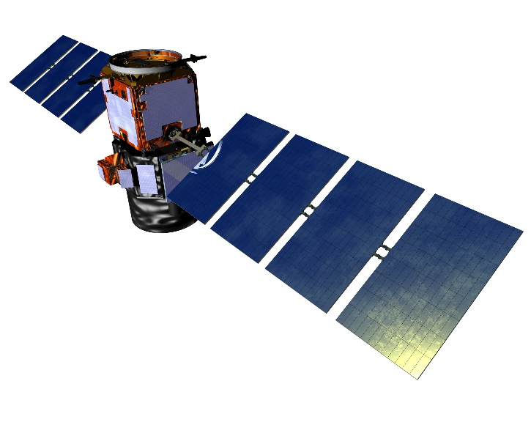
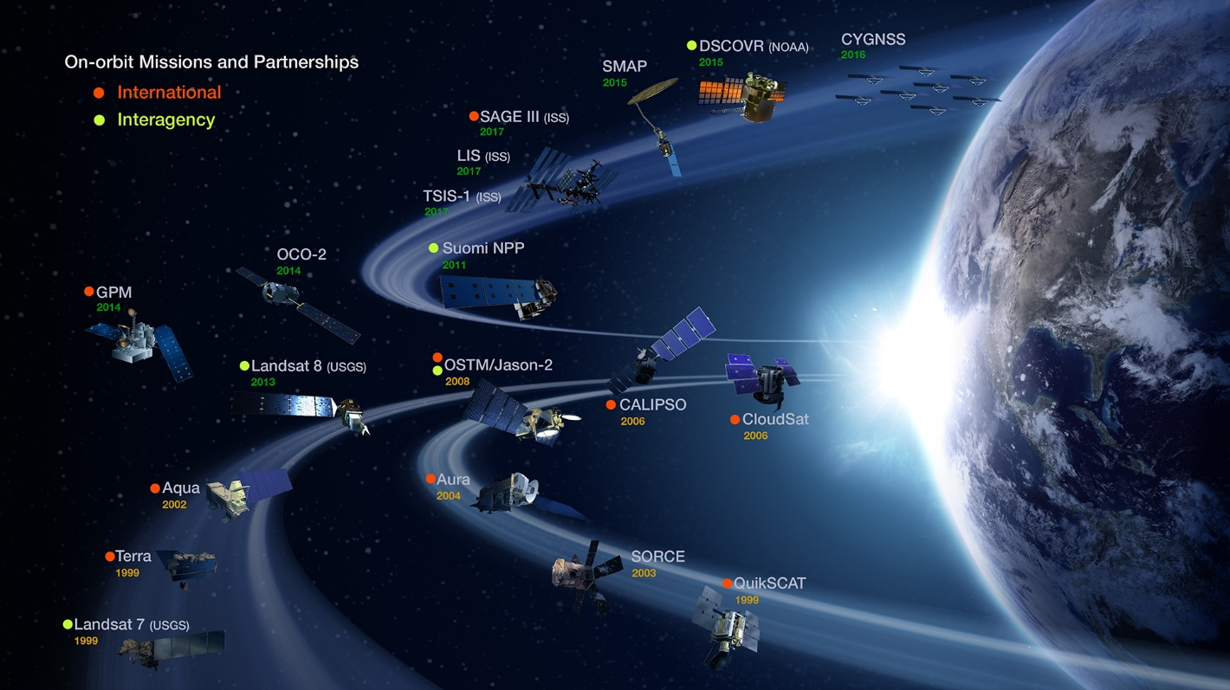
EO Resources
https://eospso.nasa.gov/current-missions
http://www.devpedia.developexchange.com/dp/index.php?title=Satellites_and_Sensors
Data Centers
https://earthdata.nasa.gov/about/daacs/daac-asdc
https://lpdaac.usgs.gov/
http://nsidc.org/daac/
https://disc.gsfc.nasa.gov/
https://podaac.jpl.nasa.gov/
https://www.asf.alaska.edu/
https://oceancolor.gsfc.nasa.gov/
https://daac.ornl.gov/
https://ghrc.nsstc.nasa.gov/home/
https://ladsweb.modaps.eosdis.nasa.gov/
Notes:
The foundation for the DEVELOP Program began in the summer of 1998 when three student interns at the Langley Research Center co-authored a research paper titled The Practical Applications of Remote Sensing (Bauer et al., 1998). Concurrently, the Digital Earth Initiative, a federal interagency project dedicated to furthering humans' understanding of the planet, initiated an effort to increase public access to federal information about the Earth and the environment. With the shared focus of these two ventures, a proposal was submitted to combine the mission of NASA's Digital Earth Initiative and the Langley students' paper. This set the stage for the creation of a new student internship program within NASA, and in 1999 the DEVELOP Program was officially formed.

