Slide 1
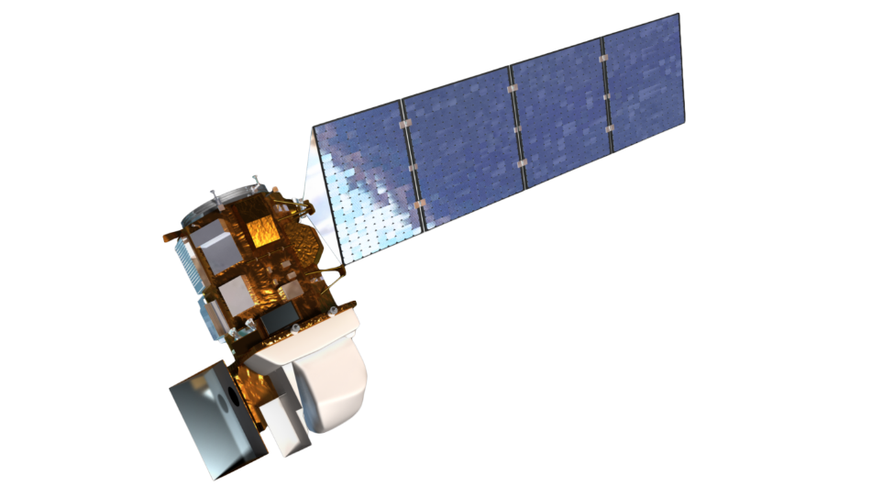
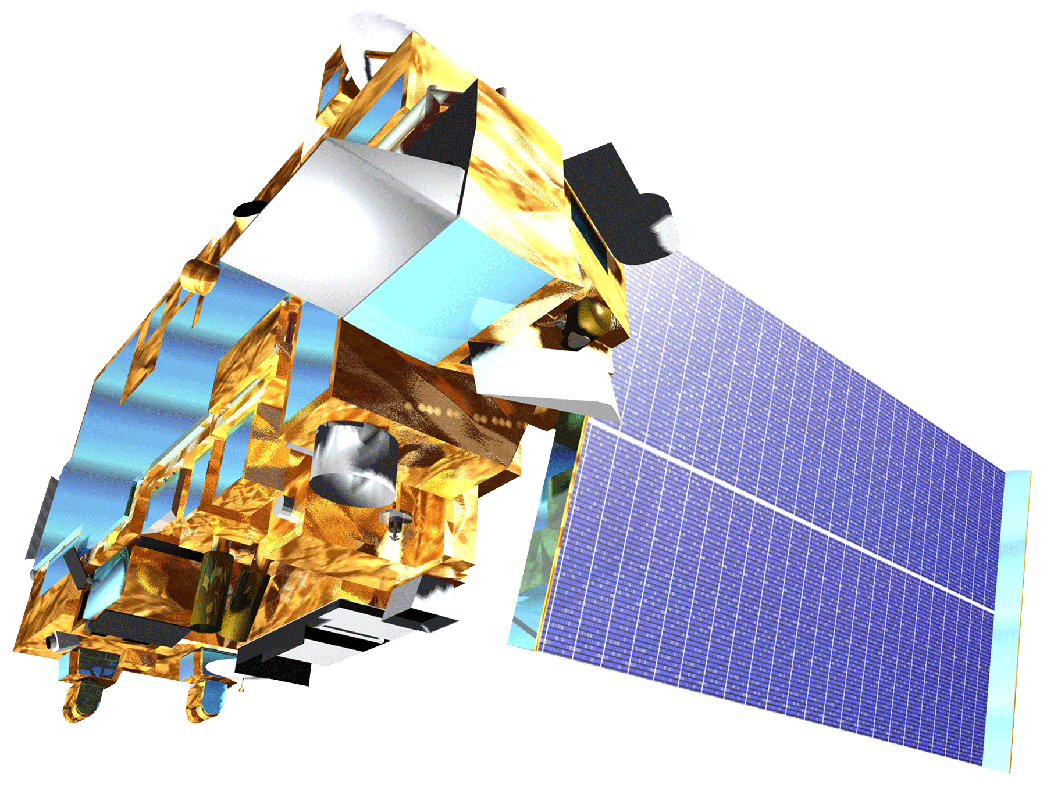
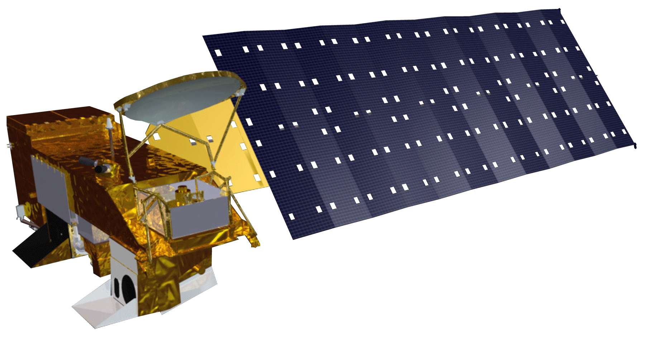
Los Angeles Oceans II
Ground Truthing Satellite Observations of Wastewater Plumes and Their Biological Impact in Santa Monica Bay, California
Rebecca Trinh (Project Lead) & Lindsay Almaleh
DEVELOP National Program at NASA Jet Propulsion Laboratory
Abstract
Objectives
The Hyperion Water Reclamation Plant is one of the largest wastewater treatment plants in the western United States. Treated sewage is generally released at depths of approximately 60 m through 8.05 km outfall pipes into the deep coastal waters of the Santa Monica Bay. In times of repair and maintenance, services on the main outfall pipe are temporarily suspended and require the plant to divert treated sewage to a shorter 1.6 km pipe that extends into shallow coastal zones. These shallow zones make it possible for the buoyant freshwater plumes to reach the surface, potentially contaminating the local environment. This diversion event occurred September 21 to November 2, 2015, and this project plans to integrate previously obtained satellite images and ancillary data collected by other scientists . By combining remotely-sensed observations with GPS-equipped drogue surface drifters and in situ readings of temperature, salinity, dissolved oxygen, pH, conductivity, transmissivity, atmospheric aerosols, colored dissolved organic matter (CDOM), and chlorophyll-a florescence, an accurate assessment of the full impact and extent at which these effluent plumes affected the Los Angeles Basin is possible. The outcome of this study can aid in developing proper methods to avoid harmful outcomes during similar diversion events in the future.
This sentence is awkwardly placed. Consider incorporating it into the next sentence.
Coordinate with the Hyperion Water Reclamation Plant research team in obtaining in situ data taken in the LA Basin
Combine and Compare NASA Earth observations and in situ data taken during the diversion event for validation.
Determine whether the expelled effluent has negatively impacted the local ecosystem or washed ashore to potentially contaminate beaches
Publish results in a journal and Hyperion’s technical report.
Methodology
Study Area
NASA Earth observations:
Chlorophyll-a
Surface Sediment
Turbidity
Landsat-8, TIR, OLI
Aqua, MODIS
Spatiotemporal
Analysis of combined
datasets
Effluent
impact
on local ecosystem and human health
Santa Monica
Bay
LAX
Sea Surface Temperature
Hyperion
Treatment
Plant
Terra ASTER
In Situ Measurements
Study Period: August 31 – November 20, 2015
JPL, Hyperspectral Instrument
Chl-a. CDOM, CTD, Atmospheric aerosols
UCSB, Surface drifters
Local current direction
Earth Observations
USC, Phytoplankton
Harmful algal blooms
HWRP, YSI
pH, DO, salinity, TDS, optical brightness
Landsat-8
HWRP, CTD
Conductivity, temperature, depth
Terra, ASTER
Aqua, MODIS
Results
Conclusions
Team Members
Project Partners
Acknowledgements
We would like to thank our science advisors, Ben Holt and Michelle Gierach (NASA JPL) for assisting us in data retrieval and analysis.
We would like to acknowledge our project partners: Curtis Cash, Ashley Booth, and Mas Dojiri at the Hyperion Water Reclamation Plant. We would also like to thank Cedric Fichot, Jayme Smith of USC, and Carter Ohlmann of UCSB for the use of their auxiliary data, along with the NASA DEVELOP National Program—all who’ve helped make this project possible.
We would lastly like to thank Mark Barker, Christine Rains, and Jack Pan, contributors on earlier phases of this project.
Lindsay Almaleh,, Rebecca Trinh (Team Lead)
Hyperion Water Reclamation Plant,
City Of Los Angeles
NASA Jet Propulsion Laboratory

