Slide 1
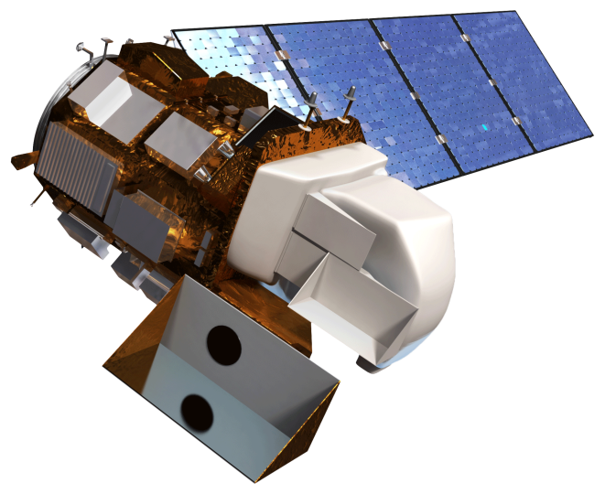
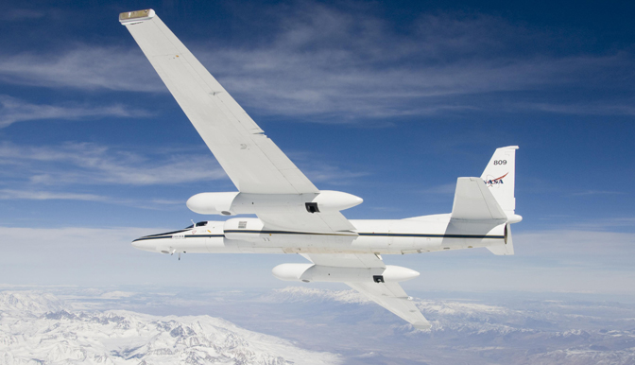
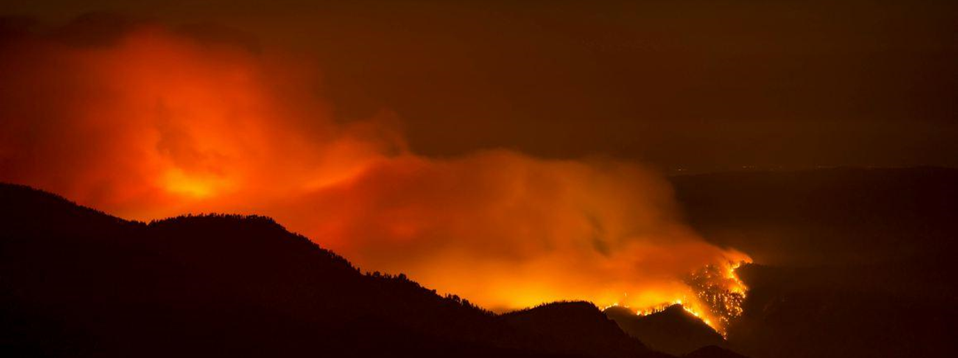
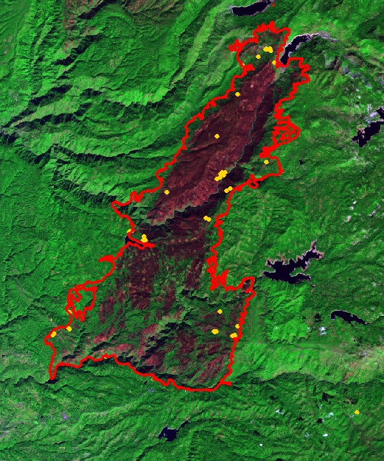
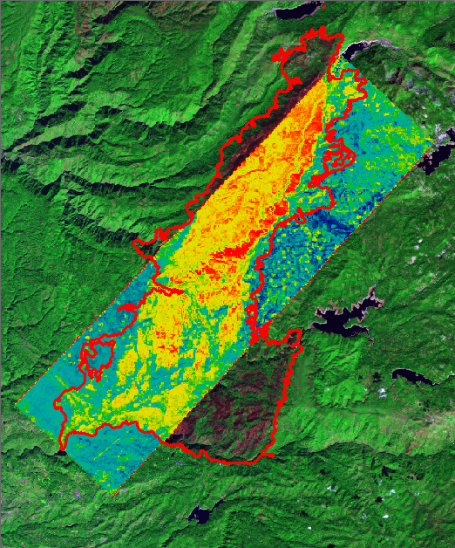
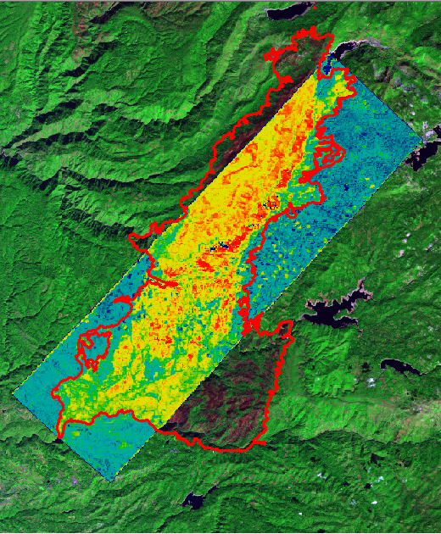
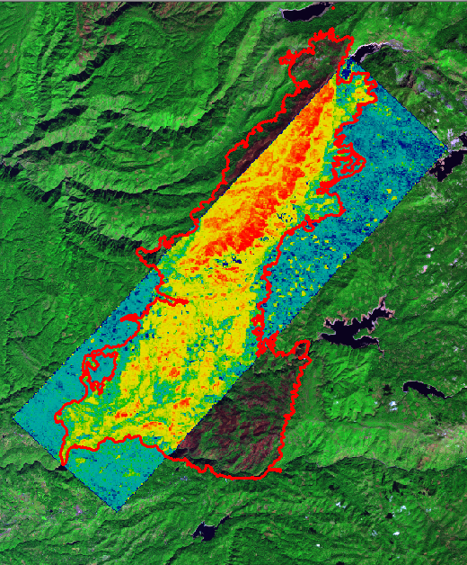
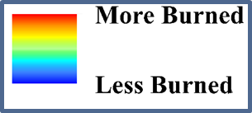
Southern California Disasters II
Assessing the Effectiveness of Simulated HyspIRI data for Use In USDA Forest Service Post-Fire Vegetation Assessment and Decision Support
Heather Nicholson (Project Lead), Madeline LeBoeuf, Amber Todoroff
NASA DEVELOP National Program at Stennis Space Center
Abstract
Study Area
The USDA Forest Service use remote sensing to monitor wildfire burn severity in multiple ways. These efforts primarily utilize Landsat imagery to produce burn severity indices which are provided to aid decision makers involved with wildfire mitigation and recovery. When the Hyperspectral Infrared Imager (HyspIRI) is launched, its high spectral resolution has potential for improving efforts to assess and mitigate natural disaster impacts on ecosystems,such as wildfire damage to forests. To help assess the capabilities and limitations of HYSPIRI prior to its scheduled launch in 2022, NASA conducted an airborne campaign to simulate HyspIRI data starting in 2013 and continuing into 2015. HyspIRI data were simulated from co-located Airborne Visible/ Infrared Imaging Spectrometer and Master/ Aster Simulator (MASTER) sensors onboard a NASA ER-2 aircraft. This NASA DEVELOP project was initiated inthe summer of 2014 to visually compare burn index products from simulated HyspIRI data for the Rim and other fires to comparable products from Landsat. This project’s second term expanded the effort to apply simulated HyspIRI data for assessing burn severity for the Aspen, French, and King fires in California. HYSPIRI and USFS Landsat burn severity indices were quantitatively compared to ground reference data from NASA JPL. The final results from this project showed how HyspIRI data may be used to enhance wildfire damage assessments and to provide additional decision support monitoring tools for agencies such as the USDA Forest Service.
Objectives
Utilize simulated HyspIRI data to compute wildfire burn severity and vegetation monitoring products
Assess accuracy of simulated HyspIRI derived products compared to similar Landsat based products
Earth Observations
Methodology
Download simulated HyspIRI data from AVIRIS and Master websites
NBR
Download Forest Service NBR, dNBR, and RdNBR burn severity products computed from Landsat data
Landsat 8 OLI
NASA ER-2 with Onboard AVIRIS and MASTER
$$\frac{(NIR−LSWIR)}{(NIR+LSWIR)}$$
dNBR
Image Source: inciweb.nwcg.gov,
Interagency all-risk incident information
management system
Conclusions
$${1000(NBR}_{pre}− {NBR}_{post})$$
Statistical analyses were performed in R. The indices were proved to have non normal distributions by Shapiro-Wilks tests.
A Wilcoxon rank-sum test with continuity correction further indicated that there is a statistically significant difference between the indices.
Spearman’s rank correlation coefficient implied that all indices were strongly correlated to the ground truth data for the King Fire.
Project results provide evidence that future HyspIRI data will be valuable for forest service post-fire decision support.
Geo-reference the data and subset the swaths to the study area
RdNBR
Normalize data sets for statistical comparison
Run statistical analyses that determine any statistically significant difference among the data sets
$$\frac{dNBR}{\begin{aligned}\sqrt{abs\left({NBR}_{pre}\right)} \\ \end{aligned}}$$
Calculate Indices
Data Analysis
Results
Landsat 8
King Fire Image
AVIRIS Simulated HyspIRI
King Fire NDSWIR
AVIRIS and MASTER Simulated HyspIRI
King Fire dNBR
Spearman’s Rank Correlation Coefficient Results: King Fire - dNBR Comparing index pixel values to ground-truth GeoCBI data
Data set name | Rho | P – Value
RAVG | 0.926 | < 0.001
MASTER | 0.880 | < 0.001
AVIRIS Narrowband | 0.815 | < 0.001
AVIRIS Broadband | 0.757 | < 0.001
AVIRIS NDSWIR | -0.885 | < 0.001
Landsat
AVIRIS
AVIRIS
MASTER
Team Members
Project Partners
Acknowledgements
USDA Forest Service Remote Sensing Applications Center
(RSAC)
USDA Forest Service Eastern Forest Environmental Threat Assessment Center (EETAC)
USDA Forest Service Missoula Fire Sciences Laboratory
HyspIRI Science Team at Jet Propulsion Laboratory
-Joseph Spruce – Science Advisor, NASA Stennis
-James Smoot – Science Advisor, NASA Stennis -Maria Kalcic – Science Advisor, NASA Stennis
-Brad Quayle -USDA FS, RSAC
-Natasha Stavros – NASA JPL for providing field data
-NASA ASP Rapid Response to King Fire and the US Forest Service for funding GeoCBI burn severity field survey
-Ross Reahard – SSC DEVELOP Center Lead
-Summer 2014 SSC DEVELOP Southern California Disasters Team – Eric Mack, Caitlin Ruby, Timothy Sutherlin, Luke Wylie
-NASA DEVELOP National Program Office
Madeline LeBoeuf, Heather Nicholson, Amber Todoroff
NASA John C. Stennis Space Center

